Slide 1


Slide 2




Caldwell Guthrie STEAM Academy
Annual Title 1 Parent Meeting
Yvette Williams Renfroe, Principal
Keisha Webb, PLC Coach
September 8, 2025

Slide 3
Title 1
What is Title I ?
Title I is a federal program designed “To provide all children significant opportunity to receive a fair, equitable, and high-quality education, and to close educational achievement gaps.”
Title I, programs and services provide customized instruction and curricula that helps these students meet academic standards and take an active, engaged interest in what they learn and can do.

Slide 4



Being a Title I school means receiving federal funding to supplement the schools existing programs. These dollars are used for… * Identifying students experiencing academic difficulties and providing timely assistance to help students meet the State’s challenging content standards. * Purchasing supplemental staff, programs, materials, and supplies. * Conducting parental involvement meetings, trainings and activities. * Recruiting, hiring and retaining highly qualified teachers Caldwell Guthrie operates as a schoolwide Title 1 Program

Slide 5
Parent and Family Engagement Plan
Caldwell Guthrie STEAM Academy embraces the concept that the more parents and the community become involved in our students’ education, the more enhanced their achievement will be. Caldwell Guthrie STEAM Academy encourages the engagement of parents and the community, as individuals, groups, mentors, advisory, and as resources persons.

Slide 6
Parent and Family Engagement Plan
Parent and Family Engagement in a child’s education is a greater predictor of academic success than whether or not that family is affluent or poor. That’s why Title I, insist on robust parent and family engagement activities at every school where federal funds support effective teaching and engaged learning.
This plan addresses how the school will implement the parental involvement requirements of the “Every Student Succeeds Act” (ESSA)
How parents can be involved in decision-making and activities
How parental involvement funds are being used
How information and training will be provided to parents
How the school will build capacity in parents and staff for stronger parental involvement
You, as a Title I parent have the right to be involved in the development of your school's Parental Involvement Plan

Slide 7
Availability of Parent Training
District Sponsored Parent Workshops
MSCS Website-Parent Resource Center
Literacy, Math and Science Nights
Envision (Math) and Wonders (Reading) Parent Workshops (School sponsored)

Slide 8
Parent Involvement Activities
PTO
Meet the Teacher
Family STEAM Night
TN Ready Proctors
Career Day
Safety Patrol
Coffee with the counselor
Literacy Night
Nine Weeks Honor’s Program
Muffins With Mom
Donuts with Dads
Math/Science Night
Parent/Teacher Conferences
Pastries with Principal

Slide 9
Parents Rights to Know
Teacher’s qualifications
Paraprofessional’s qualifications
Right to withhold information from military recruiters

Slide 10

Parent Teacher Conferences
Parent teacher conferences are an important part of maintaining communication between home and school.
There are two district – wide conferences: September 11, 2025, and January 29, 2026

Slide 11
School Compact and Student Code of Conduct
School Compact
The compact is a commitment from the school, the parent and the student to share in the responsibilities for improved academic achievement.
Student Code of Conduct
The Student Code of Conduct is a document issued by the district and is typically distributed during registration and parent-teacher conferences.

Slide 12
School Improvement Plan
Currently being updated
Includes school-wide goals and action steps
Updated each year
On file in the PLC Coach's office for review

Slide 13
Reporting Student Progress
Wednesday Folders (Student work and weekly updates)
Progress Reports every 4-4.5 weeks
Report Cards every 9 weeks
i-Ready progress
Aims Web progress monitoring

Slide 14
Teacher Qualifications
All teachers and paraprofessionals are either highly qualified or are actively working towards achieving this goal.

Slide 15
District Status
Shelby County Schools District is a
Level Five District!

Slide 16

TUTORING
Tutoring is every Tuesday and Thursday from 3:30 to 4:30 every week.
If you know that you student needs extra help, small group tutoring is available, please sign them up today.

Slide 17
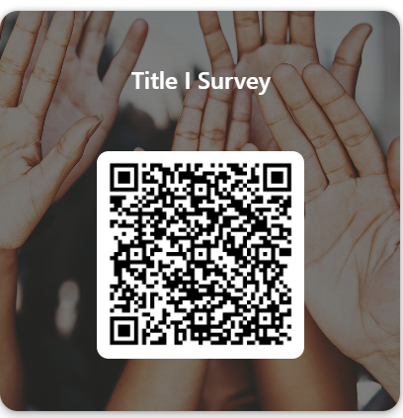


Questions Comments or Concerns
Thank you for attending our annual Title I Meeting

