Slide 1

NFCSD
P-TECH(Pathways in technology early college high school)
Parent information night
P-TECH Mechanical Technology/Engineering
P-Tech computer Information Systems/computer science
Spring 2026

Slide 2
Welcome and Introductory remarks
Mrs. Caroline Buchman- Assistant Superintendent for Curriculum and Instruction
Mr. Bryan Rotella- Administrator for PTECH
Dr. Chowdhary-PTECH Grant Director
Mrs. Dalporto, Mrs. Johnston, Ms. Flournoy, Mrs. Violante PTECH Coordinators NFHS

Slide 3
NFHS Pathways Programs- Mr. Rotella
COMPUTER SCIENCE AND INFORMATION TECHNOLOGY
BUSINESS, FINANCE, AND ENTREPRENEURSHIP
Entrepreneurship
Management / Leadership
Marketing / Hospitality / Tourism
Computer Science
Full-Stack Development (Coding / Game Design)
Computer Technology
Graphic Communications
Web Development and Game Programming

Slide 4
NFHS Pathways Programs
DESIGN, ENGINEERING, AND CONSTRUCTION TECHNOLOGY
HUMAN SERVICES
Education
Humanities
Law
Medical / Nursing
Security / Law Enforcement
SW/MH Counseling
Allied Health
Animal Science
Certified Personal Trainer
Cosmetology
Early Childhood Education
Emergency Medical Services
Health Occupations Technician (HOT)
Advanced Manufacturing
Bio / Environmental Engineering
General Construction
Mechanical Technology (PTECH 1)
Mechanical/Engineering Science (PTECH 1)
Auto Body
Automotive Technology
Building Maintenance and Management
Conservation
Diesel Technology / Heavy Equipment
Electricity / Electronics
Heat / Ventilation / Air Conditioning (HVAC)
Project Based Engineering
Welding

Slide 5
NFHS Pathways Programs
VISUAL AND PERFORMING ARTS
Media
Music Performance (Instrumental)
Music Performance (Vocal)
Music Production
Theatre Arts
Visual Arts
Animation and Video Production
Fashion Design and Interior Decorating

Slide 6
P-TECH Program Summary
P-Tech is a grant-funded program that recruits students in the 8th grade into one of two pathways that the NFCSD offers in Mechanical Technology and Computer Science
Students start the program by engaging in a summer camp after grade 8, then follow a course sequence throughout high school which includes dual enrollment/college credit classes
Students can earn their Associates degree in 4-6 years at no cost – all tuition is paid through the grant.
We work with our higher education partner SUNY Niagara and our local business partners to make this program possible
Students engage in workshops, fieldtrips, a speaker series, college planning, job shadowing and internships throughout their high school career. Students will have opportunities to interview with local businesses for jobs in their respective fields

Slide 7
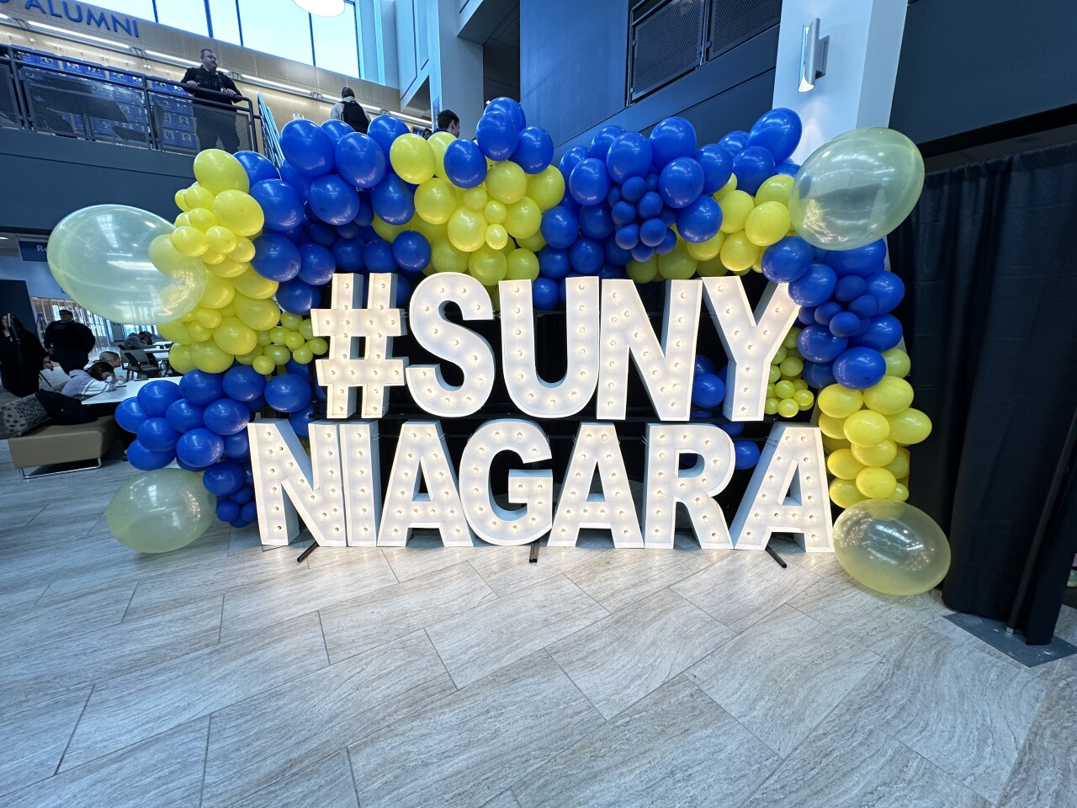
P-TECH Pathways
Mechanical Engineering/Technology
Computer Information Systems/ Science
The Computer Science pathway prepares students with fundamental programming skills and ways to utilize the computer as a problem solving tool. This pathway prepares students for positions in business, medicine, national defense, scientific exploration and more.
The Mechanical Technology pathway prepares the student to pursue a wide variety of career positions including engineering design, product development, laboratory testing, technical sales, technician, manufacturing, and much more.

Slide 8

NFCSD offers 2 PTECH programs
You can choose to enter either program
Mechanical Technology Pathway or Engineering
Some of our business partners are:
  New York Power Authority
  Linde
  VOSS Manufacturing, Inc.
  Olin
  MOOG
  Dimar
Computer Information Systems
Some of our business partners are:
  Niagara Falls Medical Memorial Center
  M and T Tech Hub
  VOSS Manufacturing, Inc.
  ODOO
  Niagara Falls City Hall
  Calspan
  Ingram Micro

Slide 9
Application process
After tonight’s presentation and our mini career fair you can determine which program may be of interest to your child
You can contact Dr. Bhawna Chowdhary to ask any questions you may have at bchowdhary@nfschools.net
Online applications for both programs will be posted on the Niagara Falls City School District website on March 18- May 31, 2026. Once on the site click on the P-TECH tab and on the bottom left are the two applications. Please apply to only one program
Applications will be reviewed and notices of acceptance will be sent in early June
In June each Prep School will host a signing day at which we celebrate students’ acceptance into both P-Tech Programs. GPS is on June 2 and LPS is on June 4 from 7:45 AM-8:30 AM in the Auditorium.

Slide 10
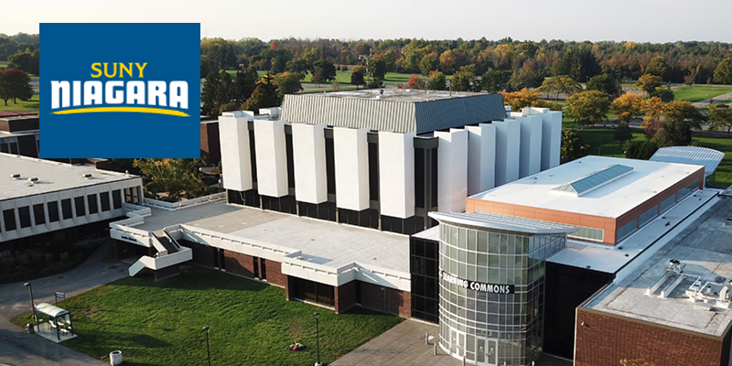
Mechanical Technology Program
In Jan of 2020, NFCSD was awarded a 7 year, $2.28 million Pathways in Technology Early College High School Grant (PTECH). In 2024 we received another grant in PTECH
The PTECH grant is designed to give students early access to college courses as well as early access to career training and preparation. Students will be provided the opportunity to accumulate up to 24 credit hours while in high school through NCCC, toward an associates degree in Mechanical Technology. They will also have access to job shadowing, internships and on the job training through our business partners, NYPA, Olin, VOSS, MOOG, ODOO and others.

Slide 11
PTECH Mechanical Technology Program
9th Grade - CFM and other high school requirements. 1st college course MET 110 summer of 9th grade.
10th Grade - CFM2, STEM Applied Innovations, MAT 111 Advanced Algebra Trig. Summer of 10th Grade TEC 110 Introduction to Technical Calculations
11th Grade - 3 College credit bearing courses: DRF 180, TEC 102, ENG 101. Summer of 11th grade DRF 279 Technical Seminar
12th Grade - TEC 120, ENG 103 and Physics, Job shadowing and Internships.
*Students can advance through PTECH program at their own pace. There is built in after school academic support 2 days per week. Most students will require one full year if not two years to complete degree requirements at SUNY Niagara.

Slide 12
PTECH-Computer Science Program
The NFCSD was the proud recipient of 1/12 schools in WNY to receive the P-Tech Grant in Computer Science in 2023.
Similar to the MET Grant we are now recruiting students in grade 8 to sign up for the Computer Science Program.
We will have a summer camp from July 6-July 17 and then students will take courses throughout high school towards an Associate’s degree in Computer Science or Computer Information Systems from NCCC at no cost to you. During summer camp you will engage in Web Design and Coding activities. You will also get to improve your Math skills.
Some courses that you will take at the High School are Computer Science, Computer Systems, Financial Accounting, Managerial Accounting, Writing for STEM, Cybersecurity, Business Commutations, Math, Coding and more.

Slide 13
PTECH Summer Camp
Mechanical Technology
Computer Science
Morning: Math
Math refresher class to prepare for next year
Focus on problem solving skills with STEM kits
Speakers
Afternoon: Technology
Paper Rockets
Bottle Rockets
Soldering
Electronics
Morning: Computer Science
Website design
App design
Basic programming skills
Afternoon: Math
Math refresher class to prepare for next year
Projects incorporating math concepts ex. Bottle Rockets and Bungee Barbie
Speakers

Slide 14
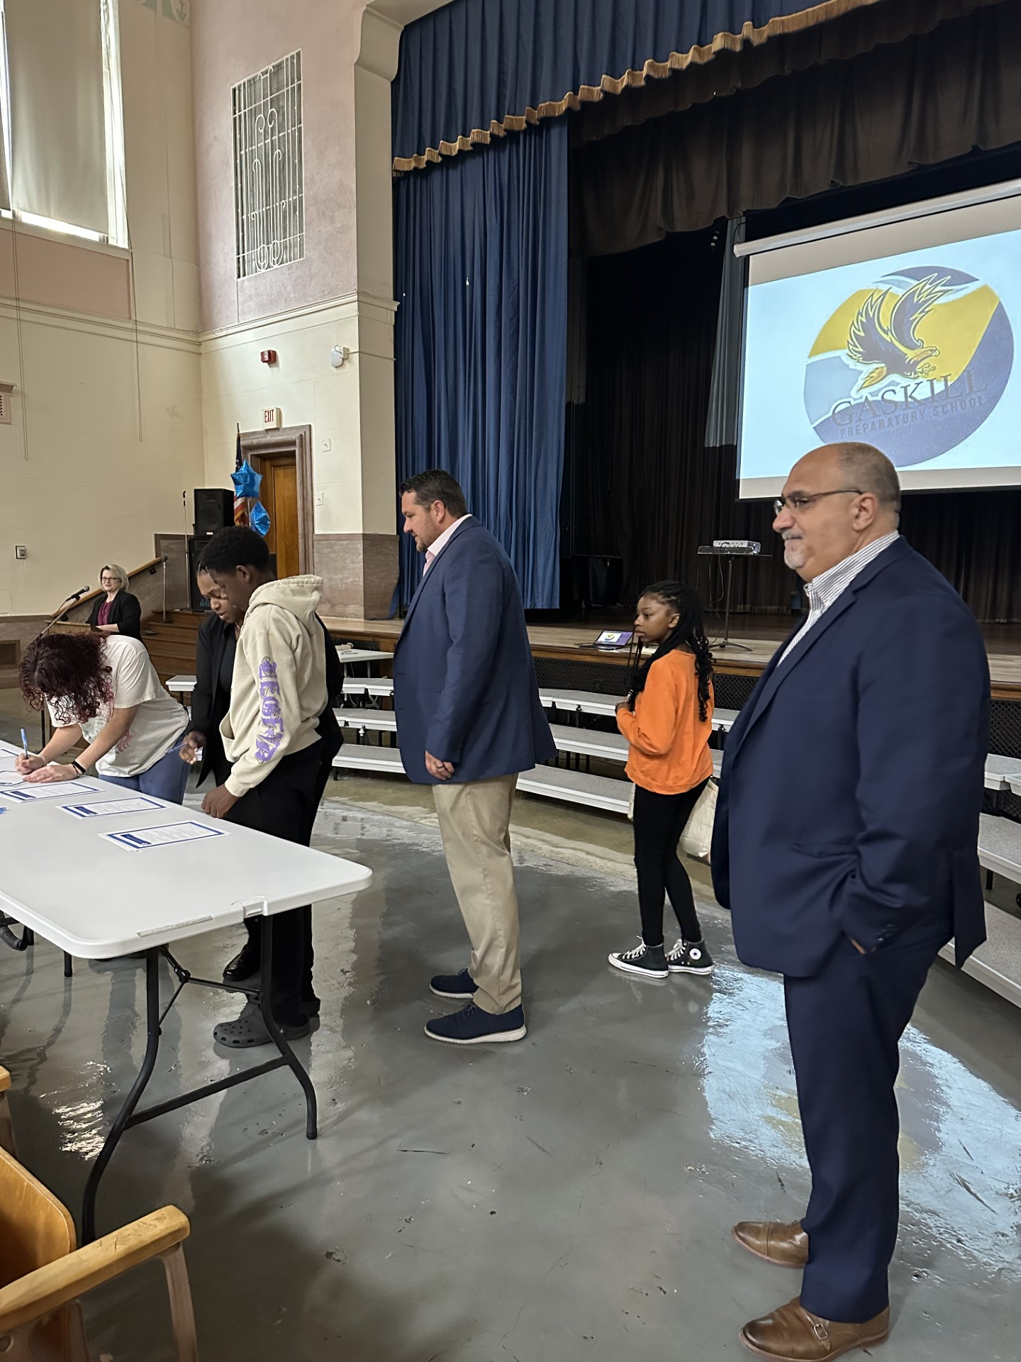
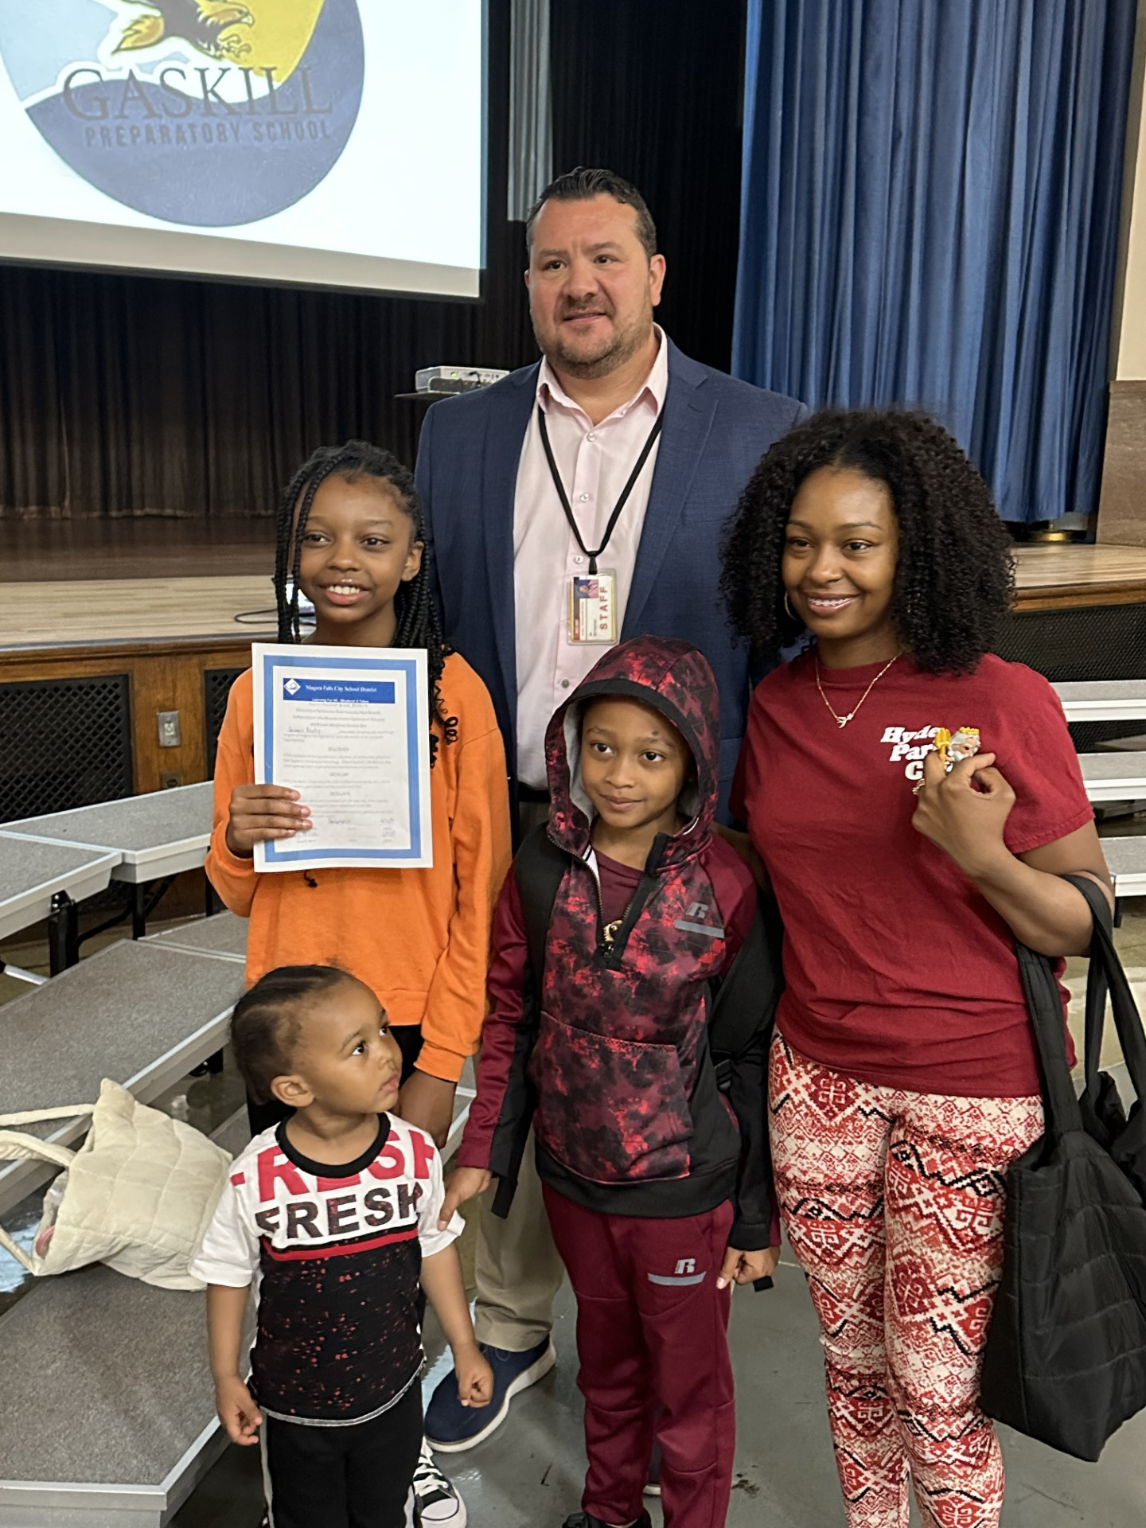
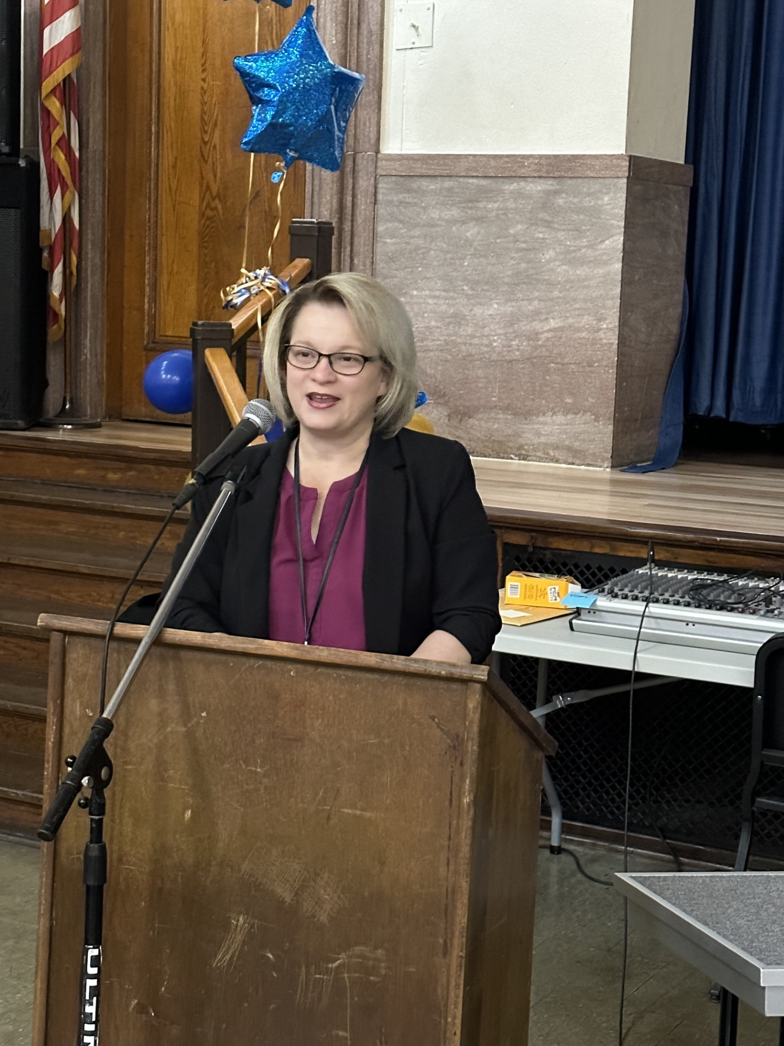
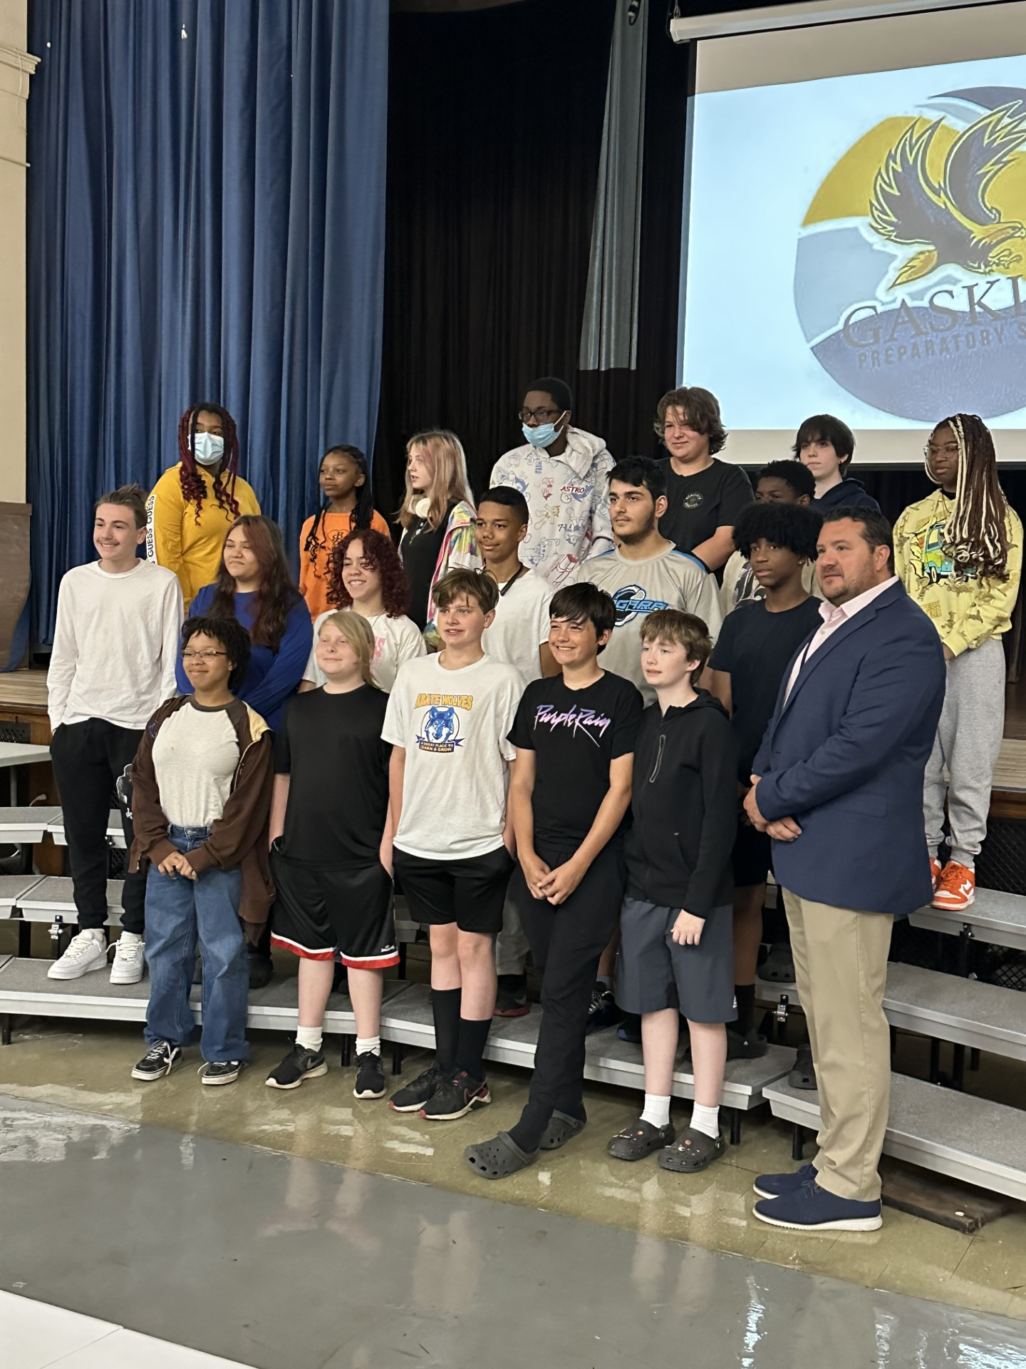
Signing day for PTECH program

Slide 15
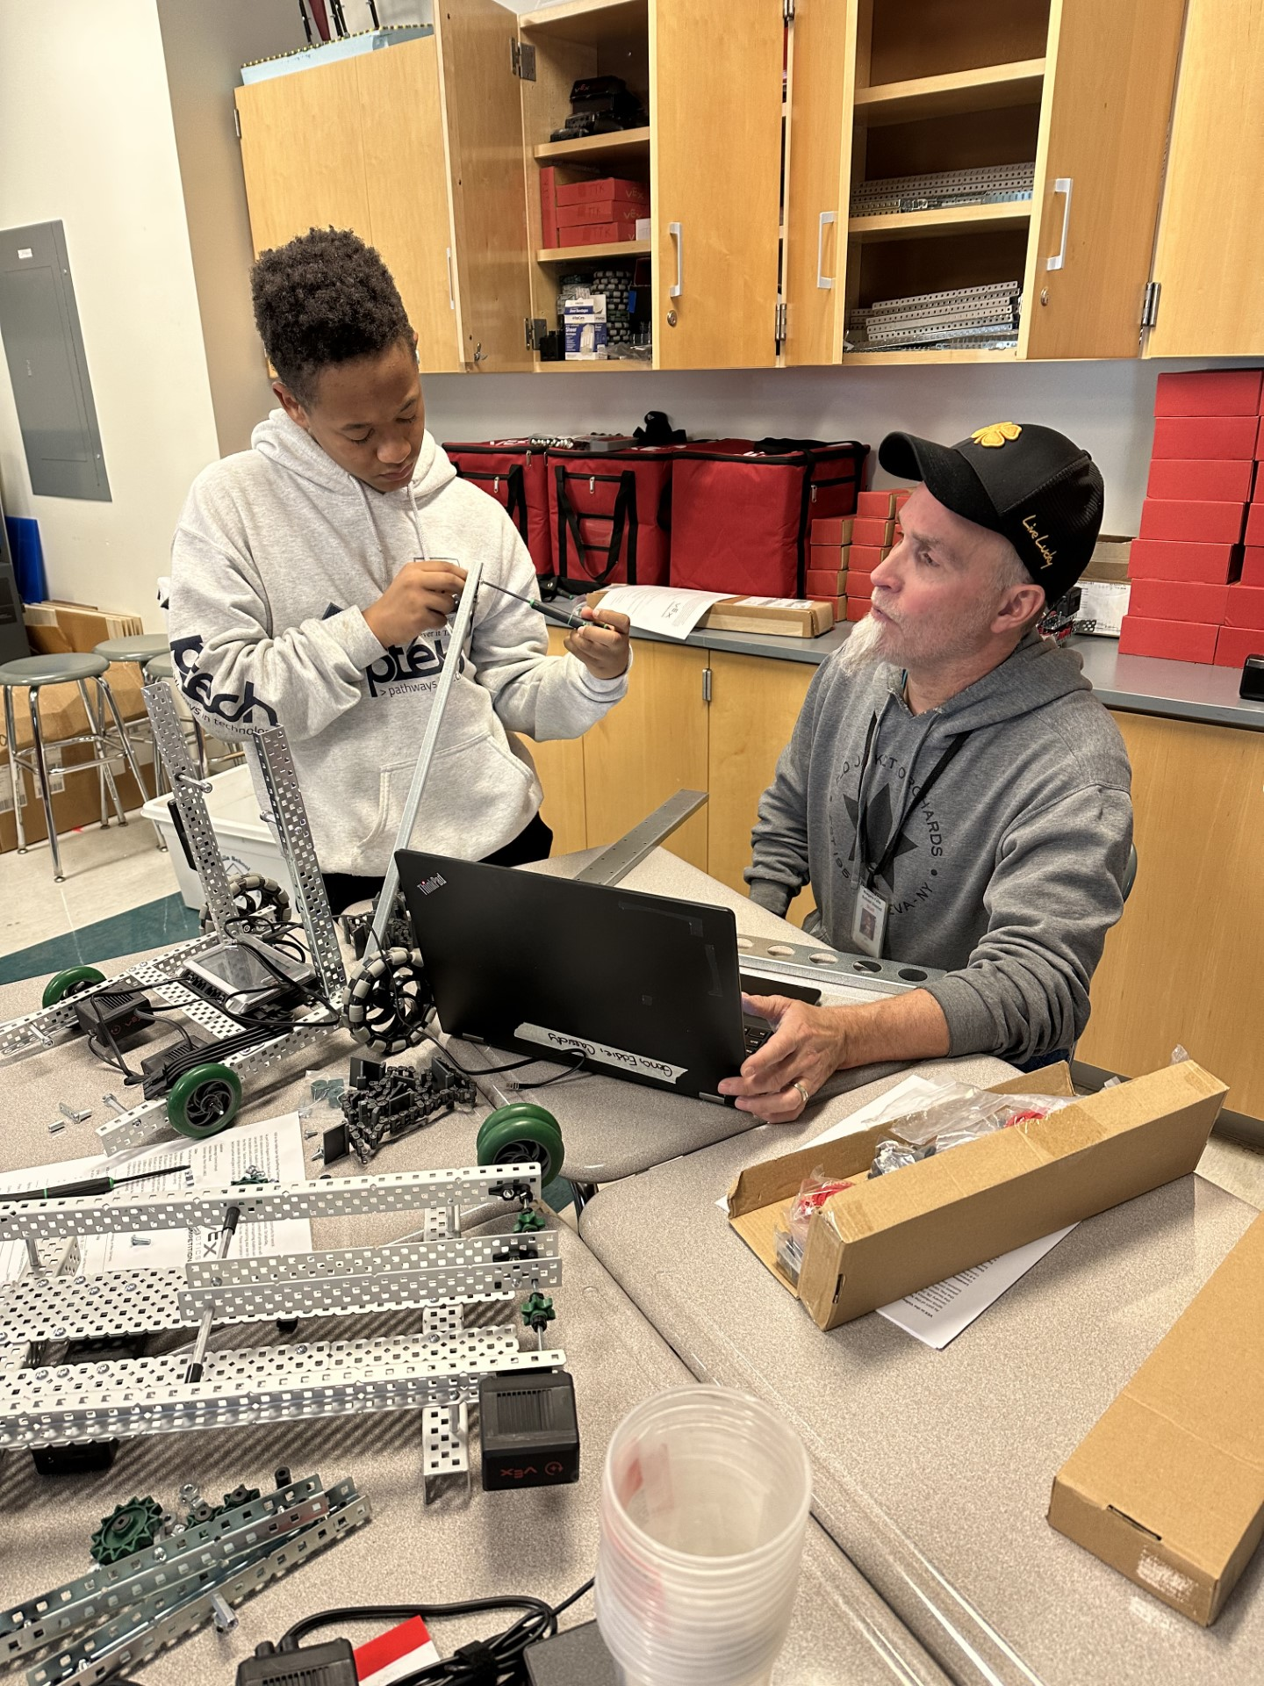
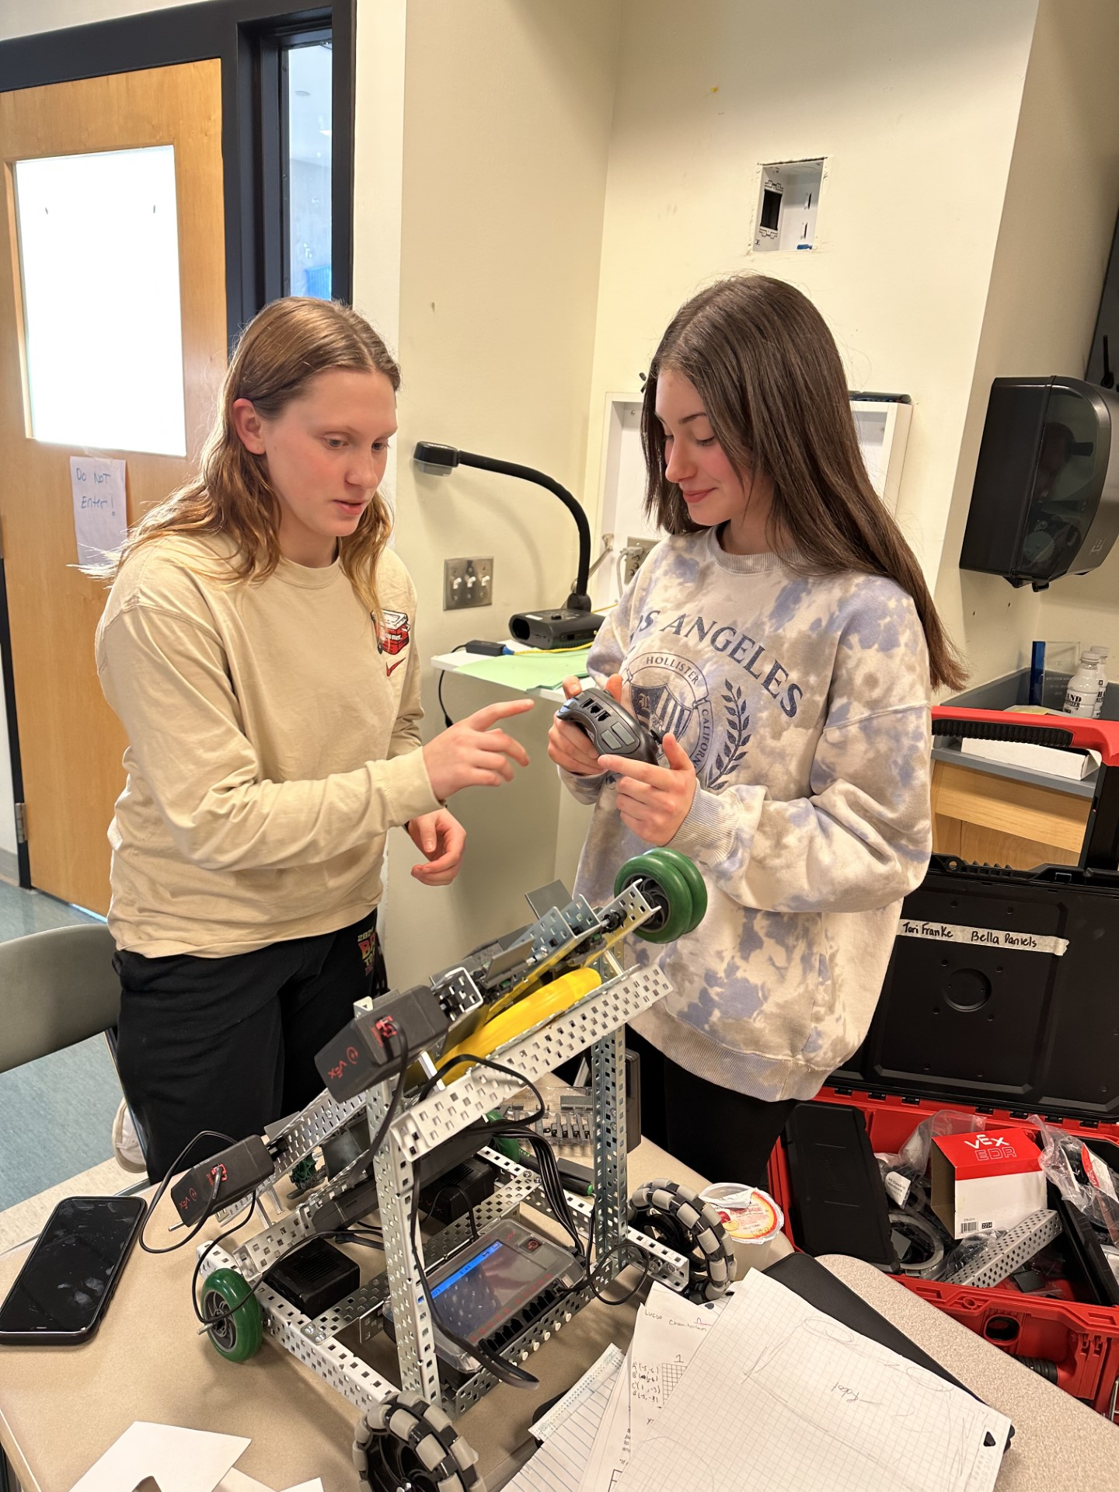
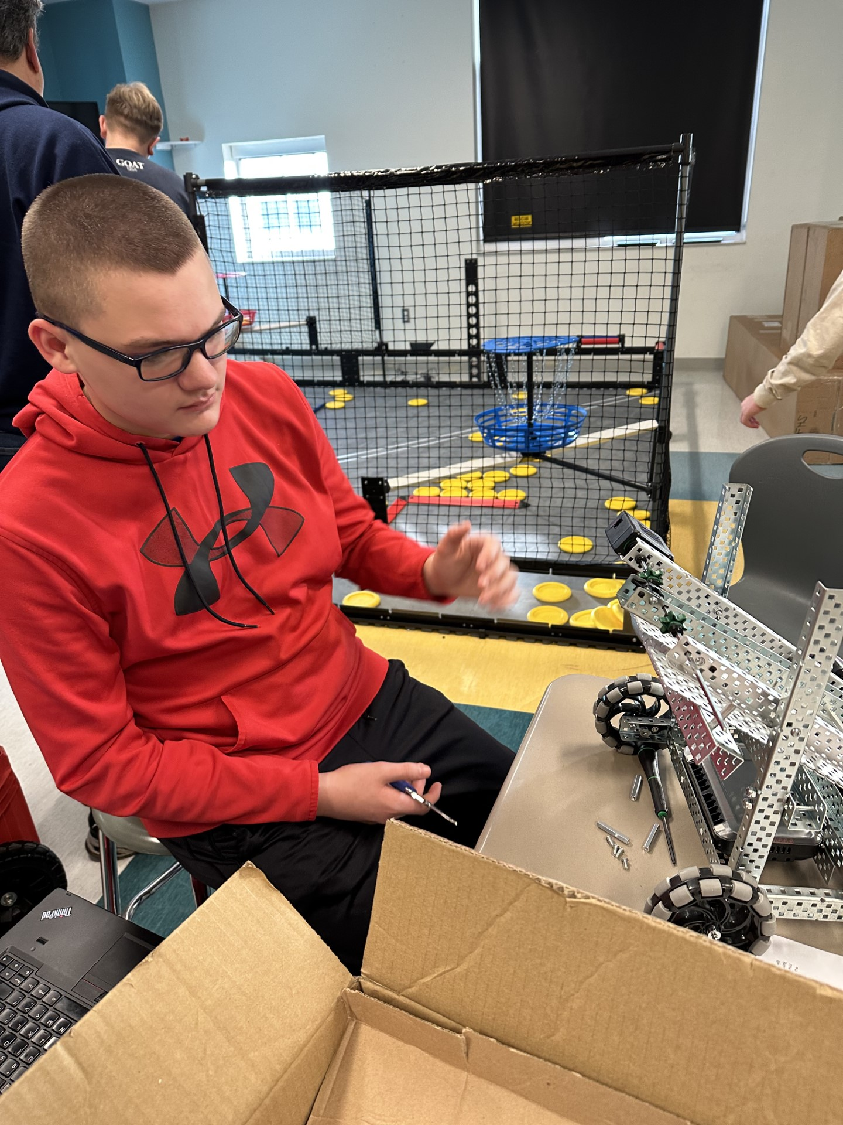
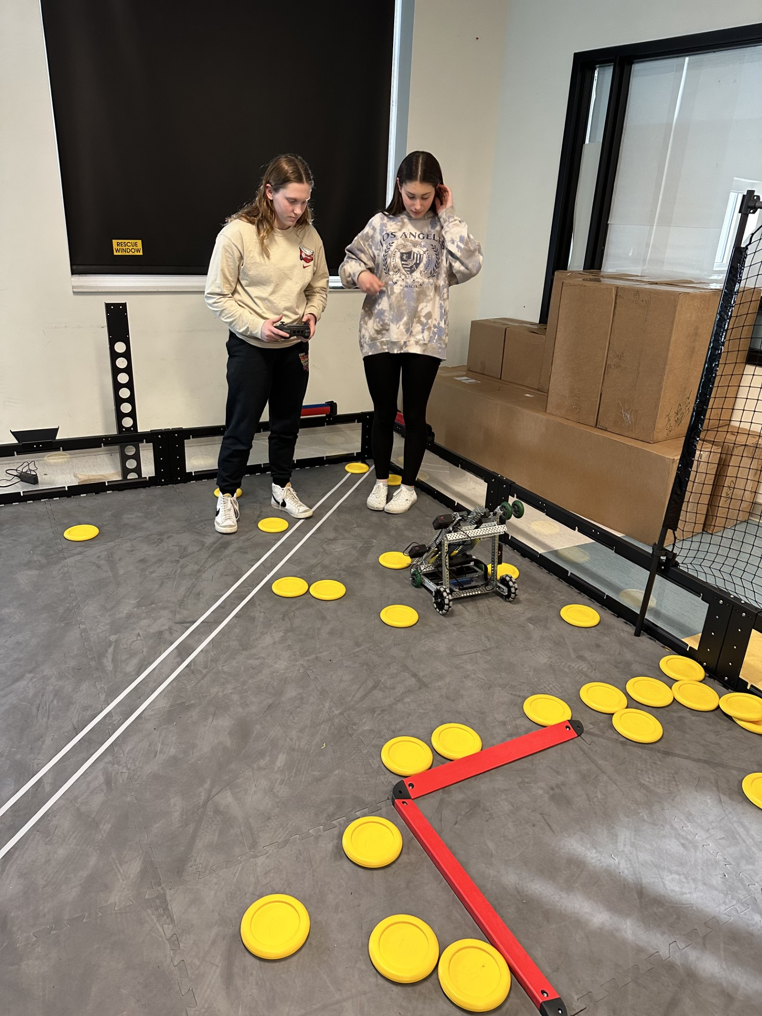
Students in Robotics Club

Slide 16
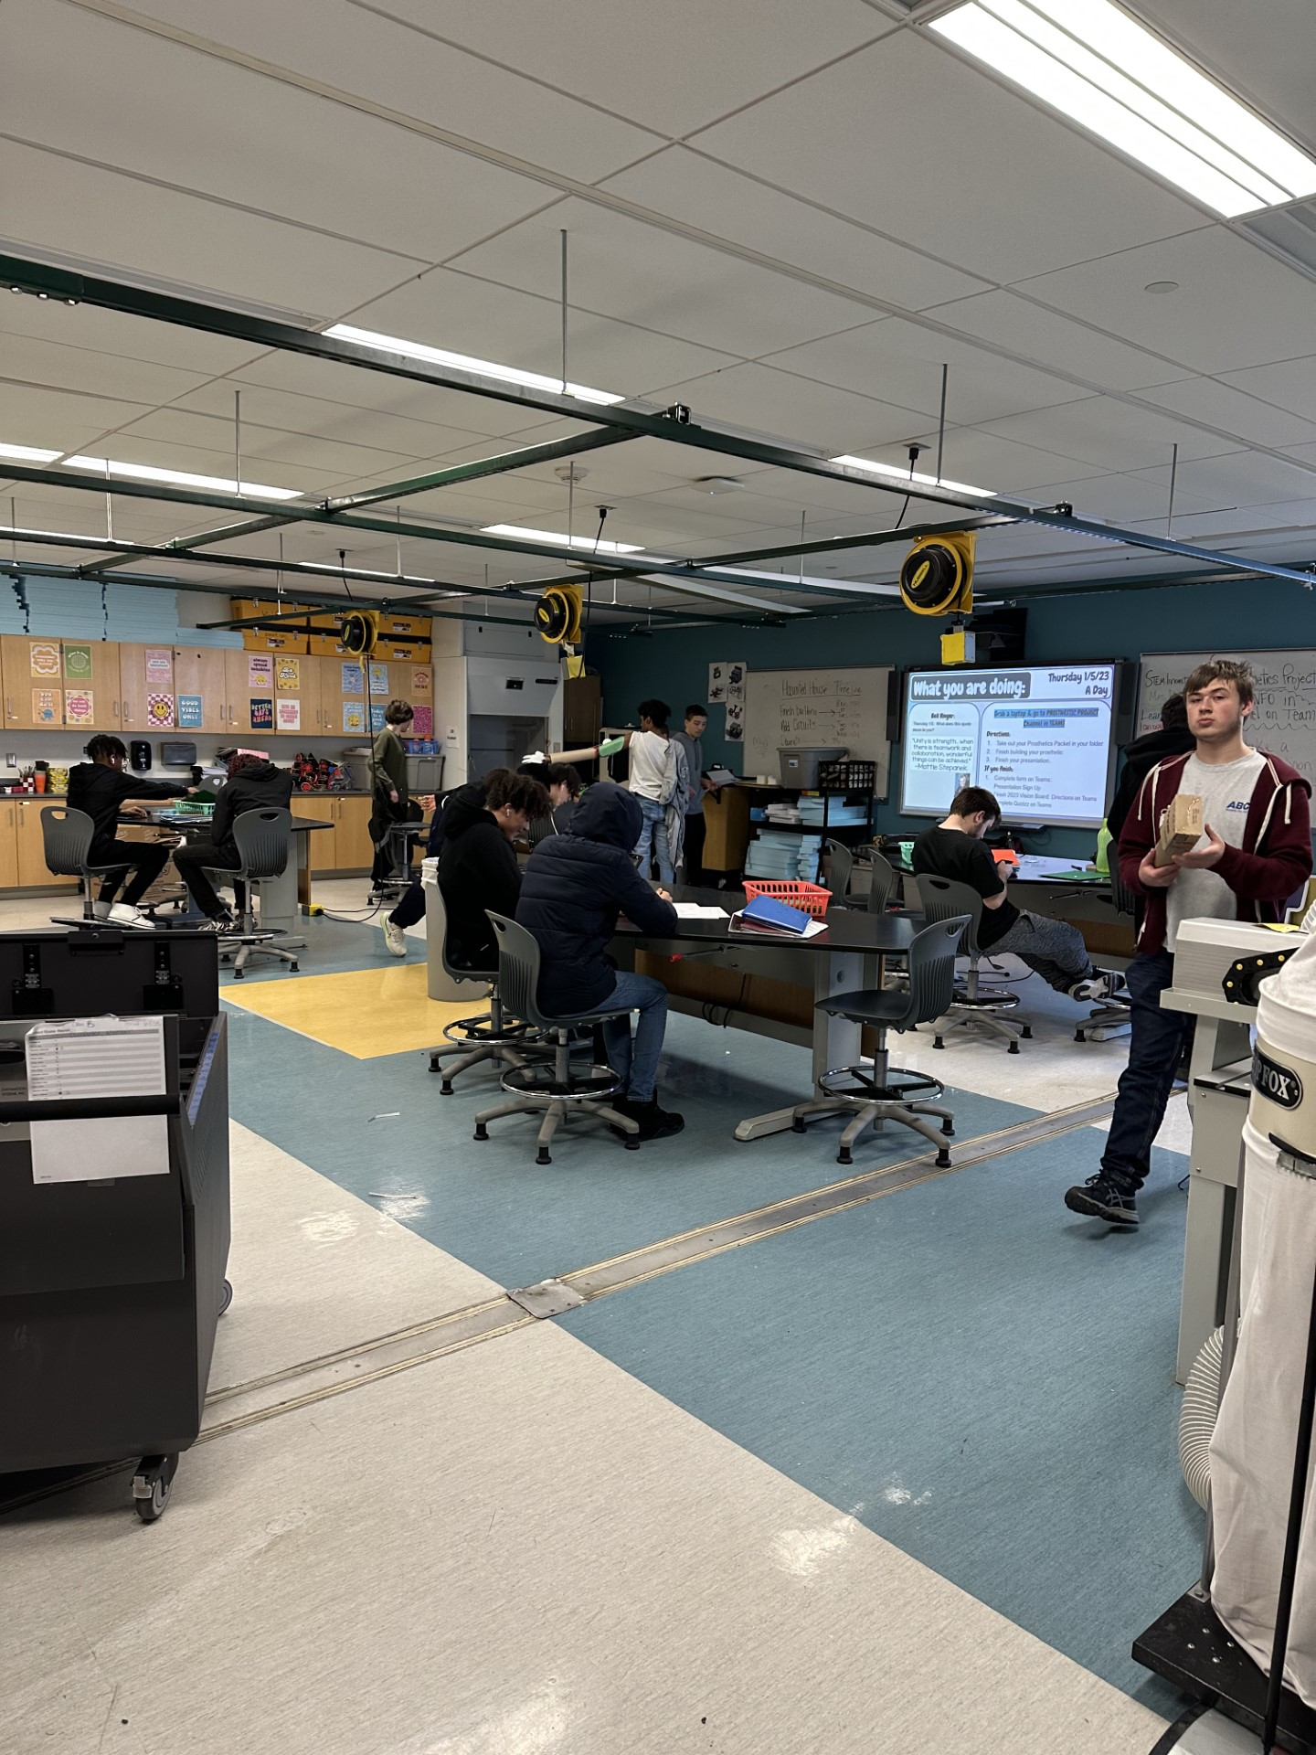
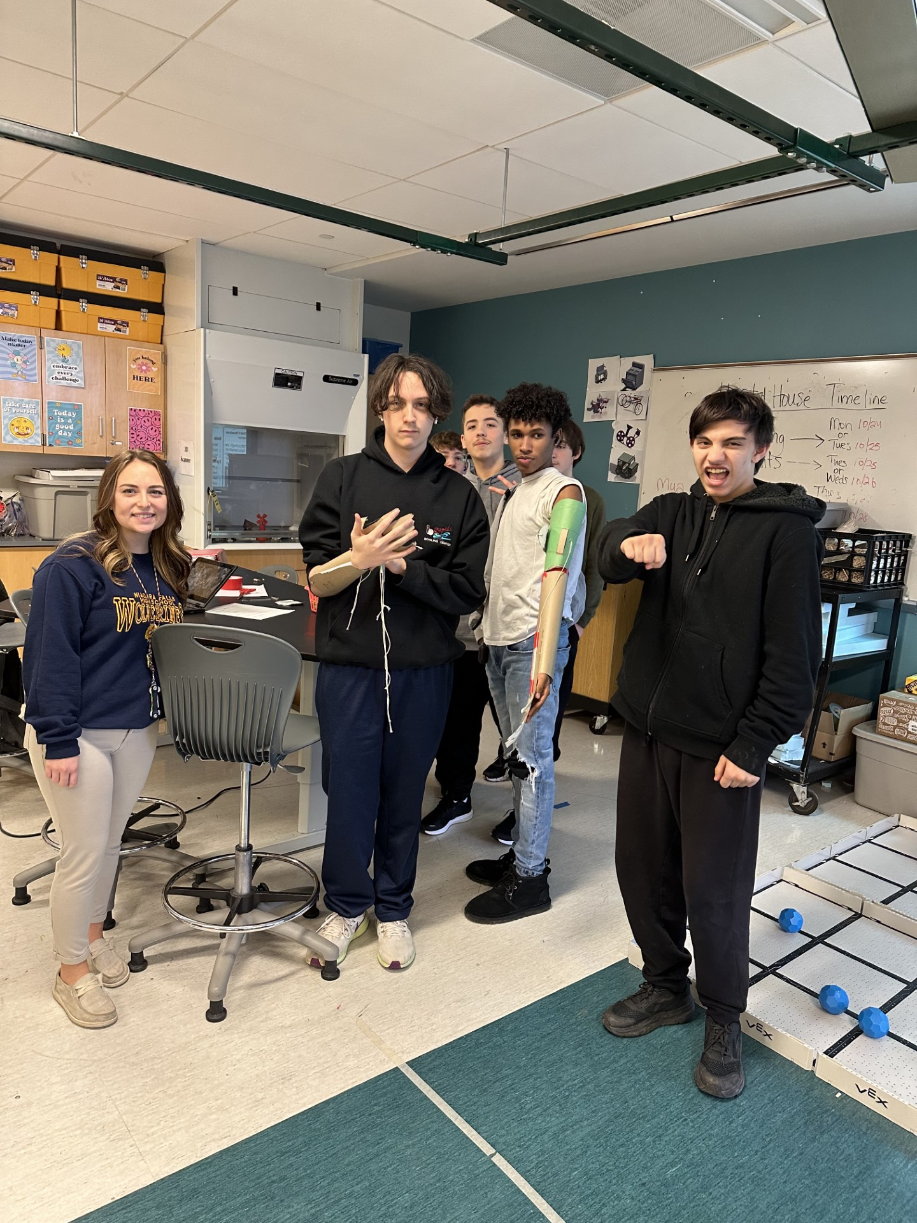
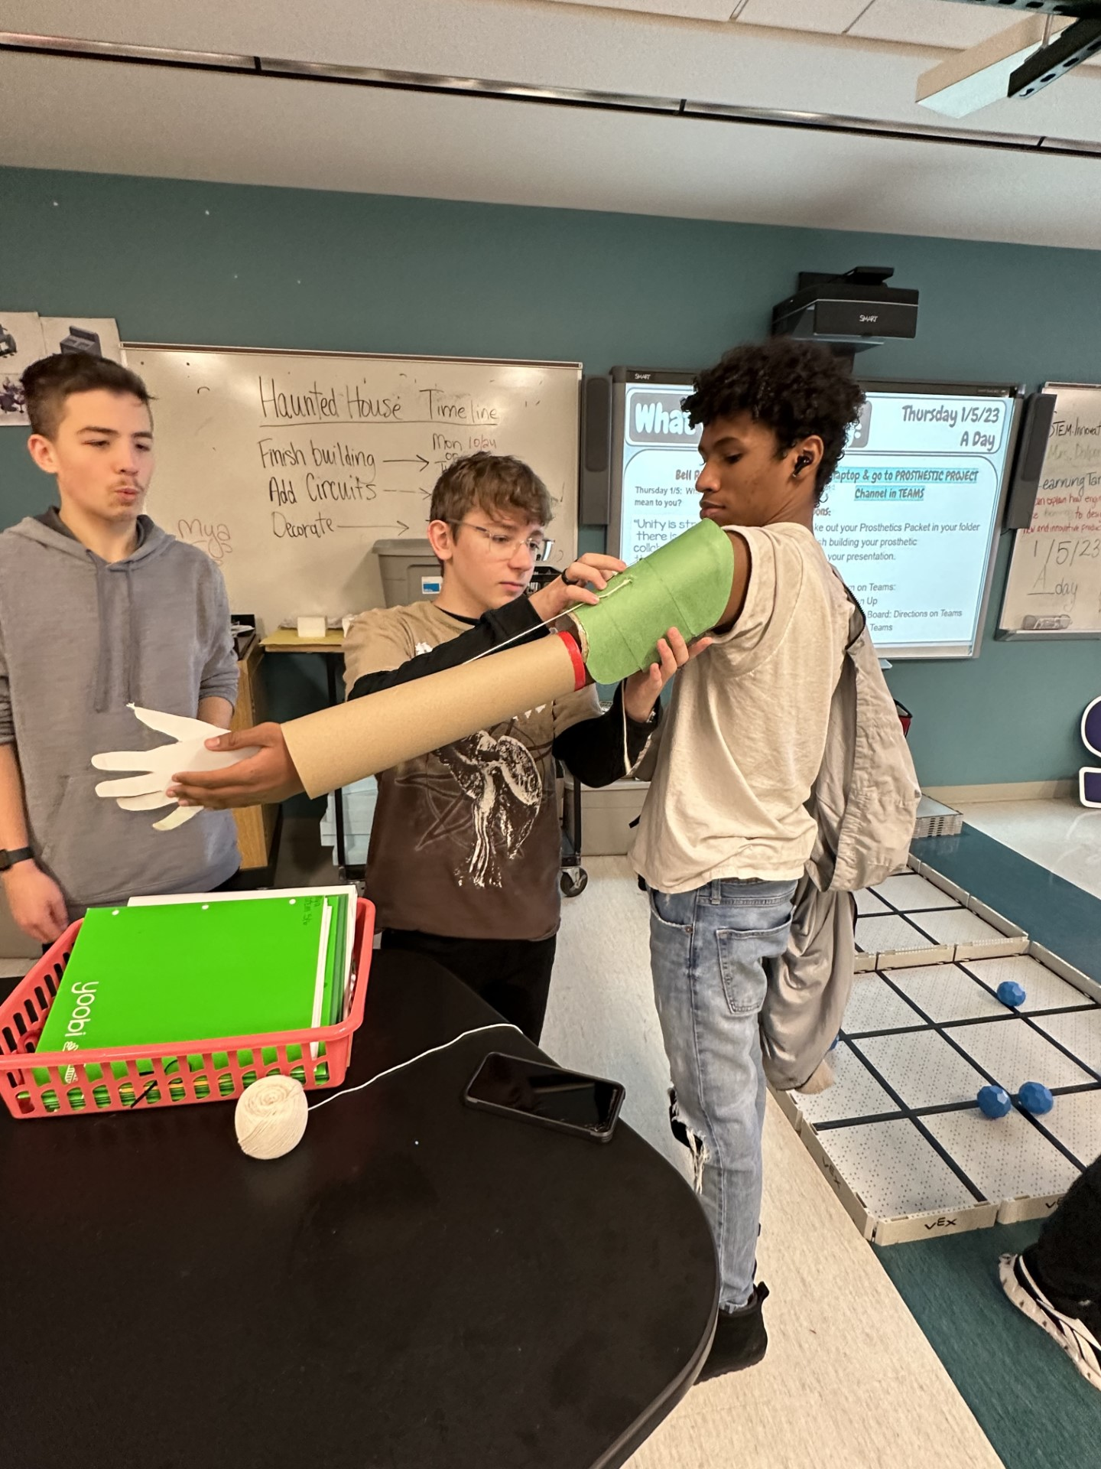
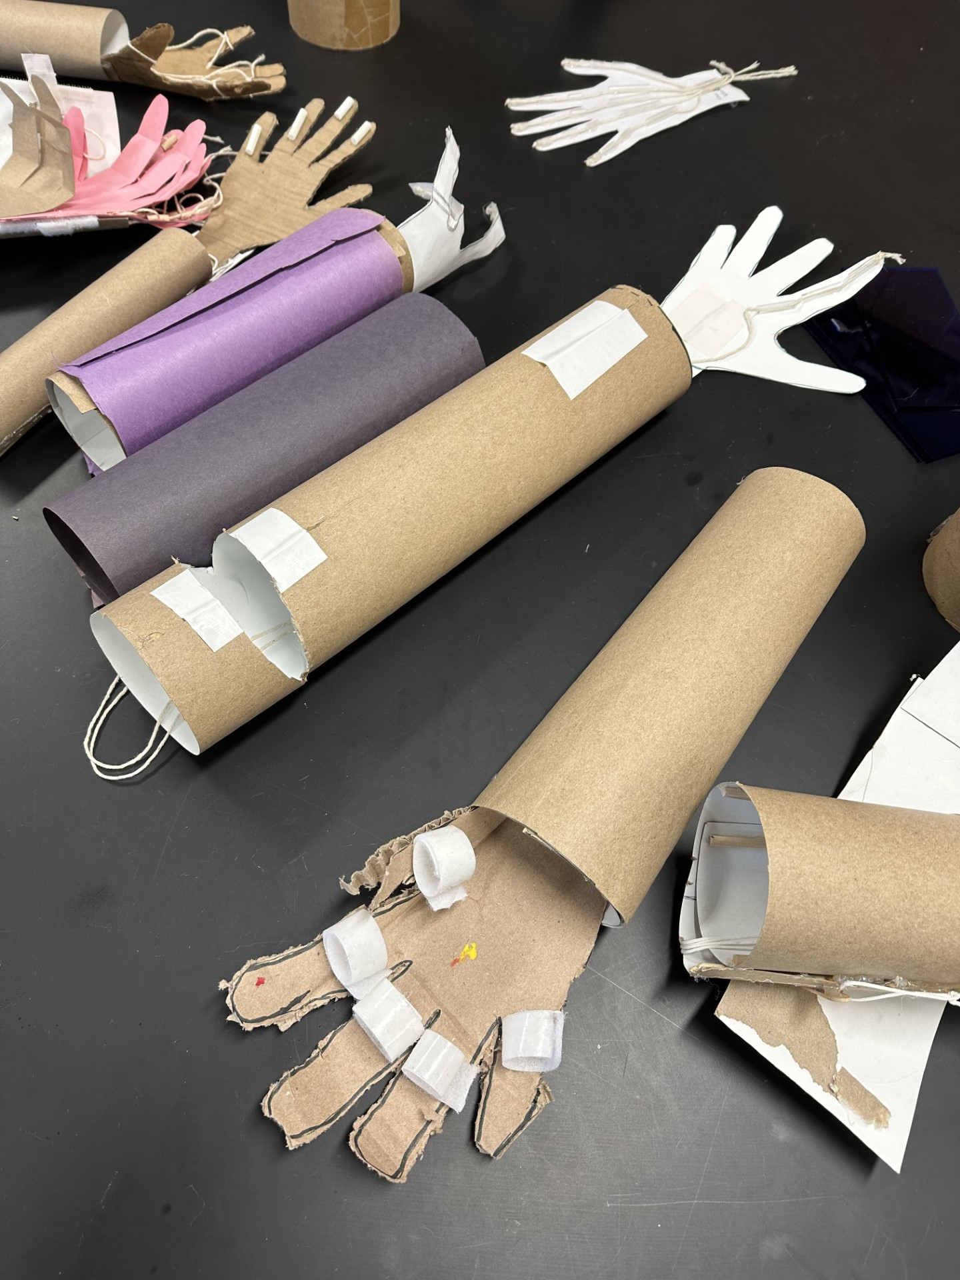
Students in Miss dalporto’s class

Slide 17
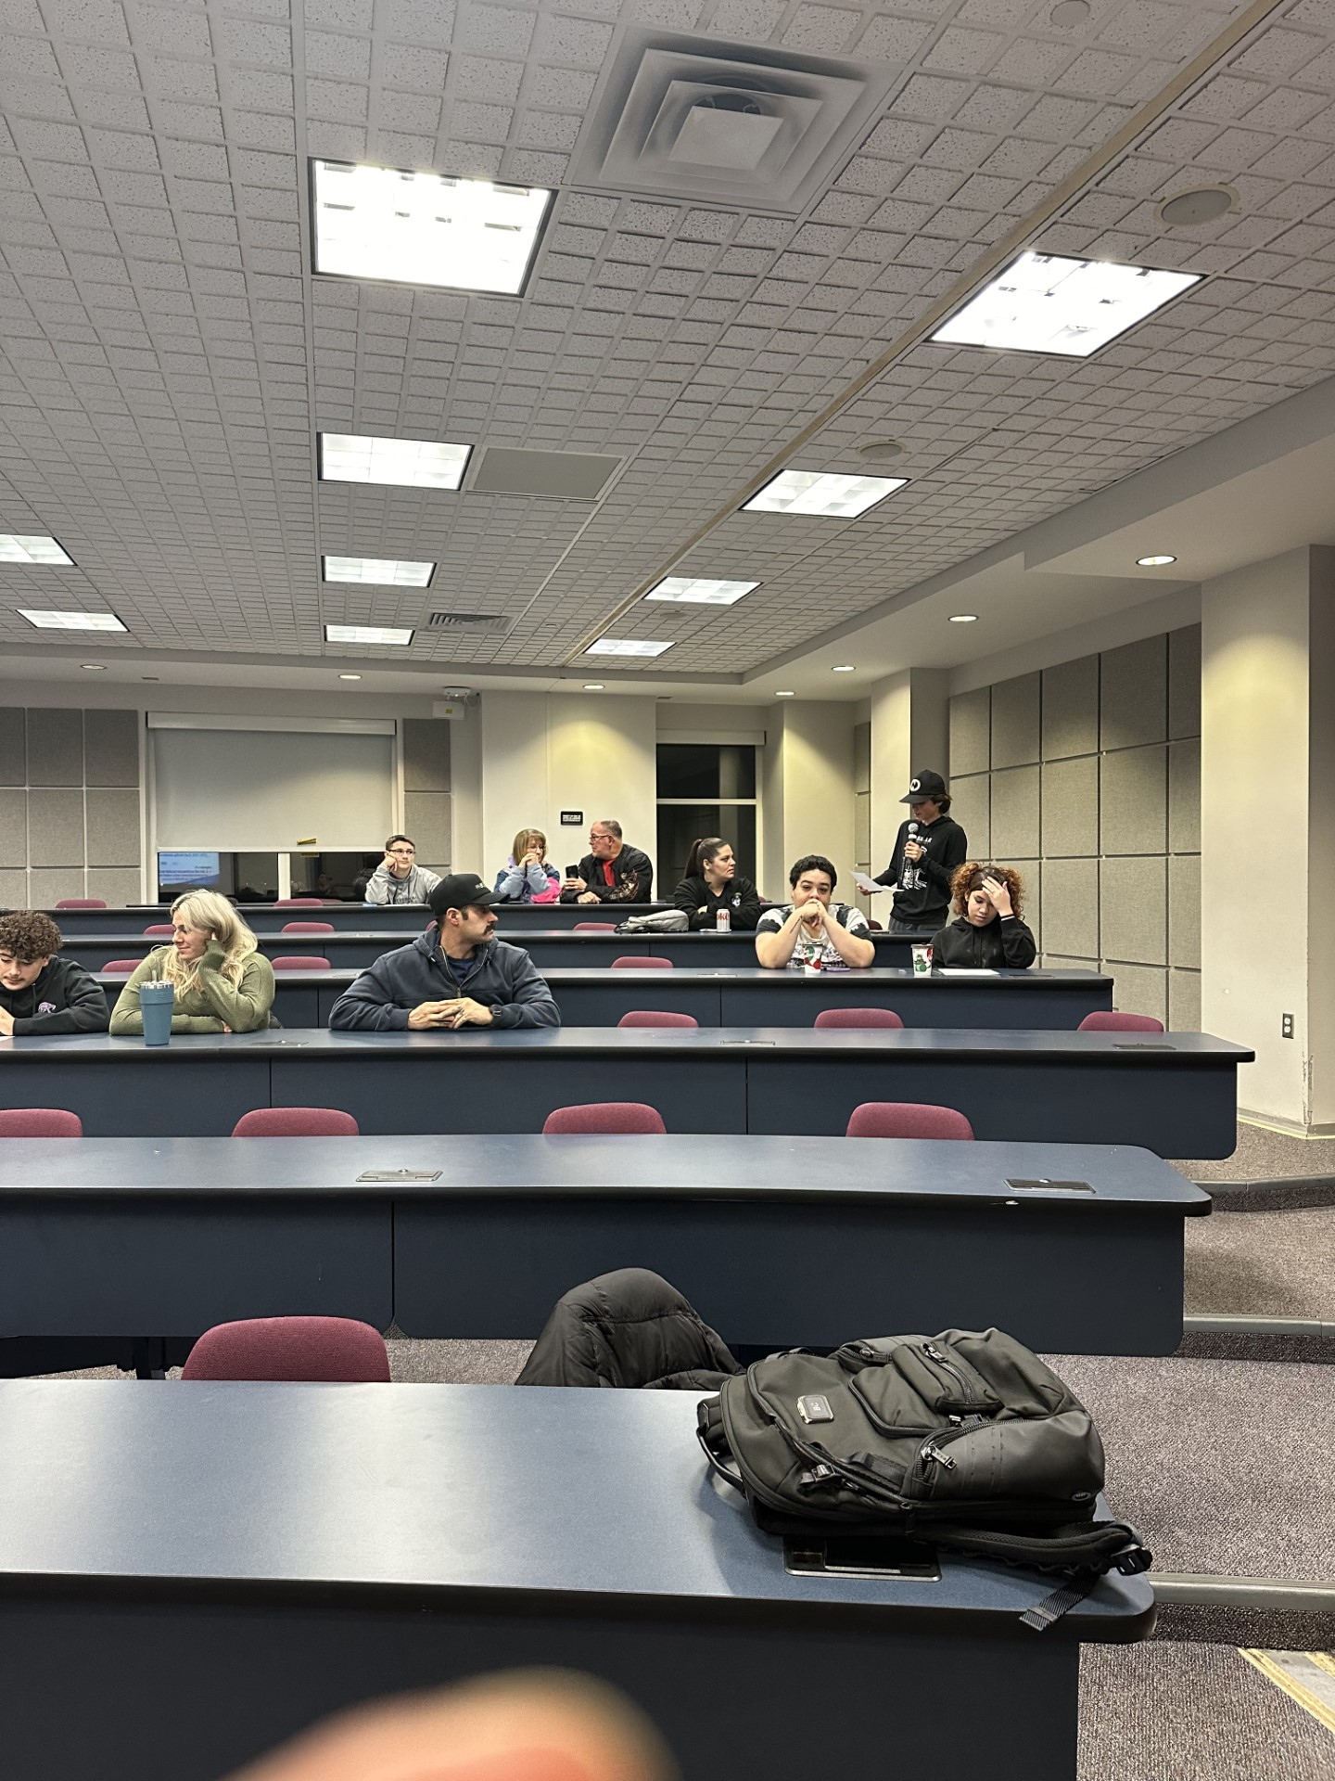
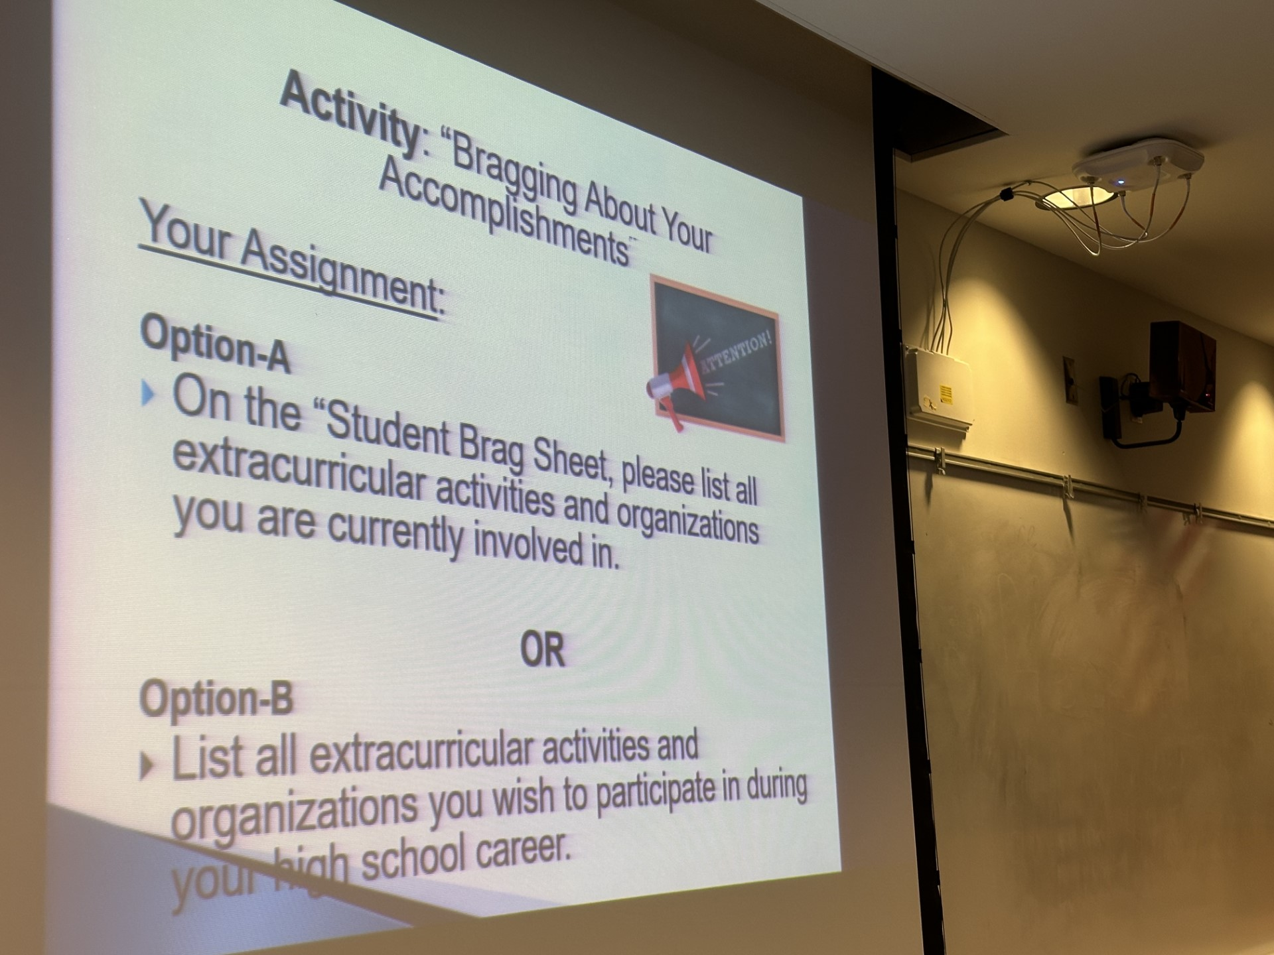
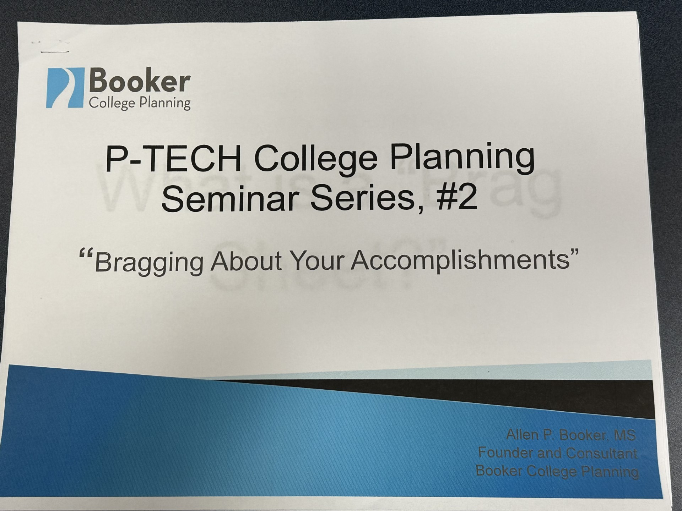
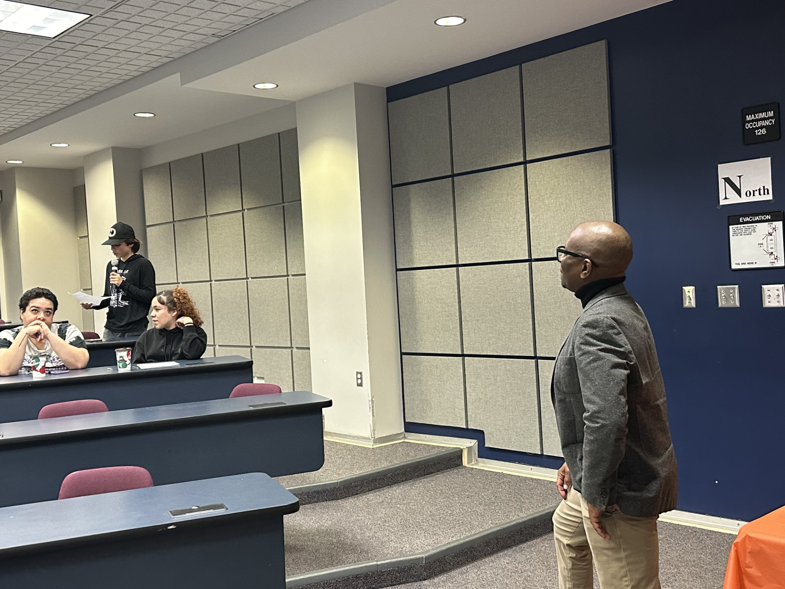
Students attending Booker College and Career planning at NFHS

Slide 18
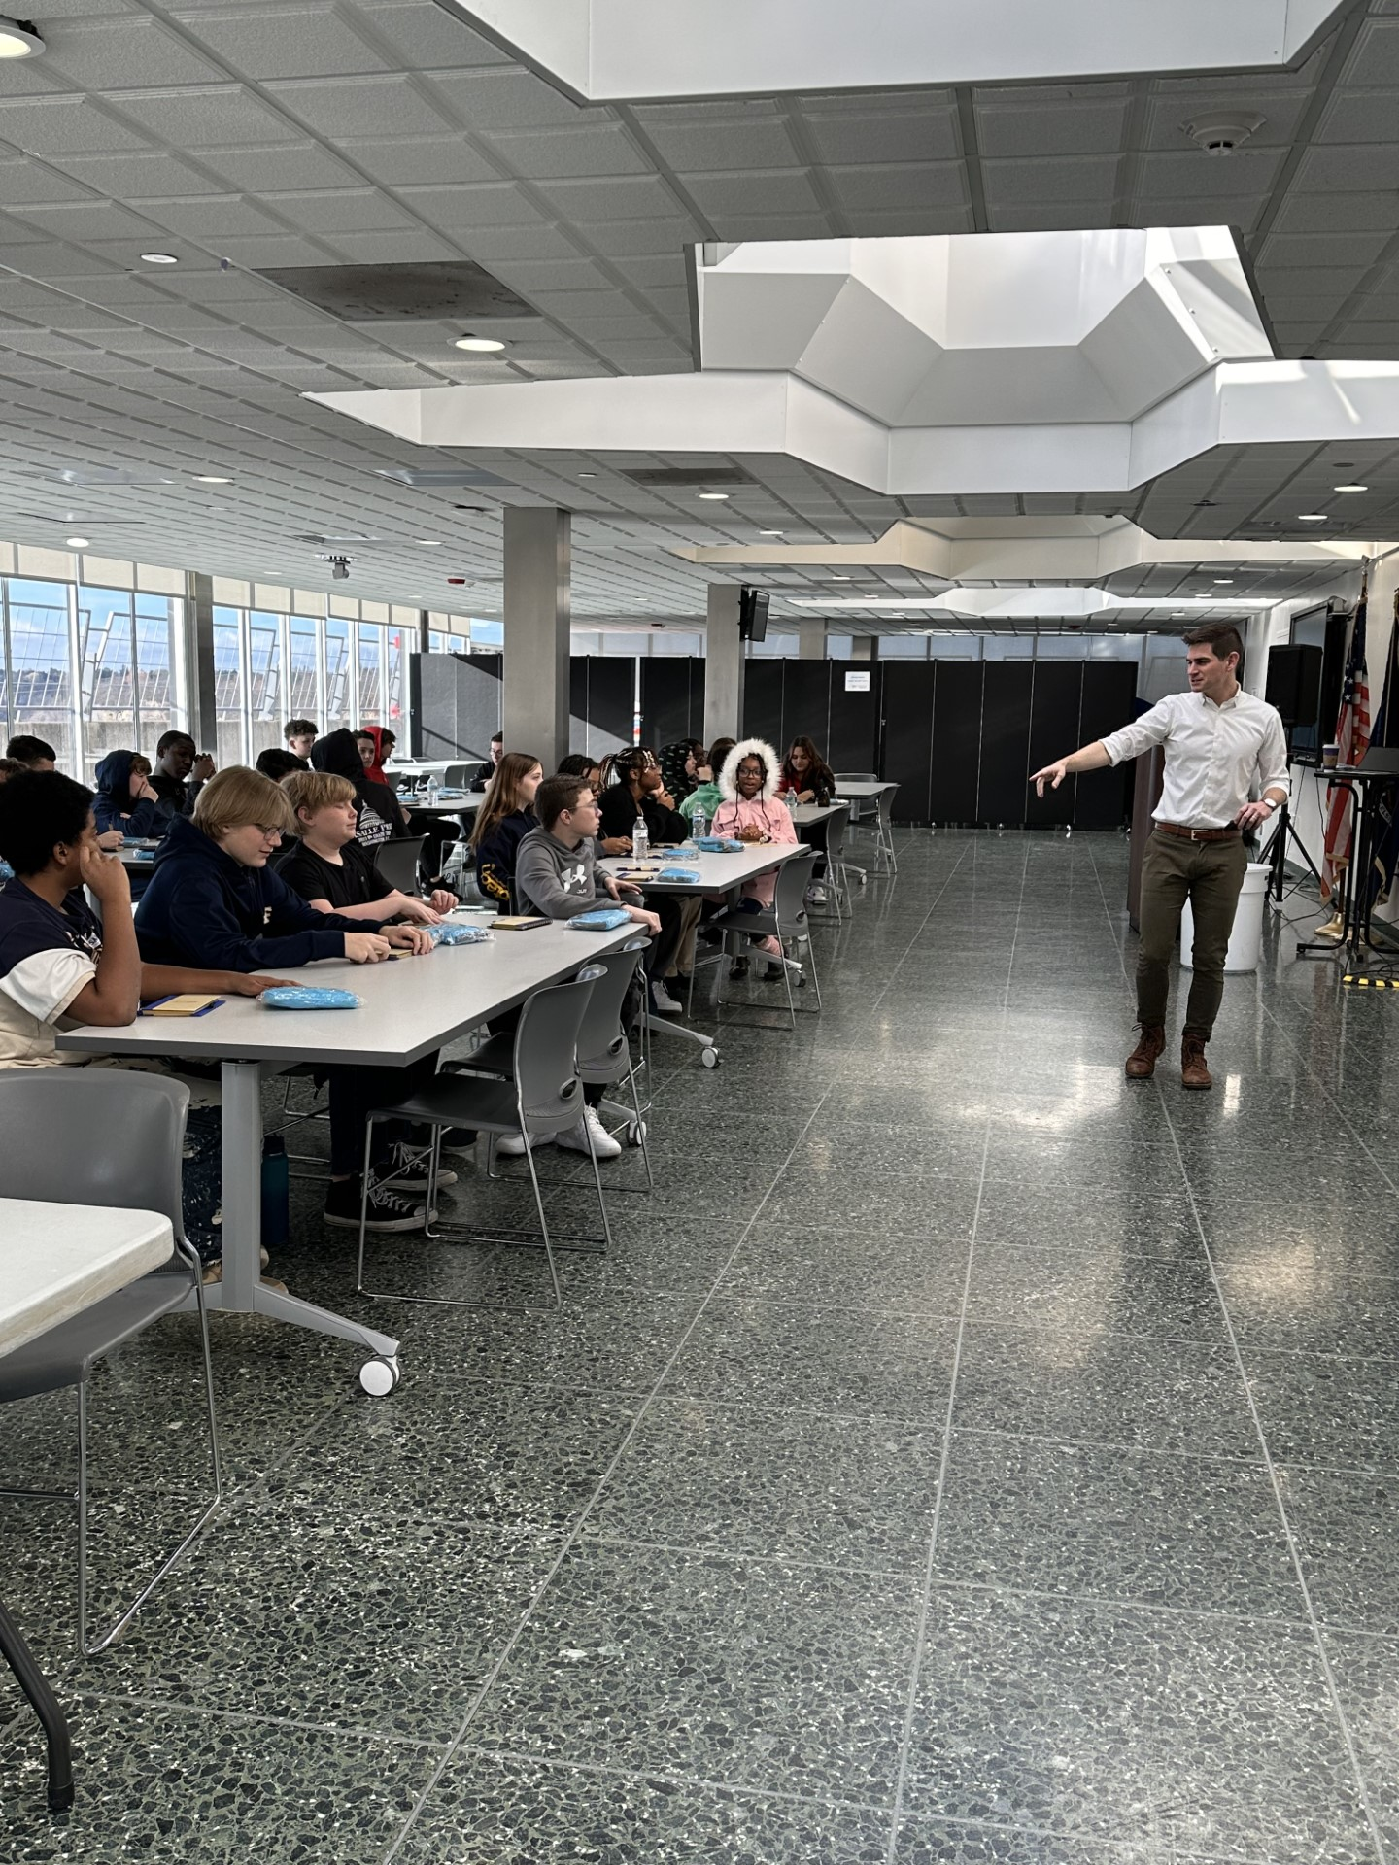
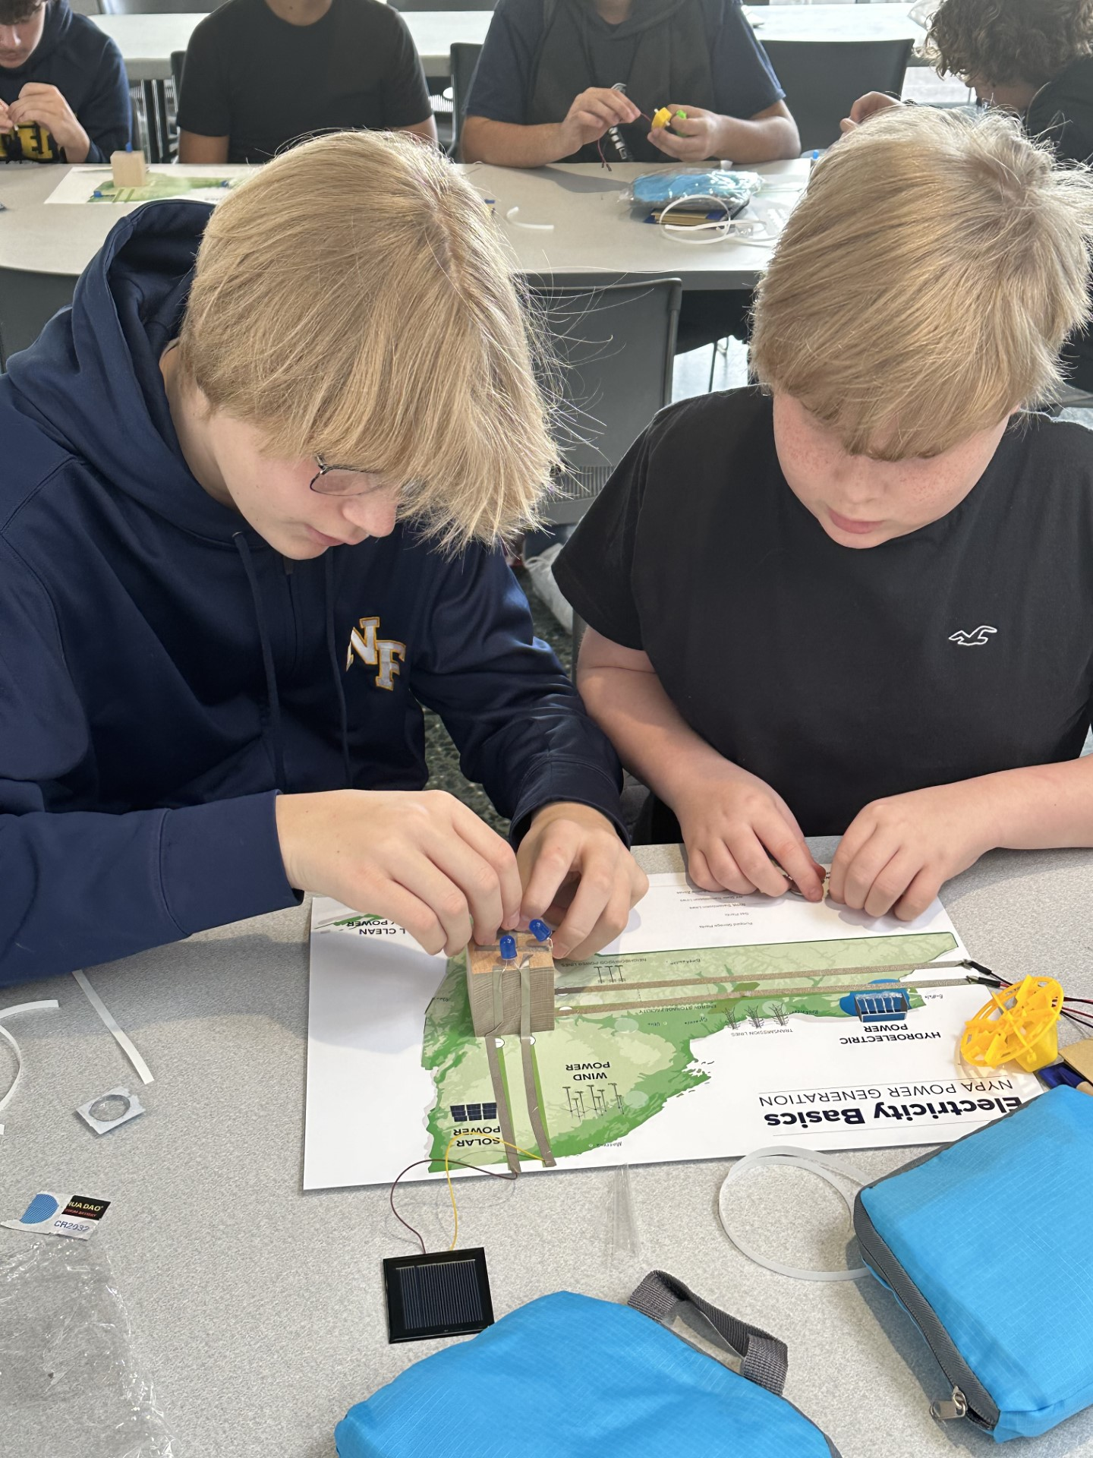
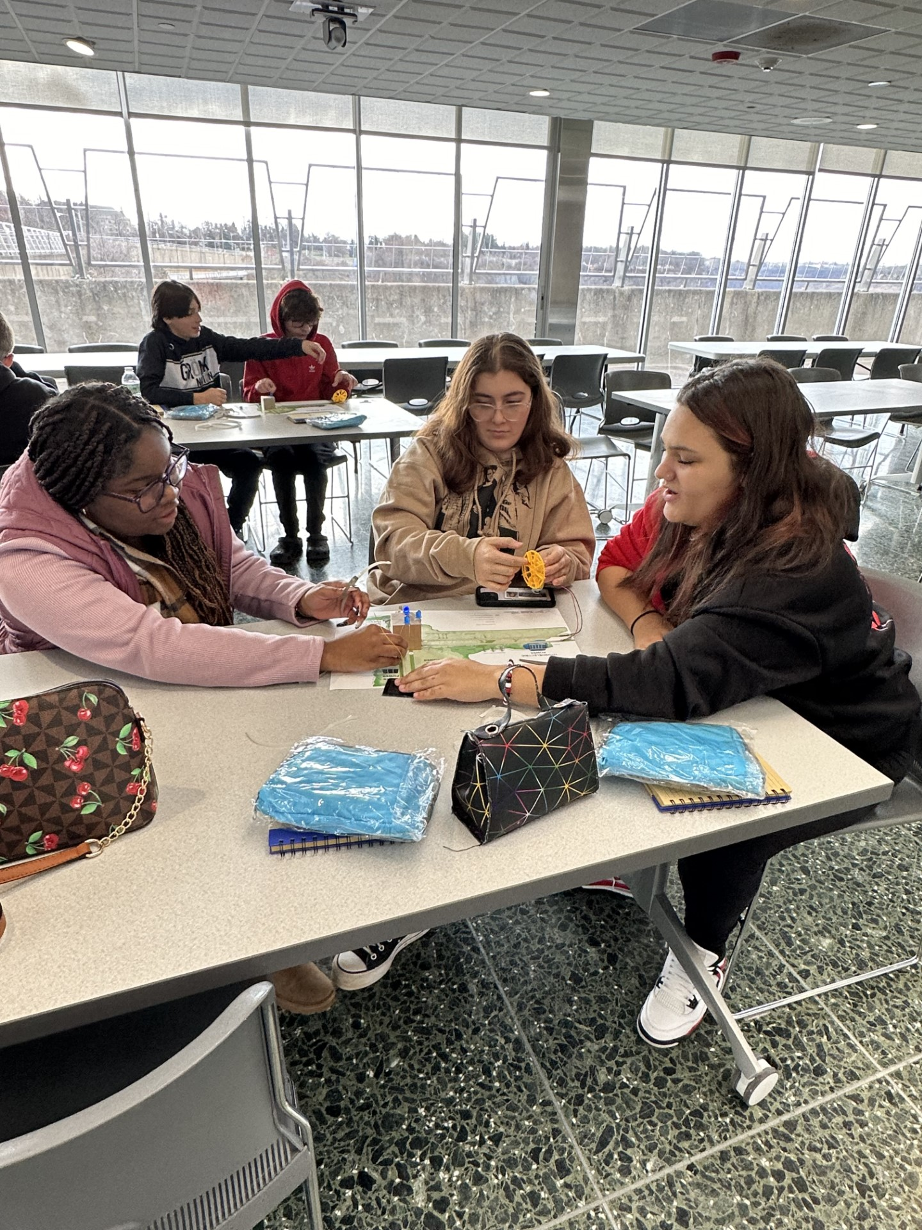
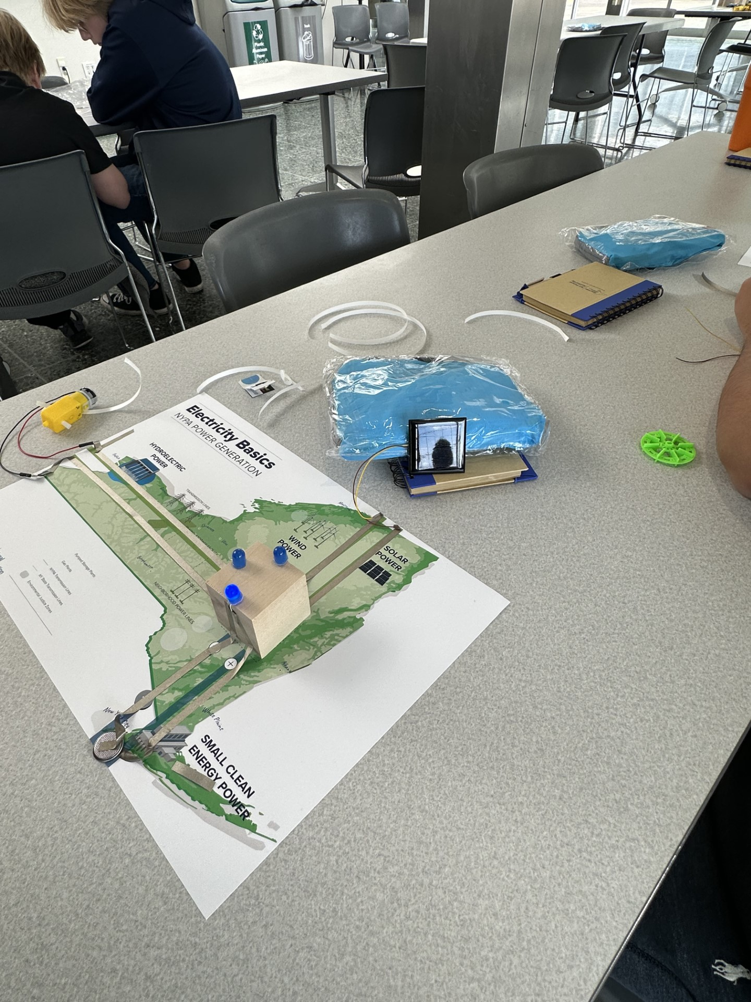
Students at NYPA-(New York power authority)

Slide 19
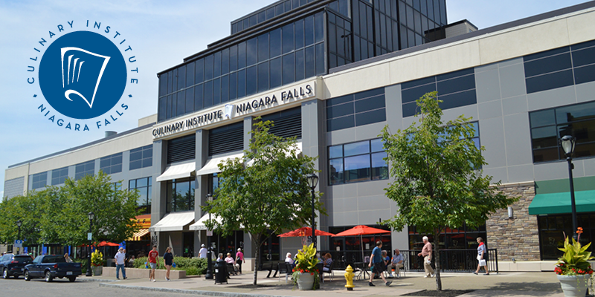
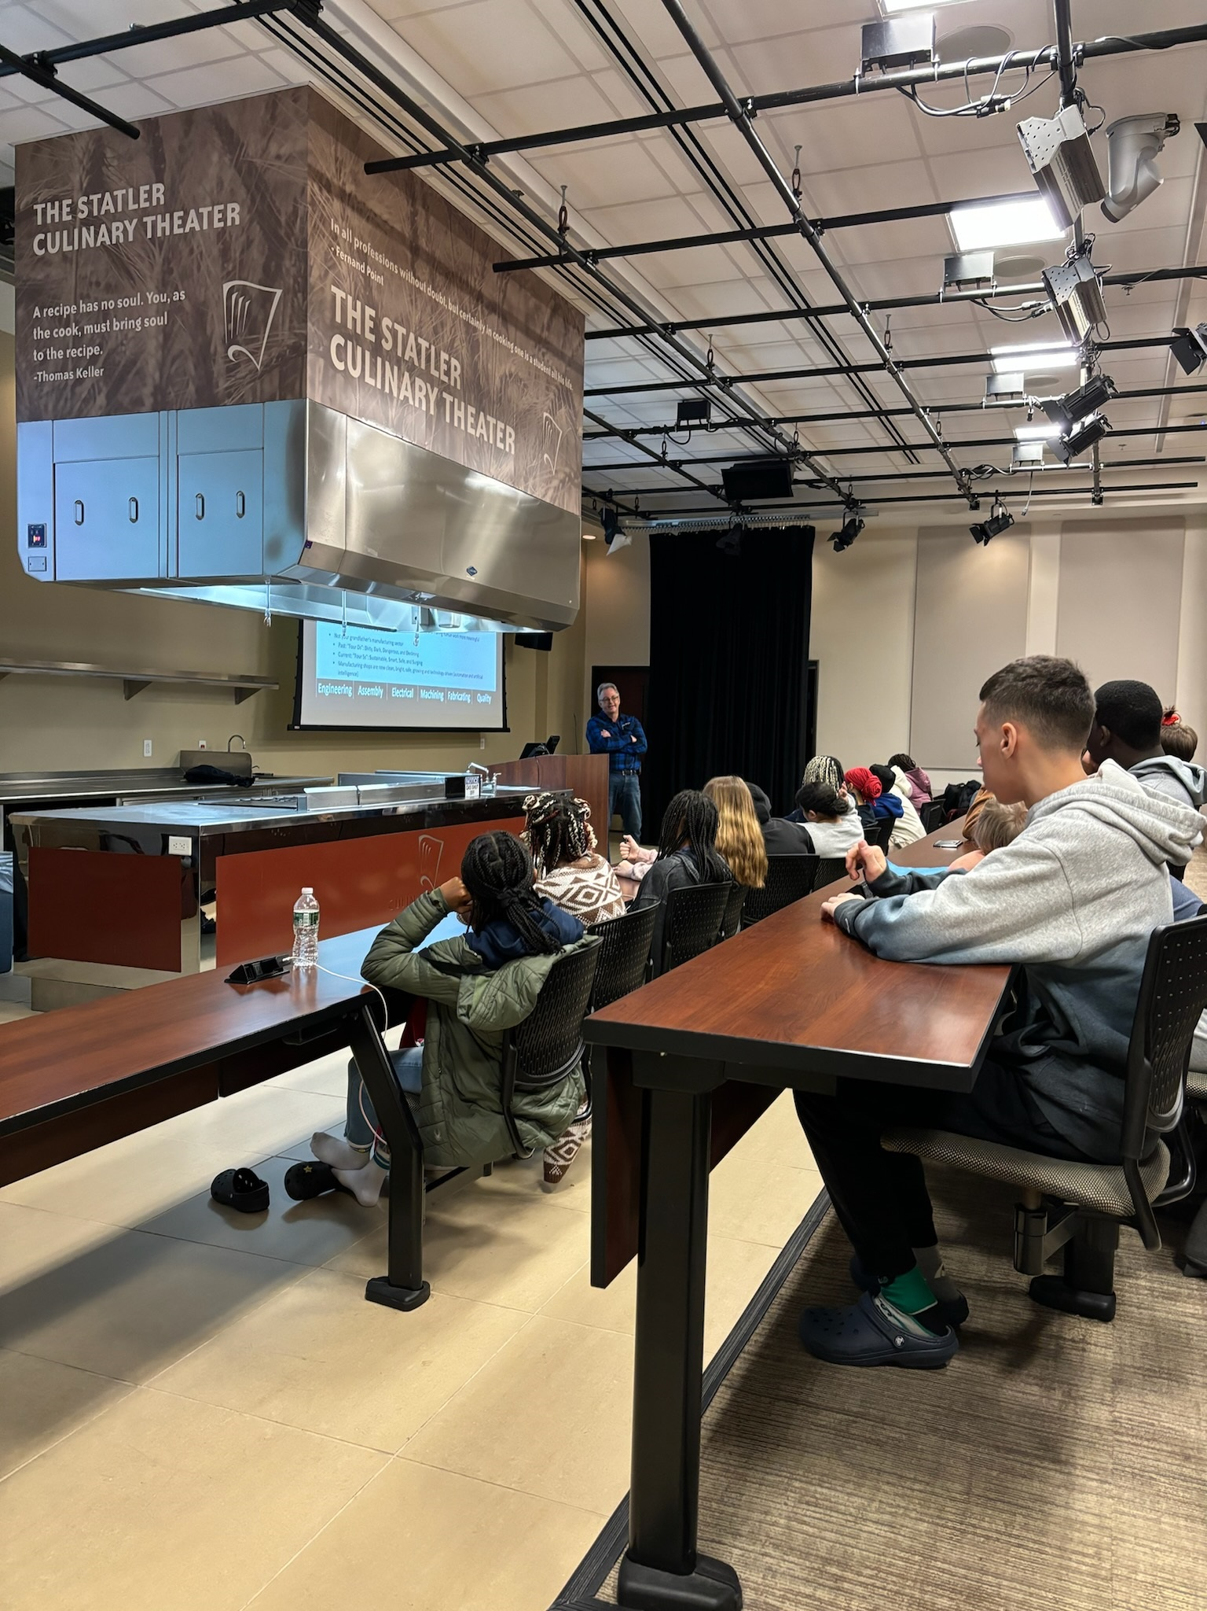
Students at savor culinary institute- career speaker series

Slide 20
Student Panel
Students from our PTECH Program from NFHS will now speak to you about some of their experiences.

Slide 21
Conclusion
Please join us now for an opportunity for you to learn more about the two P-Tech Programs in the Aux Gym.
We have all our business partners, our higher education partners and teachers as well as students who will share with all of you more about our P-Tech programs
Starting March 18- May 31 the two P-Tech Applications will be available on our NFCSD District Website. Please apply to only one program that is of interest to you.

