Slide 1
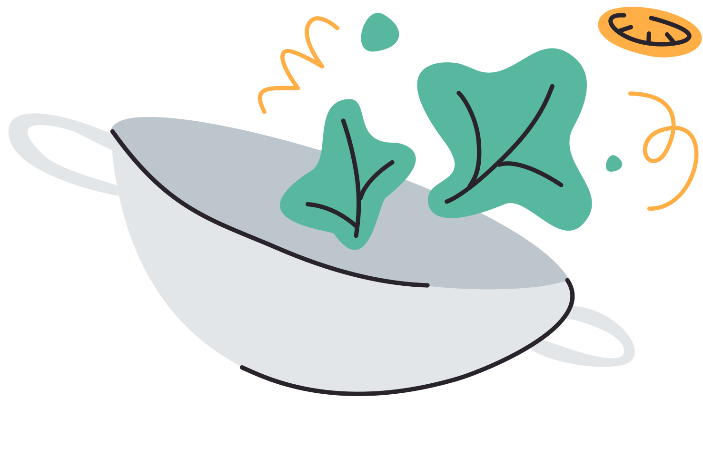

Food as Medicine
What if 80% of chronic disease was preventable —starting on your plate?​
School Wellness Conference 2026
Cornell Cooperative Extension
Creating Healthy Schools & Communities Grant
Presented By:
Laura Corrin

Slide 2
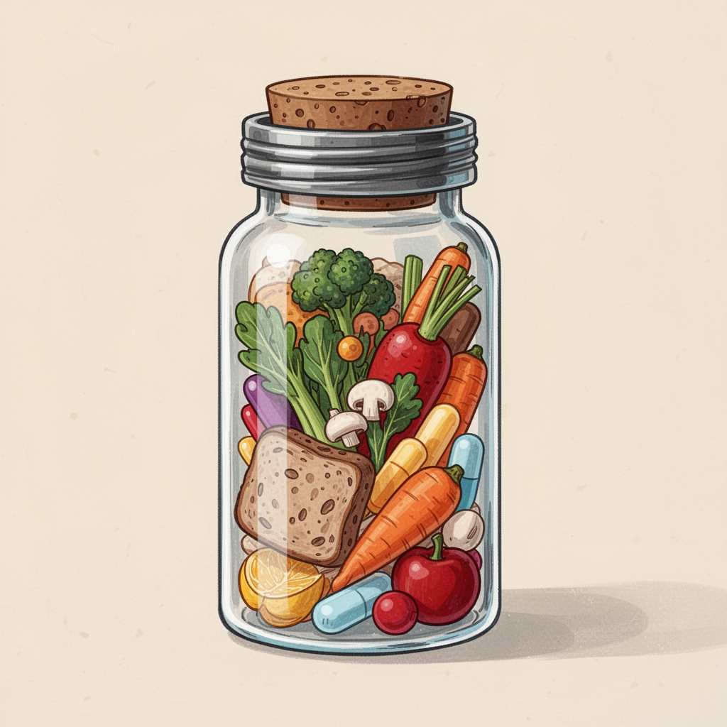
What ‘Food as Medicine’ Actually Means:
Food as medicine is using everyday foods to:​
Reduce inflammation​
Support the immune system​
Balance blood sugar​
Protect heart & brain health​
Prevent chronic disease​
​
Small daily choices.
Big lifelong impact.

Slide 3
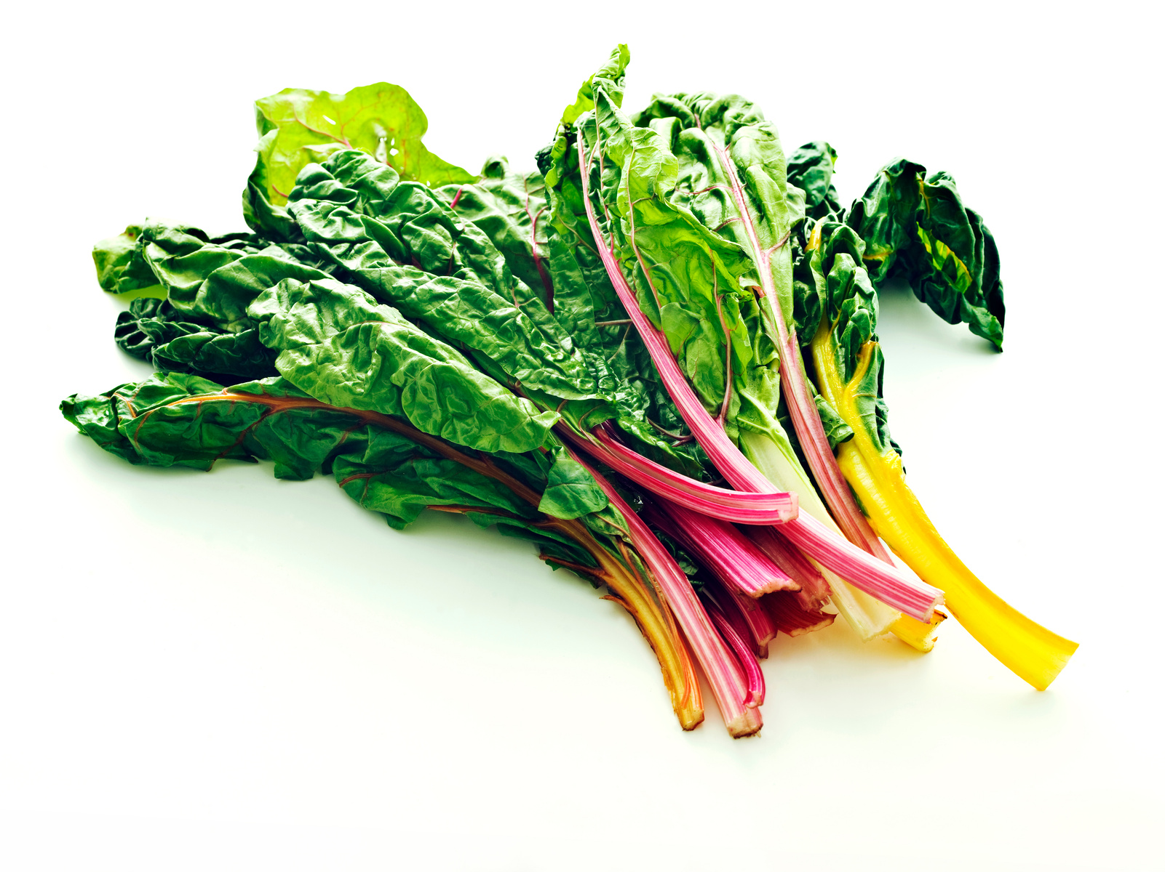
Dark and Leafy Greens & Herbs
Nutrition powerhouses that support your wholebody​
Spinach, kale, arugula, collards, Swiss chard & more​
Try 1 cup raw or 1 cup cooked every day​

Slide 4

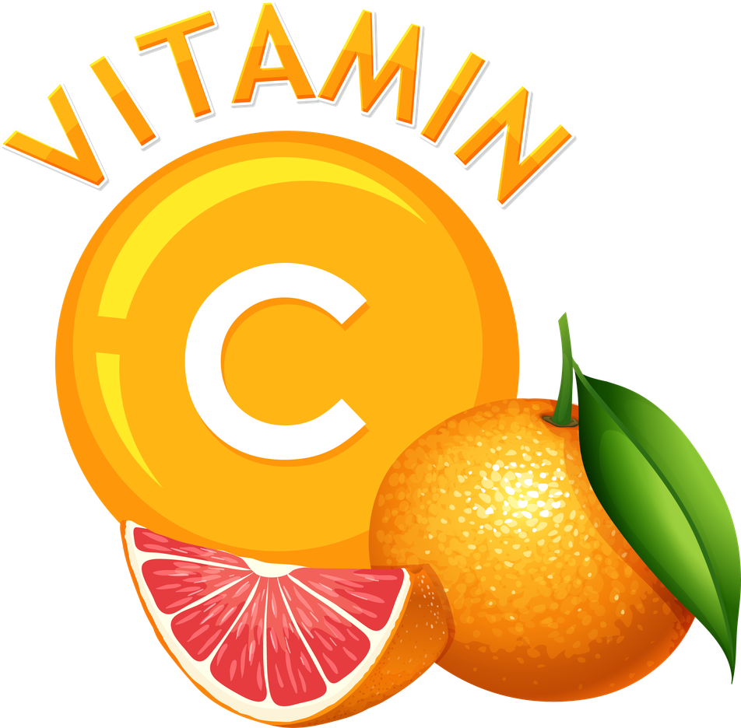
Packed with Nutrients
Vitamins A, C, E, K + Folate​
Minerals like calcium, iron, magnesium & potassium
Fiber + antioxidants like chlorophyll to protect your cells​

Slide 5
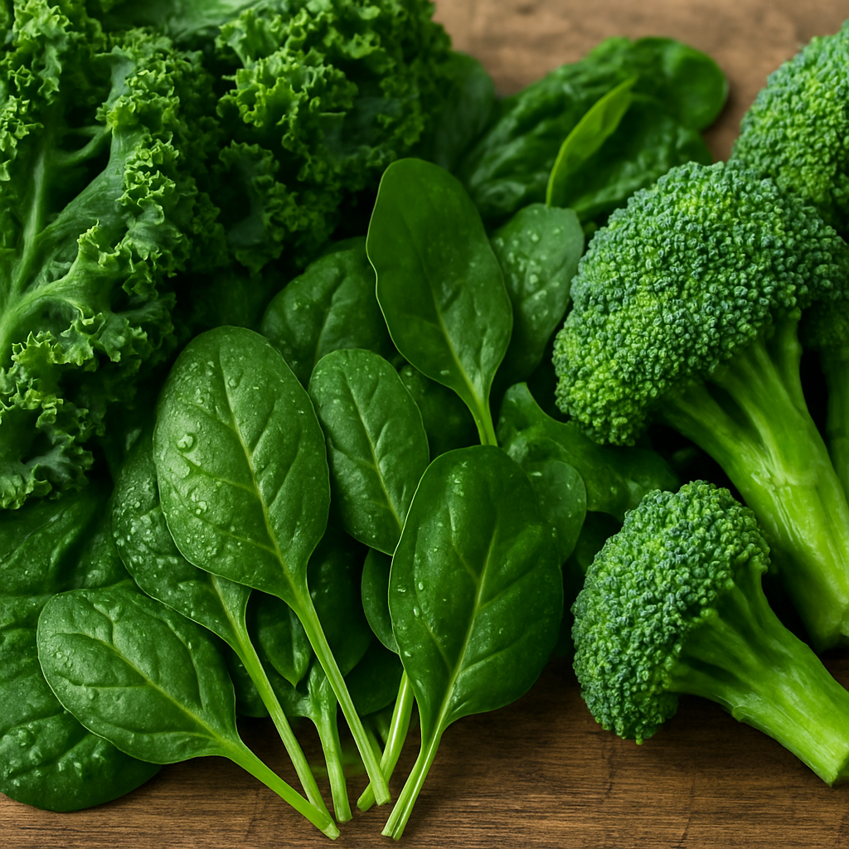
Super Greens Help Prevent Disease & Illness
Antioxidants help reduce risk of some cancers​
Folate supports cell repair & healthy metabolism​
Linked with lower risk of Type 2 diabetes​
Lowers blood pressure​
Lowers LDL cholesterol ​
Lowers Free Radical damage​
Aid in tissue healing ​
Boost your immune system ​

Slide 6
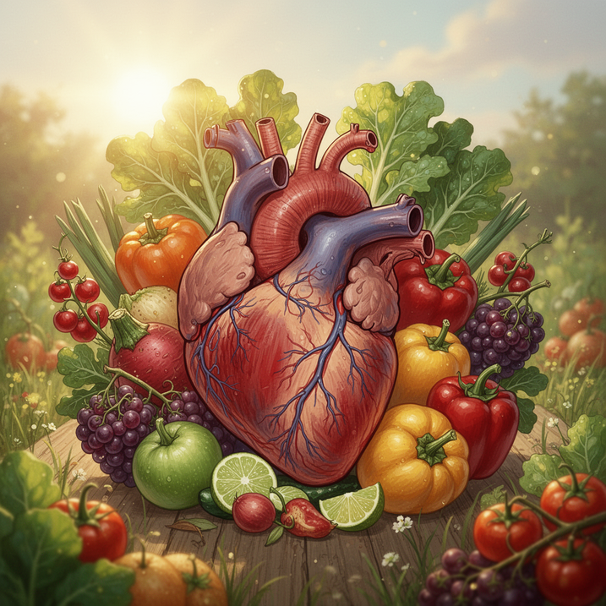

Potassium & magnesium help balance blood pressure
Fiber supports healthy cholesterol
Super Greens Heart Health
Keeps arteries flexible & your heart strong

Slide 7
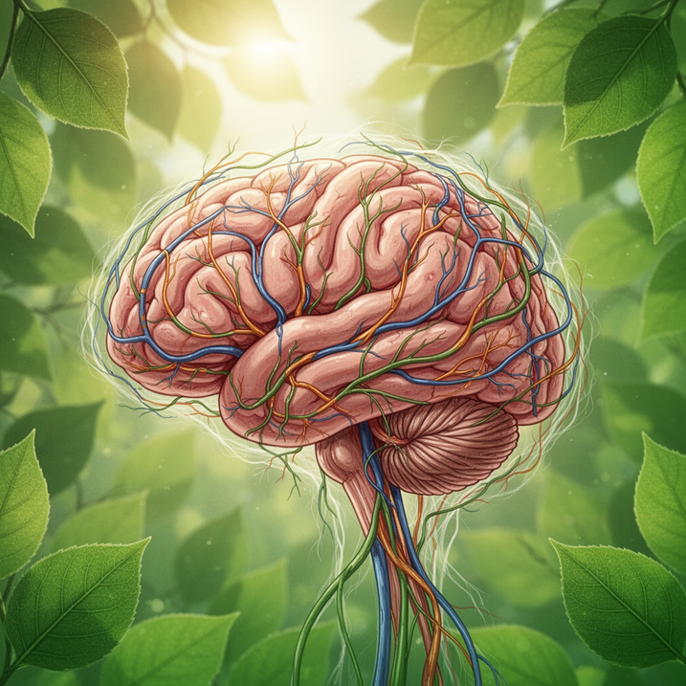
Folate & Vitamin K support memory & focus
Magnesium helps your nervous system relax
Super Greens Brain Health
Supports long‑term brain function as we age

Slide 8

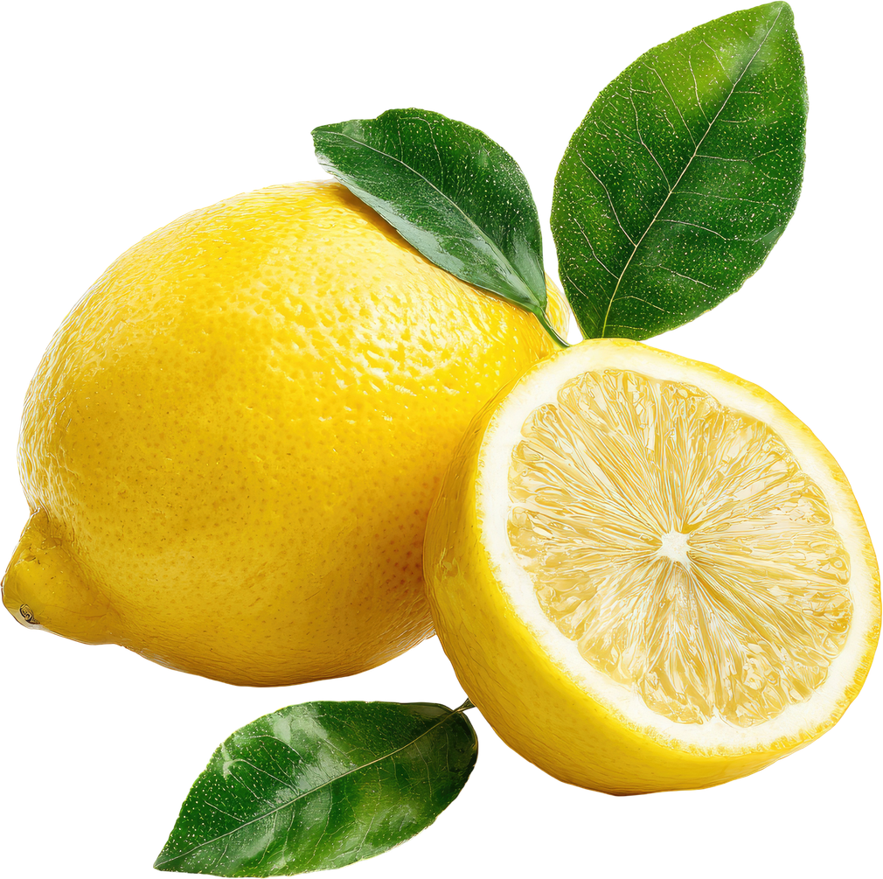
Try this Super Green Recipe
Arugula Salad with Lemon Vinaigrette
Fresh arugula, shaved Parmigiano Reggiano and add seeds for extra goodness (Top seeds are my favorite brand) ​
Lemon Vinegarette dressing: ​
¼ c good quality olive oil​
¼ of fresh lemon juice ​
1tsp of raw honey ​
1 tsp of Dijon mustard ​
1 tbsp of apple cider vinegar ​
1 tsp of sea salt ​
1 tsp of black pepper ​
Shake vigorously or whisk well. ​ ​
Eating slowly helps digestion and satisfaction. Meals become moments of calm, not rushed routines
@reallygreatsite

Slide 9
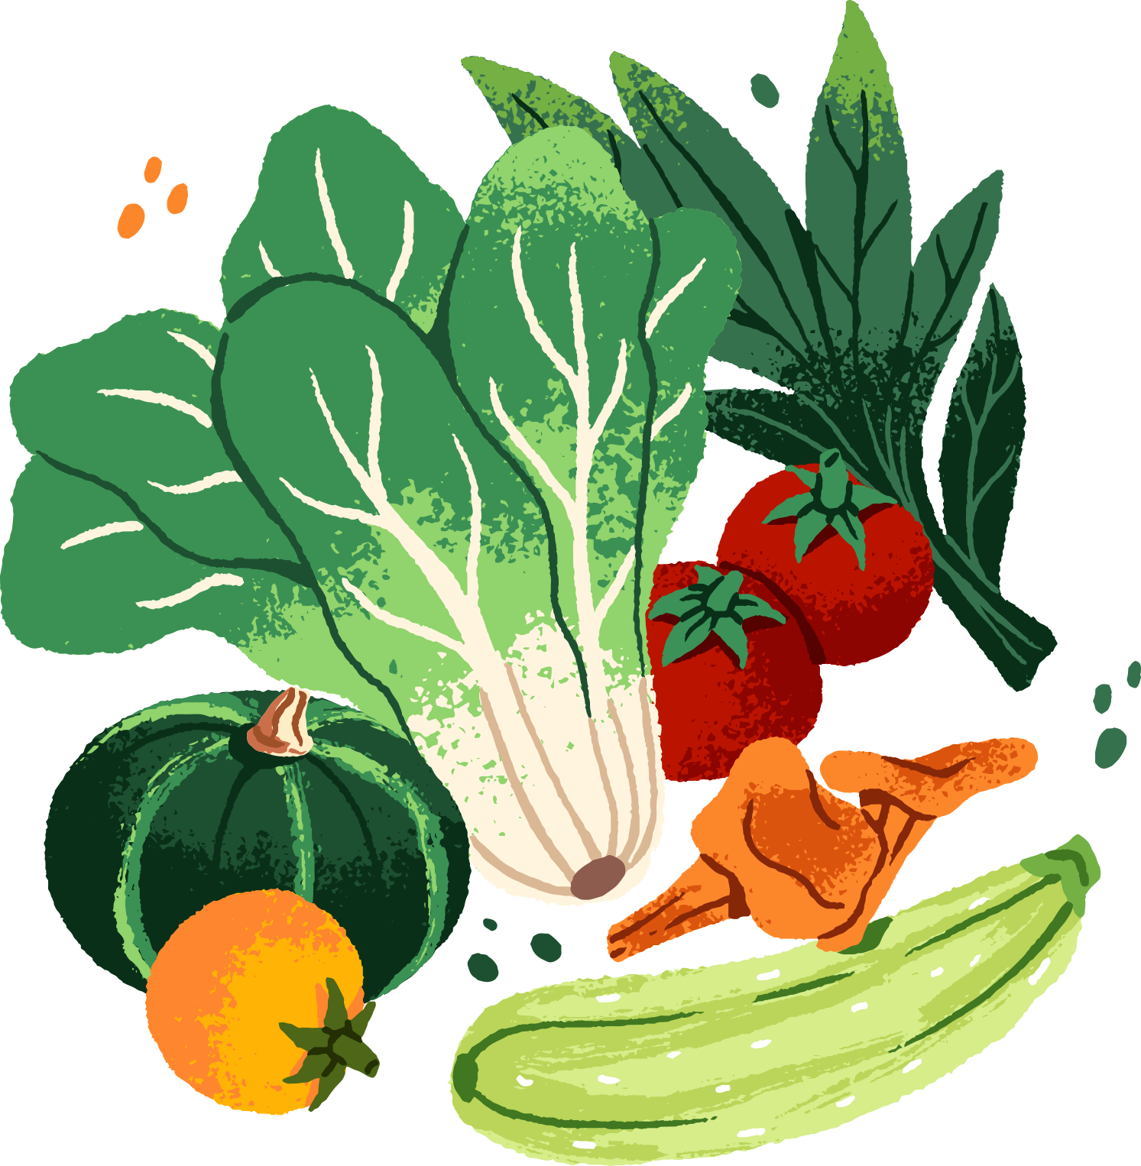
More Everyday Super Foods
Small changes
Big impact.
Affordable and tasty!

Slide 10
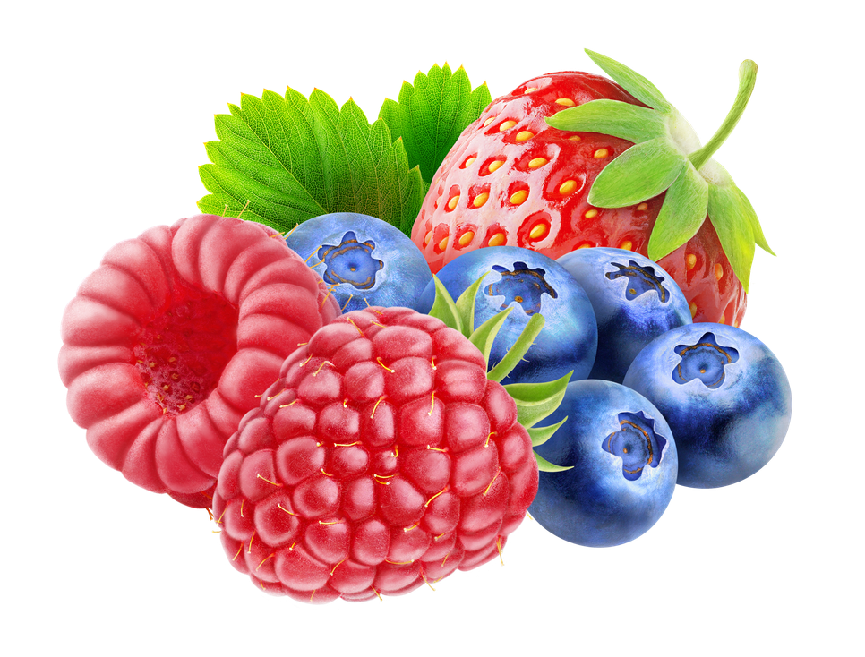
Berries
Loaded with antioxidants that protect cells
Support heart, brain, and immune health
Great fresh, frozen, or in smoothies

Slide 11
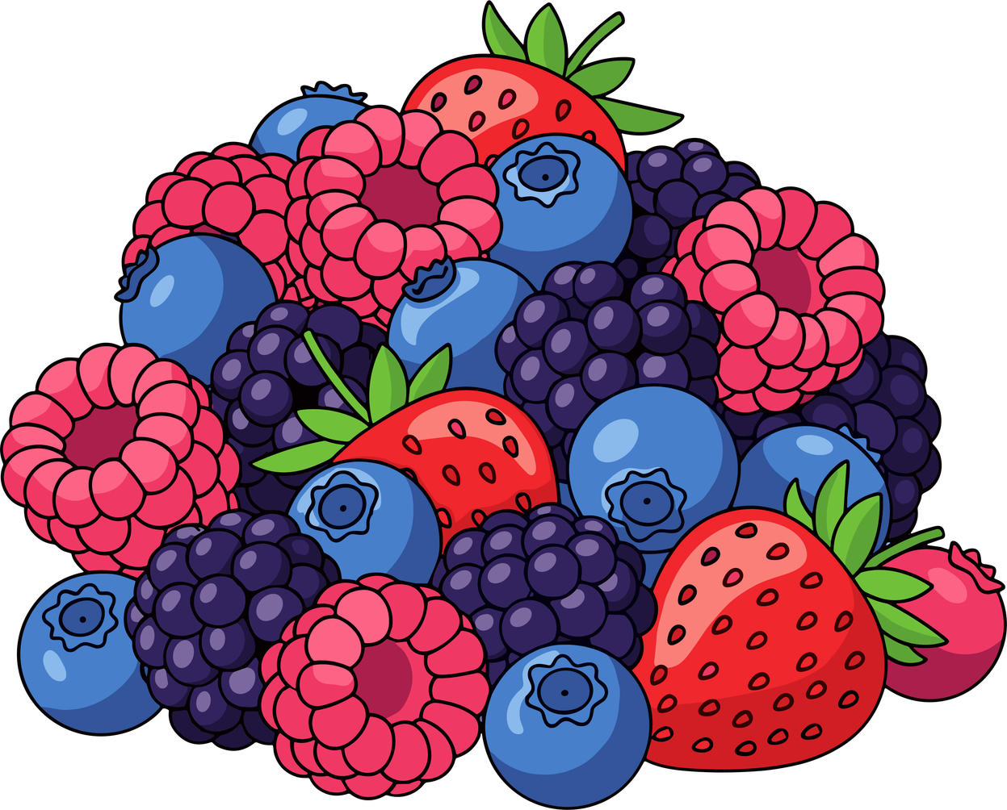
Berries Help Prevent Disease & Illness
Berries are rich in:​
Anthocyanins (potent antioxidants)​
Fiber (supports gut health & blood sugar balance)​
Vitamin C (immune support)​
Research links berry consumption with:​
Improved insulin sensitivity​
Reduced inflammation​
Better heart health​

Slide 12
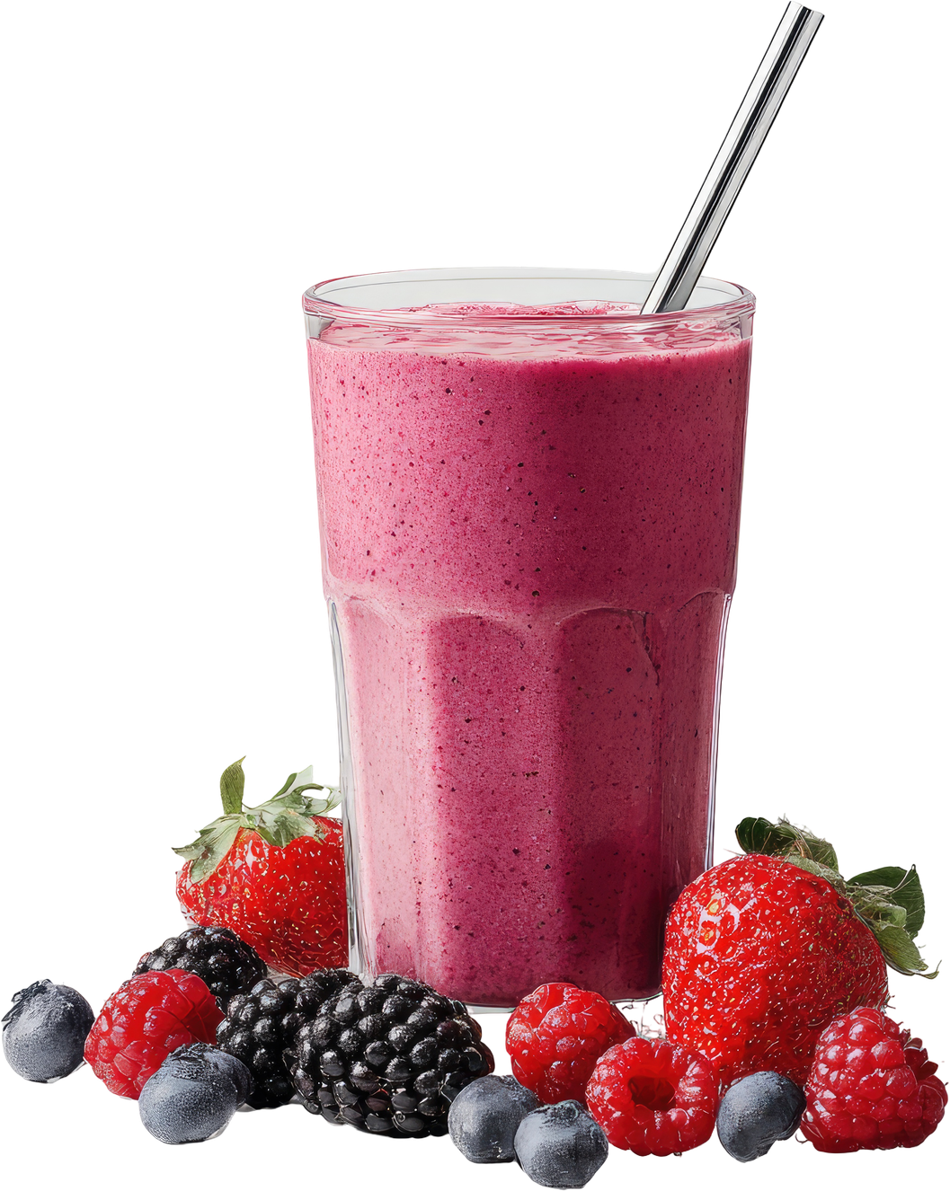
Berries for the Win....
Berry Smoothie Recipe
1 medium ripe banana
½ cupr of frozen blueberries
½ cup of frozen raspberries or strawberries
1 cup your choice of milk
1 tsp of raw honey
2 ice xubes
BLEND WELL!!

Slide 13
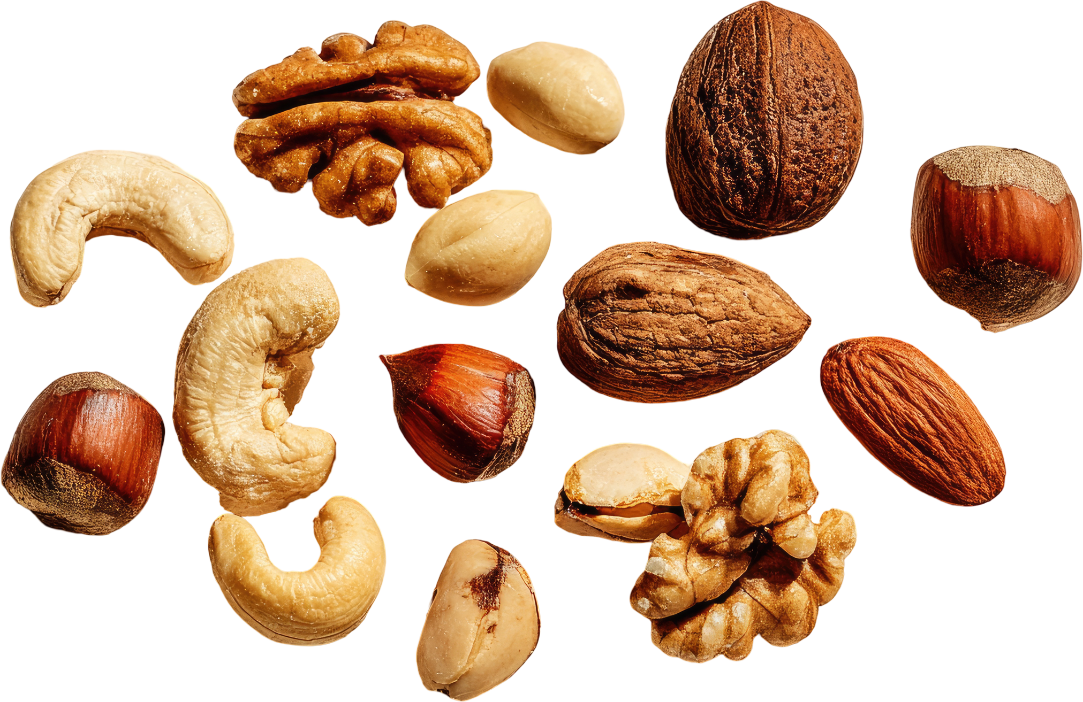
Nuts & Seeds
Just one small handful per day is associated with improved heart health and reduced inflammation.
Healthy fats support your heart & brain​
Rich in protein, minerals, and fiber
Even a small handful helps!

Slide 14
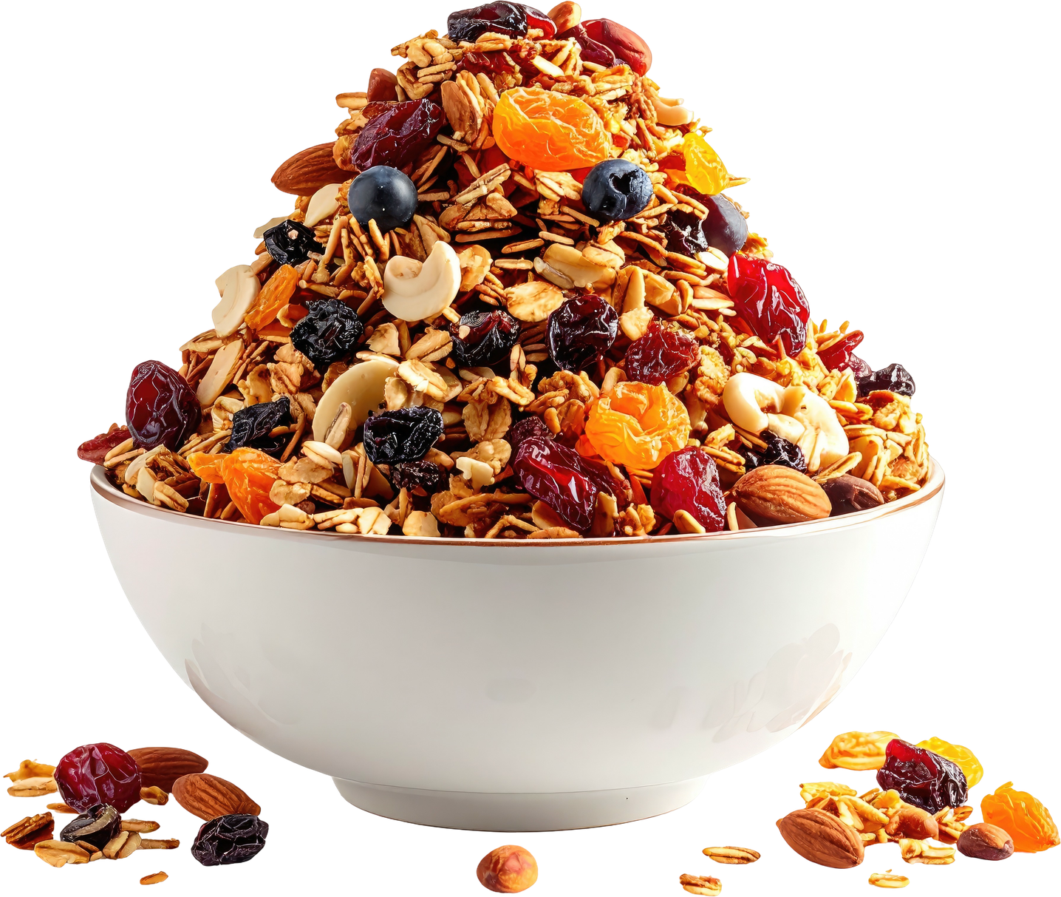
Granola - Great Way to Enjoy Nuts and Seeds

Slide 15
Great source of fiber - try homemade!
Homemade Coconut Cinnamon Honey Granola Recipe
PPreheat oven to 250 degrees ​
Mix dry ingredients in one bowl. Put wet ingredients in another bowl and melt in microwave for a 1 min or so. Pour melted ingredients into dry ingredients and mix well. Take large sheet pan and line with parchment paper. Pour mixed granola mixture onto pan and spread out evenly over paper. Put into preheated oven and bake for 1hour and 15min. Cool completely when done. Enjoy! Store in air-tight container for up to 2 weeks ​
3 C of organic oats (IGF)
​1c flaked unsweetened coconut​
½ c your choice of raw nuts chopped ​
​½ c your choice of raw nuts chopped ​
​1 tsp of cinnamon​
​pinch or two of sea salt​
​stick of grass fed unsalted butter (I use Kerry Gold) or ½ C of coconut oil . ​
​1/2c of raw honey​
​1/2c of maple syrup​

Slide 16

Inflammation: The Root of Many Chronic Diseases
Chronic low-grade inflammation is linked to:​
​
Heart disease​
Type 2 diabetes​
Alzheimer’s disease​
Autoimmune conditions​
​
Many of the foods we’re discussing help calm inflammation naturally.​

Slide 17
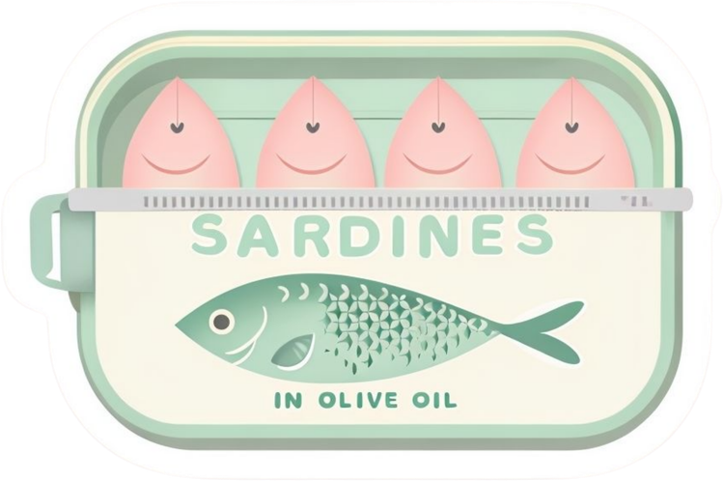

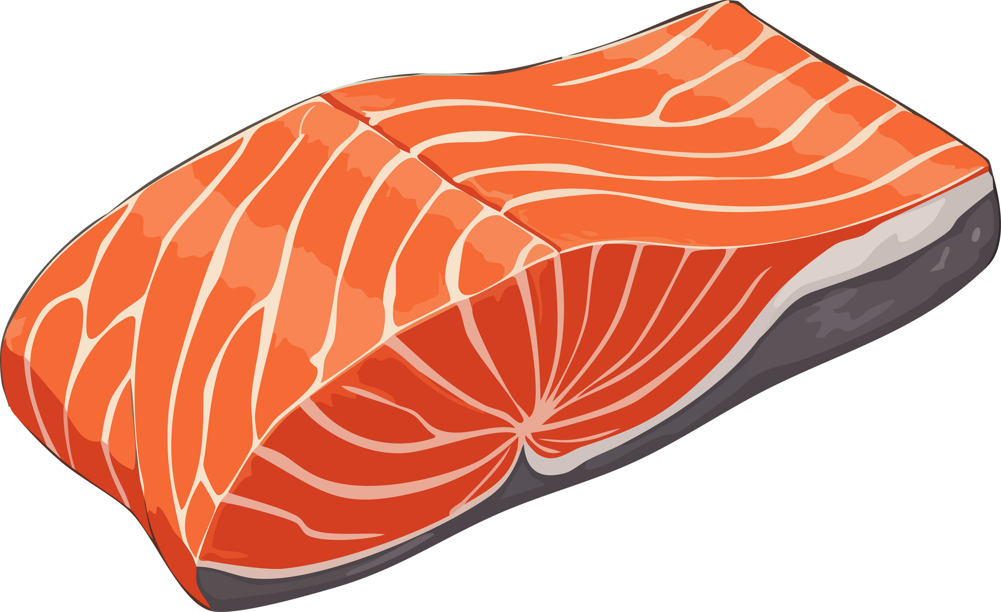
Fatty Fish
Omega-3 fats reduce inflammation
Support heart & brain health
Examples: salmon, sardines, & anchovies

Slide 18
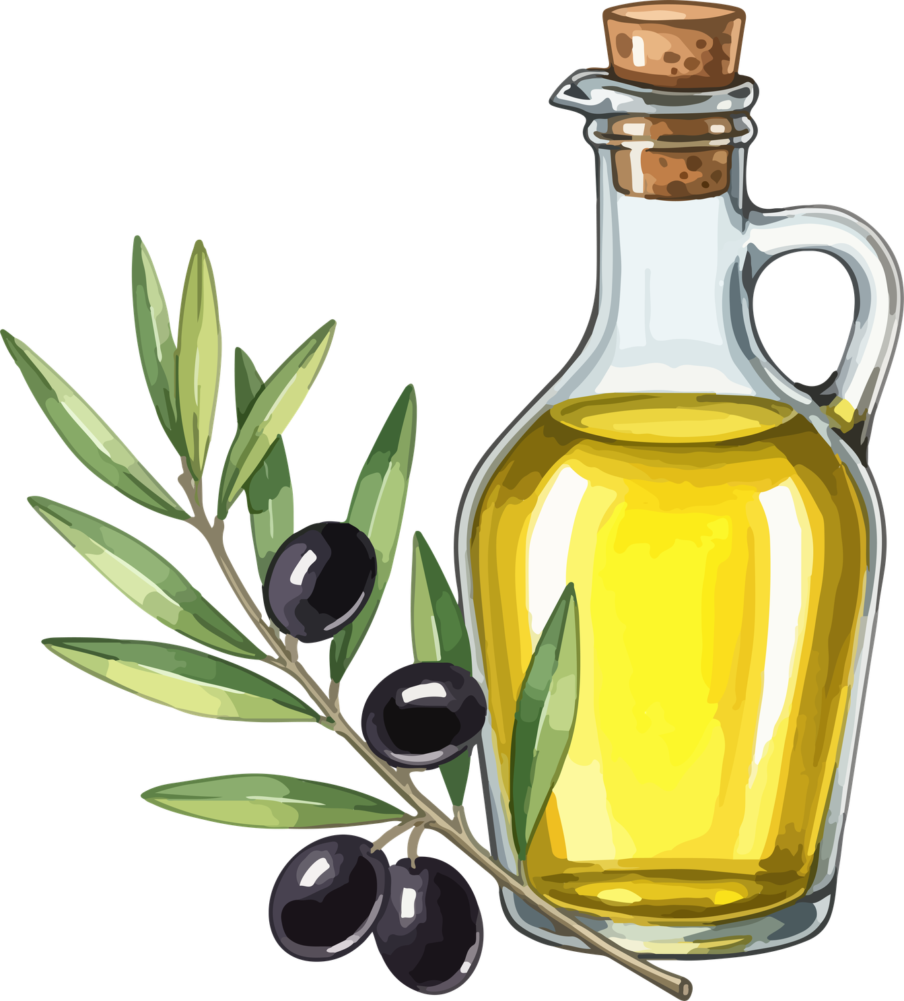
Anti-inflammatory health fat
Great for heart & blood vessels
Use as your everyday cooking oil
Olive Oil

Slide 19
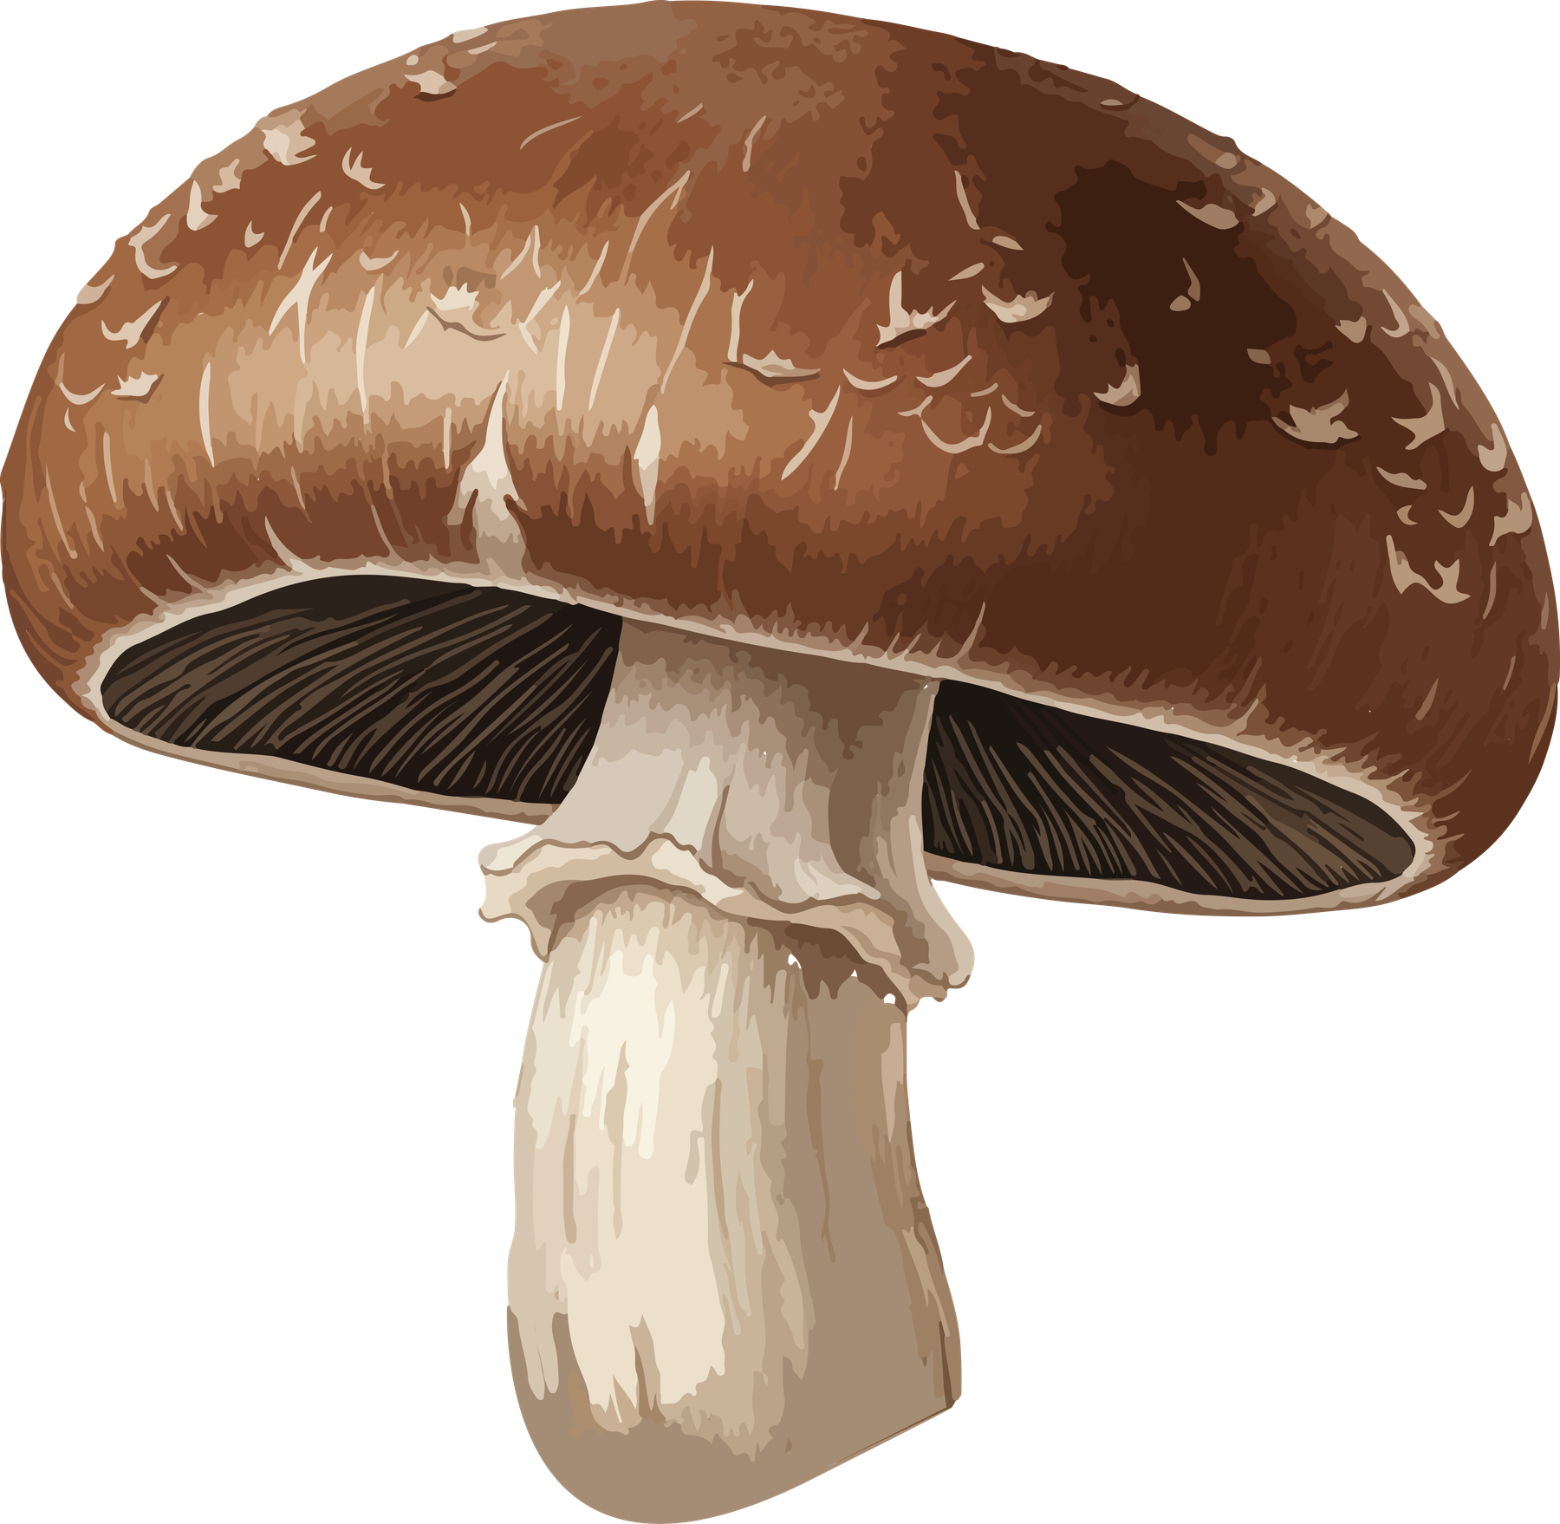
Delicious roasted or sautéed
Support immune & gut health
Contain unique antioxidants
Current research studying for Cancer fighting compounds.
Mushrooms

Slide 20
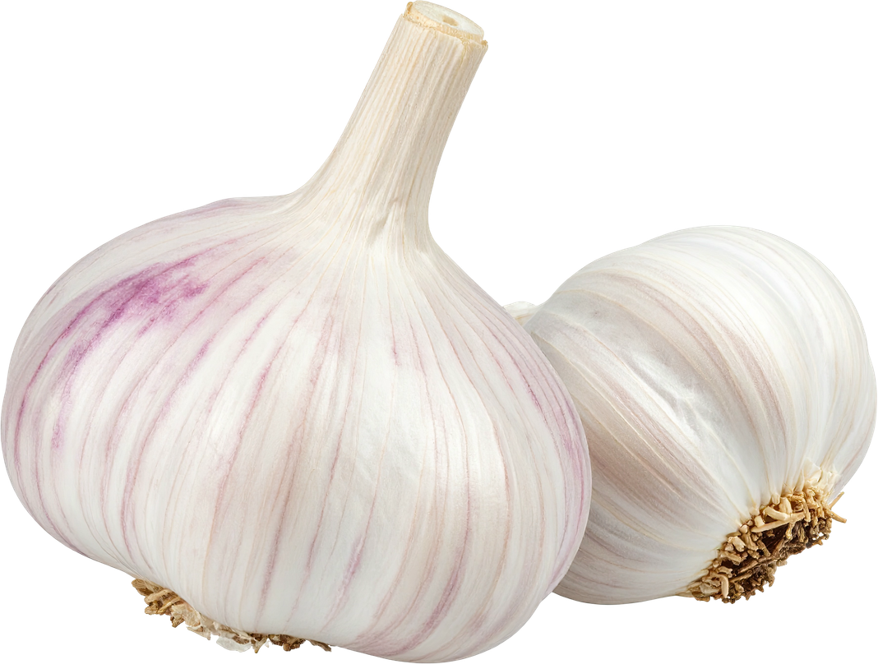

Contain bioactive compounds shown to support cardiovascular and immune health.
Packed with antibacterial and antiviral properties. ​
Contain unique antioxidants
Garlic & Onions
Support gut & heart health

Slide 21
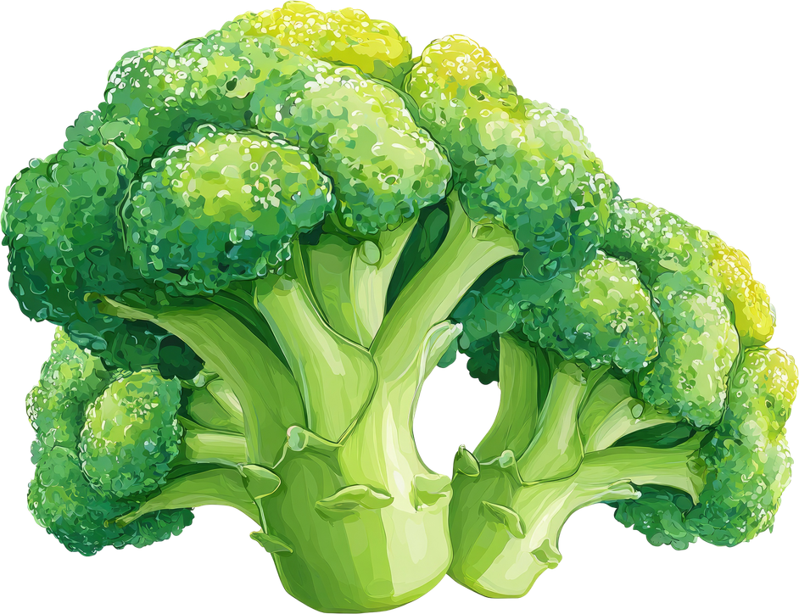
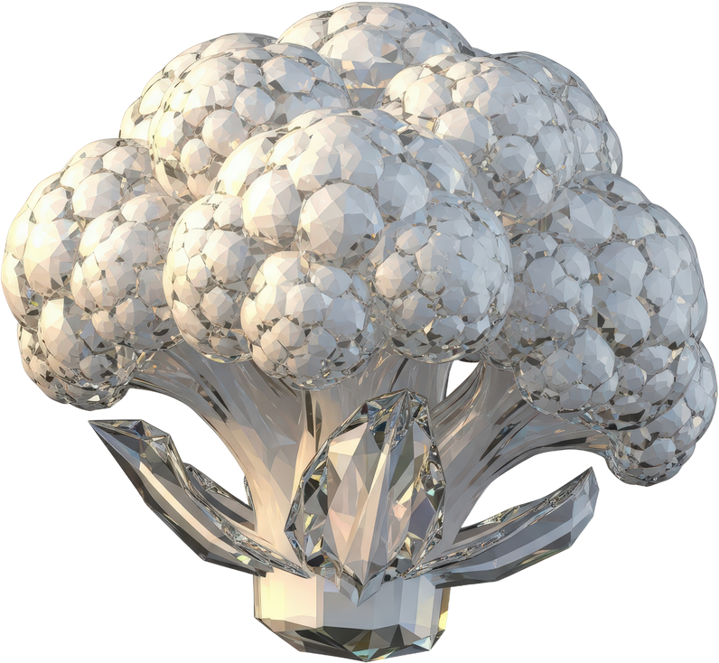
Includes broccoli, cauliflower, brussel sprouts, & cabbage
Contain sulforaphane and glucosinolates — compounds being studied for cancer-protective effects.
Great roasted, steamed, or raw. ​
Cruciferous Veggies

Slide 22
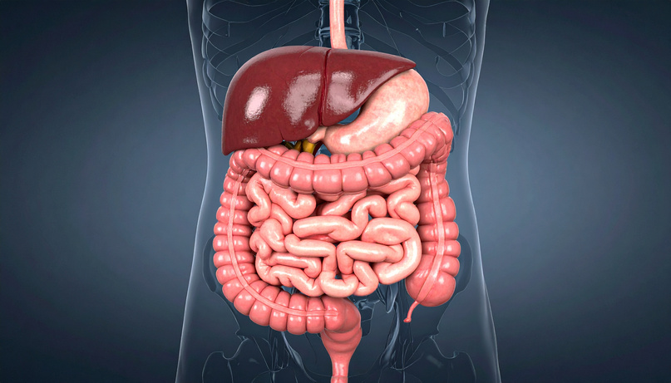
Food and Inflammation
🧠 Omega-3s reduce inflammatory markers​
Phytonutrients modulate immuno response​
🦠 Gut Microbiome​
70%+ of immune system in gut​
Fiber diversity improves microbialdiversity​
🩸 Blood Sugar Regulation​
Stable glucose = reduced risk of diabetes & heart disease​
Protein + fiber slow glucose spikes​

Slide 23
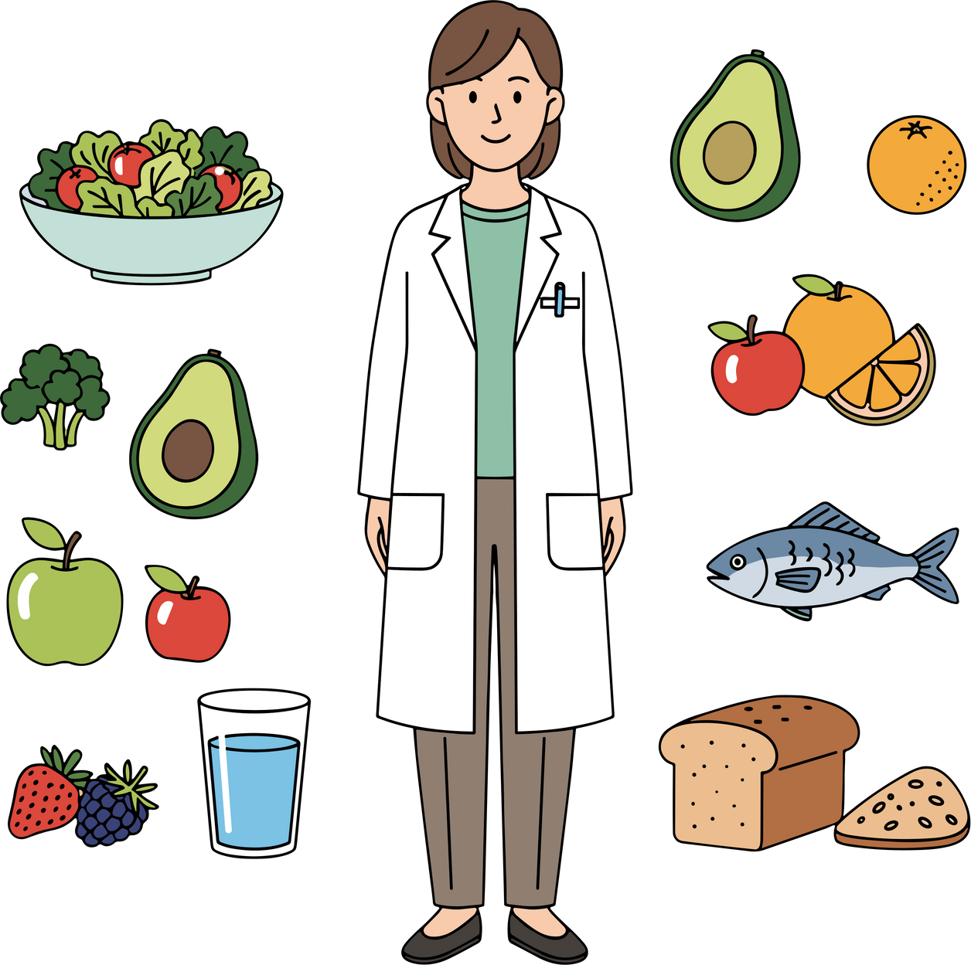
Food is Powerful Medicine!!
You don’t need a perfect diet.
Start with one simple change.
Add greens to one meal.
Swap snacks for berries.
Use olive oil instead of processed seed oils.

Slide 24

Consistency beats perfection!
Your kitchen is your first pharmacy.

Slide 25
Questions/Comments?
What’s your favorite way to incorporate Food as Medicine into your daily routine?

