Slide 1


Sustaining School Wellness:
Strategies for Long-Term Impact
Tera Siegfried
Kate Huber
Creating Healthy Schools and Communities, Erie 1 BOCES
This presentation was adapted from the Physical Activity and Nutrition Center of Excellence (PANCE)
Notes:
2 MINUTES - Kate
To get sense of who is in room:
Raise hands:
# of participants are from a CHSC grant school?
# of participants are not from a CHSC grant school?
# of participants are not from a school?
Purpose of session:
-Reflect on sustaining school wellness (especially when things such as funding can fade out of the picture)
-Tools/strategies to make a lasting impact
-Use of PSAT tool

Slide 2

Agenda
Defining sustainability
What are you trying to sustain?
Program Sustainability Assessment Tool
Reflection
This presentation was adapted from the Physical Activity and Nutrition Center of Excellence (PANCE)
Notes:
1 MINUTE - Kate

Slide 3
Stand if you…
Have been having conversations about sustainability
Have been using a sustainability plan
Have Not had a minute to think about sustainability (I’m just trying to get stuff done!)
Notes:
1 MINUTE - Tera

Slide 4
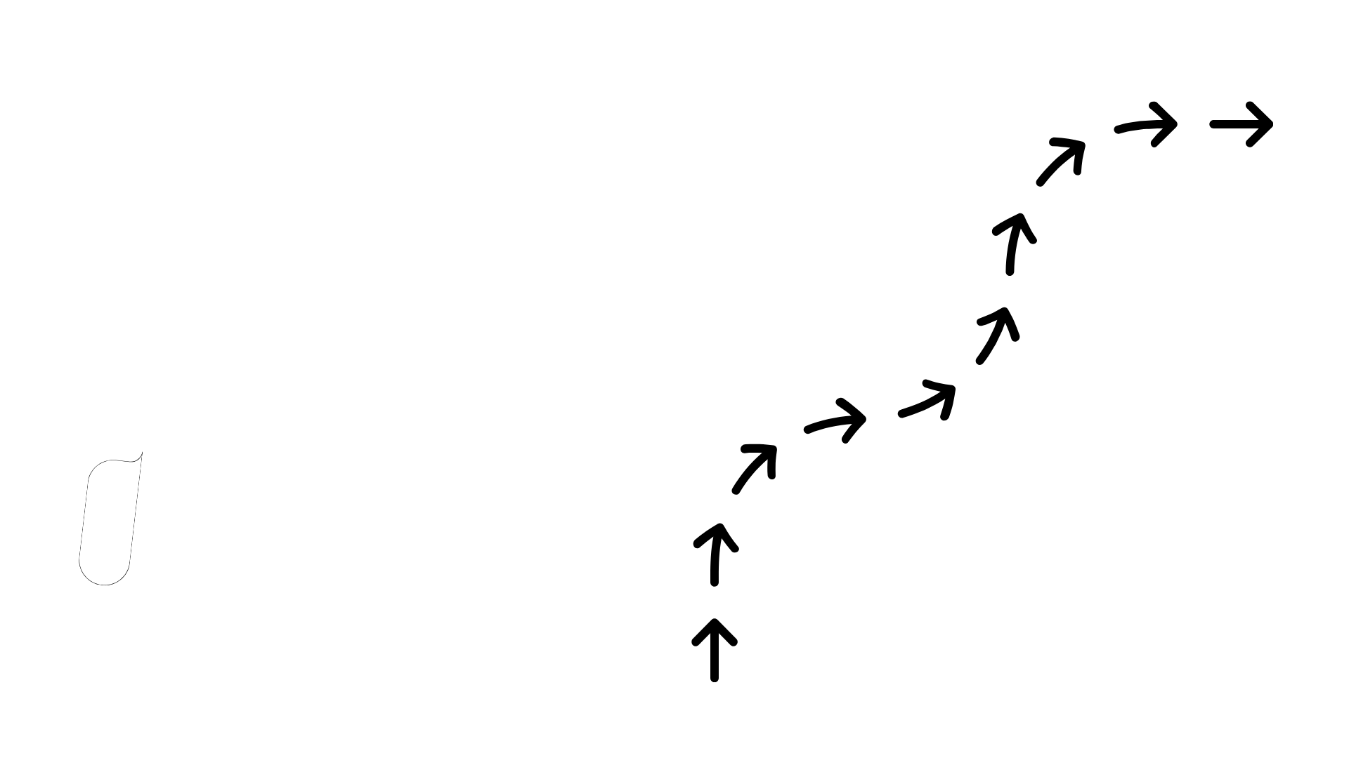

Defining Sustainability
Notes:
Tera
Before we do so, Kate is going to walk us through a brief exercise

Slide 5

Think (1 min)
Share with a partner! (2 mins)
When is a time something you worked on continued past your influence (in your personal or professional life)? What did it look like/entail?
Notes:
4 MINUTES - Kate
-Purpose: To think about what sustainability looks like to you

Slide 6

“Achieving goals and delivering impact that continues beyond the primary funding source.”
Sustainability
Hassan Khoury ©
Notes:
2 MINUTES - Kate
-Does not mean that everything lasts forever
-And does not mean doing more with less
-Think about: does this definition resonates with you - or feels challenging?

Slide 7

What are you trying to sustain?
Notes:
1 MINUTE - Tera
-If you are not a CHSC grant school/school it’s okay
-Think about in context of school wellness (Funding? Garden? Just getting started and want to keep momentum?)

Slide 8

Jot down what you’re trying to sustain
What are the achievements, goals, impact, practices, or momentum you want to sustain in your school or organization over time?
It’s okay if you’re just getting started!
Notes:
3 MINUTES -Tera
-Think about what you’re trying to sustain - goals, impact, practices, momentum?
-Think about what you most want to remain true, whether it be in your school, organization, community

Slide 9
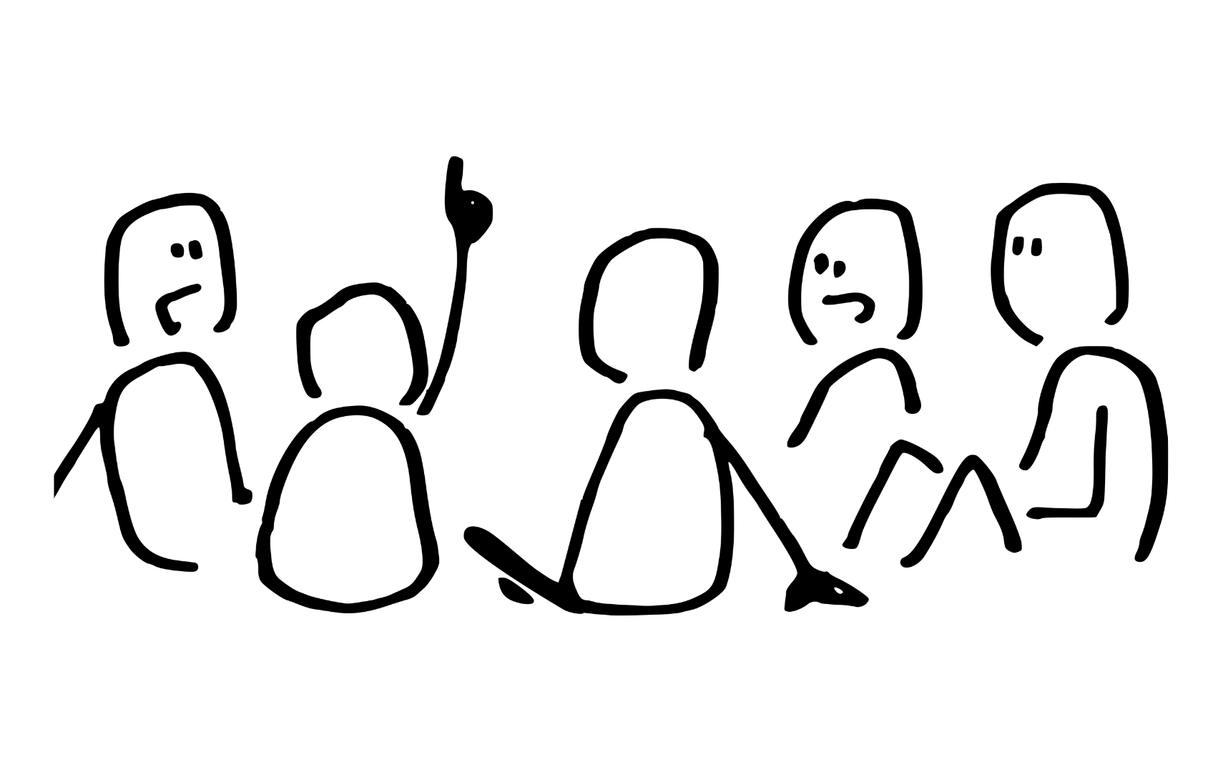
Review your list and identify 1 or 2 items you would prioritize to work toward sustaining. Why?
Share at your table!
Notes:
4 MINUTES - Kate
Why did you choose those?
-Not about doing everything, or sustaining everything- it’s about making intentional choices now that support your wellness work down the line

Slide 10
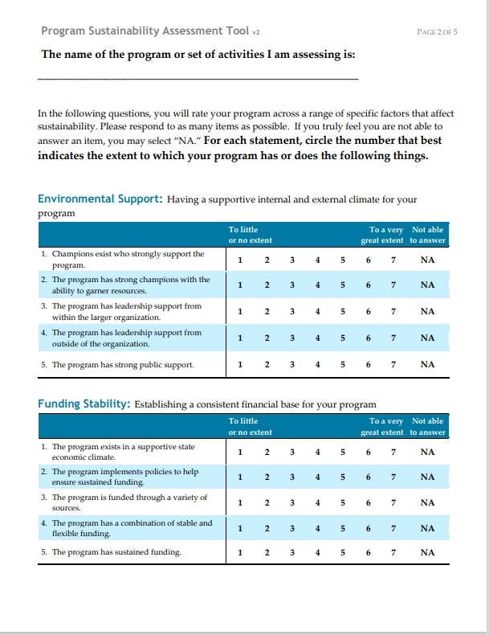
Self-assessment tool designed to evaluate a program’s capacity for long-term sustainability across 8 key areas
The Program Sustainability Assessment Tool
Notes:
4 MINUTES - Tera
-How do you know if you’re on the right track for making your efforts sustainable?
-PSAT: Instrument developed by Center for Public Health Systems Science at Washington University
-Goal: To measure program sustainability capacity and support planning for long-term program success
-Originally designed for public health programs
-A lot of components that can make something sustainable
-PSAT tool helps us understand all the factors that contribute to program sustainability
-Looks at organization/contextual factors

Slide 11
Categories
Environment/Climate
Funding
Partnerships
Organizational Capacity
Program Evaluation
Program Adaptation
Communications
Strategic Planning
Notes:
2 MINUTES - Tera
-These categories help us think about how work continues, not what work must continue
-Want to look at what makes sustainability possible and in your particular context (district gave line of funding? A lot of champions/staff who are passionate about school wellness? Strategic plans aligns with school wellness for students and teachers?)
-When you think about these categories, do they feel in line with how you’re thinking about your work and its sustainability?

Slide 12

What made you choose this category?
Environment/Climate
Funding
Partnerships
Organizational Capacity
Program Evaluation
Program Adaptation
Communications
Strategic Planning
Notes:
14 MINUTES - Tera & Kate
-If you could choose one category to prioritize your sustainability work which would you choose?
-Have 1 rep from each group share: What about this category made you want to stand here? What experience/thought made you connect with this category?
-Discuss Albany convening - default of everyone choosing funding
-Continuation of FUNDING can help scale or deepen work- but many sustainability moves don’t require it.
-Sustainability can be about: intentional relationships, systems, policies, or choices

Slide 13
Actionable Items
Environment/Climate
Have a conversation with a colleague about improving wellness
Funding
Ask your administration for a line of funding for your wellness committee
Partnerships
Identify a partner you could better engage next quarter and how you’d start that conversation
Organizational Capacity
Lean into the strengths and talents of your colleagues and what they can contribute
Program Evaluation
Use a tool (such as the PSAT, WellSAT, etc.)to identify strengths and gaps
Program Adaptation
Identify one adaptive shift you should prioritize and what the first step toward it is
Communications
Pick one audience you’re not currently reaching well and outline a first communication step
Strategic Plan
Review the goals in your plan and ensure they align with a ‘SMARTIE’ goal
Notes:
2 MINUTES - Tera
-Walk away with actionable steps in improving sustaining school wellness
-Environment/Climate - convo w/ colleague who has interest in improving student/staff wellness
-Funding: asking administrators for line of funding (garden fundraisers)
-Partnerships: Resource mapping, identifying a partner/organization in the community to engage who can support you in wellness work

Slide 14
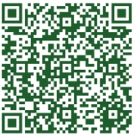

The Program Sustainability Assessment Tool
Understanding factors that can contribute to program sustainability
For more information: https://sustaintool.org/psat/
Notes:
2 MINUTES - Kate
-Can use this tool- could be in context of your building-level or district wellness committee
-Abbreviated version (short) available online
It’s a tool, not a rule!

Slide 15

What is one thing you want to try in the next 3 months?
Share it with the person sitting next to you.
Notes:
3 MINUTES - Tera
-1 min to think, 2 mins to share

Slide 16
What must be continued?
What must be transferred?
What needs to be reimagined?
What will end?
Key Questions
Notes:
2 MINUTES - Kate
-Reflection questions
-Think about these questions, and sustainability in the context of school wellness work
-Think about current successes, what makes thing sustainable now?
-How are you walking away with this info? How will it end? (If it ends, will you communicate how and why it ended?)

Slide 17
Thank You!
Tera Siegfried: tsiegfried@e1b.org
Kate Huber: khuber@e1b.org
Creating Healthy Schools and Communities, Erie 1 BOCES

