Slide 1

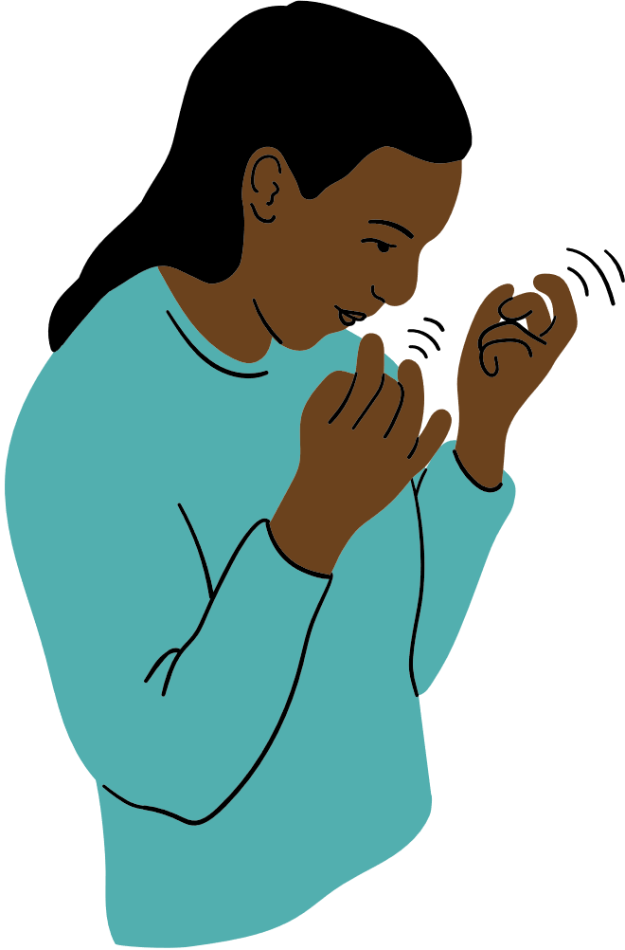
Supporting Adaptive Stimming in Schools
Presented by:
Analea Blackburn, MSW
Naomi Graham, CAT-LP

Slide 2
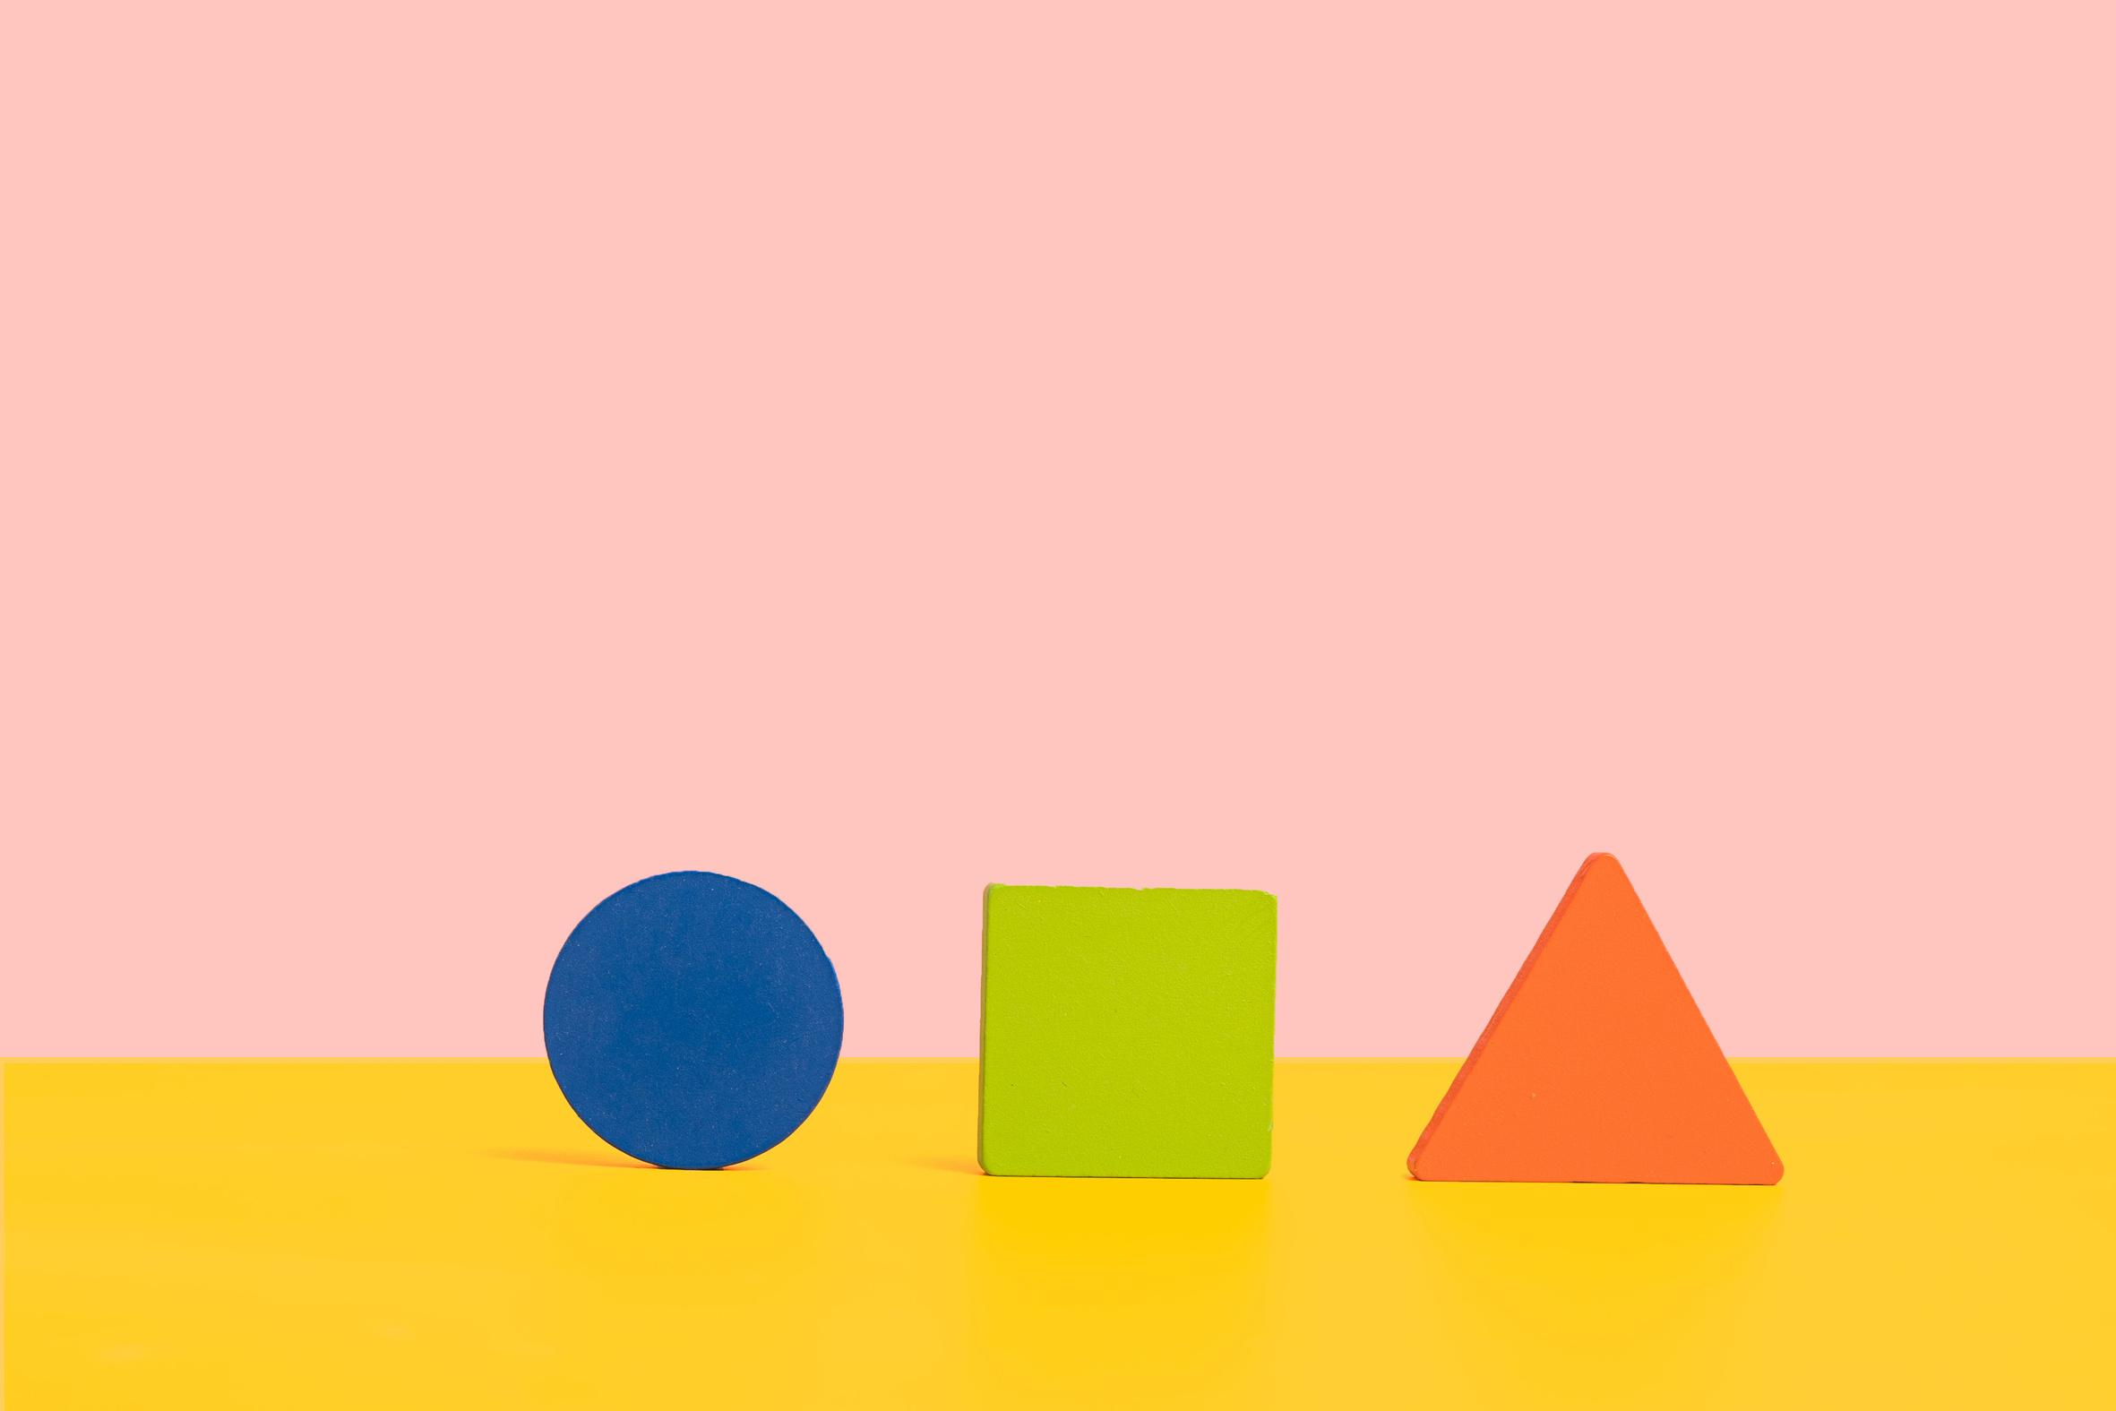
Stimming to Self-Regulate
Stimming (self-stimulating behavior) is something that people of all ages, neurocognitive abilities, and developmental levels do
Often repeated behaviors, can be overt or subtle
Stimming can help to calm or excite the sensory nervous system
Stimming can also help regulate emotions and cope with trauma responses
(Dashnaw, 2024; Nwaordu & Charlton, 2024; Sabinson, 2024)

Slide 3

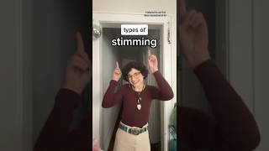

Slide 4

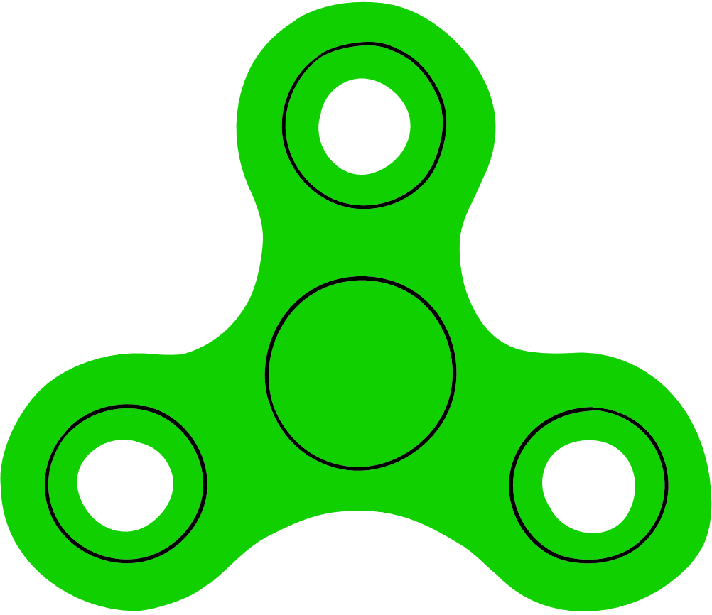


Different types of stimming
Visual (ex: blinking, staring at objects)
Vestibular (ex: spinning, rocking)
Vocal (ex: repeating words, humming)
Proprioceptive (ex: clenching muscles)
Tactile (ex: fidgeting with hair/clothing)
Auditory (ex: listening to a song on repeat)
Oral (ex: chewing on clothing)
Olfactory (ex: smelling scented lotion)
(Jenna.frieds, 2023)

Slide 5
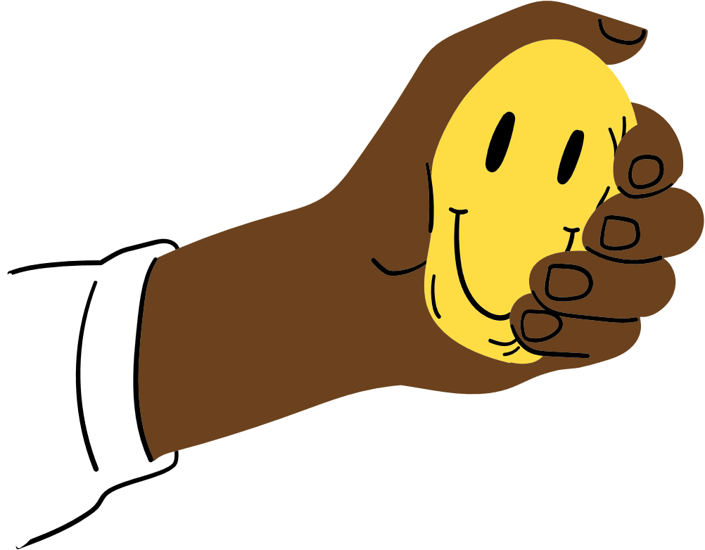
Adaptive Stimming vs Maladaptive Stimming
Adaptive stims
Are not harmful to yourself or others
Do not interfere with your ability to learn, work, or interact with others
Do not disrupt or negatively impact other people's learning or work
Fulfill your needs
Maladaptive stims
Are harmful to yourself or others
Disrupt, distract from, or interfere with yours or others’ work/learning
Cause stress, anxiety, or other negative feelings
(Cleveland Clinic, 2023; The Insititute on Trauma and Trauma-Informed Care (ITTIC), 2025; Sabinson, 2024; University at Buffalo Accessibility Resources, 2025)

Slide 6



What forms of stimming do you notice students engaging in?
Are they adaptive or maladaptive?

Slide 7

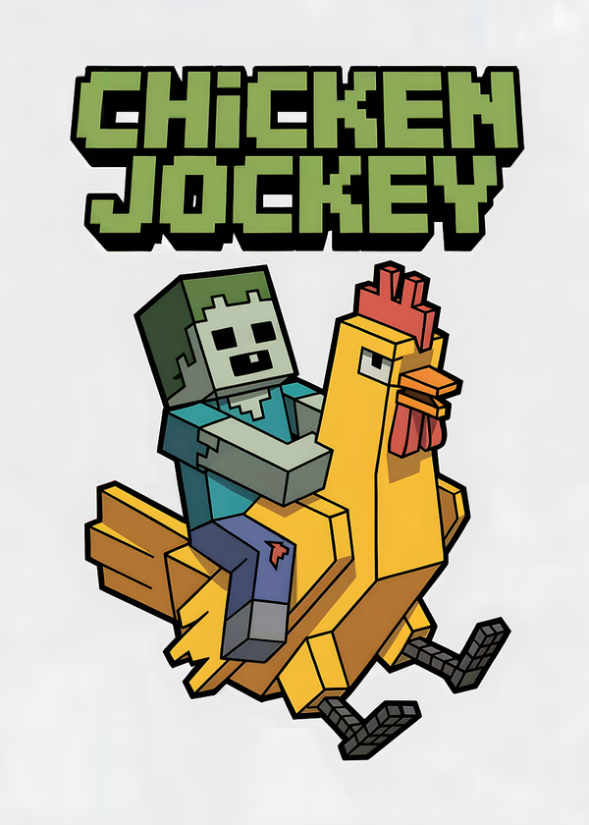
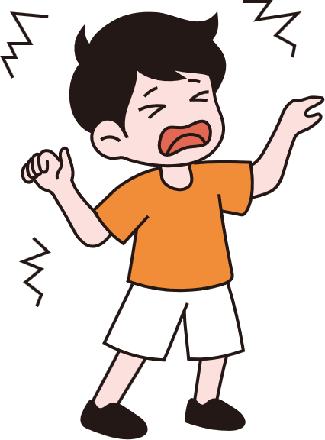
Example: Davey, an 8 year old autistic boy, repeats the phrase “chicken jockey” (a phrase from the Minecraft movie) to himself when he feels strong emotions.
Is this stimming adaptive or maladaptive?

Slide 8
Both! The adaptiveness of stimming depends on the context
Adaptive: Repeating “chicken jockey” by self, while playing, outside, etc.
Maladaptive: when repeating “chicken jockey” is distracting from Davey’s or his classmates’ learning, at night when it is time to wind-down for bed, repeating the phrase instead of eating, etc.

Slide 9

Adaptive Stimming Practice
Try practicing some of these techniques
Visual: look at the movement of the jellyfish
Auditory: listen to the calming music
Vestibular: slowly sway back and forth

Slide 10

Adaptive Stimming Practice
The Butterfly Hug
"The Butterfly Hug is a form of bilateral stimulation that can be used as a grounding technique. The process is simple and can be done in any situation. It can help bring you back to the present moment and calm your emotional state."

Slide 11
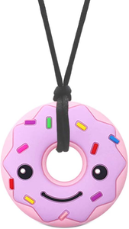


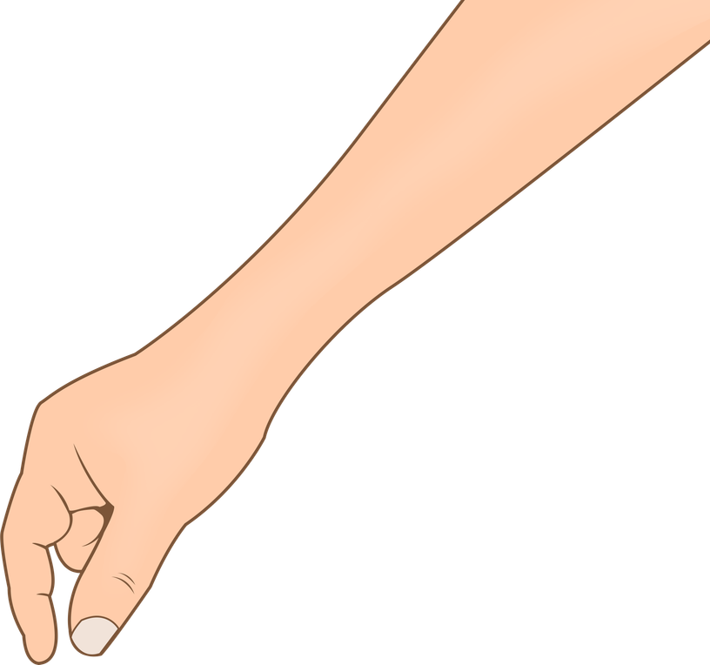
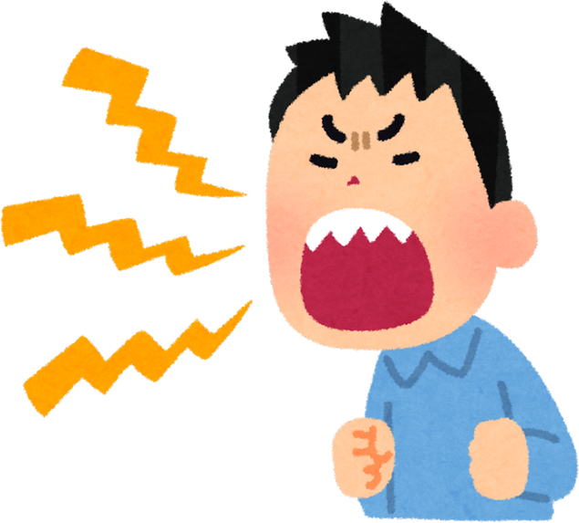
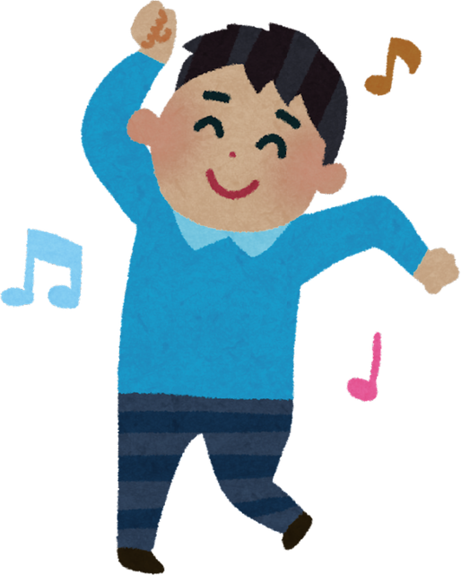



Maladaptive Stims | Adaptive Alternatives
Biting self, gagging self, or chewing on hands and fingernails | provide kids with chewy jewelry (safe and intended for stimming)
Hitting head | brush hair or use paintbrush/makeup brush on arms squeeze stress ball or stuffed animal play with play dough or stretchy noodles
Cursing or yelling in class | provide private space for yelling, pillows/stuffies to both comfort and muffle sound
Getting up or running around the classroom | schedule run-around/shake out time offer alternative seating options (standing in the back of the classroom, rocking chair) Adaptive furniture (foot hammock, ball chair)
Loud vocal stimming in class | quieter vocal stims (like popping noises, lip trills) blowing air through a straw providing other students with ear plugs and headphones
Skin, hair, or nail picking | fidget toys like a pop-it, picky mat, fidget ring peeling dried Elmer’s glue off hands wearing nail polish

Slide 12

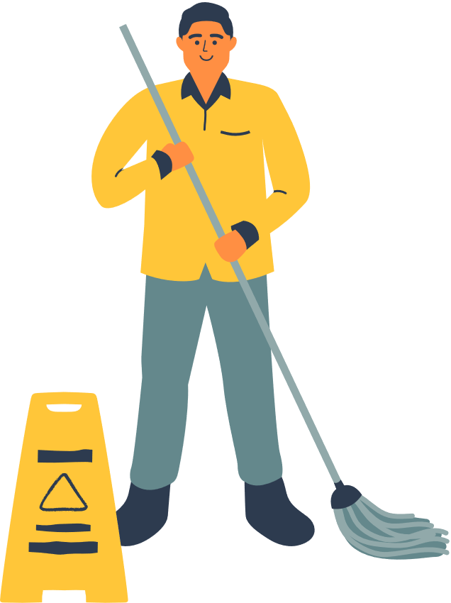


Providing Redirection:
Not Just for Teachers!
Guiding children towards adaptive stimming alternatives as after-school staff
Guiding children towards adaptive stimming alternatives as custodial, nursing, or security staff

Slide 13

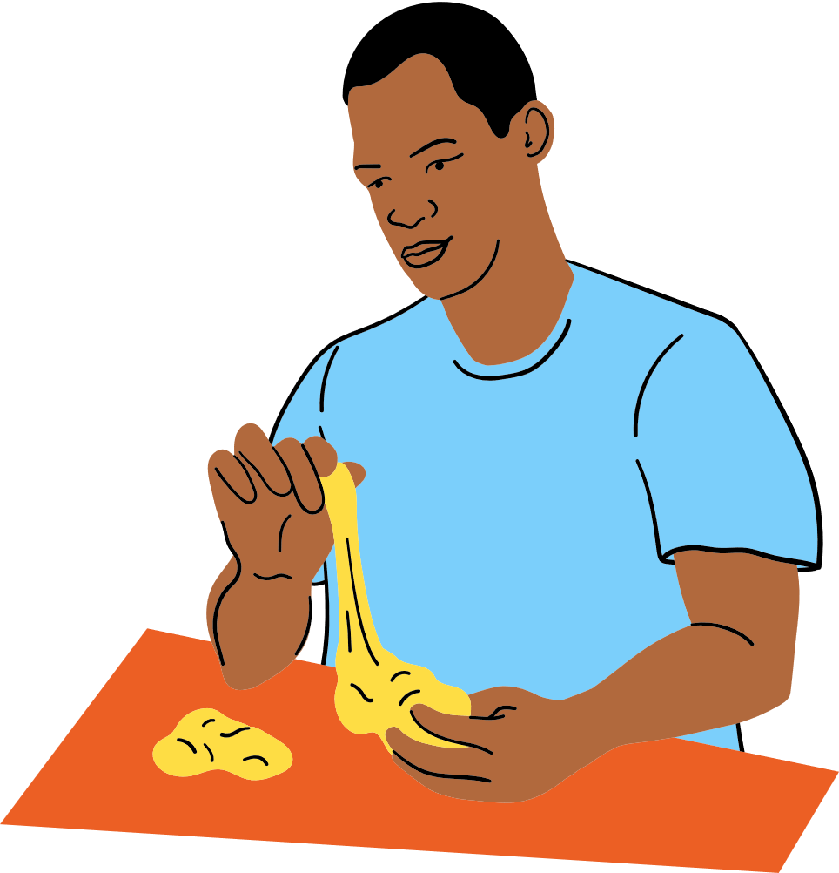


Role play!
Scenario 1
Scenario 2
Debrief:
Thoughts, emotions, or somatic experiences as STAFF - during the conflict and afterwards
Thoughts, emotions, or somatic experiences as STUDENT - during the conflict and afterwards

Slide 14

Thank You!
Questions?

