Slide 1
Special Olympics: Unified Sports
Julia Posch
jposch@nyso.org
Julia Posch
Jposch@nyso.org
Notes:
Add course description
Examples from school (partners in UPE what they will/will not do)

Slide 2
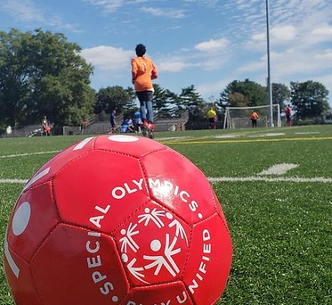
GOALS FOR THE DAY:
Understand Unified Champion Schools (UCS)
Learn about Unified Physical Education (UPE) and Unified Fitness
Learn about Young Athletes
Discuss your ideas or plans to engage in Unified Sports

Slide 3
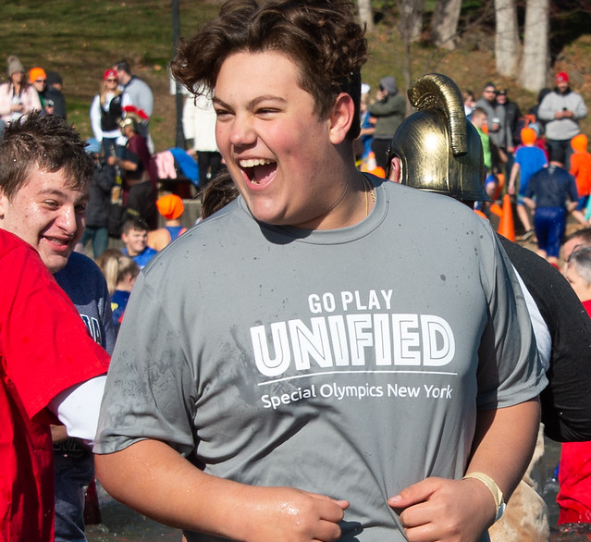
WHAT IS SPECIAL OLYMPICS?
An organization that provides year-round sports training and athletic competition for children and adults with intellectual disabilities.
Develop physical fitness
Demonstrate courage
Experience joy
Participate in sharing of gifts, skills, and friendship

Slide 4

Unified Champion Schools program is aimed at promoting social inclusion through intentionally planned and implemented activities affecting systems-wide change.
Sports as a foundation
Three-component model
Creates climates of inclusion

Slide 5


Slide 6

UNIFIED CHAMPION SCHOOLS
DISTRICT TIMELINE

Slide 7
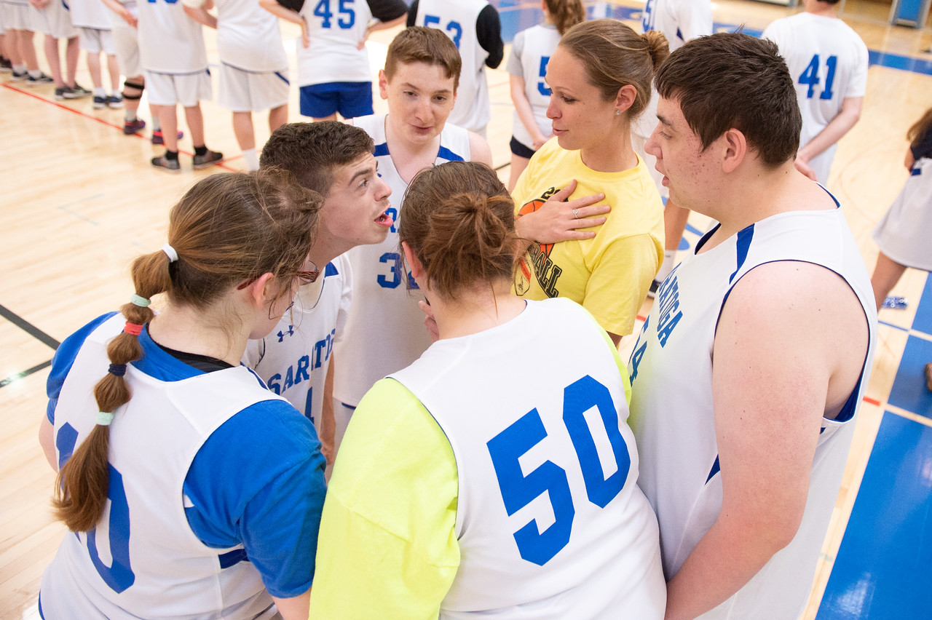
Unified Sports®
Special Olympics Unified Sports® combines an approximately equal number of students with and without intellectual disabilities on teams to train and compete.

Slide 8
Unified Sports®
Interscholastic
Official NYSPHSAA program
Offerings: Unified Sports Basketball and Bowling
Over 300 schools statewide, 52 in the Western Region
Other Models
Unified Physical Education
Young Athletes
Unified Sports as Club or Intramurals
Unified Sports Clinics and Skill Development

Slide 9
Unified Physical Education
Inclusion Weekly: Unified Physical Education - Generation Unified
Unified Physical Education is an opportunity for students of varying ability levels and backgrounds to come together on equal terms through ongoing fitness, sports, leadership and wellness activities.
Engaging in physical activity and sport alongside peers with and without disabilities helps to foster important social relationships.
This course focuses on the physical, intellectual and social growth of all participants.

Slide 10
GOALS OF A UPE PROGRAM
Align with the NYS Learning Standards
Align with the National SHAPE America Learning Standards
Be Fully Inclusive
Partners are informed of their role in the class setting and choose to be in the class
Curriculum is designed for partner and athlete growth and success

Slide 11
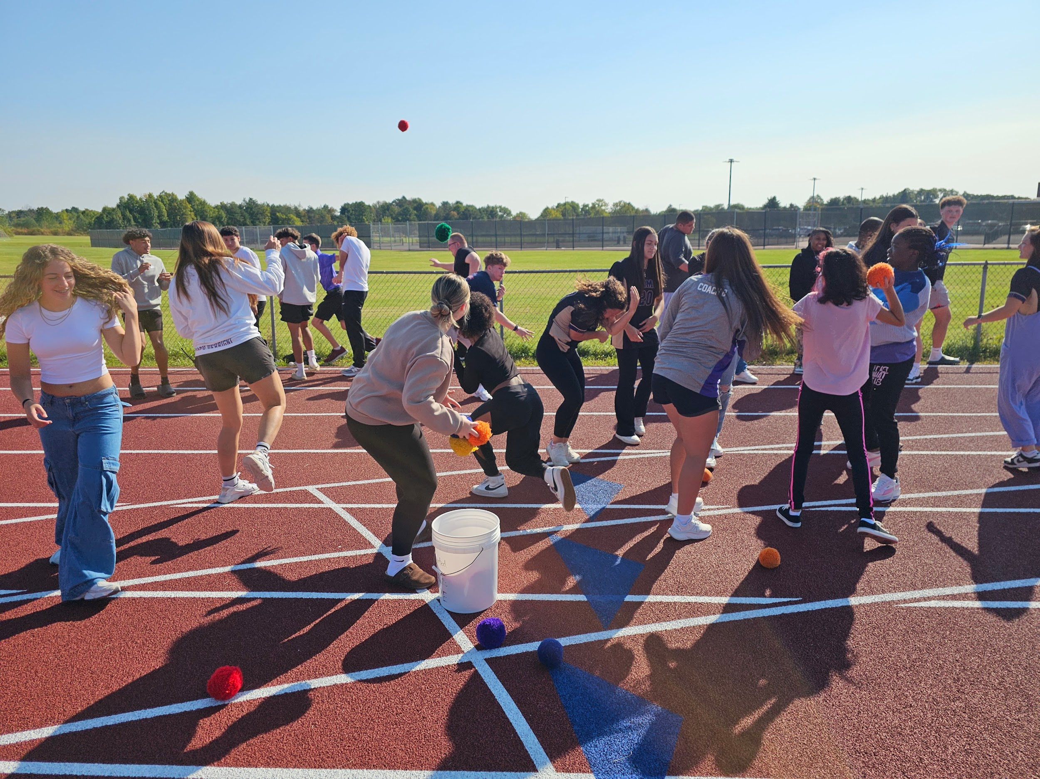
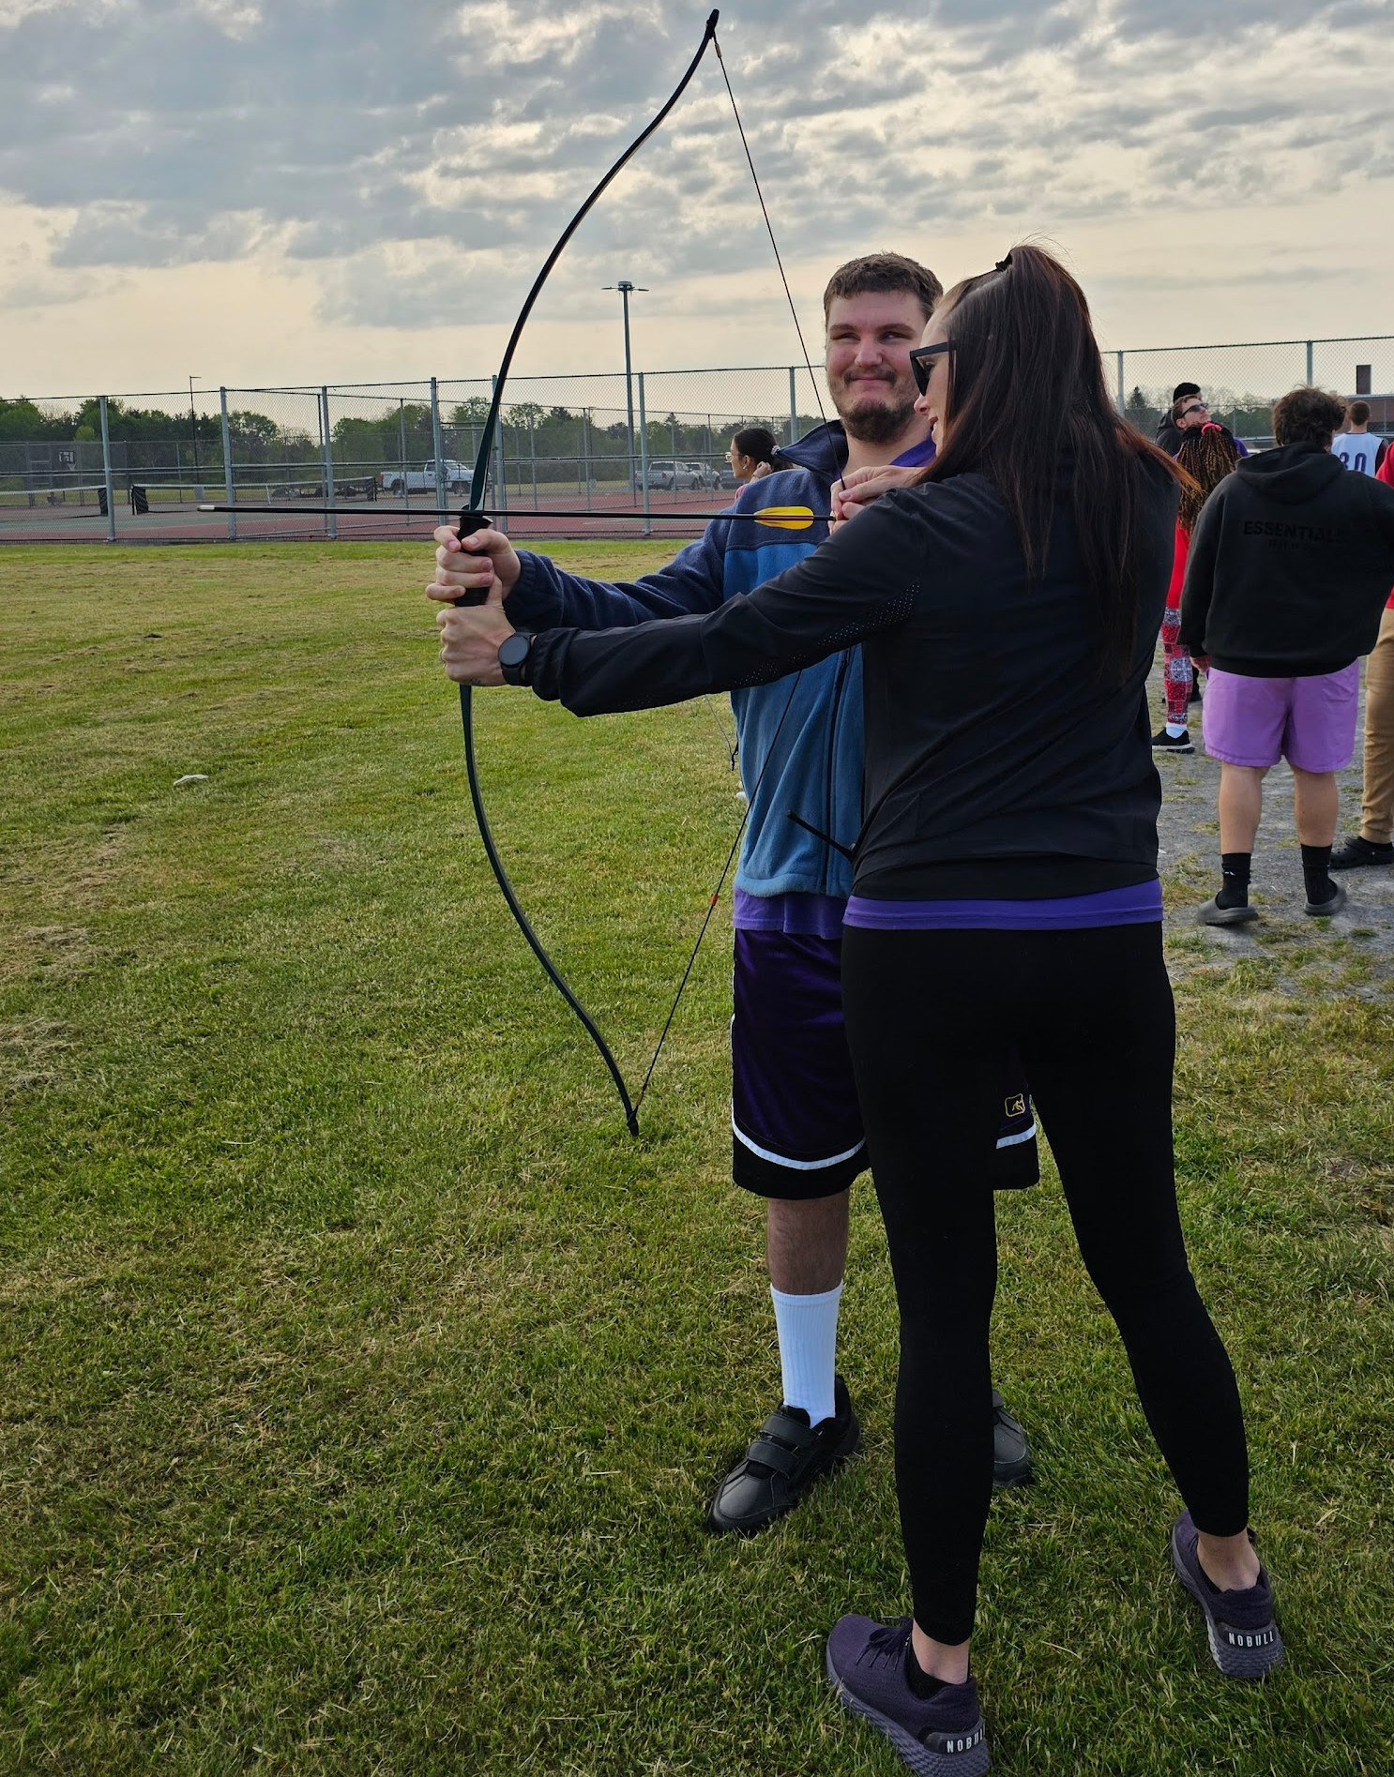
Unified Physical Education
PARTICIPATE TOGETHER
MODEL BEHAVIORS & TASKS
BE AN EQUAL
LEARN FROM EVERYONE
SUPERVISE
TEACH
MODEL APPROPRIATE LANGUAGE
ENJOY THE SOCIALIZATION
FEEL EQUAL & MAKE FRIENDS
LEARN
PARTNER
TEACHER
ATHLETE

Slide 12
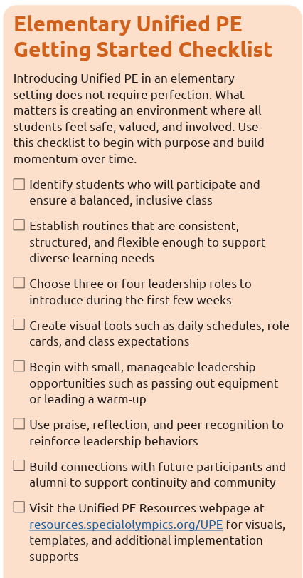
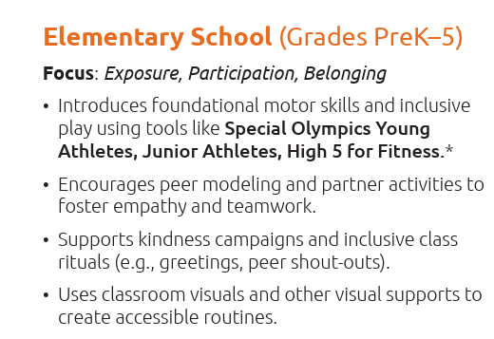
ELEMENTARY

Slide 13

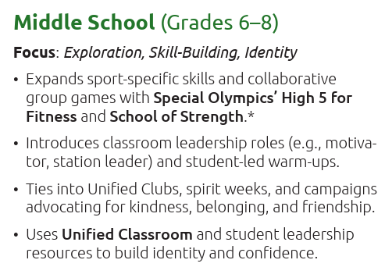
MIDDLE

Slide 14
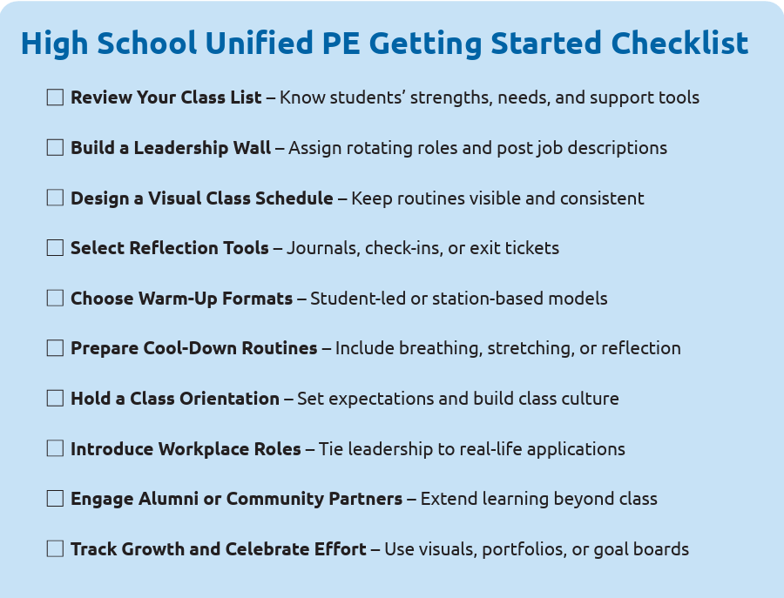
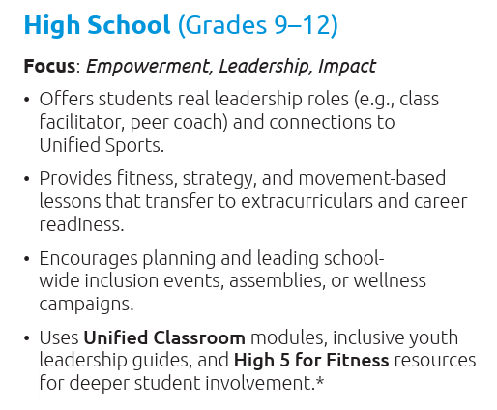
HIGH

Slide 15
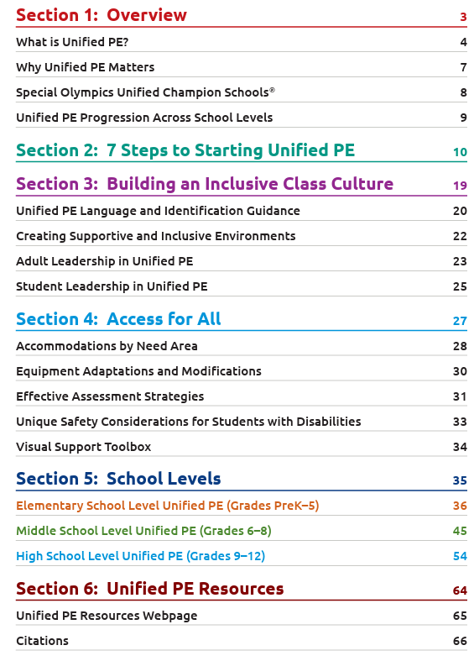




Unified Physical Education Resources
UPE PLAYBOOK
UCS Playbook - All Levels

Slide 16
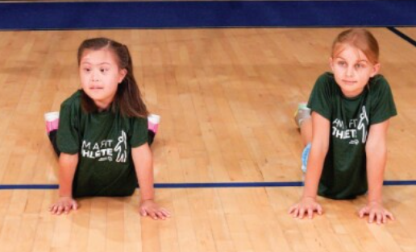
Unified Fitness
Unified Fitness clubs: Yoga, Zumba, Walking, etc.
High 5 for Fitness
  Help people between 8-21 take control of their fitness
  Aim is to increase knowledge and awareness of healthy behaviors through physical activities that improve flexibility, strength, and endurance
Performance Stations
  Can host during a school event or field day!
  Get your local college or PT office involved

Slide 17
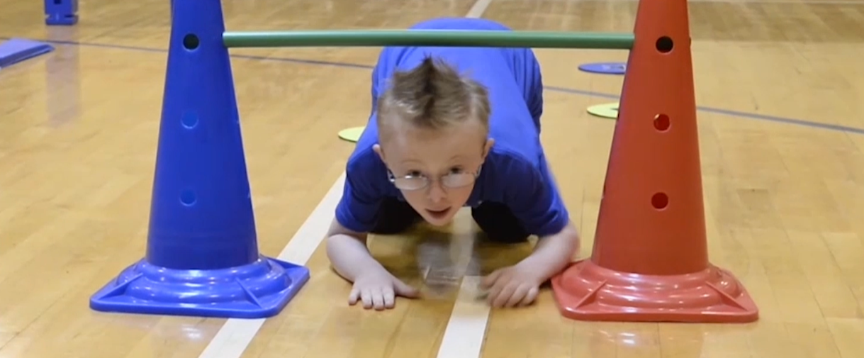
YOUNG ATHLETES

Slide 18
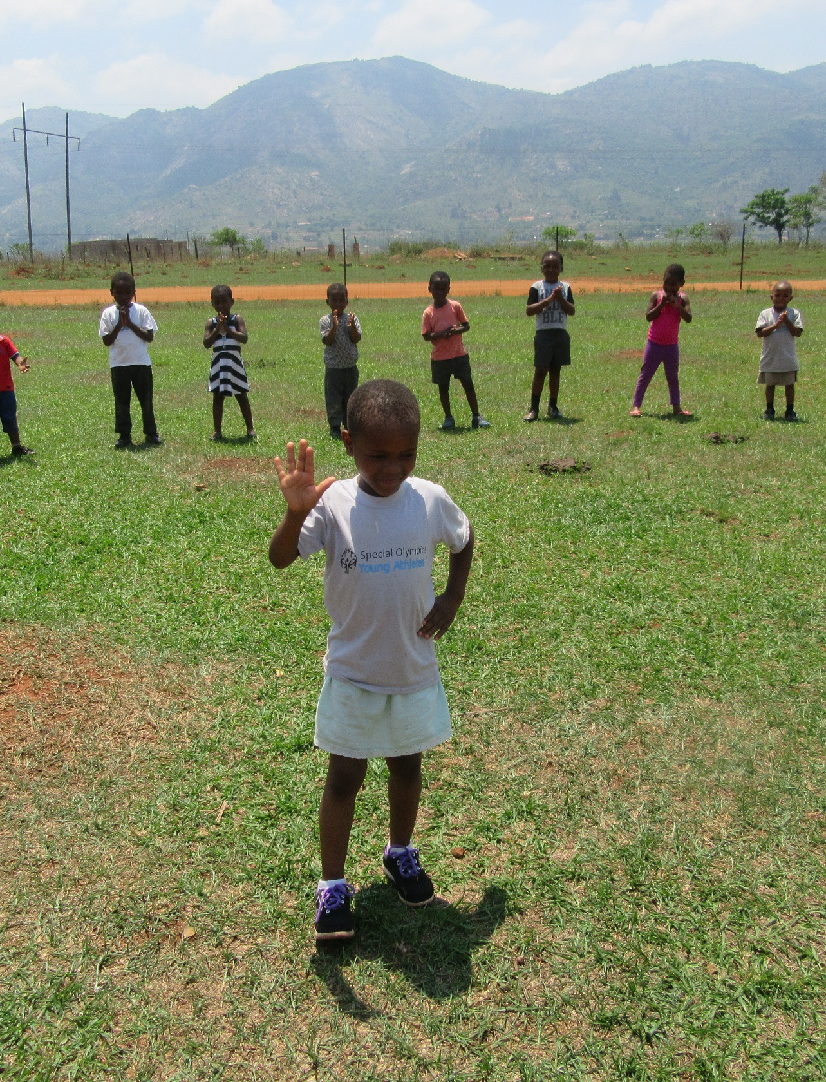
YOUNG ATHLETES
A sport and play program for children with and without intellectual disabilities (ID), ages 2-7
Introduces basic sport skills, like running, kicking and throwing
Offers families, teachers, caregivers and people from the community the chance to share the joy of sports with all children
Children of all abilities take part and they all benefit

Slide 19
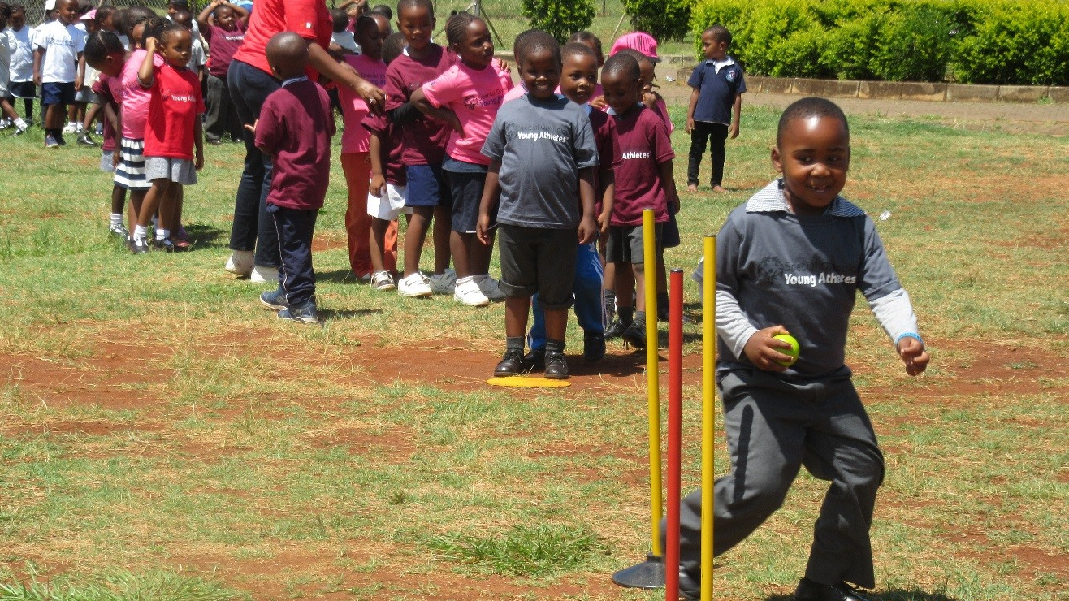
THE GOALS
Support social inclusion and inclusive play in schools, communities and homes
Let children with and without intellectual disabilities play together to learn about and understand each other
Provide children with activities and games that meet their skill and ability levels
Notes:
Social inclusion—Teaching acceptance and respect at a young age
With and without ID—Creating inclusive environments
Skill and Ability Levels—All children can participate in YA, and all children can experience success

Slide 20
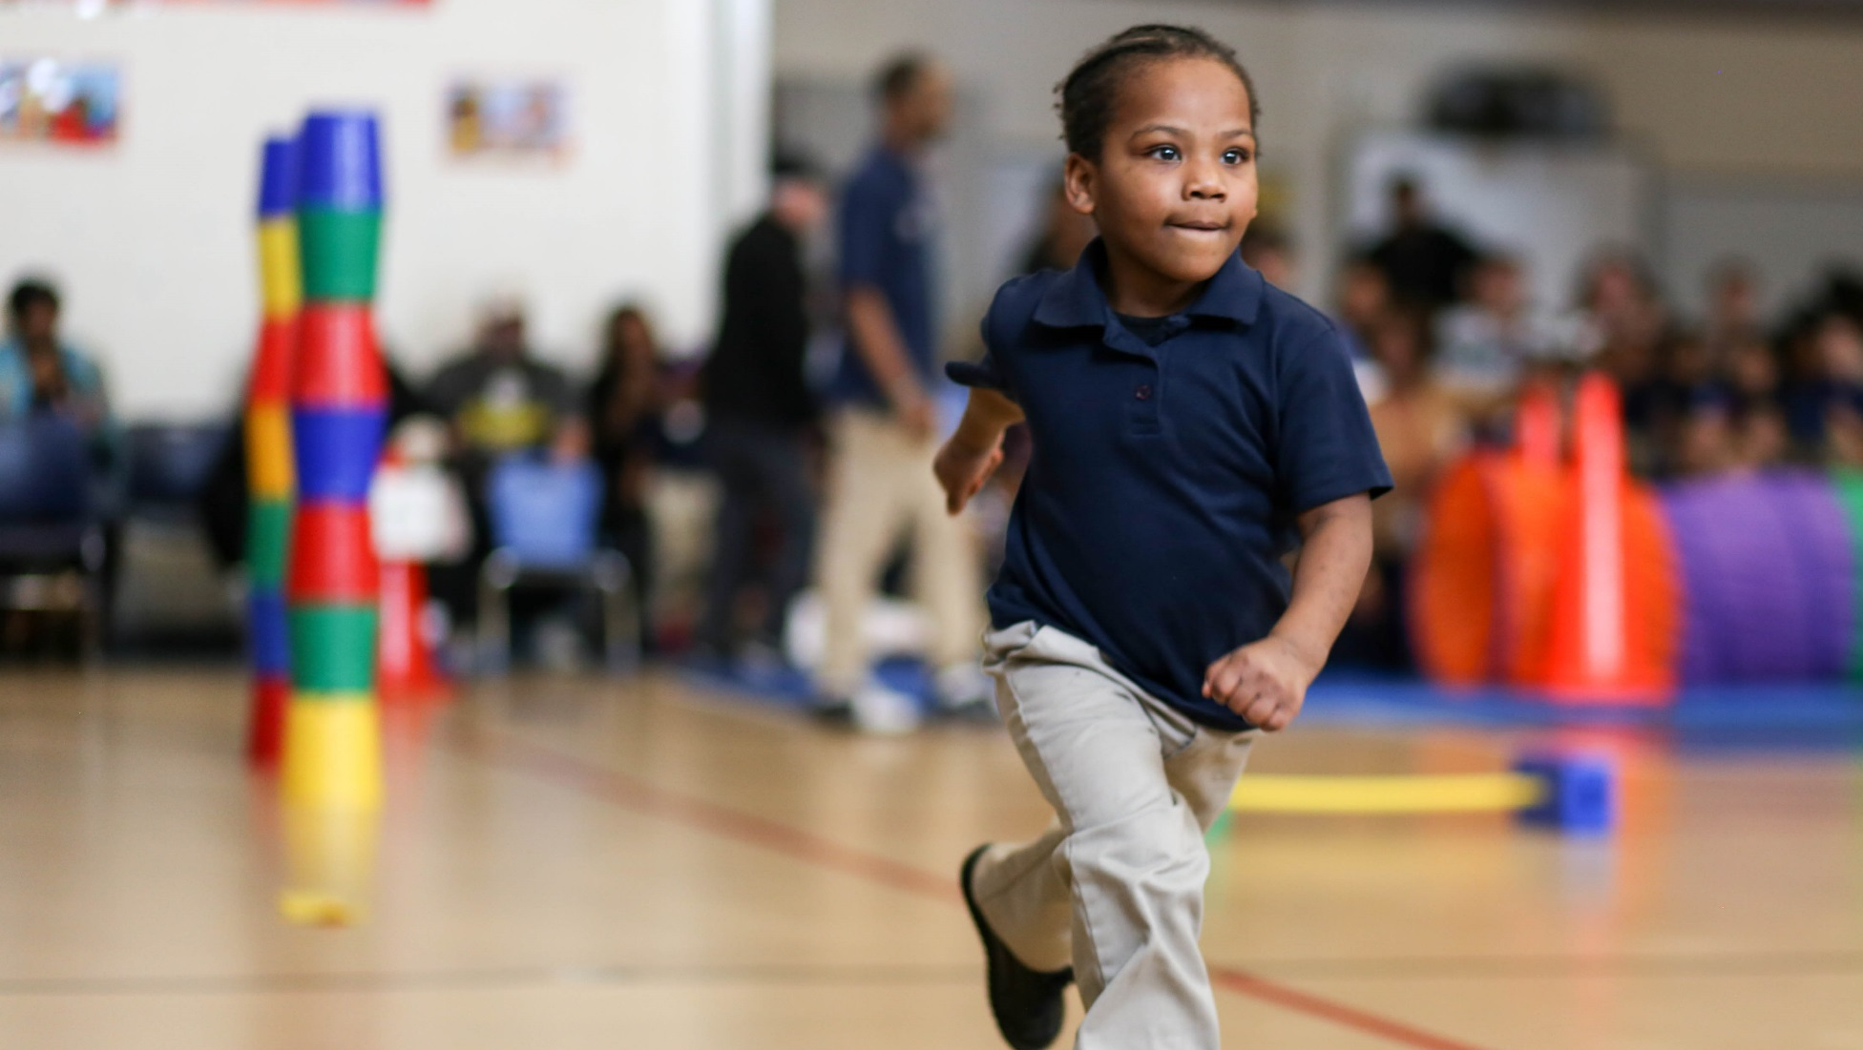
The Impact
Young Athletes Supports:
Motor Skill Development
Social, Emotional and Learning Skills
Parental Expectations
Acceptance
Notes:
Motor Skills Development: Motor Skills Development is a large benefit of Young Athletes which we have already mentioned—but it is not the only benefit
Social, Emotional and Learning Skills: Parents and teachers of children who took part in the Young Athletes curriculum said the children learned skills that they will use in pre-primary school. The children were more enthusiastic and confident. They also played better with other children
Expectations: Family members say that Young Athletes raised their hopes for their child’s future
Acceptance: Inclusive play has a benefit for children without ID as well. It helps them to better understand and accept others.

Slide 21
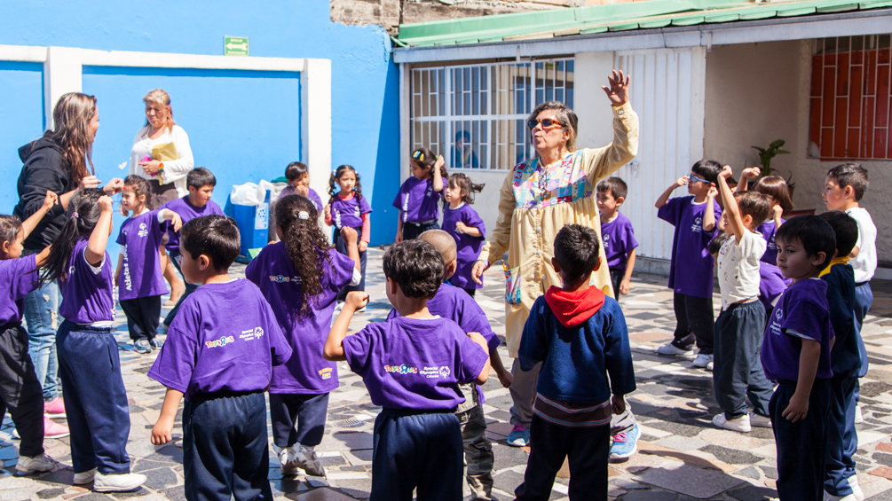
Skill Development
Foundational Skills
Walking & Running
Development of motor, social & cognitive skills
Balance & Jumping
Trapping & Catching
Throwing
Striking
Kicking
Advanced Sport Skills
Notes:
There are eight skill areas in Young Athletes that help children learn movements they will use in sports and daily life
Each skill area has activities in the Activity Guide that can be done with one child or a group of children

Slide 22
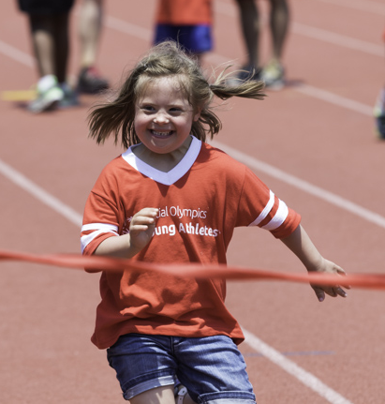

Coach Responsibilities
Before Each Session
Build your Young Athletes session plan (warm up, skill development stations, group activity, cool down).
Gather the necessary equipment (prepare to adapt equipment according to the needs of the activity and/or child).
Communicate session information (location, time, etc.) with parents.
Recruit and train volunteers.

Slide 23
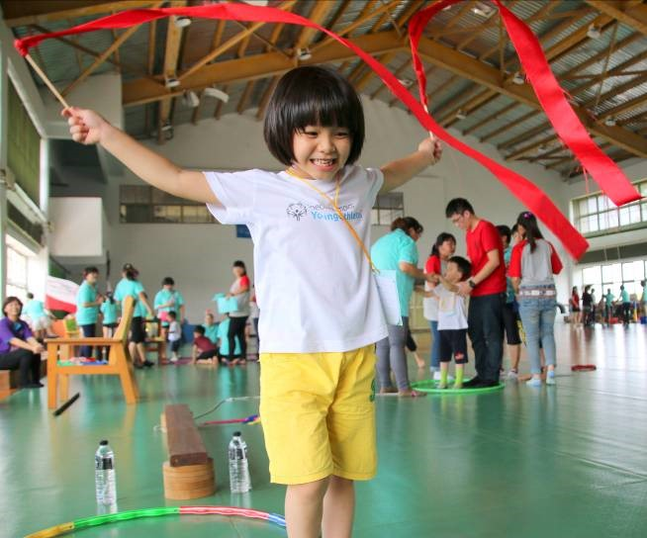
Coach Responsibilities
During Each Session
Lead all activities based on your session plan.
Allow the Young Athletes to take on leadership roles throughout the session (leading the songs, etc.).
Make modifications to activities or equipment based upon the abilities of the participants.

Slide 24
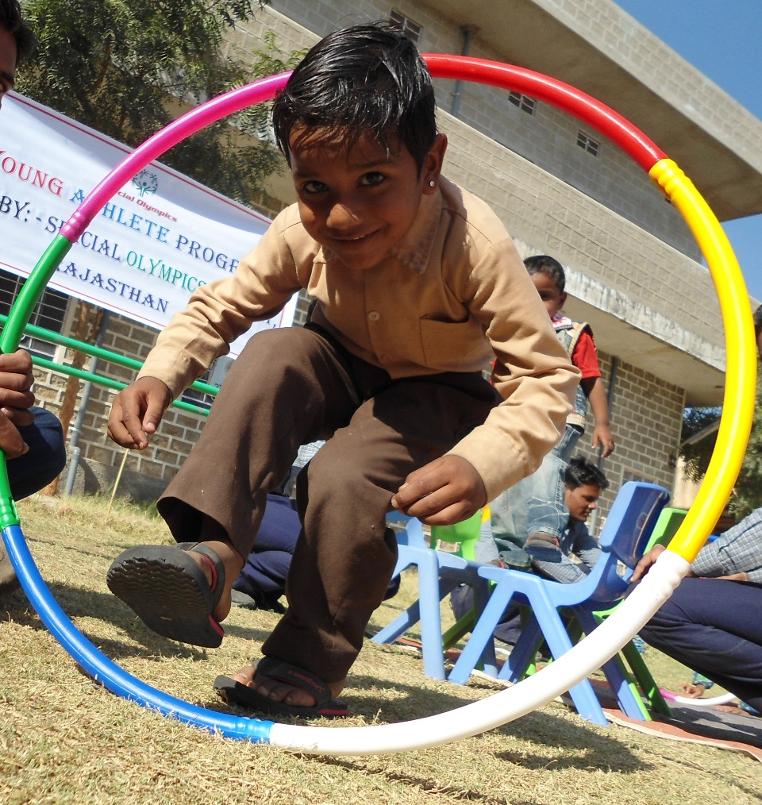
Coach Responsibilities
After Each Session
Make announcements about future sessions.
Make note of the skills that were challenging and should be worked on again in the next session.
Provide resources and information to encourage family members to continue the activities with their children at home.

Slide 25


Resources Available
Activity Guide
Eight skill areas
Activities in each skill area, listed by ease and difficulty
Information on implementing in each model
Additional resources for healthy play and modifications
Curriculum
Eight skill areas
Scripted Lesson Plans to use over an 8-week period
3 days of Lessons Plans for each week, for a total of 24 days
Lessons are designed to be offered in sequence

Slide 26
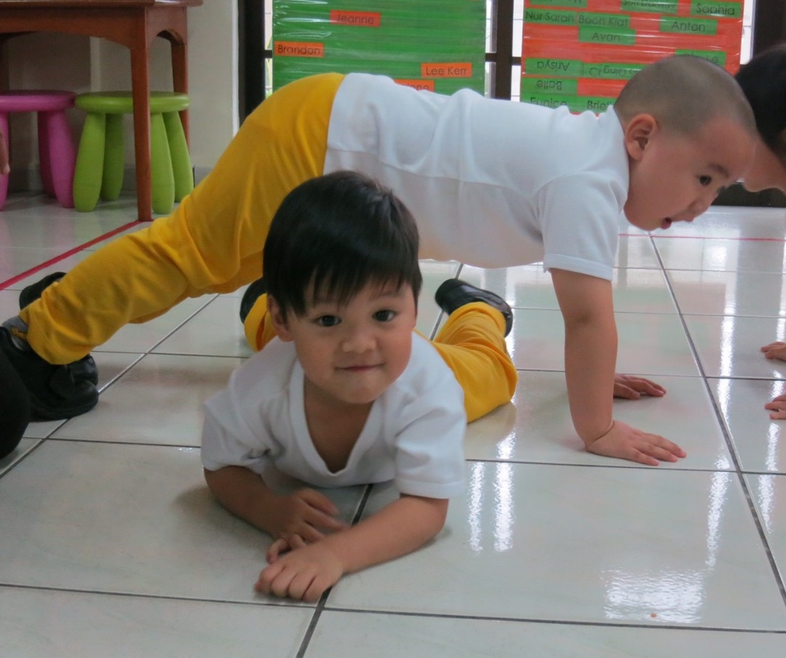
Young Athletes Structure
Program Length: Minimum of 8 weeks followed by an optional culminating/celebration event (year-round programming is preferred)
Duration: 30 – 45 minutes each session
Frequency: 2-3 times per week
Space: Young Athletes can be implemented in any space that you have available. An open area outside, a gymnasium or a room with minimal furniture would be ideal.

Slide 27
Key Components of a Session
1
2
3
4

Slide 28
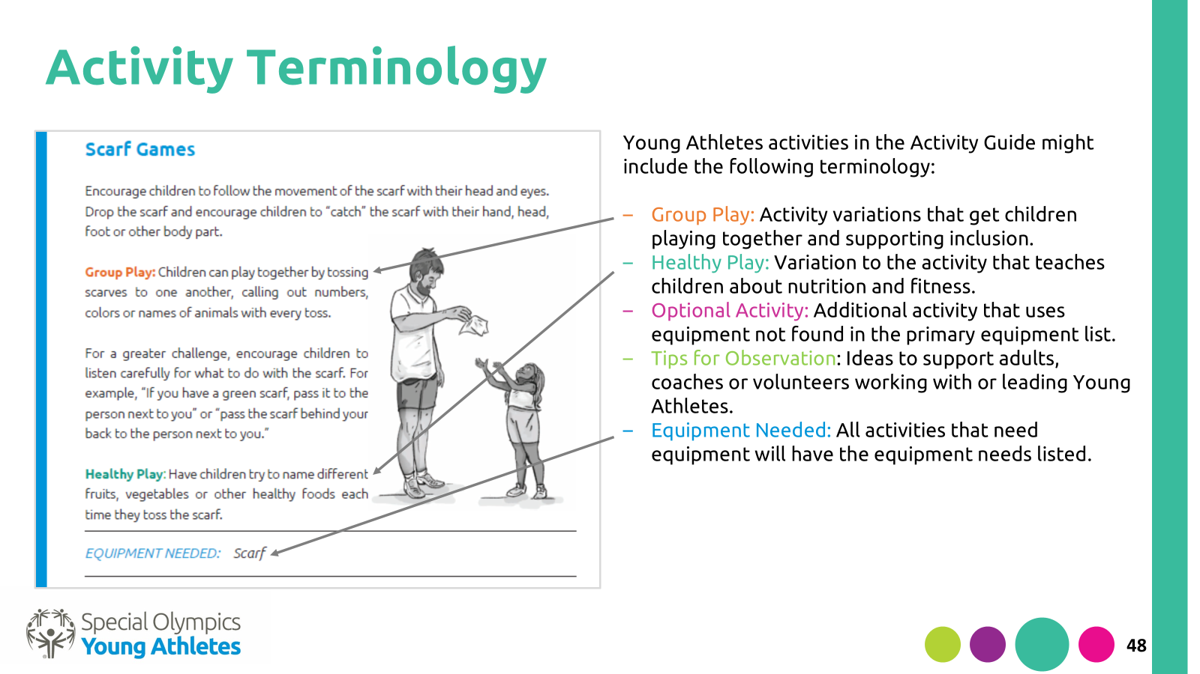


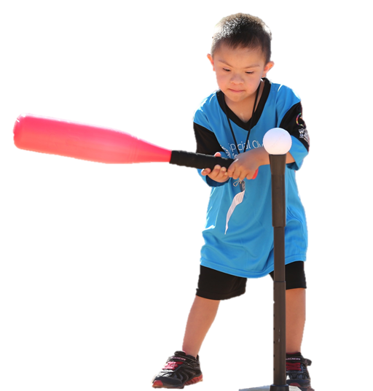
Skill Application Time!
You will see the following icons throughout the next section:
Discussion Time
Let’s Get Active!
Notes:
It’s time to get on our feet! This next session will include discussion topics and opportunities for us to try out the activities.
Only one activity per skill area will be highlighted in this section, but participants are encouraged to ask questions about any of the other activities they see in the YA Activity Guide or YA Curriculum
Have all participants stand and move the group to an area with open space for this section

Slide 29
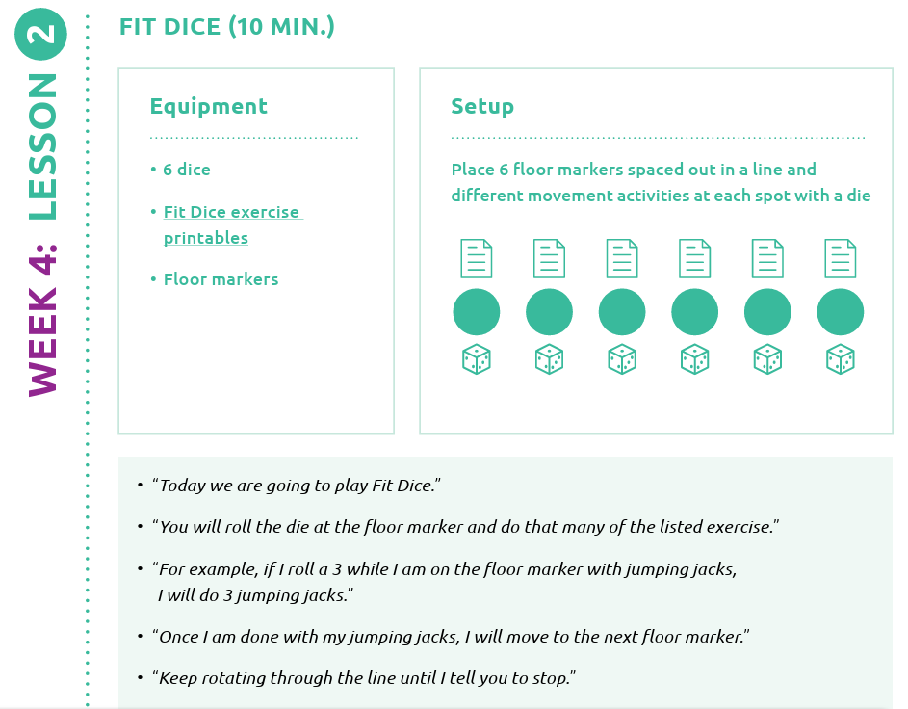
Unit 1: Foundational Skills
Notes:
I will be the coach for this activity. I will be looking for volunteers for coaches for the next activities.

Slide 30
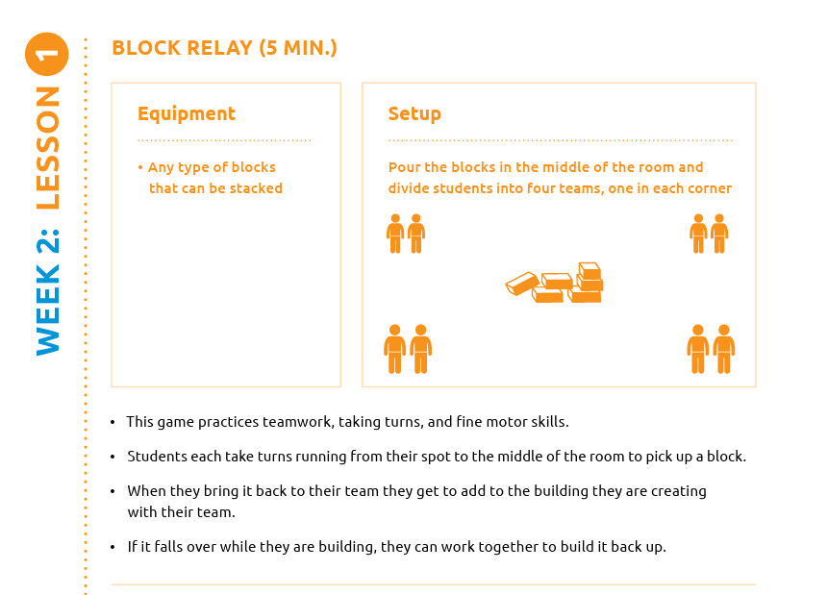
Unit 2: Walking and Running
How could healthy play be incorporated?
How could this activity be modified for a student who is in a wheelchair or uses a walker?
Notes:
How could healthy play be incorporated into this activity?
Example answer: Use colored floor markers and have the children name a healthy food that is the color of the floor marker they are stepping on

Slide 31
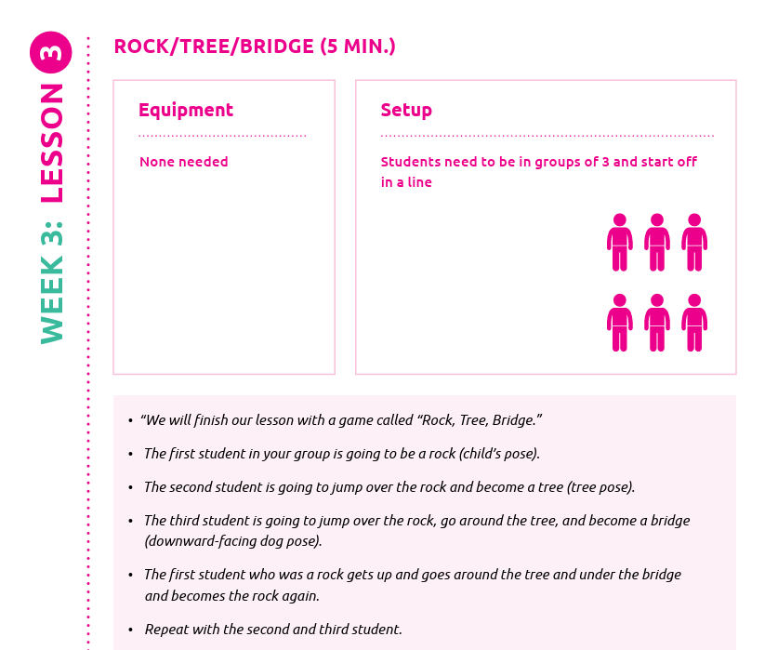
Unit 3: Balancing and Jumping
What could you do if a student is repeatedly struggling to jump over “the rock”?

Slide 32
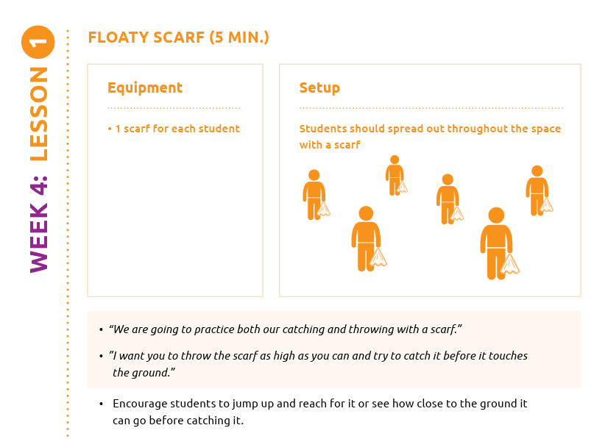
Unit 4: Trapping and Catching

Slide 33
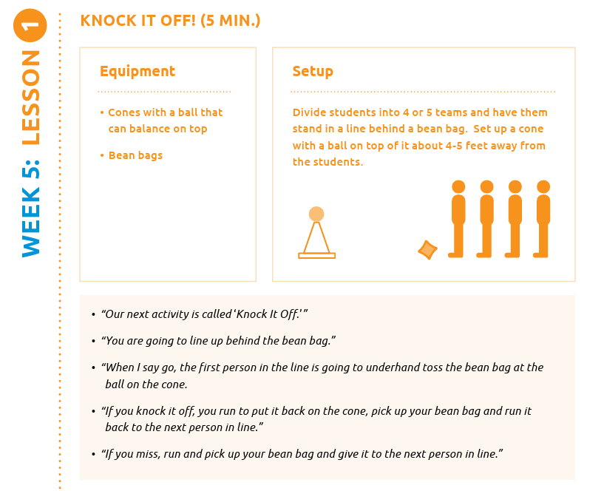
Unit 5: Throwing

Slide 34
Junior Athletes
Geared for upper elementary students
Curriculum with 8 units and 24 lesson plans
  Warmup – skill – activity – cool down
  Aligns with SHAPE
Introduction to sports that students might see in the high school
Unified PE (all school ages)
Young Athletes 2-7
Junior Athletes 8-12

Slide 35

Questions?
Julia Posch – jposch@nyso.org

