Slide 1


Teacher and Staff Wellness Caring for Ourselves to Reduce Stress & Prevent Burnout
Created and Presented by: Stephanie Wagner, LMHC-DP, Coordinator of Child and Adolescent Services with Endeavor Health Services

Slide 2
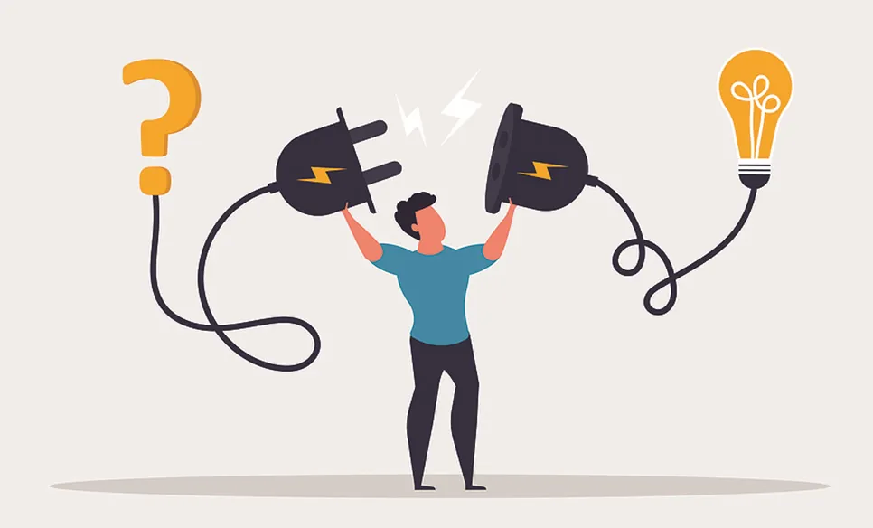
Learning Objectives
Address ways the teachers and staff can take care of themselves.
Define and discuss burnout.
We will create our own self-care plans and discuss ways to use them as needed to reduce stress/burn out.
We will also address barriers to use and how to overcome those barriers.

Slide 3
Why Teacher & Staff Wellness Matters
Educators often experience high levels of stress and emotional demands.
Chronic stress can lead to burnout, compassion fatigue, and reduced job satisfaction.
Prioritizing wellness supports personal health and professional effectiveness.
Healthy staff=healthier school communities.
Notes:
Discuss how chronic stress impacts educators and school climate. Normalize stress responses.

Slide 4

Mental Health in School Settings
Educators are exposed to high emotional demands
Secondary traumatic stress is common
Mental health impacts job performance and well-being
Supporting staff mental health supports student success
How does your school support you?
Notes:
Explain that staff mental health matters just as much as student mental health. Highlight exposure to students’ trauma.

Slide 5
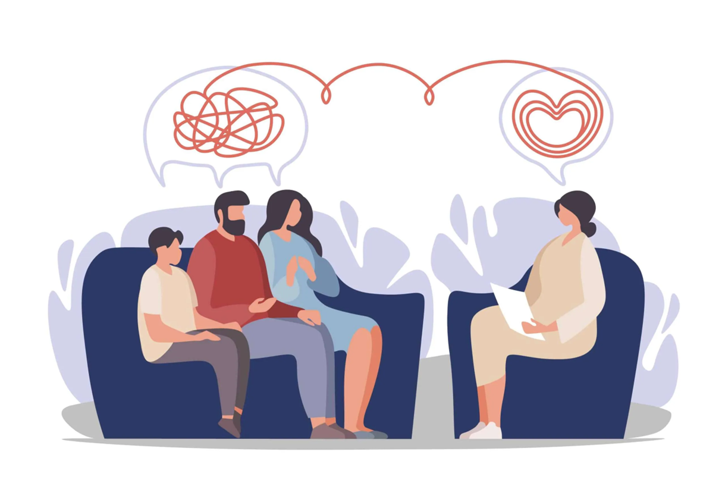
Trauma & Educator Well-being
Trauma exposure can impact emotional regulation
Signs may include exhaustion, irritability, or detachment
Trauma-informed self-care focuses on safety and regulation
Support and connection are protective factors
Notes:
Discuss secondary trauma and compassion fatigue. Reinforce that these reactions are normal, not personal failures.

Slide 6

Common Signs of Stress & Burnout
Burnout is a form of exhaustion caused by constantly feeling swamped. It happens when we experience too much emotional, physical, and mental fatigue for too long.
Physical exhaustion or frequent illness
Emotional exhaustion, irritability, or feeling overwhelmed
Decreased motivation or sense of accomplishment
Difficulty concentrating or increased negativity
Notes:
Review signs and remind staff these are common and understandable reactions to ongoing demands.

Slide 7
Understanding Self-Care
Self-care is intentional action to support physical, emotional, and mental well-being
It is proactive, not selfish or optional
Self-care looks different for everyone
Small, consistent actions matter
Notes:
Clarify that self-care is preventative and individualized. It does not have to be expensive or time-consuming.

Slide 8
Types of Self-Care
Mental
Social
Professional
Physical
Emotional
Spiritual
Financial
Trauma-Informed
Environmental
Recreational
Notes:
Physical: sleep, nutrition, movement, medical care
Emotional: setting boundaries, expressing feelings, therapy
Mental: mindfulness, breaks, limiting overcommitment
Social: supportive relationships, connection with colleagues
Professional: realistic expectations, using sick/personal time
Spiritual: any type of spiritual practice.
Financial: Budgeting…
Trauma-Informed: Supporting nervous system and regulation, grounding, senses, noticing trauma reactions.
Environmental: Creating supportive physical spaces-home, school, work, etc.
Recreational: Taking time out for FUN

Slide 9
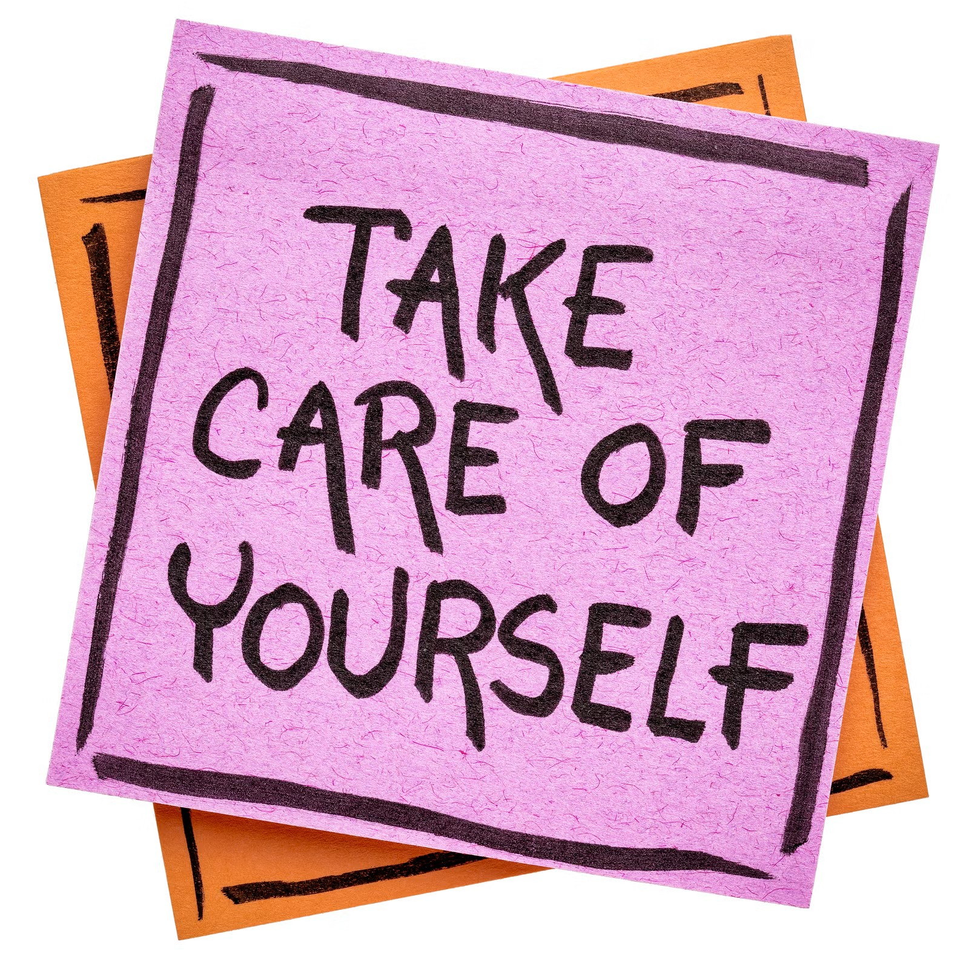
Activity!!!
-Identify current stressors (work and personal)
-List early warning signs that you are feeling overwhelmed
-Choose 3–5 self-care strategies that are realistic for you
-Identify supports and resources you already have
-Write your plan in a way that is easy to revisit

Slide 10
Common Barriers to Self-Care
Feeling guilt about prioritizing self/belief that self-care is selfish
Limited Resources
Lack of time/energy
Feeling stuck/”Nothing works”
Notes:
Normalize barriers and validate frustrations commonly experienced in school settings.

Slide 11
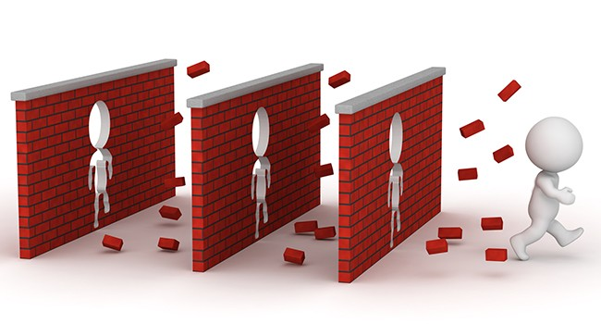
Overcoming Barriers to Self-Care
Start small—5 minutes counts
Reframe self-care as essential, not optional
Schedule self-care like an appointment
Advocate for boundaries and support when possible
Use peer/social support and accountability

Slide 12

Take time to Practice: Progressive Muscle relaxation
Progressive Muscle Relaxation (PMR) is a stress-reducing technique that teaches you to recognize and release muscle tension by systematically tensing and relaxing different muscle groups throughout your body, typically starting from your feet and working your way up. You hold the tension briefly (around 5 seconds) and then release it (for 20-30 seconds), noticing the contrast, which helps train your body to find deep relaxation and combat stress and anxiety.
Notes:
Go through script. Express you can do bits and pieces, only focus on what you need/specific areas. Can be long or short. Covert!!!

Slide 13

Building A supportive Wellness Culture
Encourage open conversations about stress and burnout
Model healthy boundaries and self-care
Share resources and wellness strategies
Support one another as a team
What do you do at your school?

Slide 14
Closing & Takeaways
What is one insight you are taking away from today?
What is one self-care strategy you will try this week?
Remember: YOU CANNOT POUR FROM AN EMPTY CUP
Your well-being matters!!

Slide 15
Resources
https://www.apa.org/topics/stress https://workplacementalhealth.org https://www.mayoclinic.org/healthy-lifestyle/stress-management https://www.nami.org https://www.mentalhealth.gov https://adaa.org https://www.learningforjustice.org https://safesupportivelearning.ed.gov/trauma-informed https://nctsn.org https://www.apa.org/helpcenter/workplace-stress https://www.mindtools.com https://store.samhsa.gov

Slide 16
Thank you!
Stephanie Wagner, Endeavor Health Services: swagner@ehsny.org and 716-895-6700 ext. 4803

