Slide 1

Revitalize and Reconnect
Self-Care for Educators
February 25, 2026

Slide 2



AGENDA
INTRODUCTION
GRATITUDE
GRATUTUDE OVER BURNOUT
A FORMULA FOR TRANSFORMING CONFLICT INTO PEACE
STRATEGIES!
WHO DOESN’T LOVE STRATEGIES FOR SELF-CARE
KEY TAKEAWAYS
ELABORATE ON WHAT YOU LEARNED

Slide 3

“What is one thing I’m looking forward to today,
and why am I grateful for the opportunity to experience it?”
“Who made a positive impact on my life recently,
and how can I show appreciation for them?”
“Which colleague am I thankful for this week,
and how have they made my work more meaningful or enjoyable?”
gratitude.

Slide 4
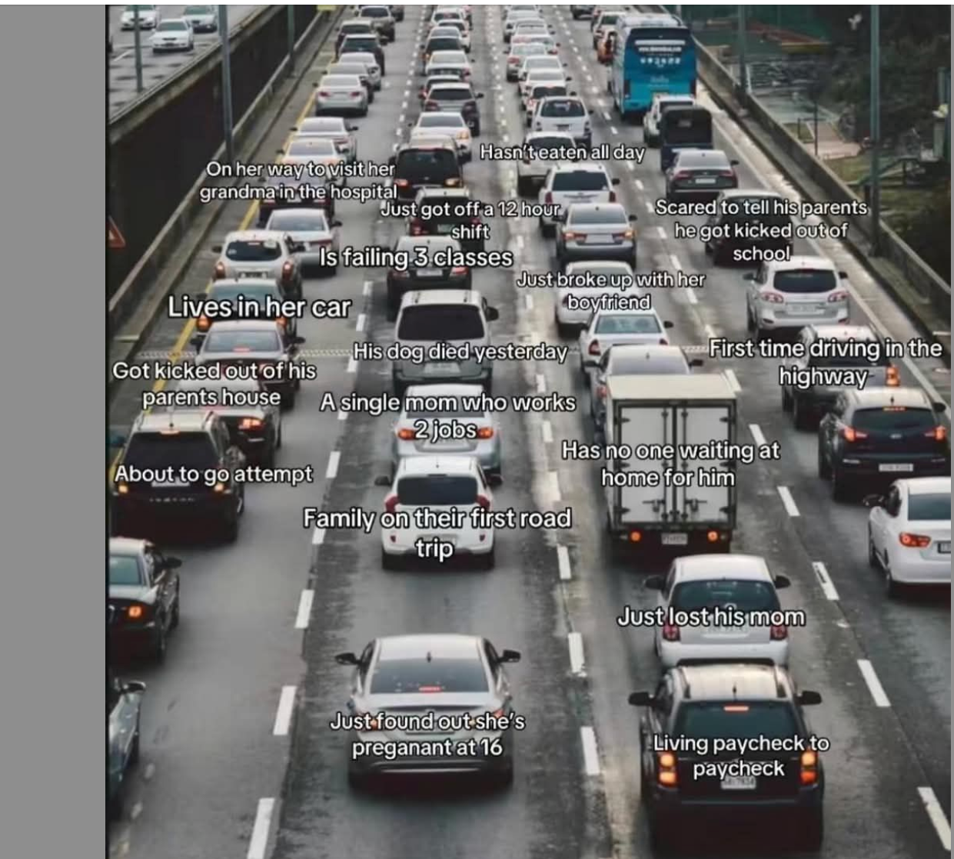
Perception
vs.
Perspective
*8 billion different tomorrows

Slide 5
Strategy 1:
Unpack on your cultural lens
Our FIRST tool for igniting emotional renewal has a large influence on how we examine data en our schools too! (in general)
Culture...
Group’s Personalility
Takes years to evolve
Based on values and beliefs
Can't be felt, even by group member
Part of us
The way we do things
Determines whether or not
improvement is possible
Climate...
Group's attitude
Easy to change
Based on perceptions
Can be felt when you enter a room
Surrounds us
The way we feel around here
The first thing that improves when
positive change is made
Gruenert & Whitaker (2015)

Slide 6
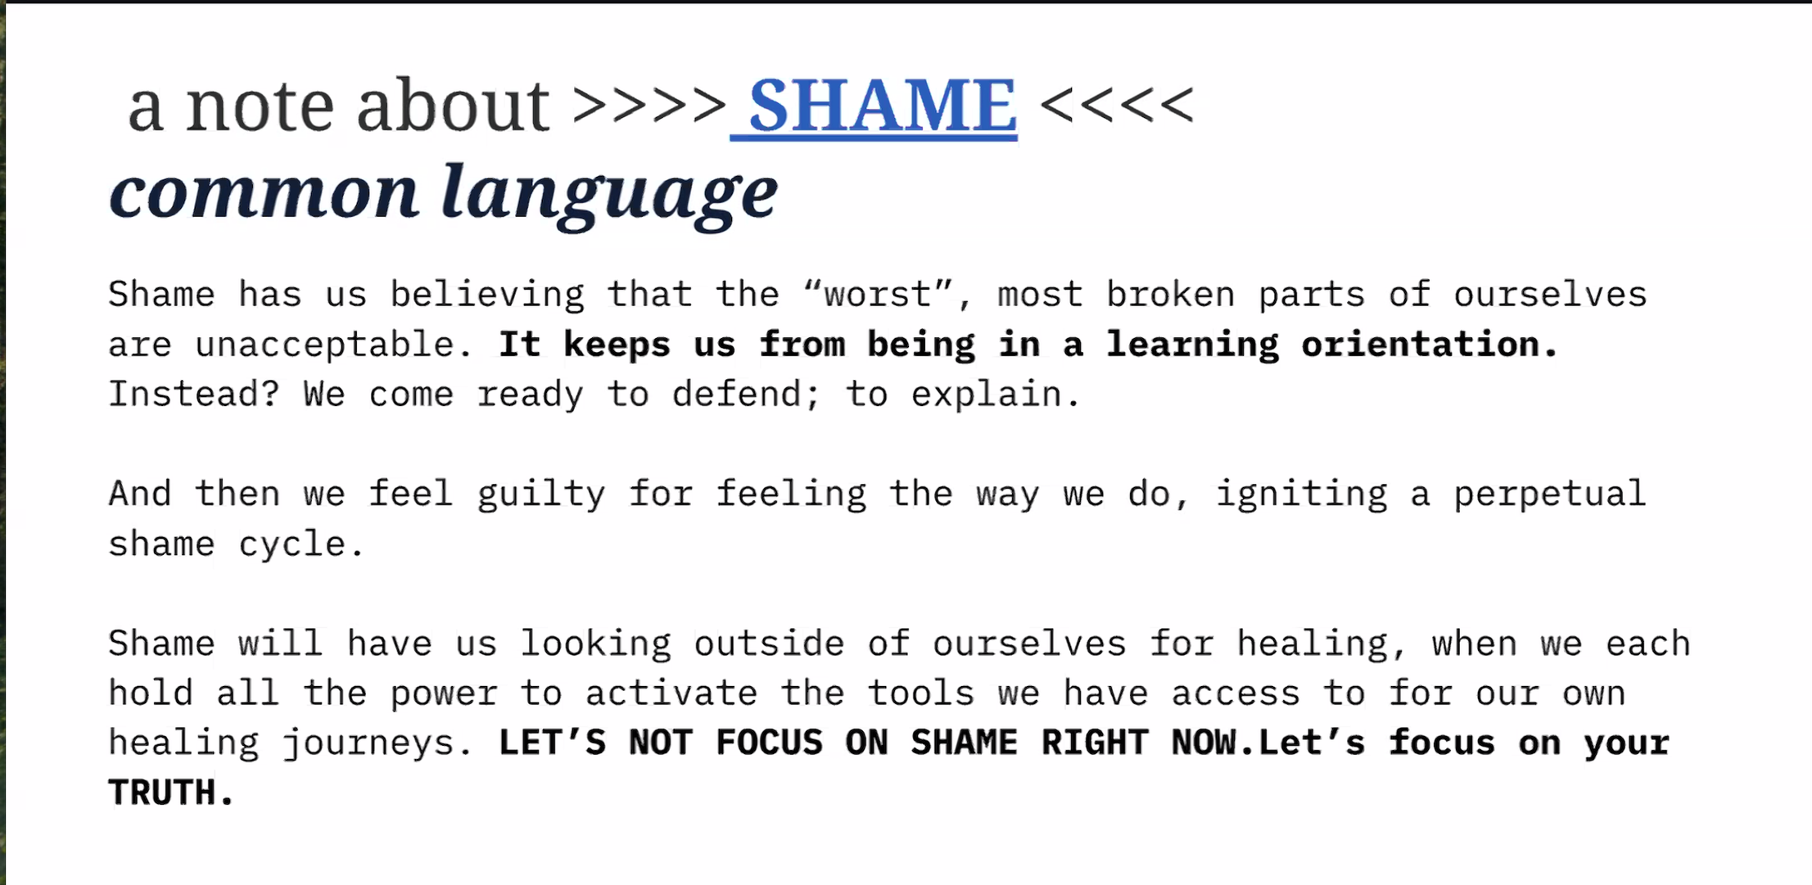
for such a time as this...

Slide 7
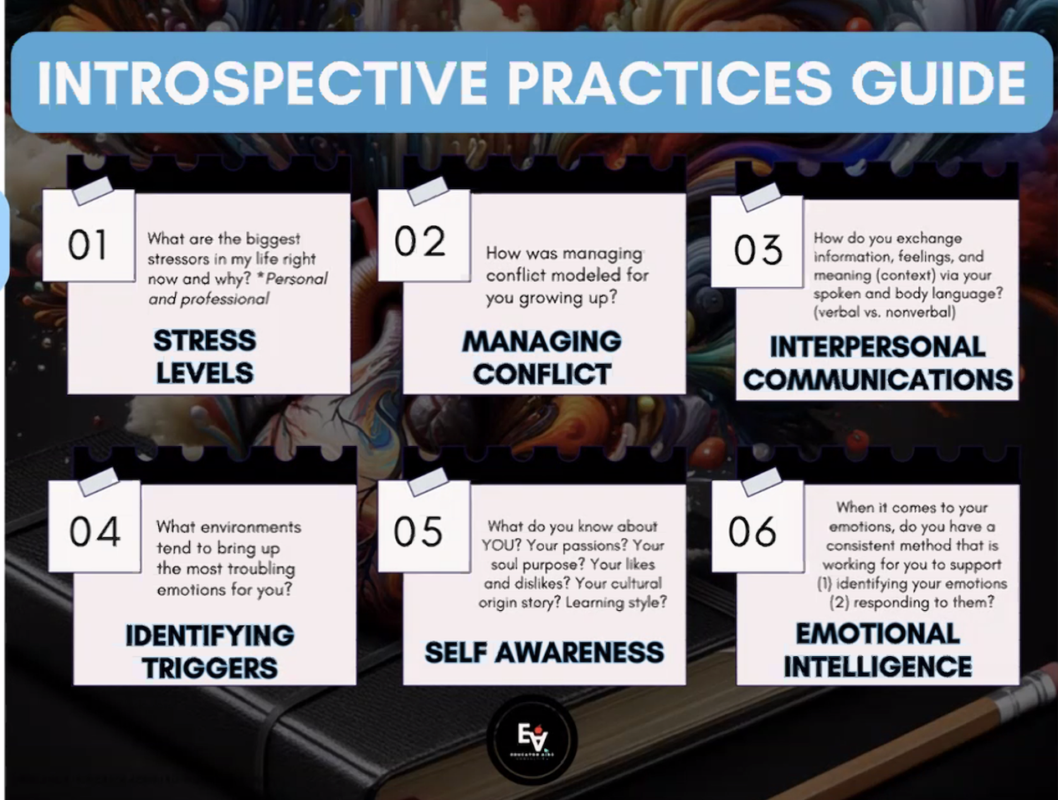
Strategy #2: Introspective Practices=
Gratitude > Burnout
HOW DO I FEEL?!?!
WHO AM I?
REALLY?!

Slide 8
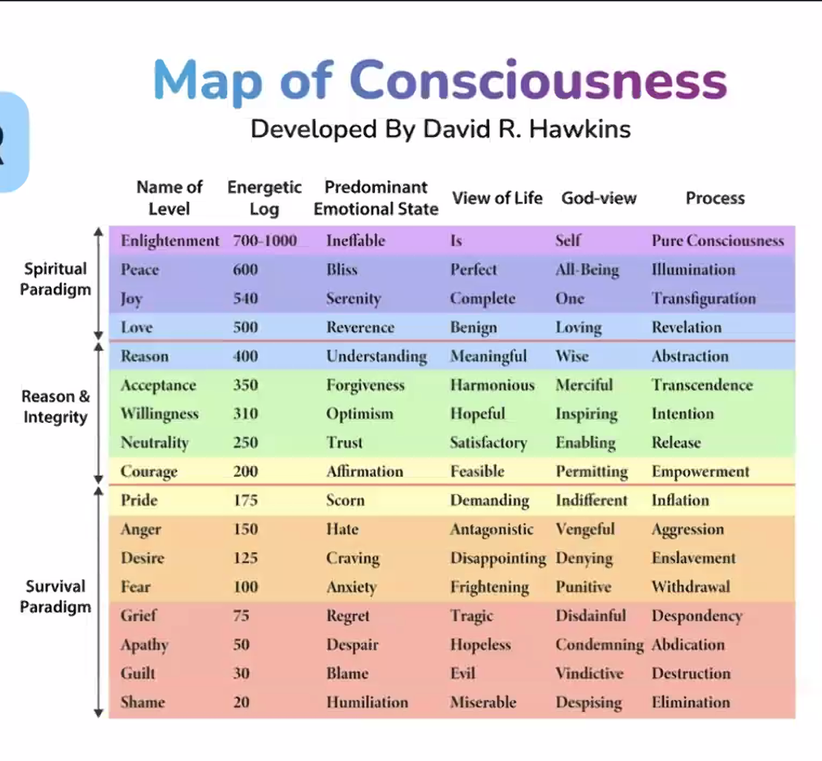
Strategy #3:
Reprogramming Your Nervous System=
Your Energetic Frequency
Unpack when you think about the frequencies of peace and joy.
What was an event in your life where your predominant emotional state was a frequency of bliss or serenity?
Notes:
NOTE: ONE SPIRITUAL THEORY (LAW OF ATTRACTION) SAYS THAT IF YOU HOLD A SINGLE THOUGHT WITH UNDIVIDED ATTENTION FOR ABOUT 17 SECONDS, YOU "ACTIVATE" A VIBRATION THAT BEGINS ATTRACTING SIMILAR THOUGHTS OR ENERGY.
**THERE IS NO PEER-REVIEWED NEUROSCIENCE OR PSYCHOLOGY RESEARCH THAT IDENTIFIES A SPECIAL PHYSICAL "COMBUSTION POINT" AT EXACTLY 17 SECONDS WHERE ENERGY STARTS
ATTRACTING MORE OF THE SAME ENERGY.
THOUGH... MANY SCIENTIFIC STUDIES HAVE FOUND THAT FOCUSED ATTENTION CAN STRENGTHEN NEURAL PATHWAYS AND SHAPE BEHAVIOR OVER TIME.

Slide 9
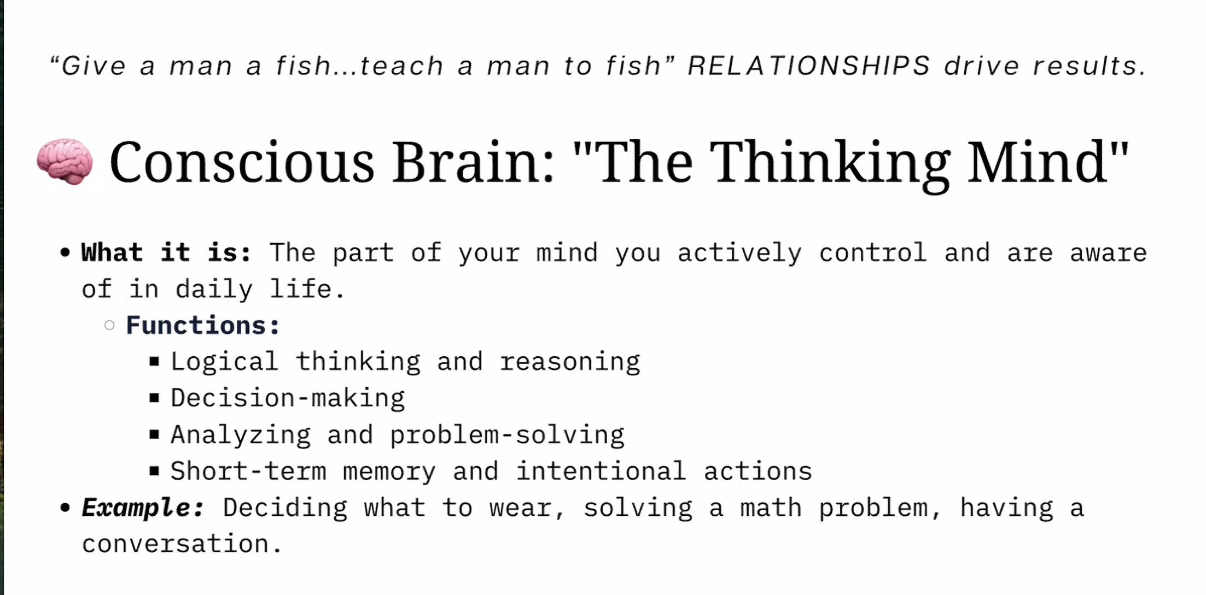
Notes:
Dr. Justine Gonzales

Slide 10
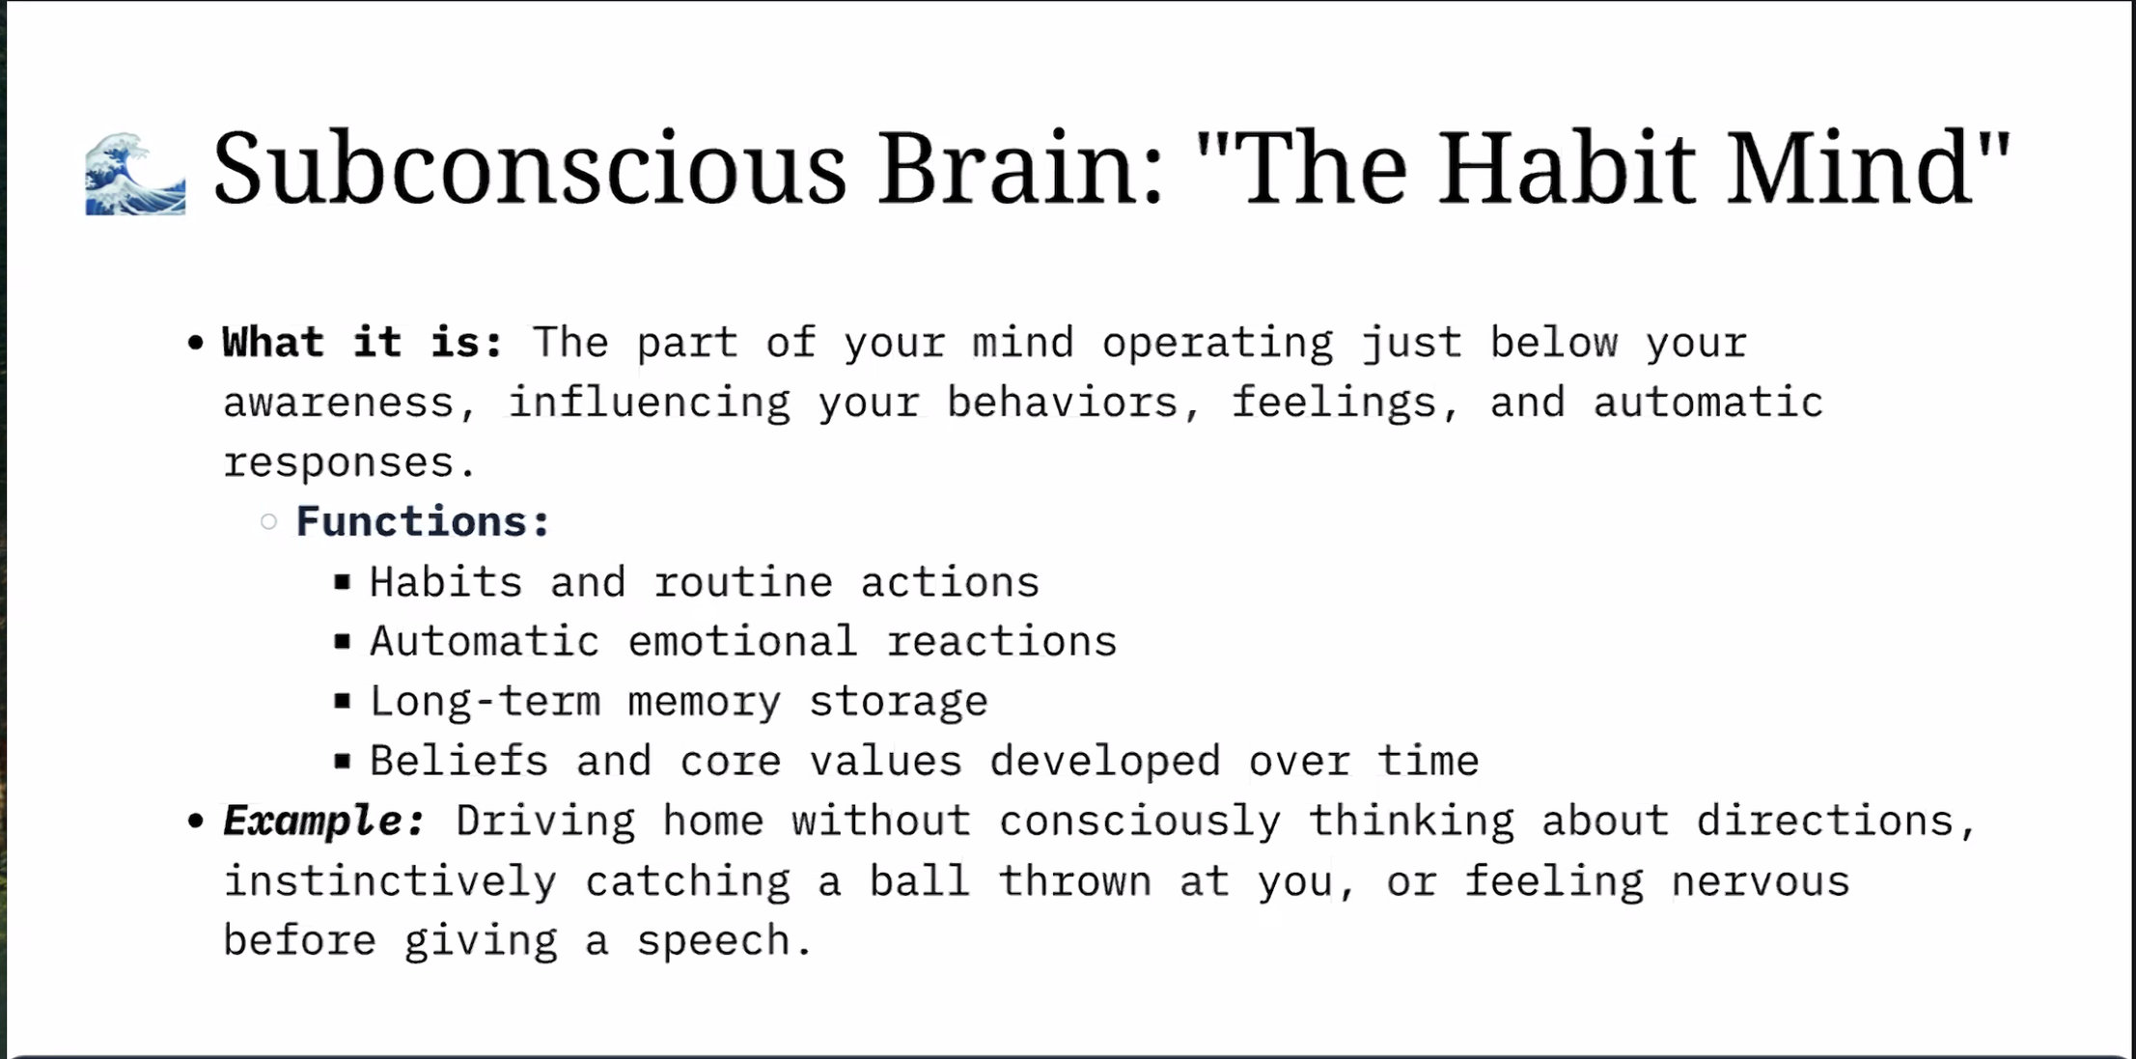

Slide 11
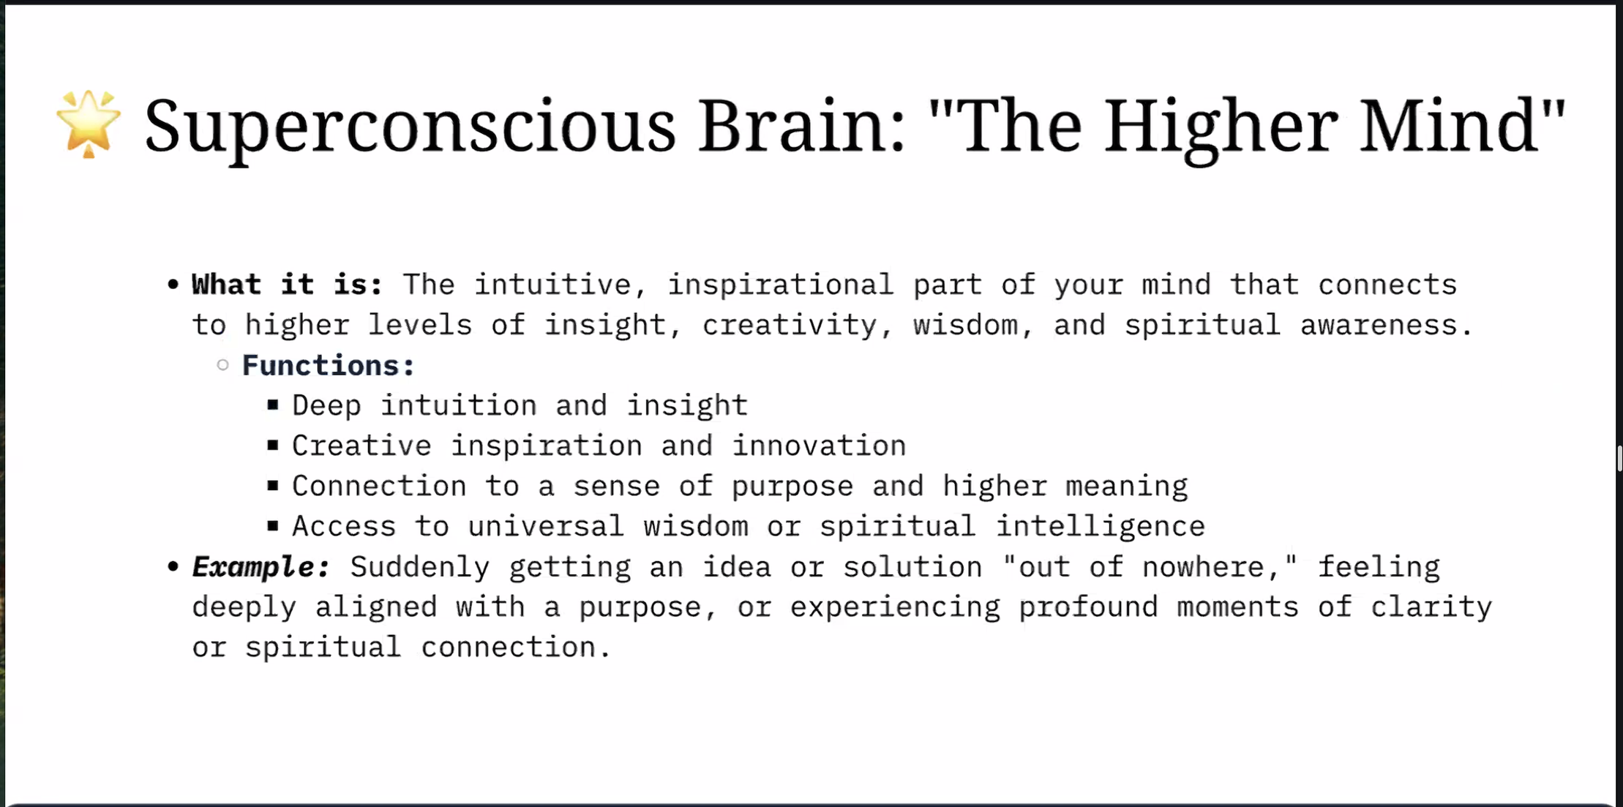

Slide 12
"Until you make the unconscious conscious, it will direct your life and you will call it fate.”
-Carl Jung

Slide 13
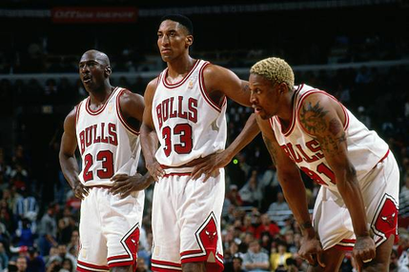
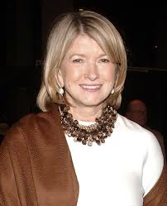
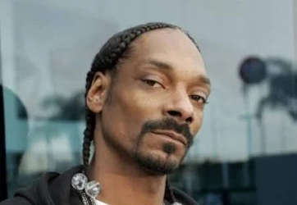
Strategy #4: Define your systems for personal accountability.
AccountABILITY is...
Shared engagement made not only between leaders and their teams, but made between individuals on the teams with each other. This transforms how we monitor progress from a top down and hierarchical into something internalized by those who help generate ideas and actions that drive continuous improvement.
This can also apply to SELF-ACCOUNTABILITY and being honest with yourself about what you NEED!
What does each person need when they are in the game?

Slide 14
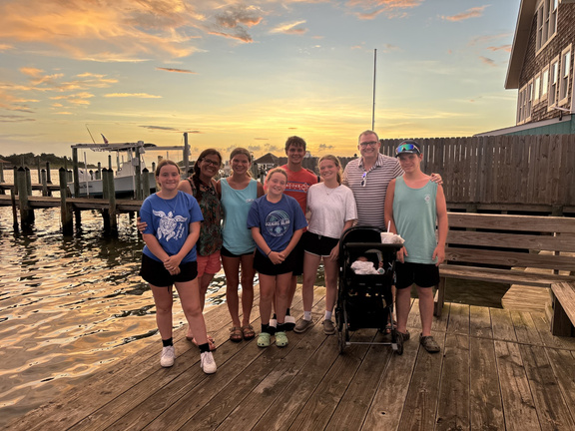

Strategy #5: Love Learning YOU and Share Who You Are With Your Teams!
Kelli Cullen
One of my favorite texts is "Jesus and the Disinherited" by Howard Thurman. In this prolific text (first published in
1949), Thurman writes: "In this world the socially dis-advantaged man is constantly given a negative answer to the most important personal questions upon which mental health depends:
Who am I? What am I?".
Community Schools
Who Am I?
What Am I?
Notes:
Living testimony:
I want to know me. What did my soul come to do?

Slide 15

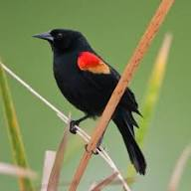
WHO DO YOU ASPIRE TO BE ON THIS FOLKTALE?
TALE OF THE RED-WINGED BLACKBIRD
Strategy #6: TRUST YOUR LEADERSHIP VOICE (EVEN AS YOU GAIN VALUABLE LESSONS!) AND BE UNAPOLOGETIC ABOUT DOING WHAT IS BEST FOR STUDENTS!
Notes:
The tale of the red-winged blackbird, particularly the Chitimacha Native American legend reported by Katherine Judson in 1914, explains how the bird acquired its distinctive red shoulder patches. It tells of a brave blackbird that warned others about a man setting a marsh on fire and was injured by the man, staining its wings with blood.
Key Elements of the Tale:
The Conflict: An angry man attempts to destroy the world by setting fire to the marshes.
The Hero: A little blackbird tries to warn everyone by shouting "Ku nam wi cu!" (the world is burning).
The Injury: The man throws a shell at the bird to stop it, hitting its wings.
The Symbolism: The bird's wings are permanently stained red with blood, representing courage, sacrifice, and protection of the marsh.
This legend is often used to symbolize the bird as a guardian or a reminder to be watchful.

Slide 16
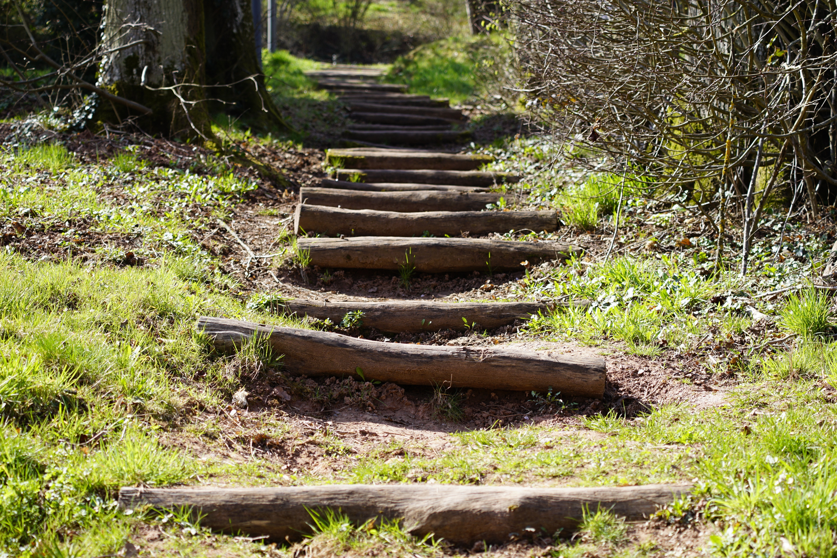
.
Strategy #7: Gracefully, and Unapologetically, commit to a path of learning yourself through consistent strategies, based only upon what YOU know about YOU.

Slide 17
Taking care of your mind is just
as important as caring for your body.

Slide 18
Thank You!
Credit: Dr. Justine Gonzales
kelli_cullen@caboces.org

