Slide 1

NAVIGATING THE YOUTH VAPING CRISIS WITH THE SAFER PROGRAM

Slide 2
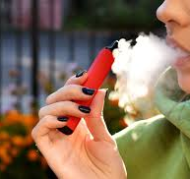
AGENDA
The SAFER Program
Cannabis briefing
Vaping briefing
Q & A

Slide 3

CANNABIS SEEMS TO FOLLOW ME…
SAFER Project Director
MACP, CASAC-M
20+ years clinical experience
Cannabis Specialization
Notes:
My Lens
Unofficial “Weed Girl” now the “Cannabis Queen”
Netherlands – Dutch farming family
Canada legalized Federally in 2018
NYS legalized on March 31, 2021

Slide 4
EARLY INTERVENTION MATTERS
Nearly 70% of adolescents who try an illicit drug < age 13 will develop an addiction within 7 years
Compared with 27% for those who first try an illicit drug after age 17.​
Critical period of brain development ages 12-30
Brains are highly neuroplastic and sensitive to toxic substances
More susceptible to developing addiction with early exposure
Early Intervention – We can do better!
Notes:
https://addiction.surgeongeneral.gov/table-of-contents

Slide 5

SAFER Program
Horizon Health Services was awarded a grant by SAHMSA in September 2024 that allows us to provide SBIRT services in the community!
SBIRT (Screening Brief Intervention & Referral to Treatment) is a public health approach to the delivery of early intervention and treatment services for both persons with and at risk of substance use disorders.
By providing this program on site, we are helping to eliminate barriers to service and are genuinely meeting youth where they are at.

Slide 6

YEAR 1 IMPACT
136 unique students served to date and counting!
Actively providing onsite SAFER interventions in 18 school districts
Delivered 30 student facing educational presentations and 53 faculty / administration facing presentations!
47 students were recommended to a higher level of care following the SAFER intervention with over 70% warmly connecting to follow-up services.
70 Family Peer support interventions

Slide 7

Normalizing the Conversation
Without judgement
Without shame and blame
Without scare tactics
Science based facts
Planting seeds
Conversations not confrontations

Slide 8
TARGET POPULUATION
This program specifically targets youth at risk of or currently using substances by offering services at middle schools, high schools, and colleges/universities ages 10-25.
We aim to reach youth who wouldn’t typically walk through our door who we know may be disproportionately at risk of co-occurring disorders .

Slide 9
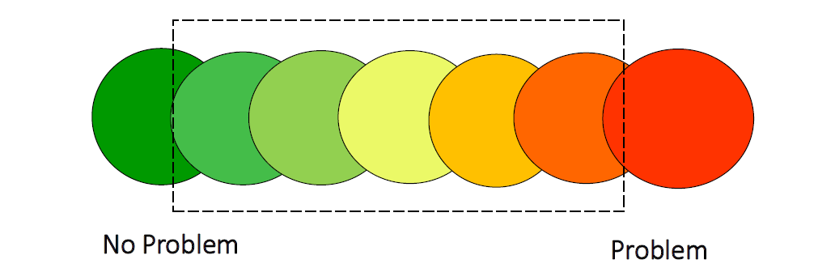
SUBSTANCE USE CONTINUUM
Notes:
Looking to screen patients in the light green and yellow zones.

Slide 10
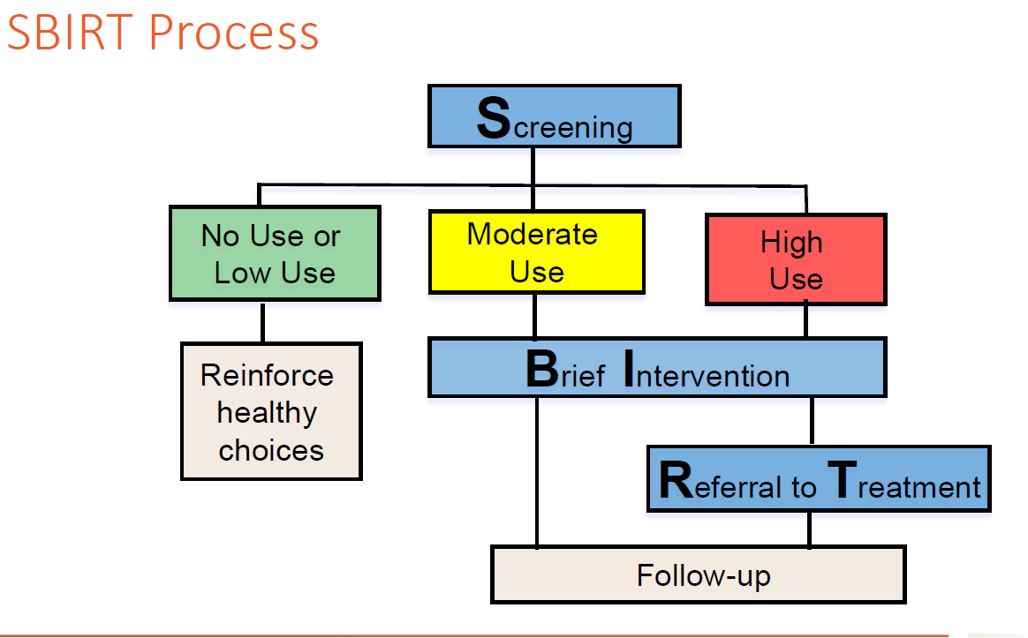
The SBIRT Intervention
Screening quickly assesses the severity of substance use and identifies the appropriate level of treatment.
Brief intervention focuses on increasing insight and awareness regarding substance use and motivation toward behavioral change.
Referral to treatment provides those identified as needing more extensive treatment with access to specialty care.
Notes:
SUD psychoeducation focus on Nicotine, Cannabis and overdose prevention
Screening and Reinforcement of healthy choices
Brief intervention
1-5 sessions
Extended intervention
Up to 12 sessions
Referral to Treatment

Slide 11
SBIRT Intervention Outcomes
One Time SBIRT - Support and Reinforcement
Brief Intervention – 2-5 sessions
Brief Treatment – 5-12 sessions
Referral to Treatment – warm linkage to community MH / SUD services
Notes:
Pre-admission services are filling a meaningful gap in the treatment continuum.

Slide 12
Meet The Team
Project Director: Erin Parr
Project Coordinator: Emmanuela Deng Gac
Case Manager
Family Support Liaison
3 SAFER program counselors
26 school-based counselors

Slide 13

MHA Youth Peers
Partnership with Mental Health Advocates of WNY
Youth peers with SUD and MH lived experience
Minimum of 4 free peers to peer sessions through the grant

Slide 14
ERIE 1 BOCES PARTNERSHIP
Utilized JUUL funding to hire a Part time coordinator tasked with the identification of at-risk students within the Erie 1 BOCES Community Schools Network
Collaborative partnership with Horizon to provide prevention, early identification, and referral support for students experiencing substance use including vaping and related behavioral health concerns through the SAFER Program.

Slide 15

Horizon Speakers Bureau
Students, faculty, clinical staff, parents and community organizations
Vaping 101
Cannabis & The Adolescent Brain
Harm Reduction
Youth Drug Trends
How to be a Coping Coach

Slide 16

Referrals
SAFERreferrals@horizon-health.org

Slide 17

CANNABIS BRIEFING
CLEARING THE HAZE

Slide 18

CULTURAL SHIFT
Increased perception of safety following legalization
Perpetuation of misinformation
Impact of Cannabis marketing
Notes:
Impact of exposure to cannabis marketing on youth intentions to use and perception of safety which are predictors of future use.
Addictive Behaviors
Volume 153, June 2024, 107981
Cannabis advertising impacts on youth cannabis use intentions following recreational legalization in Canada: An Ecological Momentary Assessment (EMA) study
Author links open overlay panelChelsea Noël ª, Deborah Scharf ª ^{b}, Anna Koné ^{b}, Christopher Armiento ª, Daniel Dylan ^{c}

Slide 19
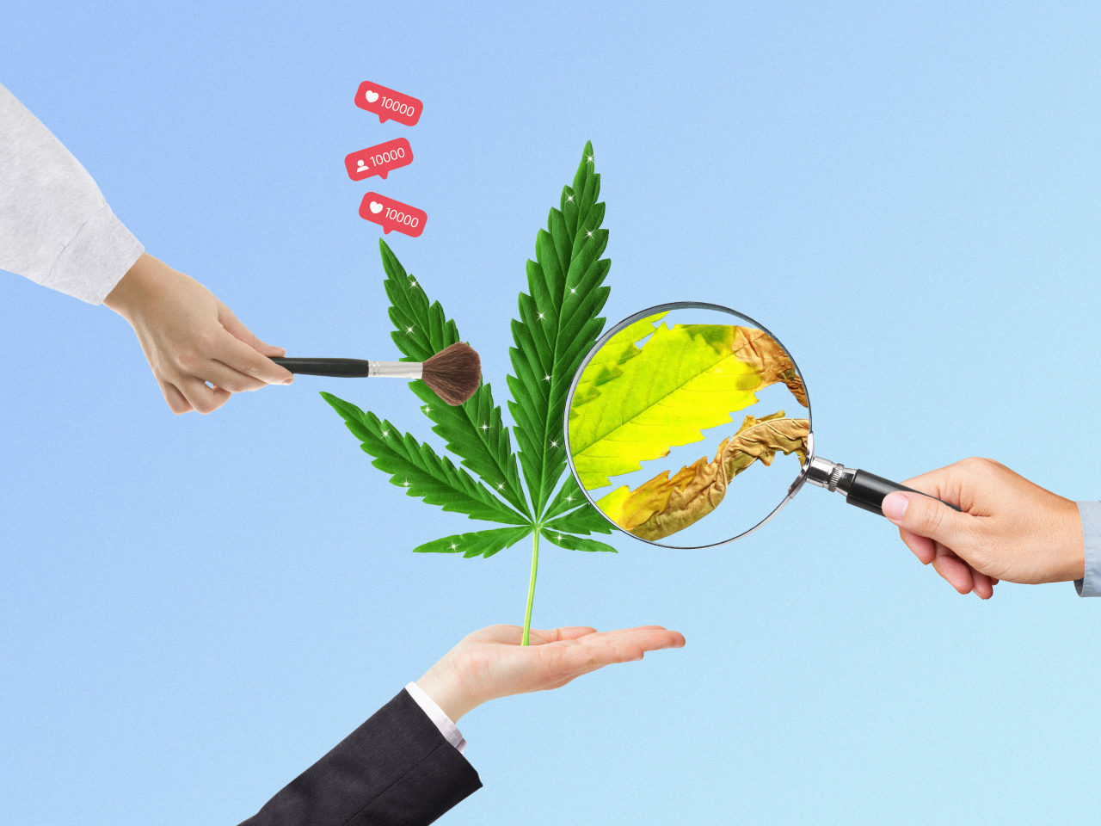
LEGAL DOESN’T MEAN SAFE FOR EVERYONE
Pregnant or breastfeeding
Under age 25 ( or 30!)
Older adults
Cardiac conditions
Pre-existing SPMI
Family hx of SPMI

Slide 20
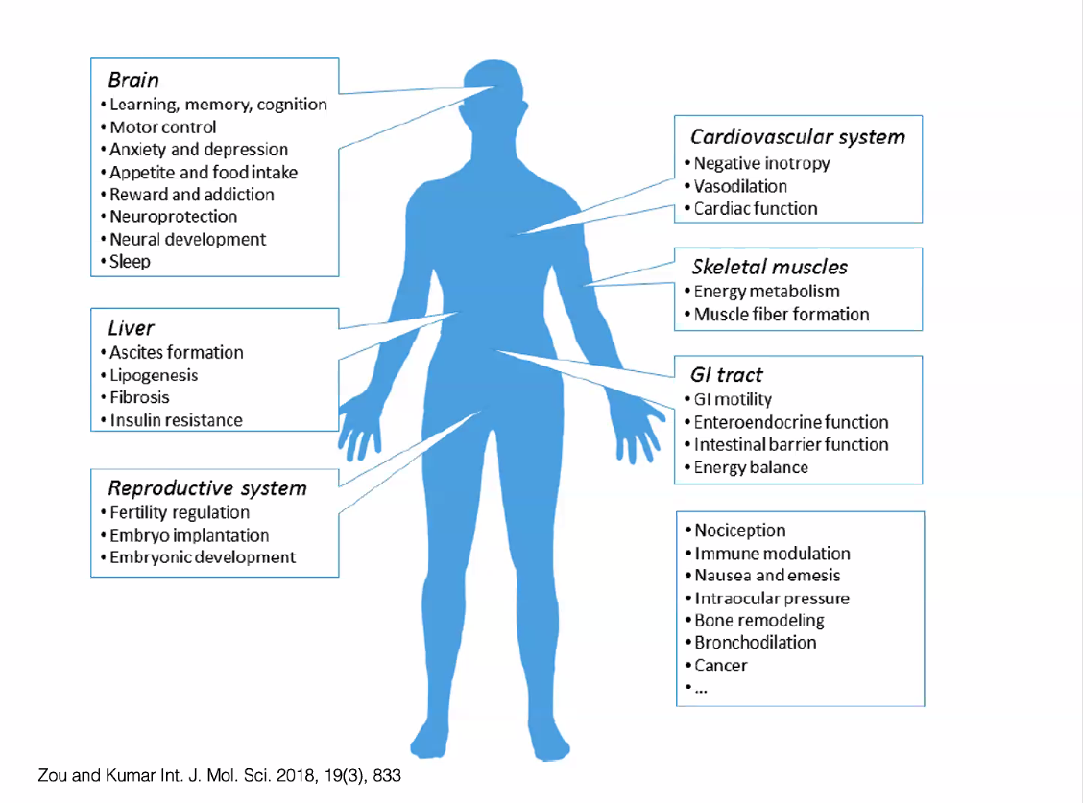
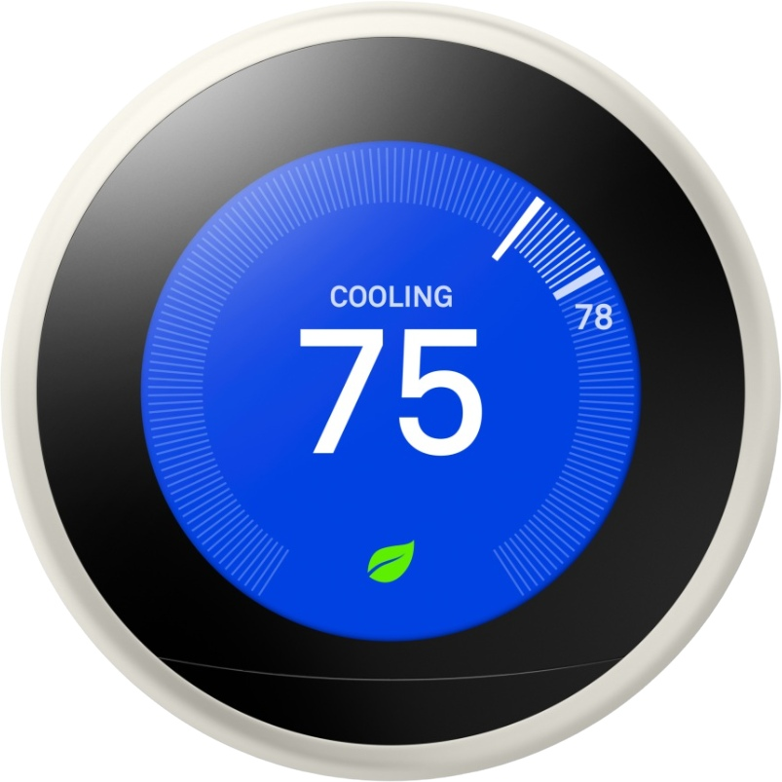
THE ENDOCANNABINOID SYSTEM
Notes:
Gastrointestinal activity / metabolism
Cardiovascular activity
Pain perception
Modulation of neurotransmitter release
Maintenance of bone mass
Protection and growth of neurons
Immune function
Inflammatory reactions
Inhibition of tumor cells
Hormonal regulation

Slide 21
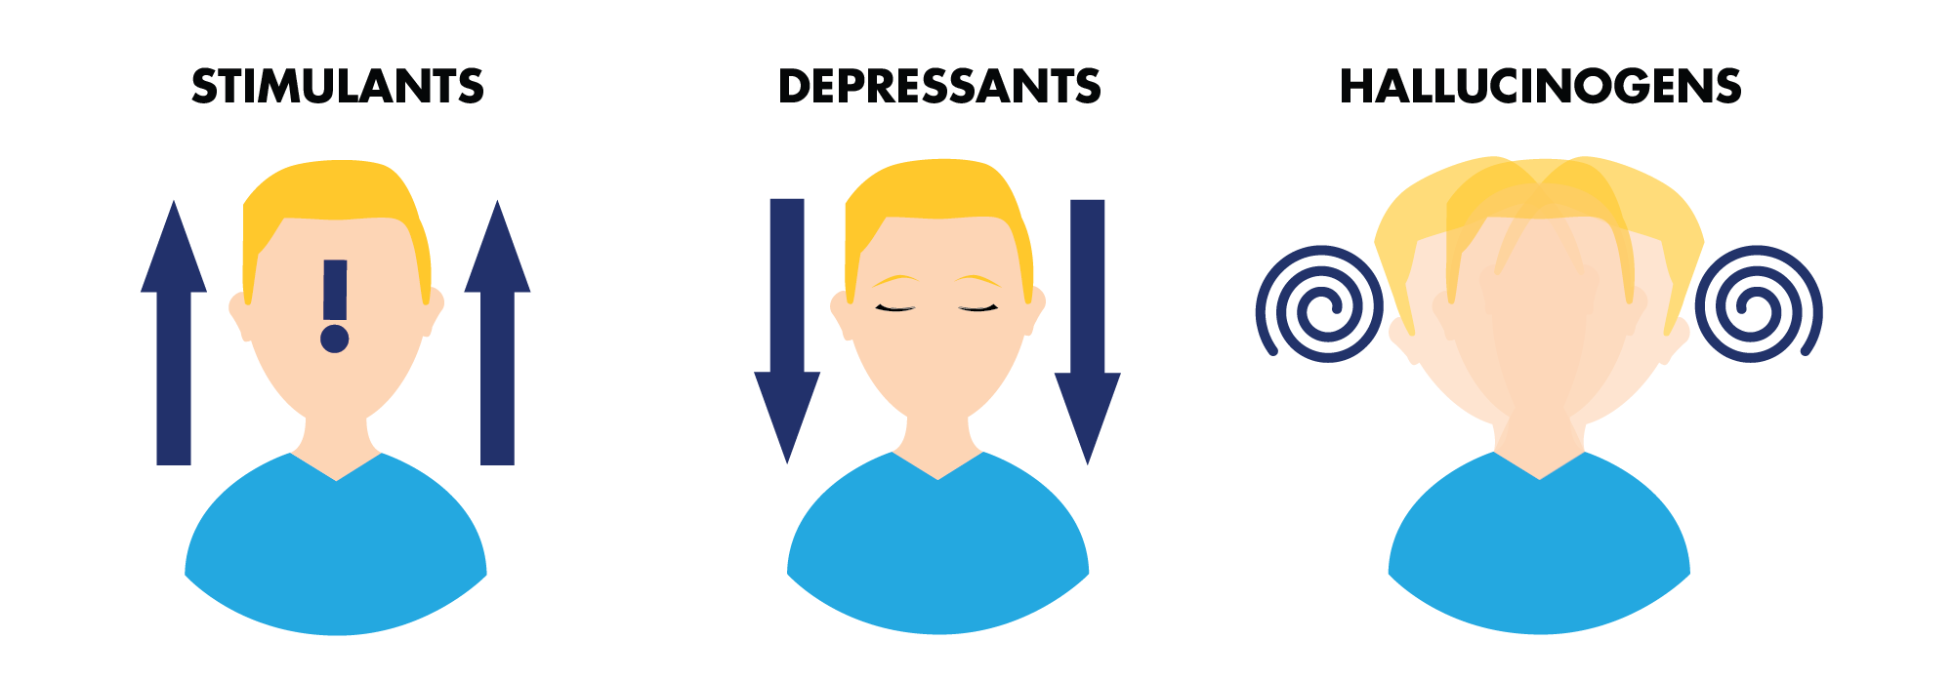
MIXED EFFECT DRUG
Notes:
Intoxicant
Stimulant
Depressant
Hallucinogen
Teratogen

Slide 22
PLANT & PERSON VARIABLES
DOSAGE
STRAIN
POTENCY / FREQUENCY
TERPENES
CANNABINOIDS
METHOD OF USE
ENVIRONMENTAL FACTORS
PRODUCT CONTAMINENTS
HISTORY OF MENTAL ILLNESS
GENETIC VULNERABILITES
METABOLISM / TOLERANCE
GENERAL PHYSICAL HEALTH
CHRONIC HEALTH CONDITIONS
SENSITIVITY TO TERPENES
GENDER / AGE
EXPECTATIONS
ENVIRONMENT

Slide 23
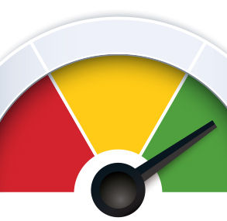
DOSE DEPENDENT EFFECTS
LOW – reduced anxiety, high, sense of calm or energy, munchies
MODERATE – impaired coordination, concentration, memory and judgement
HIGH – paranoia, high anxiety, perceptual changes and psychosis, persistent vomiting

Slide 24

WOODSTOCK 1969
National average for THC potency in 1969 was 1-3%
Today’s cannabis is a completely different substance.
Notes:
Potency remained pretty low into the 80s and 90s – 4-5 %
2008 – 10%
2014 – 12%
2018 – 18 -20%
Present day – 30% for flower 80-90% for dabs / concentrates

Slide 25
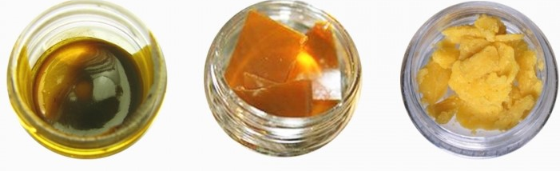
POTENCY MATTERS
THC levels above 18% are considered HIGH
Most street weed contains approx 30% THC or higher
THC oils (shatter, wax, dabs) can contain up to 80-90% THC

Slide 26

“SYNTHETIC” CANNABINOIDS
Delta 8
Delta 10
THC-0
HHC
THCP
K2 /SPICE
Notes:
HHC = hexahydrocannabinol similar to THC. Semi synthetic. Found in trace amounts in the cannabis plant and modified.
THCP = 9 tetrahyrocannabiphorol. Most potent cannabinoid. Stronger than THC but does not produce hallucinations
DELTA-8
Delta-8 is more similar to THC than CBD
“hazy” legality when first on the market
Primarily extracted from hemp derived CBD.
Unwanted or negative side effects are the same at THC. Safe dosing is unclear.
Very little research on Delta-8 to date and is an unregulated product.
Recently placed on DEA list as a schedule 1 drug and is now considered illegal because it is not naturally derived and can only be obtained synthetically
CAUTION
U.S. Cannabis Council trade group and other researchers found high levels of intoxicants in several of the products, as well as metals in some of them.
Delta-8 is particularly concerning to some scientists because it can be easy to make. Users can simply mix over-the-counter CBD with battery acid, pool chemicals or even household vinegar to produce it, although there are methods that don’t use acids.
Uptick in poison reports and hospitalizations
DELTA-10
Delta-10 is a cannabinoid found in trace amounts in the cannabis plant. Like regular THC, it can get you high, but it is less potent than Delta-9. This makes it similar to Delta-8.
CBD oil is first extracted from legally grown hemp. The resulting oil is processed into either delta-10 THC or delta-8 THC. Delta 8 and 10 are sometimes combined in the same product.
Delta-10 is commonly reported to provide energizing effects
Delta-8 is reported to be more sedating.
CAUTION - Delta-10 THC is not easy to manufacture. It must be refined extensively, so you usually don’t see it in abundance. If you see a product out there that says 99% delta-10, don’t believe it.
THC-O
Created by chemically converting CBD into either Delta 9 THC or Delta 8 THC, and then converting those cannabinoids into their acetate ester form, which is called THC-O
More intoxicating than the Deltas because it binds more tightly to receptors which can create more psychedelic / hallucinogenic effects
thermal degradation can cause the formation of a dangerous lung toxicant called ketene
Vitamin E acetate (a common vape filler) when over heated can also create ketene
Is also NOT considered legal by the DEA as it is not naturally occurring the hemp plant
THC-O is considered a “pro-drug” so the effects take longer (20-60 minutes) and are not experienced until it is fully processed by the body
a synthetic compound derived from hemp called THC-O acetate—often referred to simply as THC-O (pronounced “THC oh”)
THC-O’s appeal lies in its potency and its legal status. Research has found that it’s roughly three times stronger than conventional THC. It has been called “the psychedelic cannabinoid” for its borderline hallucinatory effects.
Because it’s derived from federally legal hemp, THC-O products are becoming increasingly popular in the states where consumers don’t have access to legal, state-licensed delta-9 THC products.
While THC-O products like vape carts and tinctures are available for purchase online, both their legal status and their safety remain unproven.

Slide 27
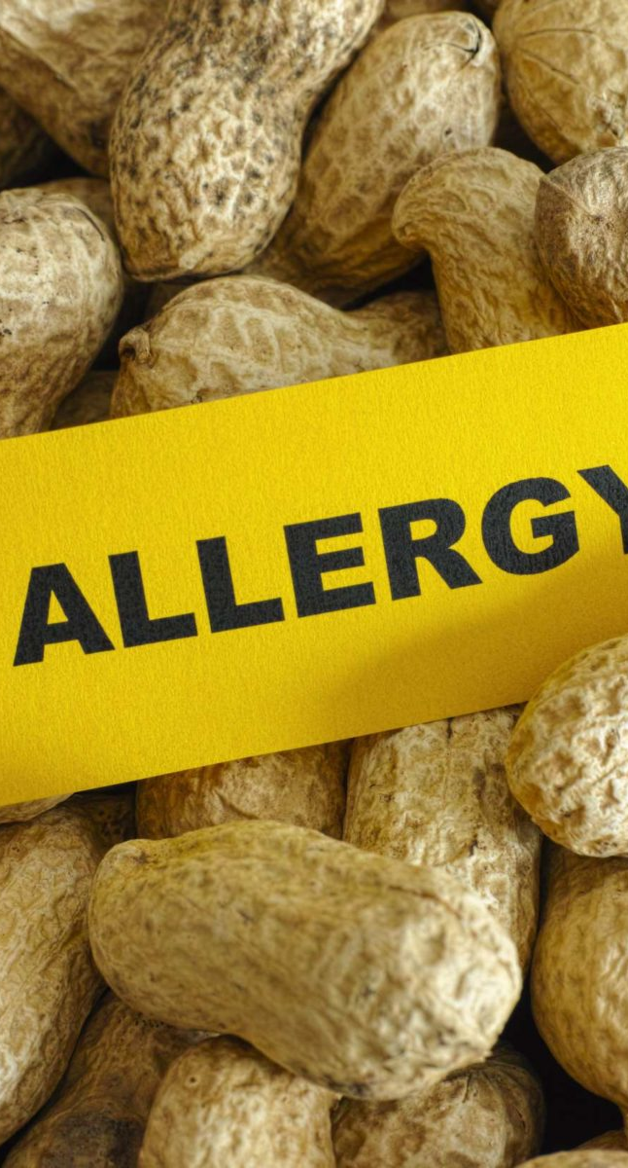

POT & PEANUTS
MOST people will not have an adverse reaction
SOME people will experience transient breaks from reality
SMALL group of people will require treatment and develop a psychotic disorder
Notes:
High potency THC poses the greatest risk

Slide 28
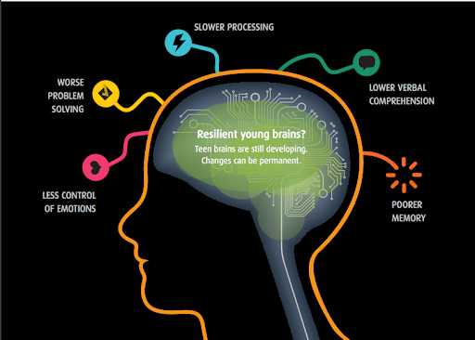

Slide 29
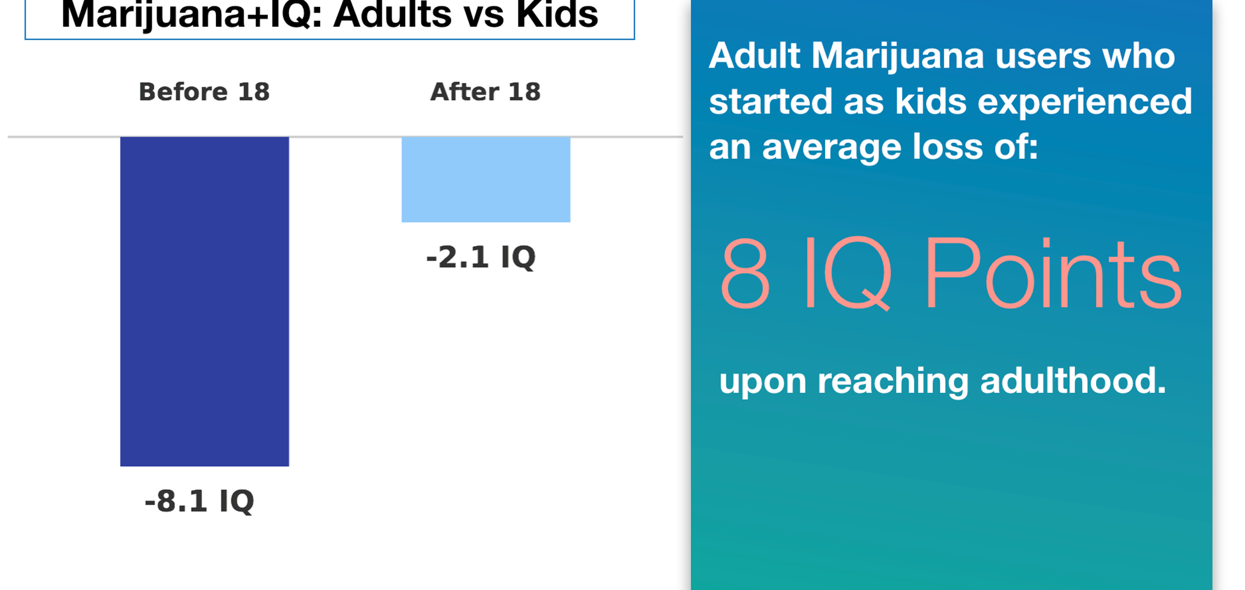
Notes:
Does not mean that if you are over 25 you are free and clear.
Regular / Heavy users in middle age can experience up to 5 point IQ drop
Increased risk of early dementia

Slide 30
WHO IS AT RISK?
Early cannabis users
Frequent “chronic” users
High potency users
Family history of mental illness
Family history of substance use
Stressed out / Poor coping
Preexisting mental health issues
Notes:
Age is a key risk factor for developing a cannabis use disorder
NIDA researchers found that 10.7% of teenagers between the age of 12 and 17 developed cannabis use disorders, versus 6.4% of young adults between the age of 18 and 25.
Adolescents may develop addiction faster than adults
YOUTH TALK TO YOUR ADULTS – ADULTS TALK TO YOUR YOUTH about family history of SUD/MH so everyone can make the most informed choices based on history and genetic factors

Slide 31
CANNABIS TRENDS
Strong black / gray market sales
Underage sales without enforcement / penalty
Dabbing high potency oils, waxes and resins
Decline in smoking flower
Increase in edible use
Risk of contamination
Youth and parent perception of safety
Unintended ingestion at home and school
Lack of parental awareness regarding safe storage
Notes:
Greater presence of cannabis in the school setting

Slide 32
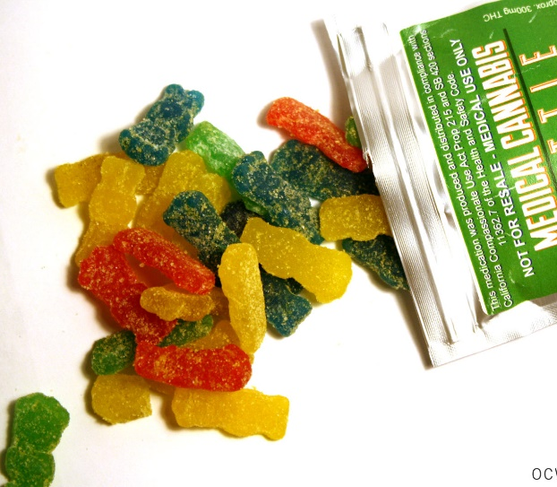
ARE EDIBLES LESS HARMFUL
Intoxication effect from inhalation can last roughly 1-2.5 hrs. as opposed to ingestion which can last from 4 – 12 hrs.
Same blood levels achieved as smoking, just over a different time course
We’re still learning about the possible long-term effects of ingesting cannabis

Slide 33
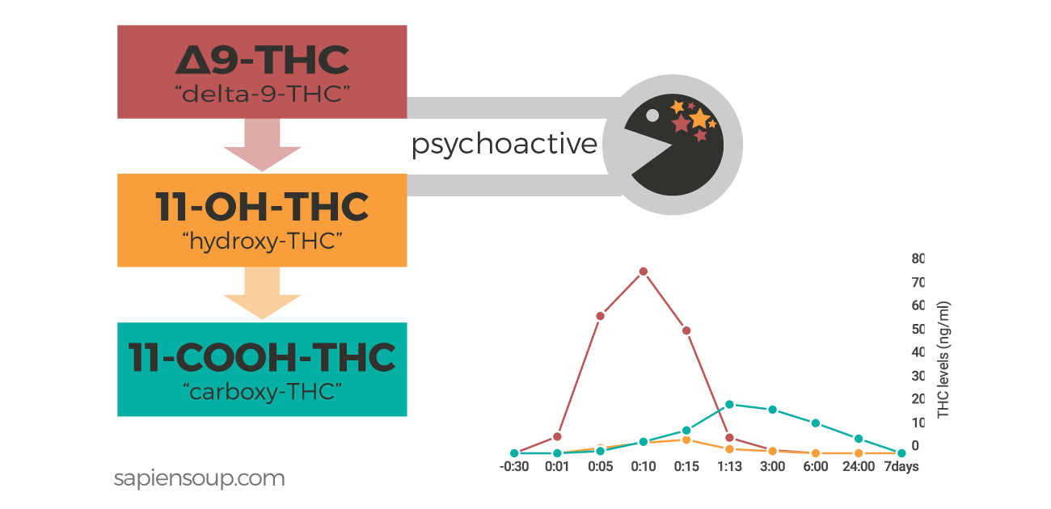
Notes:
When ingested, THC is metabolized through the liver and broken down into metabolites. 11-OH-THC is a metabolite formed within the human body after ingestion
Highly psychoactive – even more so than THC in some cases!
These metabolites can be 10 x higher with edibles vs. smoking / vaping
Some people will have over 3 x more 11-OH-THC in their blood than THC after ingestion!
11 Hydroxy gets people higher, faster, and longer than THC

Slide 34
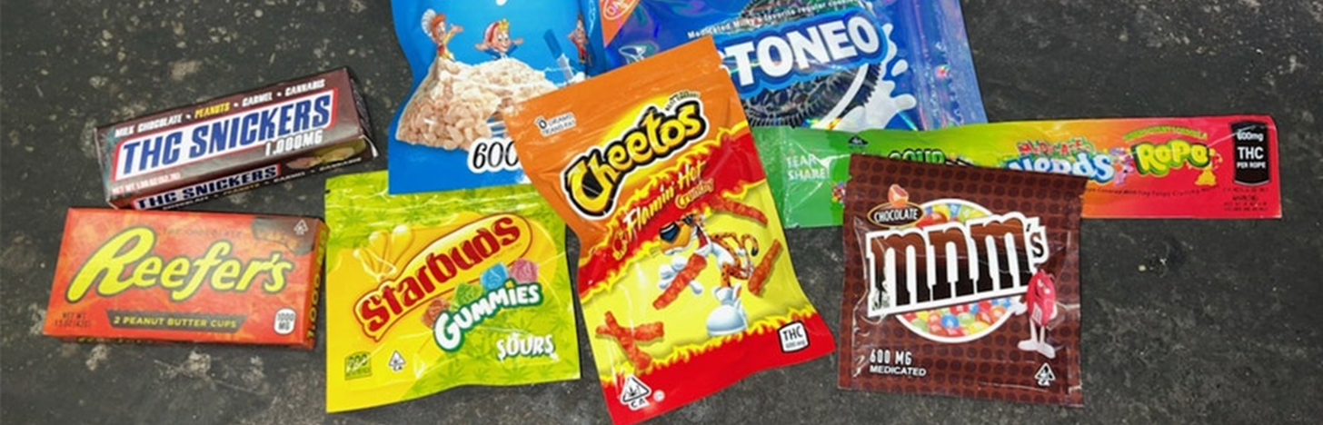
KIDS DON’T KNOW THE DIFFERENCE

Slide 35
INTOXICATION AT SCHOOL – 911
Unintended ingestion with cannabis naïve individual
Loss of consciousness / alertness
Neurological effects – seizure and coma in severe cases
Respiratory issues – respiratory depression
Cardiovascular effects – rapid heart rate or hypotension
Drowsiness, lethargy, vomiting , Cannabis induced Hyperemesis (CHE)
Psychosis – is not a typical response
Confiscate and test the vapes - Send to Roswell

Slide 36
VAPING BRIEFING
LOST IN THE CLOUDS

Slide 37
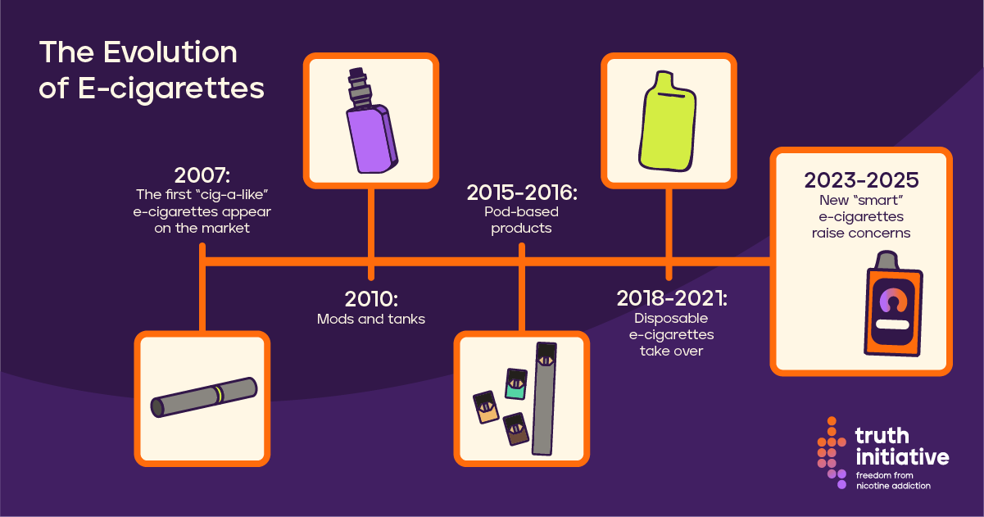

Slide 38
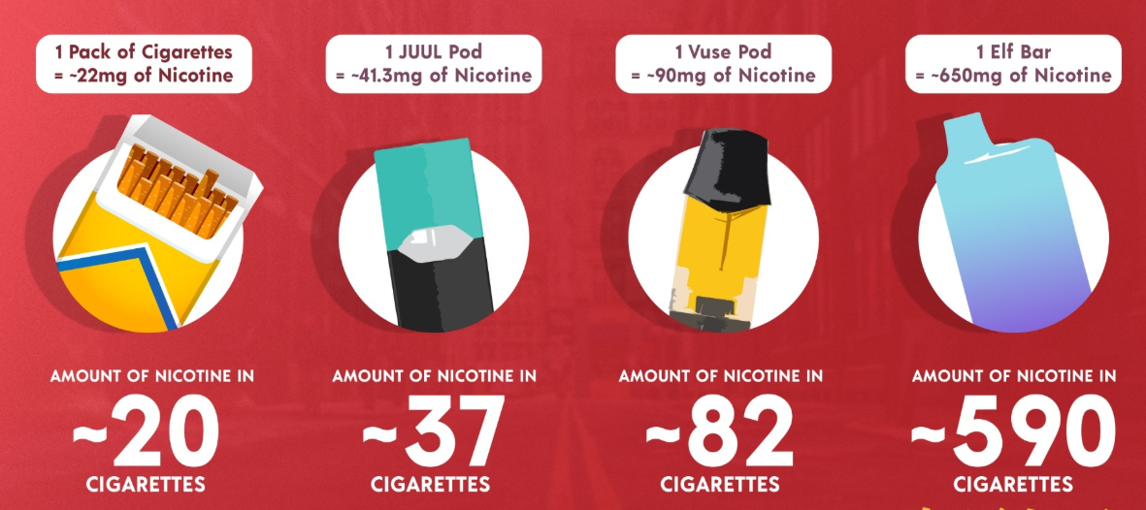

Slide 39

Vaping Epidemic
According to the CDC, In 2024, e-cigarettes were the mostly commonly used tobacco product among middle and high school students in the US
1.63 million (5.9%) of students currently use e-cigs
29% of teens who vape reported daily use
89% of teens who vape use flavored products
Co-Use (cannabis & nicotine) trend is on the rise with 1 in 3 students who have ever vaped also reporting cannabis use
Notes:
CDC data

Slide 40
VAPING TRENDS
Repurposed, refilled and unregulated vapes
Non rx use of NRT to avoid vaping at school
Youth vaping rates declined from 7.7% in 2023 to 5.9% in 2024
One of the most common causes of school suspensions
May be experiencing severe nicotine dependency
Nicotine withdrawal is impacting daily functioning
Need to improve access to quit supports
Notes:
Vaping is most common among ages 13-40. Chance are very high that if you become addicted to nicotine as

Slide 41
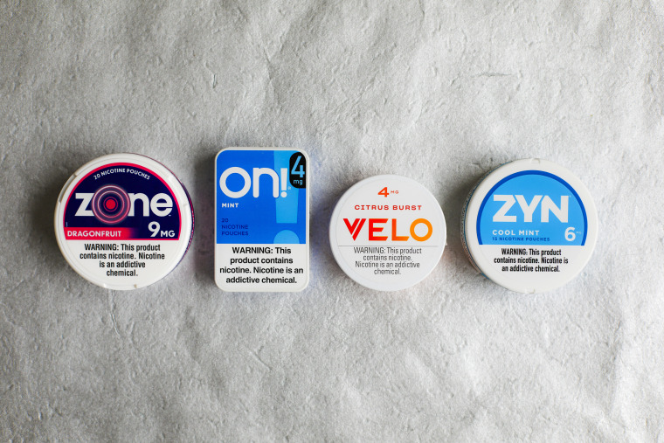
ORAL NICOTINE
Youth declining tobacco use or vaping during assessments and later disclosing oral use of pouches
TikTok “Zynfluencers”
3-6 mg nicotine per pouch
Lower Risk not No Risk
Nicotine toxicity / dependency
Nicotine infused toothpicks
Notes:
NYS Smokers Quitline – free smoking cessation supplies
Zyn pouches – do not contain cancer-causing chemicals and other toxic substances found in cigarette smoke.
Risks:
Addiction
Cardiovascular effects
Gum damage
Nausea
Appealing to kids
Sleeping with the pouches in mouth overnight
Nicotine Toothpicks & Pouches: Discreet, But Dangerous It's important to know that even when products are labeled as “smoke-free” or “tobacco-free,” they are not risk-free. Side effects and long-term health issues may include: Nicotine addiction. Tooth wear, staining, and discoloration.Oct 13, 2025

Slide 42
NICOTINE POUCH INGESTION
Reports of young children accidentally eating nicotine pouches rose 763% between 2020 and 2023.
134,663 cases of unintended ingestion between 2010 and 2023
Nausea and vomiting most common outcome
Can be severe consequences including seizures, respiratory failure, and death (particularly with liquid nicotine ingestion)
Nicotine pouch ingestions were 1.5 times more likely to lead to serious medical outcomes compared to other nicotine products.
Notes:
Study in Pediatrics journal
Analysis of Poison Control data
6 – 15mg nicotine per pouch x 15 pouches = 90 mg nicotine if the entire container is consumed.

Slide 43
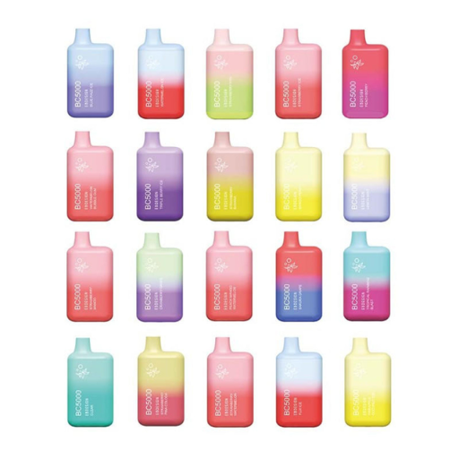
VAPE FLAVORS
Menthol, mint, mango, dessert, candy
Inhibit nicotine metabolism = you need to vape more
Suppresses lung irritation = so you can inhale more
Decrease immune function
Increase inflammation
All designed to increase nicotine dependency
Popcorn Lung and EVALI

Slide 44
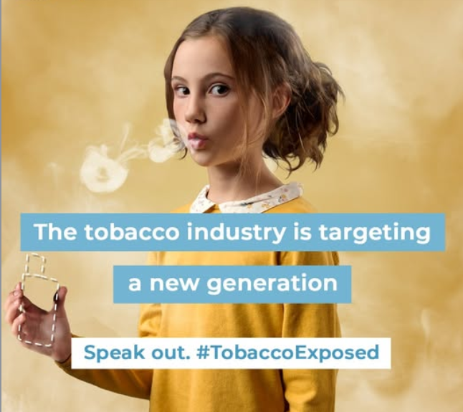
Notes:
Tobacco products kill 8 million people a year. They need the next generation to become the “replacement” smokers.

Slide 45
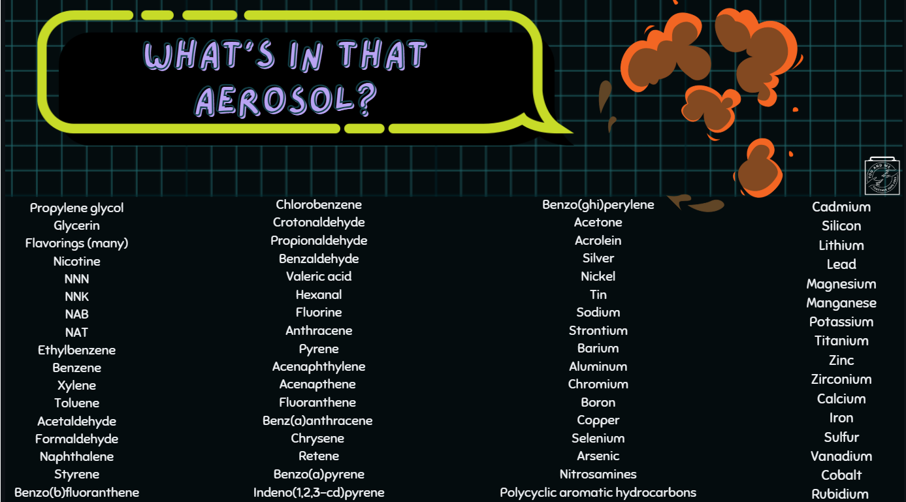

Slide 46
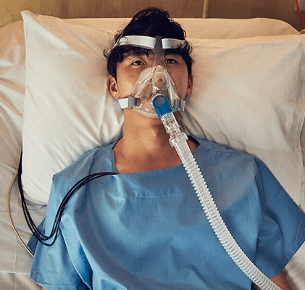
Every Hit is a Hit to Your Health
The harmful chemicals can expose other people or animals through the respiratory system, ingestion, and skin exposure
Exposure can lead to cancer, respiratory infections, can cause asthma to worsen, lung collapse, among other problems
Exposure is most prevalent at HOME

Slide 47

SECONDHAND AEROSOL MAKES KIDS SICK
More bronchitis and pneumonia
More wheezing and coughing
More ear infections
More severe, frequent asthma
Higher risks of SIDS for infants exposed in utero or after birth

Slide 48
Third Hand Aerosol Pollution
Remains in indoor reservoirs
Re-emitted back into the gas phase
Re-suspended in dust
Re-acts with oxidants to yield potentially harmful byproducts
Exposure can last hours, days, months, or years

Slide 49
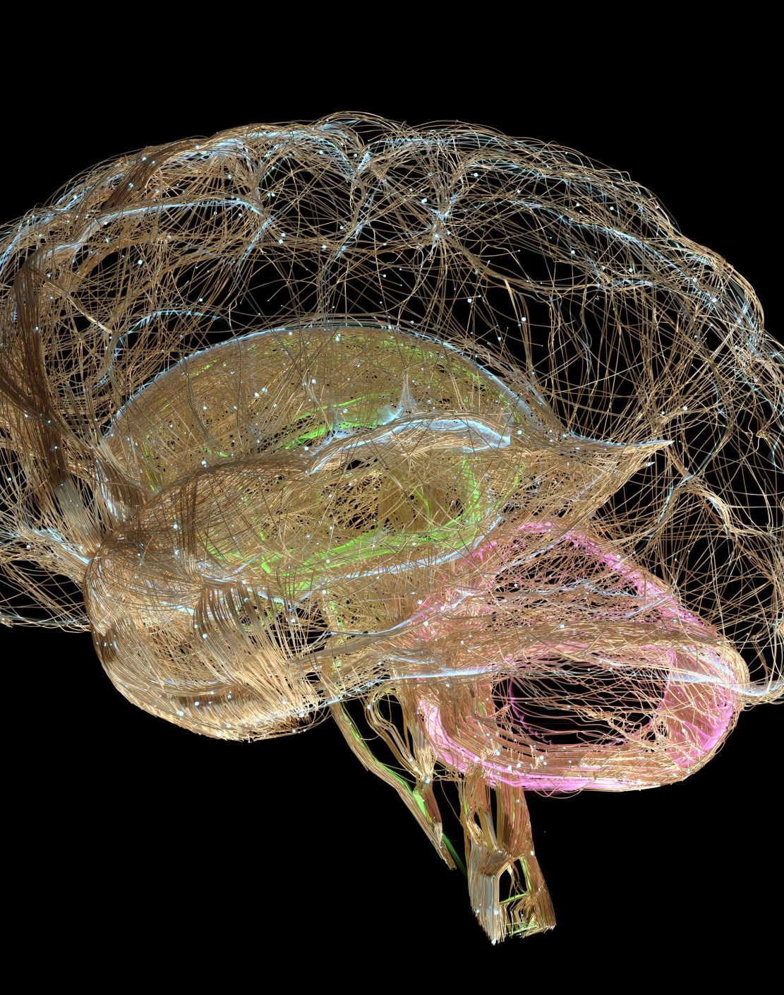
HARMS TO THE DEVELOPING BRAIN
Restricts blood flow to the brain
Severe addiction and dependence
Prematurely ages the brain
Worsen existing MH symptoms
Nicotine harms parts of the brain responsible for:
Attention
Learning
Mood
Impulse control
Notes:
American Association of Pediatrics presentation – Bonnie Halpern-Fletcher
Primes the brain to expect passive dopamine hits rather than youth “earning” their dopamine through natural rewards.

Slide 50
COPING COACH
Language matters – Found vs. Caught
Validate the dependency and the challenge of change
Educate on the symptoms of withdrawal
Teach coping skills
Urge surfing
Mindfulness
The 3 Ds (delay, distract, decide, deep breath
HALT (Hungry, Angry, Lonely, Tired)
Watch for signs of psychiatric instability
Love your Lungs kit

Slide 51

THANKS & THC-YOU LATER
Questions
Comments
Feedback

