Slide 1

Strengthening Mental Health Outcomes for School-Aged Children Through Evidence-Based Approaches
Wafa El Solh (she/her), Public Health Educator
Suzanne Canfield (she/her), Project Coordinator
February 26, 2026
Notes:
Our introductions and express our gratitude for being here today.

Slide 2
AGENDA
Introductions
Overview
Social Determinants of Health
Youth Mental Health Focus
Activity 1
School-based Equity Approach
Activity 2
Conclusion
Notes:
This is an overview of our presentation for the day. As we progress through please feel free to ask any questions as they come and we will do our best to answer them. There will also be time at the end and we are around afterwards if you want to discuss anything further.

Slide 3
Overview

Slide 4
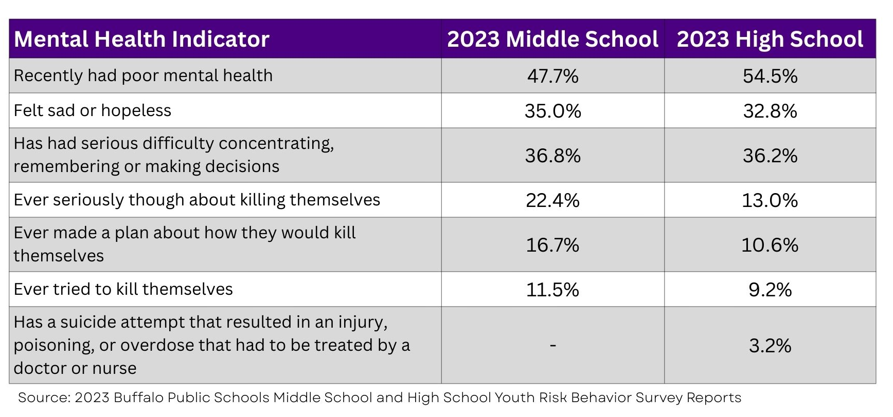
Why Youth Mental Health Matters
Notes:
So let’s talk about why this matters, why we’re here today.
Data from the CDC, American Academy of Pediatrics, and other health organizations indicate that rates of youth mental health challenges in the US are at historic highs, with significant increases in anxiety, depression, and suicidal ideation over the past decade.
Locally, according to the Buffalo Public School Youth Risk Behavior Survey (BSYRBS) completed in 2023 we see a response from 2 different groups of students, one in the middle school and one in the high school who experience these thoughts and behaviors. As you can see, there is a high rate of response of middle school aged youth and high school youth for recently having poor mental health for reasons such as mental health not being addressed at an early age and high levels of academic stress and social stress.
Nearly half of middle school age youth and more than half of high school age youth said they recently had poor mental health. Additionally, more than 1 in 10 middle school age youth and nearly as many high school age youth reported that they have tried to kill themselves.

Slide 5
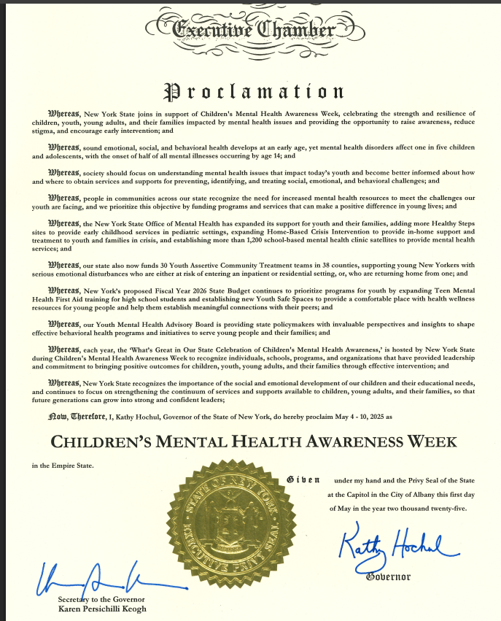
Gov. Hochul recognized Children’s Mental Health Awareness Week in May 2025
Notes:
We just saw the high rates of poor mental health and suicidal ideation among students in Buffalo. Those figures are also high across New York State, prompting Gov. Kathy Hochul to recognize Children's Mental Health Awareness Week in May, which is Mental Health Awareness Month.
Children's Mental Health Awareness Week recognizes the highly stigmatized issue of mental health and highlights how "sound emotional, social and behavioral health develops at an early age, yet mental health disorders affect 1 in 5 children and adolescents, with the onset of half of all mental illnesses occurring by age 14."
Youth Mental Health Awareness Week is a great opportunity for educators and administrators to uplift this proclamation with a dedicated mental health support activity during this time.
It is worth noting that Gov. Kathy Hochul announced on January 5, 2026 the expansion of the Teen MHFA curriculum to all 10th grade High School students and Youth MHFA for adults who work with youth which is a safeguard to protect our students. More to come from NYS guidance on how this will be implemented in schools.

Slide 6
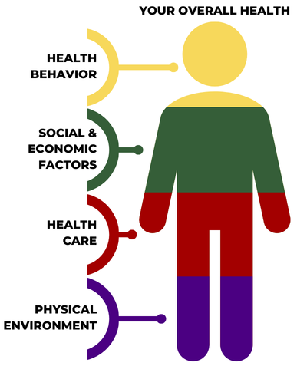
What are SDOH?
The social determinants of health (SDOH) are factors that can influence your health and health behaviors. These factors have a big impact on health and are changed through policy, programs, and power.
Health disparities are preventable differences in the rates of disease, injury, violence, or opportunities to achieve optimal health that are experienced by communities that have been disadvantaged by their social or economic status, geographic location, and environment.
Notes:
As we begin our deeper dive into the mental health realm, it's important to recognize the SDOH and how they affect mental health particularly in the youth we are talking about today.
These factors strongly affect the youth mental health, and we will go into more detail in the upcoming slides.
[read the first point from the slide]
The World Health Organization (WHO) defines social determinants of health as “the conditions in which people are born, grow, live, work and age, and people’s access to power, money, and resources.” These nonmedical factors can influence your health and health behaviors and have a significant impact on health disparities.
SDOH factors are out of your control. Data shows that these factors have more of an impact on a person's health than individual health behaviors like diet and exercise.
[read the second point from the slide]
Health disparities are preventable differences in how many people get sick and how bad the sickness is if they get the illness. Health disparities can be found across ZIP codes, race and ethnicity, age, sexual orientation, social and economic status, education level, and more. They occur when factors have more negative outcomes with certain communities, such as Black and brown communities, LGBTQ+ communities, and rural communities, in higher proportions.
If you are interested in tools that explain the social determinants of health and health disparities, check out resources listed on erie.gov/health-equity, including the publication, Let's Talk About Health Equity and this SDOH graphic, available for print or download.
Full definition with source for reference only.: Health disparities are preventable differences in the burden of disease, injury, violence, or opportunities to achieve optimal health that are experienced by populations that have been disadvantaged by their social or economic status, geographic location, and environment. Many populations experience health disparities, including people from some racial and ethnic minority groups, people with disabilities, women, people who are LGBTQIA+, people with limited English proficiency, and other groups.
HTTPS://WWW.CDC.GOV/HEALTHEQUITY/WHATIS/INDEX.HTML)

Slide 7
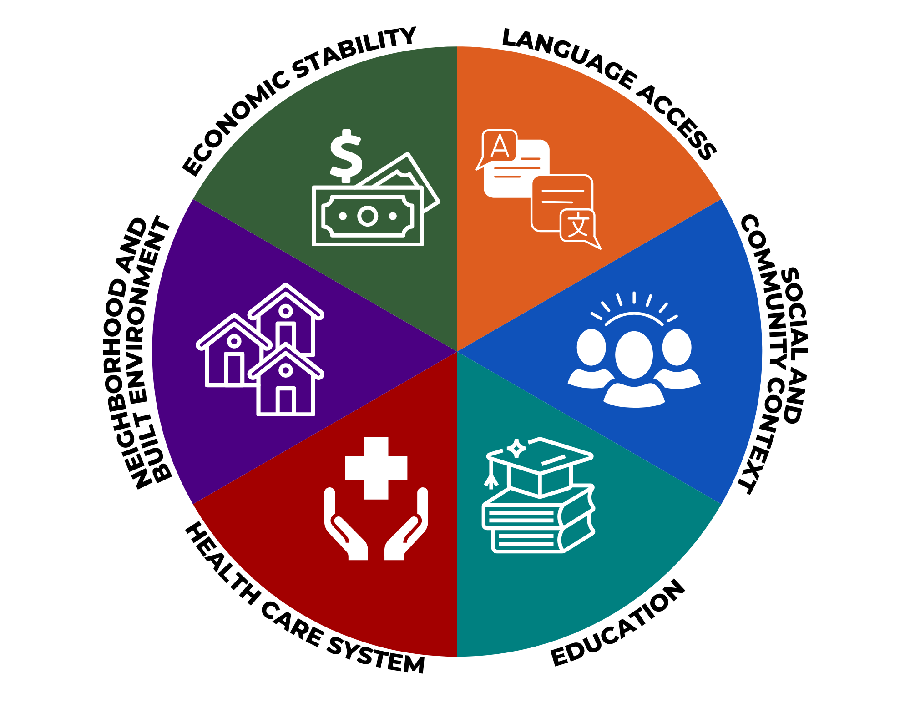
Factors that Influence Your Health
Housing instability and food insecurity
Access to English as a new language
Adverse Childhood Experiences (ACEs)
Neighborhood poverty
Poor access to health care
Low educational attainment
Notes:
The social determinants of health, or SDOH, are factors that influence your health that are out of your control include:
Economic stability such as:
Housing instability
Food insecurity
Unemployment or job insecurity
Poverty and income inequality
Poor access to transportation
Neighborhood and build environment factors such as:
Adverse built environment
Neighborhood poverty
Neighborhood disorder
Pollution
Global climate change impact
Health care system factors like poor access to health care, health literacy, and health care availability,
Language access factors like access to English as a new language, translation, and interpretation,
Social and community context factors like
Adverse Childhood Experiences (ACEs)
Discrimination or social exclusion
Exposure to violence
Criminal justice involvement
And education factors like access to early childhood education and low educational attainment.
These factors are also interconnected. For example, housing instability and neighborhood poverty can impact access to health care, which impacts access to diagnosis and treatment, which in turn can impact educational attainment, all of which can affect a student's mental health and overall health.
We know that students who are Black and brown, LGBTQIA+, or who live in rural areas experience these underlying factors differently than their peers, keeping them from reaching their full health potential when it comes to not only physical health and lifespan but also mental health. This means that these students may be in the same classrooms with the same teachers as their peers but having completely different life experiences and a different educational experience.

Slide 8
Youth Mental Health Focus
Notes:
To take a closer look at youth mental health across Erie County, we are going to look at data from HEALTHeLINK, a local health information exchange that securely shares health information among medical providers for all of Erie County, about youth ages 0-17 from 2020-2024 in the few next slides.
We will look at the top 3 diagnoses among youth 0-17: anxiety, ADHD, and depression. You will see these data broken down by race and that diagnosis rates are high among all youth regardless of race breakdown.

Slide 9
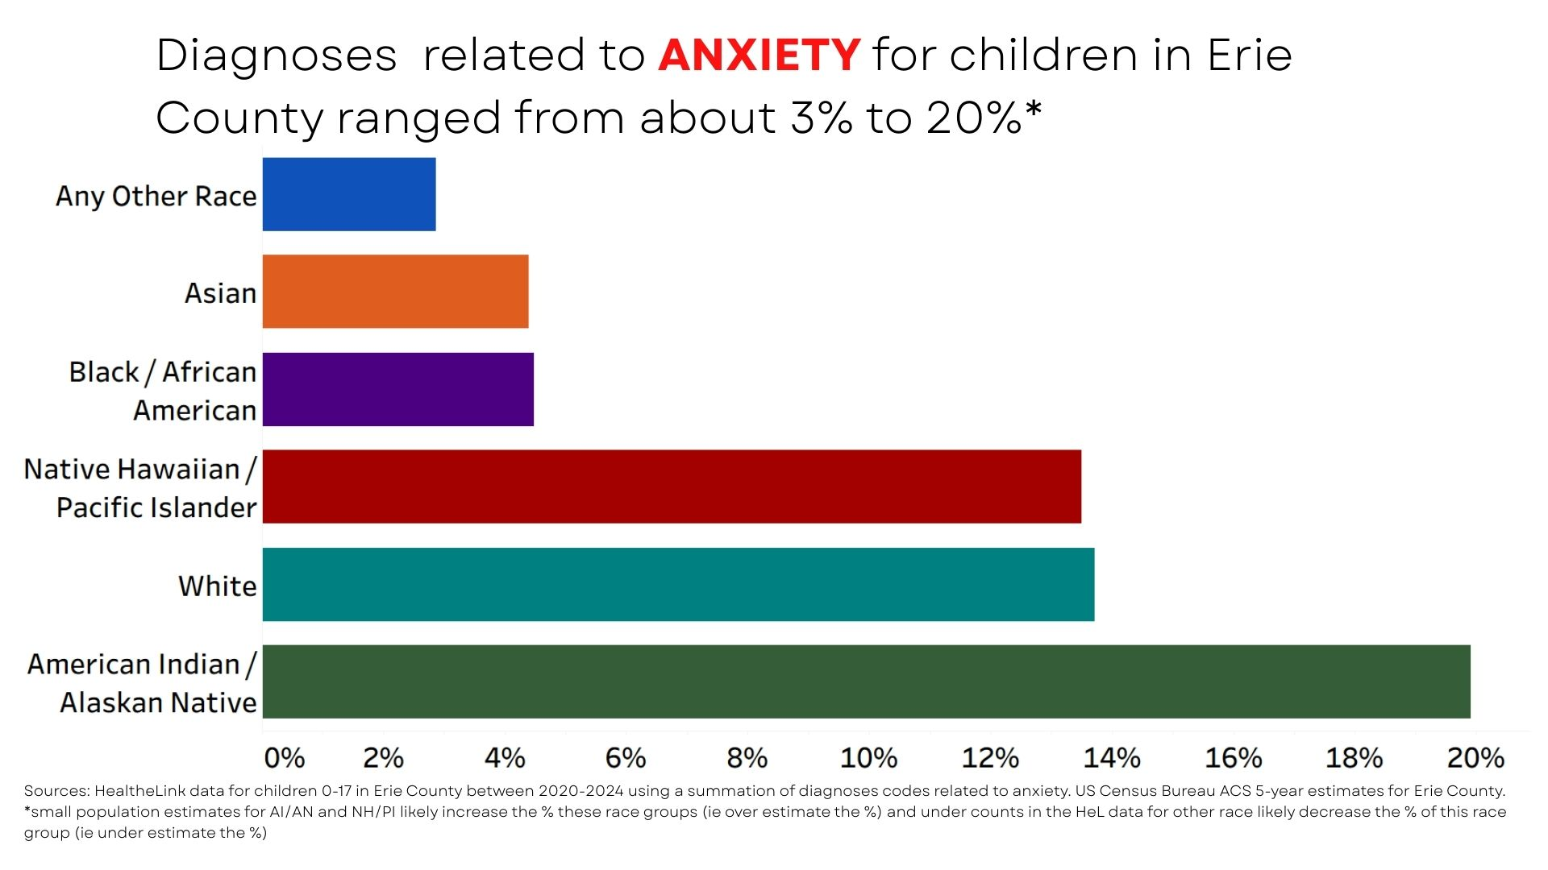
Anxiety Diagnoses for Youth in Erie County
2020-2024
Notes:
We know anxiety—and other mental health diagnoses—are underdiagnosed in minority populations due to barriers within the factors that influence health that we will discuss a little later.
AI/AN and NH/PI are very small group estimates so those percentages are likely inflated.
The roughly 3x higher rate of anxiety dx in White children compared to Black and Asian children likely reflects the disparities in access to primary and specialty care.
There is a High Discrepancy in all 3 upcoming slides between those receiving a mental health diagnosis vs. the youth self-reporting poor mental health

Slide 10
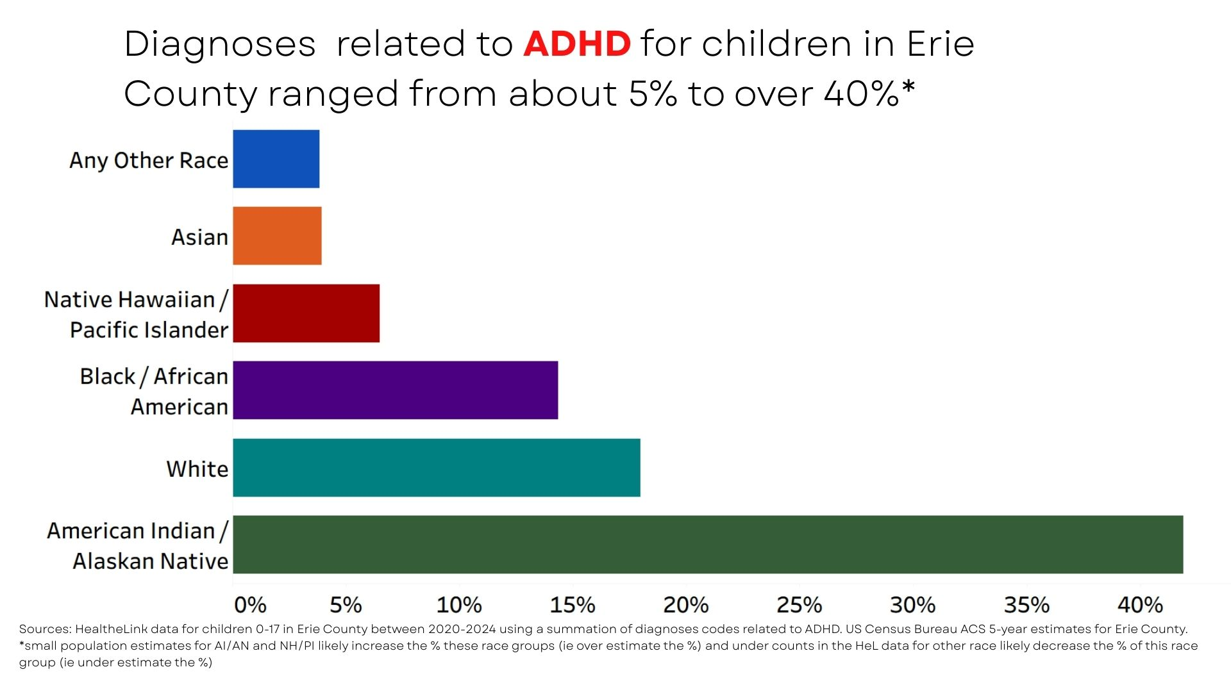
ADHD Diagnoses for Youth in Erie County
2020-2024
Notes:
Why is the percentage for ADHD so much higher than those for depression and anxiety? Teachers are generally more trained and better equipped to identify ADHD compared to anxiety and depression. Because ADHD manifests as externalized, disruptive behaviors (hyperactivity, impulsivity, inattention) that directly interfere with classroom management, teachers identify these symptoms more easily and accurately than internalized, quiet symptoms like anxiety or depression.

Slide 11
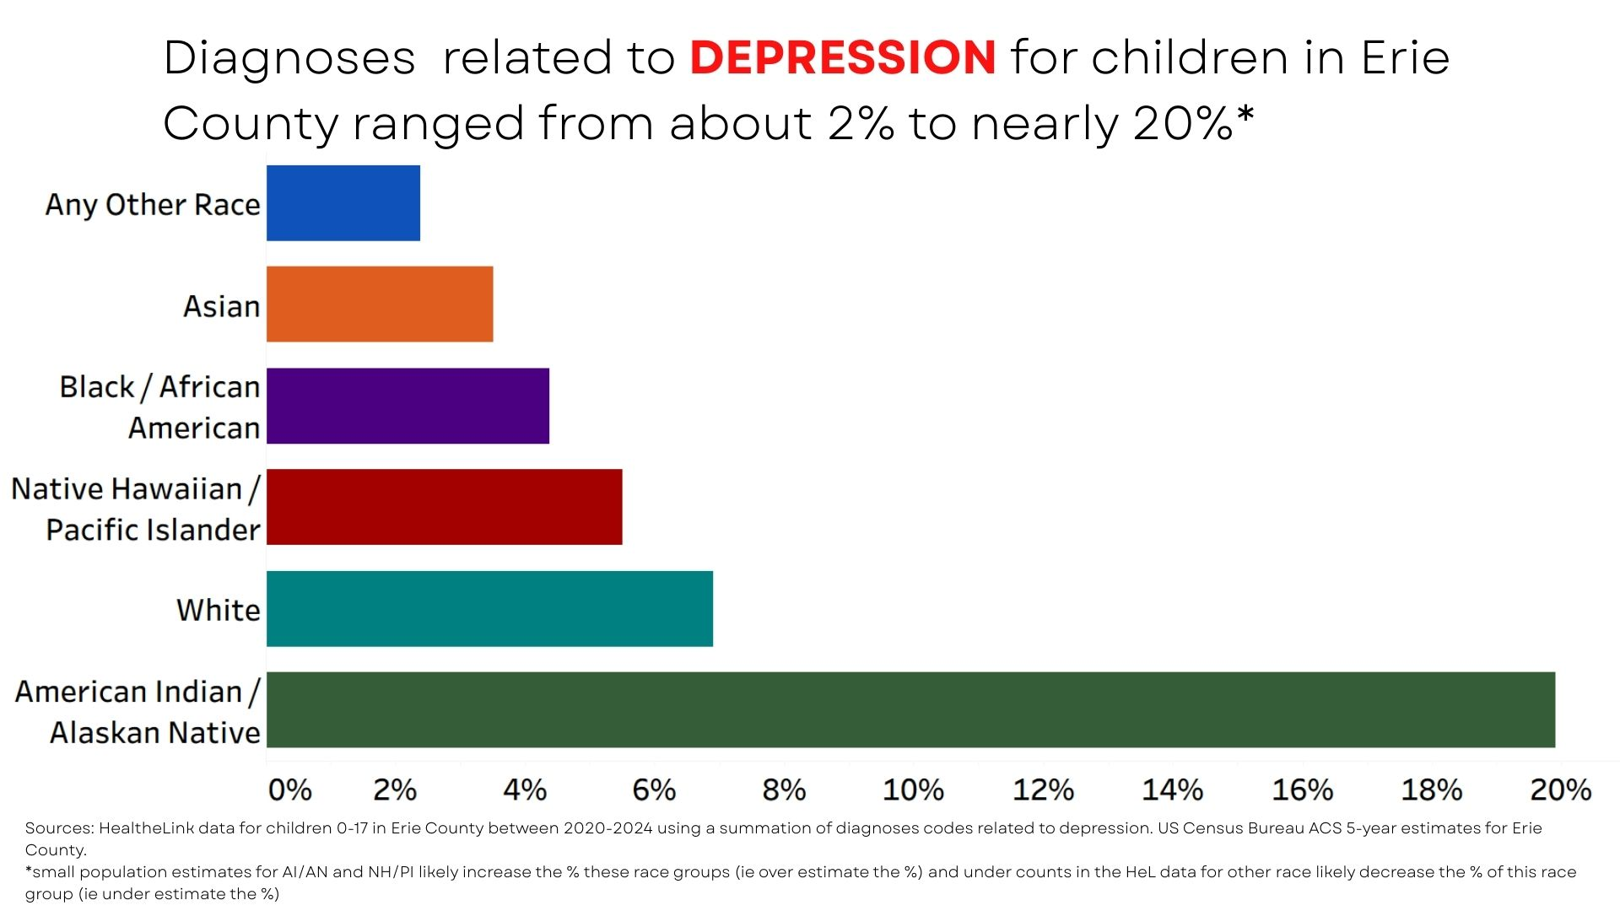
Depression Diagnoses for Youth in Erie County
2020-2024
Notes:
And lastly for Depression diagnosis in Erie County, ages 0-17, we can see that diagnoses overall are lower but still evident and can be primarily because symptoms—such as irritability, acting out or academic decline are often mistaken for normal teenage moodiness or behavioral problems.
Diagnosing depression in youth is often considered more challenging than ADHD due to high symptom overlap (concentration, mood), the inability to distinguish between the two when co-occurring, and the internalizing nature of depression. While both share symptoms like poor focus and low motivation, ADHD typically appears earlier, whereas depression is often masked by ADHD symptoms or develops as a secondary reaction.

Slide 12
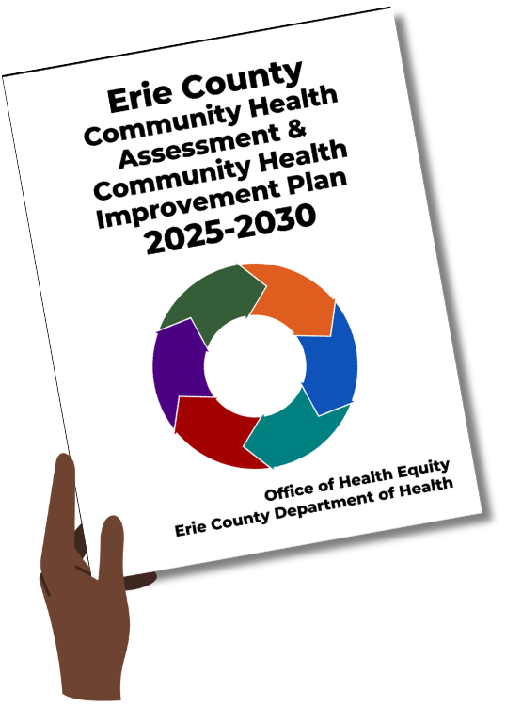
Erie County Community Health Assessment &
Community Health Improvement Plan
The Community Health Assessment (CHA) provides a comprehensive review of the health and well-being of the people who live in Erie County.
The Community Health Improvement Plan (CHIP) details interventions and strategies to address these priorities, including asset mapping related to multiple priorities, campaigns to raise awareness of existing resources, and pilot programs.
For more information, visit: erie.gov/CHA
Notes:
[read all contents of slide]
Together, the Community Health Assessment (CHA) and Community Health Improvement Plant (CHIP) summarize the information about the county’s current health status, needs, and issues; and then plan where resources should be used to best meet the community’s needs. This is shared with community partners and is available for anyone to view, we will provide a direct QR code at the end of the presentation as well.

Slide 13
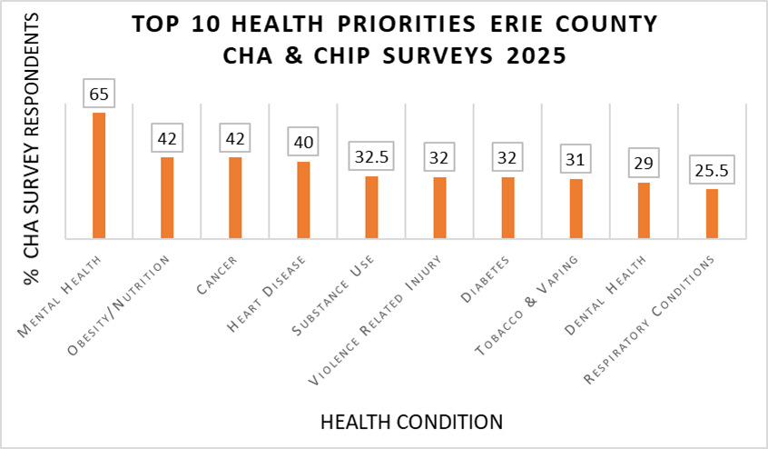
Community Health Assessment Survey
Notes:
In the 2025-2030 Community Health Assessment/Community Health Improvement Plan, Mental Health remains the top priority of Erie County.
Mental Health is the top priority listed in the Community Health Improvement Plan (CHIP). The 2022 racially-motivated shooting at Tops supermarket has amplified trauma and created a more urgent need for support, especially for students of color. Demand for services outpaces availability. The City of Buffalo has been a HRSA-designated Mental Health Provider Shortage Area since 2022. The Health Resources & Services Administration or HRSA ("HER-suh") is an agency of the U.S. Department of Health and Human Services that provides health care to people who are geographically isolated and economically or medically vulnerable.

Slide 14

Community Health Assessment Quotes
“There is a severe lack of appropriate and available mental health care for children and youth.”
- Health Care Provider Interview
“We can train kids in schools around mental health.”
- CYSHCN Family Interview
Notes:
As a part of the 2025-2030 CHA, the ECOHE held a series of community focus groups as well as interviews with health care providers and families. Quotes and other takeaways from these focus groups and interviews helped emphasize the importance of an increased focus on mental health, including youth mental health, across Erie County.
[read through contents of slide]

Slide 15

Community Health Assessment Quotes
“Mental health is a big thing and unfortunately, especially in the areas that a lot of us come from, mental health is not talked about. It’s not taken as seriously as it should be. So it would be nice if schools started implementing something concerning mental health to be able to identify when children are dealing with mental health issues and not being written off as [having] behavioral issues. To have someone to advocate for these children rather than pacify them, stating that they have something which may be misdiagnosed."
- New and Expectant Mothers​
Focus Group
Notes:
[read through contents of slide]

Slide 16
Community Health Assessment Takeaways
Health care providers as well as community members discussed how the cost of mental health care and inadequate insurance are barriers for many seeking care.
Several health care providers in addition to multiple community members noted stigma as a barrier to seeking mental health care.
Notes:
Some additional takeaways from the CHA include that [read through contents of slide]

Slide 17

Activity 1: Stress Signals
What are the stress signals you see in students?
Notes:
Option 1: Break out groups (10-12 min)
Break the room into three groups. (2 min) People supporting:
Elementary school students
Middle school students
High school students
2. On provided chart paper, write what are common stress or mental health signals you are seeing in students? (5 mins)
3. Debrief (6 mins) Ask a rep from each group to take 2 minutes to share some of their responses. Ask the next group to build on the previous group's list. SEE NOTES BELOW.
Option 2: Popcorn style discussion (4 min)
Ask the room the following questions: (2 min)
How many people in the room are supporting elementary school students? Middle school? High school?
Note: These groups are likely seeing vastly different stress signals.
2. What are some of the stress signals you are seeing in students at school? Suggest people just say their challenges aloud. Allow for 5-8 responses. If silence lingers or responses jumble, allow for time for raised hands and make your own suggestions.
Debrief (2 min) SEE NOTES BELOW.
Debrief:
Many of these signs or stress signals align with early signs and symptoms of a mental health challenge. A lot of times they are mistakenly seen as normal characteristics adolescent development. For example, tiredness or fatigue would be a stress signal. A lot of times fatigue is mistaken for a normal part of growing up or adolescent changes. Recognizing and addressing these signs and symptoms early on decreases the likelihood of a mental health crisis situation.
Note: Make sure absenteeism is mentioned as a compounding issue.

Slide 18
School-Based Equity Approach
Notes:
Thank you everyone for participating in that activity, now moving on to discuss school-based equity strategies to improve mental health among students.

Slide 19
Academic & Behavioral Impacts
Research has found that anxiety, depression, and mental health are the primary drivers for absenteeism.
*Mentalhealthamerica.org
Communities where students experience higher rates of poverty, transportation issues, or health problems have significantly higher rates of chronic absenteeism.
There are racial disparities in chronic absenteeism.
African American and Hispanic students are twice as likely to be chronically absent compared to White students.
*NYS Dept of Education 2022-2023 data
Notes:
Chronic absenteeism is when students miss 10% or more of school days.
[read through contents of slide]
This suggests that despite the lower rates of diagnoses we saw earlier, African American and Hispanic students are twice as likely to experience anxiety, depression, and mental health challenges compared to White students.

Slide 20
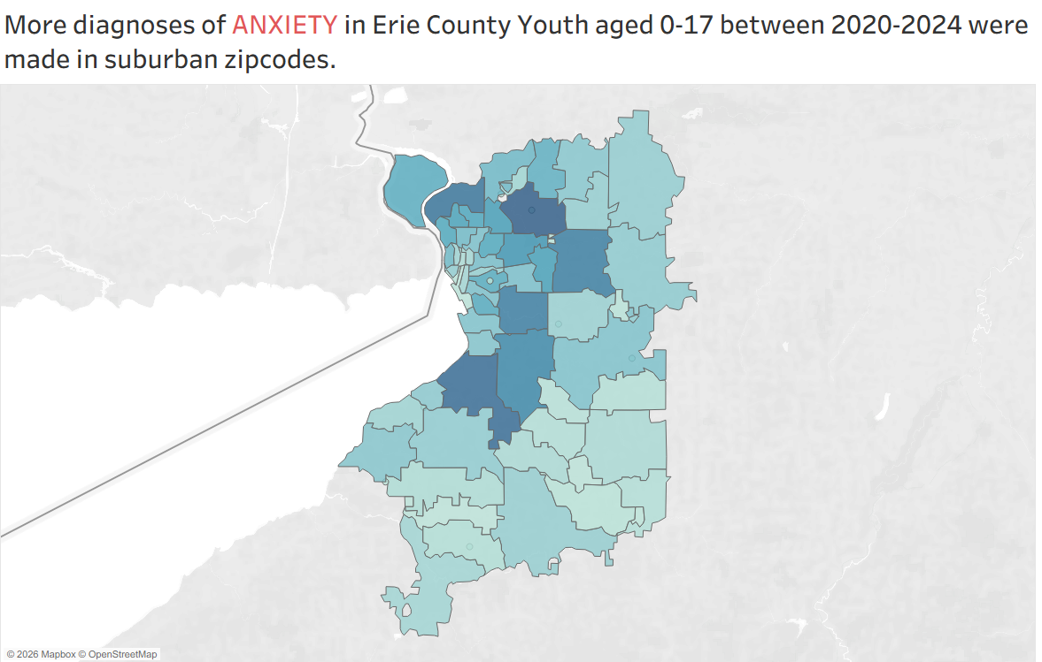
Anxiety Diagnoses for Youth in Erie County
2020-2024
Notes:
This heat map shows the location counts of anxiety diagnoses in Erie County youth. Maps of rates of diagnosis of depression and ADHD look similar to this one. The darker the area, the higher the number of diagnoses.
This heat map shows that the fir^{st} ring suburbs have higher diagnosis rates for anxiety. However, we only have data for diagnosis rates, which means we only have data on the youth who successfully accessed treatment. We do not have data on how many youth experience anxiety, diagnosed or undiagnosed. This means we don't truly know how many youth in Erie County are living with anxiety or other mental health conditions.
The majority of residents of the first ring suburbs are people who are White and of higher socioeconomic status. These residents are less likely to face SDOH barriers like access to care, ability to pay, and transportation. We cannot know what this map would look like if these SDOH barriers to mental health diagnoses were removed.
How can school districts close the gaps in those lighter shaded areas we are seeing predominately in urban and rural communities? This is an opportunity to support mental health within the schools in those areas.

Slide 21
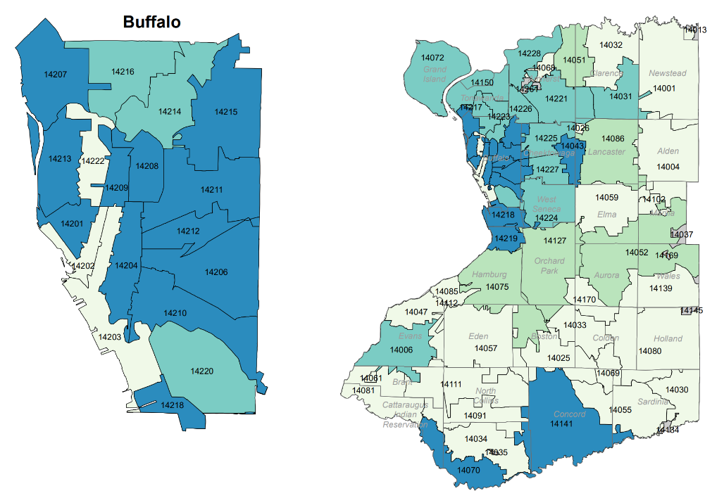
Pediatric Mental Health Related Emergency Room Visits (per 10,000 population) in Erie County by ZIP Code
Notes:
These maps show rates of pediatric mental health related emergency room visits. In contrast to the last map, we can see the areas that had lower rates of diagnosis are seeing higher rates of mental health related ER visits. This is a reflection of barriers to care including lack of access to care, access to insurance, and financial constraints. Similarly, in the areas where there are higher rates of diagnosis, there are fewer ER visits. This is likely because of the higher rates of successful access to mental health care.

Slide 22
Opportunities for Schools
Time spent around youth on a daily basis
Experiences stressors
Early identification and intervention is key
Notes:
[read through contents of slide]
School staff may consist of trusted adults in various roles such as teaches, coaches, bus drivers, volunteers, school-resource officers, etc.). School staff see students more often than their families do and know those students in a different context.
Students are often under stress while in the school environment (can be social stressors, academic stressors), making them more likely to show signs and symptoms of a mental health challenge. You could be that one adult or person that the student has opened up to in that day or week.
If every adult in a school environment is trained to look for these signs and symptoms, there is an increased opportunity for early identification and intervention.

Slide 23
School Culture & Belonging
Schools create opportunities:
For students to build connections with each other and staff
For students to be treated equitably regardless of who they are
For school staff to ensure that students are affirmed and safe in every classroom, office, hallway, and bus
Notes:
School culture and belonging influence youth mental health. The feeling of belonging or connectedness is a protective factor in mental health which means it decreases the risk factors. Positive school culture and a strong sense of belonging significantly improve youth mental health by reducing anxiety, depression, and stress while fostering higher-self esteem and better academic performance. Inclusive and supportive environments are essential for positive mental health.
[read through contents of slide]
The culture and climate of the school as a whole matters, but so does the culture and climate of each space that students visit throughout their school day.

Slide 24

What is MHFA?
Mental Health First Aid (MHFA) is an evidence-based training that gives you the skills to recognize when someone is facing a mental health or substance use challenge, and the confidence to be their first source of support.
Notes:
[read through contents of slide]
MHFA was developed using national level data. It provides tools intended to help recognize early signs and symptoms, how to offer support to someone experiencing a mental health challenge, and how to support them until they are connected to the professional help they need.
Another goal of this training is to reduce stigma around conversations about mental health so that students are less hesitant to seek professional help. Staying true to the ECOHE mission, we offer MHFA training that is equity-aligned and culturally relevant.

Slide 25
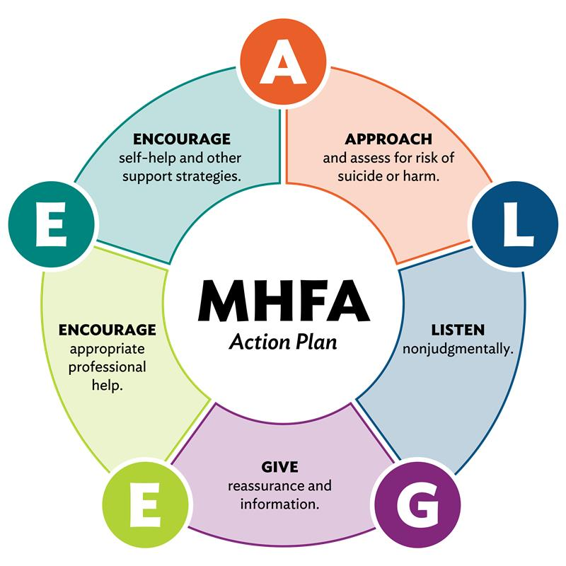
Mental Health First Aid
85% of educators say they need better training to handle student mental health
The MHFA Action Plan (ALGEE) gives you the tools to respond with confidence
Source: Children and Youth Services Review
Volume 73, February 2017, Pages 384-391
Notes:
[read through contents of slide and briefly explain the ALGEE]

Slide 26
Types of Mental Health First Aid
Adult MHFA for adults interacting with other adults
Youth MHFA for adults interacting with youth ages 12-18
Teen MHFA for teens to provide peer support
Notes:
There are three structured MHFA courses:
Adult MHFA for adults/staff
Youth MHFA for adults interacting with youth ages 12-18
Teen MHFA for teens to provide peer support
The ECOHE provides training and certification in Youth Mental Health First Aid and Adult Mental Health First Aid. There are virtual and in-person learning modalities for these curriculums, however our office delivers Adult and Youth in person. Scheduling is flexible and we can deliver the training both within and outside normal business operating hours including weekends. This allows those interested equitable access to trainings and understanding the needs of the community to meet them where they're at.

Slide 27
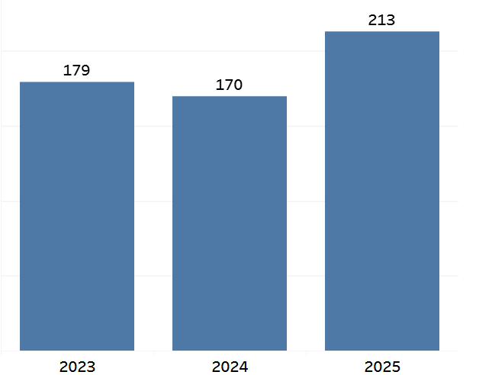
Youth Mental Health First Aiders Trained and Certified by ECOHE
ECOHE trains adults interacting with youth ages 12-18
Including school staff, volunteers, after school program staff, coaches, bus drivers, athletic trainers, etc.
Notes:
Since 2023, we have trained a total of 562 Erie County residents who interact with youth which encompasses: school staff, volunteers, after school program staff, coaches, athletic trainers, etc. We broke that total down by year since we started delivering the MHFA training, we expect to train even more Erie County residents in YMHFA in 2026.
Anecdote by Wafa:
This past November, a MHFA participant who works as a school athletic trainer shared that they never thought they would apply what they learned the same week they completed the training. They were able to assist two students: one of them had suicidal ideation and the second was engaging in NSSI. The participant stated that if it wasn’t for YMHFA training they would not have known how to approach those situations with confidence.

Slide 28
What is Mindfulness?
The psychological process of intentionally bringing one's attention to the internal and external experiences occurring in the present moment.
Why is this helpful?
Notes:
Mindfulness is the psychological process of intentionally bringing one's attention to the internal and external experiences occurring in the present moment. It involves observing thoughts, emotions, and sensations without judgment or reaction.
This is helpful because it may help increase focus, manage pain, build healthy habits, reduce depression, reduce anxiety, manage stress and improve sleep by helping them relax. In a school setting it can offer a time and space for the moment and re-centering.

Slide 29
Mindfulness Program
The Erie County Office of Health Equity's mindfulness program teaches participants about the benefits of mindfulness and several activities they can do on their own and share with others.
2 types of workshops:
90-minute interactive teacher training
60-minute interactive classroom program
Notes:
[read first point]
Our office offers 2 types of mindfulness workshops: a 90 minute interactive teacher training that will teach you what it means to be mindful, including the purpose of mindfulness in a classroom setting
Mindfulness can be used at school or at home or on the bus when the student feels overwhelmed.

Slide 30
Children & Youth With Special Health Care Needs Program
The Erie County Office of Health Equity's Children and Youth with Special Healthcare Needs (CYSHCN) Program seeks to improve the coordination of care for children and youth who have special health care needs.
CYSHCN can help with:
Matching families with community resources
Referring to community programs
Advocacy with health care providers and school districts
Linkage to medical providers and specialists
Support and play groups
Transition to adult services
And more!
Notes:
[read through contents of slide]

Slide 31

Children & Youth With Special Health Care Needs Program
Eligibility for the CYSHCN Program:
Infants, children and youth up to 21 years old who live in Erie County
Infants, children and youth who have a serious or chronic medical, physical, behavioral, emotional or developmental condition
A diagnosis is NOT required.
Notes:
[read through contents of slide]
The CYSHCN Program can help address barriers to mental health care for students and their families.

Slide 32
Staff Wellness Matters Too!
Educator burnout impacts students
Vicarious trauma
Retention and morale
Implementation of a self-care plan
Notes:
Educators’ mental health is foundational to school functionality and student success. When teachers are burnt out or experiencing secondary trauma, the entire school ecosystem suffers.
Educator Burnout:
Contagious Stress: Teacher stress is directly linked to higher stress in students. A stressed teacher can create a tense, anxious classroom environment.
Diminished Quality of Instruction: Burnout leads to decreased engagement, less empathy, and lower-quality instruction, which directly hinders academic achievement.
Classroom Management Issues: Burnout is linked to increased classroom disruption and a reduced ability to manage behavior effectively.
Reduced Emotional Support: Teachers experiencing burnout have less emotional energy to support students in crisis, breaking the bond necessary for learning.
STS:
"The Cost of Caring": Secondary Traumatic Stress (STS) happens when educators hear about or witness the traumatic experiences of their students.
Symptoms Mirror PTSD: Educators with STS may experience anxiety, sleep disturbances, intrusive thoughts about student trauma, and emotional numbness.
Often Unrecognized: Many educators do not realize they are suffering from secondary trauma, often misdiagnosing it as general, everyday stress.
High Risk Factors: Highly empathetic teachers, new teachers, and those working in high-poverty or high-trauma areas are at the highest risk, which again is tied to equity.
Retention & Morale:
The "Exit" Crisis: Teacher burnout is a primary driver of the nationwide teacher shortage, with high percentages of teachers considering leaving the profession due to burnout.
Lost Instructional Time: When teachers leave, the disruption causes significant learning loss (estimates suggest 32 to 72 days of lost instructional time per departing teacher).
Toxic Culture: High burnout creates a negative, "survival mode" environment that reduces morale and makes it harder for everyone to work.
Impact on Colleagues: When staff leave, the increased workload on remaining teachers creates a "snowball effect" of burnout.
Implementation of a Self-Care Plan:
It’s a Necessity, Not a Luxury: Self-care must be viewed as a professional responsibility to maintain long-term career sustainability.
Components of a Plan:
Physical: Prioritizing sleep, exercise, and nutritious food to manage stress.
Emotional/Social: Setting clear boundaries (e.g., no email after 5 PM), seeking peer support, and talking with colleagues.
Professional: Utilizing mental health days and practicing mindfulness (shamelessly put it in a plug for Betsy’s program and that we have this info at our table in front to stop by at the end if you’d like to know more)
Systemic Support Needed: Individual self-care is not enough. Schools must implement systemic changes, such as reducing administrative burdens and providing accessible mental health resources.
Culture of Support: Administrators should foster a culture where asking for help is not seen as a sign of weakness, but as a proactive measure.
"If we're not good to ourselves, we're no good for our students." " Supporting staff mental health is the most effective way to ensure long-term student success and school stability.”

Slide 33

Activity 2: Wellness Wins BINGO
What are the wellness wins in your school environment?
Notes:
Wellness Wins BINGO (8 min)
To wrap up our discussion, let's synthesize everything we've talked about today with a quick game of Wellness Wins Bingo. There will be a prize but won't need to get too competitive because we've reserved one for each of you!
Everyone has a BINGO board and there are some pens available if you need one. You can work together with those around you or feel free to get up and move around the room. (5 min)
This is a celebration of the wins in your school environment and the programs you wish to implement.
Start by marking off programs that already exist at your school. We encourage you to move around the room and connect with others who may have implemented one of these interventions in their school or classroom and you can mark theirs off as well!
Programs that you are working on or want to implement count, too! We encourage you to gather ideas by filling in the free squares with any suggestions or ideas from others in the room. Feel free to get creative with your ideas and hopefully we will have a moment to share some with the whole group after!
Call out "WELLNESS WIN" once you fill a line – vertical, horizontal, or diagonal.
We will chat briefly as a group after you've had time to work through your BINGO boards.
Debrief (~3 mins)
What strengths do we already have?
Where are the gaps?
What are some good ideas you have that weren't listed? Tell us how you filled your blank spaces!
Just for us: Why this activity works – This is strengths-based and encouraging ending with supportive suggestions attendees can takeaway.

Slide 34
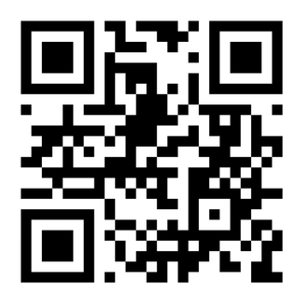
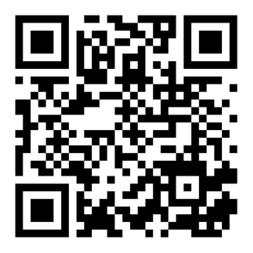
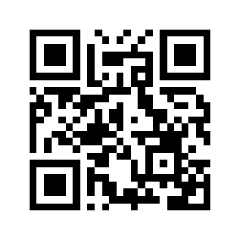
To Learn More
Mental Health
First Aid
Mindfulness
Program
CYSHCN
Program
erie.gov/MHFA
www3.erie.gov/health/mindfulness
erie.gov/CYSHCN
Email: healthequity@erie.gov
Web: erie.gov/health-equity
Notes:
Thank you everyone for attending and participating in our discussion today. We hope that you leave today with enough background information and ideas to implement some new wellness supports in your school. We also hope that you continue to talk about youth mental health. Here are some QR codes for programs we talked about earlier as well as our website to learn more. If you haven't taken MHFA but would like to, we have information with us for that right here (pointing to our table where our comp is). Our office mindfulness training is also linked here. You can request both of these trainings through these links or you can email us for more information. Trainings can be for your school, small group, or for you as an individual. Our office also publishes a ton of public health information that can help you and your community start conversations on topics such as mental health, grief, food access, emergency preparedness, chronic illness, and more. You can find PDFs of these publications on our webpage and you can even request that printed copies are sent to your school. We brought some of these materials with us today and flyers from the programs we mentioned. We invite you to stop up and take what you’d like. Thank you everyone again, it's been our pleasure to spend this time with you today!

