Slide 1


STRENGTHENING SCHOOL-FAMILY PARTNERSHIPS THROUGH FUNDS OF KNOWLEDGE
MS. CATRICE HUFF
BUFFALO PUBLIC SCHOOLS
FAMILY ENGAGEMENT SUPERVISOR
Notes:
introductions

Slide 2


FACE TEAM
Dr. Ramona Reynolds Chief/Cabinet Level
Dr. Alyssa Monfuletho Assistant Superintendent
Dr. Jennifer Rich Director
Ms. Catrice Huff Family Engagement Supervisor
Mr. Anthony Vaccaro Family Engagement Supervisor
Mr. Joe Agro Parent Advocate
Ms. Colette Clemons Administrative Assistant
Ms. Shyla Early Community Resource Leader
Ms. Toiya Carr Community Resource Leader
Mr. Oumar Adam Hassaballah Community Resource Leader
Mr. Jordan Velazquez Community Resource Leader
Ms. Kaitlyn Roberts Community Resource Leader
Mr. Jimmy Barnes Community Resource Leader II

Slide 3


OBJECTIVES
Understand the concept of Family Funds of Knowledge and its foundation in educational research.
Learn practical strategies to identify, honor, and integrate family knowledge into school practices to foster equity and collaboration.
Notes:
Read objectives

Slide 4


BPS FAMILY ENGAGEMENT DEFINITION
Active voice, involvement, and presence of parents, families, and community members working with all in school, home and/or community to ensure ongoing learning, wellness and development.
Notes:
The Buffalo Public Schools has a definition for family engagement defined in Board Policy 3170. Read it – then you can mention how it basically says it takes a village to ensure the success of the students in BPS.

Slide 5
CULTURALLY RESPONSIVE FAMILY ENGAGEMENT
Culturally responsive family engagement is the practice of authentic, equal partnership with families, rooted in a deep knowledge and appreciation for the rich social and cultural identities, assets, habits and contexts that families bring to learning.
(NYU Metropolitan Center for Research on Equity and the Transformation of Schools)
Notes:
Today we are going to focus on the components of Culturally Responsive Family Engagement where we are truly honoring family funds of knowledge and creating space to welcome families as co-collaborators in the classroom.

Slide 6

DUAL CAPACITY-BUILDING FRAMEWORK FOR FAMILY-SCHOOL PARTNERSHIPS
Notes:
The Buffalo Public Schools has adopted the Dual Capacity-Building Framework for Family-School Partnerships. This a family engagement framework that is used throughout the entire District…in every school and every department.

Slide 7

The Dual Capacity-Building Framework for Family-School Partnerships
(Version 2)
The Challenge Essential Conditions Policy and Program Goals Capacity Outcomes
Process conditions
Relational: built on mutual trust
Linked to learning and development
Asset-based
Culturally responsive and respectful
Collaborative
Interactive
Organizational conditions
Systemic: embraced by leadership across the organization
Integrated: embedded in all strategies
Sustained: with resources and infrastructure
Educators
Have not been exposed to strong examples of family engagement
Have received minimal training
May not see partnership as an essential practice
May have developed deficit mindsets
Build and enhance the capacity of educators and families in the “4 C” areas:
Capabilities (skills + knowledge)
Connections (networks)
Cognition (shifts in beliefs and values)
Confidence (self-efficacy)
Educators are empowered to:
Connect family engagement to learning and development
Engage families as co-creators
Honor family funds of knowledge
Create welcoming cultures
Effective partnerships that support student and school improvement
Families
Have not been exposed to strong examples of family engagement
Have had negative past experiences with schools and educators
May not feel invited to contribute to their children's education
May feel disrespected, unheard, and unvalued
Families engage in diverse roles:
Co-creators
Supporters
Encouragers
Monitors
Advocates
Models
Notes:
Raise your hand if this image looks familiar to you. Acknowledge those who have raised their hand…ask them if they’ve attended any other trainings.
This is a beautiful graphic, but there is a lot going on. Point out the end goal of “effective partnerships that support student and school improvement”. Then quickly acknowledge the challenges…ask if anyone received family engagement training when they were in college, or if they had any other family engagement coursework that was required. Then point out that families also experience challenges around trust based on their own experiences.
Now let’s look at how we are going to collectively build the capacity of our educators and families. Since we wanted to focus on these capacity outcomes, we created posters for every school. (go to the next slide and talk about the posters)….if anyone still needs posters, let Jen know

Slide 8
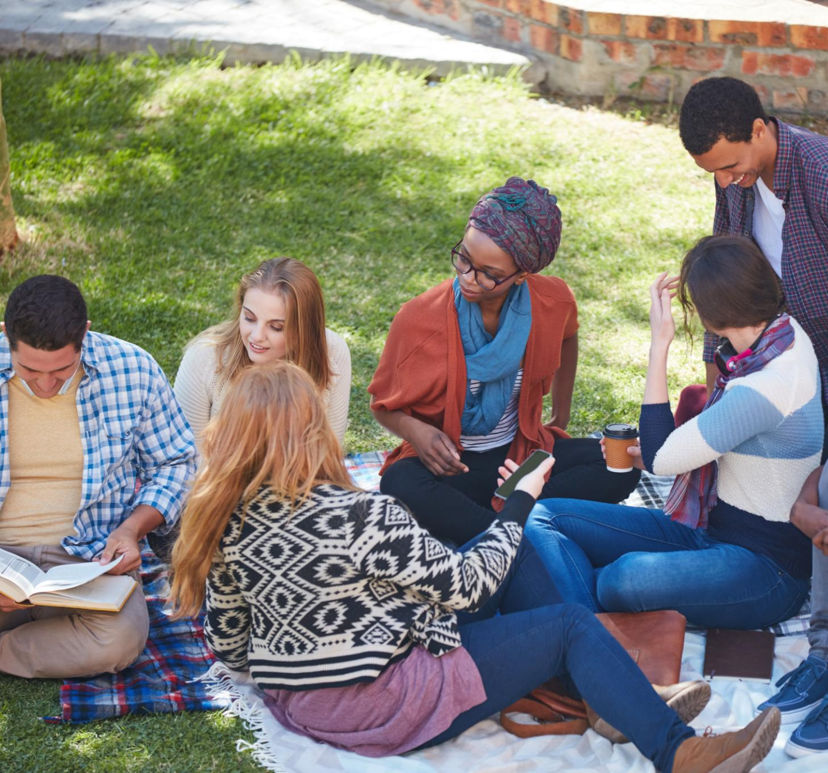
FUNDS OF KNOWLEDGE
Definition of Funds of Knowledge
  Funds of Knowledge are the cultural and practical knowledge families share within their communities, enriching learning.
Importance of Lived Experiences
  Lived experiences shape learning by providing valuable insights that enhance educational processes.
Families as Learning Partners
  Viewing families as partners and co-educators fosters collaboration and moves beyond deficit-based models.
Notes:
Funds of Knowledge refers to the cultural, experiential, and practical knowledge that families possess and share within their communities. This concept emphasizes the importance of lived experiences in shaping learning and recognizes that every family contributes valuable insights and skills that can enrich the educational process. By understanding this framework, educators can move beyond deficit-based models and instead view families as partners and co-educators in the learning journey.

Slide 9
EXAMPLES OF FAMILY FUNDS OF KNOWLEDGE
Cultural Wealth & Expertise
Families possess deep knowledge in areas like storytelling, problem-solving, resourcefulness, and traditions that shape identity and resilience.
Intergenerational Learning
Cooking, crafting, financial literacy, and community organizing.
Recognizing Hidden Knowledge
Home repair, gardening, caregiving, and navigating social systems.
Bridging Home and Institutional Knowledge
Schools should validate and integrate family wisdom into learning and decision making.
Honoring Lived Experiences
Sharing family stories, cultural practices, and lived experiences.
Practical Application
Encouraging discussions where people reflect on what they’ve learned from their families and how it shapes their lives today.

Slide 10

BARRIERS TO FAMILY ENGAGEMENT
Logistical barriers (ex. unable to attend meetings)
Communication barriers (ex. parents feel that often the school only reaches out because of bad news)
Barriers to establishing trust (ex. misconceptions about what parent engagement is, negative interactions with school)
Lack of confidence in the school

Slide 11

PRACTICAL STRATEGIES
Gathering Family Stories
  Collecting family stories and experiences helps educators design relevant and meaningful curriculum content.
Inviting Family Expertise
  Inviting families to share their knowledge enriches classroom learning and strengthens home-school connections.
Culturally Responsive Activities
  Designing activities that reflect students' cultural backgrounds fosters engagement and inclusion.
Building Trust and Communication
  Inclusive and respectful communication builds trust between educators, students, and families.
Notes:
Educators can implement the concept of Family Funds of Knowledge through several practical strategies. These include gathering family stories and experiences to inform curriculum design, inviting families to share their expertise in classroom settings, designing culturally responsive activities that reflect students' backgrounds, and building trust through inclusive and respectful communication. These steps help create a learning environment that values diversity and fosters meaningful connections between home and school.

Slide 12


STRATEGIES FOR BUILDING TRUST
Benevolence
  Having families’ best interest at heart. Acting to protect their interest. Showing generosity and personal regard.
Reliability
  Families being able to depend on school & department staff to come through for them, to act consistently, and to follow through.
Competence
  Every staff member has the ability to perform the tasks required by his or her position.
Honesty
  School & department staff demonstrates integrity, represents situations fairly, and speaks truthfully to families and to one another.
(Hoy & Tschannen-Moran, 1999, p. 189)

Slide 13

MEETING PARENTS WHERE THEY ARE
Notes:
https://youtu.be/4kmRP39RX08?si=u3KtFtxm_NJTJcwt

Slide 14
VIDEO REFLECTION
How was Gregory able to establish trust with Amber?
What are some other ways he could have approached this conversation?

Slide 15

BENEFITS FOR FAMILIES AND YOUTH
Strengthened Relationships
  Honoring family knowledge deepens connections between families, youth, and educators, fostering trust and collaboration.
Increased Student Engagement
  Validating home experiences boosts students’ confidence and engagement in classroom learning and activities.
Empowered Family Participation
  Families feel empowered to contribute to school decisions and see their influence in the learning environment.
Inclusive Education
  These practices promote a more inclusive, equitable educational experience for all students and families.
Notes:
Honoring Family Funds of Knowledge has significant benefits for both families and youth. It increases their sense of belonging and strengthens relationships with educators. Students become more engaged and confident when their home experiences are validated in the classroom. Families feel empowered to participate in school decision-making and see their contributions reflected in the learning environment. These outcomes support a more inclusive and equitable educational experience for all.

Slide 16
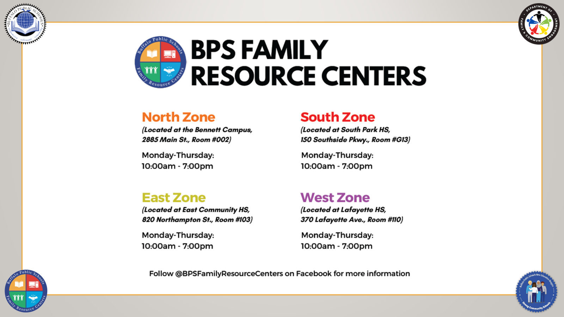

Slide 17
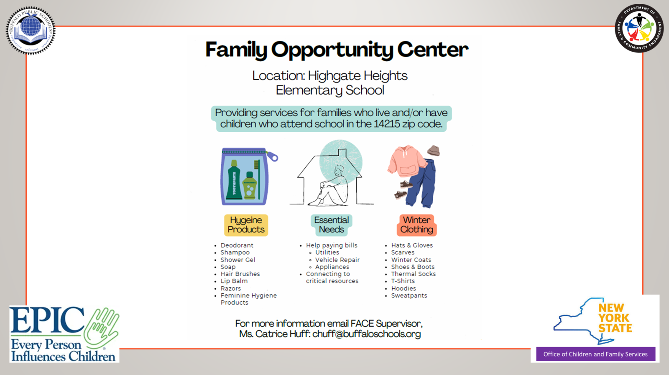

Slide 18
PARENT LEADERSHIP
BOARD RECOGNIZED PARENT GROUPS, PTO/PTA, BUILDING LEVEL TEAMS

Slide 19
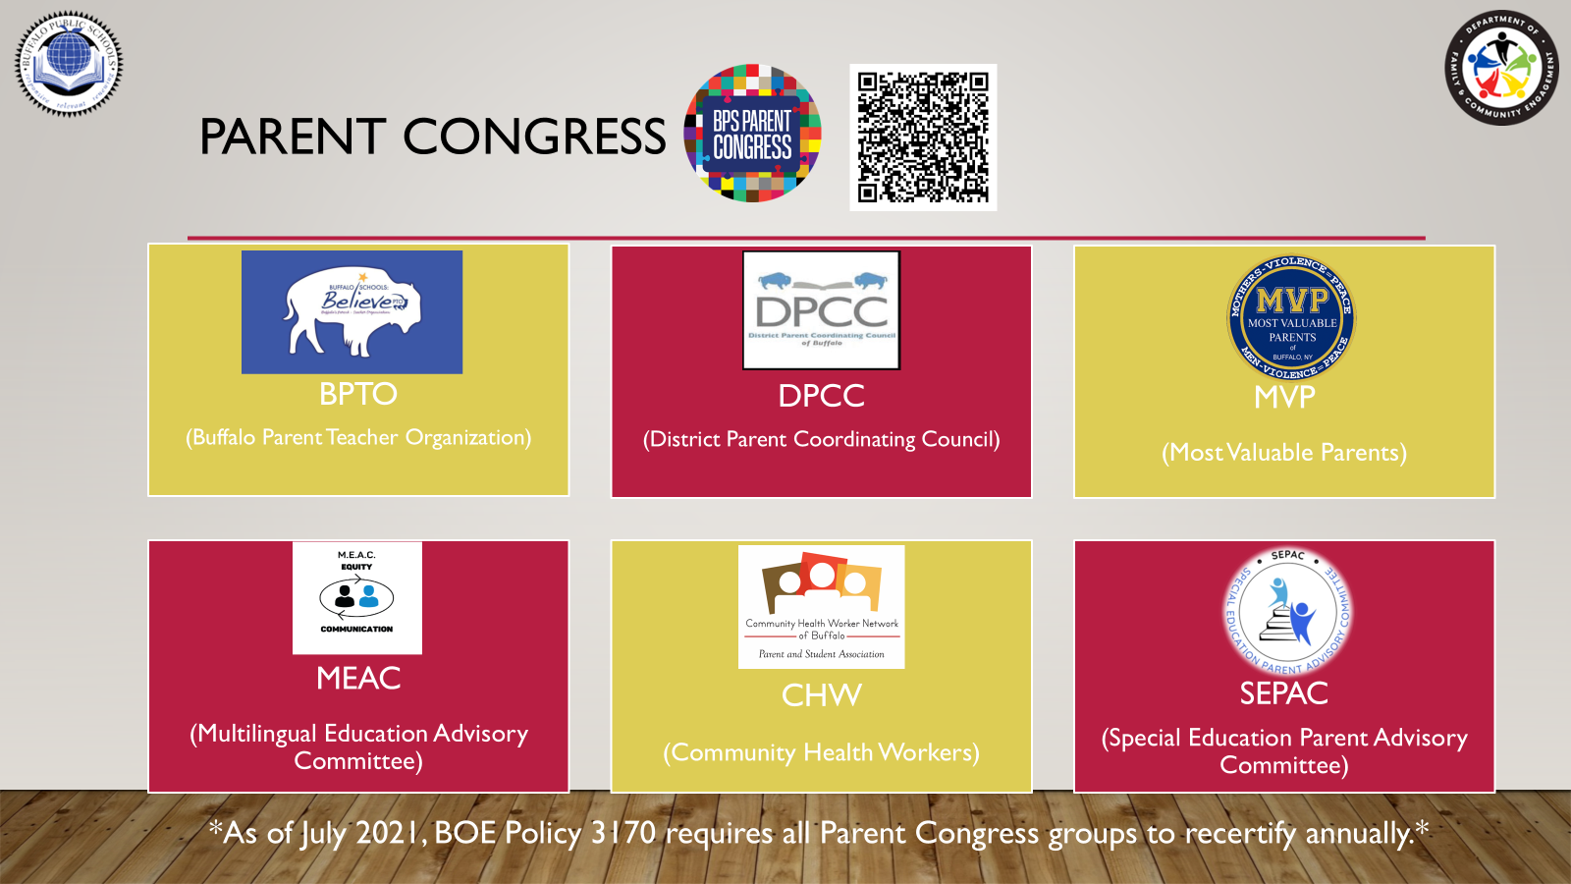

Slide 20
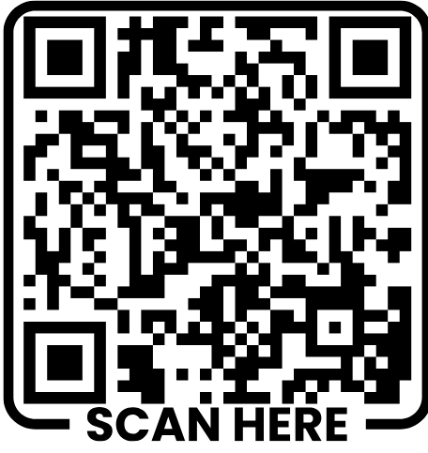


Slide 21
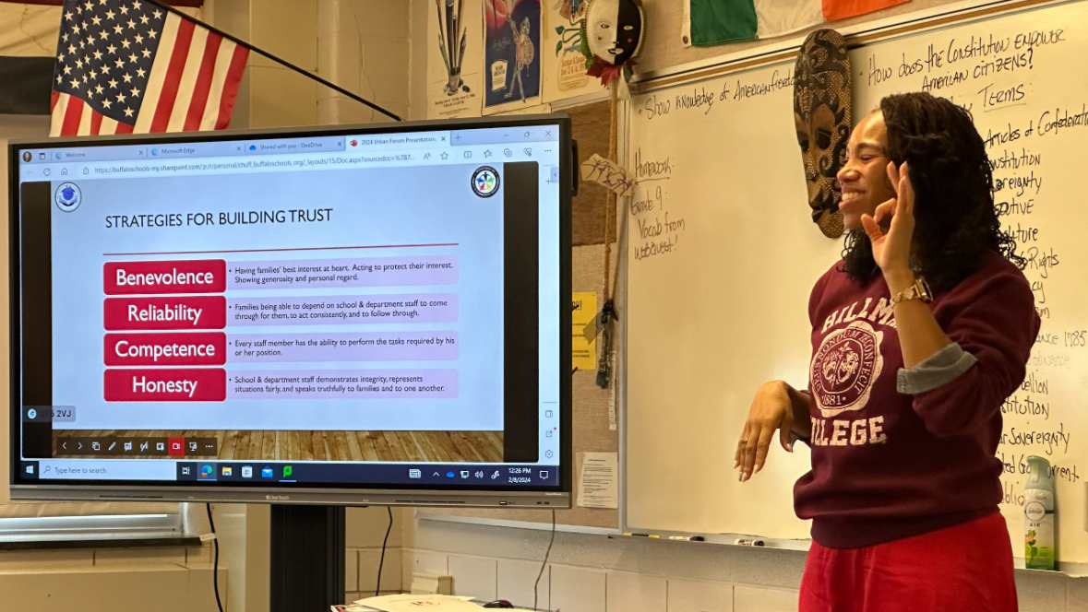
THANK YOU!

