Slide 1


Annual Title I Meeting
Sept. 25, 2025
Dr. Wakima Tutwiler, Principal
Mrs. Shatarra Johnson, Asst. Principal
“Great on Purpose”

Slide 2

What is the Purpose of Title I?
Medical Districts’ Mission and Vision
Notice of District/School Progress/ School Status
Continuous School Improvement Plan
Student Code of Conduct
MDHS School Parent Student Compact
Reporting Pupil Progress
Parent-Teacher Conferences
MDHS Family Engagement Plan
Policies for Family Engagement (MCS Family Engagement Policy and Plan; School Plan)
Availability of Parent Training/ Opportunities for additional Parent Meetings
Parents’ Right to Know
Annual Title I Meeting Agenda

Slide 3
The purpose of the Annual Title I meeting is to provide information to families of participating children about the Title I program and their right to be involved in their child’s education.
Each school served under Title I, Part A must hold an annual meeting, at a time convenient for families, to inform them of their school’s participation in Title I programs and to explain the Title I requirements and the right of families to be involved in those programs.
Purpose of the Annual Title I Meeting

Slide 4

To increase academic achievement
To provide direct instructional support to students
To provide professional development for teachers
To promote parent education and involvement
Goals of
Title I, Part A Program

Slide 5
Did You Know?
Medical District High School is a Title I School.
The purpose of the Title I, Part A program is to provide federal dollars to supplement educational opportunities for students who attend schools with high numbers or percentages of children from low-income families and are most at risk of failing to meet the state’s challenging academic achievement standards.
Title I, Part A funds are to be used to provide all students significant opportunity to receive a fair, equitable, and high-quality education, and to close educational gaps.
(U.S. Department of Education)
Purpose of the Title I, Part A Program

Slide 6

Mission: Medical District High School will graduate college and career-ready critical thinkers who are emotionally conscious, socially responsible, and prepared to embrace their role in the global community.
Vision: Medical District High School's vision is to develop independent, well-rounded students who will excel academically, socially, and emotionally through the collaborative efforts of staff, parents, and community partners. Students will complete all requirements for high school graduation while pursuing an Associate degree.
Mission and Vision

Slide 7


Medical District High School’s Curriculum
In partnership with Southwest Tennessee Community College, Medical District is in its 4th year of operation with a rigorous academic curriculum where students have the opportunity to earn both a traditional high school diploma and an Associate Degree at the same time.

Slide 8

Student coursework aligns with three Pathways:
Allied Health
The University Parallel Allied Health Sciences degree (A.S.) provides a solid foundation for gaining entry into a number of health science programs. This degree pathway may be used by students interested in health care fields such as Nursing, Radiology, Medical Laboratory Technology, medical research, and more.
Information Technology
The Tennessee Transfer Pathway, Information Systems Emphasis (A.S.) degree is designed so that students completing this program will be able to transfer into a baccalaureate program in Information Systems. Students interested in careers in Systems Analysis, Database Administration, Network Administration, and Programming should consider this degree.
General Studies
The University Parallel, General Studies Emphasis (A.S.) is a two-year program for students who have not decided on a major but are planning to complete a Bachelor's degree at a four-year university.

Slide 9
Medical District High School’s
Academic Status
2024-2025 TCAP Performance Rates
ELA | 65.0% Met and/or Exceeded Expectations ~ 70.0% (Goal for 25-26)
Math | 35.4% Met and/or Exceeded Expectations ~ 40.0% (Goal for 25-26)

Slide 10
Forms of Assessments Used to Measure Student Progress
District Assessment | Description
TCAP (EOC) | Only students scheduled to complete English I or II, Algebra I or II, Geometry, Biology, or U.S. History in December will take these assessments. EOC tests will be online.

Slide 11
The Continuous School Improvement Plan is an action plan that identifies the areas a school plans to focus on in the current school year, the performance goals they want students to achieve, and how the school plans to collaboratively meet these goals.
The plan is updated regularly to reflect the strategies being used.
It is developed by a team of stakeholders which must include faculty, staff members, parents, and students, where applicable.
Continuous
School Improvement Plan

Slide 12

Continuous School Improvement Plan Goals
Goal 1: Medical District High School will increase ELA on-track and mastery proficiency rates in all grades from 65.0% in
2025 to 70.0% in 2026.
Goal 2: Medical District High School will increase Math on-track and mastery proficiency rates in all grades from 35.4%
in 2025 to 40.0% in 2026.
Goal 3: Medical District High School will increase the percentage of Ready Graduates from 95.6% in 2025 to 100.0% in 2026.
***We also want to ensure that Medical District High School students are successfully and concurrently working towards both an Honors Diploma and an Associate's Degree.

Slide 13
Student Code of Conduct (SCS Policy #6022)
The Shelby County Board of Education accepts the responsibility for establishing and maintaining proper standards of discipline and behavior in the public schools.
          In order to maintain good order and ensure an environment conducive to learning, the Board considers behavior or conduct occurring on school property or at any school sponsored activity occurring off school property which interferes with the above to be offenses.

Slide 14
Student Code of Conduct (continued)
The District establishes the Shelby County Schools Student Code of Conduct to provide a sample of unacceptable student behaviors and a related sample of disciplinary actions.
            The Code of Conduct and any revisions shall be approved and adopted by the SCS Board of Commissioners as the student discipline policy of the district.
Notes:
Medical District’s students are issued a copy of the Student Code of Conduct at the open of each school year, and each student is expected to conduct themselves accordingly.

Slide 15
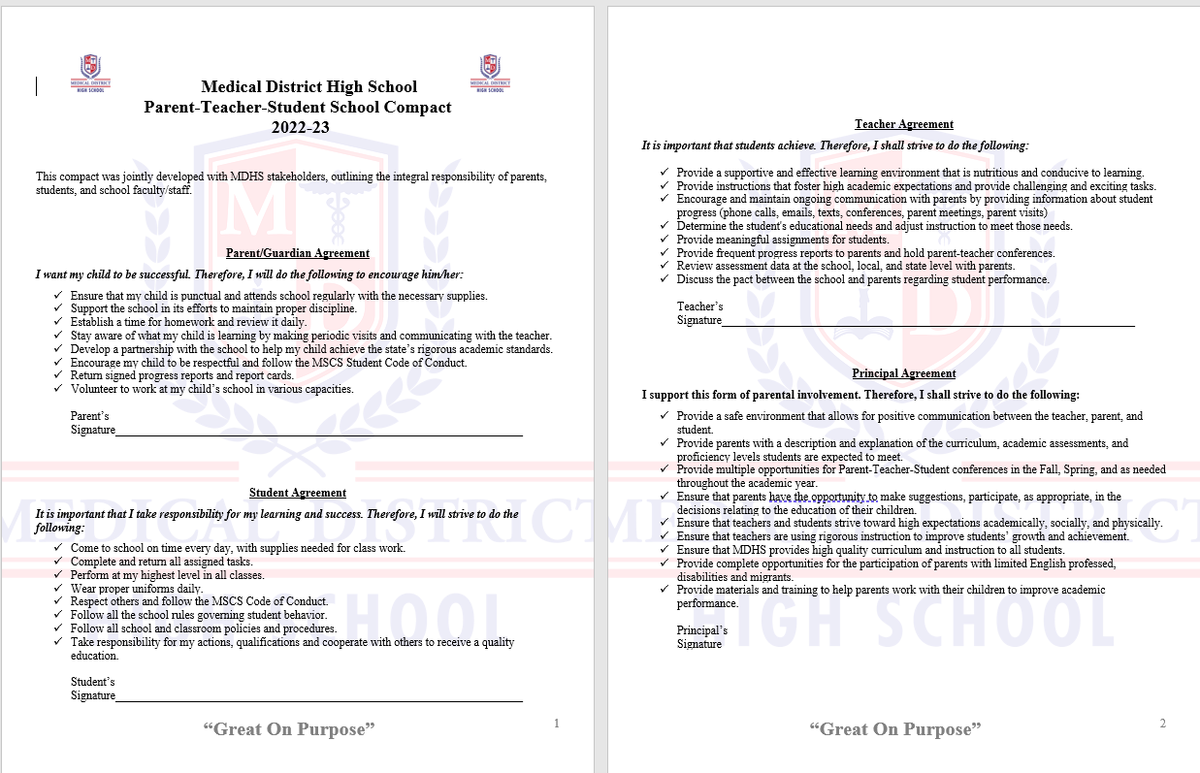
School-Parent Compact
Notes:
Medical District has a School-Parent Compact that outlines how students, parents, and the entire school staff will share the responsibility for improving student academic achievement and how parents will help develop a partnership to help students achieve the State and District’s high academic standards. This compact is jointly revised by all stakeholders annually.

Slide 16

Parent Teacher Conferences
Fall | Spring
Sept. 4, 2025 (4 -7 pm) | February 22, 2026 (4 – 7 pm)
Notes:
Medical District, in accordance with Memphis Shelby County Schools guidelines, will be encouraging Parent and Teacher Conferences this year in person.

Slide 17
Report Card Period and Progress Reports
Report Card Period Quarter | Progress Reports Distributed & Available via Parent Portal | Report Cards Distributed & Available via Parent Portal
1st | September 3, 2025 | October 27, 2025
2nd | November 12, 2025 | January 14, 2026
3rd | February 11, 2026 | April 1, 2026
4th | April 22, 2026 | May 21, 2026
Notes:
Medical District will be reporting your child’s academic progress via the Power School Parent Portal and printed Report Cards each nine weeks and each semester for the year.
Progress Reports will be issued every 4.5 weeks. In some cases, individual teachers may reach out to discuss your child’s progress weekly and/or daily.

Slide 18
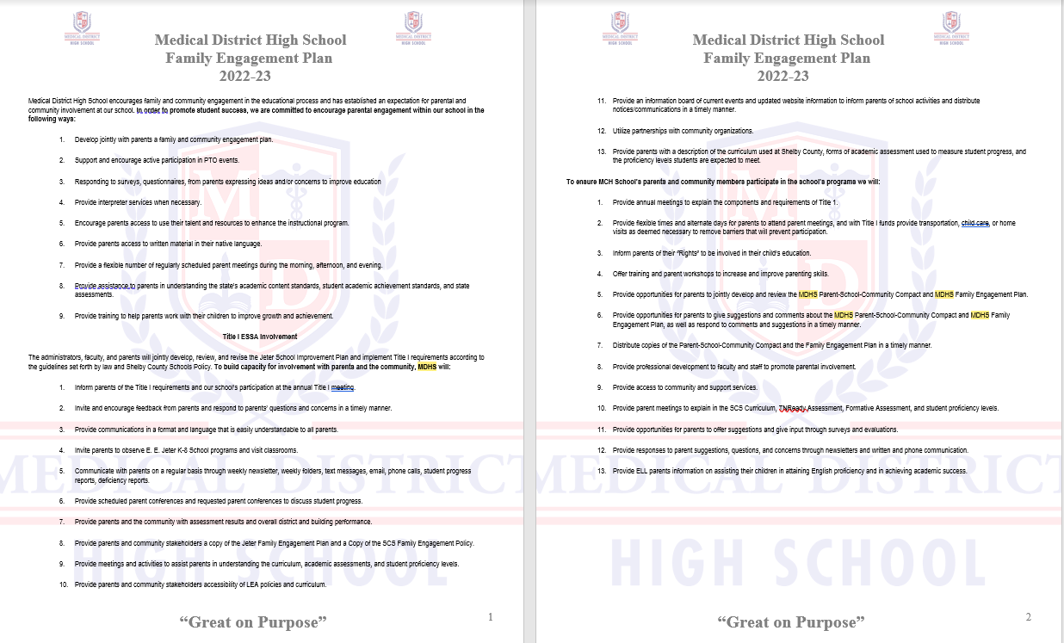
Family Engagement Plan (SCS Policy 7000)

Slide 19

Family and Community Engagement Center (FACE)
Memphis, Tennessee 38112
160 South Hollywood Street
Room 164
Notes:
Title I requires that LEAs- Superintendents and Principals work through schools to ensure the Parent and Family Engagement Policy is at work. This Policy looks like the following events take place annually at MDHS:
*Annual Title I Parent Meeting
*School Improvement Plan meetings where academic data
snapshots are shared and parents are invited to serve on the SIP
Committee
*Parents are kept informed of their Students’ progress
*Parents are invited to Teacher Conferences quarterly
*Parents are informed of Extended Learning and other Title I
Student Supports;
*Additional Parent/Family Engagement activities that will further
involve families in the School Community and ensure their
students are receiving a high quality education.

Slide 20


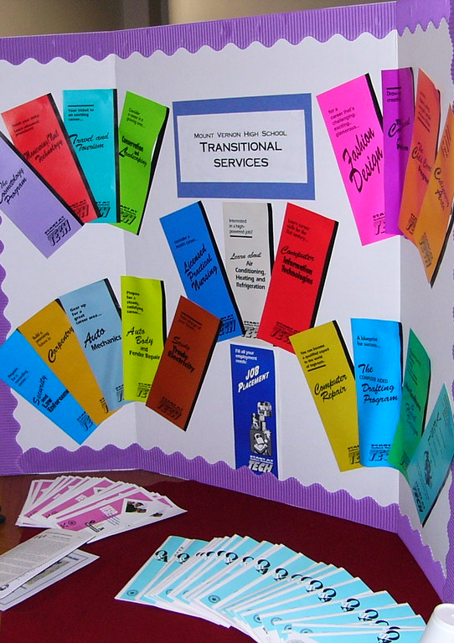

Opportunities for Additional
Parent Meetings: Muffins for Moms, Curriculum Nights, and Parent-Teacher Conferences
Notes:
Medical District encourages Parents to follow the 2023-24 SCS District Calendar for opportunities to engage in parent training this year.
We also encourage our Parents to bring questions, comments and concerns to our school administrators. If necessary, with administrator approval, additional parent meeting opportunities will be provided this year.

Slide 21
All parents have the right to request the following:
A teacher’s professional qualifications, which includes state qualifications, licensure, grade/s certification, waivers
A teacher’s baccalaureate and /or graduate degree, fields of endorsement, previous teaching experience
A paraprofessional’s qualifications
An assurance that their child’s name, address, and telephone listing not be released to military recruiters.
All parents will receive information on the following:
Their child’s level of achievement in each of the state academic assessments
Their option to request a transfer to another school within the district if their child is the victim of a violent crime at school
Their right to timely notification that their child has been assigned, or has been taught for four or more consecutive weeks by, a teacher who is not highly effective.
Parents’ Right to Know
Notes:
Medical District supports Title I Parents Right to Know.

Slide 22

Questions
.

Slide 23
Thank You!
Your attendance was greatly appreciated!
“Great on Purpose”
Carlos Smith, Title I Facilitator

