Slide 1

Class of 2026
Post-Secondary Planning

Slide 2
Etowah Administration
Principal
Mr. Robert Horn
Assistant Principals
Mr. Scott Bradley (A-C)
Ms. Janet Baggett (D-Hog)
Dr. Brett Pinckard (Hol-Mit)
Mr. Matthew Renney (Mix-Rub)
Ms. Kelly Flatt (Rud-Z)
Dr. Curt Ashley

Slide 3
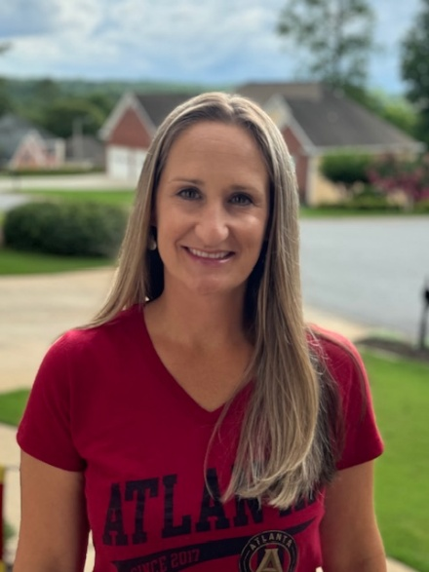
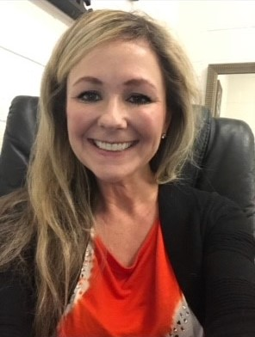
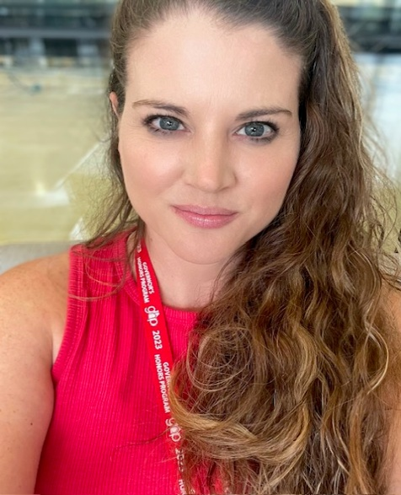
Counseling Staff
Whitney Morberg A-C
Alayna Petersen
D-Hog
Sharon Gustafson
Hol-Mit

Slide 4
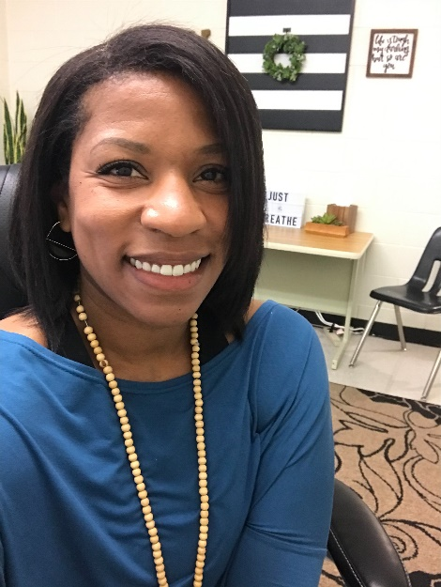

Counseling Staff
Taylor Herman
Mix-Rub
Lauren Watkins
Rud-Z

Slide 5
Planning Information
Counseling Office information
Make sure you accept your 2025 EHS Student Services Course on Canvas for important announcements.
Post-secondary planning
Gain knowledge in next steps toward post-secondary plans:
Military service
Workforce
Apprenticeships
College Admissions
Other
Probe Fair August 26th 6-8pm Cherokee HS
Curriculum Night September 10th 6pm
Financial Aid Night October 15th 6:30pm Virtual

Slide 6
Requirements for 2026
Graduates
Core Course Requirements
Elective Requirements
1 Unit of Health (.5) and Personal Fitness (.5)
3 Units of required electives
  World Language, Fine Arts and/or Career/Technical
4 Units of miscellaneous electives
TAA provides potential .5 credit Pass or Fail grade
4 Units of Literature
4 Units of Math
4 Units of Science
Must include Biology, Physical Science or Physics, and Earth, Environmental, or Chemistry
3 Units of Social Studies
23 total units are required for graduation
Honor Graduates: cumulative weighted NGA of 90 or above

Slide 7

International Skills Diploma Seal (ISDS)
“The International Skills Diploma Seal is awarded to graduating high school students who complete an international education curriculum and engage in extracurricular activities and experiences that foster the achievement of global competencies.”
“It is a signal to employers and higher education institutions that a student is prepared to participate in the global economy.”

Slide 8

Preliminary Selection
Three years of the same World Language
4 units of International Focus courses
https://gadoe.org/grants-awards-diploma-seals/international-skills-diploma-seal/
Total of World Language Units and International Focus Units must equal at least 8
Notes:
May require more than one slide

Slide 9
4 Extracurricular Activities or Experiences
Activities with Global Themes or in a Global Context
  Examples:
  Exchange programs
  International and language clubs
  Travel abroad
  Science and social studies fairs
  Model UN
  Global classroom projects
Notes:
Pleasure vacations will not count unless there was a service or an exchange component.

Slide 10
20 Hours of Documented Global Community Service
Examples:
  Raising Money for Hands and Feet Ministries
  Providing activities for children of Spanish speaking parents that come to school for informational evening seminars
  Providing translation services in school-based events
  Any approved school-based cross cultural /global community service activity
  Faith-based mission trips
  Volunteering in Citizenship classes
  Volunteering in English classes
  Shoeboxes for Christmas
Notes:
Students will need to provide documentation either signed by a supervisor with a brochure or picture. A parent signature may be accepted with a brochure or picture documenting service.

Slide 11
Capstone Project
The Capstone Project must include an international focus and demonstrate connections between the international course work, the extracurricular activities, the service project, and product developed during the senior project.
Product Log will include additional work composed of documentation of Global Community Service and Extracurricular Activities along with a written reflection
Contact Michelle.mcgowan@cherokeek12.net
To apply
Notes:
AP Lit students will present the international portion of their project at a later date.

Slide 12
Fine Arts Skills Diploma
It’s fun! It’s Easy!
“It is a signal to employers and higher education institutions that a student is prepared to participate in the creative economy.”
Honorees will receive a seal on their diploma, a cord to wear at graduation, and will be recognized at Honors Night.

Slide 13
Preliminary Selection
You must have completed a Fine Arts Pathway and one more Fine Arts elective or CTAE elective.

Slide 14
2 Fine Arts Related
Extracurricular Activities or Experiences:
Activities that are fine arts related could be -
  Examples:
  One Act Play
  School Musical
  Marching Band
  Jazz ensemble or other musical ensemble
  FFA or Agricultural competition
  Photography portfolio
  Fashion Design portfolio
  Interior Design project
Notes:
Pleasure vacations will not count unless there was a service or an exchange component.

Slide 15
20 Hours of Documented
Arts Related Community Service
Examples:
Face painting at a school or community event
Preparing/participating in community haunted houses/zombie fests for charity
Caroling for cans (food drive)
Operation Graduation
Helping to re-design your neighbor’s kitchen
Notes:
Students will need to provide documentation either signed by a supervisor with a brochure or picture. A parent signature may be accepted with a brochure or picture documenting service. Complete the EHS Community Service Log.

Slide 16

Capstone Project
Your Capstone Project should include a Fine Arts focus.
Notes:
AP Lit students will present the fine arts portion of their project at a later date.

Slide 17
Your post-secondary goal?
Military service
Workforce
Technical College
Two-year college
Four-year college
Other …..

Slide 18
Armed Forces
High school diploma critically important
Very few spots are open for students without a high school diploma.
To even be considered, recruits with a GED must have much higher scores on the ASVAB than recruits with diplomas.
ASVAB testing at EHS is scheduled for November 14th, at 8:15 am in the Pod 2. Register online and email Ciarra.Malto@cherokeek12.net for questions. ASVAB Registration
For other requirements, see a recruiter from the branch of service in which you’re interested.

Slide 19
Work Force
  What type of industry do you want to work in?
  Do they have special training that’s required for entry?
  Is there a specific company you want to work for?
  Do they have an application online?
  Do they require a resume?
  What is the long-term growth potential for this industry?
  Bureau of Labor Statistics Occupational Outlook handbook https://www.bls.gov/ooh/

Slide 20
Work Force
Opportunities for Apprenticeships
Research trade jobs, manufacturing, and industries for benefits, training, and unions.
https://www.apprenticeship.gov/career-seekers
Paid Apprenticeships in Mechanical Trades

Slide 21
Types of Resumes
Chronological – Use when you have consistent career progression.
Functional – Use with little experience (less than 2 years), employment gaps, or recent grads. Focus on skills rather than lack of experience.
Hybrid – Use when you have more than 2 years of work experience, but less than 5, or are applying for a position in another industry.
https://www.jobhero.com/resume/formats

Slide 22
Functional Resume Items
Prepare
Reflect a Job Posting’s exact phrasing
Create an attention-grabbing objective statement or professional summary
List your Top Skills
List Work History in reverse chronological order
https://www.jobhero.com/resume/formats

Slide 23
General Resume Tips
Make your name and contact information stand out
Write an Impactful Objective
Keep it under 2 pages
Keep it professional
https://www.jobhero.com/resume/formats

Slide 24
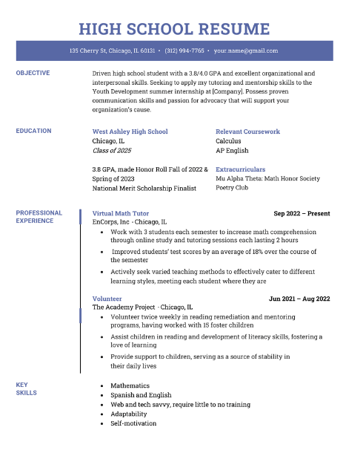
Work Force: Functional Resume

Slide 25
Technical, 2 year, or 4-year College?
How do you decide which college is right for you?
  Who are you?
  What do you need to succeed?
  What’s your admissions profile?
  How far from home do you want to be?
  How large a college do you want?
  What activities are available?
  What else is important to you?
  VISIT THE CAMPUS!
*Seniors can take two days for a college visit. The absences will be excused with a dated letter on letterhead from the college visited.

Slide 26
Technical, 2 year, or 4-year College?
Technical College:
SAT/ACT not required.
  Use Accuplacer exam to determine placement
Qualifies for HOPE Grant
Chattahoochee Tech is nearby
4 Year College:
Each college determines their minimum entrance requirements
Minimum GPA
ACT or SAT scores
Georgia 4-year colleges require:
  College Preparatory Curriculum requirements (2 years world language)
  Freshman Index requirement
  Minimum results on Test Scores
2 Year Community College:
SAT/ACT may not be required: could use Accuplacer exam for placement
School determines minimum GPA
Nearby 2-year schools: Georgia Highlands & GSU Perimeter College
Notes:
FRESHMAN INDEX NUMBER: The University System of Georgia colleges and universities use a standardized calculation to determine appropriate college placement for students in the state of Georgia. This is known as the Freshman Index Number. The Freshman Index is calculated by combining the core high school grade point average (GPA on a 4.0 scale) with the highest earned SAT or ACT test scores. The high school GPA is calculated from the grades earned in the 17 Required High School Curriculum (RHSC) courses for those students graduating 2012 or later.
The following formulas are used to calculate a student's freshman index:
Formula for SAT Test Takers
Freshman Index =
(500 x High School GPA)
+ SAT Critical Reading + SAT Math
Formula for ACT Test Takers
Freshman Index =
(500 x High School GPA)
+ (ACT Composite score x 42) + 88
Type of Institution
Minimum Freshman Index (FI)
Research Institutions
Georgia Tech, UGA , GA State, Emory
2500
Regional Universities
Georgia Southern, Valdosta State
2040
State Universities
GCSU, KSU, SPSU, UWG, NGCSU
1940
State Colleges
Gainesville State, Georgia Gwinnett College
1830
Two-Year Colleges
No FI Requirement

Slide 27


*Must maintain a 2.0 once admitted
https://tcsg.edu/free-tuition/

Slide 28
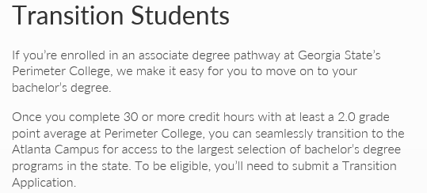
2 Year Colleges
Transferring to 4 Year Colleges:
Georgia Perimeter to Georgia State University
https://admissions.gsu.edu/bachelors-degree/apply/#transition

Slide 29

SAT/ACT
SAT/ACT can be taken multiple times
Usually required to apply to colleges and universities (not required for technical colleges)
College-bound Seniors should try to take fall semester, if possible, to meet application deadlines
SAT vs. ACT: both are recognized at MOST colleges and universities

Slide 30
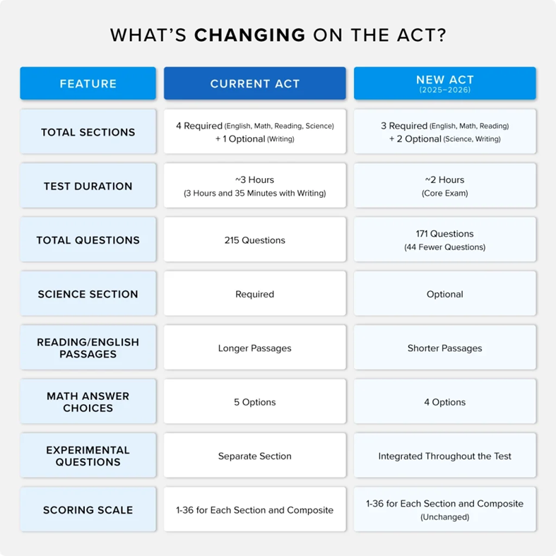

Slide 31

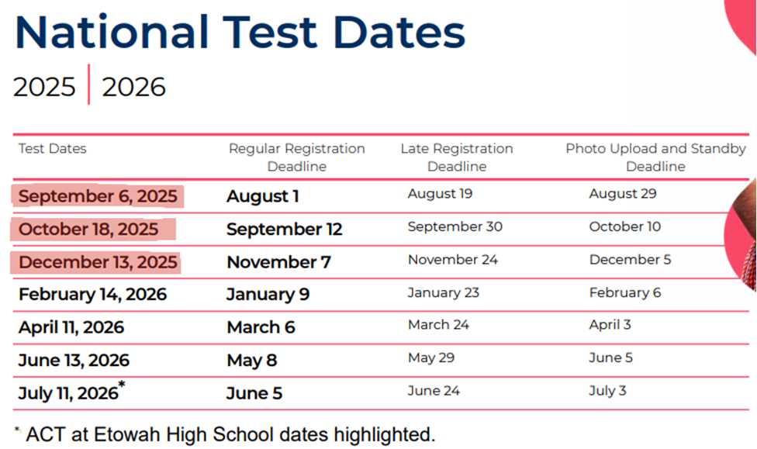
Notes:
March 5 is the first administration of the newly redesigned SAT.

Slide 32
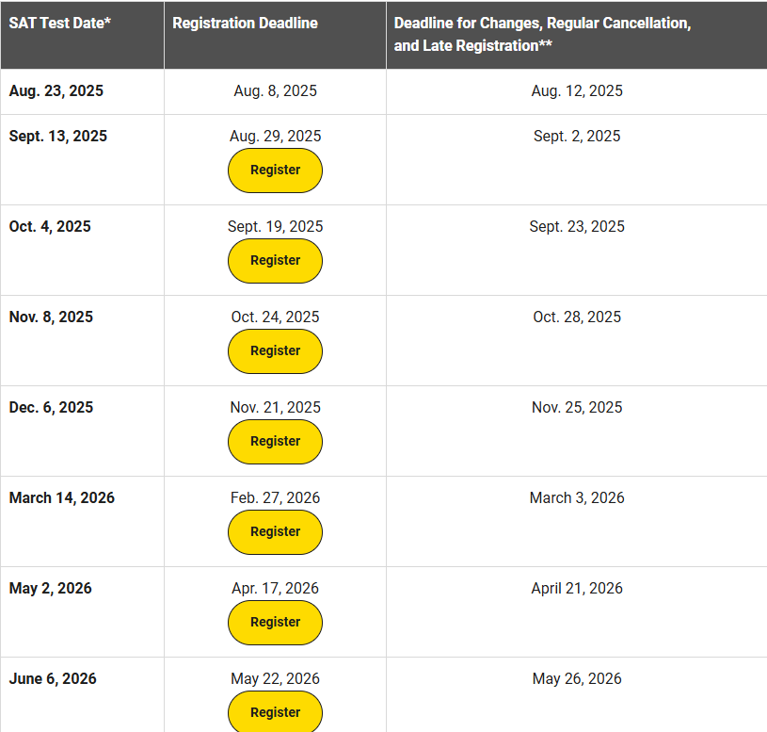
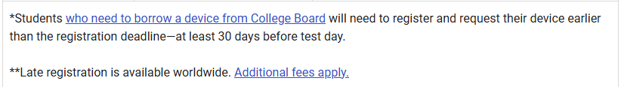
SAT Dates
  EHS DATE
  10/29 School Day
  12th Grade Only
  www.collegeboard.org
Notes:
March 5 is the first administration of the newly redesigned SAT.

Slide 33

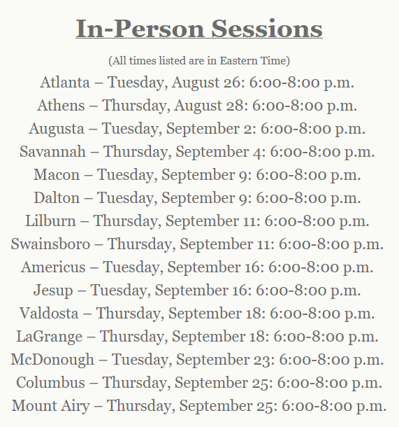
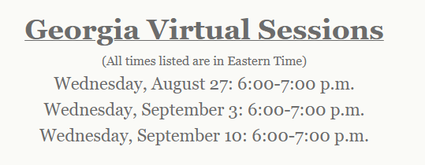
http://www.peachstatetour.org/students.html
Notes:
Log on to gaprobe.org select high school students and you can register for a barcode that colleges can scan to automatically get your information and be able to send you information without you having to fill out their info cards all night.

Slide 34

    www.gaprobe.org
Notes:
Log on to gaprobe.org select high school students and you can register for a barcode that colleges can scan to automatically get your information and be able to send you information without you having to fill out their info cards all night.

Slide 35
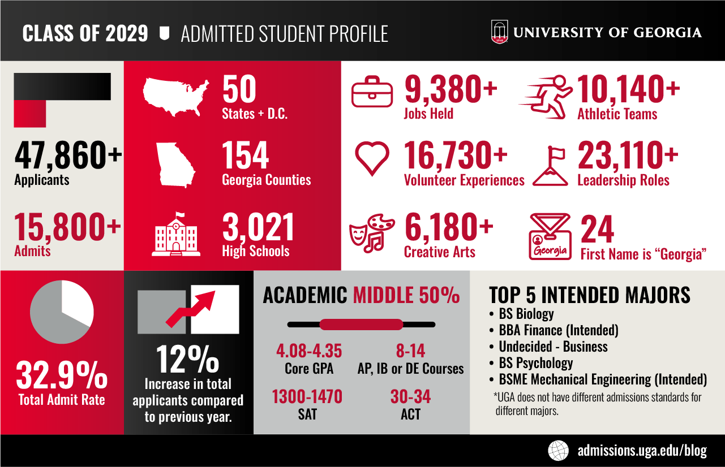

2025 Freshman Admits

Slide 36
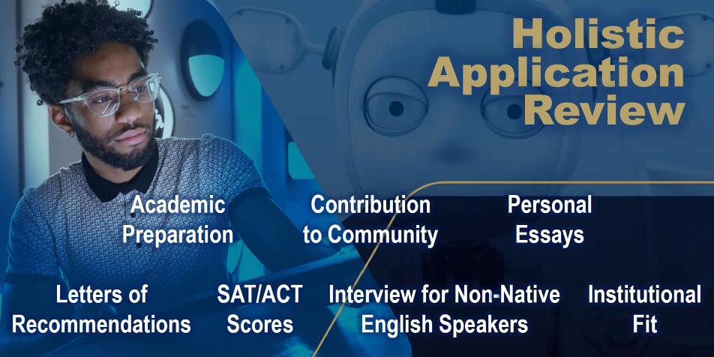




Georgia Southern University Admissions Info
Georgia State University Admissions Info
Albany State University Admissions Info
Georgia Military College Admissions Info
Click here to find Georgia's College and University Admissions Requirements

Slide 37
I’ve got my list of colleges – what’s next
(Stretch School, I think I Have this School, In the Bag school)
Before you apply make sure you’re eligible.
Have you taken the ACT or SAT?
  Register directly with the testing agencies!
  www.collegeboard.org & www.actstudent.org
  Check with the colleges to which you are interested in applying to determine the final test date accepted for admissions.
Do you meet the grade requirements? What is your Academic GPA?
  Colleges individually decide how they calculate their admissions academic GPA.
  Typically, basis is English, Math, Science, Social Studies, and World Language courses.
  Most will calculate an unweighted GPA on a 4.0 scale
Determine the additional requirements of the application:
  Counselor or Teacher recommendation?
  Essay?

Slide 38
NOW APPLY!
The Common Application: Fill out one form for multiple participating colleges
Check to see if your schools are available
www.commonapp.org
Through GAfutures.org
Through the individual college website

Slide 39

You may be asked to…
Submit an essay:
  Not every college application requires an essay.
  Number one rule from college admissions officers – PROOFREAD and FOLLOW DIRECTIONS.
  Be yourself in your essay!
  https://www.collegeessayguy.com/college-essay-resources FREE ESSAY RESOURCES

Slide 40
You may be asked to…
Submit a Transcript
Transcripts can be requested:
www.gafutures.org
  In-State participating schools only
  FREE!!!
www.parchment.com
  In or Out of State Colleges
  Around $5.90 per request
Before submitting your transcript check it for accuracy. VERY IMPORTANT FOR HOPE ELIGIBILITY

Slide 41
You may be asked to…
Submit a Counselor Recommendation: Located on the Senior Canvas Page and Student Services Webpage
Not required for all college applications
Counselor Recommendation Request packets must be dropped off or emailed to your counselor two working weeks prior to due date.

Slide 42
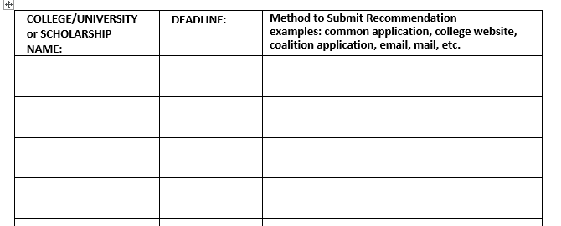
Counselor Recommendation
There is a Counselor Recommendation Request packet under senior info on the EHS website that is required to be submitted to your counselor’s email before a recommendation will/can be written.
Counselor Recommendation Form
List each application requiring a recommendation with due dates
Make sure you link your counselor
Need another recommendation later?
This is the only form you need to turn in again.

Slide 43
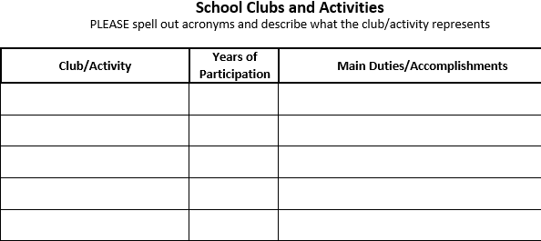
Counselor Recommendation
Self-Assessment Form (REQUIRED)
Answer questions and tell us all about yourself!
Use this information to create your resume

Slide 44
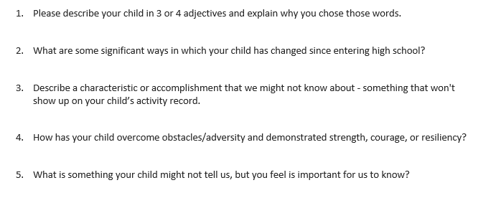
Counselor Recommendation
Parent Rating Form
RECOMMENDED, but will not delay recommendation if not turned in. Parents can email the form directly to your school counselor.

Slide 45

Teacher Recommendation
To receive a teacher recommendation, you will need to ask a teacher who knows you well enough to write about you.
Deal directly with the teacher!
  Talk with the teacher to see what he/she requires from you in order to write a recommendation and let your teacher know that they will be receiving a link to upload your recommendation.
  Follow-up with a thank-you note!

Slide 46
I’ve applied. What Now?
Once you are notified of acceptance by letter or email to your dream college, you’ll be expected to pay for it. The college will communicate with you directly on deadlines for housing, meal plans, financial aid and orientation.
Funding Sources:
  Federal - FAFSA: https://studentaid.gov/
    Application for 26-27 is not open yet. It should open Oct 1st.
Institutional
  Specific college Financial Aid website
  Departmental
  Business school, Music Department, etc.
  Private-Etowah High School/ Student Services/ Scholarships

Slide 47
Financial Aid
Because your financial aid package is created for you and is based on the cost of attending a particular school, your aid amounts will vary from school to school.
Figuring Out Net Price
Follow these easy steps to figure out your net price, or net cost, for each school, and find out which school will be most affordable for you.
First, find the cost of attendance for your program on the aid offer. If the school doesn’t list the cost of attendance on the aid offer, ask the financial aid office for this figure. Make sure it includes amounts you will pay to the school directly (such as tuition and fees) as well as other costs (such as living expenses, books and supplies, and transportation).
Next, subtract the grant and scholarship amounts on your aid offer from the cost of attendance amount. Also subtract any savings you have available to put toward your school costs for the school year. The remaining amount is your net or out-of-pocket cost.
Compare the net costs for the schools you are considering. The net cost is the amount you will have to pay out of your pocket, using earnings from work or loan funds that you borrow.
https://studentaid.gov/complete-aid-process/comparing-aid-offers

Slide 48

FINANCIAL AID NIGHT
Virtual Financial Aid Night
October 15th, 2025
A representative from the Georgia Student Finance Commission will answer questions related to FAFSA, HOPE, LOANS, GRANTS, etc.
Join on your computer, mobile app or room device
Join the meeting now
Meeting ID: 255 481 045 167 4
Passcode: 8ks6Rv3N

Slide 49
HOPE and Zell Miller Scholarship
SSN Verification:
Social Security numbers are required to be in ASPEN for a student to be HOPE eligible.
Rigor Requirement
4 courses complete prior to graduation (examples: Advanced Algebra or higher, Chemistry, Physics, Astronomy, Zoology, 2nd year of Foreign Language or higher, AP Courses)
HOPE Scholarship:
3.0 academic GPA, covers The new rule states that HOPE will cover “100%” of tuition, but there are caveats.
Zell Miller scholarship:
3.7 academic GPA—covers 100% of tuition
SAT 1200 combined CR and Math or 25 ACT composite
This is the information that was shared with us:
HOPE will cover the current year at 100% of the prior year tuition amount. Example: the 2024 year of college gets covered at 2023 tuition rate under HOPE, the 2025 year gets covered at the 2024 rate. If the rates are the same from one year to the next, HOPE funds at 100%; if the rates change from one year to the next then HOPE only covers the amount equal to the prior year.
www.GAFutures.org

Slide 50
HOPE and Zell Miller Scholarship
1. HOPE:
3.0 Core GPA (AP classes weighted +.5 up to 4.0)
Students must maintain a 3.0 GPA in college
HOPE GPA IS NOT ROUNDED! 2.9999 is ineligible!!!
To apply for HOPE/Zell, FAFSA or GSFAPP
*HOPE/Zell Application
2. Zell Miller:
3.7 Core GPA (add .5 weighting for AP courses up to 4.0)
Students must maintain a 3.3 GPA in college
Students who drop below the college 3.3 GPA can earn Regular HOPE if their college GPA remains above 3.0
NOT ROUNDED: 3.6999 will receive HOPE, not Zell Miller
You must submit your SAT or ACT scores to the GA Student Finance Commission for Zell
*Test Score Submission Information

Slide 51

Four of these courses required prior to graduation
Requirement | Examples
Advanced Math | Advanced Algebra, Adv. Financial Algebra, Statistical Reasoning, Pre-Calc, Calculus, Honors Multi Variable Calculus
Advanced Science | Chemistry, Physics, Forensics, Anatomy, Astronomy, Zoology
AP Core Courses | AP English, AP Math, AP Science, AP Social Studies, AP Computer Science, AP Psychology
Dual Core Courses | Various Courses
Advanced World Lang | Spanish, French, German, (2,3,4 and AP)

Slide 52



Scholarships
DON’T PAY TO SEARCH OR VIEW SCHOLARSHIPS
www.fastweb.com
www.collegescholarships.com
www.gafutures.org
and MANY OTHERS
The amount of scholarship money awarded is directly proportional to the amount of time spent searching and applying

Slide 53

Scholarships
  Electronic Scholarship Library
  Weekly student newsletter sent on Fridays through parent square
Etowah Scholarship Page

Slide 54

Resources:
EHS Senior Info on the counselor Canvas Page
A-Z Senior Reference Guide
Counselor Rec Packet
This classroom presentation
https://ehs.cherokeek12.net/student-services
https://bigfuture.collegeboard.org/
Georgia Match

Slide 55
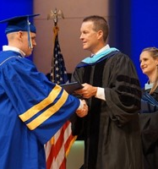
Graduation
TBD
First Baptist Church of Woodstock
Ceremony live streamed https://fbcw.org/

Slide 56

Smart Money Choices
Student Loan Trouble
After College Loan Debt

Slide 57

Your questions?

