Slide 1


Notes:
Good morning/afternoon/evening:
On May 2, voters who live within the Dallas ISD boundaries will vote in the 2026 bond election. This presentation was created to provide you with objective facts about the election and to direct you to resources where you can learn more factual information about what is included in the proposal. Because of state law, nothing that I say during this presentation should be construed as advocating either for or against this election.

Slide 2

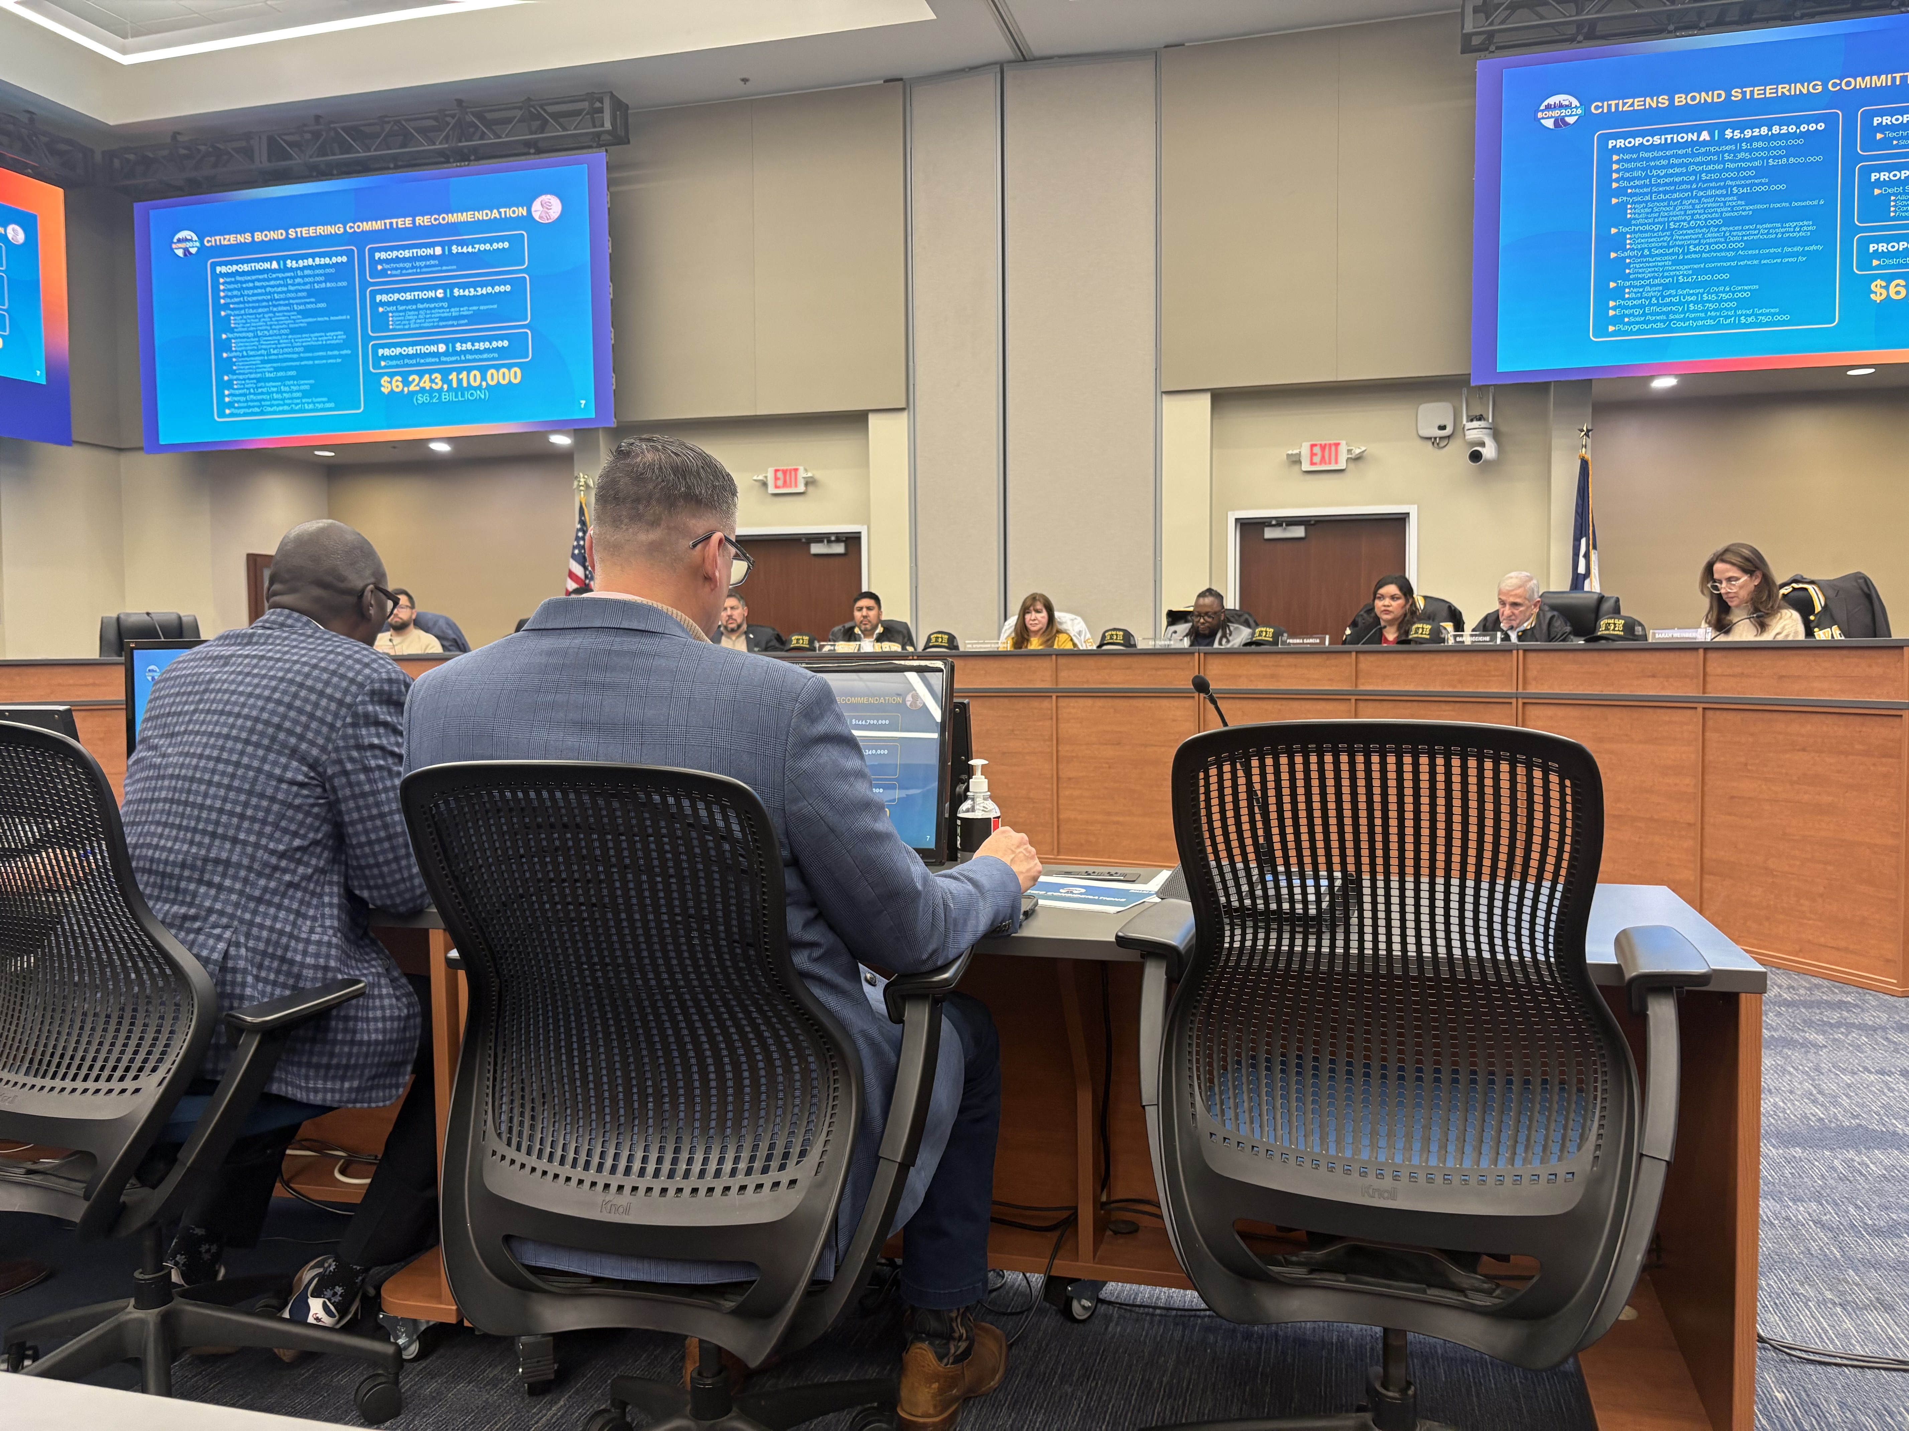
WHEN IS THE BOND ELECTION?
By a unanimous vote, the Dallas ISD Board of Trustees took action on Feb. 12 to approve calling a Bond Election to be held May 2, 2026, to authorize the issuance of
$6.2 billion in bonds
Notes:
In February, the board voted unanimously to send a $6.2 billion bond election to voters on May 2. Early voting begins April 20 and runs through April 28.

Slide 3
WHAT IS A SCHOOL BOND ELECTION?
A school bond election asks voters for permission to sell bonds to investors to raise capital for specific projects, such as building new schools or renovating existing facilities.
It is similar to a homeowner taking out a mortgage to pay for a house and then paying it back over time.
Notes:
What is a bond election? Bond elections ask voters to raise capital for specific projects, such as building new schools or renovating existing facilities—then paying them back over time. They are similar to a homeowner taking out a mortgage to pay for a house and then paying it back over time.

Slide 4
WHAT IS A SCHOOL BOND ELECTION?
Bond funds can only be used for capital projects—things that last many years—not for daily expenses.
They cannot be used for teacher salaries, utilities, supplies, or academic programs. Bonds let school districts fund facility improvements up front and repay the cost gradually through property taxes.
Notes:
Bond funds can only be used for capital projects such as new schools or renovating them—and not for teacher salaries, utilities, supplies or programs. Bonds let school districts fund facility improvements up front and repay the cost gradually over time through property taxes.

Slide 5
WHAT IS IN THE DALLAS ISD BOND ELECTION?
There are 4 propositions on the Ballot—Props A, B, C and D.
Proposition A ($5.929 billion) includes:
26 new replacement campuses
Districtwide renovations at all campuses
Facility upgrades, including the removal of ~700 portables
Safety and security improvements
Technology: cybersecurity and connectivity
Science labs and furniture replacements
Transportation: new buses and bus safety equipment
Playgrounds, courtyards and turf for schools
Physical education upgrade
Notes:
There are 4 propositions on the ballot. State law requires certain propositions to be voted on separately.
Proposition A covers most of the proposal and recommendations from the Citizens Bond Steering Committee, including 26 replacement schools, renovations and upgrades at all campuses, including the removal of approximately 700 portables that are in use for nearly 10,000 students.
Proposition A also would pay for Safety and Security updates, cybersecurity updates, science labs, furniture replacements, new school buses, playgrounds, courtyards and turf for schools.

Slide 6
WHAT IS IN THE DALLAS ISD BOND ELECTION?
Proposition B ($144.7 million)
Technology upgrades, including student, staff and classroom devices
Proposition C ($143.3 million)
Would allow the district to refinance $143 million in debt, giving it the ability to redirect more resources back to classroom operations
Proposition D ($26.25 million)
Repairs and renovations to school district swimming pools
Notes:
State law also requires that the following three propositions be voted on individually:
Proposition B ($144.7 million) includes technology upgrades for classroom devices and laptops to be used by students and staff.
Proposition C would allow the district to refinance $143 million in debt, giving it the ability to redirect more resources back to classroom operations
Proposition D ($26.25 million) would repair and renovate the district’s swimming pools—where students learn to swim.

Slide 7
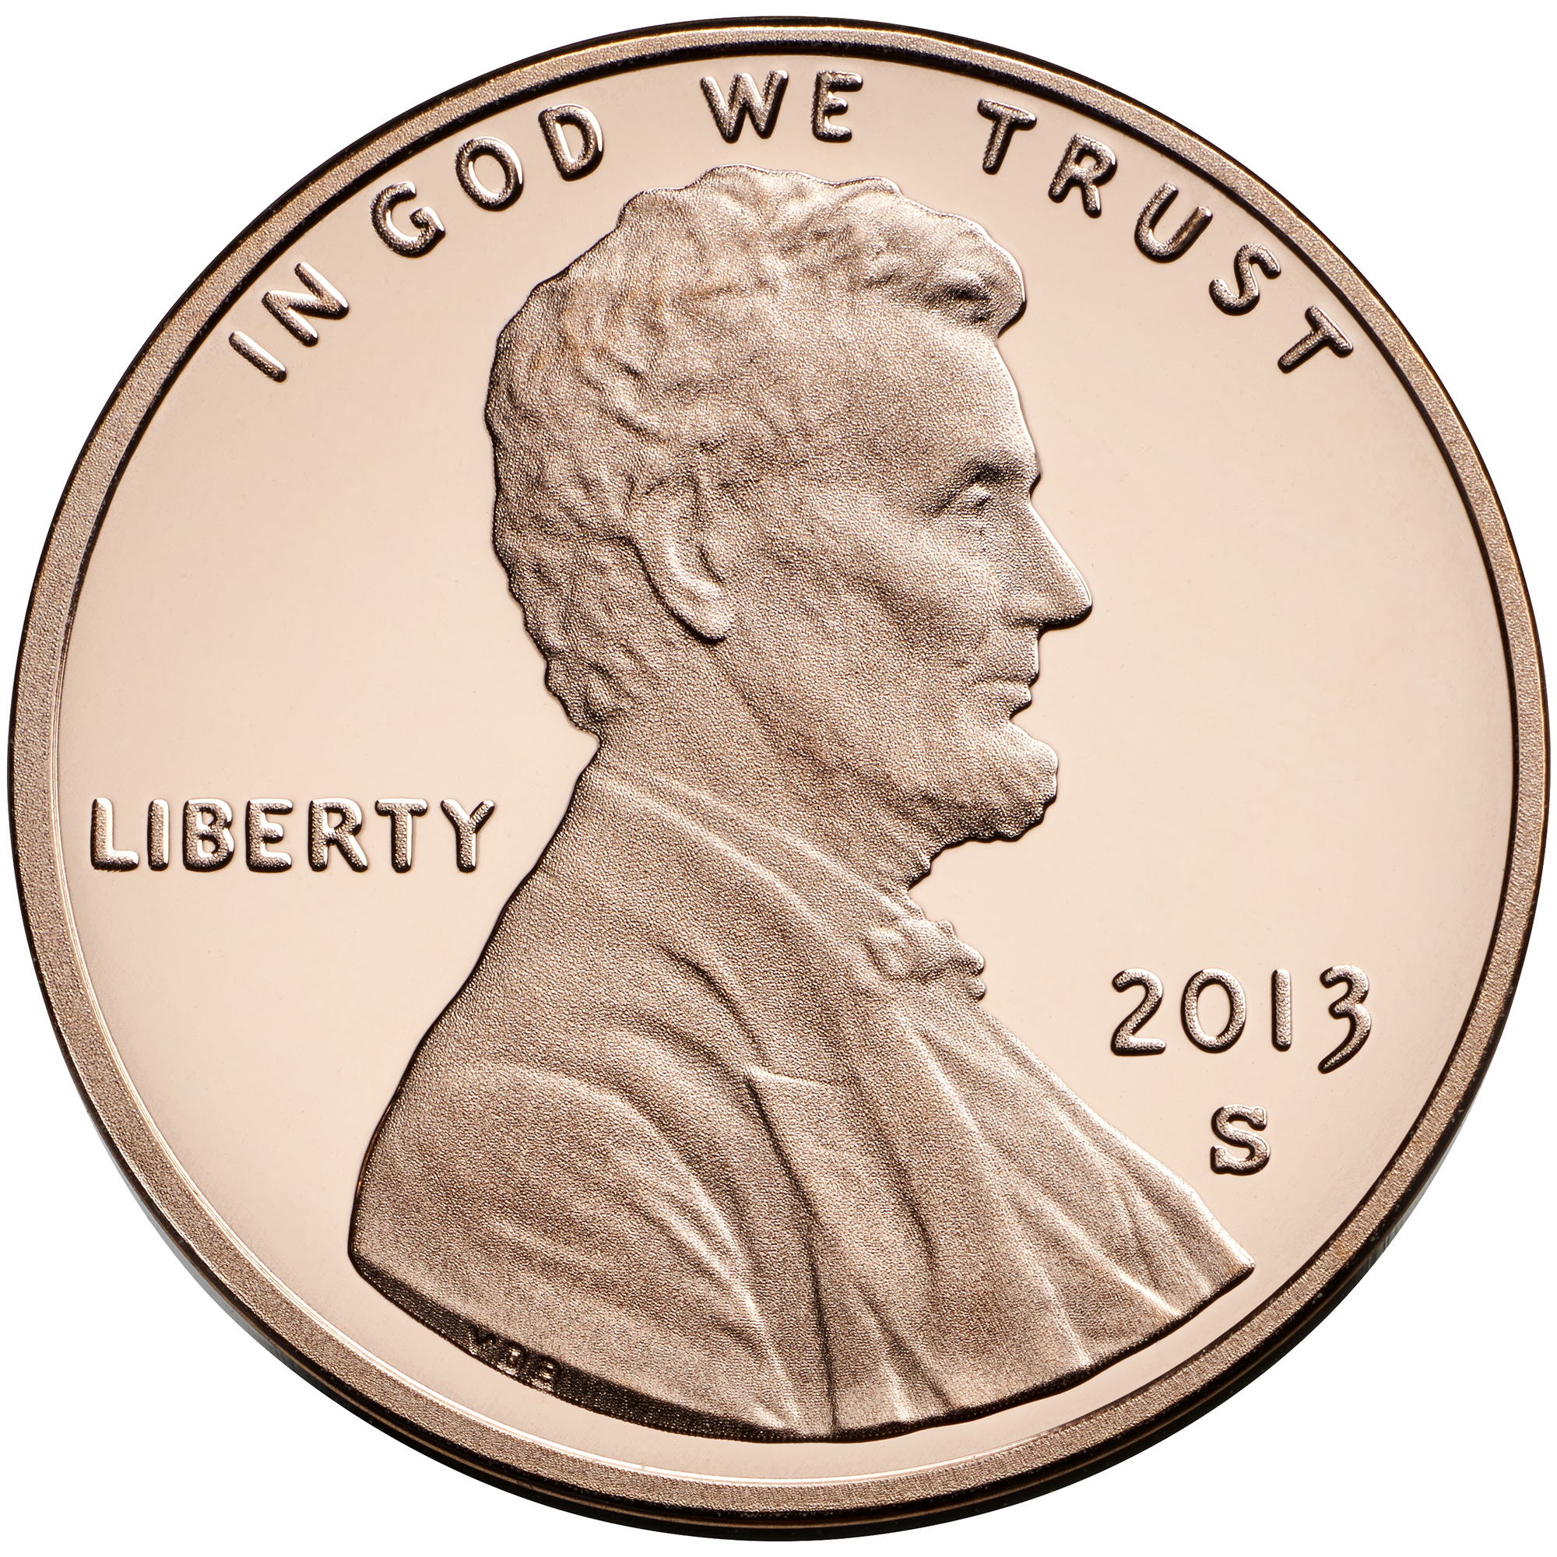
HOW MUCH WOULD
THIS ELECTION INCREASE TAXES?
1 CENT TAX RATE INCREASE
A 1 penny property tax rate increase on an average $500,000 home* would cost ~$2.79 a month or $33.48 a year.
Property owners 65 and above would NOT be impacted, unless major improvements are made to the homestead
* With a homestead exemption
Notes:
How much would this cost taxpayers?
There would be a one-cent property tax rate increase. That means--on an average $500,000 home, assuming a homestead exemption has been filed, it would cost an additional $2.79 a month or $33.48 a year. Property owners 65 and above who have applied for the homestead exemption would NOT be impacted, unless major improvements are made to the homestead.

Slide 8
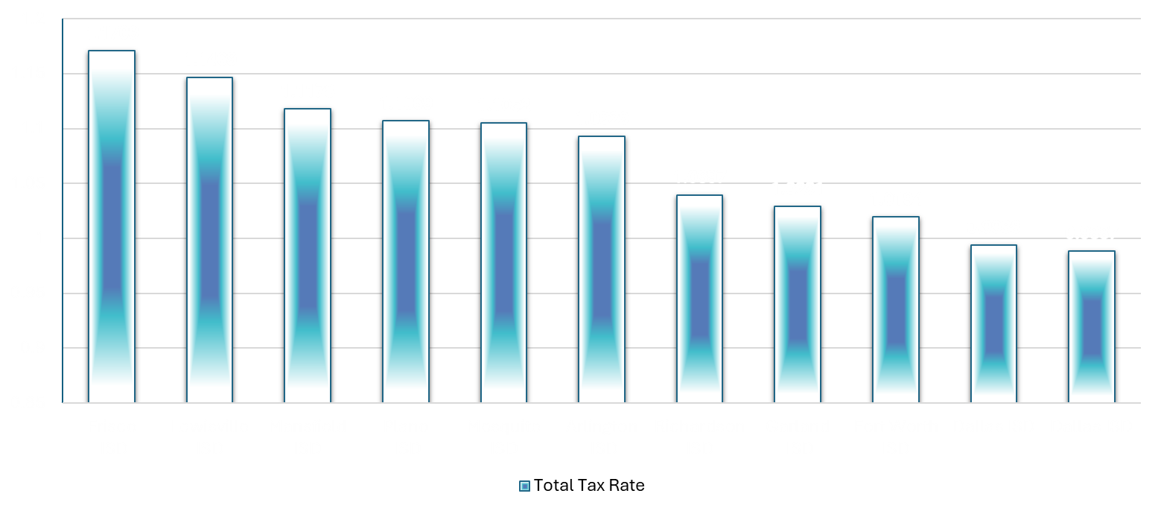
WHAT IS DALLAS ISD’S TAX RATE IN COMPARISON TO OTHER LARGE DISTRICTS IN NORTH TEXAS?
2026 Projected
.01 cent increase
Notes:
Dallas ISD’s tax rate is the lowest among the other 10 largest school districts in North Texas and if voters approve the bond election, the District’s tax rate would still be lower than the 10 largest districts in the DFW area.

Slide 9
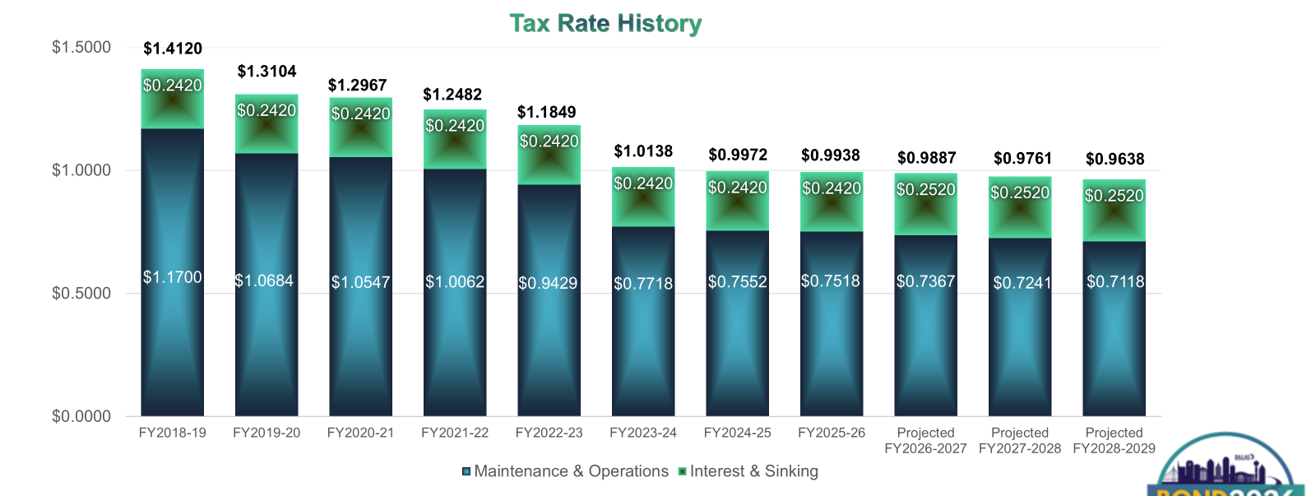
DALLAS ISD TAX RATES
PROJECTED
2026 Projected
.01 cent increase
Notes:
Dallas ISD’s tax rate has decreased each of the last 7 years. Even if the election is approved by voters, Dallas ISD’s tax rate is projected to decrease each of the next 3 years because of tax compression (decreased property taxes) by Texas lawmakers.

Slide 10

RECENT AREA BOND PROPOSALS
$500K Average Home Market Value Tax Impact
District | Election Year | Bond Package ($) | Enrollment | Monthly Tax Impact | Yearly Tax Impact
Richardson ISD | 2025 | 1,400,000,000 | 36,000 | $10.00 | $124.00
Garland ISD | 2023 | 1,279,000,000 | 51,000 | $14.32 | $171.86
Corsicana ISD | 2025 | 205,000,000 | 5,940 | $67.20 | $806.40
Cleburne ISD | 2025 | 232,000,000 | 7,200 | $4.17 | $50.00
Sunnyvale ISD | 2024 | 95,740,000 | 2,317 | $12.35 | $148.20
Calallen ISD | 2024 | 12,573,000 | 3,877 | $8.50 | $102.07
Dallas ISD | 2026 | 6,243,110,000 | 133,748 | $2.79 | $33.48
Notes:
To provide perspective, here’s how Dallas ISD’s bond proposal compares to other recent school district bond proposals.
While Dallas ISD’s total bond package is higher than other districts, because of the number of students, the monthly and yearly impact is lower than that of other Texas school districts that recently passed bond elections.

Slide 11
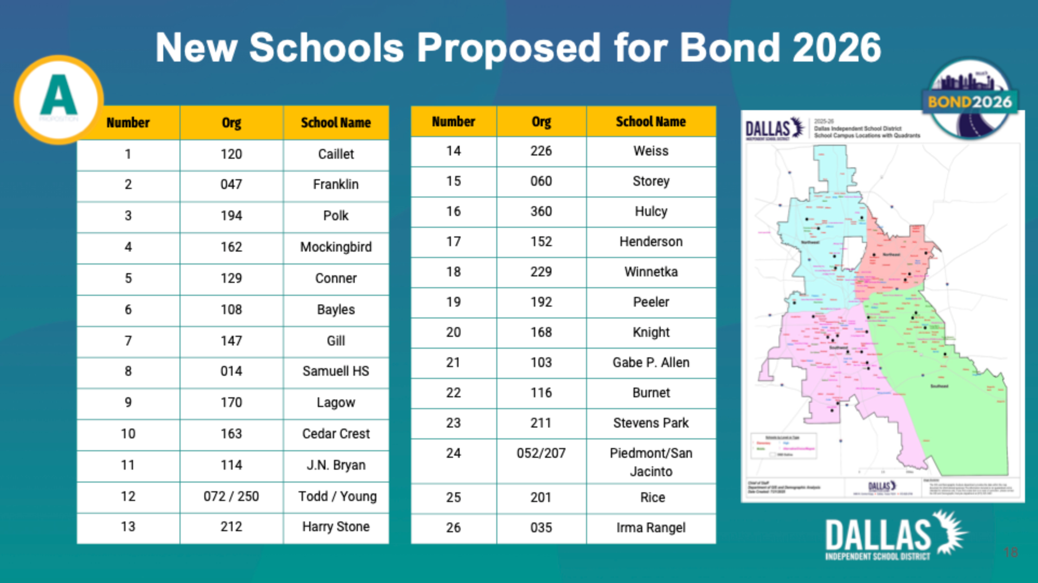
Notes:
These are the 26 schools that would receive new buildings in the 2026 bond proposal. They are spread throughout Dallas ISD. Two of the schools would be combined into one campus as an elementary school along with an adjoining middle school. This is similar to Jack Lowe Elementary and Sam Tasby Middle School.

Slide 12
BOND 2026 WEBSITE
Summary
1-page summary in English and Spanish
Video
Frequently Asked Questions
Proposed Scope for Each Campus
List of Proposed New Schools
Tax Impact Estimator
Citizens Bond Steering Committee information
Bond Planning Timeline
Register to Vote/Important Dates
2020 Bond Dashboard
Notes:
Additional information, including a summary in English and Spanish and a video, is available on the district’s bond website, which can be found at dallasisd.org. On that website is a Proposed Scope for Each Campus which allows you to see what is planned for every school across the district.

Slide 13
BOND 2026 WEBSITE
Notes:
Here are sample pages of what would be proposed for each school.

Slide 14
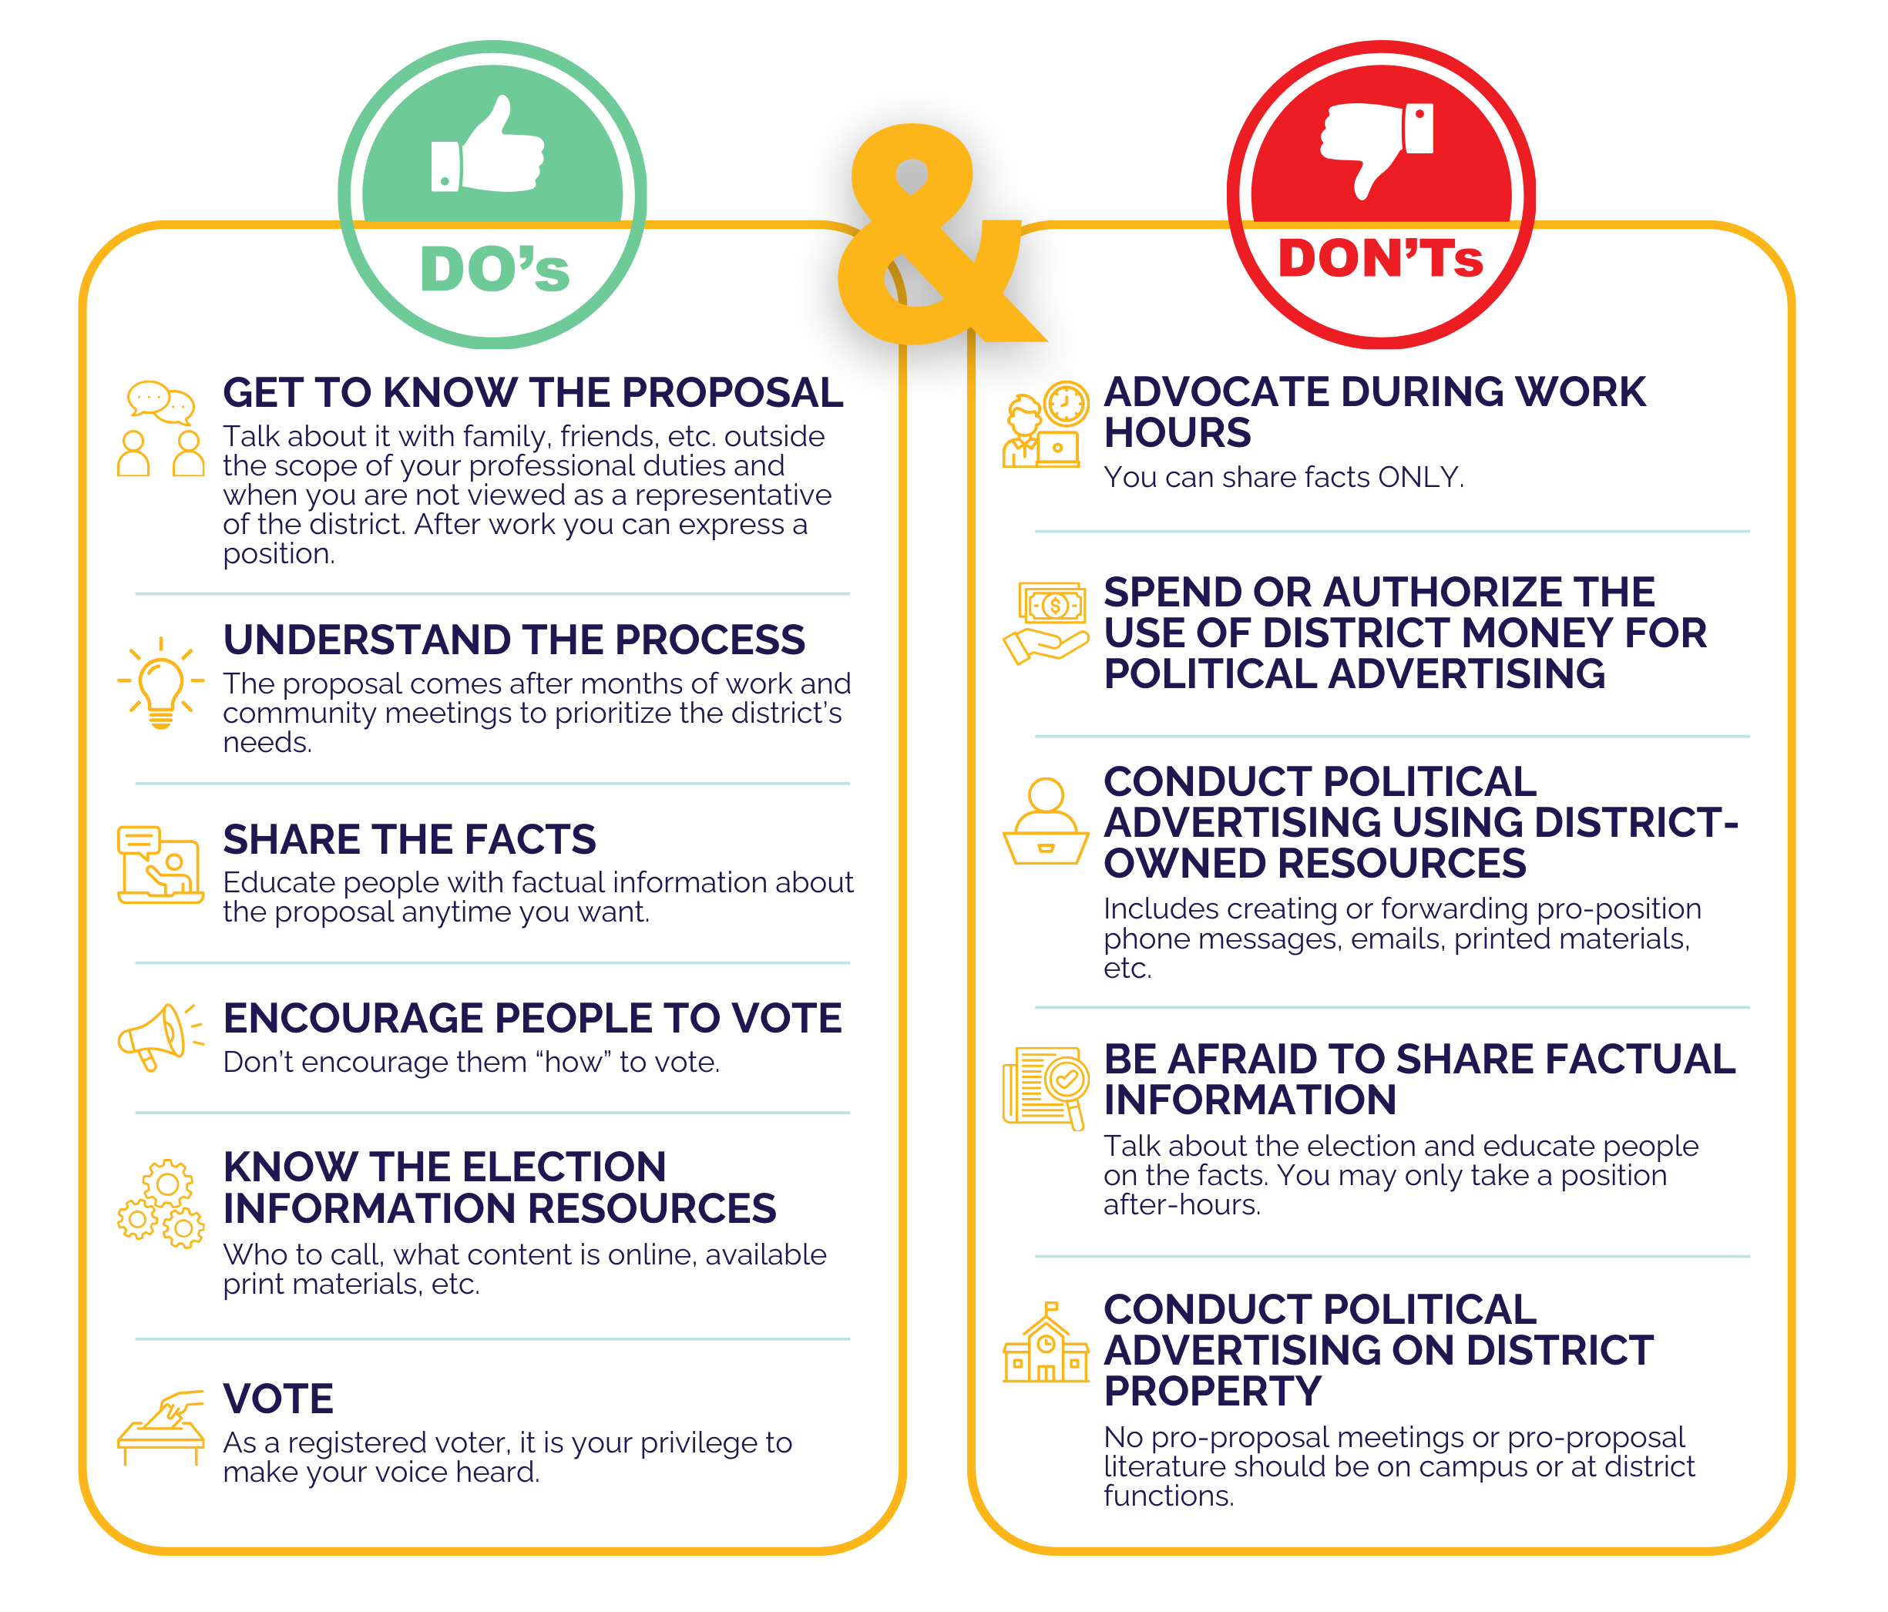
Notes:
Dallas ISD staff can only share facts about the bond election and cannot spend or authorize the use of district money or resources for political advertising. We can, however, encourage people to vote. These Do’s and Don’ts have been provided to school staff about the bond election.

Slide 15
WHAT ARE KEY DATES ASSOCIATED WITH THE BOND ELECTION?
April 2: Deadline to register to vote in the election
April 20-28: Early Voting
May 2: Election Day
Notes:
These are key dates associated with the bond:
April 2 is the deadline to register to vote in the election; if you are already registered at your current address, you do not need to re-register.
Early Voting begins April 20 and runs through April 28.
Saturday, May 2 is Election Day. Polls will be open until 7 p.m.

Slide 16
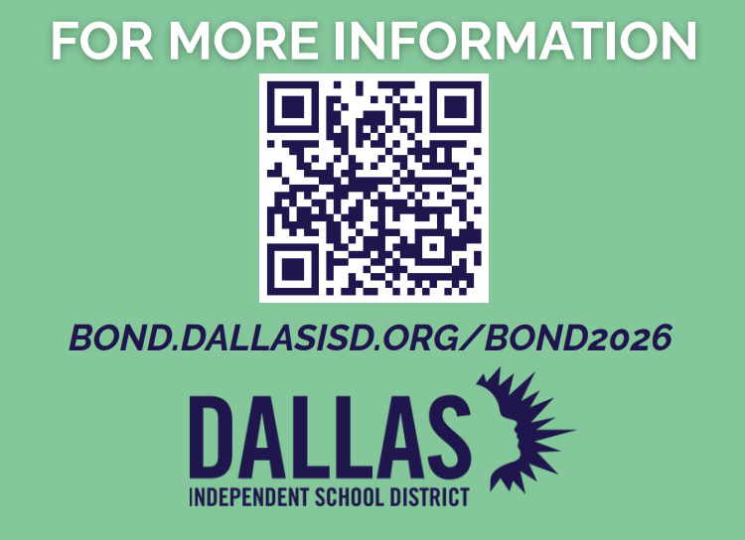
Notes:
Thank you. Again, if you have additional questions, please consult the district’s website or the QR code on the screen.

