Slide 1

Welcome
Title I 2025
Ross Elementary
Principal – Dr. Stephanie Waller
Assistant Principal – Ms. Carla Ross
PLC Coach ELA – Mrs. Monice Montague Williams
PLC Coach Mathematics – Mrs. Tarsha Hudson

Slide 2
Title I
Mrs. Monice Montague- Williams
Before School Tutoring Registration
Tuesdays & Thursdays 7:30 A.M. – 9:00 A.M.
Family Engagement
School Compact
Parents Right to Know
Student Handbook

Slide 3
What is Title 1
Title I is the largest federal aid program for our nation’s schools.
The goal of Title I is to ensure that all students have a fair and equal opportunity to obtain a high-quality education.
Title I resources are directed to schools with high poverty levels.
Title I program serves millions of children in elementary and secondary schools each year.

Slide 4
What is
TITLE
1
Shelby County Schools has roughly 200 (including Charter) schools operating under the Title I program
Ross Elementary is a Federally funded School-wide Title I School
Required by Every Student Succeeds Act (ESSA) to create a positive and supportive learning environment that results in high levels of achievement for all students at Ross.

Slide 5
TITLE 1 FUNDS
Instructional materials for students
Instructional resources for teachers
Extended Learning Opportunities for students
Parental Learning Opportunities
Parental involvement activities
Parent communication

Slide 6
PARENT’S RIGHT TO KNOW
You have a right to request the following:
A teacher’s professional qualifications, licensure, or certification
A paraprofessional’s qualifications
Academic services available for your child

Slide 7
MEASURES of ACHIEVEMENT
Ross Elementary is continuing to grow and make gains academically!
With new and more rigorous Tennessee State Standards and assessments for grades K-12, there have been and will be more changes in our measures of achievement.

Slide 8
PARENTAL INVOLVEMENT
As a part of Every Student Succeeds Act (ESSA), parental involvement is required in the educational process.
Research has shown that effective parental involvement leads to higher academic achievement for children.

Slide 9
Parental Involvement/
Family Engagement Plan
Purpose: To build a long-range program of collaboration between the school and parents that will effectively support the school’s vision of providing a high-quality education for all students.
Goal: To prepare parents with the knowledge of the skills and information needed to help their children be successful in school.

Slide 10
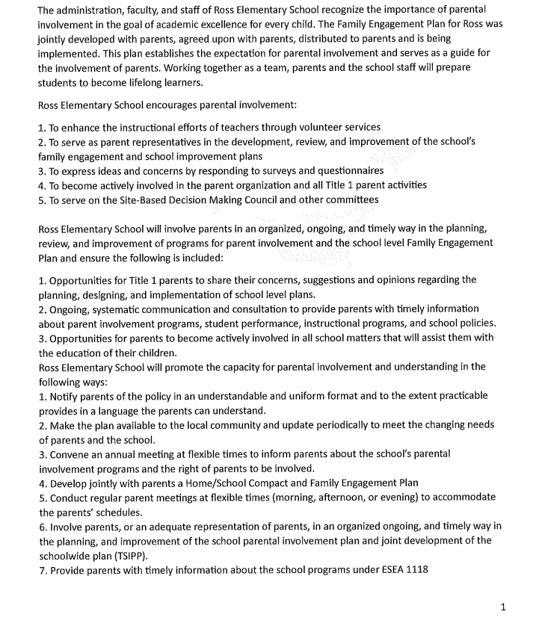
FAMILY ENGAGEMENT PLAN

Slide 11
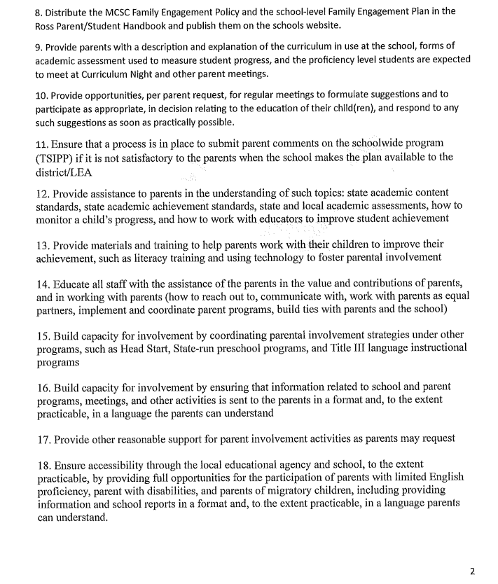
FAMILY ENGAGEMENT PLAN cont.

Slide 12
Ross Elementary’s Parent/Family Engagement Plan
Ross Elementary School has a special responsibility to our parents and the community by providing opportunities for you to get involved and share the responsibility of promoting success in our children.
To ensure that our parents participate in the development and implementation of the school’s program, Ross Elementary will do the following:
  Develop jointly with parents a written school level family engagement plan and parent-school compact showing how parents, school, and students share responsibilities.
  Distribute the family engagement plan and parent-school compact to all students, parents and staff members and acquire all signatures.
  Convene an annual meeting at flexible times and invite all parents to attend in order to explain the components and requirements of Title I Program.
  Provide regular and flexible parent meetings, parent trainings and “Family Nights” in the area of Literacy, Math, Science, and Social Studies.
  Provide parents with timely information about upcoming events and programs through the use of weekly newsletters from teachers and a monthly school wide newsletter.

Slide 13
Ross Elementary Family Engagement Plan
Parents play an important role in the success of children. Our parents can fulfill this level of success by:
Attending meetings, programs, workshops, and other school activities.
Participating in AT LEAST ONE school sponsored parent-teacher conference.
Serving on a committee and participating in the decision-making process.
Responding to memos, surveys, and questionnaires expressing ideas and concerns.
Serving as a volunteer at the school.
Ensuring that your child studies at home and completes homework assignments.
Voicing concerns and providing feedback at parent meetings.

Slide 14
Title I Home/School Compact
Purpose: The compact is designed to put emphasis on the shared responsibility of parents and schools for the high performance of children.
Designed: The document is an agreement between the parent, student, teacher, and Principal Waller, that is aimed at helping students emphasize the importance of improving and increasing student achievement.

Slide 15
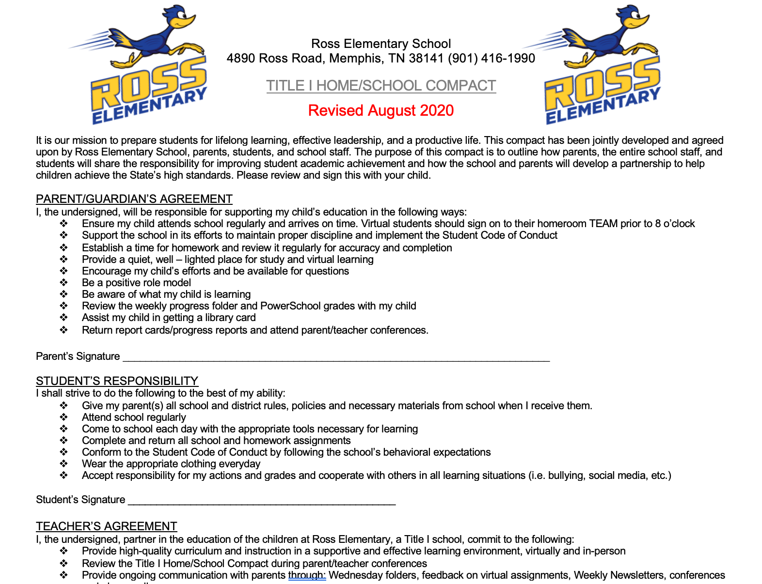
Ross Elementary School
Title I Home/School Compact
Revised May 2025

Slide 16
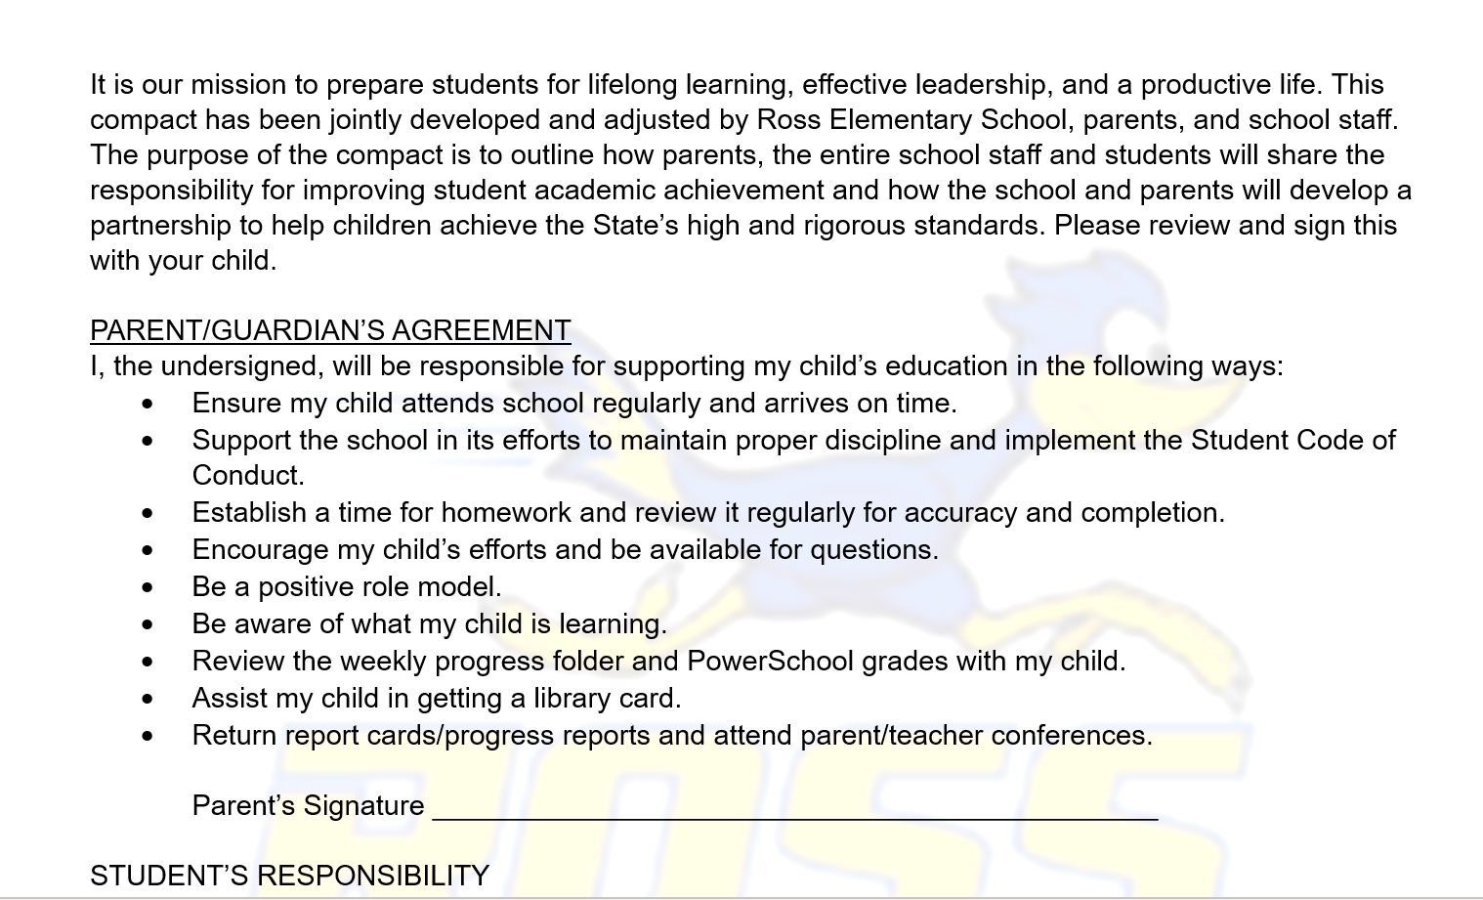
Ross Elementary
Code of Conduct

Slide 17
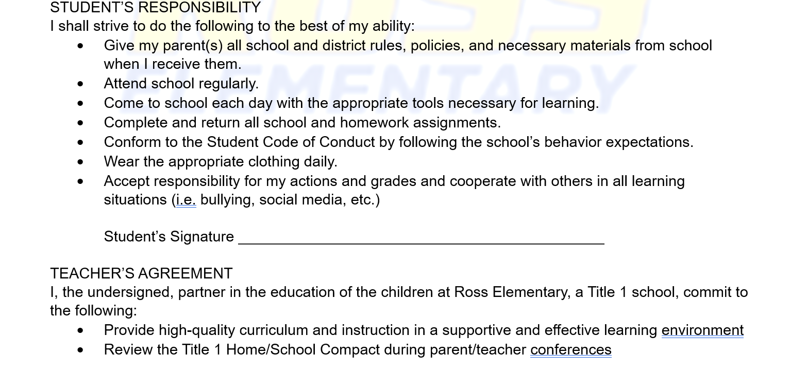

Slide 18
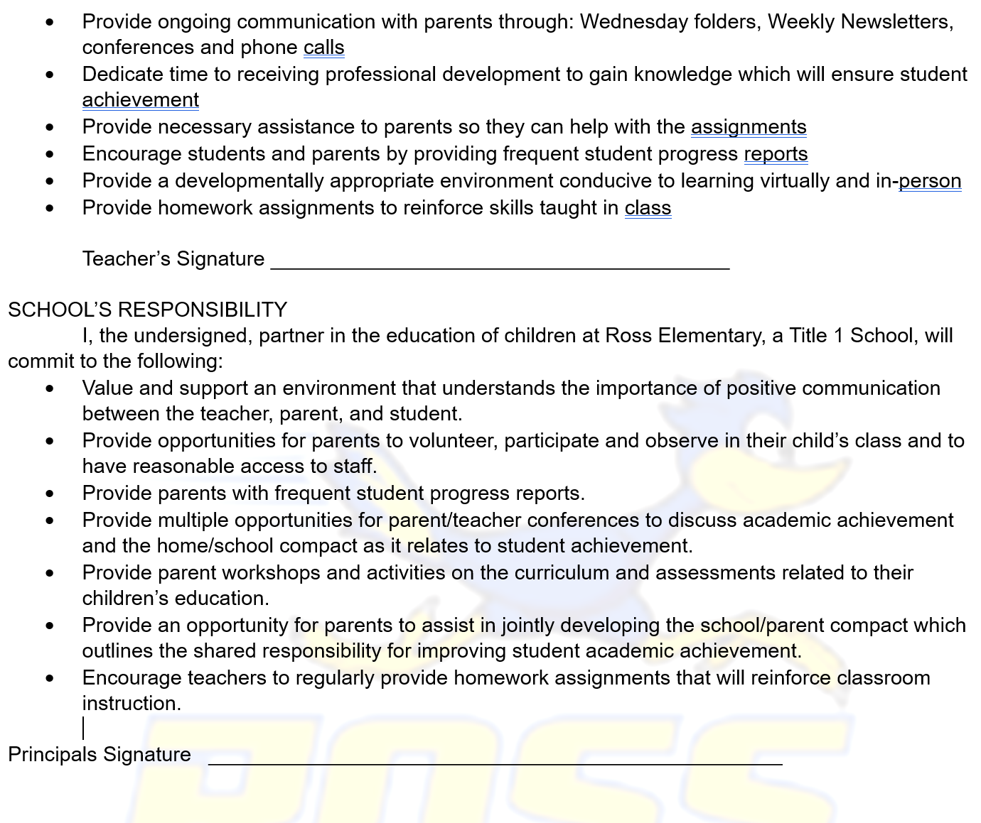

Slide 19
Opportunities for Parental Involvement-School Level
2nd Semester
Pastries with Parents
Data Night
Family Math/Science Night
Reading Fair
Field Day-May 2025
**You will receive more information regarding each of these parent activities as we approach them during the school year.
1st Semester
Title Parent Meeting
Parent University
Data Night
Family Literacy Night
Read for the Record

Slide 20
Opportunities for Parental Involvement-School Level
Volunteer Opportunities:
Arise2Read Volunteer (2nd Grade)
TNREADY Proctor

Slide 21

OPEN HOUSE

Slide 22
Parent Teacher Conferences
Shelby County Schools has scheduled two dates this school year for parent-teacher conferences. Conferences are completed once a semester.
  Additional Conferences can be scheduled as needed with your child’s teacher, during their planning time or before/after school (at the teacher’s availability).

Slide 23
During registration, you electronically signed the 2025 – 2026 Shelby County Schools Student-Parent Handbook.
Within the handbook is the SCS Student Code of Conduct, which is a guide to behavioral and disciplinary actions in Shelby County Schools.
Student Code of Conduct

Slide 24
School Improvement Plan
Our School Improvement Plan is the instructional guide for our school.
The purpose of the School Improvement Plan is to assist educators in using data to prioritize performance targets for our school to determine a focus or clarity of purpose for improving student performance.
Revisions for the 2025-2026 school year occurred in May of 2025. We will update the plan throughout the year as need. Your input is needed and valued to improved the school’s performance. You have received a copy as you entered the door. A copy is also in the front off for you to view at any time.

Slide 25
Staff Introduction
Principal Dr. Stephanie Waller

Slide 26
School Wide Expectations
Attendance
RTI 2
Professional School Counselor
Professional School Counselor
Mrs. Shirley Lowery
Ms. Terrica Hamlett

Slide 27

Classroom Visits
&
Survey
2025

