Slide 1



Annual Title I Parent Meeting
Scenic Hills Elementary
2025-2026
Mrs. Camie Cox, PLC Coach

Slide 2

Table of Contents!
Title I Meeting Agenda
District/School Progress/School Status
What is a Title I school?
Parent Training and Opportunities for additional parent meetings
What are your rights?
Teacher Qualifications
Parent and Family Engagement Policy and Requirements
Notice of Title I School Status
Parent-Teacher Conferences
School-Parent Compact
Student Code of Conduct
School Improvement Plan

Slide 3

01
What is Title I?
The goal of Title I is to provide a high-quality education for every child.
Title I is the largest federal aid program for our nation’s schools.
Title I resources are directed to schools with high poverty levels.

Slide 4

Parents’ Rights to Know
Request opportunities for regular meetings to formulate suggestions and to participate, as appropriate, in decisions about the education of your child.
The Every Student Succeeds Act (ESSA) allows parents and guardians the ability to request information regarding the professional qualifications of the student’s teachers and paraprofessionals.
The families and parents of Title I students have a right, by law, to:
Request and receive information on the qualifications of your child’s teacher and paraprofessional who are working with your child

Slide 5
What is a Parent and Family Engagement Policy?
These plans address how the district and school will implement the parent and family engagement requirememtns of ESSA. Components include:
how parents and families can be involved in decision-making and activities;
how parent and family engagement funds are being used;
You as a Title I parent or family member, have the right to be involved in the development of these plans
how information and training will be provided to families; and
how the school will build capacity in families and staff for strong parent and family engagement

Slide 6
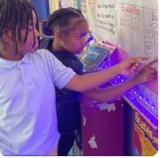
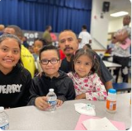

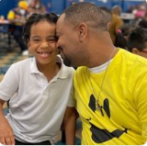
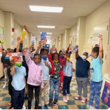

“Through effective communication with parents, teachers can have the greatest impact on their side, teachers can more effectively manage most academic and behavioral issues that arise. When the most important adults in a child’s life are working together, students benefit enormously.”

Slide 7

Book Title. P52
More Benefits of Family Engagement
For students:
For Parents and Families:
For schools and Teachers:
Higher grades and test scores
Better attendance
More positive attitudes and better behavior
Higher graduation rates
Greater enrollment in postsecondary education
More confidence and trust in the school
Creates a home environment that encourages learning
Encourages families to form stronger relationships with teachers and other families
Improved teacher and staff morale
Higher ratings of schools and teachers by families
More support from families

Slide 8
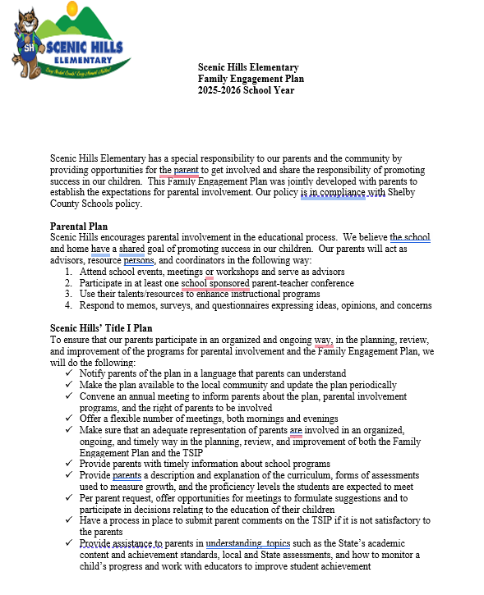
Family Engagement Plan
Purpose: To build a long-range program of collaboration between the school and parents that will effectively support the school’s vision of providing a high-quality education for all students.
Goal: To prepare parents with the knowledge of
the skills and information needed to help their children be successful in school.
found on the school’s website at https://schools.scsk12.org/scenichills-es

Slide 9
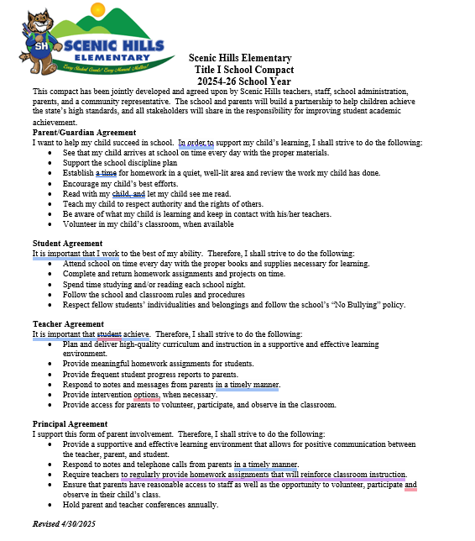
School-Parent Compact
Purpose: The compact is designed to put emphasis on the shared responsibility of parents and schools for the high performance of children.
Designed: The compact has outlined how parents, the entire school staff, and students will share responsibility for improved student achievement.
found on the school’s website at https://schools.scsk12.org/scenichills-es

Slide 10
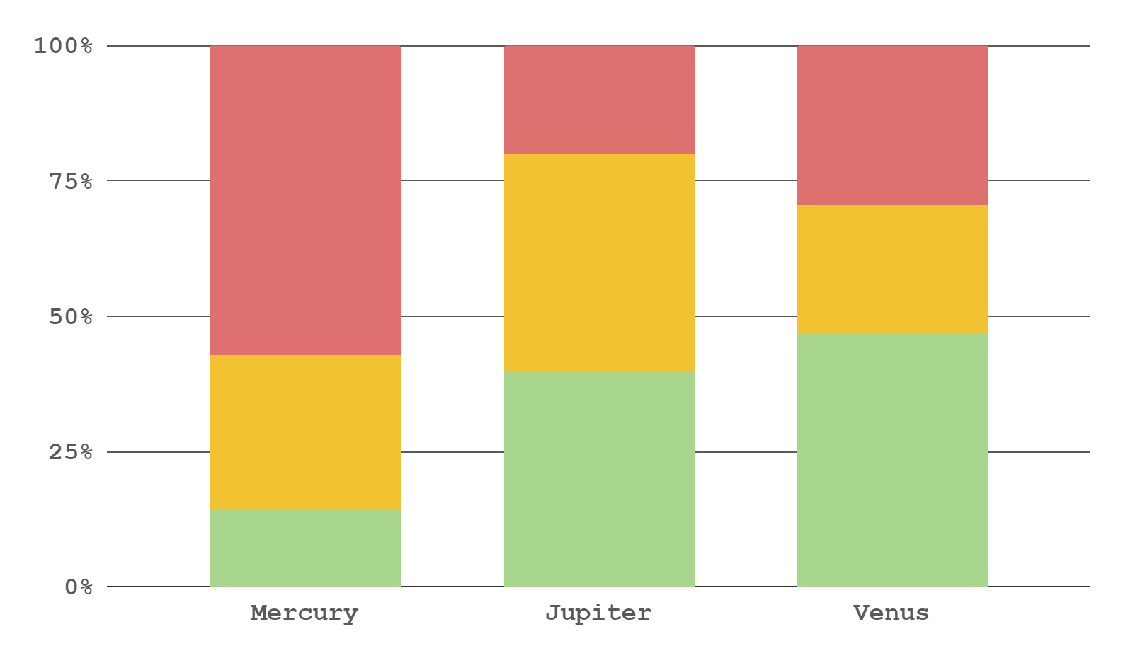

Did you know this?
35%
65%
Teachers at Scenic Hills Elementary have several ways of communicating student progress!!
HW Folders
Newsletters
Monthly Calendars
Intervention Reports:
I-Ready
TN Ready/Parent Reports
Progress Reports
Report cards
Phone calls to parents
Daily folders
Family Night
Parent teacher conferences

Slide 11

Opportunities for Parental Involvement
How can you be involved?
Serve as a volunteer at the school.
Attending meetings, program, workshops, and other school activities.
Ensuring that your child studies at home and completes homework assignments.
Participating in AT LEAST ONE school sponsored parent-teacher conference.
Sign students up for tutoring!
Before school tutoring begins September 8th Information will be sent home soon!
LiveSchool is our school’s behavior management system.
Sign-up info will be sent home
Serve on a committee and participating in the decision-making process.

Slide 12
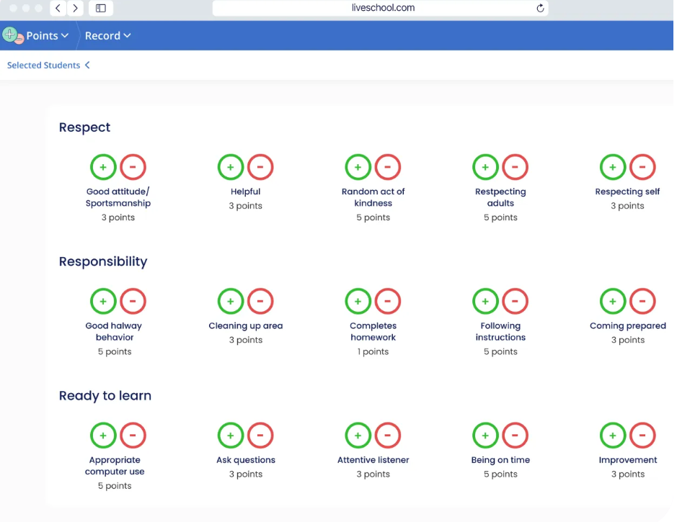
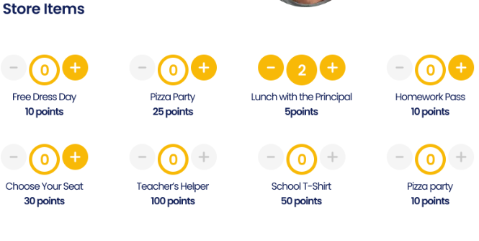

Slide 13
Thanks!
Do you have any questions?
PLC Coach
Camie Cox
coxc@scsk12.org
901-416-4342
Angela Brookins
Professional School Counselor
brookinsam@scsk12.org
901-416-4342
Family Engagement Specialist:
Tameka Coburn
coburntd@scsk12.org
Please keep this slide for attribution.

