Slide 1

Title IX K-12 Training
Level 1 Training
with Melissa Martinez Bondy and Kate V. Davis

Slide 2
Disclaimers
We can’t help ourselves. We’re lawyers.
We are not giving you legal advice
Consult with your legal counsel regarding how best to address a specific situation

Slide 3
Posting These Training Materials?
Yes!
Your Title IX Coordinator is required by 106.45(b)(10)(i)(D) to post materials to train Title IX personnel on its website
We know this and this is why this slide deck has been made available to you electronically

Slide 4

Title IX Prohibits Sex Discrimination
“No person in the United States shall, on the basis of sex, be excluded from participation in, be denied the benefits of, or be subjected to discrimination under any education program or activity receiving Federal financial assistance…”

Slide 5
Discrimination = Treating people differently
Discrimination is the act of treating people differently based on a protected characteristic (or stereotypes based on that characteristic)
Focus on access to education opportunities, resources, programs
Disparate treatment in the workplace/school
Disparate impact claims (neutral policies that have discriminatory impacts

Slide 6
Sex Discrimination under Title IX 34 C.F.R. § 106.31(b)
Treat one person differently from another in determining whether such person satisfies any requirement or condition for the provision of such aid, benefit, or service
Provide different aid, benefits, or services, or provide aid, benefits, or services in a different manner
Deny any person such aid, benefit, or service
Subject any person to separate or different rules of behavior, sanctions, or other treatment

Slide 7
Sex Discrimination under Title IX (con’t.) 34 C.F.R. § 106.31(b)
Apply any rule concerning the domicile or residence of a student or applicant
Aid or perpetuate discrimination against any person by providing significant assistance to any agency, organization, or person which discriminates on the basis of sex in providing any benefit or service to students or employees
Otherwise limit any person in the enjoyment of any right, privilege, advantage, or opportunity

Slide 8
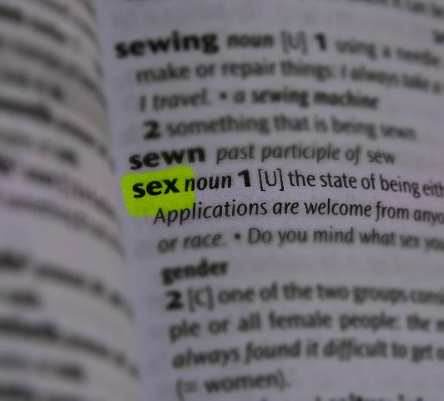
What does “sex” mean?
Biological sex
Gender
Sex stereotyping
Sexual orientation**
“Sex” as a verb

Slide 9

Sexual Harassment Definitions under the Title IX Regulations

Slide 10

Definitions of Sexual Harassment under Title IX
Three Categories

Slide 11
Quid Pro Quo
An employee of the recipient conditioning the provision of an aid, benefit, or service of the recipient on an individual’s participation in unwelcome sexual conduct

Slide 12
Quid Pro Quo (con’t.)
Latin phrase meaning “this for that” or “something for something”
Respondent must be an employee
May involve a power differential
“Everyone knows that so-and-so…”
Voluntary conduct between some may put observers in the position of believing that something sexual is necessary to get something favorable

Slide 13
Hostile Environment
Unwelcome conduct determined by a reasonable person to be so severe, pervasive, and objectively offensive that it effectively denies a person equal access to the recipient’s education program or activity

Slide 14
Hostile Environment (con’t.)
Unwelcomeness is subjective
Severe, pervasive, and objectively offensive is based on reasonable person standard
Can occur:
off-campus (if in educational program or activity)
between people in a dating/romantic relationship
between people of incompatible sexual orientations
Intent is not an element

Slide 15
Clery Crimes
Sexual Assault – Rape**, criminal sexual contact** (formerly “fondling”), statutory rape, incest
Dating violence
Domestic violence
Stalking (on the basis of sex)
**Definitions updated in June 2025

Slide 16
Clery Crimes (con’t.)
Severe, pervasive, and objectively offensive are not elements
Consent requires an affirmative agreement to engage in sexual activity
Look to policy definition
Different from “unwelcome” under hostile environment

Slide 17
The School’s Obligation
A recipient with actual knowledge of sexual harassment in an educational program or activity of the recipient against a person in the United States, must respond promptly in a manner that is not deliberately indifferent. A recipient is only deliberately indifferent if its response to sexual harassment is unreasonable in light of known circumstances.

Slide 18
When does a school have notice of sexual harassment?
Actual knowledge = notice of sexual harassment or allegations of sexual harassment to a recipient’s:
Title IX Coordinator, or
Any official of the recipient who has authority to institute corrective measures on behalf of the recipient, or
To any employee of an elementary or secondary school
34 C.F.R. § 106.30(a)

Slide 19
General Response to Sexual Harassment
District obligation is to respond promptly in a manner that is not deliberately indifferent
Deliberate indifference = clearly unreasonable in light of known circumstances
Title IX Coordinator must promptly contact complainant to discuss supportive measures and explain the process for filing a formal complaint

Slide 20
Formal Complaint
Formal Complaint – “a document filed by a complainant or signed by the Title IX Coordinator alleging sexual harassment against a respondent and requesting that the recipient investigate the allegation of sexual harassment”
Complainant – “an individual who is alleged to be the victim of conduct that could constitute sexual harassment”
Triggers Grievance Process

Slide 21
Presumption: Respondent is Not Responsible
“[The grievance process must include] a presumption that the Respondent is not responsible for the alleged conduct until a determination regarding responsibility is made at the conclusion of the grievance process”
34 C.F.R. § 106.45(b)(1)(iv)

Slide 22
Discipline Must Wait
Title IX regs impose an intensive and lengthy process for intake, investigation, and determination of conduct involving sexual harassment
Respondent is presumed not responsible, which means the entire grievance process MUST be completed BEFORE any discipline is imposed

Slide 23
Jurisdiction
“If the conduct alleged in the formal complaint would not constitute sexual harassment… even if proved, did not occur in the recipient’s education program or activity, or did not occur against a person in the United States, then the recipient must dismiss the formal complaint with regard to that conduct for purposes of sexual harassment under Title IX or this part; such a dismissal does not preclude action under another provision of the recipient’s code of conduct.”
34 C.F.R. § 106.44

Slide 24
Educational Program or Activity
“Includes locations, events, or circumstances over which the recipient exercised substantial control over both the respondent and the context in which the sexual harassment occurs, and also includes any building owned or controlled by a student organization that is officially recognized by a postsecondary institution.”
34 C.F.R. §106.30(a)

Slide 25
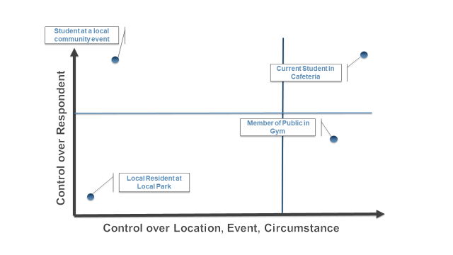
Determining Jurisdiction

Slide 26
Hypothetical #1
Chuck and Mary Sue are both bus drivers. Chuck asks Mary Sue out on a date, but Mary Sue says no.
Chuck asks Mary Sue out over the radio, and Mary Sue says no again. The transportation supervisor warns them both informally not to discuss personal matters over the radio.
Chuck corners Mary Sue in the breakroom before the morning route and asks her why she won’t go out with him. He won’t let her leave until she says yes. Their supervisor writes them both up for starting their routes late.
Do you agree with the supervisor’s response?

Slide 27
Hypothetical #2
Mr. Smith is a well-loved teacher in your building where you are the principal
He is always commenting on how pretty his female students look
Josie, a student, is his helper and comes to his room during 4th period class to grade papers
Josie’s mother brings you text messages that Mr. Smith has been sending to Josie. They are personal, but not sexual.
What should the principal do?

Slide 28
Hypothetical #3
10th grader Cole approaches a trusted teacher after class and mentions that he was at a party last Friday night
Cole tells the teacher he was kissing another student at the party, and then she reached down his pants and touched him in a way that made him uncomfortable after he told her to stop
Cole asks the teacher not to tell anyone, saying he “doesn’t want to make a big deal out of it”
What should the teacher do?

Slide 29
Hypothetical #4
You’re a custodian in the school district
While working in the boys’ locker room one evening, you overhear a student complaining to his friend about the annual “hazing ritual” that happens in the locker room
The student tells his friends that he’s “dreading the towel on his privates…”
What should the custodian do?

Slide 30

Mandatory Reporting
Child Abuse
Felonies
If a school employee engages in sexual conduct with a student, it must be reported
Even if the student is 18**
Professional Conduct Reporting**

Slide 31
Retaliation
Retaliation defined in part: “No recipient or other person may intimidate, threaten, coerce, or discriminate against any individual for the purpose of interfering with any right or privilege secured by Title IX or this part, or because the individual has made a report or complaint, testified, assisted, or participated or refused to participate in any manner in an investigation, proceeding, or hearing under this part…”
34 C.F.R. § 106.71

Slide 32
Retaliation (con’t.)
Report this immediately to the Title IX Coordinator
Adverse action against an individual
Abuse, violence, threats, and intimidation
More than just someone expressing their opinion

Slide 33
Key Takeaways for Staff
Understand the definition of sexual harassment
Know who the District’s Title IX Coordinator is (see Board policy)
Report any potential Title IX violation to the Title IX Coordinator the same day you receive notice of it – including acts of retaliation
Understand supportive measures you may need to help implement

Slide 34
Key Takeaways for Administrators
Everything listed in the previous slide for staff
Ensure Title IX policy is up to date
Follow notice and posting requirements for anti-discrimination, Title IX policies, and training materials

Slide 35
Training Requirements for Your Title IX Team
The definition of sexual harassment as defined in 34 C.F.R. § 106.30
The scope of the district’s education program or activity
How to conduct an investigation and the grievance process, including appeals and informal resolution
How to consistently apply definitions used by the district with respect to consent (or the absence/negation of consent)
How to serve impartially and avoid prejudgment of facts at issue, conflicts of interest, and bias
Additional requirements for decision-makers and investigators

Slide 36
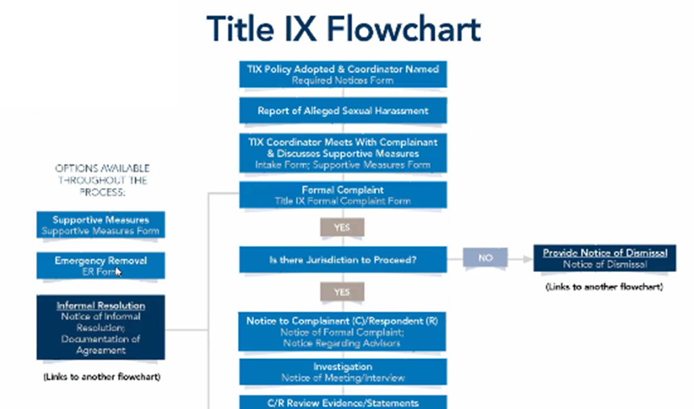
Bricker’s Updated Title IX Toolkit Available for download: k12tixtoolkit.bricker.com
Available to clients + non-clients
Access a package of templates and corresponding flow charts (notice → complaint → appeal)

Slide 37
Thank you for attending!
Remember – additional information available at:
Title IX Resource Center at www.bricker.com/titleix

Slide 38
Contact Information
Melissa Martinez Bondy
mbondy@bricker.com
614.227.8875
Kate V. Davis
kdavis@bricker.com
937.535.3902

