Slide 1

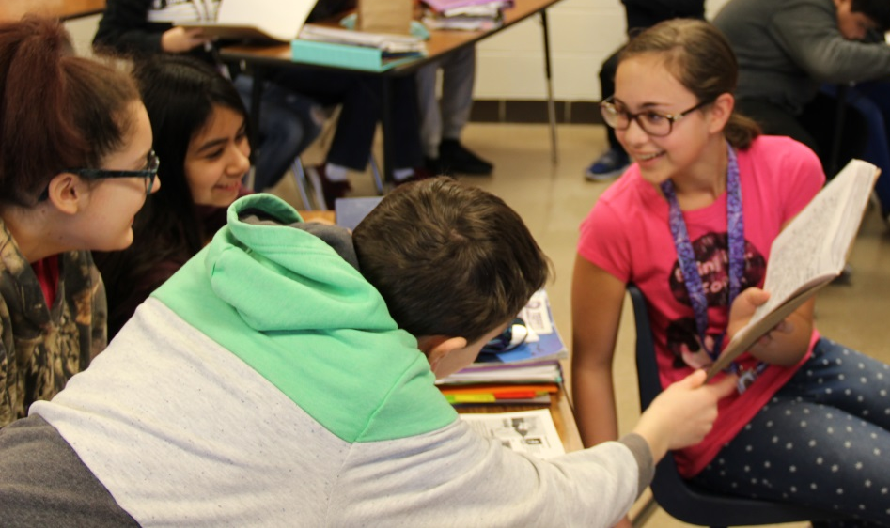




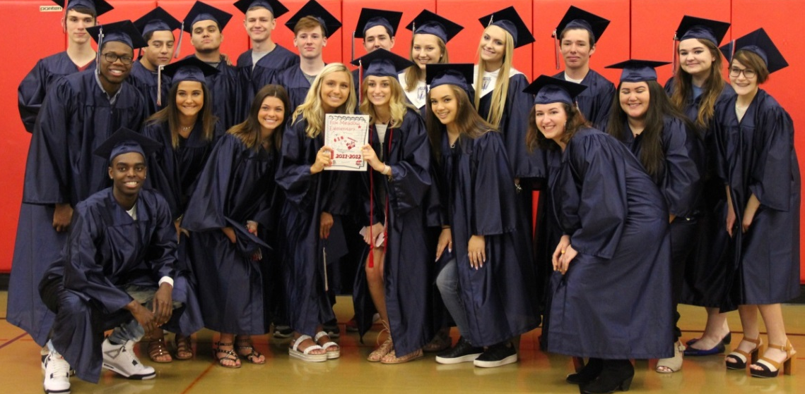

Slide 2

School District U-46
Elementary Mathematics Curriculum and Resource Adoption
for School Year 2026-2027
Board of Education Presentation
Amy Ingente, Math Coordinator
February 9, 2026

Slide 3

Purpose
Recommend the adoption of curricular resources and updated curriculum documents to support instruction and student achievement in elementary mathematics.

Slide 4
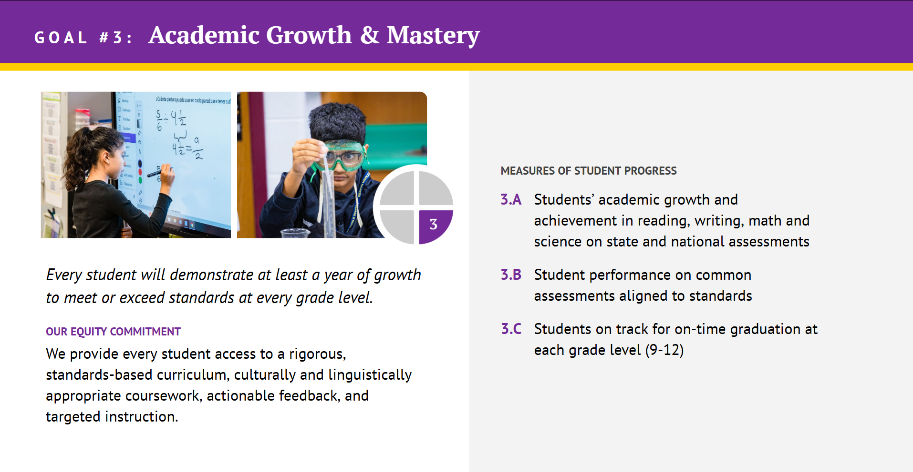
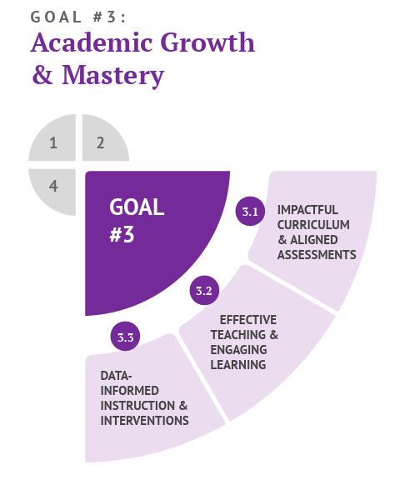
Alignment to Strategic Plan

Slide 5

Rationale
Previous resource adoption in 2015, and update in 2021.
Teacher feedback: not enough materials and strategies to meet the needs and range of learners in our classrooms.
No significant improvements in student performance data.
Need to adopt a new resource that is aligned to standards and meets the needs for all of our students.

Slide 6

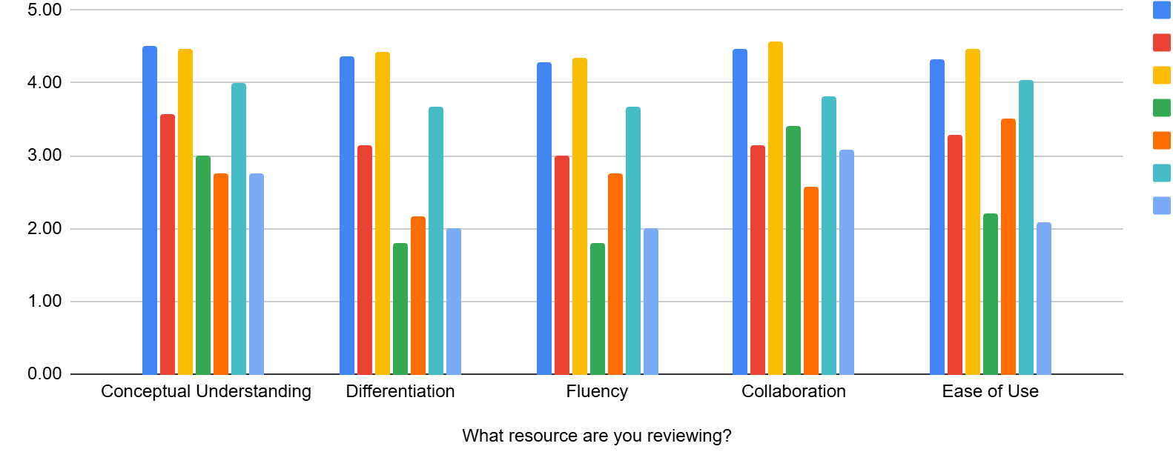
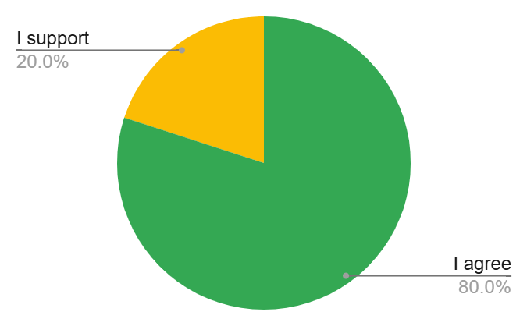

Process
Round 1 (Spring 2025) → Teacher feedback on available aligned resources
Round 2 (June 2025) → Top three publishers invited to present to teachers Consensus conversations
Adoption of the resource that was unanimously selected by teachers at the June resource review.
55 participants
65 signed up, 45 attended

Slide 7



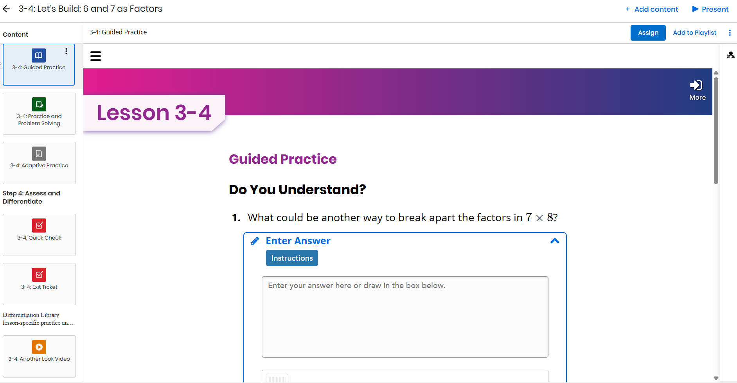
Recommended Resources
Teacher Edition
+ Differentiation Library
+ Intervention System
Student Consumable Workbook + One per student, per year
+ Grades K-5
Online Platform
(textbook available offline)
English and Spanish Resource

Slide 8
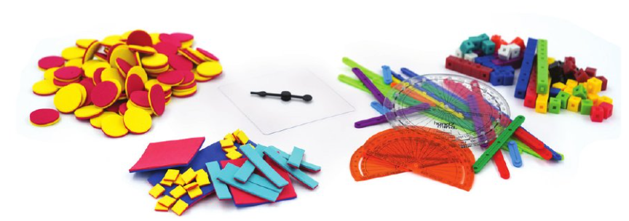
Recommended Resources
Classroom manipulative kits for grades K - 5.

Slide 9
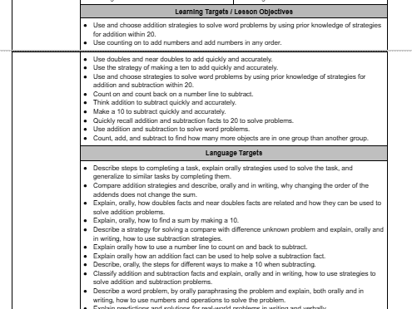
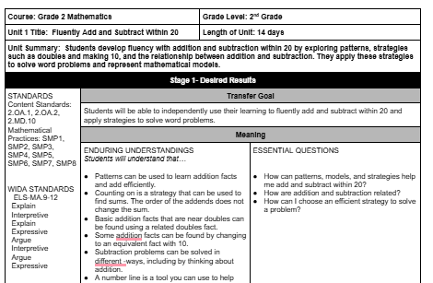
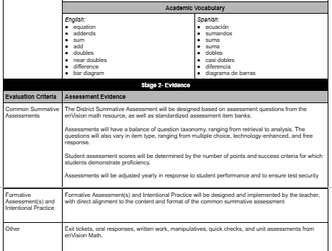
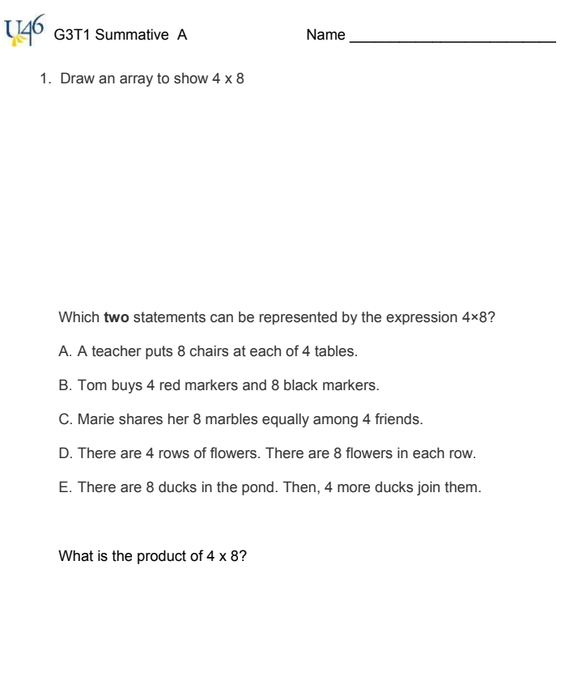
Recommended Resources
Revised curriculum documents to support the resource implementation

Slide 10
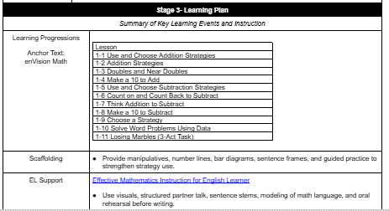
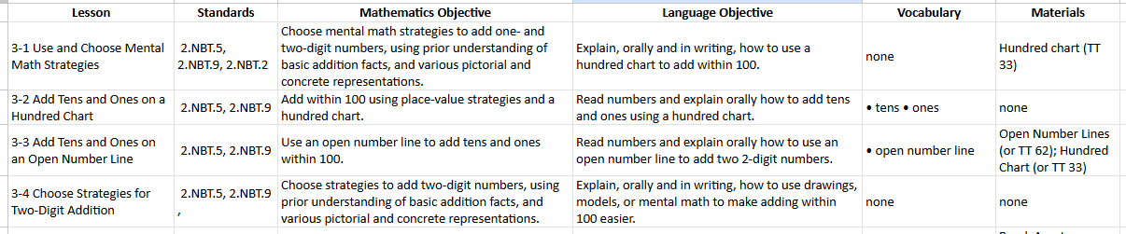
Recommended Resources

Slide 11

Recommendations for Implementation
Adoption of resources for the 2026-2027 school year.
Professional Learning (PL) beginning in Spring 2026.
Program activation and resource review
Implementation essentials
Additional sessions during the school year supporting the resource, problem solving, and mathematical discussions within each course
Contract includes 25 PL sessions in year 1; 5 sessions in years 2 - 6.

Slide 12
Cost
Item | Total Cost
Textbooks and Online Licenses | $3,878,650.00
Manipulative Kits | $456,900.00
Professional Development | $185,100.00
Shipping and Handling | $385,630.51
TOTAL | $4,906,280.51
Textbook cost is approximately $42.00 per student per year.

Slide 13
Evaluation of Change
Data will be reviewed from various indicators, such as:
Platform usage
District Common Assessments
IAR
i-Ready’s universal screener
to monitor students’ level of proficiency and growth at every grade level.
Scores from these measures will be compared to previous years to evaluate the effectiveness of the updated resources and curriculum frameworks.

Slide 14
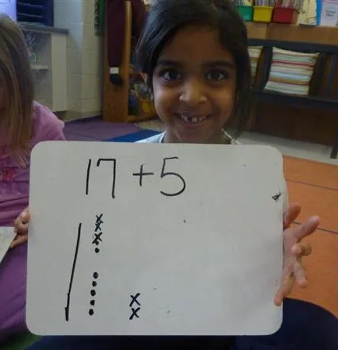
Proposed Results
Through the adoption and fidelitous implementation of the new resource, curriculum frameworks, and assessments, we will standardize our expectations for rigorous, standards-based curriculum, culturally and linguistically appropriate coursework, and targeted learning experiences to improve outcomes for all students.

