Slide 1


U-46 AI Update:
ChatGPT Edu for Staff Use
February 23, 2026

Slide 2


Background
Board-approved Staff access to ChatGPT Edu in October 2026.
U-46-controlled staff-only workspace with administrative oversight.
Safe, secure, and compliant with state and federal laws for staff use.
Supports instruction, operations, and communication.

Slide 3
Professional Learning
Month | Professional Learning | Participants | Details
October - present | AI101: Educators' Intro to AI Canvas course | 756 : all staff who have access to ChatGPT Edu; | Basics of AI Use cases and AI prompting District AI guidelines: Board-approved curriculum, data protection, equity, AI as a thought partner ChatGPT fundamentals & external resources
October | First steps with ChatGPT Edu virtual training (5 sessions) | 491 U-46 Staff | Introduction to ChatGPT Edu Applications of AI in education Recap & engagement on district AI guidelines
November | Tech building coaches ChatGPT Edu Training | 57 Instructional Tech Building Coaches; involved with ChatGPT rollout | In-depth exploration of ChatGPT Edu features & District guidelines To support adoption in schools
November & December | Optional OpenAI virtual sessions |  | Sessions to support adoption district-wide for IS, admin, & teachers
January | SSW Training | 100 SSWs | Specific applications for SSWs, & data protection
February 27 | ChatGPT Edu: Practical Classroom Use Cases for Teachers | 47 registered | Lesson planning support Differentiation and scaffolding Creating exemplars, models, and practice items
 | ChatGPT Edu Time Saving Strategies for the Classroom | 30 registered | Creating student group projects and defined roles Generating exit tickets and quick checks for understanding Supporting emails, newsletters, and family communication

Slide 4
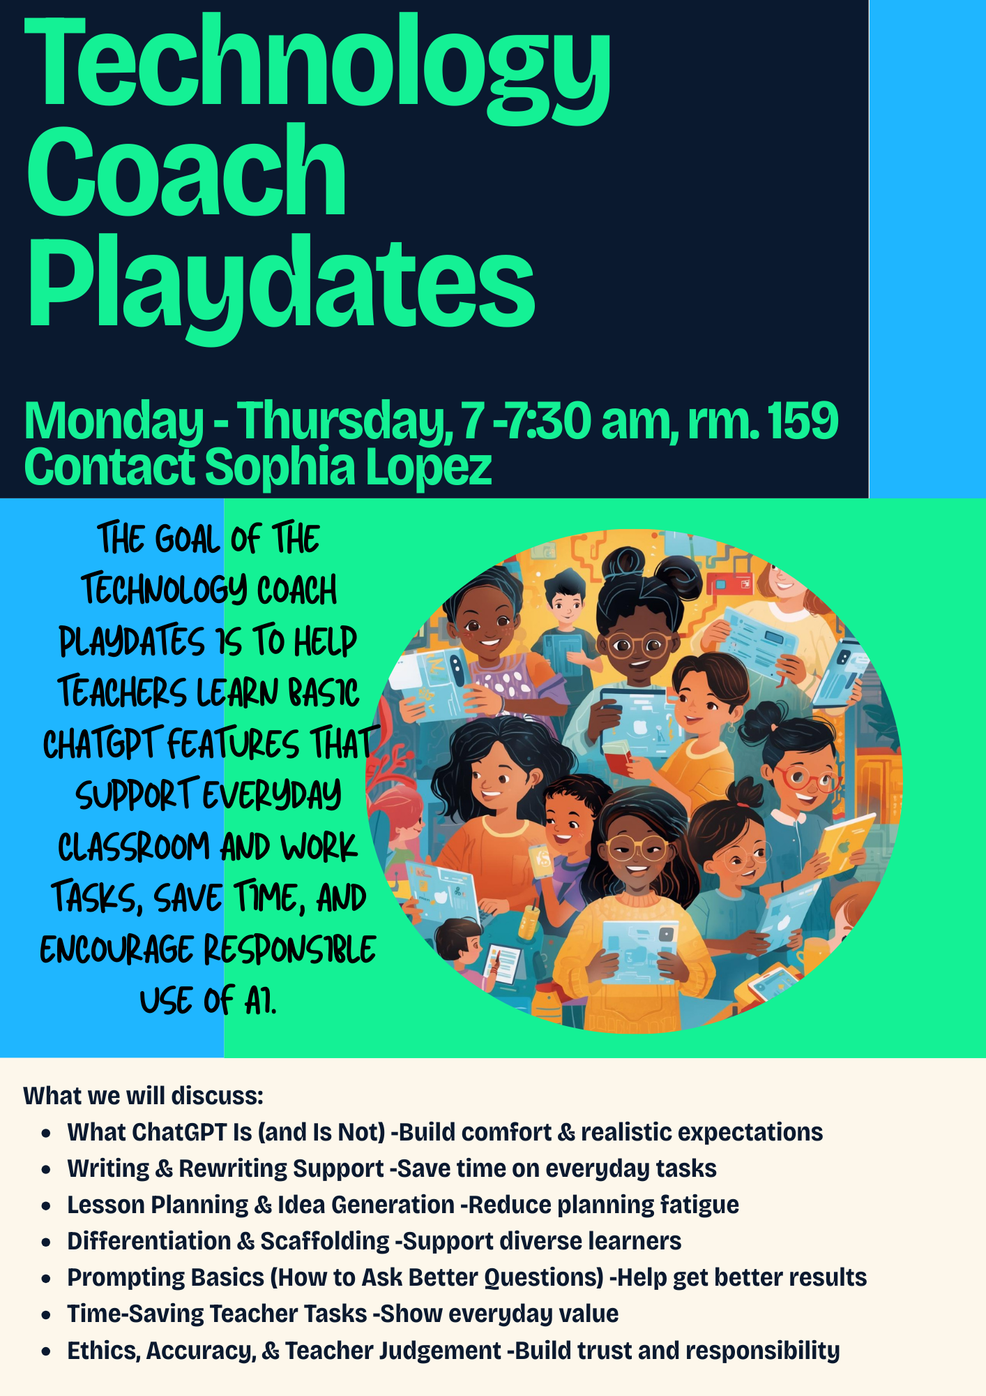

Coaches Professional Learning
Click here!

Slide 5

Adoption and Use Trends
Based on ChatGPT Analytics
Examples of use cases and collaboration: coaching, pacing monitoring, school communications, feedback on lesson planning, professional learning, restorative circles.
Month | Total users | Total messages Sent
November | 622 | 32,473
December | 704 | 30,238
January | 740 | 40,909
February 23 | 756 | 36,330

Slide 6
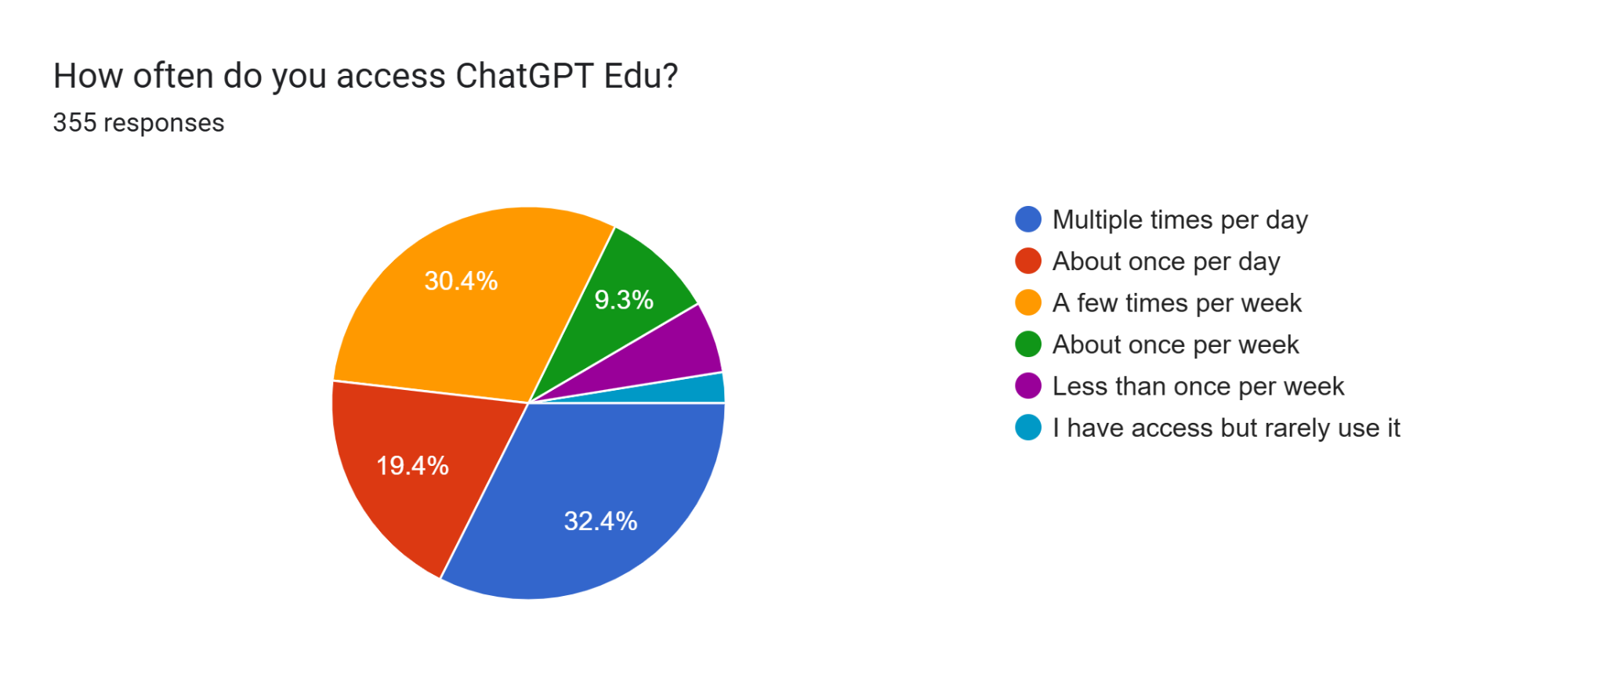
Participants Survey: Usage
355 respondents (47% of pilot participants)
Daily and weekly usage: Over 80% of respondents access ChatGPT Edu at least a few times per week, with nearly one-third using it multiple times per day.

Slide 7
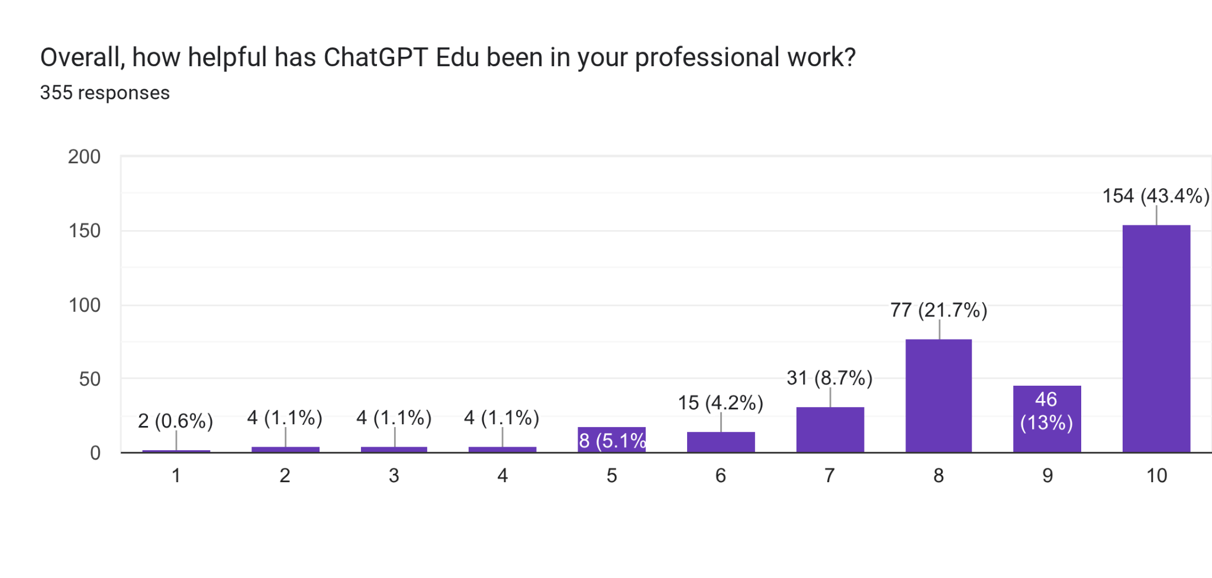
Participants Survey: Helpfulness
ChatGPT Edu is perceived as highly helpful, with nearly 80% of respondents rating it an 8 or higher on helpfulness.

Slide 8
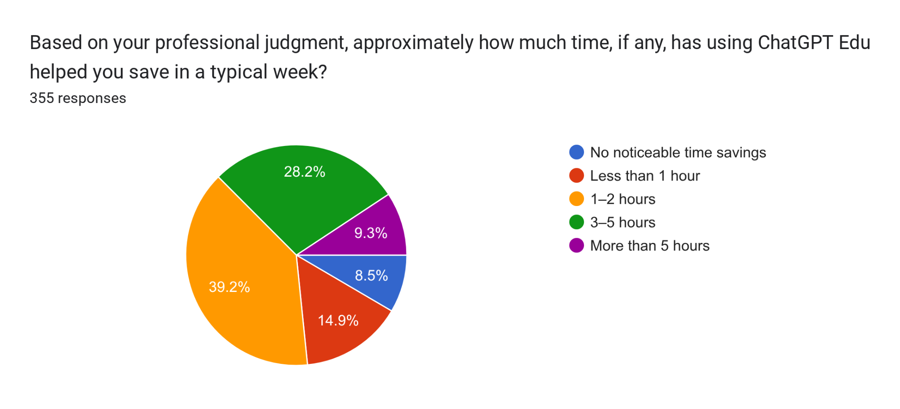
Participants Survey: Time Saving
Most users report weekly time savings:
Over 70% estimate saving 1–5 hours per week
28% estimate saving 3–5 hours per week
Most common uses are:
Creating instructional materials (63%)
Lesson planning (59%)
Brainstorming for class activities (59%)
Differentiation (54%)

Slide 9

Dr. Richard Lebron
Tefft Middle School AI Integration

Slide 10

AI Integration for Instructional Planning
Tefft Middle School launched AI professional learning to support teachers in designing high quality, standards aligned lessons.
AI supports our Instructional Clarity model, SfRE equity practices, and district approved curriculum.
AI is positioned as a planning support tool that enhances teacher practice while reinforcing professional judgment.

Slide 11

Professional Development Overview
Timeline
First Year Teachers: November through December
All Staff Expansion: December through January
Ongoing Department Specific Sessions: Before and after school, voluntary
Participants
44 staff members actively participating in the AI pilot.
8 additional staff registered and completing AI101 Canvas onboarding.
67 of 74 staff members received AI training through staff and department meetings.

Slide 12
Implementation Highlights
Teachers practiced evaluating and adapting AI generated lessons rather than using them as written.
Planning emphasized:
Illinois Learning Standards alignment
Marzano’s Taxonomy
Interdependent student tasks
Use of Board-approved curriculum resources
Department specific training was requested by staff due to strong relevance and applicability.

Slide 13
Observed Impact (Anecdotal)
Learning targets more clearly aligned to Illinois Learning Standards.
Stronger alignment between learning targets and classroom activities.
Increased intentional use of curricular resources, especially in mathematics.
Increased use of interdependent tasks aligned to the Instructional Clarity model.
Improved teacher confidence in lesson design and instructional clarity.

Slide 14
Future Plans for Tefft MS:
Continue department specific AI planning support
Support staff completing AI onboarding requirements
Expand focus on:
Differentiation
Alignment with our instructional clarity model
Alignment with our U-46 Strategic Plan
Equity driven instructional design

Slide 15

Sophia Lopez
5th Grade Teacher - Highland Elementary School
Notes:
Focus on that it compliments what the district is doing, and that it is going deeper to support teachers in instruction

Slide 16
How ChatGPT Supports My Work - Literacy: Tall-Tale Narrative Writing
Aligns Lesson Planning and unit design to rigorous Common Core standards (Goal 3.1-high-quality instruction)
Integrates literacy and Social Studies to deepen thinking and relevance (Goal 3.2 - Engaging, meaningful learning).
Designs authentic performance tasks that promote creativity and real-world application (Goal 3.3 - Student ownership and application).
How ChatGPT Supports My Work - Math: Lesson Clarity and Instructional Design
Creates clear learning targets and success criteria so students understand expectations (Goal 3.1 Clarity and rigor).
Supports academic discussion with language targets and vocabulary (Goal 3.2 - Student voice and engagement.
Provides structured lesson flow and consistent checks for understanding to strengthen intentional instruction (Goal 3.3 - Purposeful planning and student-centered learning.

Slide 17
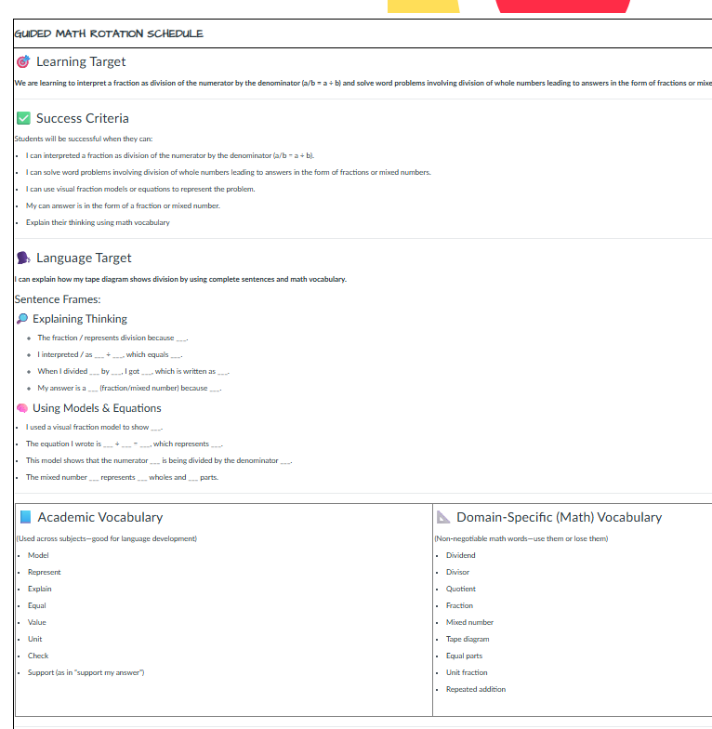
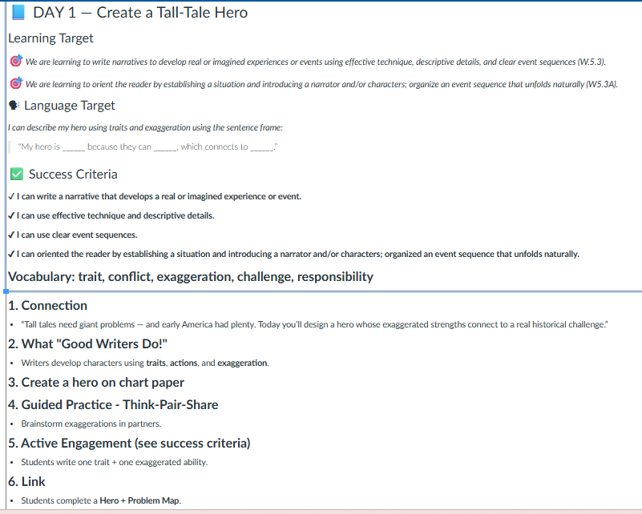
Impact on Student Learning & Engagement

Slide 18

Sergiusz Zgrzebski
Teacher at Beacon Academy - South Elgin High School

Slide 19

Teacher sharing

Slide 20
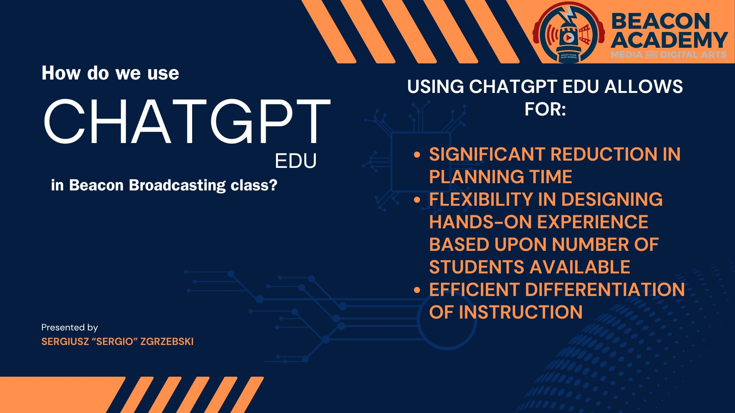
Teacher sharing

Slide 21
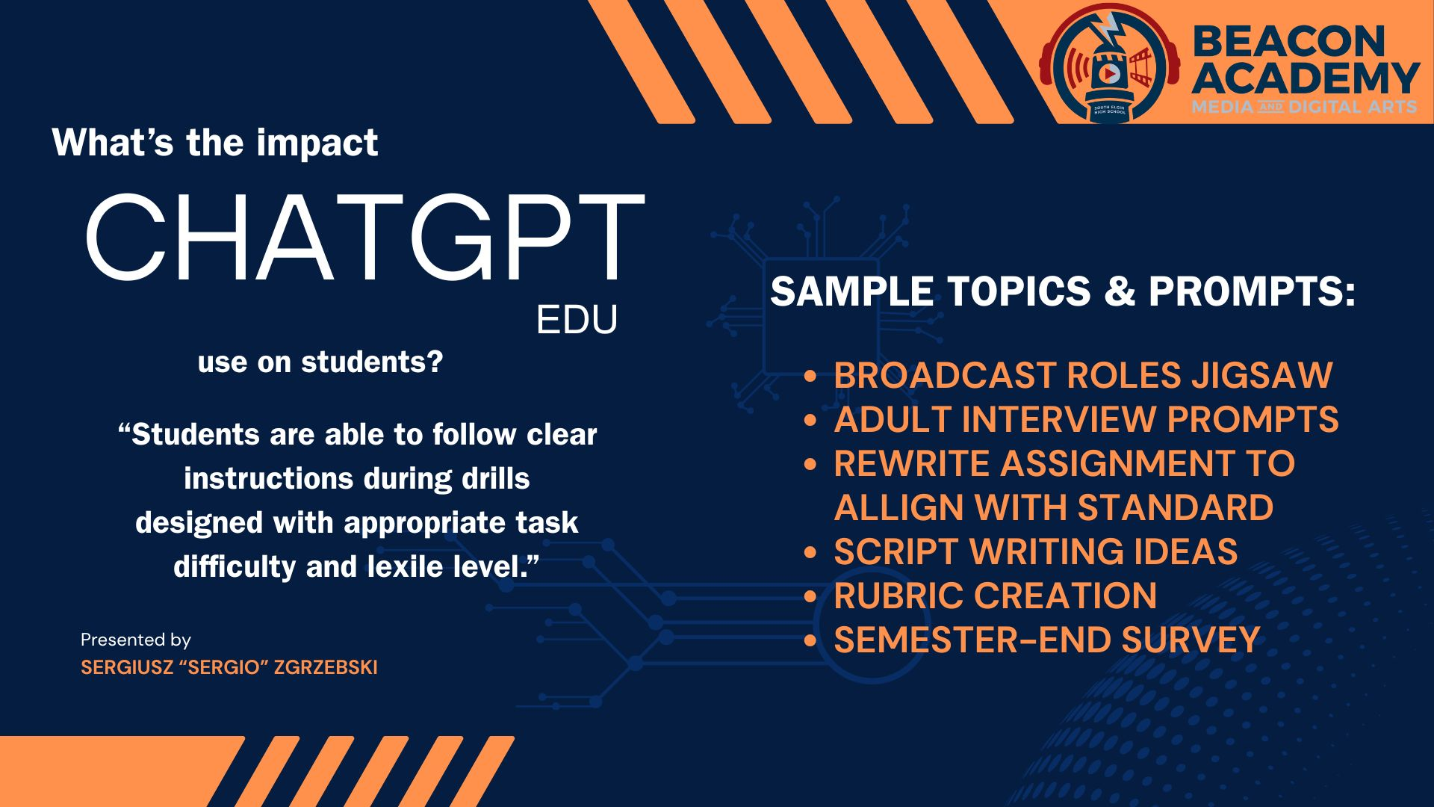
Teacher sharing

Slide 22
Valerie Albuck
English Language Arts Teacher - Tefft Middle School

Slide 23
How I use it
Uploading curriculum materials for a lesson and asking Chat GPT to create tasks that are:
⭐Analysis or Knowledge utilization taxonomy level
⭐Interdependent
⭐Requires students to receive and respond to feedback from peers.
Notes:
How you’re using ChatGPT Edu

Slide 24
It supports my work by assisting me with…
⭐Strategically scaffolding learning to challenge advanced students while supporting those who need additional guidance.
⭐Meeting U-46’s Instructional Clarity expectations.
⭐Increasing taxonomy level of tasks for students.
⭐Creating engaging tasks for students.
Notes:
How it’s supporting your work

Slide 25
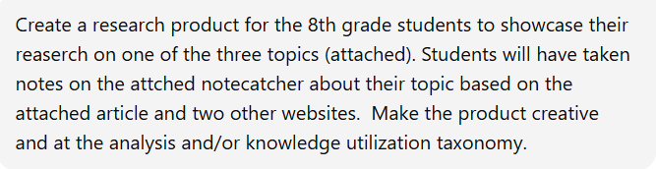
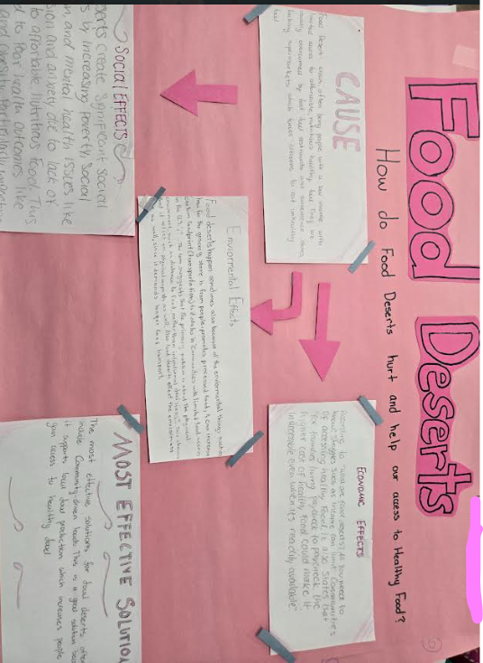
Impact
Students worked interdependently to research and create their organizers, providing meaningful feedback to one another and to other teams throughout the process.
The impact was a higher level of understanding and deeper expertise on their topics. Students were able to apply their research to real-world situations.
When it came time for assessment, students confidently drew on their knowledge and research to create their presentations.
Chat GPT Prompt
Original assignment:
Students fill out a note-catcher and discuss.
Chat GPT assignment: Students research effects of pesticides, organic food, or food desserts on peoples’ access to healthy food.
They create an organizer- to show what affects these have environmentally, economically, and socially.
Notes:
The impact you’ve observed on student learning or engagement, including the context of the artifact you shared

Slide 26
Recommendations and Next Steps
Continue with Early Access Program through December 2026.
Assess program over the summer and make any necessary adjustments for the 26-27 school year.
Provide an opportunity for new participants to join the pilot (ex. new teachers) in the Fall.
Will still need to complete Canvas course, other required Professional Development.

Slide 27

Thank you for listening!
Any questions?

