Slide 1

GES Annual Title 1 Meeting
2025-2026

Slide 2

Meeting Agenda
Tuesday, August 12, 2025 5:00 PM
I. Welcome……………..……………………Stacy Spinosa-Johnson
Principal
II. Parent and Student Expectations ........................... Stacy Spinosa-Johnson
Principal
III. Title I Annual Presentation….… Elizabeth Emmerson
PLC Coach/Title 1 Coordinator
Lori Newborn
Instructional Facilitator
Presentation Topics: Family Engagement, Pupil Progress Reporting, Parent-Teacher Conferences, Parent Involvement Requirements, Parent Training, AYP Status/School Data, School Improvement Plan, Parent Meetings, Teacher Qualifications, Parent’s Right to Know, Title I School Status, School/Parent Compact, Student Code of Conduct
IV. Optional Schools & International Studies………….. Amy Dacus
Optional Coordinator
V. Parent Training: Fundamentals of RTI2……Lori Newborn
RTI2
VI. Closing, Questions & Dismissal… Stacy Spinosa-Johnson
Principal

Slide 3


Annual Title 1 Meeting
Elizabeth Emmerson
Federal Programs Title 1 Coordinator
Professional Learning Community Coach
ELA Admin Lead
Lori Newborn
Instructional Facilitator
Math Admin Lead

Slide 4

Germantown Elementary School
is a school-wide participant in the
Title 1 Program
All students benefit through receiving supplemental materials, current technology, and extended learning opportunities.

Slide 5


What is Title 1?
The largest federal aid program for our nation’s schools; serving millions of children each year.
The goal of Title 1 is to ensure a high-quality education for every child by providing funding to close the educational gap.

Slide 6

Title 1 Program Funding
Provides for:
Additional teachers and assistants
Additional training of school staff
Extra time for instruction (extended learning)
A variety of supplemental instructional resources

Slide 7

School Improvement Plan
The School Improvement Plan is updated yearly with parent and community input to meet the needs of the students at Germantown and is available to all parents through the school website.
A committee of administrators, teachers and parents meet yearly to review the school improvement plan. If the school goals have not been met in the SIP, the plan must be revised to meet the needs of current students.
*2025-2026 SIP is currently under revision and is due 9/1. After federal approval, it will be uploaded to the website.

Slide 8

GES 24-25 Data
Performance is used to determine if our annual goals are met.
Opportunities to Celebrate:
TNReady proficiency growth SY24 to SY25 in Math
iReady growth SY24 to SY25 in ELA/Math
Opportunities for Growth:
TNReady % OnTrack or Mastered ELA
Targeting 3/4 grade proficiency (Literacy Commitment)
Tier1 percentage for iReady in both ELA & Math
 | Grades 3-5 ELA | Grades 3-5 Math
TNReady (unofficial) | 43.2% On Track or Mastered | 38.3% On Track or Mastered
IReady Final Spring Diagnostic Whole school | 53 % Tier1 | 50% Tier1
Strategies to address growth opportunities
Ensuring intentional planning (45 min collaborative planning with Admin Content Leads)
Specialized Assistants in literacy classrooms
Intentional walk-throughs by admin/ILT with specific and timely feedback
Targeted mentoring and PD for teachers
Deliberate intervention for targeted students:
RTI2 Block
Supplemental ELA tutoring 2nd- 5th

Slide 9

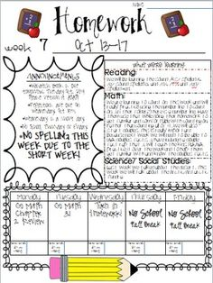
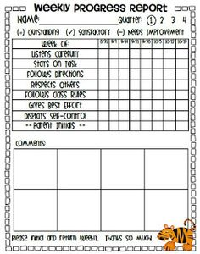


Reporting Student Progress
Weekly Wednesday Folders
GES Class Dojo – download the app!
Progress Reports available in PowerSchool every 4.5 weeks
Report Cards Every Nine Week Period
NEW! – Parents will be invited to participate in Student Teacher Data Conferences! KNOW the DATA!
The lines of communication between GES and our parents are always open
Parent Conferences: ALL parents!
  September 11, 2025 4:30-7:00 (teachers will meet with ALL parents during this week)
  January 29, 2026 4:30-7:00 (teachers will meet with ALL parents during this week)
  Contact your child’s teacher to schedule an appointment before or after school as needed

Slide 10
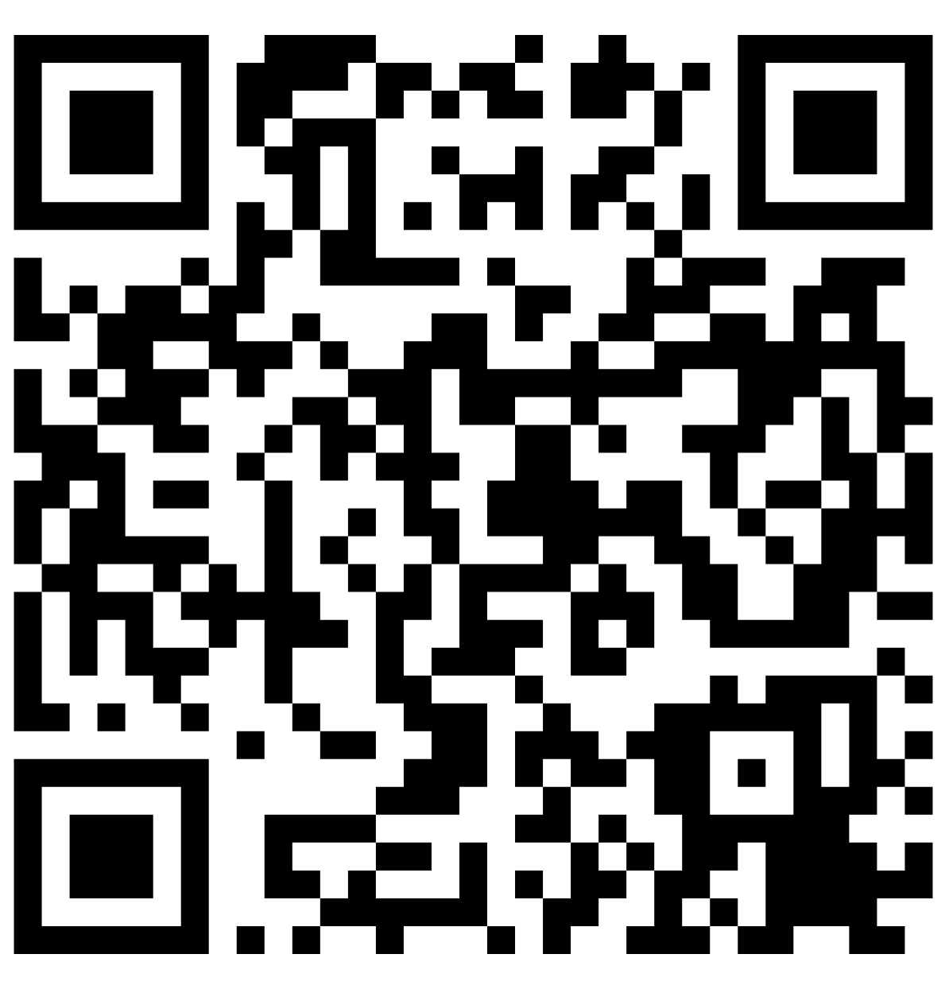
Parental Involvement Requirements @ GES
Support Your Child’s Education | Be Involved at School | Communicate
Attend School Daily Be Punctual *Tardy if not in seats AT 9:15 *instruction begins at 9:15 daily NO early checkouts (no check out after 3:30) Provide a quiet place at home for students where they can focus for homework and studying | Attend Parent Meetings and Trainings PTO- Join if you have not! Become a Volunteer (background check required) Attend School Events/Data Rallies per the GES parent communication monthly calendar | Ensure all contact information is correct in PowerSchool Check Student Wednesday Folders Dojo/Remind Emails/ blackboard calls & texts Stay in regular communication with your child’s teacher Be responsive when teachers/admin reach out to you Follow GES on Facebook & Instagram
Background Checks

Slide 11

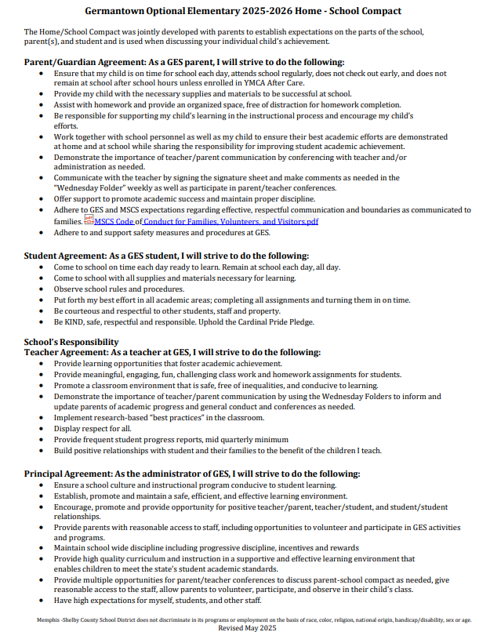
School-Parent Compact

Slide 12
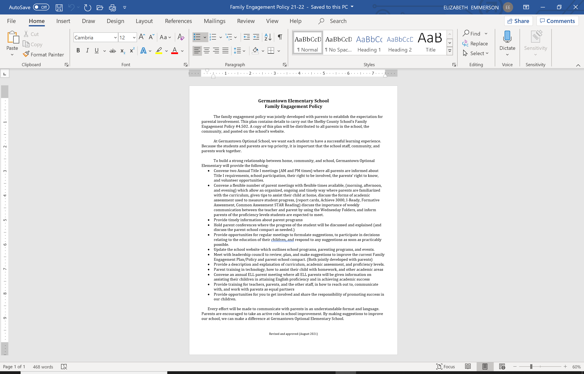
Opportunities for Additional Parent Training
Annual Title I Parent MTG
Parent and Family Engagement Activities
  Games with Grands 9/9&10
  Literacy Night October 28th
  Math & Science Night
  January 22nd
  Grade Level Data Rallies
  Student data conferences
  District Data Nights (Fall/Spring)

Slide 13
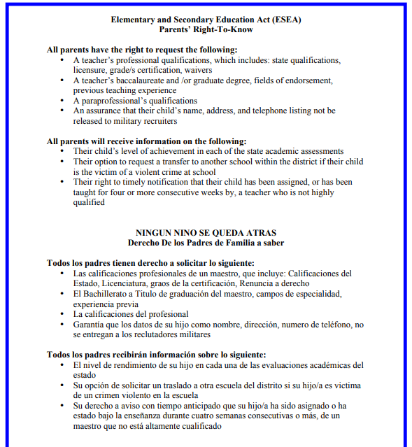
Parents Right to Know
Teacher Qualifications:
All GES teachers hold a state-issued teaching certificate or permit

Slide 14

How to Help My Child at Home!
Make reading an everyday habit at home; schedule a time!
Review information sent home from the school.
Communicate with your child’s teacher for more resources!
Celebrate your child’s success!
Attend parent/teacher conferences!

Slide 15

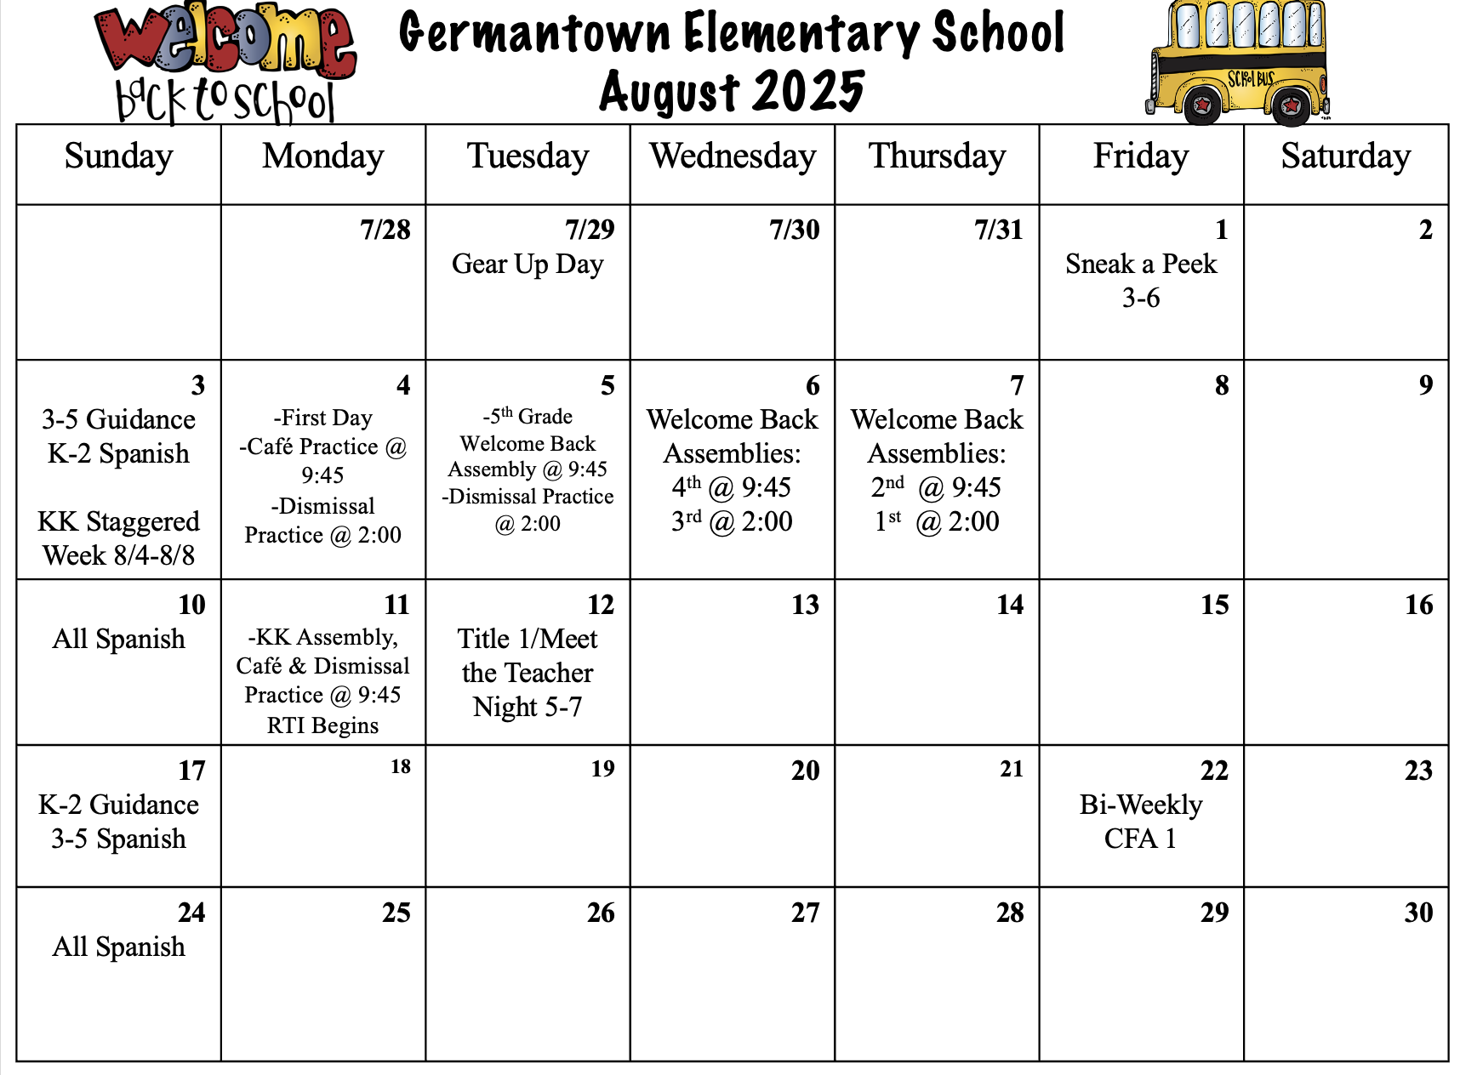
GES strives to create a unique family environment for our students to learn and grow in. Understanding not every day will be perfect, but we all come each day with what we have and where we are.
Please stay updated on events happening in our building and support us and your children in anyway you can.

Slide 16

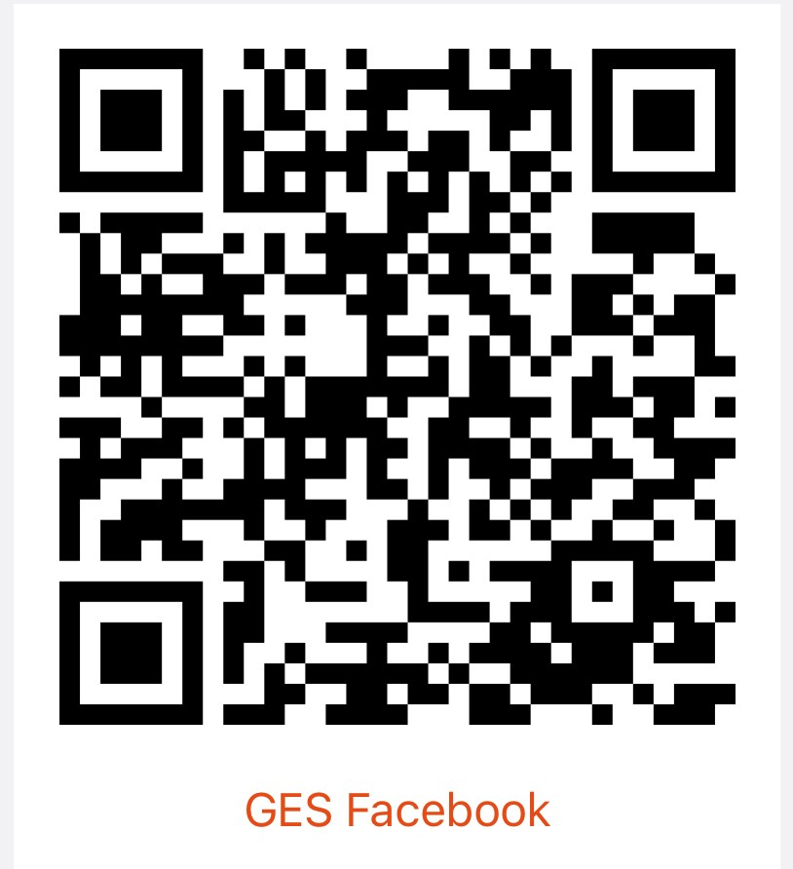
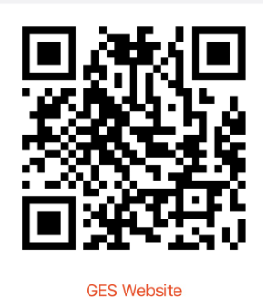
Parents can stay informed of student progress and what is happening at Germantown through:
Teacher communication (Dojo, Remind, Email, weekly folders)
PowerSchool
Facebook GES Website

Slide 17

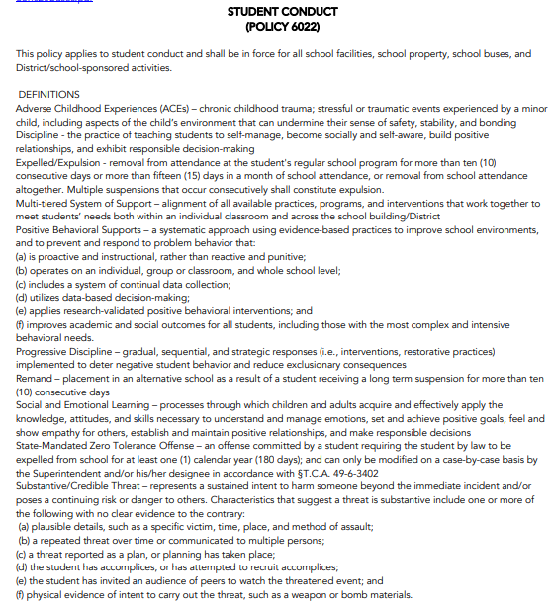
Student Code of Conduct
2025-26 Student Parent Handbook
MSCS Student Code of Conduct

Slide 18


