Slide 1
Reading Comprehension Strategies

Slide 2
Reading Strategies
Self-Monitoring (slides 2-3)
Summary (slides 5-8)
Graphic Organizers (slides 9-11)
Asking Questions (slides 12-13)
Generating Questions (slides 14-16)
Identifying Story/Text Structures (slides 17-19)
Relating Material to Prior Knowledge (slides 20-22)

Slide 3
Self-Monitoring
Students should:
Be aware that they do not understand
Identify what they do not understand
Look back through the text to clarify
Restate the difficult passage in their own words

Slide 4
Self-Monitoring To Dos
Support can:
Model self-questioning as they are reading
Use sticky notes marked with places where students should be checking for understanding
Teach students how to use a coding strategy to mark places in texts that causes confusion, require further information

Slide 5
Summarizing
Helps with:
Identify or generate main ideas
Focus on key details
Connect the main or central ideas
Use key words and phrases
Eliminate unnecessary information
Take succinct but complete notes
Remember what they read

Slide 6
Summarizing To Dos
For each paragraph (or section) you read:
Pick out important details and highlight them
Circle/underline the key words in these details
Cross out the less important ideas or ideas that are repeated
List the key words in order
Trim the key words down to one or two topic sentences

Slide 7
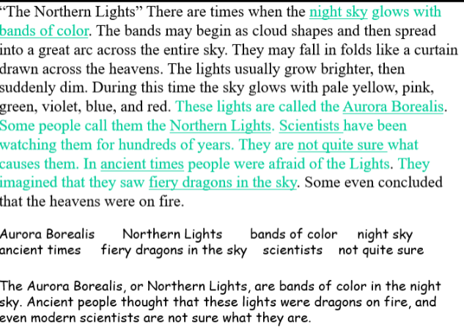
Summary Example

Slide 8
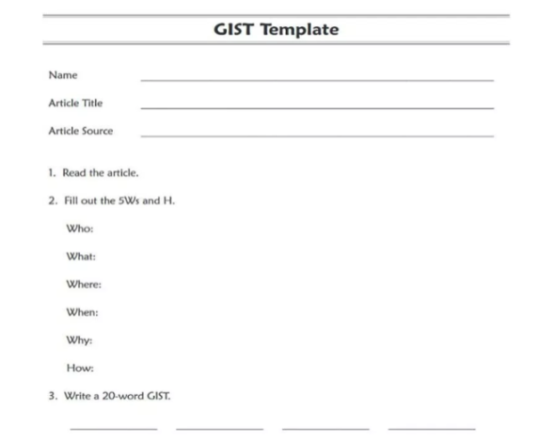
Summary Example

Slide 9
Graphic Organizers
Graphic organizers help students:
Focus on specific concepts (compare/contrast, cause/effect, etc.)
Read and understand different types of texts
Use visual models to organize their thoughts and ideas
Help struggling students focus on the “bigger ideas” in a text

Slide 10
Graphic Organizers To Dos
Help students use graphic organizers:
Carefully choose the appropriate organizer for the task
Model and practice with students
Begin with simple organizers before moving to more complex ones
Fill in portions of the organizer for students to scaffold
Use color-coding and highlighting
Help students learn how to create their own organizers for various types of texts and purposes

Slide 11
Graphic Organizer Examples
Story structure organizers (beginning/middle/end chart)
Charts for main ideas/details
Cause-effect charts
Venn diagrams for comparing/contrasting

Slide 12
Asking Questions
Asking questions before, during, and after reading:
Gives students a purpose for reading
Focuses students’ attention on what they are going to learn
Helps student think actively as they read
Encourages student to monitor their comprehension
Helps students review content and relate what they have learned to what they already know
Helps student go beyond essential facts to thinking more deeply about material they have read

Slide 13
Asking Questions To Do
When asking questions, remember to:
Focus on predicting and activating background knowledge before reading
Ask mostly literal questions during reading, focused on recalling and understanding basic information
Focus on extending students’ understanding after reading

Slide 14
Generating Questions
Asking their own questions as they read, students should:
Stay more focused on the text
Become more aware of their understanding/confusion when reading
Learn to understand what types of information they are learning
Learn to combine information from different segments of text

Slide 15
Generating Questions To Do
Support can help students learn to generate their own questions by:
Providing extensive practice in answering questions
Beginning with “who?” “what?” “when?” “where?”
Then add “why?” and “how?”
Using question stems
Using sticky notes to help students identify where they could ask themselves questions

Slide 16
Generating Questions - Example
What other things would you like to know before reading the story?
(Students should be think who, what, when, where, and why questions)
Tell students that, as they read the story, they can look for the answers to their questions.
(Help student with process of answering their own questions, you can write the questions on a chart and refer to them frequently. Give student set of sticky notes and encourage them to place a note in the text when they find an answer to one of their questions).

Slide 17
Identifying Story/Text Structures
Begin with story maps of narrative text
Teach categories of narrative text structure (characters, setting, events, problem, resolution)
Teach five structures of informational text (description, cause/effect, compare/contrast, sequence, problem/solution)
Teach use of signal words to determine text structure

Slide 18
Five Informational Text Structures
Cause/Effect
  Tell what happened and why it happened
Compare/Contrast
  Shows how two or more things are alike/different
Sequence
  Tells events in order
Problem/Solution
  Tells about a problem and gives one or more possible solutions
Description
  Gives features/examples/characteristics of an idea, person, place, thing

Slide 19
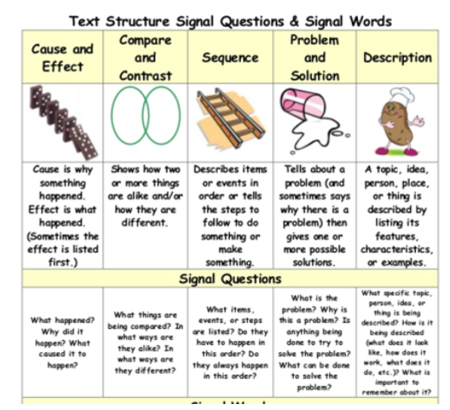

Slide 20
Relating Material to Prior Knowledge
Ask specific questions to activate prior knowledge before reading
Use KWL Chart
Use Anticipation Guide
Use “Let’s Predict” using key vocabular words from passage
Pre-teach vocabulary

Slide 21
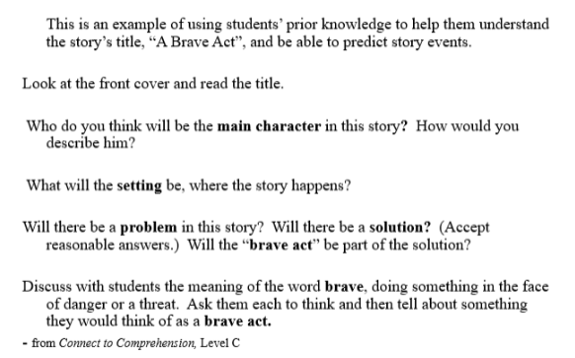
Relating Material to Prior Knowledge - Example

Slide 22
Anticipation Guide
Use before reading to assess background knowledge and to make predictions
Using during reading to encourage self-monitoring
Use after reading to focus ideas, cite text evidence

