Slide 1

Governor’s 2026/27 Proposed State Budget
Notes:
This picture is Editable, To change picture, Right click on far right side of photo > Select Change Picture

Slide 3
Overview
State Economic Overview
Governor’s 2026/27 Proposed State Budget Highlights and Impacts
Enrollment and Position History
Reporting Timelines
Upcoming Budget Discussions

Slide 4
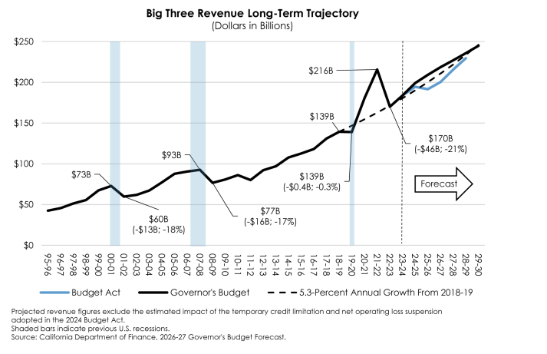
State Revenue Growth
Source: Governor’s Budget K-12 Education, page 179

Slide 5
State Economic Overview
California’s Economy – “California’s responsibility is to act with steady hands and anticipate future instability.”
State Reserves
State Rainy Day Reserve – $4.1 billion
Unemployment Rates as of November 2025
National – 4.6%
State – 5.5%
Fresno County – 8.2%

Slide 6
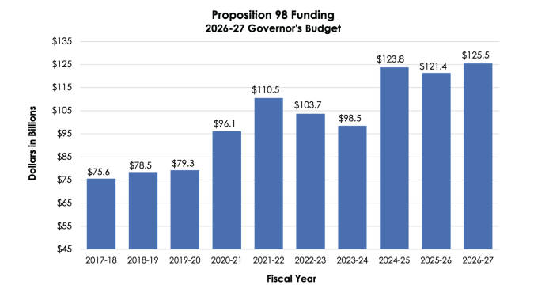
State Proposition 98 Funding
Source: Governor’s Budget K-12 Education, page 17

Slide 7
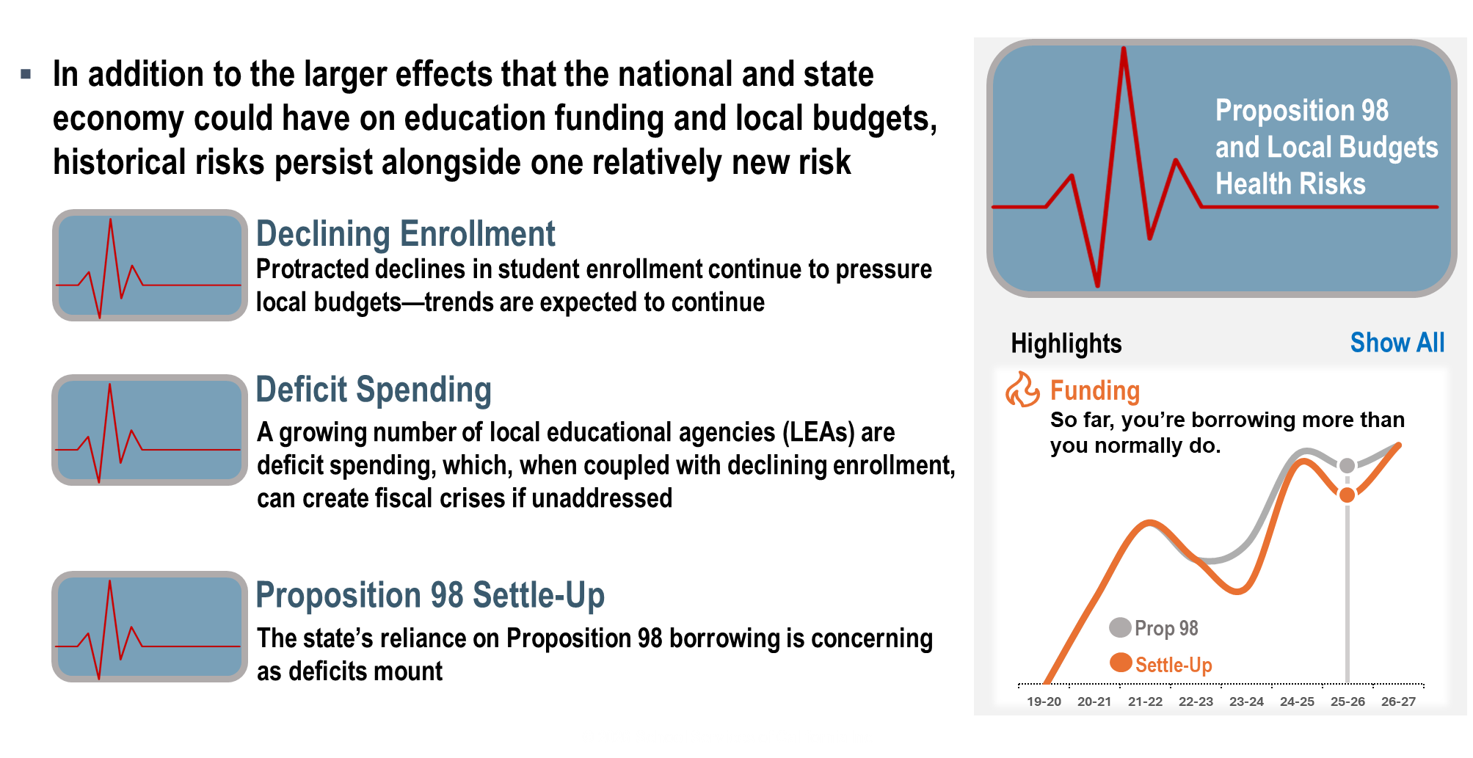
Risk to Proposition 98 and Local Budgets
Source: SSC Governor’s Budget K-12 Education, slide 37

Slide 8
Governor’s 2026/27 Proposed State Budget
Local Control Funding Formula (LCFF) – $18.3 million for COLA of 2.41%
Special Education – $4.8 million for COLA of 2.41% plus an increase to the base rate
PERS – ($700,000) lowered costs for statutory increases (no change to STRS rate)
Health/Welfare – $24.3 million additional costs per the collective bargaining agreement (one-time lower rate for 2023/24, 2024/25, 2025/26)
Workers’ Compensation – $700,000 increased rate to fund at 90%
Planned Reductions – ($25.0) million
Additional ($25.0) million in 2027/28

Slide 9
Local Control Funding Formula (LCFF)
COLA | 2025/26 | 2026/27 | 2027/28 | 2028/29
2025/26 Adopted Budget | 2.30% | 3.02% | 3.42% | 3.31%
2026/27 Proposed Adopted Budget | 2.30% | 2.41% | 3.06% | 3.34%
Change | -- | (0.61%) | (0.36%) | 0.03%
Funding | 2025/26 | 2026/27 | 2027/28 | 2028/29
2025/26 Adopted Budget | $ 1,006,168,792 | $ 1,031,959,982 | $ 1,058,540,978 | $ 1,080,783,235
2026/27 Proposed Adopted Budget | $ 1,009,080,846 | $ 1,027,420,114 | $ 1,048,246,435 | $ 1,066,876,369
Change | $2,912,054 | ($4,539,868) | ($10,294,543) | ($13,906,866)
Source: Governor’s Budget K-12 Education, page 17

Slide 10
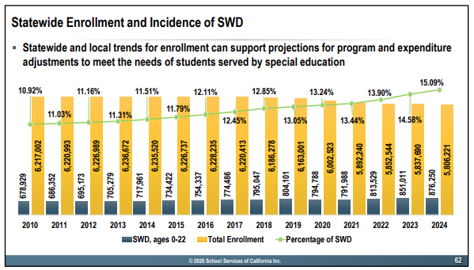
Special Education
 | 2019/20 | 2020/21 | 2021/22 | 2022/23 | 2023/24 | 2024/25 | 2025/26*
Special Education Students | 8,352 | 8,867 | 9,029 | 9,506 | 9,997 | 10,683 | 10,683
Federal Revenue | $16.0 | $15.1 | $16.1 | $18.1 | $19.6 | $19.0 | $19.8
State/Local Revenue | $50.1 | $55.2 | $71.2 | $76.4 | $76.5 | $77.9 | $78.7
District Contribution | $73.1 | $69.1 | $63.9 | $73.2 | $97.4 | $132.2 | $142.3
Total | $139.2 | $139.4 | $151.2 | $167.7 | $193.5 | $229.1 | $240.8
District Contribution/LCFF % | 9.4% | 8.8% | 7.5% | 7.7% | 9.6% | 13.2% | 14.3%
* Projected

Slide 11
Governor’s 2026/27 Proposed State Budget
Student Support and Professional Development Discretionary Block Grant
$2.8 billion one-time Estimated $31.5 million for Fresno Unified ($512.48 per ADA)
$757.0 million restores the remaining funds deferred in 2023 Budget Act Estimated $11.9 million for Fresno Unified ($228 per 2021-22 ADA and UPP) Requires a student needs assessment and include in LCAP
$1.0 billion ongoing funds to expand community schools Ongoing investment will support both existing grantees and additional community schools Fresno Unified has been awarded with 32 schools with 5-year grants starting in 2023/24, 2024/25, and 2025/26
$100 million for Kitchen Infrastructure one-time grants Increased funding for Farm to School Incubator Grant
U.S. Department of Health and Human Services announced a freeze on federal fiscal year 2025 over concerns of fraud and misuse in five states, including California. The estimated impact to CA is $5.0 billion The affected states sued and a federal judge granted temporary restraining order
Eliminate $1.9 billion in cash deferrals
Learning Recovery Block Grant
Community Schools
Nutrition Services
Nutrition
Child Development
Transportation
Cash Deferrals

Slide 12
Block Grant Uses
Block Grant Allocations | Learning Recovery Block Grant | Student Support Block Grant
2022/23 Allocation | $106,600,000 | --
2025/26 Allocation | $6,000,000 | $19,300,000
2026/27 Estimated Allocation | $11,800,000 | $31,800,000
Total | $124,400,000 | $51,100,000
Block Grant Uses | Learning Recovery Block Grant | Student Support Block Grant
2023/24 to 2027/28 Early Literacy Investment | $120,000,000 | --
2025/26 One-time student laptop purchase | -- | $8,000,000
2026/27 – 2030/31 PARS Payments | $4,400,000 | $43,100,000
Total | $124,400,000 | $51,100,000

Slide 13
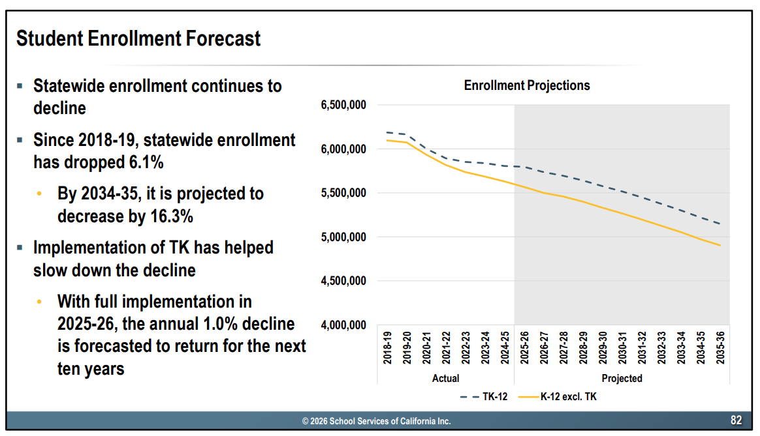
Historical Attendance and Positions

Slide 14
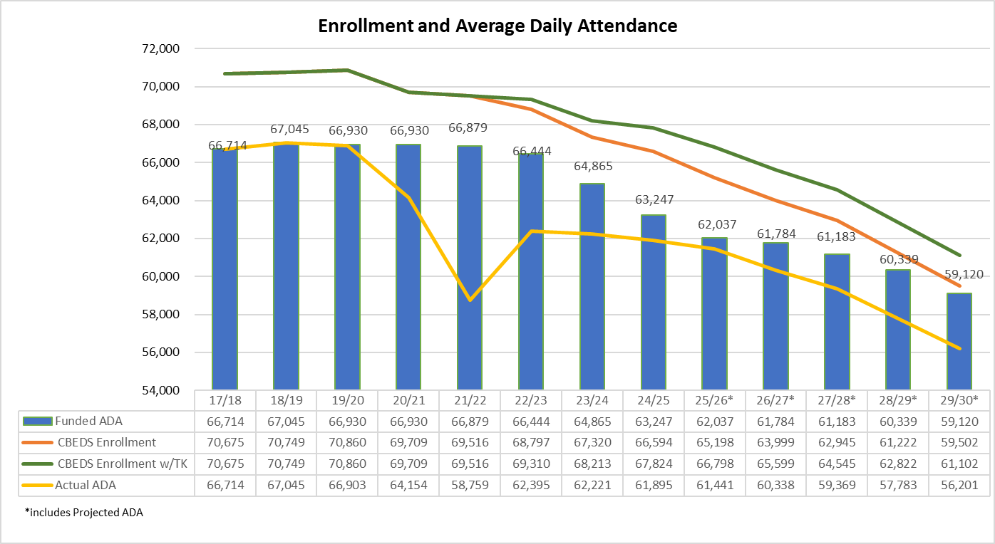
Average Daily Attendance TK-12

Slide 15
TK-6 Enrollment – Small Schools
 | 2018/19 | 2025/26 | Difference
Wolters Elementary | 457 | 381 | (76)
Holland Elementary | 463 | 376 | (87)
Kirk Elementary | 356 | 365 | 9
Starr Elementary | 394 | 356 | (38)
Gibson Elementary | 477 | 356 | (121)
Lowell Elementary | 459 | 346 | (113)
Jackson Elementary | 452 | 345 | (107)
Anthony Elementary | 479 | 345 | (134)
Webster Elementary | 389 | 342 | (47)
Jefferson Elementary | 461 | 336 | (125)

Slide 16
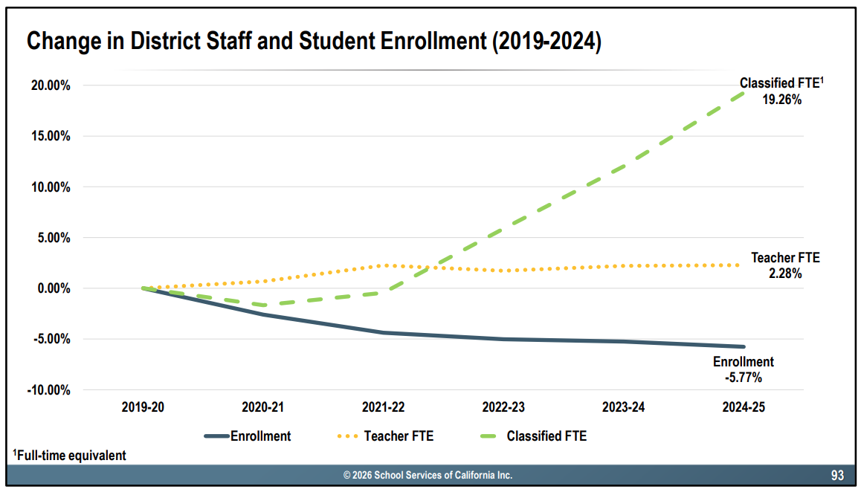
Historical Attendance and Positions – Statewide

Slide 17
Historical Attendance and Positions – Districtwide

Slide 18
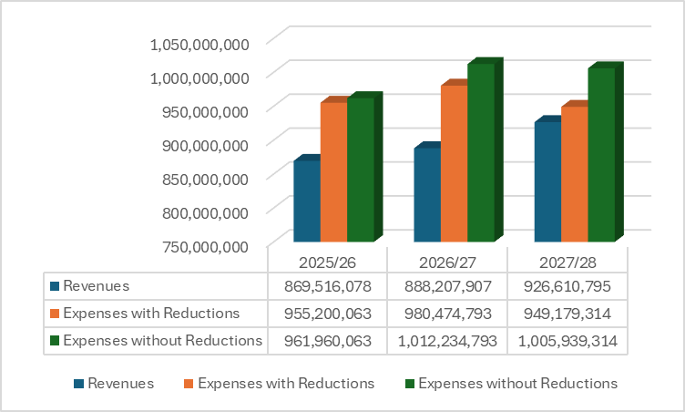
Reduction Impact
$25.0 million Reductions
$25.0 million Reductions
$6.8 million Reductions

Slide 19
Preliminary Central Office Reductions
Positions | 2024/25 | 2025/26 | 2026/27
Administrative Analyst, Analyst I, Analyst II | (2.0) | (2.0) | (3.0)
Assistant Superintendent | (1.0) | -- | (4.0)
Clinical School Social Worker, School Counselor, Guidance Learning Advisor | (4.0) | (2.0) | (2.0)
Coordinator I, Coordinator II | -- | 1.0 | --
Director, Executive Director, Exec. Officers, Administrator, Community Relations Officer | 1.0 | (4.0) | (7.0)
Manager I, Manager II, Manager III, Project Manager | (7.0) | (5.0) | (4.0)
Supervisors | -- | 1.0 | --
Classified Positions | (9.1) | (12.3) | (19.4)
Teachers on Special Assignment, Literacy Coach, Climate and Culture Specialist and Resource Specialist | (39.2) | (11.0) | (2.0)
Total Central Office Change | (61.3) | (34.3) | (41.4)

Slide 20
Preliminary PARS Savings
Employee Group | Number of Retirements | 2026/27 Budget FTE Not Replaced | 2026/27 Budget Savings
Certificated | 265 | 13.0 | $2,334,000
Classified | 219 | 52.4 | $5,422,000
Management/ Supervisory | 84 | 39.0 | $8,982,000
Total | 568 | 104.4 | $16,738,000

Slide 21
Financial Reporting Timelines
February - April
June
Governor’s Proposed Budget
Staffing Parameters
School Site Allocations
Budget Presentations
Draft LCAP
Budget Presentations
Governor’s May Revise
LCAP Educational Partner Feedback
SPSA Approval
Public Hearings LCAP and Budget
Adopt LCAP and Budget
December - January
May

