Slide 1
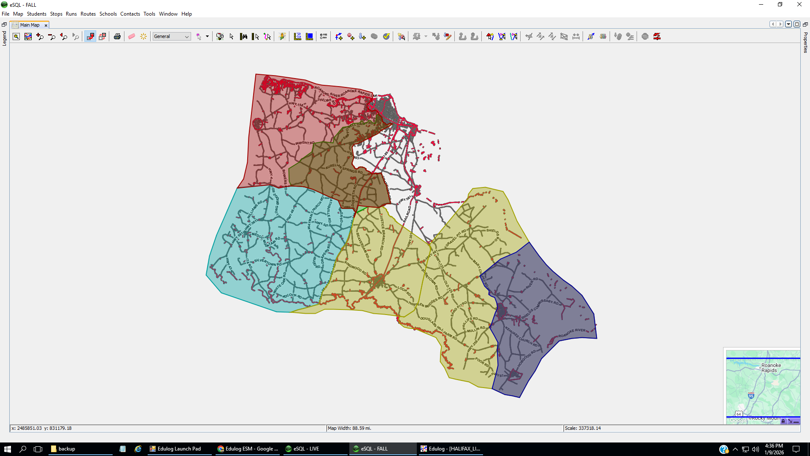
Davie/Everetts
Aurelian Springs
Northwest
Southeast
Eastman
Enfield/Inborden
SNELA
Attendance Boundaries

Slide 2
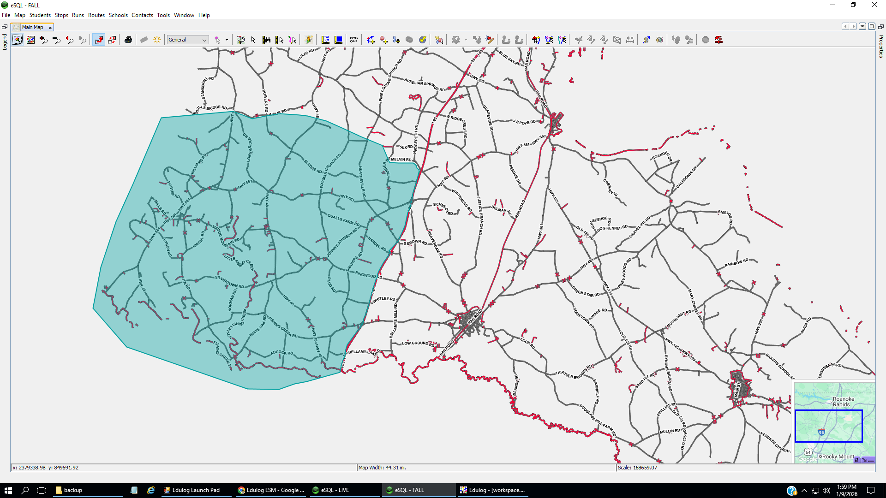
Bus 2: Hollister
Porter Rd, Hwy 156
Bus 6: Sledge Rd,
Heathsville Rd
Bus 4: Medoc
Bus 1: Hollister
Hwy 43, Mills Rd
Lynch Rd
Bus 5: Draper’s Rd,
Ringwood Rd
Bus 3: White Oak, Ita Rd,
Silvertown
Proposed buses needed by neighborhoods.

