Slide 1


Slide 2

Partnerships = Stronger Systems How N-SSBA’s Partnerships help Longwood Legislative Breakfast 2.7.26 Bob Vecchio, Executive Director, Nassau-Suffolk School Boards Association

Slide 3

Relationship building always matters!
Every interaction with people can have a meaningful impact down the road.
Establish relationships with all levels of government from local to national
Partnerships with local levels of government can play an important role
Suffolk County Board of Elections and voting machines –ES BOCES, SCSSA
LIA connections to Manufacturing led to partnership with the Marine Industrial Base
LIPA Advisory board to preserve PILOT payments

Slide 4
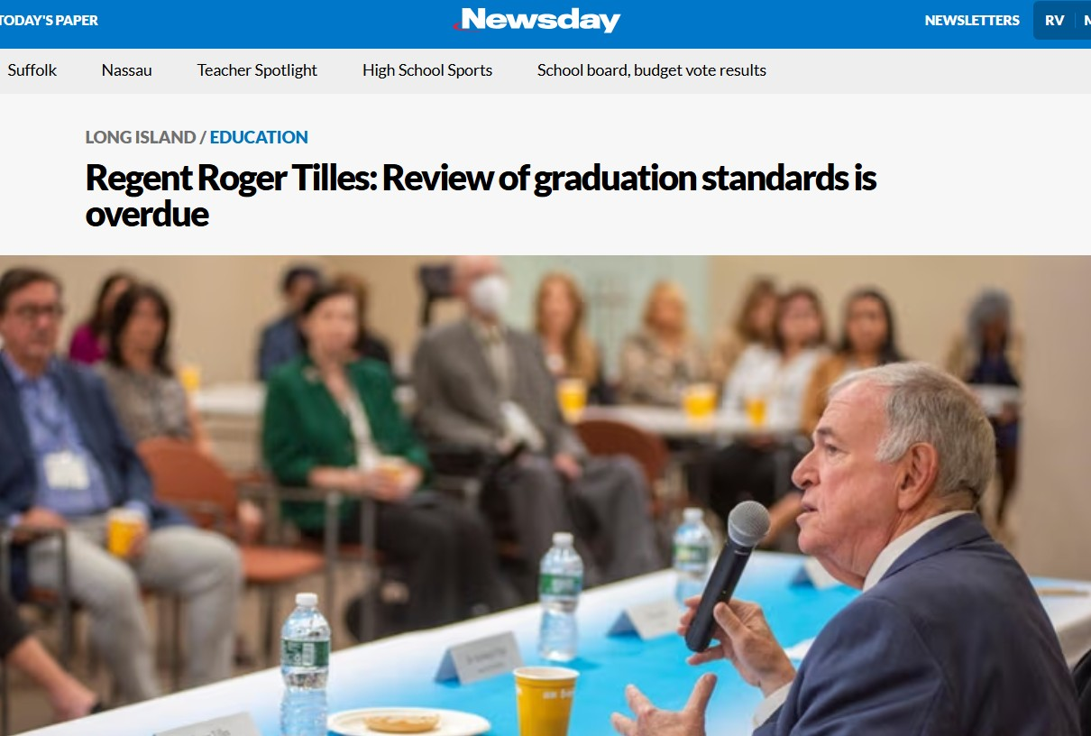
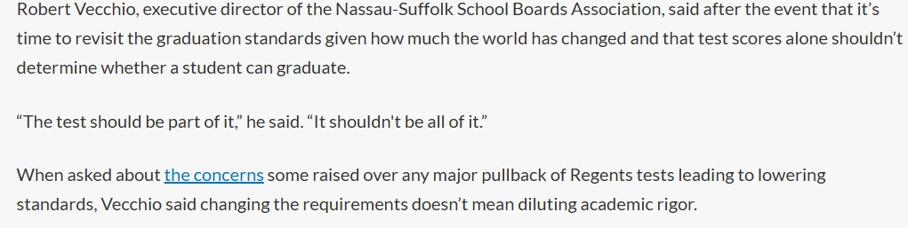
Relationships with media can lead to opportunities for advocacy
This article from Newsday in 2022 and this quote

Slide 5
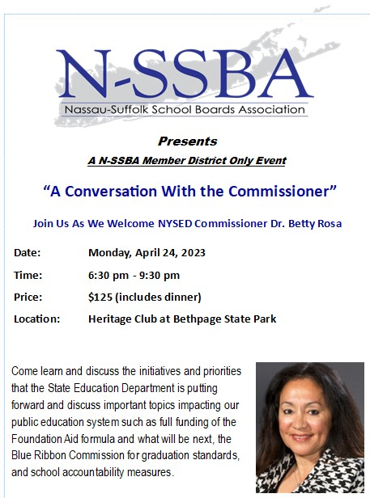
Led to this!

Slide 6
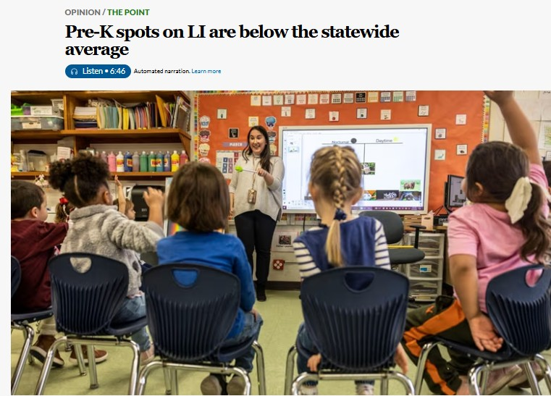
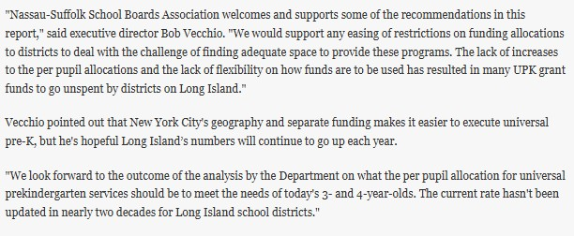
This article and quote

Slide 7
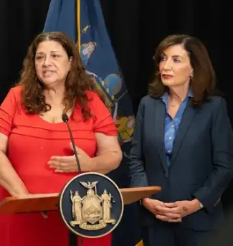
Led to this!
A phone call with Deputy Secretary of Education for Governor Hochul, Maria Fernandez about reforms needed for UPK funding

Slide 8
Find value in every relationship and build it, you never know when it will provide you with an opportunity to excel

Slide 9
We value the partnerships we have, and we want to thank them All of our Board of Education Trustees SCSSA, NCCSS, ES BOCES, WS BOCES, Nassau BOCES, NYSSBA, NYSCOSS, ASBO, PTA, SCOPE, LIA, and Our Local, State, and Federal Officials

Slide 10


Thank you

Slide 11


Stronger Together: Partnership with Eastern Suffolk BOCES
David Wicks, Chief Operating Officer, Eastern Suffolk BOCES

Slide 12



Partnership with ESBOCES
Programs and services operated by BOCES may be more
cost-effective and efficient for school districts.
Students with disabilities learn skills that may enable them
to transition to a workplace.
Career and Technical Education prepares students to be
college and career ready.
Cost-saving administrative and business services are available.
Professional development opportunities for all levels of leadership,
administration, and staff.

Slide 13
What are some of the programs
and services offered by BOCES?
Leadership Services
Office of the District Superintendent / Chief Operating Officer
Advocacy Initiatives
Diversity, Equity, and Inclusion
Leadership Meetings and Development
Employee and Student Assistance Services
Federal & State School Support Initiatives
Management Services
Administrative Services
Business Services
Facilities Management
Technology Integration
Planning & Program Improvement
Educational Services
Special Education
Career Technical Education (for school-aged students and adults)
Special Career Education
Regional Information Center
Educational Support Services
Human Resources Services
Personnel Services
Recruitment
Certification
Professional Development
Compliance
787
Services
61
CoSers
Provided by Eastern Suffolk BOCES

Slide 14
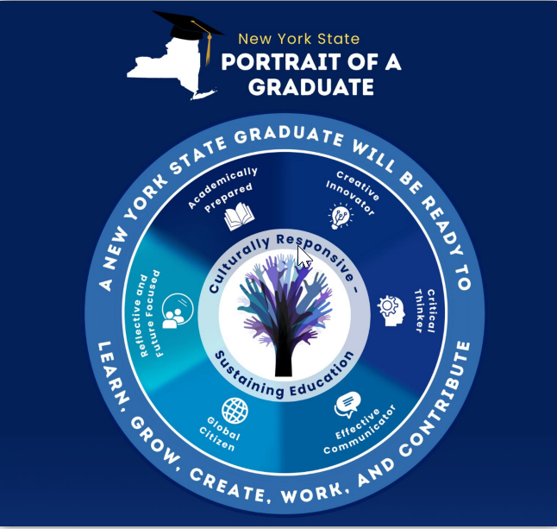
NY Inspires: Portrait of a Graduate Steering Committee
Mission:
The steering committee unites the region through identifying bright spots and blind spots, collaboration, modeling and innovation. The committee promotes practices that empower students, strengthen instructional programs and achieve equitable transformative outcomes.
Coordinated, cross-departmental partnership model bringing expertise together to support districts
Regional information sessions focused on each approved component of the NY Inspires plan
Host site for NYSED statewide events: Blue Ribbon Commission recommendations; implementation of PoG in grades P-5
Notes:
ESBOCES is supporting NY Inspires and the NYS Portrait of a Graduate through a coordinated, cross-departmental partnership model that brings expertise together to better serve districts.
ESBOCES established a NY Inspires Steering Committee with leadership from Educational Support Services, Diversity, Equity & Inclusion, Career and Technical Education, Special Education, and LIRBERN to ensure aligned, system-wide support.
Steering Committee members include
Dr. Krystle Hernandez-Barnett, Divisional Administrator, Educational Support Services
Kate Davern, Director of Educational Support Services
Jachan Watkis, Director of Diversity, Equity & Inclusion
Dr. Jordan Gonzalez, Administrative Coordinator, LIRBERN
Sean Pugni, Divisional Administrator, Special Education
Emily Puccio, Divisional Administrator, Career & Technical Education
Dr. Jordan Gonzalez and Jachan Watkis served on the Blue-Ribbon Commission whose recommendations informed NY Inspires, bringing firsthand insight into both the vision and its practical implementation.
Dr. Krystle Hernandez-Barnett and Kate Davern serve on the NYSED Graduate Measures Communication Network and regularly share updates and guidance at monthly Curriculum Council meetings.
Jachan Watkis and Dr. Krystle Hernandez-Barnett have led a series of regional information sessions focused on each approved component of the NY Inspires plan, including an overview of NY Inspires, Regents exam exemptions for major life events, and implementation of the NYS Portrait of a Graduate
ESBOCES has served as a host site for NYSED statewide events focused on the Blue Ribbon Commission recommendations and the implementation of the NYS Portrait of a Graduate in grades P–5.

Slide 15
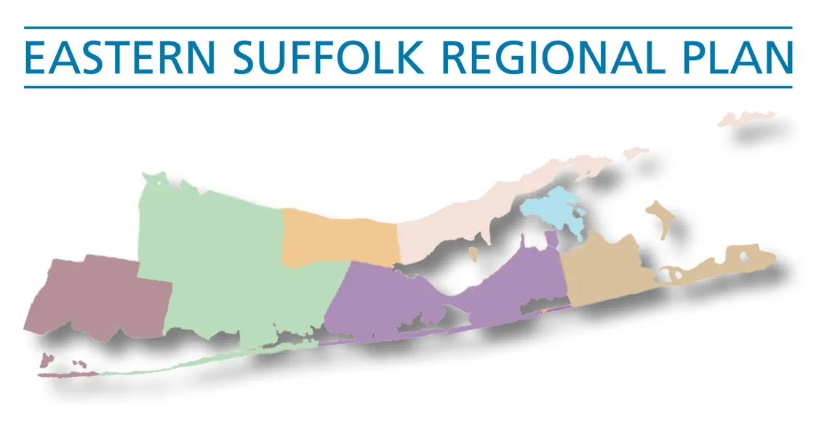
Regionalization Plan
Maximize student access to opportunities, ensure equity, and support students and families.
Remove barriers, be fiscally responsible, and leverage strengths for the benefit of the community.
Plan and facilitate equitable services, identify needs and resources, and work together to address gaps and support educational programs.
3 primary strands: Continuous Improvement, Innovation & Enrichment Opportunities, and Leadership & Workforce Capacity.

Slide 16
5-Year Demographic Trends
ESBOCES Component Districts
Demographic Change
2020-2021 to 2024-2025
Long Island Districts
Demographic Change
2020-2021 to 2024-2025
9.3%
16.8%
-0.1%
10.7%
9.0%
1.9%
-2.3%
9.6%
5.5%
1.4%
Although overall enrollment has been declining, we still see an increase in the # of SWD and ELL/MLL students over the past five years.
-2.2%
-2.2%
K-12
Enrollment
Students
with
Disabilities
ELL/MLL
Economically
Disadvantaged
K-12
Enrollment
Students
with
Disabilities
ELL/MLL
Economically
Disadvantaged
Source: NYS School Report Cards (2020-2021 and 2024-2025)

Slide 17
5-Year Demographic Trends
ESBOCES CTE
Demographic Change
2020-2021 to 2024-2025
ESBOCES Special Education
Demographic Change
2020-2021 to 2024-2025
21.6%
47.3%
81.2%
22.0%
20.7%
20.7%
111.3%
10.9%
Enrollment
Students
with
Disabilities
ELL/MLL
Economically
Disadvantaged
Enrollment
Students
with
Disabilities
ELL/MLL
Economically
Disadvantaged
Sources: ESBOCES CTE Department
ESBOCES SPED Department (from eSchool)

Slide 18
Shifting Student Demographics and Needs
% of K-12 Enrollment
 | 2015-2016 |  |  | 2024-2025
 | % ELL | % SWD | % ECDIS | % ELL | % SWD | % ECDIS
Suffolk County | 8.0% | 14.7% | 38.4% | 13.6% | 18.1% | 44.2%
Nassau County | 7.0% | 12.8% | 29.8% | 8.8% | 15.7% | 33.0%
Long Island | 7.6% | 13.8% | 34.5% | 11.4% | 17.0% | 38.9%
Rest of State (excludes NYC & LI) | 3.9% | 14.8% | 45.3% | 6.3% | 17.3% | 48.7%
Even through a generally declining enrollment, the demographic groups of ELLs/MLLs, students with disabilities, and economically disadvantaged are experiencing increases in numbers.
Source: NYS School Report Cards (2015-2016 and 2024-2025)
Notes:
**UPDATED FOR 2026**

Slide 19
Shifting Student Demographics
10-Year Change in Racial/Ethnic Enrollment 2015-16 to 2024-25
 | Suffolk County | Nassau County | Long Island | Rest of State (excludes NYC & LI)
American Indian/Alaska Native | 23.5% | 51.9% | 33.5% | -16.5%
Asian/Other Pacific Islander | 11.8% | 58.0% | 44.4% | 12.6%
Black/African American | -12.7% | -23.0% | -18.3% | -18.7%
Hispanic/Latino | 32.1% | 14.6% | 24.8% | 28.4%
White | -32.6% | -26.0% | -29.8% | -18.2%
Multiracial | 57.4% | 81.8% | 66.7% | 61.2%
Source: NYS School Report Cards (2015-2016 and 2024-2025)
Notes:
**UPDATED FOR 2026**

Slide 20
Shifting Student Demographics
10-Year Change in Racial/Ethnic Enrollment 2015-16 to 2024-25
Source: NYS School Report Cards (2015-2016 and 2024-2025)
Notes:
**UPDATED FOR 2026**
ROS excludes both NYC and Long Island

Slide 21
Shifting Student Demographics and Needs
ELL/MLL Change
 | 2015-16 | 2024-25 | Total Change | % Change
Suffolk County | 19,200 | 29,303 | 10,103 | 52.6%
Nassau County | 13,869 | 16,665 | 2,796 | 20.2%
Long Island | 33,069 | 45,968 | 12,899 | 39.0%
Rest of State (excludes NYC & LI) | 43,552 | 64,866 | 21,314 | 48.9%
Source: NYS School Report Cards (2015-2016 and 2024-2025)
Notes:
**UPDATED FOR 2026**

Slide 22
Shifting Student Demographics and Needs
Budget Impact Survey: 2025-2026
# of positions added to educate ELLs/MLLs
# of responding school districts | 74
# of responding school districts adding positions | 16
# of positions added | 30
Additional impact to budget (26 district responses) | $9.2 million
Approximate overall budget (55 district responses) | $130.6 million
 | # of districts adding positions | # of positions added
Low Wealth (CWR < 1.000) | 12 | 22
Mid Wealth (CWR 1.000-1.999) | 3 | 7
High Wealth (CWR > 2.000) | 1 | 1
Notes:
**UPDATED FOR 2026**

Slide 23
Shifting Student Demographics and Needs
Students with Disabilities Change
 | 2015-16 | 2024-25 | Total Change | % Change
Suffolk County | 35,006 | 38,979 | 3,973 | 11.3%
Nassau County | 25,522 | 29,841 | 4,319 | 16.9%
Long Island | 60,528 | 68,820 | 8,292 | 13.7%
Rest of State (excludes NYC & LI) | 167,293 | 178,528 | 11,235 | 6.7%
Source: NYS School Report Cards (2015-2016 and 2024-2025)
Notes:
**UPDATED FOR 2026**

Slide 24
Student Outcomes
Long Island 2019 Total Cohort – 5 Year Outcomes – August 2024
 | Suffolk Total Cohort = 19,029 | Nassau Total Cohort = 16,055 | Long Island Total Cohort = 35,084
Graduation Rate | 92.7% | 94.7% | 93.6%
Local Diploma | 0.7% | 0.4% | 0.6%
Regents Diploma | 39.3% | 28.7% | 34.4%
Advanced Regents Diploma | 52.8% | 65.5% | 58.6%
Non Diploma Credential | 0.2% | 0.4% | 0.3%
Still Enrolled | 3.1% | 2.4% | 2.8%
GED | 0.02% | 0.3% | 0.2%
Dropout | 3.9% | 2.2% | 3.1%
Source: 2023-2024 NYS School Report Cards
Notes:
**UPDATED FOR 2026**
Note: Am not using 2024-2025 school report card because outcomes/graduation rate data is not available yet. (this is typical each year, timing-wise)

Slide 25

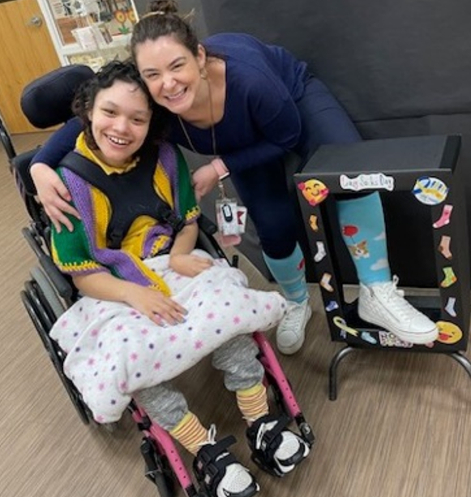

Special Education Services
Evaluation Services
Related Services
Itinerant Services
Specialized Classroom Services
Transitional Services
Interagency Collaborations

Slide 26
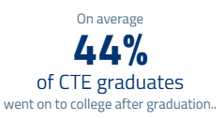

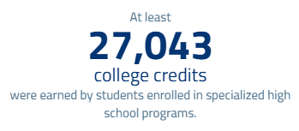
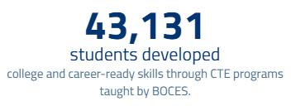
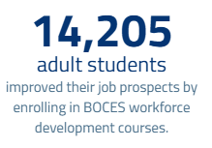

Career and Technical Education
Technical skills in specific trade areas for:
School-aged children
Adult Continuing Education
Special Career Education
In-district programs
Industry certifications
NYS licenses and credentials
CTE pathways endorsement
College credits
Work experiences
Trade/Industry specific scholarships
Professional and soft skills development
Leadership and community service opportunities
Competitions and customer service
Source: https://boces.org/infographics/by-the-numbers/index.html
Notes:
https://boces.org/infographics/by-the-numbers/index.html

Slide 27


Educational Support Services
Through shared services, BOCES provides cost-effective services to support educational programs.
Arts-in-Education/Exploratory Enrichment
Assessment Scoring & Training Services
Curriculum and Development Services
Enrichment Programs: School Year and Summer
Leadership Development & Placement Service
Model Schools
Professional Development
Regional Summer School
School Data Bank Services
School Library System
Third Party Assessment Services

Slide 28

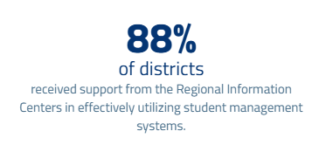
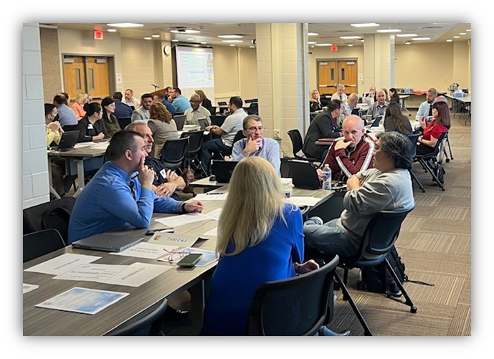
Suffolk Regional Information Center
Cyber Security
Data Warehouse
Education Law 2-D Compliance
Financial & District Services
Intellipath
Internet Services
LAN/WAN Support Services
NYC Charter School Project
SPED and Student Management Systems
Technology Acquisition Services
Test Scanning and Reporting Services
Virtual Learning
Source: https://boces.org/infographics/by-the-numbers/index.html

Slide 29
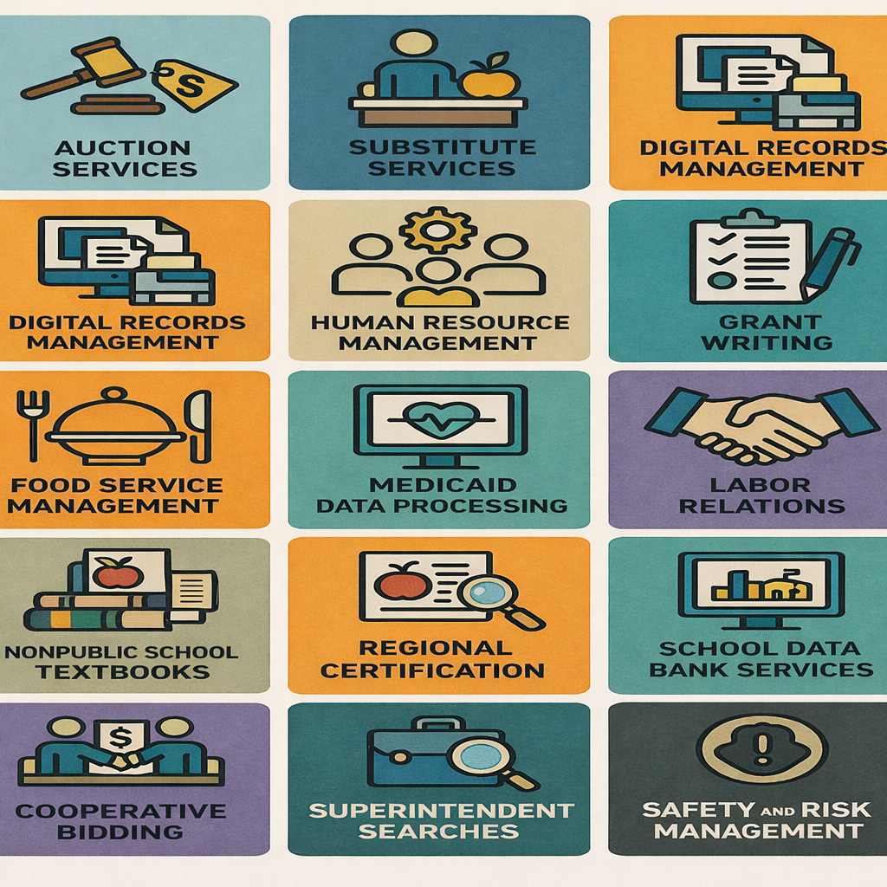
Shared Services
175
districts share
central business office staff
or functions via BOCES
743
cooperative bids
were organized by the 37 BOCES this past year
353
school districts
currently participate in a BOCES coordinated
health benefits consortium
Source: https://boces.org/infographics/by-the-numbers/index.html

Slide 30

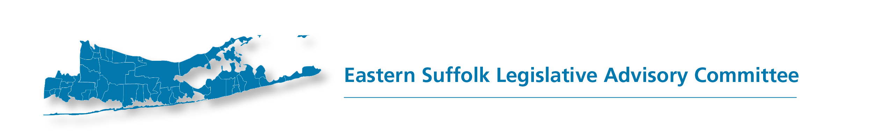
Regional Advocacy
Partnership with Hinman Straub
School Funding: Foundation Aid Formula reform
Local Financial Management
Child Victims Act
Zero Emission School Buses
Charter School Approval and Funding

Slide 31



Regional Advocacy:
Federal & State School Support Initiatives
Cathy Romano, ESBOCES Board Trustee, NYSSBA Area 12 Director
Grant and specially-funded programs include:
Long Island Regional Bilingual Education Resource Network (L.I. RBERN)
21st Century Community Learning Centers
Every Student Succeeds Act (ESSA) Title III Consortia
Family / Migrant Education Outreach Program

Slide 32
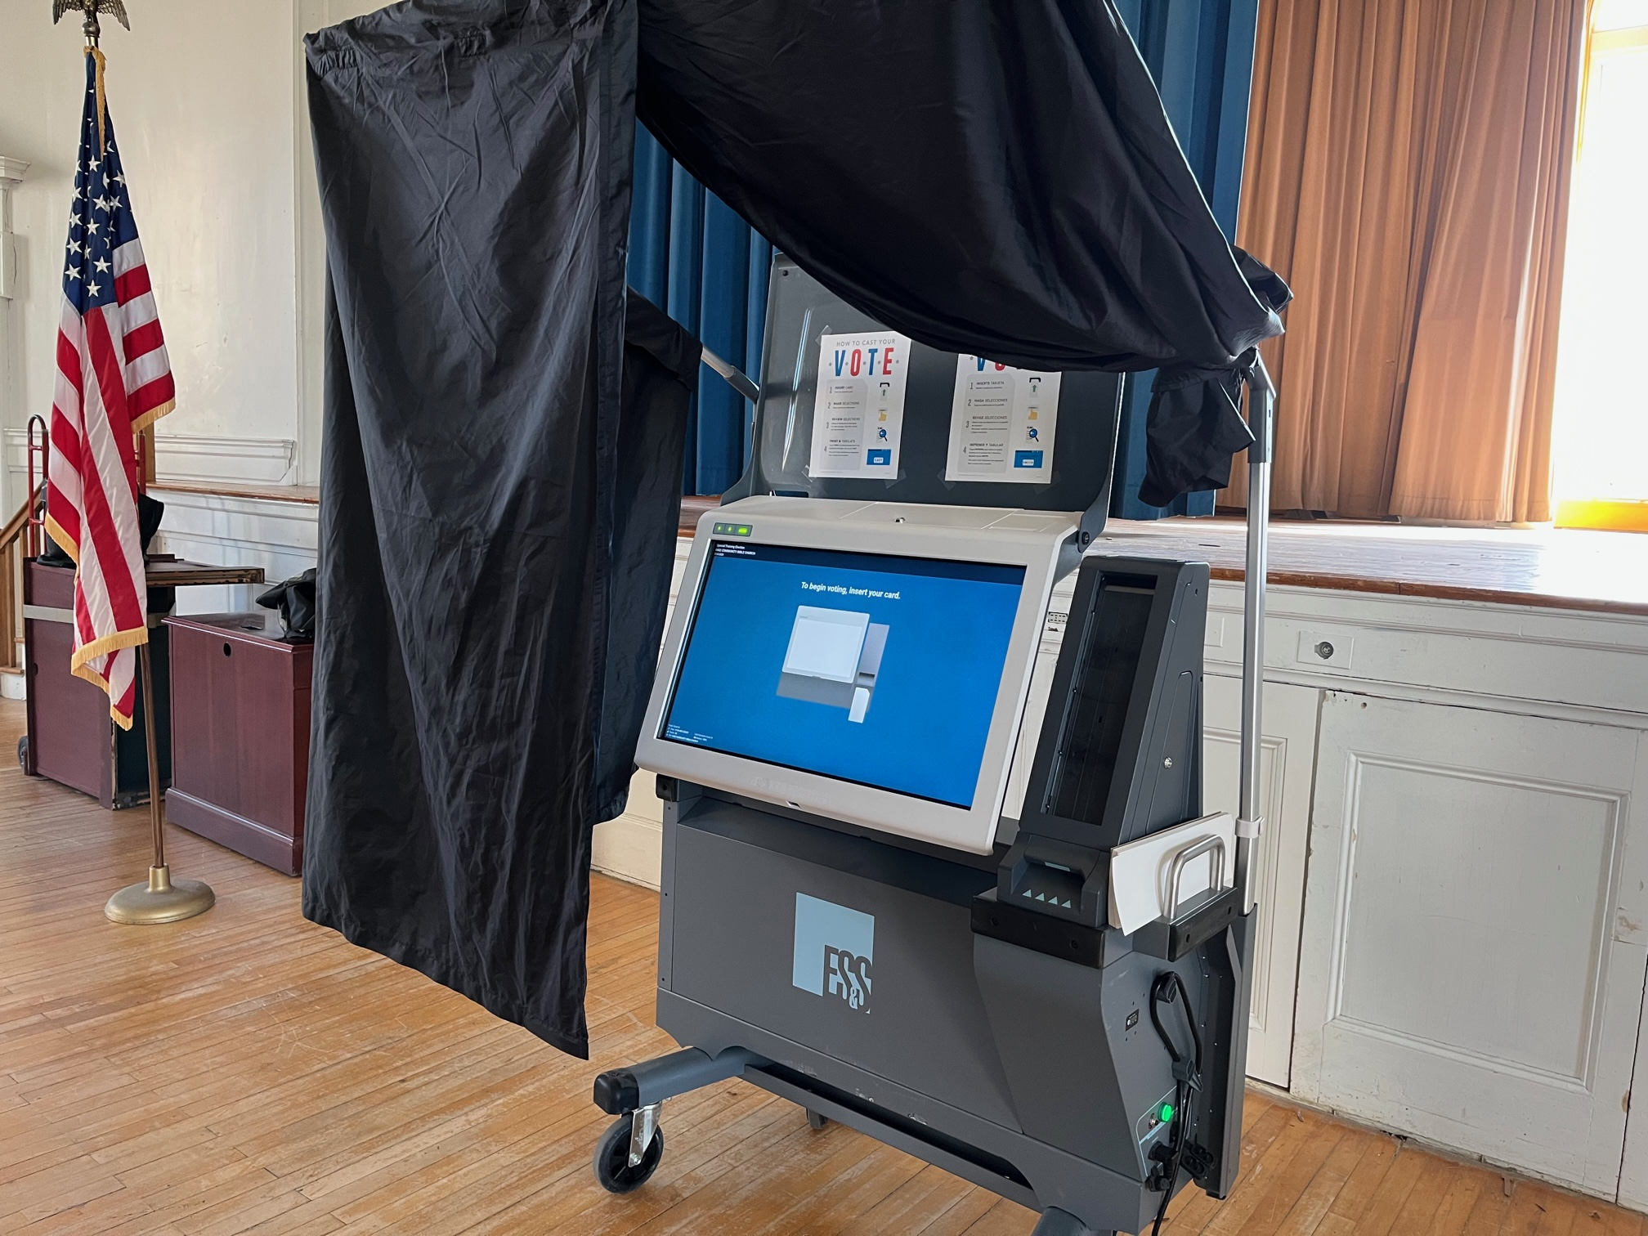
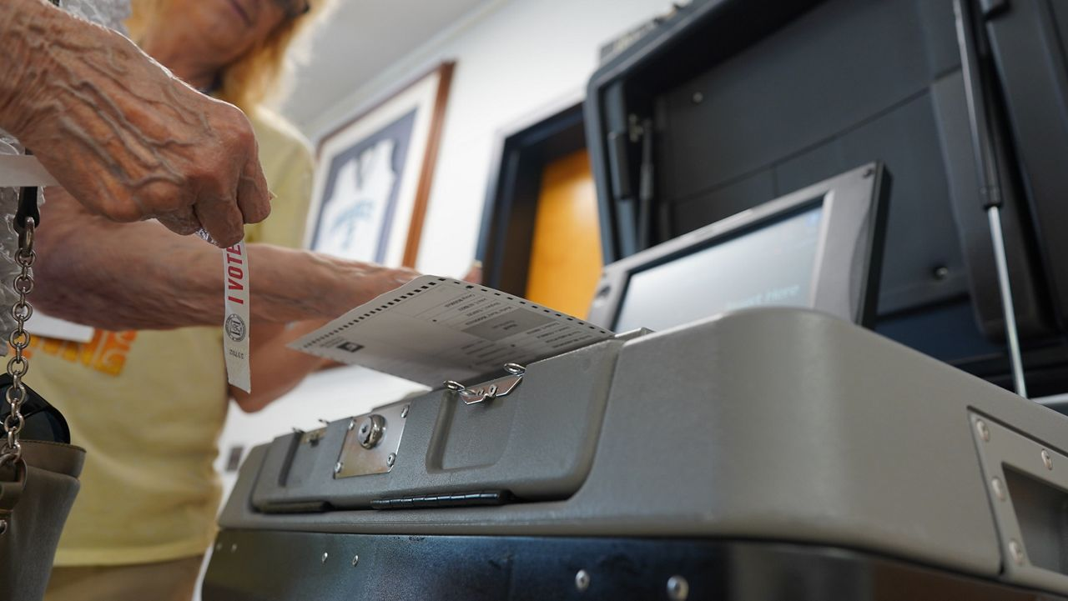
Budget Vote and School Board Elections
Partnership between ESBOCES, N-SSBA, SCSSA, WSBOCES, Suffolk County Board of Elections
Solution for 2025-26
ESBOCES covered costs for Suffolk county districts to relieve administrative and financial burdens
Charges supported through the ESBOCES Administrative Budget

Slide 33
Reimagining Educational Services to Build Bridges for Success
Reflect, Assess, Adjust
Regional Partnership
Values-Based Leadership
Program Evolution

Slide 34

Eastern Suffolk BOCES
Board and Administration
President
Lisa Israel
Vice President
Robert P. Sweeney
Arlene Barresi
Angelo Cassarino
Linda S. Goldsmith
William Hsiang
Members
Kelli Anne Jennings
Susan Lipman
Joseph LoSchiavo
Anne Mackesey
James F. McKenna
Brian O. Mealy
Victoria Molloy
Catherine M. Romano
John Wyche
Ex-Officio Student Members
Dixon Busching Jayden Iglesias Jasmin Montenegro Polanco
District Superintendent
Jasmin Varela, Ed.D.
Chief Operating Officer
David Wicks
Associate Superintendent
Claudy Damus-Makelele – Educational Services
Associate Superintendent
James J. Stucchio – Management Services
Assistant Superintendent
Nichelle Rivers, Ed.D. – Human Resources
Directors
Leah Arnold – Career, Technical and Adult Education
Kate Davern – Educational Support Services
Arlene Durkalski - Human Resources
Mark Finnerty – Facilities
Katelyn Fretto – Business Services
Gina Reilly – Special Education
Darlene Roces – Regional Information Center
Elaine Romeyk – Administrative Services
Jachan Watkis – Diversity, Equity, and Inclusion
www.esboces.org
Eastern Suffolk BOCES does not discriminate against any employee, student, applicant for employment, or candidate for enrollment on the basis of gender, race, color, religion or creed, age, weight, national origin, marital status, disability, sexual orientation, gender identity or expression, transgender status, military or veteran status, domestic violence victim status, genetic predisposition or carrier status, or any other classification protected by Federal, State, or local law. This policy of nondiscrimination includes: access by students to educational programs, student activities, recruitment, appointment and promotion of employees, salaries, pay, and other benefits. ESBOCES also provides equal access to the Boy Scouts and other designated youth groups. ESBOCES fully complies with all applicable rules and regulations pertaining to civil rights for students and employees (e.g., Title IX of the Education Amendments of 1972, § 504 of the Rehabilitation Act of 1973, Titles VI and VII of the Civil Rights Act of 1964, Dignity for All Students Act, § 303 of Age Discrimination Act of 1975, the Americans with Disabilities Act of 1990, and the Boy Scouts of America Equal Access Act of 2001). Inquiries regarding the implementation of the above laws should be directed to either of ESBOCES Civil Rights Compliance Officers at ComplianceOfficers@esboces.org: the Assistant Superintendent for Human Resources, 631-687-3029, or the Associate Superintendent for Educational Services, 631-687-3056, 201 Sunrise Highway, Patchogue, NY 11772. Inquiries may also be addressed to the Office for Civil Rights at the US Department of Education, 32 Old Slip, 26th Floor, New York, NY 10005, 646-428-3800, OCR.NewYork@ed.gov.
Notes:
**UPDATED FOR 2026**

