Slide 1
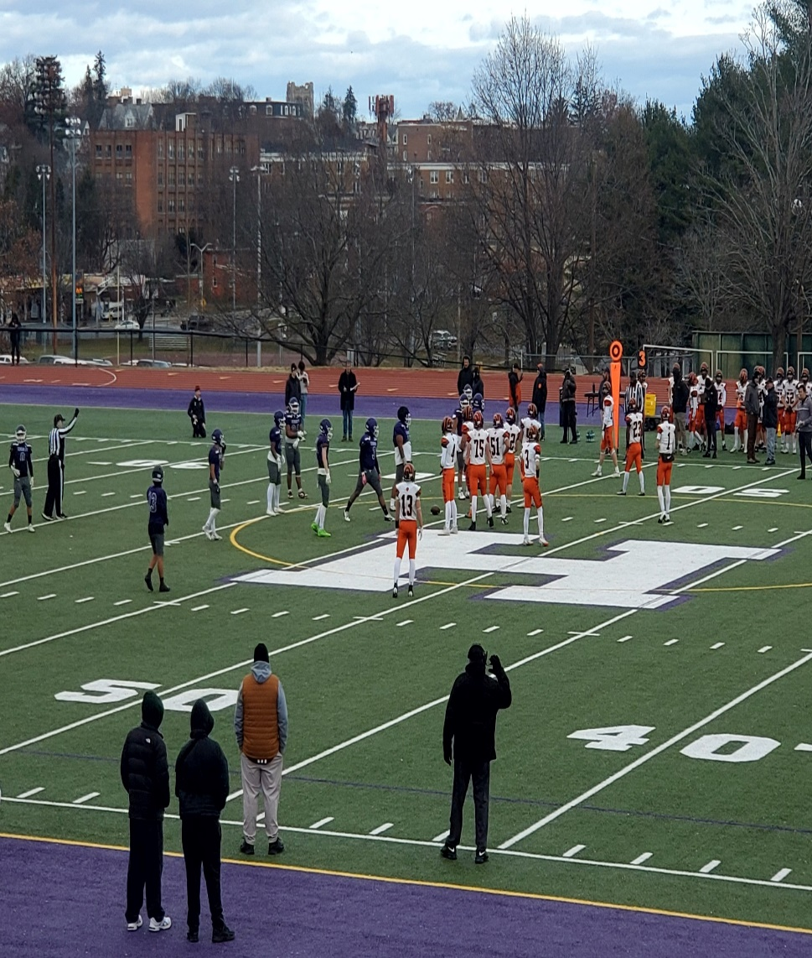
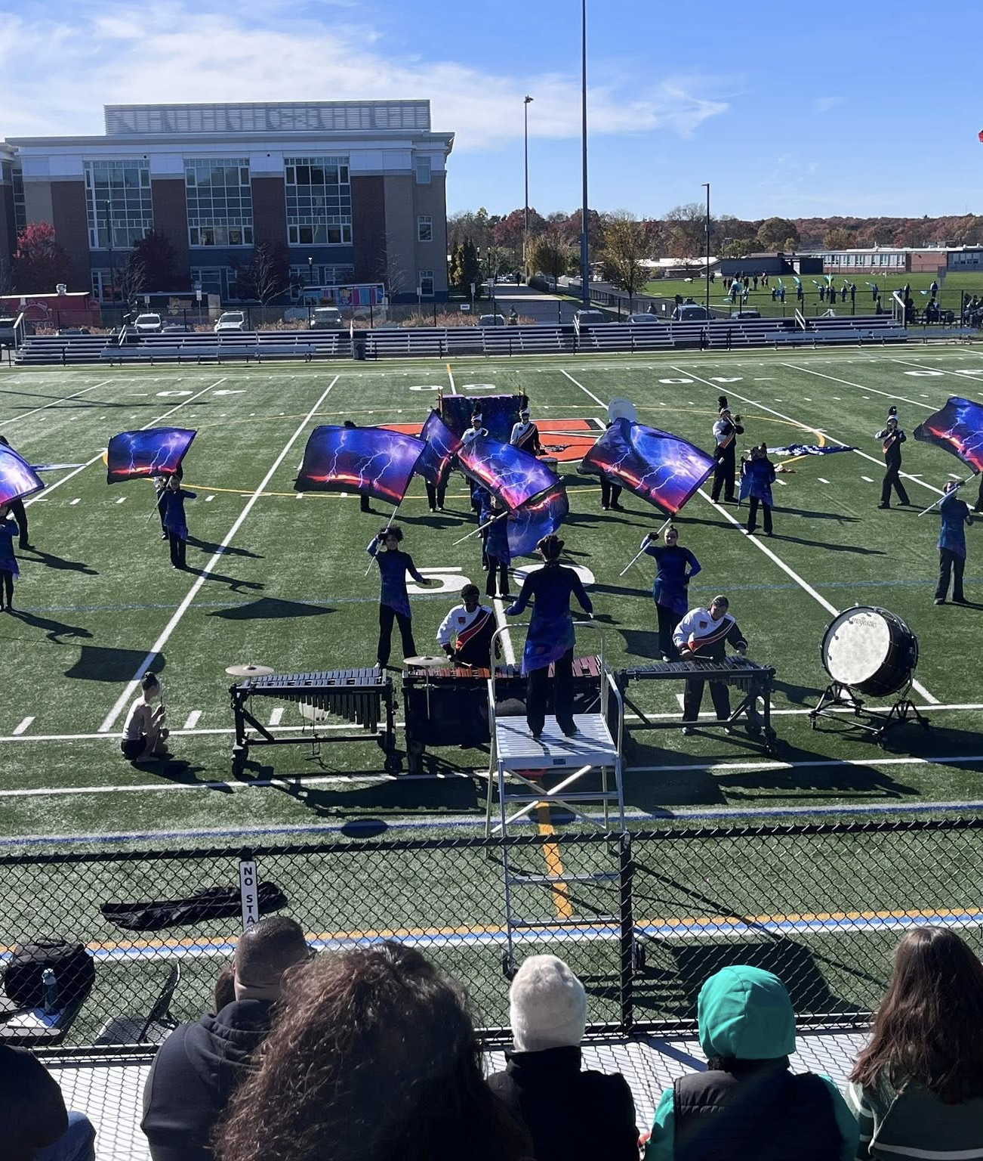
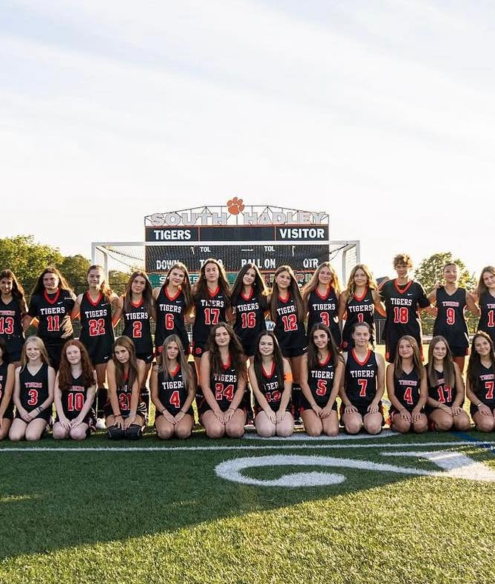
Extracurricular activities: building, belonging, leadership, and opportunity

Slide 2
Why Extracurriculars matters
Builds connection and belonging (students feel known and engaged)
Develops leadership, teamwork, responsibility, and perseverance
Strengthens school culture and community pride
Supports student well-being and positive peer networks
Creates pathways for students who connect through arts, athletics, service, and clubs

Slide 3
Participation snapshot
80% of the high school student body participates in a sport or activity
Approximately 80-100 students per season participate in athletics

Slide 4
High School Athletics offerings
Fall
Volleyball
Golf
Football
Field Hockey
Cross Country (Co-op)
Girls Soccer
Boys Soccer
Cheerleading
Winter
Boys Basketball
Girls Basketball
Swimming (Co-op)
Wrestling
Cheerleading
Ice Hockey (Co-op)
Indoor Track
Spring
Boys Lacrosse
Girls Lacrosse
Softball
Baseball
Track

Slide 5
High School Activities and arts
Art Club
Gaming Club
Gay Straight Alliance
Environmental Club
Leo Club
Peer Leaders
Student Union
Spotlight (Newspaper)
Student Council
Yearbook
Concert Band
Chorus
Jazz Band
Marching Band
Harlequins (Drama)

Slide 6
Middle school and elementary offerings
Middle School
Cooking Club
Drama
Art Club
Band
Chorus
Elementary
Lego Club
Art Club

Slide 7
Family fees and access
Student Participation Fees (HS Athletics)
$225 for all sports except football
$250 for football
Spectator Fees
$4 - $6 per game

Slide 8
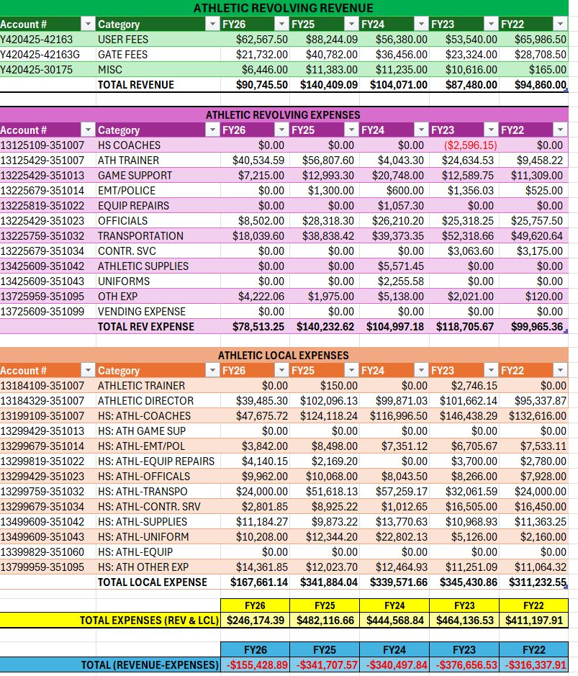

Slide 9
Budget constraints and the risk of cuts
All Sports
All Clubs
Marching Band

Slide 10
What we lose if extra curriculars are eliminated
Students lose belonging and connection to school
Reduced social-emotional well-being and trusted adult mentorship
Fewer leadership, teamwork, and life-skill opportunities
Weaker school culture, pride, and community engagement
Fewer safe, structured after-school options
Equity gap grows – families without access to private programs are hit hardest
Lower student engagement and attendance
Families may school choice out to districts with stronger offerings
Enroll loss creates added long-term budget pressure
Less college/career readiness through activities and experiences

