Slide 1
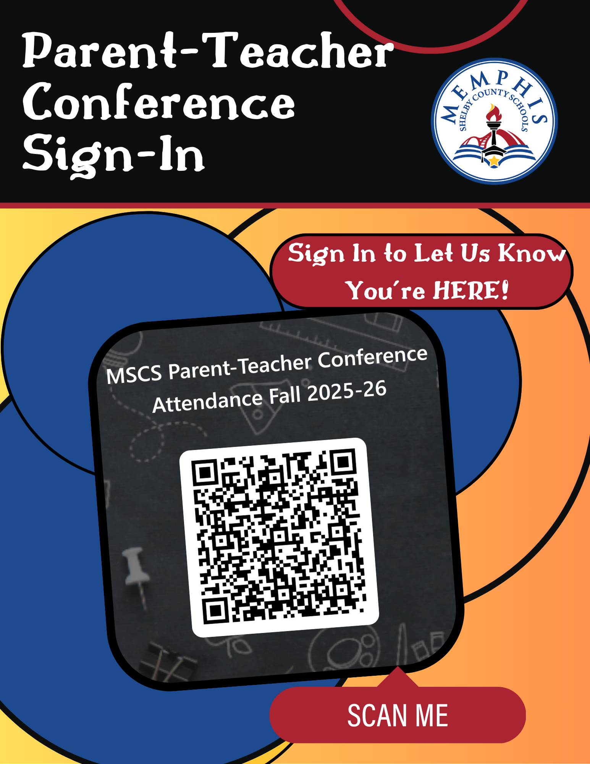

Slide 2



Woodstock Middle School
September 9, 2025
Mr. Willie Bolden, Principal
Ms. Marsha Carodine, Assistant Principal
Mr. Raheem-Asad Merriweather, Professional Learning Coach
Ms. Sarah Jackson, Professional School Counselor
Mr. T. Greer, Community Engagement Specialist

Slide 3
📌 Purpose of Tile I
Provide additional academic support to help all students meet challenging state standards
Ensure equitable access to high-quality education for all children
Close achievement gaps between advantaged and disadvantaged students
Strengthen parent and family engagement in the learning process
Support schools with resources, professional development, and funding to improve student outcomes
📘 Title I is designed to give every child a fair, equal, and significant opportunity to obtain a high-quality education.

Slide 4
📌 Reporting Pupil Progress
Progress Reports issued mid-quarter to keep families informed
Report Cards sent at the end of each quarter with academic and behavioral updates
Parent Portal Access for real-time grades, attendance, and assignments
Parent-Teacher Conferences scheduled throughout the year to review progress and set goals
Intervention & Support Plans shared with families if students need additional academic support
📊 Families are encouraged to monitor student progress regularly and collaborate with teachers to support student success.

Slide 5
📌 Parent-Teacher Conferences
Held each semester to review student progress
Provide an opportunity to discuss academic performance, behavior, and goals
Allow families to collaborate with teachers on support strategies for success
Conferences may be scheduled in-person, by phone, or virtually for flexibility
Interpreter services available upon request to ensure clear communication
📝 Conferences strengthen the partnership between home and school by ensuring every family has a voice in their child’s education.

Slide 6
📌 Parent & Family Engagement Requirements
Family Engagement Plan
Parents are the primary teachers of their children
Family involvement is essential to student success
Woodstock MS administrators, staff, and parents developed the plan together
Parents Can:
Serve on the Site-Based Leadership Team
Respond to memos, surveys, and questionnaires
Support Title I requirements
Parents Will Be:
Invited to the Annual Title I Meeting
Notified of policies in a clear, understandable format
Informed of their rights to be involved
Offered opportunities to participate in school affairs
Asked for feedback and given timely information about parent programs
Provided with assessment results and explanations of curriculum, assessments, and proficiency levels

Slide 7
📌 Availability of Parent Training
Workshops & Sessions offered throughout the school year on academic strategies and student support
Family Engagement Nights to learn tools for supporting learning at home
Technology Trainings on using Parent Portal, Clever, and other digital platforms
Community Resources shared to connect families with additional learning opportunities
Flexible Scheduling (daytime and evening sessions) to meet the needs of all families
🤝 Parent training empowers families to actively support their child’s success at Woodstock Middle School.

Slide 8

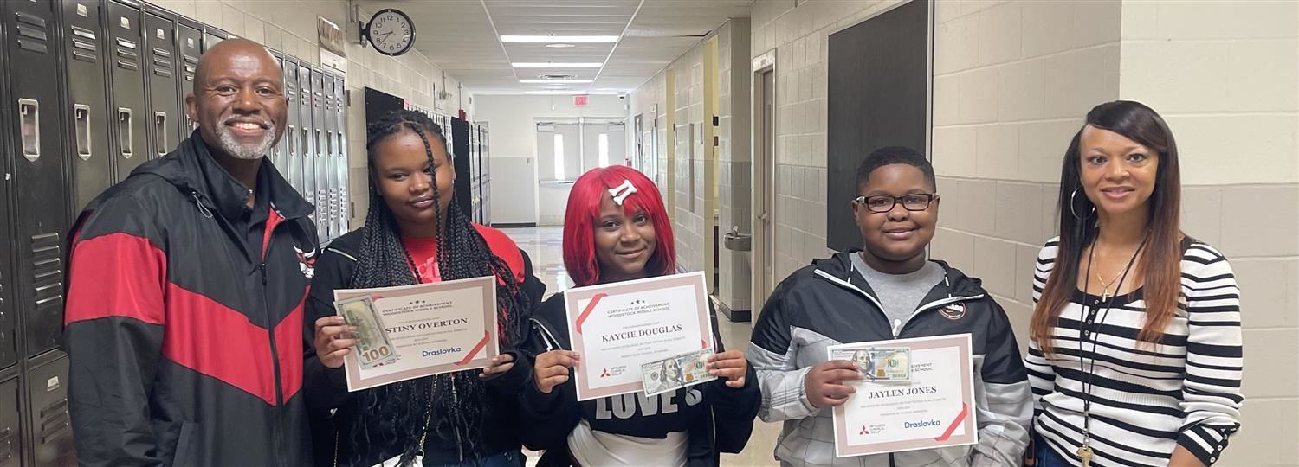
📌 District/School Progress/School Status
Mr. Willie Bolden, Principal

Slide 9
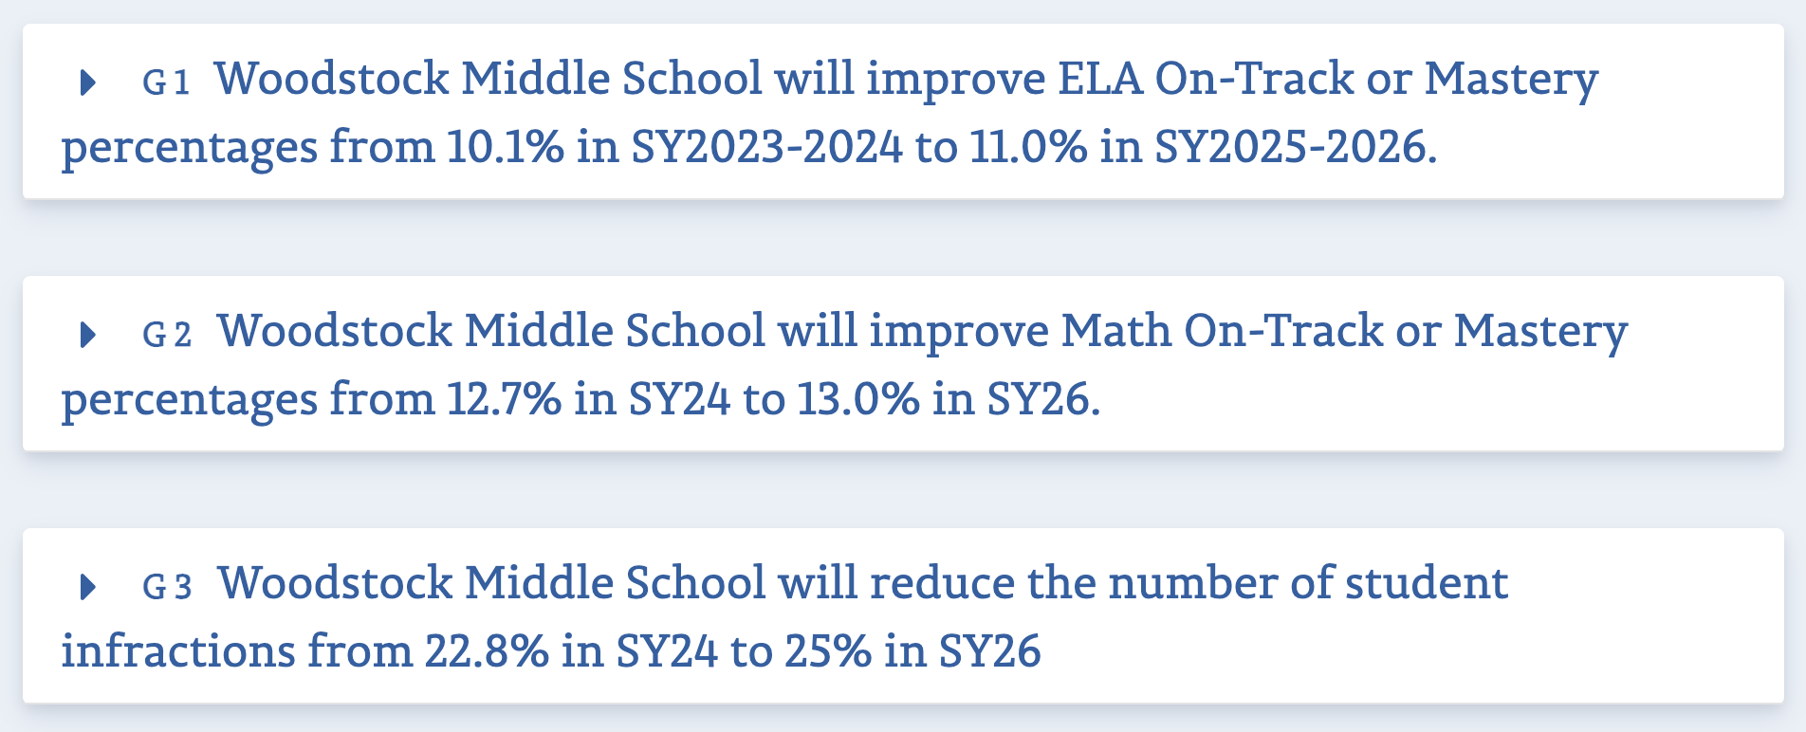
📌 School Improvement Plan
Mr. Raheem-Asad Merriweather, PLC Coach

Slide 10
📌 School Improvement Plan
Woodstock Middle School will have an assessment team that will meet and create common assessments for ELA, math, science, and social studies bi-weekly to monitor students’ progress in learning and applying the state standards as well as to determine the reteaching of state standards to students.
Woodstock Middle will implement “Data Nights” each semester and Parent-Teacher Conferences each
semester and upon requests of the administration, teachers, or parents to keep parents informed of the schools’ academic progress.
The family engagement specialist will establish partnerships with adopters to connect Woodstock Middle School with community resources that support the teaching and learning environment and the overall well-being of students to assist with increasing the progressive discipline support rate.

Slide 11
📌 Opportunities for Additional Parent Meetings
Academic Nights (Math, ELA, Science, Technology)
Quarterly Data Chats (iReady, CFA, TCAP updates)
Grade-Level Progress Meetings
STEM Showcase / Family Literacy Night
Code of Conduct & PBIS Workshops
Mental Health & Wellness Sessions
Parent Advisory Council (PAC) Meetings
Coffee with the Principal / PLC Coach

Slide 12
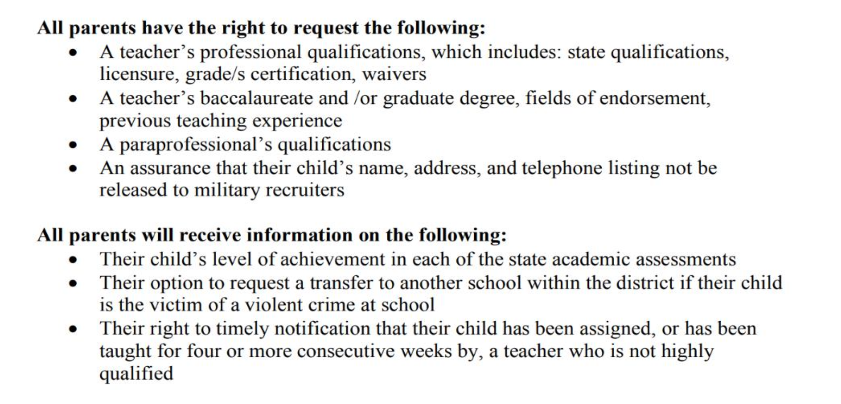
📌 Teacher Qualifications & Parents’ Right to Know

Slide 13
📌 Notice of Title I School Status

Slide 14
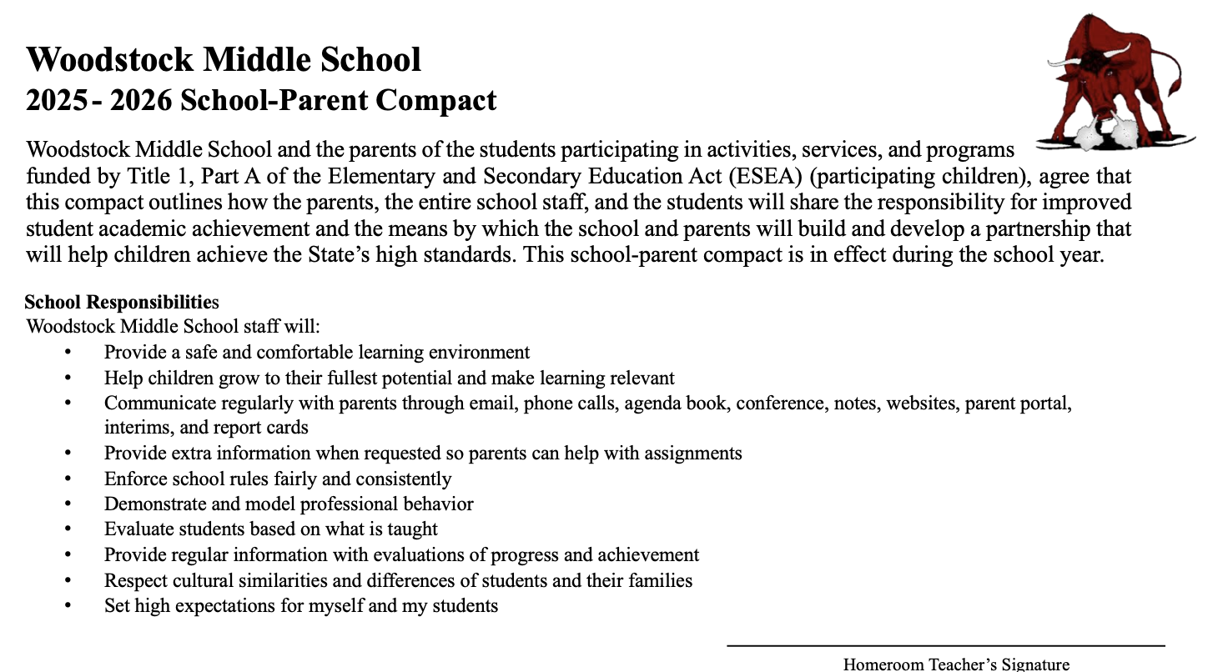
📌School-Parent Compact

Slide 15
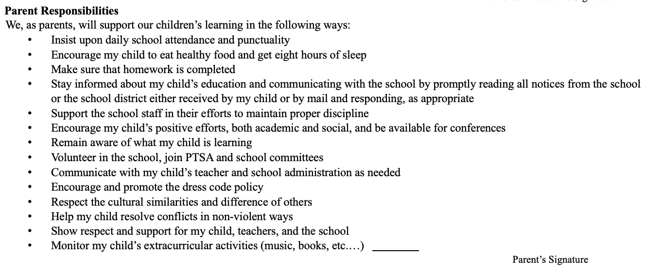
📌School-Parent Compact

Slide 16
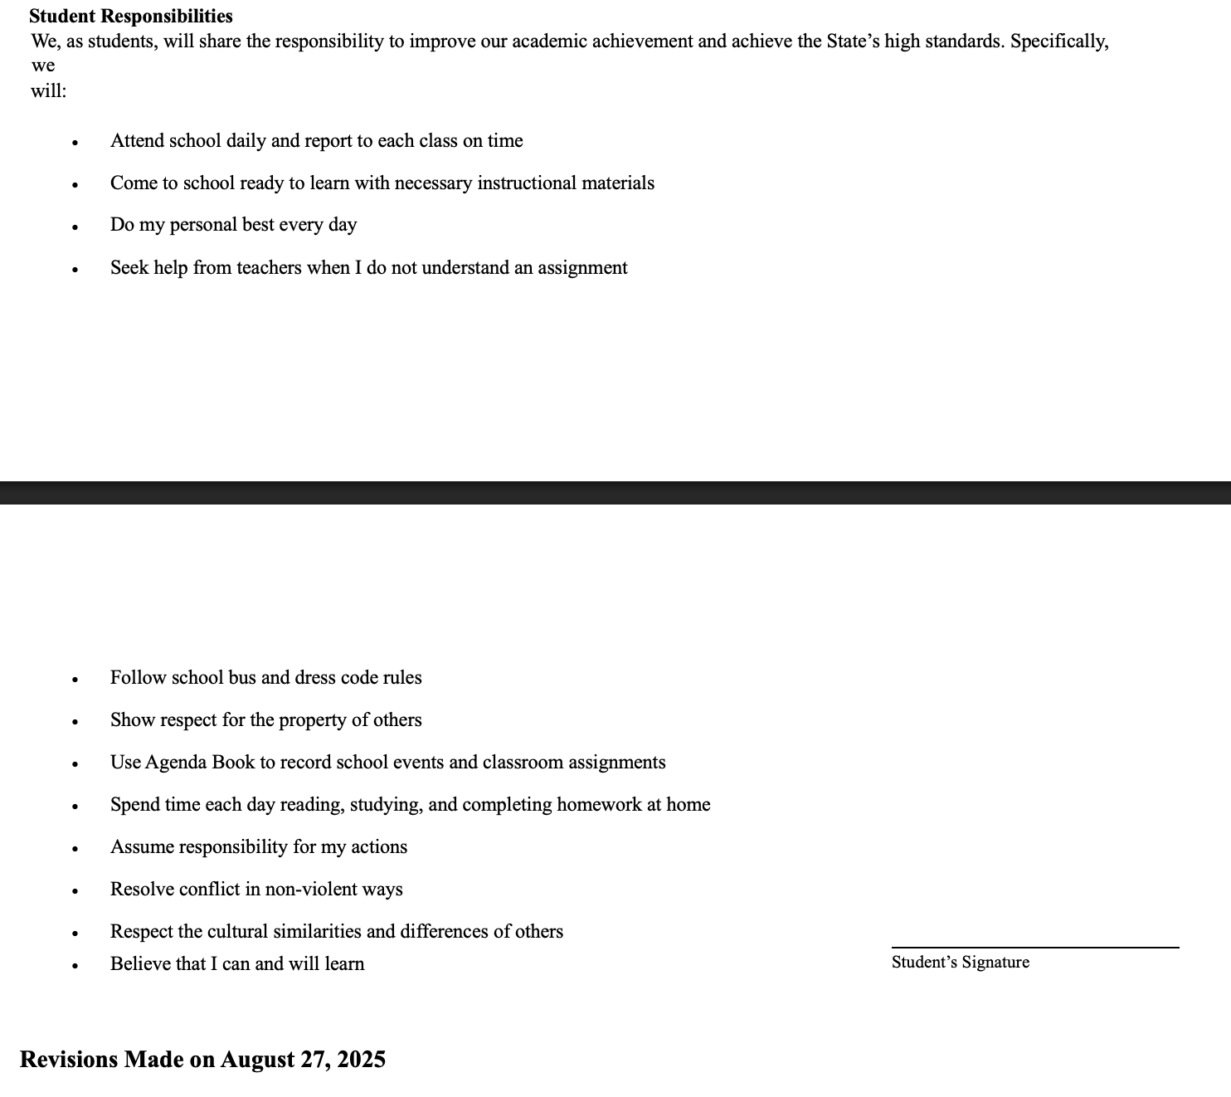
📌School-Parent Compact

Slide 17
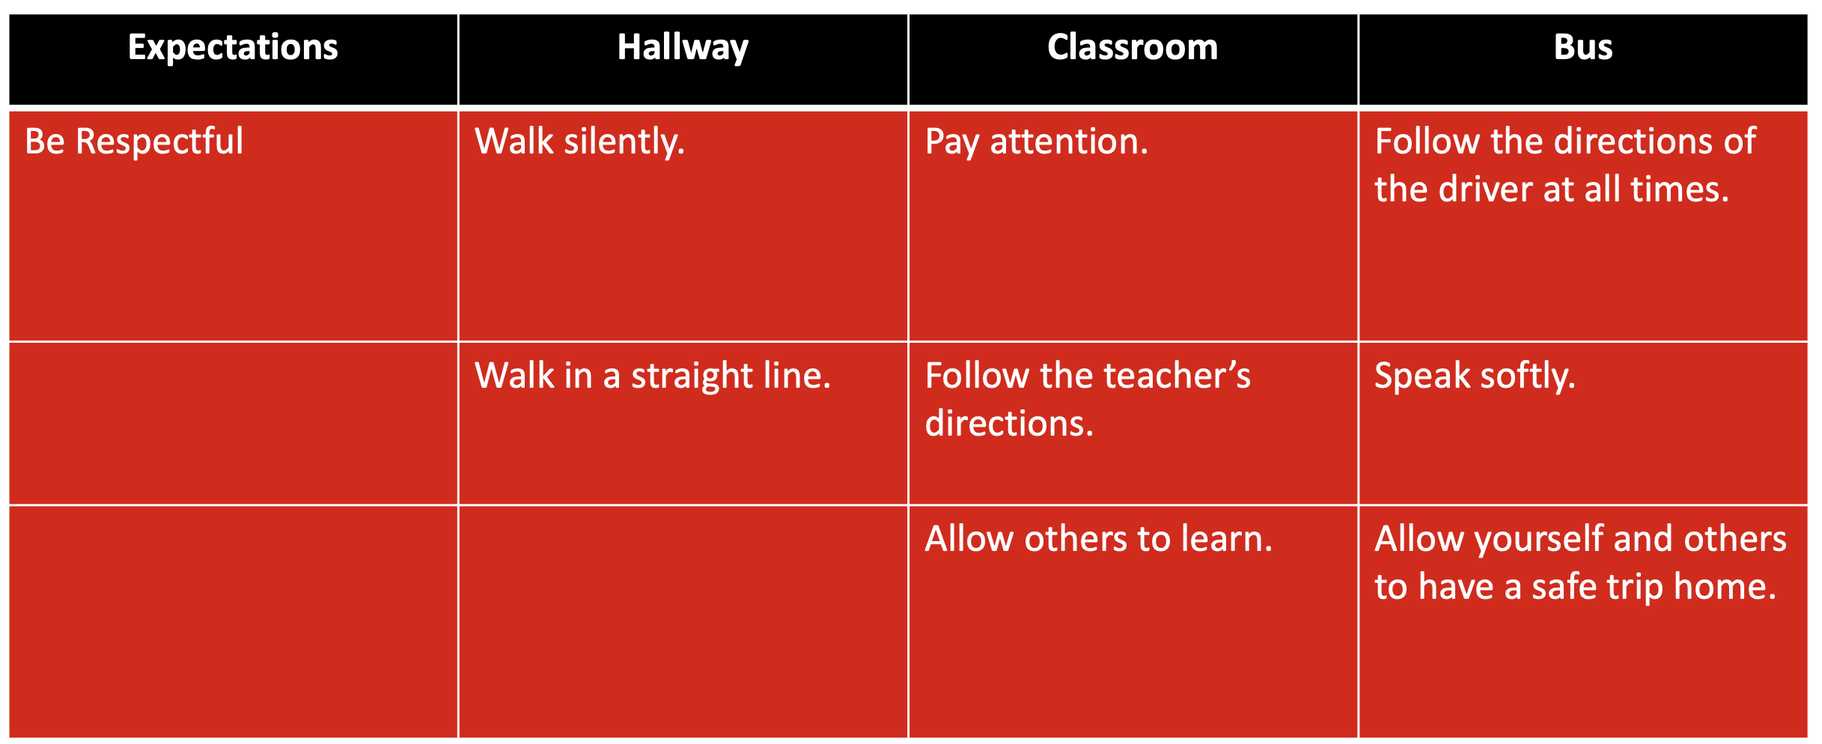
📌Student Code of Conduct

Slide 18
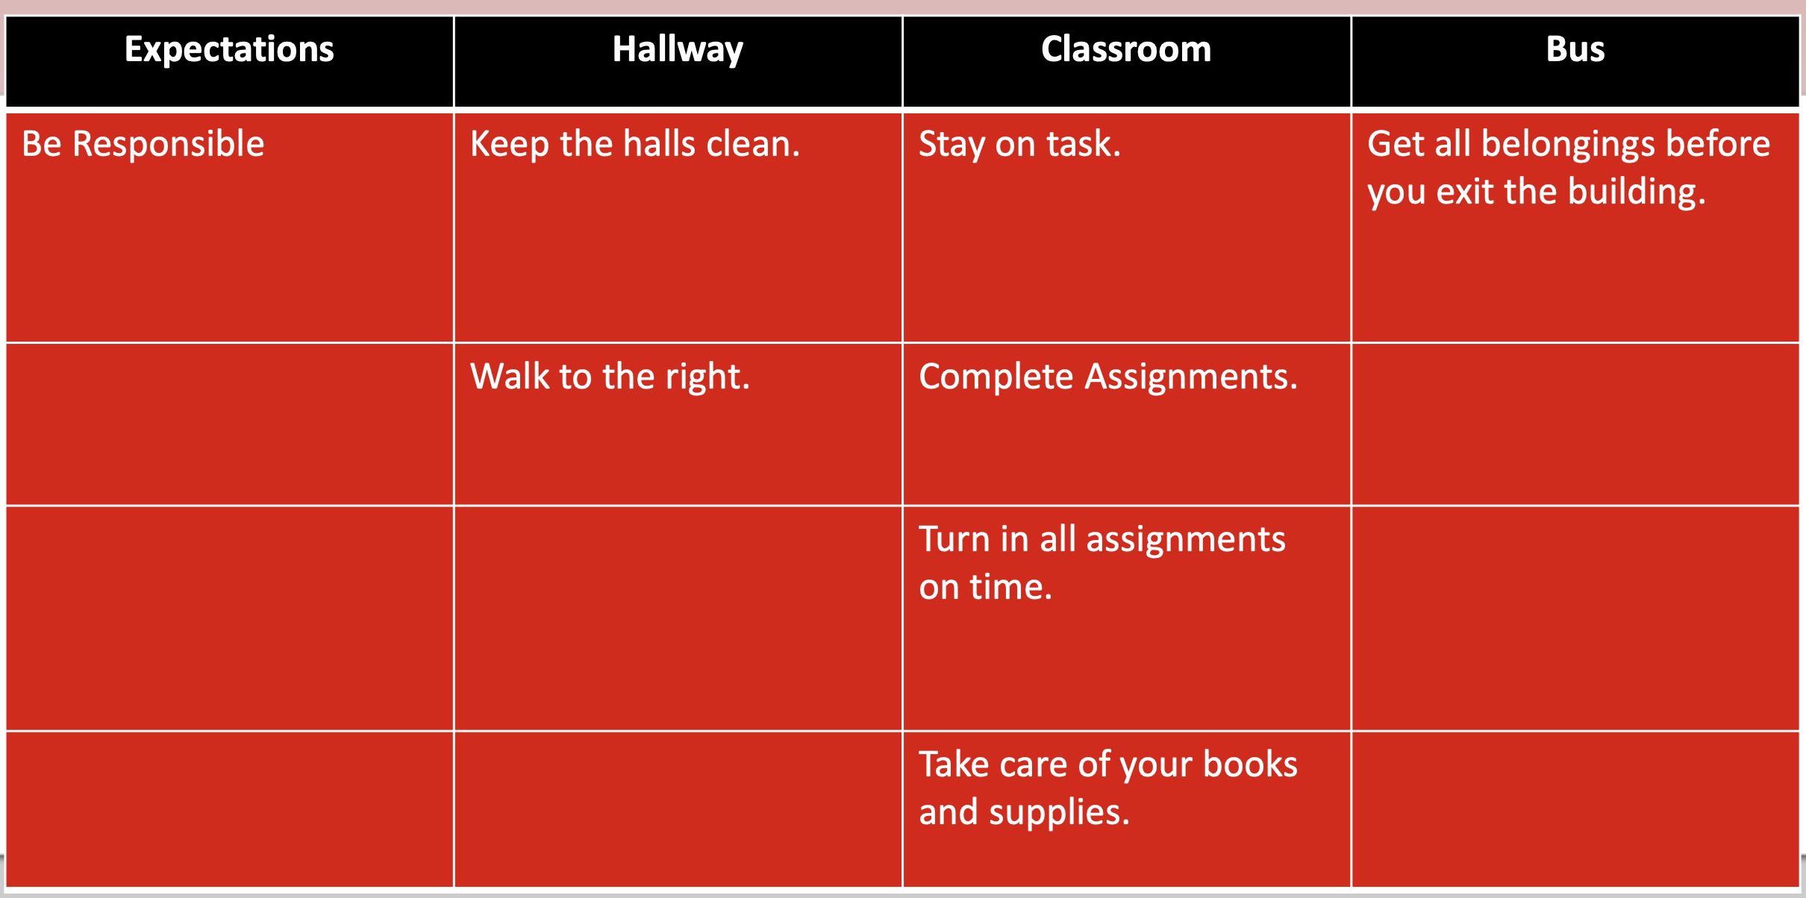
📌Student Code of Conduct

Slide 19
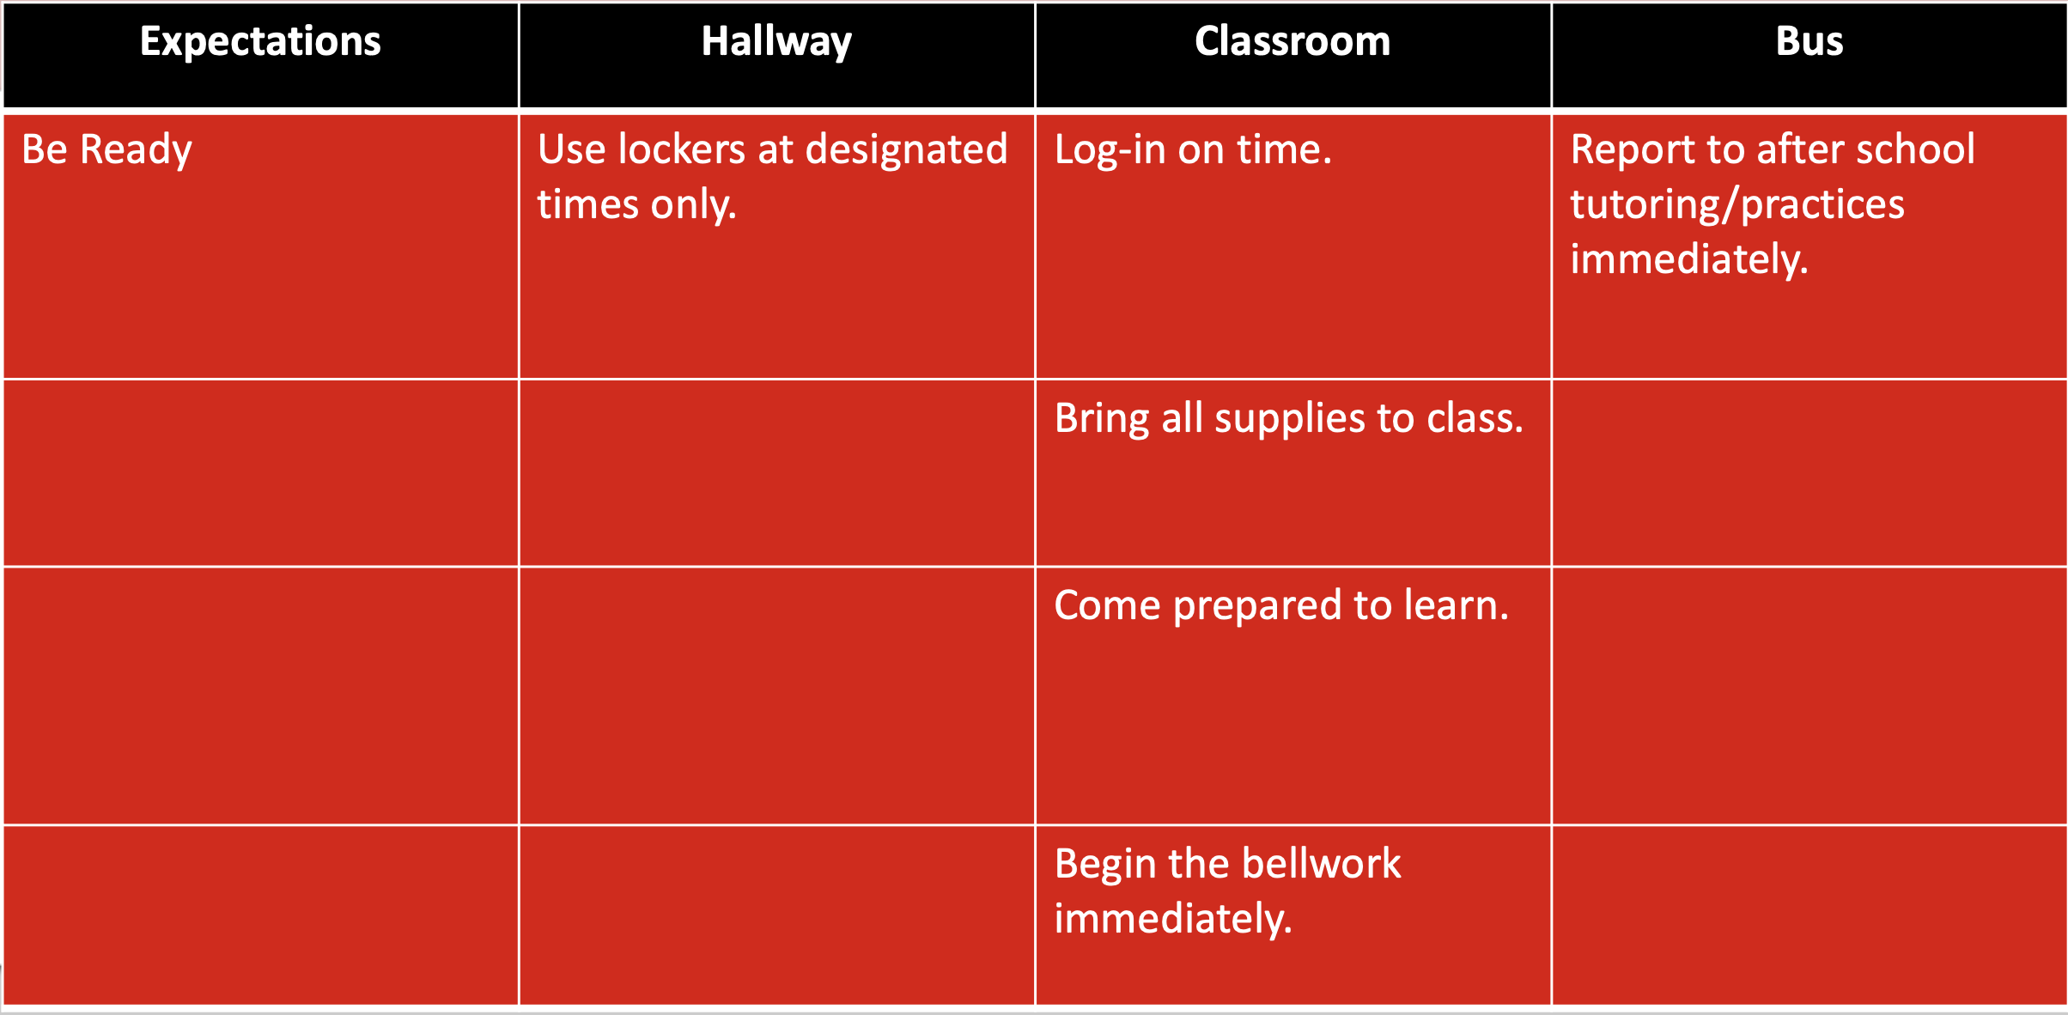
📌Student Code of Conduct

Slide 20


Slide 21


