Slide 1


Annual title I parent meeting
Sept. 17,2025
9:00 AM
4:00 PM
Rod Peterson, principal
Jeanine Evans, Asst. Principal
Angela Wright, Asst. Principal
Tanita White-Hilliard, Interim Asst. Principal
Treena guyton, plc coach
Sandra polk, plc coach

Slide 2

AGENDA
Welcome & Purpose
Vision & School Status
Title I Information
  What is Title I?
  Title I Funding Overview
  Title I Supplemental Support
Parent’s Right To Know (includes handout)
Parent and Family Engagement Policy
Available Parent Training
Student Progress Reporting Periods
25/26 SY Parent Teacher Conferences
School-​Parent Compact (includes handout)
Student Code of Conduct
Family Engagement Opportunities
Opportunities for Additional Parent Meetings
Colonial Middle School Dance Team
Feedback Survey

Slide 3

PATRIOT’S VISION
Colonial Middle School provides an environment of cultural and creative diversity. All students, as lifelong learners, are challenged to develop skills necessary to reach high academic levels and to become productive citizens.

Slide 4
School Current Status
COLONIAL IS CURRENTLY
LEVEL 5
Letter Grade B
Colonial Teachers meet State/District Qualifications Guidelines

Slide 5
What is Title I?
Title I is the largest federal assistance
program for our nation’s schools.
The goal of Title I is to provide a higher quality of education for every child. Its purpose is to address the academic needs of students in order to assist them in achieving Tennessee Academic Standards.
The program serves millions of children in public elementary and secondary schools each year including eligible students in private schools.

Slide 6
Title I Funding Overview
The federal government provides funding to states each year for the Title I program.
The Tennessee Department of Education allocates the money to our district.
The school district identifies eligible schools and distributes the Title I funds to the school.
Colonial Middle implements a school wide program, in which all students benefit from the supplemental services provided by Title I.

Slide 7
Title I Supplemental Support
Additional Educational Support Professionals
Additional Training for School Staff
Extra Time for Instructional Support
(Before/After School Programs)
Parental Involvement Activities
Supplemental Teaching Materials, Equipment and Technology

Slide 8
Parent’s Right To Know
As a Title I parent, you have the right to be involved in the development of the following plans and documents for our school:
School Improvement Plan (SIP)
Parent Engagement Plan for the School and District
You may request and attend meetings to express your opinions and to formulate suggestions and to participate, as appropriate, in decisions relating to the education of your children.

Slide 9
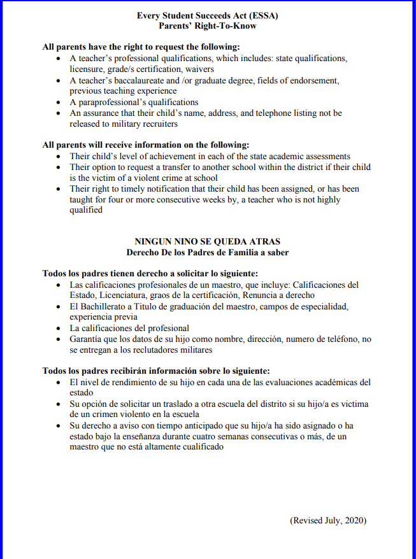

Slide 10
Parent’s Right To Know
As a Title I parent, you also have the right to:
Know your child’s level of achievement on assessments in English Language Arts, Mathematics, Social Studies, and Science.
Request and receive information on the qualifications of your child’s teacher and educational support professionals that are working with your child.
Know if your child is taught by a non-highly qualified teacher for four or more consecutive weeks.

Slide 11
Parent and Family Engagement Plan
Parental Involvement Opportunities at Colonial Middle School
Utilize your talents and/or resources to enhance the instructional programs at Colonial Middle School
    Serving on the CMS School Improvement Plan Committee
    Becoming a Volunteer
Responding to questionnaires, surveys, and memos expressing thoughts, suggestions, and/or concerns.
Attending school events such as Parent Nights
Serving as an advisor to various organizations
SIP VOLUNTEERS (We are asking for Volunteers)

Slide 12
Available Parent training
Tracking Your Child’s Attendance (Attendance Matters)
PowerSchool
Microsoft TEAMS
Homework Hotline
Tutoring (See QR Codes sheet for signup.)
What to do if your device breaks, stop working, lost, or stolen
Contacting the teacher (See website to schedule conferences.)

Slide 13
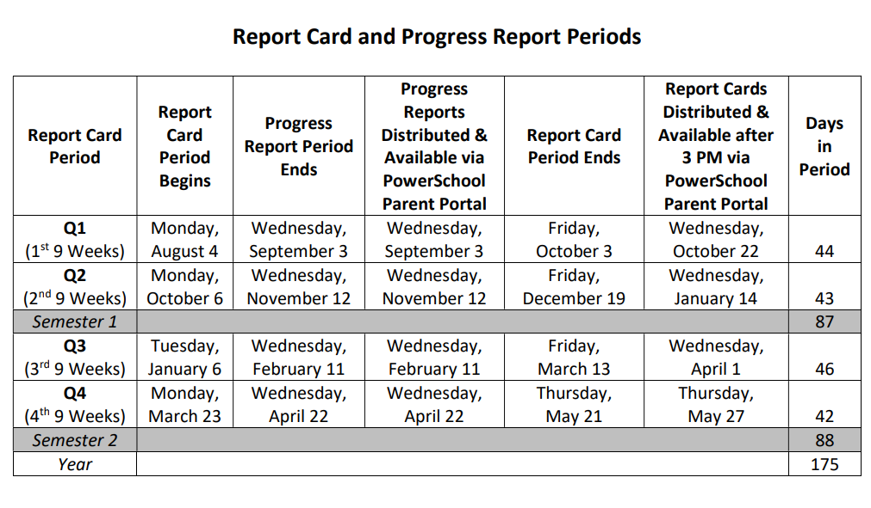
PROGRESS REPORTS

Slide 14

Parent teacher conference dates
September 9th
(4:00 pm- 7:00 pm)
April 27th
(4:00 pm – 7:00 pm)
If you need to schedule a conference before or after the dates listed, please feel free to contact your child’s teacher or complete a request form on the school’s website to schedule a conference.

Slide 15
Parent, Student, Teacher, and School Compact
This compact is a commitment between the parent, student, teacher and school to share in the responsibility of improved academic achievement.
Title I Parents have the right to be involved in the development of the School-Parent Compact.

Slide 16
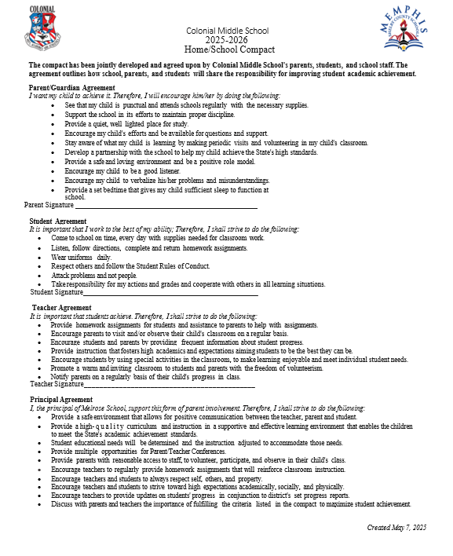
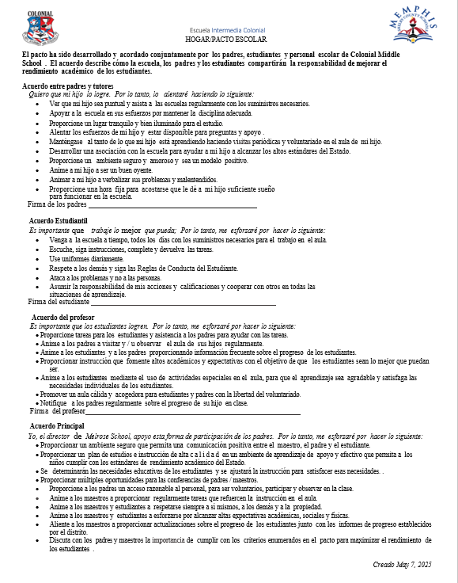
Parent, Student, Teacher, and School Compact

Slide 17
mScs student code of conduct
Accessed on District and school websites
SCS student code of conduct specifies behavior that is accepted or prohibited in the school as well as in any setting that is related to the school. Codes of conduct generally state the behavior expected to be demonstrated by the student.
Discipline policies outline consequences/punishments that will occur in response to specific misbehavior.
The student Code of Conduct can be found in the Memphis-Shelby County Schools Student- Parent Handbook.

Slide 18
Opportunities for additional parent meetings
Open House
Parent Teacher Conferences
Data Meetings
Arts & Performance Evenings
Curriculum Fair
This Photo by Unknown Author is licensed under CC BY-SA-NC

Slide 19
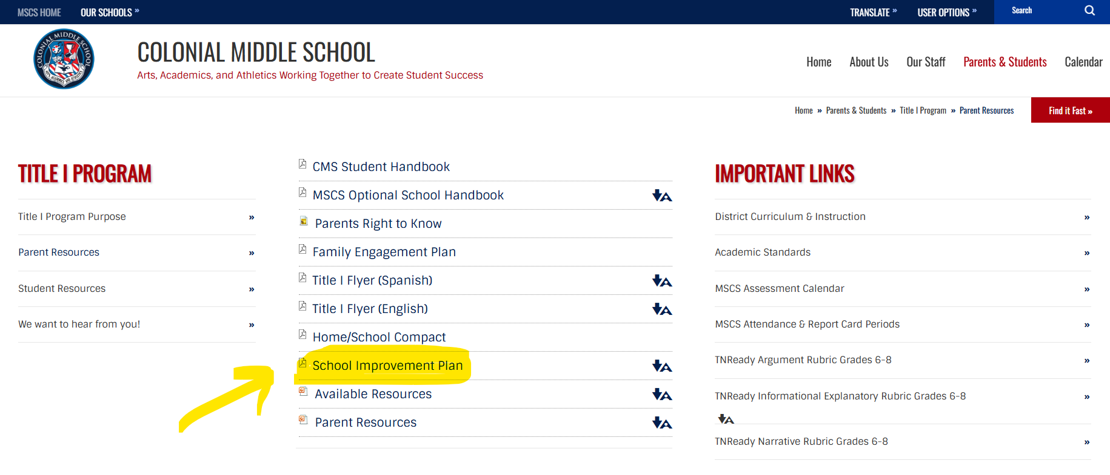
School Improvement Plan (sip)
Follow this link to access the SIP. https://schools.scsk12.org/Page/8405

Slide 20

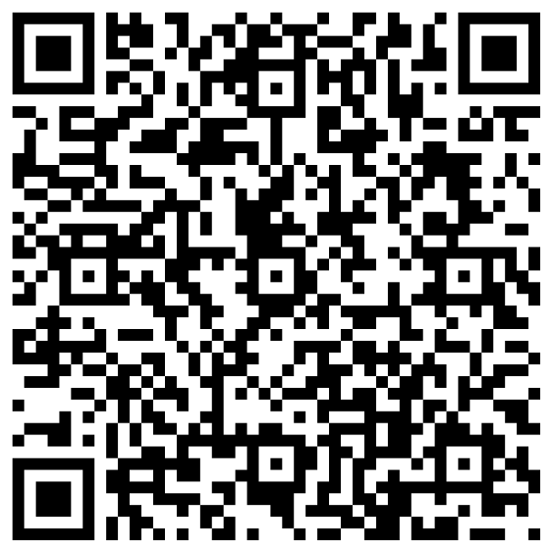
Parent’s Feedback is vital
We value your feedback and want to hear your thoughts about today’s Title I Parent Meeting. You can share your feedback by completing a quick survey. Please visit our school website or simply scan the QR code shown on the screen to access the survey. Your input helps us improve and better serve our families. Please go on Colonial’s Website and provide feedback on the various survey links.
PARENT SURVEY

Slide 21
contact information
Treena Guyton, PLC Coach
Email: guytontk@scsk12.org
Sandra Polk, PLC Coach
Email: polksc@scsk12.org
Phone: (901)416-8980

