Slide 1

Annual Title 1 Night
August 12th and 14th 5:00-6:30 PM
G. Wayne Davis, Principal
Mattie Smith, Assistant Principal
Rica Davis, PLC Coach

Slide 2
Agenda
Notice of Title 1 School Status​
Parent's Right to Know​
Teacher Qualifications​
Family Engagement Policy​
Parental Involvement Requirements​
Availability of Parent Training​
School/Parent Compact​
Reporting Pupil Progress​
Parent Teacher Conferences​
School Progess/School Status​
School Improvement Plan​
Student Code of Conduct​
Student Clubs

Slide 3
DID YOU KNOW?
Grahamwoood Elementary is a federally funded Title 1 school.​
Funds are available for academic programs, strategies, additional teachers, staff development, materials, supplies, technology and parent training.​
Elementary Secondary Education Act (ESEA)/Title 1 requires schools create a positive, supportive learning environment that results in high achievement for ALL students.

Slide 4
PARENTS’ RIGHT TO KNOW
A teacher's professional qualifications, licensure, certification and/or waivers​
A paraprofessional's qualifications​
Assurance that your child's information will not be released to military recruiters.
Their child's level of achievement on each of the state's academic assessment.​
District's Family Involvement Policy and School Parent Involvement Policy

Slide 5
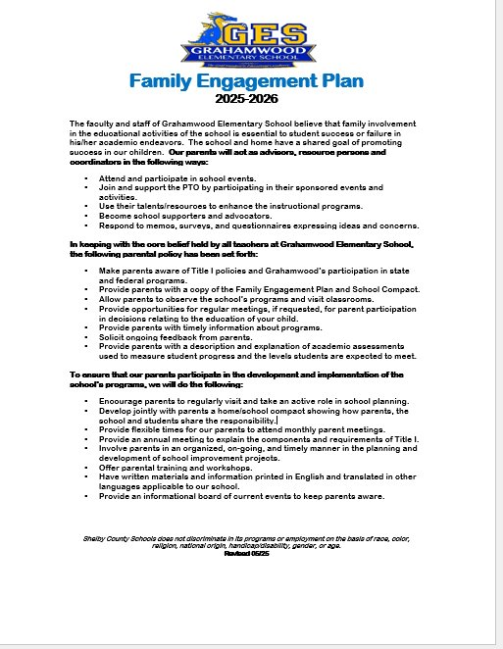
FAMILY ENGAGEMENT POLICY #7009
Purpose:
• To partner with families to provide MSCS students with a home/school/community environment that encourages academic achievement and performance standards.
• MSCS Family Engagement Policy
• GES Family Engagement Plan

Slide 6
FAMILY ENGAGEMENT POLICY #7009
All volunteers must go through MSCS to obtain volunteer status. Please contact 901‑416‑7600 or email scsface@scsk12.org.

Slide 7
Parent Training/Family Engagement
Grahamwood Elementary offers the following:
Coffee and Chat with the Counselors
How to Workshops: How to help with homework, how to help your child with reading
Math Family Night
Literacy Night
STEM Night
Donuts with Grownups: TCAP testing strategies
Lunch with loved ones (Grandparent’s Day)
GTPO Bring your Buns to School
Musical Programs

Slide 8
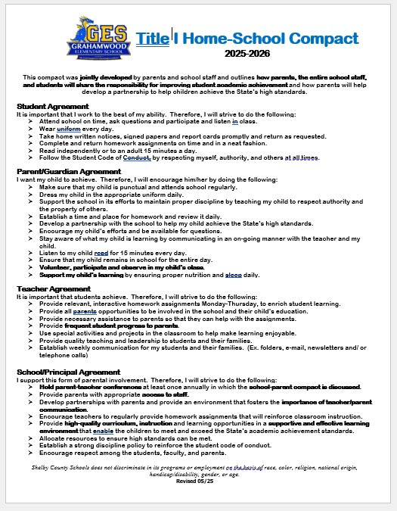
SCHOOL/PARENT COMPACT
Identifies mutual responsibility of each party to help Title 1schools succeed. ​
Jointly developed with parents​ every May
Outlines how parents, the entire school staff, and students will share responsibility for improved student achievement.

Slide 9
REPORTING Student PROGRESS
• Weekly Wednesday Folders
• PowerSchool
• Report Cards
• Progress Reports
• Teacher/Parent Communication
• Quarterly Assessment Data

Slide 10
PARENT TEACHER IMPORTANT DATES
Progress Reports
  Wednesday, September 3rd
  Wednesday, November 12th
Parent Teacher Conferences
  Thursday, September 11 4-7 p.m.​
  Thursday, January 29th 4-7 p.m.​
Report Cards
  Wednesday, October 22nd

Slide 11
School Improvement Plan
All Schools are required to have one: It is a comprehensive plan on how the school will improve​. Each Plan includes​:
SMART Goals for improvement​
Identifies area of growth​
Explains how Title 1 funds will be used to meet the goals​
The plan is available on Grahamwood's website​

Slide 12

Student Code of Conduct/
Grahamwood's Discipline Policy

Slide 13


