Slide 1


Slide 2
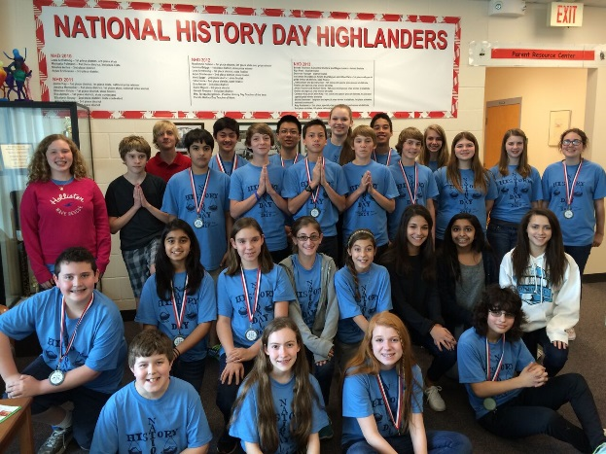
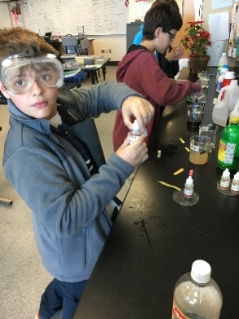
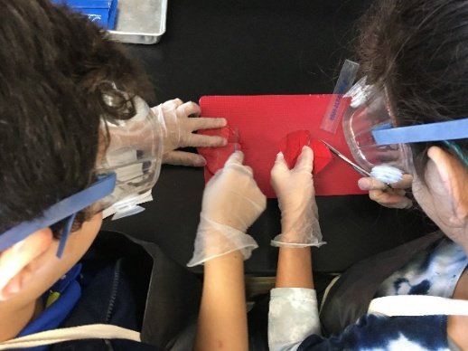
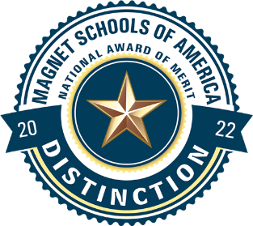
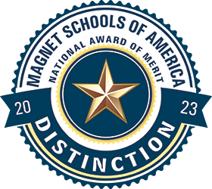
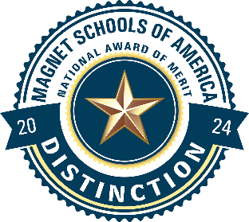
Your Center for Gifted Studies
Principal Garyn Boyd
Assistant Principals William Muhlstadt (6th)
Erika Sun (7th)
Joanna Bernal (CGS/8th)
School Guidance Counselors
Heather Askew (6th)
Jennifer Coughlin (7th)
Shante Norton (8th)
CGS Magnet Coordinator Karyn Smith
The Dunedin Highland Middle School Center for Gifted Studies offers more than just gifted classes. We provide qualified scholars with a nurturing community of peers and caring, gifted-endorsed teachers who strive to challenge and develop gifted adolescents to their fullest potential!

Slide 3
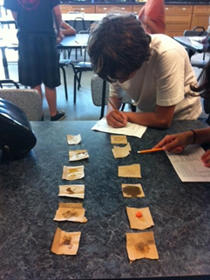
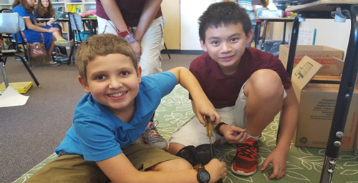
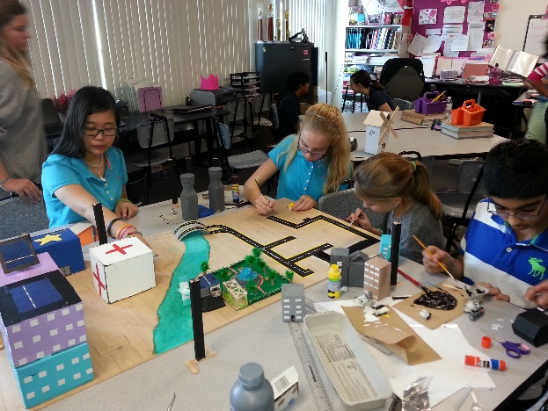
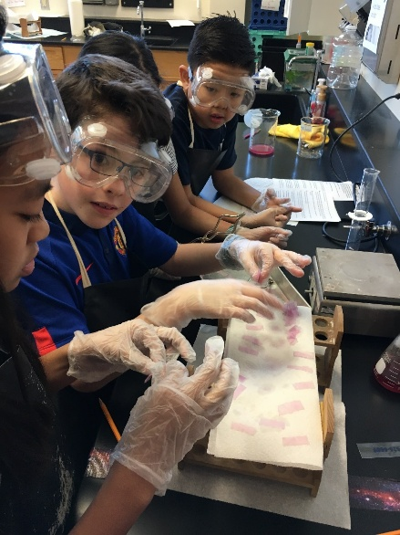
Your Center for Gifted Studies
We are a community of gifted-endorsed educators with over 250 years of combined teaching experience and 12 graduate degrees.
We provide academic experiences to students’ daily lessons in each of our curriculum areas and specialized courses.

Slide 4
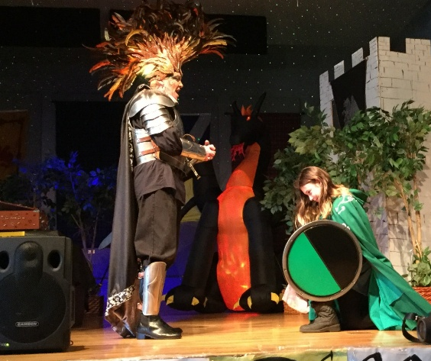
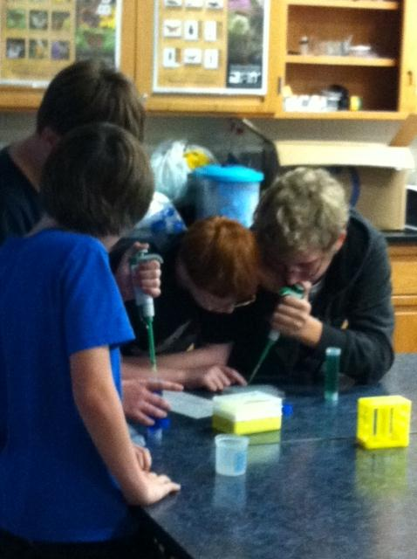
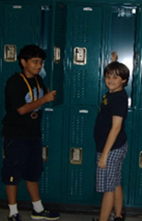
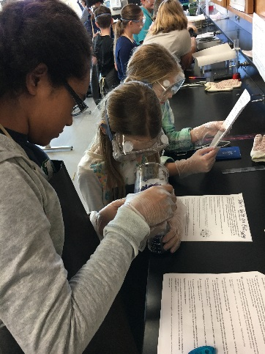
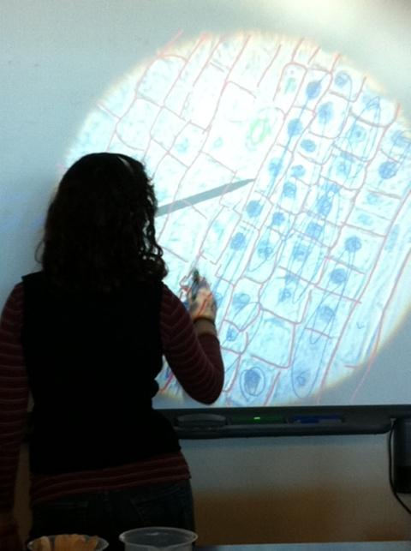
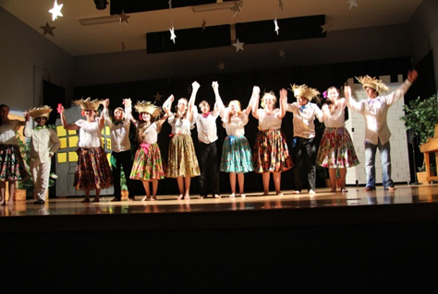
Your Center for Gifted Studies
6th Grade Team Heather Marley, Teresa Nocella, Laura Playford, Cesar Riquetti, Katrina Walters
7th Grade Team Tamara Bendely, Caitlin Lackett, Laura Vaughan, Tessa Heitmeyer, Maria deKoter
8th Grade Team Teresa Bergstrom, Kathleen Earle, Michelle Emry, Jacqueline Finch

Slide 5
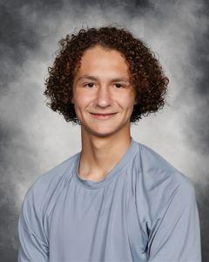
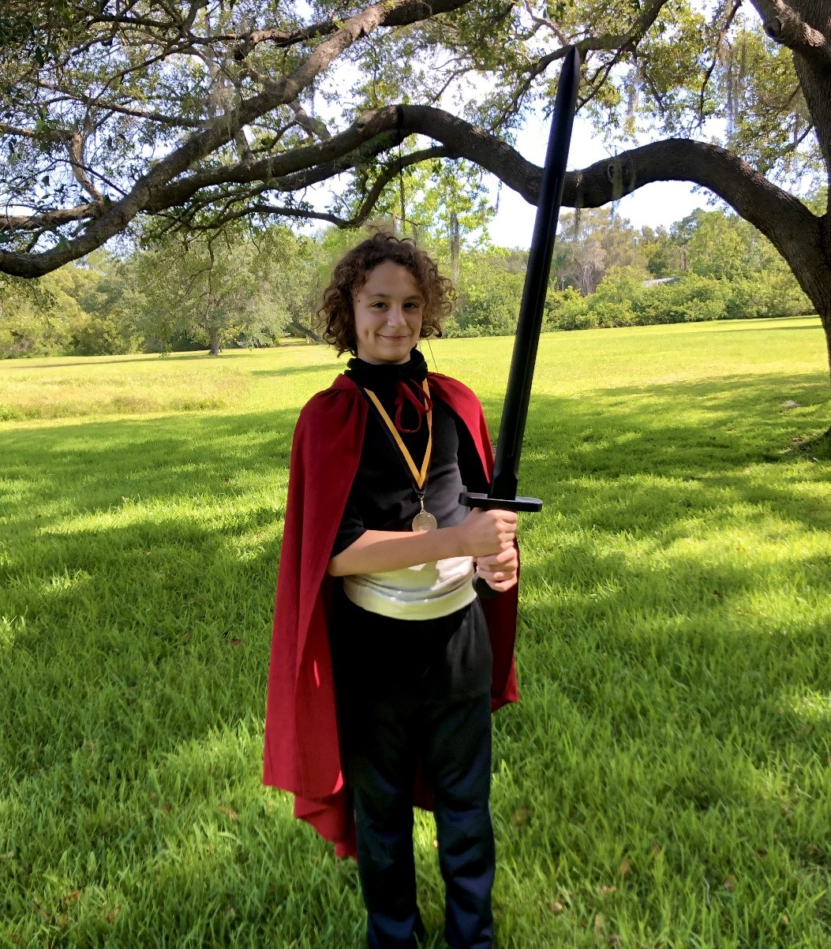
CGS Alumni Keynote
Will Kent

Slide 6
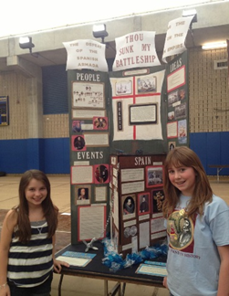
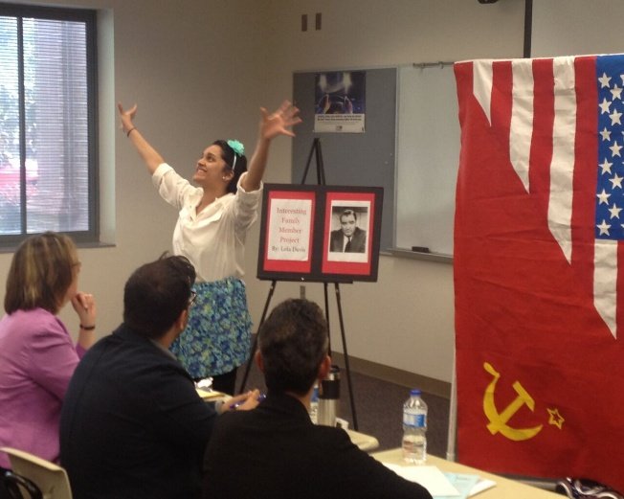
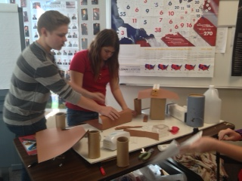
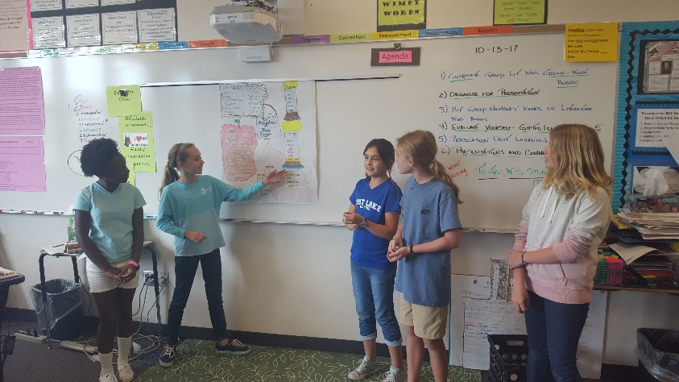
How is the CGS Different?
Pinellas County Middle School Centers for Gifted Studies provide a full-time gifted program experience for students.
The curriculum philosophy is grounded in the belief that gifted students require comprehensive and on-going differentiated curriculum and instruction.
Our curriculum is integrated across the broad thematic concepts of change, systems, conflict and justice, using an interdisciplinary approach.
The unique curriculum design promotes in-depth learning and creative, critical and complex thinking.

Slide 7
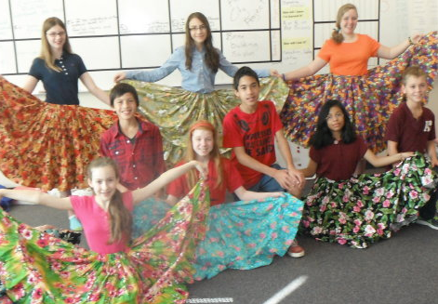
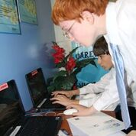
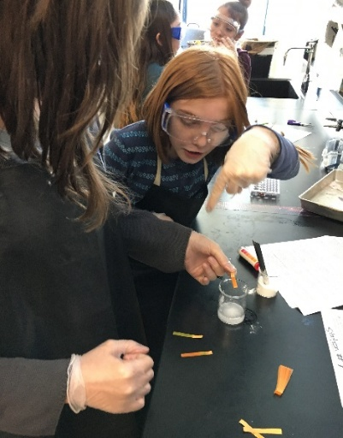
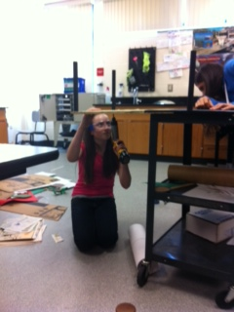
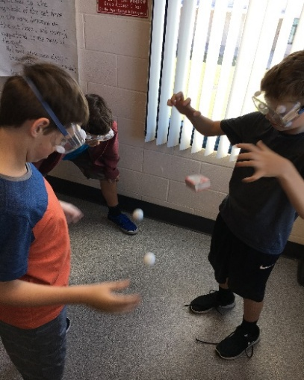
How is the CGS Different?
Our Curriculum:
Aligned with the National Association for Gifted Children Curriculum Standards and the Florida Frameworks for K-12 Gifted Learners
Advanced and Enriched content based on gifted education best practices and innovative pedagogy from leading experts
College of William & Mary and Vanderbilt University Language Arts, Science, and Advanced Academics Units
Accelerated courses, earning up to 7 high school credits

Slide 8
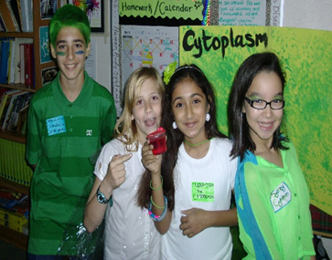
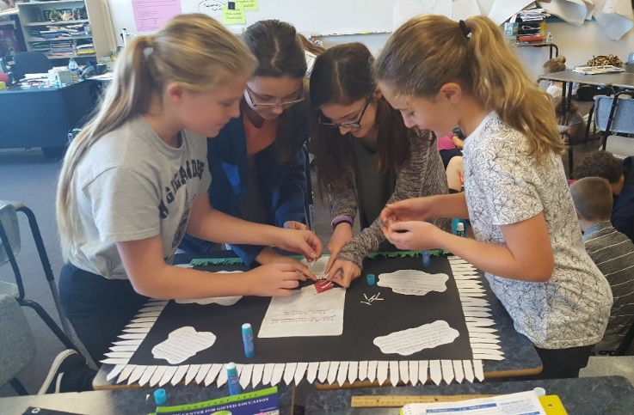
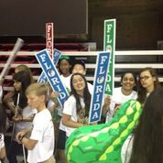
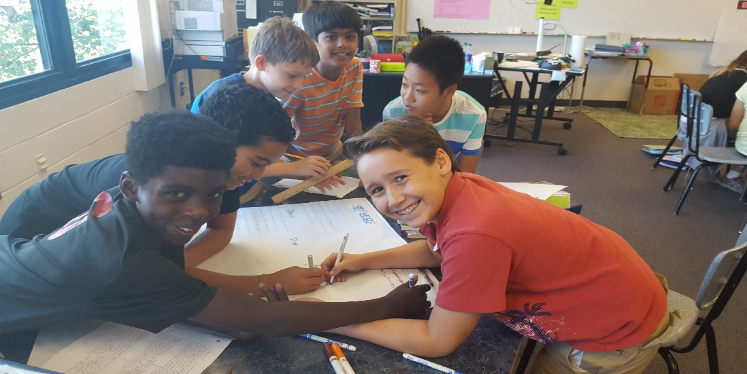
How is the CGS Different?
Our Students Develop:
Critical and creative thinking skills
Self-understanding
Independent learning skills and attitudes
Aesthetic appreciation and artistic/creative expression
The social skills and dynamics of leadership
Higher level oral, written, and technological communication skills

Slide 9
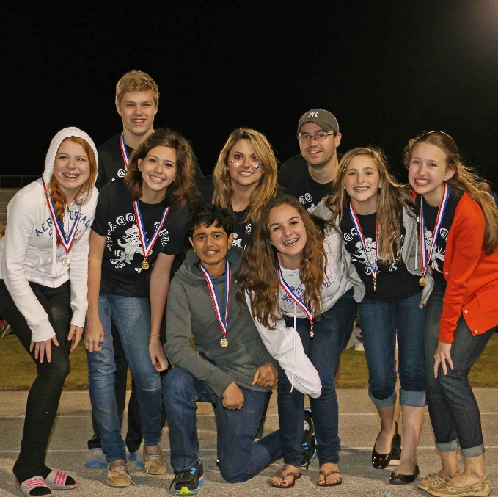
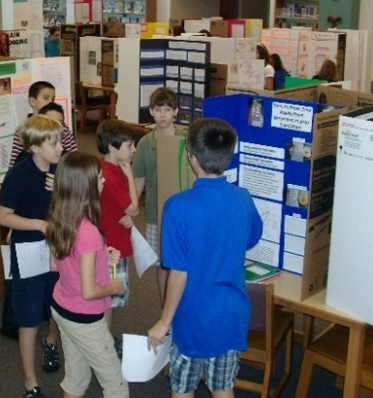
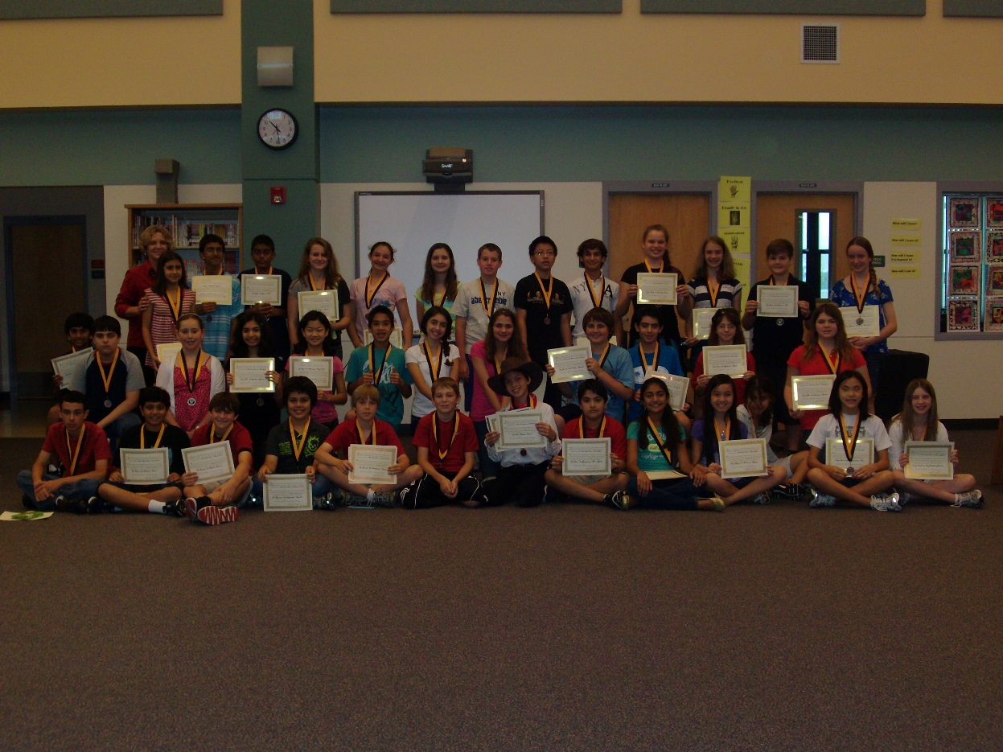
Clubs & Academic Competitions
Battle of the Books
Boys Read
Builder’s Club
Chess Club
Debated Club
Future Cities
Jazz Band
Junior Rho Kappa Honor Society
Mighty Mu
Model Un
Morning News Crew
Musical Theater
National History Day
National Junior Honor Society
Odyssey of the Mind
Pipe Band
Principal’s Multicultural Advisory Committee (PMAC)
Rock Band
SAVE Club
Scripps Spelling Bee
STEM Club
Yearbook

Slide 10
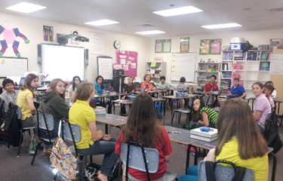
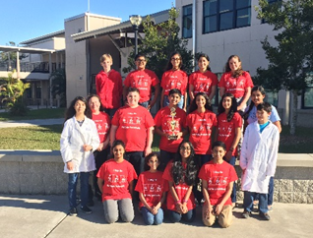
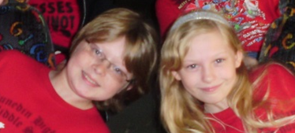
A Middle School Center for Gifted Studies
IS NOT…
IS…
A place where gifted kids and the social emotional needs of gifted are understood.
A place where there is flexibility in curriculum and scheduling
A place with extra/enrichment curricular activities and integrated/interdisciplinary curriculum
A place for pure teaming and collaboration across networks
A place for global thinking, intellectual agility and adaptability
A place to develop creative thinking, inquiry, intellectual curiosity and imagination
A prep school
Just for high achievers
Mediation for general education
General education with gifted kids
A piece of cake for teachers
A ticket to IB
A junior IB

Slide 11
Great Reasons to Choose the Center for Gifted Studies
10
We are a Magnet School of Distinction with a fifteen-year track record of proven excellence.
All core classes are 100% comprised of gifted students, elevating academic conversations and expectations. All gifted classes are in one wing of our campus for a true school-within-a-school feel!
All CGS teachers are gifted endorsed, and instruction is designed to meet the unique socio-emotional and intellectual needs of gifted learners.
CGS Highlanders continue to SHINE! Multiple State of Florida High Impact Teachers, Teacher of the Year Nominees, and PCS Top 10 Finalist and People's Choice Teacher of the Year. Our alumni become PCS National Merit Semi-Finalists and PCS Valedictorians and Salutatorians. Many graduates pursue post-secondary degrees at prestigious institutions of higher learning.
Great Scores and Accomplishments: We maintain top placement in the district for all EOC and Exam scores!
The socio-emotional aspect of our program is invaluable:
All gifted classes are in one wing of our campus for a true school-within-a-school feel!
All students in the classes are gifted further elevating academic conversations and expectations.
CGS teacher teams work succinctly to provide grade-specific and vertically-aligned support for all scholars in the Center.

Slide 12
Great Reasons to Choose the Center for Gifted Studies
10
Capstone Events and Curriculum: Caen Laida Awards Ceremony, Dunedin Highland History Day, Word Stem 500, Vanderbilt, Interact, and College of William and Mary Curriculum Units
Microsoft Office Specialization - 100% of the students enrolled in the computer elective classes earned a Microsoft Office Specialist certification in at least one area of specialization. Many students have earned all specializations!
Smart Classrooms: 1-to-1 laptops and access to technology: Smart Boards, Video Recording Technology, Computer Labs, iPad Carts for classroom use.
Field Trips: Dali Museum, MOSI, Finance Park, St. Petersburg International Folk Festival, Museum of Fine Arts, James Museum of Western and Wildlife Art, Florida Orchestra, Gradventure (Universal Studios/Islands of Adventure) and more.
Academic Competitions:
Odyssey of the Mind World Champions (2016) and State Finalists (2024)
National History Day District, State and National Finalists and Champions (2011-2025)
Mighty Mu Champions for both Team and Individuals for 6th and 7th Math, Algebra, and Geometry (2022-2025)
Community and State Essay Contest Winners
State Geography Bee and National Scripps Spelling Bee participants
Model UN’s Secretary General’s Award for Outstanding Delegation (2019)

Slide 13
CGS Course Progression with Additional Curricular/Instructional Differentiation designed for Gifted Learners
Content Areas | 6th Grade | 7th Grade | 8th Grade
Language Arts | Language Arts I, Advanced (6th grade Advanced Language Arts) | Language Arts II, Advanced (7th grade Advanced Language Arts) | English I Honors (HS Credit)
Mathematics | 7th Grade Advanced Math or 6th Grade Advanced Math | Algebra I Honors (HS Credit) or 7th Grade Accelerated Math (Pre-Algebra) | Geometry I Honors (HS Credit) or Algebra I Honors (HS Credit)
Science | Comprehensive Science I, Accelerated Honors | Comprehensive Science II, Accelerated Honors | Earth Space Science Honors (HS Credit)
Social Studies | U.S. History Advanced | Civics Advanced | Pre-AP World History and Geography (HS Credit)
Advanced Academics | Advanced Academics 6th Grade | Advanced Academics 7th Grade | Advanced Academics 8th Grade
World Languages (optional) |  | World Language I: Spanish (HS Credit pending EOC Assessment) | World Language II: Spanish (HS Credit pending EOC Assessment)
Electives (All Grades) | 2D and 3D Art Pre-AP Visual Arts (8th Grade) AVID Health/PE | Digital Information Technology Information & Communication Tech. I/II Theater I/II/III/Musical Theater | Band I/II/III Chorus I/II/III Orchestra I/II Highland Dancing/Color Guard

Slide 14
Next Steps for Future Highlanders
What are your next steps?
Apply for and select DHMS Center for Gifted Studies as your #1 choice through FOCUS between January 6th – 16th (by 5pm).
Accept your DHMS offer between February 10th – 20th (by 5pm).
All Gifted Educational Plans are verified before seat offers are made.
Elective Selection and Elective Expo is after the acceptance period.

Slide 15
Next Steps for Future Highlanders
Register for CGS Boot Camp!
We hold a one-day middle school prep camp in late July for all our new CGS Highlanders! We will cover some amazing topics taught by our very own CGS teachers.
What Does a CGS Class Period Feel Like?
How to Be a Highlander
How to Open a Locker
How to be Middle School Ready
DHMS Campus Tour
Question/Answer CGS Parent Session

Slide 16

Star Student-Led Tours
Student Ambassadors will now guide you on a tour of our Center!
Please wait to be dismissed until your area is called.
Red
Black
Blue
Green
Gold
Silver

