Slide 1


Talent Identification Program (TIP)
Dr. Andrea Flocken • Specialist, Advanced Studies and Academic Excellence
flockena@pcsb.org

Slide 2


Purpose of the TIP SAT Program
Identify and support academically talented 7th grade students by providing opportunities for advanced learning and enrichment.
Guide students and families in developing a college-preparatory academic plan that supports success in 8th grade, high school, and beyond.
Offer early exposure to the SAT to help students gain valuable experience and confidence, positioning them for future recognition through National Merit, College Board National Recognition Programs, and university admissions.
Notes:
PCS TIP is intended to increase student awareness and enrollment in higher level courses beginning in the 8th grade, while fostering college readiness through early exposure to measurable, tested SAT skills.

Slide 3
TIP SAT Benefits the Student
BENEFIT | IMPACT ON PSAT/NMSQT & NATIONAL MERIT
Academic Prep | Improves test scores and confidence
Early Identification | Encourages long-term planning and readiness
Scholarship Access | Opens doors to financial aid and recognition
College Readiness | Aligns students with AP, SAT and career pathways
Notes:
PCS TIP is intended to increase student awareness and enrollment in higher level courses beginning in the 8th grade, while fostering college readiness through early exposure to measurable, tested SAT skills.

Slide 4

SAT Facts
Accepted by almost ALL U.S. colleges​
Typically taken by students during the spring of their junior year and the fall of their senior year​
Combined with high school GPA, a direct predictor of potential college success
By taking the SAT early, students gain valuable insight into the skills measured on both the PSAT and SAT. This experience helps students feel more confident and prepared, often leading to stronger results when they take these important college-readiness exams in high school.
Notes:
- Students should look at colleges they are already planning on attending and start reviewing their SAT requirements

Slide 5
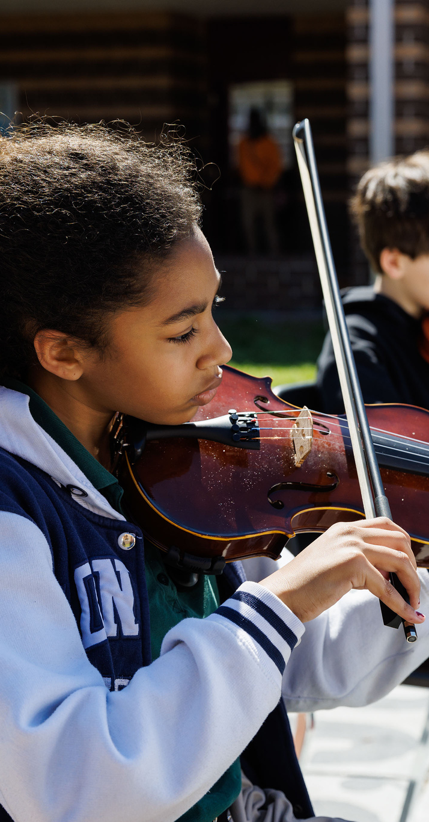
How to Register
Review the TIP information and discuss this tremendous opportunity with your student.
The cost of the test is $40; use the RevTrak link for TIPS SAT (on your school website) to register by January 16, 2026. No registrations will be accepted after this date. https://pcsb.revtrak.net/advanced-studies/tip-sat-exams/#/list
Use available resources to practice SAT Questions between now and test day.
Test day at your school will be March 10 or 11, 2026.
Celebrate your student's success in April 2026 at University of South Florida's campus in St Petersburg. More information will be shared as we get closer to that time.
Notes:
- Students should look at colleges they are already planning on attending and start reviewing their SAT requirements

Slide 6

SAT Prep

Slide 7

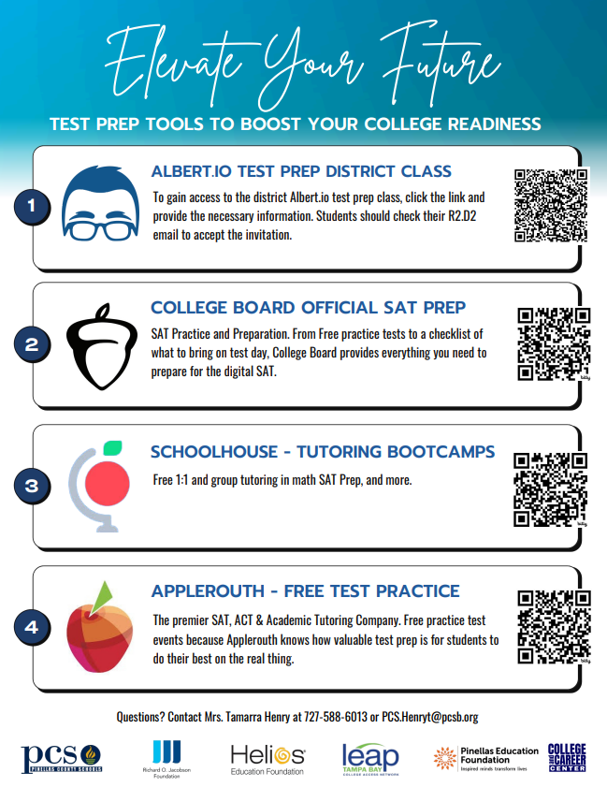
Preparing for the SAT

Slide 8

SAT Test Day Experience and Results

Slide 9

SAT Test Day
Students should get a good night’s sleep the night before and eat breakfast on test day.
Be on time for school. Being on time will allow students to be prepared for test day without feeling rushed.
The SAT test is digital – students should bring fully charged laptop and charger.
Students can bring water and a snack to have during breaks.
Notes:
Although high school grades are a very useful indicator of how students will perform in college, there is great variation in grading standards and course rigor within and across high schools. SAT is one way for colleges to compare students across schools, districts, states and countries. A combination of SAT scores and grades is the best predictor of success in college.

Slide 10

SAT Test Day
Students should NOT bring cell phones or other electronic devices, including, but not limited to smart watches, headphones/ear buds, or any device capable of recording audio or video content
Total testing time is about 2 hours and 15 minutes:
Component | Time Allotted (minutes) | Number of Questions/Tasks
Reading and Writing | 64 (two 32-minute modules) | 54
Math | 70 (two 35-minute modules) | 44
Total | 134 | 98
Notes:
Although high school grades are a very useful indicator of how students will perform in college, there is great variation in grading standards and course rigor within and across high schools. SAT is one way for colleges to compare students across schools, districts, states and countries. A combination of SAT scores and grades is the best predictor of success in college.

Slide 11
SAT Results
This testing experience is key - gaining testing experience now helps students build the confidence and skills they’ll need to reach their future goals.
PCS will receive your SAT Results in early April.

Slide 12

Road to Recognition

Slide 13
PCS TIP Road to Recognition
Saturday, April 11th , 2026 at USF St. Petersburg
  Flyers will be shared on test day. Register quickly! Spots are limited.
  Results will be sent home with your student after the event for those who do not attend.
  Due to space constraints, students who register will only be able to bring 1 parent/guardian.

