Slide 1

Westside
Elementary School
Annual Title I Meeting
September 25, 2025
Kesha McKinney,
PLC Coach/Title I Coordinator

Slide 2
School’s vision and Mission
The Mission and Vision of Westside Elementary is to maintain high expectations and promote academic excellence for all students. We foster a positive and caring school climate and culture in which all children and adults feel welcomed, respected, trusted and valued as an important part of the Westside School Family.
The Westside Way – Be Respectful, Be Responsible, Be Ready!
We BELIEVE:
All students can achieve.
All students are special and valued.
All students deserve access to equitable, personalized, quality learning an instruction.
Working together, we will provide a respectful and impactful learning environment.

Slide 3

What is Title I?

Slide 4

Title I is….
The largest federal aid program for our nation’s schools
It’s goal is to provide a high quality education for every child
serves millions of children

Slide 5

Funding Source
$
$
The federal government provides funding to states each year for Title I.
The State Education Agency sends the money to the Local Education Agencies (LEA) based on the number of low income families within the district.
The LEA identifies schools with the highest percentage of children from low income families and provides them with Title I resources.

Slide 6
The Title I School
Works with the LEA to:
identify students most in need of educational help (students do not have to be from low-income families to be helped.)
set goals for improvement.
measure student progress.
develop programs that add to regular classroom instruction.
works to involve parents in all aspects of the program.

Slide 7


Slide 8

Title I programs generally offer:
Additional teachers and assistants
Additional training of school staff
Extra time for instruction
A variety of teaching methods and materials
Counseling and mentoring

Slide 9
The School’s Title I program
Is reviewed each year by administrators, teachers and parents. If goals have not been met, the plans must be revised.

Slide 10
The Family Engagement Plan
*Is a major component of the Title I program and can be found in the Westside Elementary School Handbook.
*All parents will receive this handbook.

Slide 11

School Improvement Plan
The School Improvement Plan is updated yearly with parent and community input to meet the needs of the students at WES and is available to all parents & stakeholders through the school website.

Slide 12
Parent’s Right to Know
A teacher’s professional qualifications, licensure, grade(s) certification, waivers
A teacher’s baccalaureate and/or graduate degree, fields of endorsement, previous teaching experience
A paraprofessional’s qualifications
An annual notice of Student Education Records Privacy and notice for disclosure of School Directory Information
An assurance that their child’s name, address and telephone listing will not be released to military recruiters

Slide 13
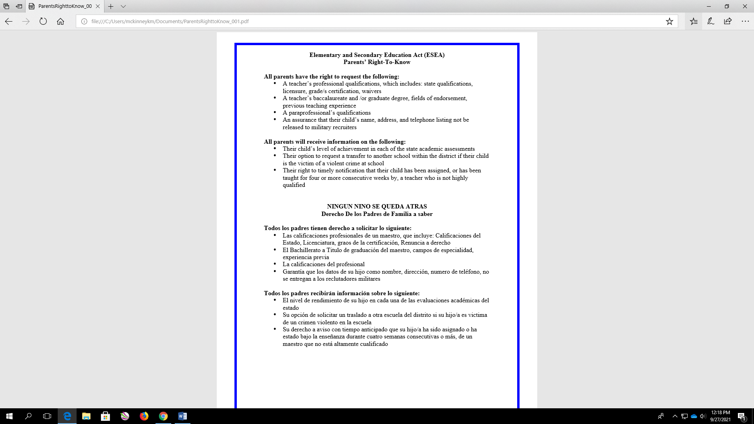
Westside
Elementary School
Annual Title I Meeting
Tuesday, September 21, 2021
Kesha McKinney, PLC Coach/Title I Coordinator

Slide 14
All parents will receive information on the following:
Their child’s level of achievement on each of the state’s academic assessments
Notification of right to transfer their child to another school in the district if the student becomes the victim of a violent crime or is assigned to an unsafe school
District & School Family Involvement Policy
Their right to public school choice if their child’s school is identified for school improvement

Slide 15

Reporting Pupil Progress
Westside Elementary School will convene four parent meetings with flexible times to discuss the forms of academic assessment used to measure student progress.
WES will convene 2 parent data nights to discuss testing results.

Slide 16
Parent Conferences
The school will hold district parent conferences where the progress of students will be discussed and explained. The dates for these conferences are
September 11, 2025 at 4:00 pm
Teachers will schedule meetings before school, during their planning time, and after school to accommodate parent schedules as necessary.
January 29, 2026
at 4:00 pm

Slide 17
Title I Notices
Parent/Student/School Compact which is a document jointly developed with parents to establish expectations on the parts of the school, parent(s), and students and is used when discussing your individual child’s achievement.

Slide 18
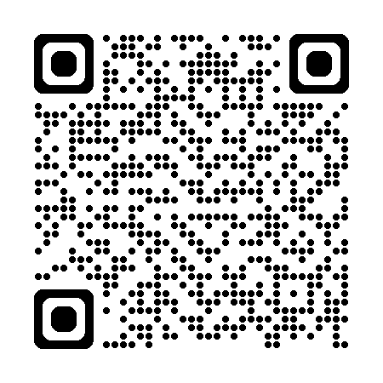
Student code of conduct
The Code of Conduct can be found on the MSCS website and our school’s webpage.

Slide 19
As a parent:
You influence your child’s education because you are their first teacher.
You know your child best.
Your Title I program needs your help.
The Annual Title I meeting is the place to start.
Notes:
Influence:
Your involvement can boost your child’s achievement. By taking an active role, you'll show your child:
How important he or she is to you
How important education is to you
That you and the school are a team, working to help children succeed
Best:
Share information about your child’s interests, abilities, etc., with teachers
Judge whether Title I is meeting your child’s needs
Speak up if you notice an problems. (But don’t criticize the school, its teachers or principal in front of your child)
Help:
To determine program goals
Plan and carry out programs
Evaluate programs
Work with your child at home and even in school, as a teacher’s assistant or volunteer.
Place:
Learn more about Title I
Learn about your rights as a Title I parent
Meet other parents and teachers
Begin a process of communication and cooperation between parents and schools.

Slide 20
Share a love of learning by:
Setting a good example
Making learning fun
Taking advantage of resources
Reading to your child
Asking your child to read to you
Limiting TV time

Slide 21
Encourage good study habits by:
Agreeing on a time and arranging a quiet place to study or complete homework
Being ready to help
Showing respect for studying
Allowing breaks

Slide 22
Get to know your child’s school by:
Attending school events
Joining parent organizations
Volunteering
Becoming a room parent
Attending parent-teacher conferences
Keeping teachers informed
Asking about training opportunities

Slide 23
SCS Curriculum & WES Instruction
Reading Curriculum - Wonders
Math Curriculum – EnVision Math
Social Studies – Social Studies Weekly/Gallopade
Science – Savvas
~~~~~~~~~~~~~~~~~~~~~~~~~~~~~~Teachers plan together weekly
Teachers have their own style of teaching and delivery

Slide 24

Thank you!

