Slide 1
GRAPHING FUNCTIONS
Week of October 19-22, 2020
APEX Lesson 2.2

Slide 2
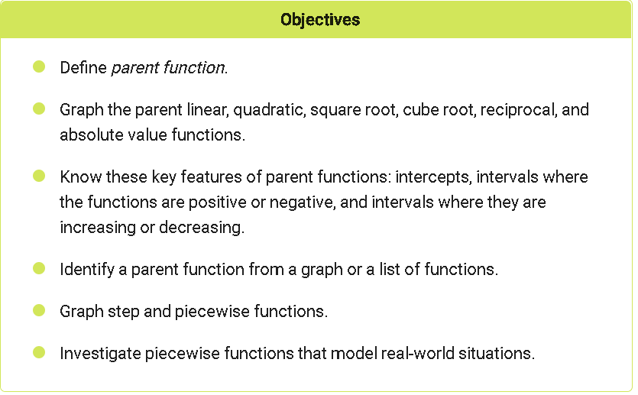
Graphing Functions

Slide 3
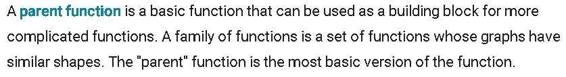
Graphing Functions

Slide 4
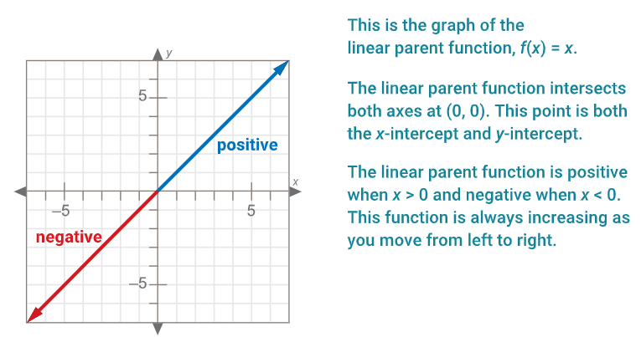
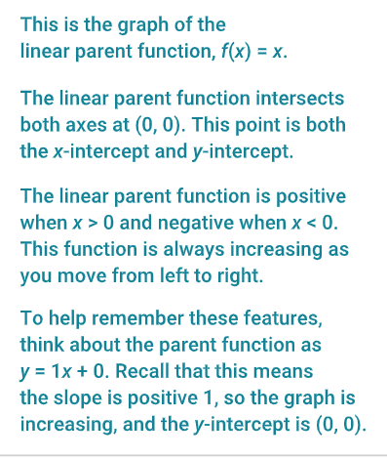

Slide 5
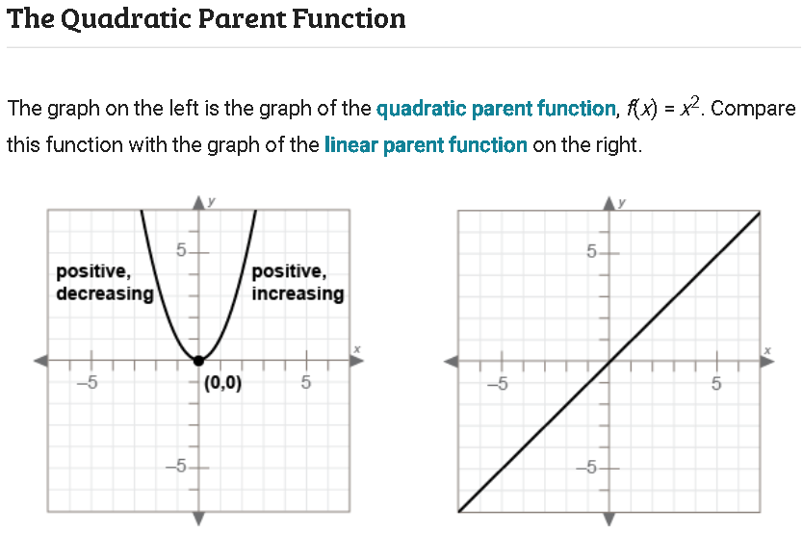
Graphing Functions

Slide 6
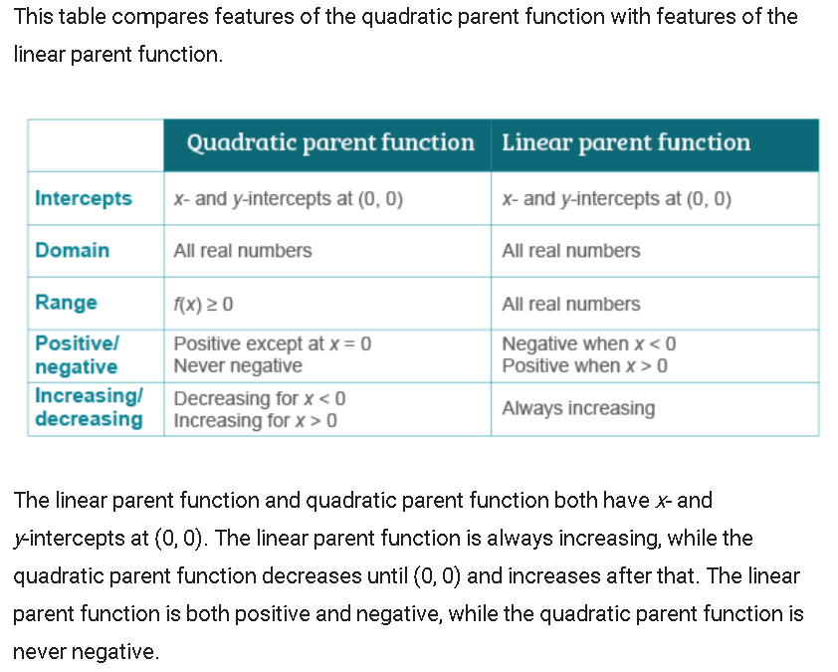
Graphing Functions

Slide 7
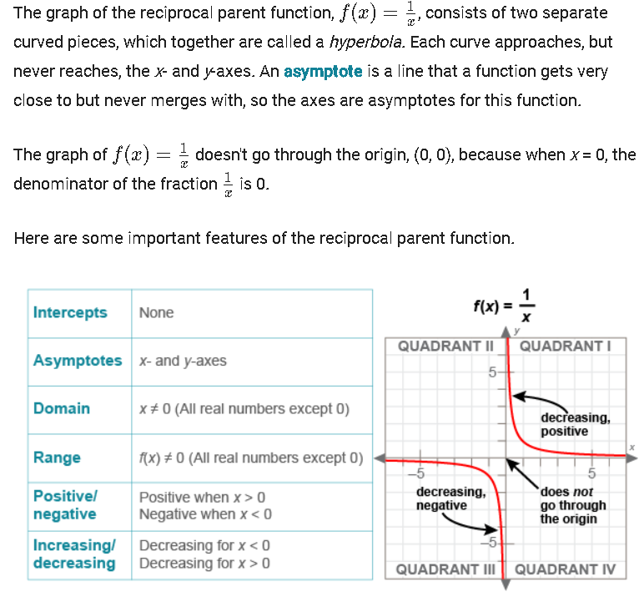
Reciprocal Parent Function (1/x)

Slide 8
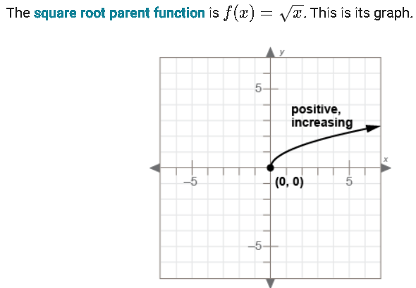
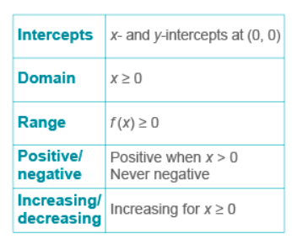
Graphing Functions

Slide 9
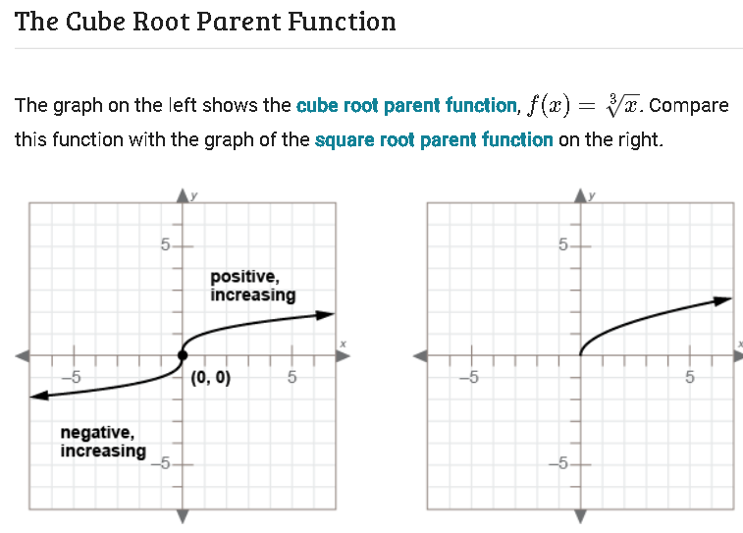
Graphing Functions

Slide 10
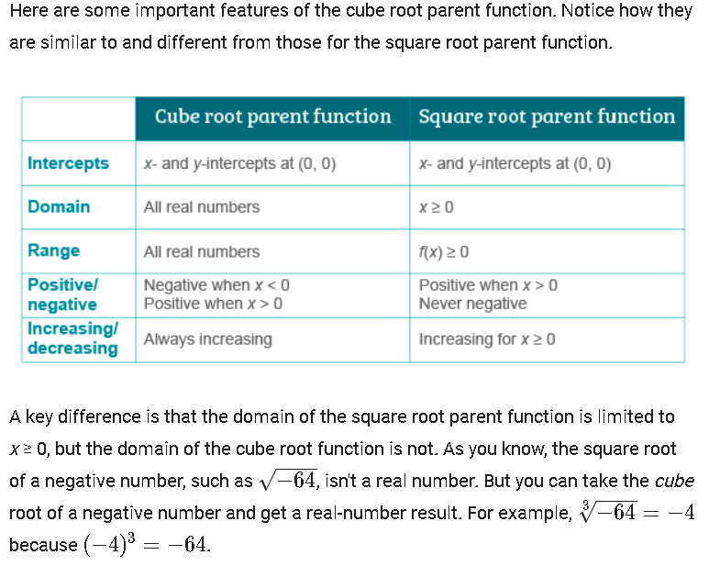
Graphing Functions

Slide 11
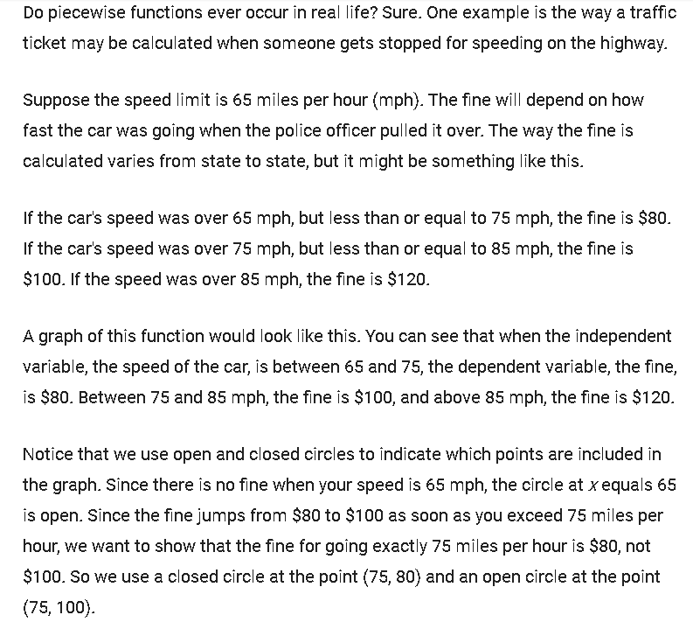
Piecewise Functions

Slide 12
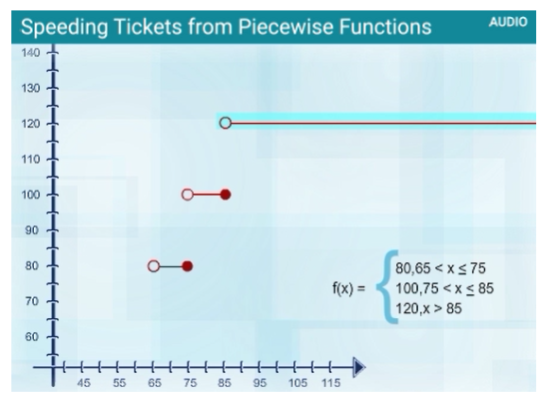
Graph of Piecewise Functions

Slide 13
Graphing Functions
Watch the APEX video for step function. Here’s the link, you need to sign – in with your APEX account to access it.
https://course.apexlearning.com/public/activity/2/2/1/page/11

Slide 14
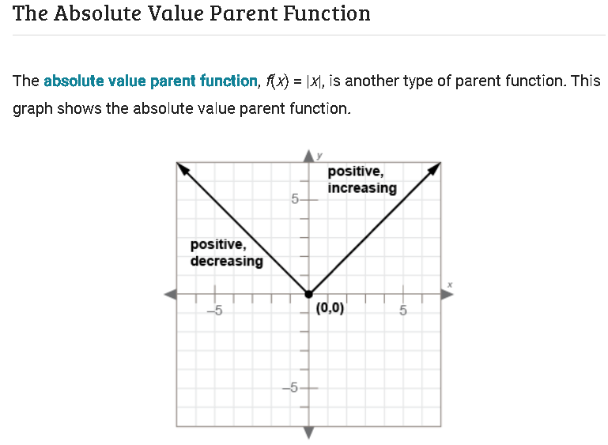
Graphing Functions

Slide 15
