Slide 1
Window Rock High School
Week 1
August 6 and 7, 2020
First day of Online Learning
Algebra 2, College Algebra and Pre-Calculus

Slide 2
1st Day Online Learning
Goals
Make connections with students.
Establish a healthy classroom community.
Engage student mathematical curiosity.

Slide 3
Welcome Back Students!
August 6 and 7, 2020
First day of Online Learning
Algebra 2, College Algebra and Pre-Calculus

Slide 4
Are you ready?
The math department prepared a scavenger hunt to get you familiarize with zoom online learning. I want all the students to participate in the scavenger hunt. Get your computer ready…and start working on the scavenger hunt activity…of course is not all about technology..you will find math questions and survey questions in this exercises.

Slide 5
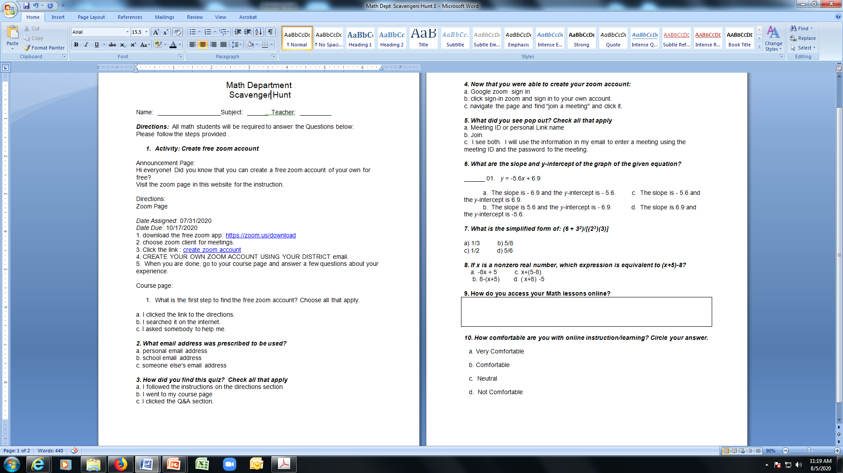
Math Department Scavenger Hunt

Slide 6
Homework – “ABOUT ME”
I need to get to know you on our first meeting online. I want you to reflect on the questions written on the next slide. This will be your first assignment in my class. The title of your homework is “ABOUT ME”. Let us practice our writing skills and look at the questions on the next slide.

Slide 7
About ME – Student HOMEWORK
Tell me about how you have been successful in learning and at reaching your goals. What support do you need to be ready to learn?
Tell me about what brings you joy and makes you smile? What are things you find helpful?
Tell me about your expectations in this class.
Tell me about your concern in taking math class especially online.

Slide 8
Thank you…
Thank you for participating and looking forward of working with you all.
Enjoy the rest of the day.

Slide 9
Pre-Test for Algebra 2, College Algebra and Pre-Calculus
Week 2
August 10 – 14, 2020

Slide 10
Pre-Test Direction
All students are required to take the pre-test in math class. In order to take the pre-test, you must have a Savvas (Pearson) Realize username and password. There are 40 questions on the pre-test and you have the whole week to finish it.
Here’s the link to your pre-test
https://www.savvasrealize.com/community/program/bb1bc279-a9fc-36f9-b04f-ee4b273587f4/17/assessment/f1c0177b-64ff-447c-b0db-588a6c6dd029/1/edit
Copy and paste it in your browser.
Any question(s)…please email me at mjoson@wrschool.net.

