Slide 1

Title I Annual Meeting
for Parents & Families
October 23, 2025
2025 - 2026

Slide 2
Our Purpose
The Elementary and Secondary Education Act (ESEA), as amended by the Every Student Succeeds Act (ESSA) of 2015, requires that each Title I School hold an Annual Meeting for parents/families/community members for the purpose of:
Informing you of your school’s participation in Title I services
Explaining the requirements of Title I, Part A
Explaining your rights as parents to be engaged

Slide 3

What is a Title 1 School?
Title I is the largest federally funded educational program. A Title I school is a school receiving federal funds for students.
The basic principle of Title I is that schools with large concentrations of low-income students receive supplemental funds to meet students’ educational goals.

Slide 4
But what does it really mean?!
Being a Title I school means receiving federal funding to enhance existing programs. These funds are used for:
Identifying and assisting students facing academic challenges
Purchasing supplemental staff, programs, materials, and supplies
Conducting parent and family engagement activities
Recruiting and retaining highly-qualified teachers
Additionally, Title I schools promote ongoing parent and family engagement and advocate for parents’ rights.

Slide 5

02
TUTORING SERVICES
01
TEACHER ASSISTANTS
04
PARENT ENGAGEMENT
03
PROFESSIONAL DEVELOPMENT FOR STAFF
05
SUPPLIES AND MATERIALS
HOW ARE FUNDS USED AT MILA?

Slide 6
The 1%
LEAs or school districts with a Title I allocation over $500,000 must set aside 1% of that funding for parent and family engagement.
Allocation:
  10% can be reserved for district-wide initiatives.
  90% is distributed to Title I schools for local activities and events.
Title I parents have the right to influence how these funds are used, typically through the School Improvement Team (SIT).

Slide 7
CMS Parent and Family Engagement
This policy outlines how CMS will meet the parent and family engagement requirements of the Every Student Succeeds Act (ESSA). It includes:
Expectations for parents
Opportunities for parents to engage in decision-making
Efforts to build capacity for effective engagement activities to boost student achievement
Parents in Title I schools have the right to participate in the review and evaluation of this policy annually.

Slide 8
MILA School Improvement Plan
The School Improvement Plan (SIP) is created in an online platform called NCStar.
It includes:
  A Comprehensive Needs Assessment
  Goals and Strategies to Address Academic Needs of Students
  Professional Development Needs
  Coordination of Resources and Comprehensive Budget
  The School’s Parent and Family Engagement Goals
Parents of students at Title I schools have the right to be engaged in the development of this plan
Access the SIP on our website: https://mountainislandlakeacademyk8.cmsk12.org/pages/our-school/school-improvement
  User Name: GuestS16797
  Password: GuestS16797

Slide 9
What is included in the School’s Parent and Family Engagement Policy? | What is the School Compact?
Implementation of parent and family engagement requirements of the Every Student Succeeds Act (ESSA). How parents can be engaged in decision-making and activities. Use of parent and family engagement funds. Provision of information and training to parents. Building capacity in parents and staff for strong engagement. | The compact is a commitment from the school, the parent/family, and the student, to share in the responsibility for improved academic achievement. Parents and families of students in Title I schools have the right to be involved in the revision/review of the School Compact.

Slide 10

NEED TO CONTACT US?
IF you want to get involved or have some feedback for MILA
Please email administration at:
Dominiquee.hyde@cms.k12.nc.us
Tiffanyl.leonard@cms.k12.nc.us

Slide 11
How do I request the qualifications of my child’s teachers? | How will I be notified if my child is taught by a teacher who is not Highly Qualified?
Title I parents and families have the right to request the qualifications of their child’s teachers. Request Process: You can request it from: Ms. Leonard at tiffanyl.leonard@cms.k12.nc.us. Requests should be completed within 30 days. | Parents and families are notified if teachers do not meet ESSA’s requirements for Highly Qualified. Definition of Highly Qualified: In NC, this means passing the required licensure exams or receiving alternate licensure as set out by NC law.

Slide 12

North Carolina Course of Study
The full North Carolina Standard Course of Study (NCSCOS) can be viewed using the link below:
http://www.dpi.state.nc.us/curriculum/
For more information about the NCSCOS and professional development at your school site, please reach out to dominiquee.hyde@cms.k12.nc.us

Slide 13
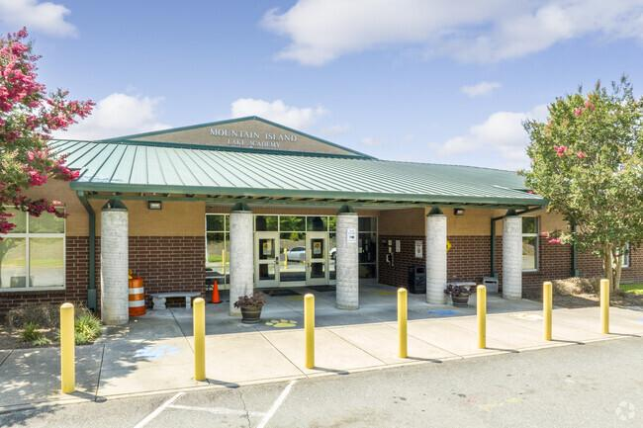
Thank you!
We are happy to have you be a part of the MILA family! Enjoy curriculum night!

