Slide 1


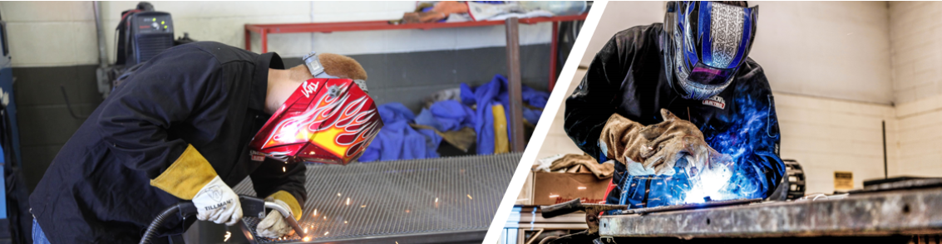



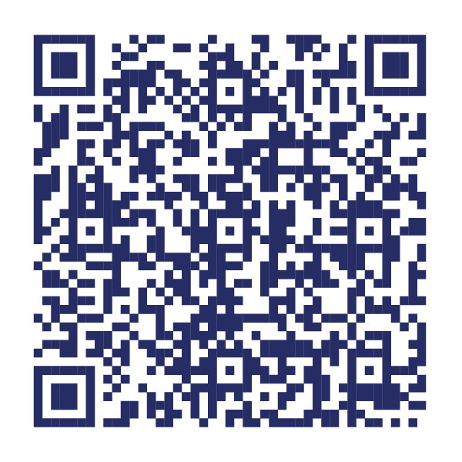
Statewide Program of Study: Welding — Page 1
Revised–November 2025
Manufacturing Career Cluster
The Manufacturing career cluster focuses on planning, managing, and performing the processing of materials into intermediate or final products and related professional and technical support activities such as production planning and control, maintenance, and process engineering. This career cluster includes occupations ranging from welder and machinist to industrial engineering technician and semi-conductor processing technician.
Statewide Program of Study: Welding
The Welding Program of Study focuses on the development and use of automatic and computer-controlled machines, tools, and robots that perform work on metal or plastic. CTE learners will learn how to modify parts to make or repair machine tools or maintain individual machines and how to use hand-welding or flame-cutting equipment.
Secondary Courses for High School Credit
Level 1 | Principles of Manufacturing Introduction to Welding
Level 2 | Introduction to Film Interpretation of Weldments Welding I Occupational Safety and Environmental Technology I Entrepreneurship I
Level 3 | Welding II Welding II + Welding II Lab
Level 4 | Practicum in Manufacturing Practicum in Manufacturing + Extended Practicum in Manufacturing Practicum in Entrepreneurship Practicum in Entrepreneurship + Extended Practicum in Entrepreneurship Career Preparation for Programs of Study Career Preparation for Programs of Study + Extended Career Preparation
Example Postsecondary Opportunities
Apprenticeships
Welding
Associate Degrees
Welding Technology
Building/Construction Site Management
Operations Management and Supervision
Bachelor’s Degrees
Welding Technology
Construction Management
Project Management
Building/Construction Site Management
Master’s, Doctoral, and Professional Degrees
Engineering
Engineering/Industrial Management
Manufacturing Engineering
Construction Engineering
Work-Based Learning and Expanded Learning Opportunities
Work-Based Learning Activities | Job shadow a welder Intern for a local welding company
Expanded Learning Opportunities | Tour a welding shop Participate in SkillsUSA or TSA Participate in a welding project that benefits the community
Example Aligned Occupations
Welders, Cutters, Solderers, and Brazers
Aligned Industry-Based Certifications
Median Wage: $48,494
Annual Openings: 5,636
10-Year Growth: 23%
API 1104 Welding Pipelines and Related Facilities
AWS Certified Welder
AWS D1.1 Structural Steel
AWS D9.1 Sheet Metal Welding
AWS SENSE Level 1: Entry Welder
Construction Technology Certification Level I
Core
Industrial Technology Maintenance (ITM) - Maintenance Welding
Welding - Job Ready
Welding and Fabrication
Welding Level 2
Welding Level I
First-Line Supervisors of Production and Operating Workers
Median Wage: $62,514
Annual Openings: 6,566
10-Year Growth: 17%
Welding
Industrial Production Managers
Median Wage: $124,377
Annual Openings: 1,544
10-Year Growth: 19%
Data Source: TexasWages, Texas Workforce Commission. Retrieved 3/8/2024.
Successful completion of the Welding program of study will fulfill requirements of the Business and Industry endorsement.
For more information visit: https://tea.texas.gov/academics/college-career-and-military-prep/career-and-technical-education/m-welding-extendedpptx.pdf

Slide 2











Statewide Program of Study: Welding — Page 2
Manufacturing Career Cluster
Statewide Program of Study: Welding
Course Information
Course |  | Prerequisites | Corequisites | Career Clusters
Principles of Manufacturing* 13032200 (1 credit) |  | Prerequisites: None Corequisites: None Recommended Prerequisites: Algebra I or Geometry Recommended Corequisites: None
Introduction to Welding* 13032250 (1 credit) |  | Prerequisites: None Corequisites: None Recommended Prerequisites: Algebra I Recommended Corequisites: Algebra I | 1. Architecture and Construction 2. Manufacturing
Level 1
Course |  | Prerequisites | Corequisites | Career Clusters
Introduction to Film Interpretation of Weldments N1303687 (1 credit) |  | Prerequisites: None Corequisites: None Recommended Prerequisites: Algebra I Recommended Corequisites: None | 1. Manufacturing
Welding I* 13032300 (2 credits) |  | Prerequisites: None Corequisites: None Recommended Prerequisites: Algebra I, Principles of Manufacturing, Introduction to Precision Metal Manufacturing, or Introduction to Welding Recommended Corequisites: None | 1. Manufacturing
Occupational Safety and Environmental Technology I* N1303680 (1 credit) |  | Prerequisites: None Corequisites: None Recommended Prerequisites: Principles of Transportation Systems, Principles of Distribution and Logistics, or Principles of Manufacturing Recommended Corequisites: None
Entrepreneurship I 13011101 (1 credit) |  | Prerequisites: None Corequisites: None Recommended Prerequisites: Principles of Business, Marketing, and Finance Recommended Corequisites: None
Level 2
Course |  | Prerequisites | Corequisites | Career Clusters
Welding II 13032400 (2 credits) |  | Prerequisites: Welding l Corequisites: None Recommended Prerequisites: Algebra I or Geometry Recommended Corequisites: Welding II Lab | 1. Manufacturing
Continued on next page |  | -- | --
Level 3
Welding
* Indicates course is included in more than one program of study in this career cluster.
For additional information on the Manufacturing career cluster,
contact cte@tea.texas.gov or visit https://tea.texas.gov/cte
[LEA name] does not discriminate on the basis of race, color, national origin, sex, or disability in its programs or activities and provides equal access to the Boy Scouts and other designated youth groups. The following person has been designated to handle inquiries regarding the nondiscrimination policies: [title], [address], [telephone number], [email]. Further nondiscrimination information can be found at Notification of Nondiscrimination in Career and Technical Education Programs.

Slide 3

Statewide Program of Study: Welding — Page 3
Manufacturing Career Cluster
Statewide Program of Study: Welding
Course Information
Course |  | Prerequisites | Corequisites | Career Clusters
Welding II + Welding II Lab 13032410 (3 credits) |  | Prerequisites: Welding l Corequisites: None Recommended Prerequisites: Algebra I or Geometry Recommended Corequisites: None | 1. Manufacturing
Level 3
Course |  | Prerequisites | Corequisites | Career Clusters
Practicum in Manufacturing* First Time Taken: 13033000 (2 credits) Second Time Taken: 13033010 (2 credits) |  | Prerequisites: None Corequisites: None Recommended Prerequisites: None Recommended Corequisites: None
Practicum in Manufacturing + Extended Practicum in Manufacturing* First Time Taken: 13033005 (3 credits) Second Time Taken: 13033015 (3 credits) |  | Prerequisites: None Corequisites: None Recommended Prerequisites: None Recommended Corequisites: None
Practicum in Entrepreneurship* First Time Taken: 13011111 (2 credits) |  | Prerequisites: None Corequisites: None Recommended Prerequisites: Entrepreneurship I and II, or successful completion of at least two courses in a CTE program of study Recommended Corequisites: None
Practicum in Entrepreneurship + Extended Practicum in Entrepreneurship* First Time Taken: 13011121 (3 credits) |  | Prerequisites: None Corequisites: None Recommended Prerequisites: Entrepreneurship I and II or successful completion of at least two courses in a CTE program of study Recommended Corequisites: None
Continued on next page |  | -- | --
Level 4
* Indicates course is included in more than one program of study in this career cluster.
Welding
For additional information on the Manufacturing career cluster,
contact cte@tea.texas.gov or visit https://tea.texas.gov/cte
[LEA name] does not discriminate on the basis of race, color, national origin, sex, or disability in its programs or activities and provides equal access to the Boy Scouts and other designated youth groups. The following person has been designated to handle inquiries regarding the nondiscrimination policies: [title], [address], [telephone number], [email]. Further nondiscrimination information can be found at Notification of Nondiscrimination in Career and Technical Education Programs.

Slide 4



Statewide Program of Study: Welding — Page 4
Manufacturing Career Cluster
Statewide Program of Study: Welding
Course Information
Course |  | Prerequisites | Corequisites | Career Clusters
Career Preparation for Programs of Study* First Time Taken: 12701121 (2 credits) |  | Prerequisites: At least one Level 2 or higher CTE course Corequisites: None Recommended Prerequisites: None Recommended Corequisites: None
Career Preparation for Programs of Study + Extended Career Preparation* First Time Taken: 12701141 (3 credits) |  | Prerequisites: At least one Level 2 or higher CTE course Corequisites: None Recommended Prerequisites: None Recommended Corequisites: None
Level 4
* Indicates course is included in more than one program of study in this career cluster.
Welding
For additional information on the Manufacturing career cluster,
contact cte@tea.texas.gov or visit https://tea.texas.gov/cte
[LEA name] does not discriminate on the basis of race, color, national origin, sex, or disability in its programs or activities and provides equal access to the Boy Scouts and other designated youth groups. The following person has been designated to handle inquiries regarding the nondiscrimination policies: [title], [address], [telephone number], [email]. Further nondiscrimination information can be found at Notification of Nondiscrimination in Career and Technical Education Programs.

