Slide 1


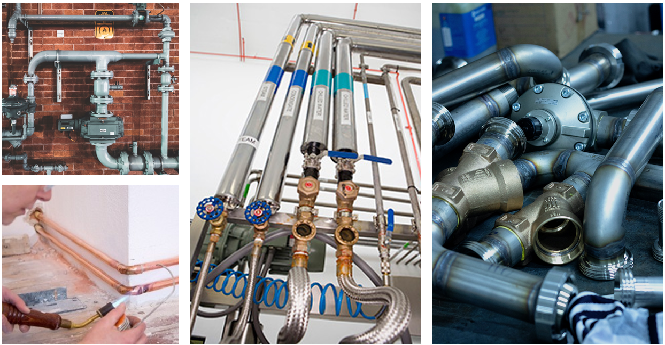





Statewide Program of Study: Plumbing and Pipefitting — Page 1
Revised–November 2025
Architecture and Construction Career Cluster
The Architecture and Construction career cluster focuses on designing, planning, managing, building, and maintaining the built environment. This career cluster includes occupations ranging from architect, carpenter, and construction manager to electrician, plumber and heating, air conditioning, and refrigeration technician.
Statewide Program of Study: Plumbing and Pipefitting
The Plumbing and Pipefitting program of study focuses on occupational and educational opportunities related to assembling, installing, and repairing pipes, fittings, or fixtures of heating, water, and drainage systems. The program of study includes maintaining pipe supports and related hydraulic or pneumatic equipment for steam, hot water, heating, cooling, lubricating, and sprinkling.
Secondary Courses for High School Credit
Level 1 | Principles of Architecture Principles of Construction Introduction to Welding
Level 2 | Pipefitting Technology I Pipefitting Technology I + Pipefitting Technology Lab I Plumbing Technology I Building Maintenance Technology I Entrepreneurship I
Level 3 | Pipefitting Technology II Pipefitting Technology II + Pipefitting Technology Lab II Plumbing Technology II
Level 4 | Practicum in Construction Technology Practicum in Construction Technology + Extended Practicum in Construction Technology Practicum in Entrepreneurship Practicum in Entrepreneurship + Extended Practicum in Entrepreneurship Career Preparation for Programs of Study Career Preparation for Programs of Study + Extended Career Preparation
Example Postsecondary Opportunities
Apprenticeships
Plumber
Pipefitter
Associate Degrees
Pipefitting/Pipefitter and Sprinkler Fitter
Construction Site Management
Plumbing Technology
Property Maintenance
Bachelor’s Degrees
Construction Engineering
Construction Management
Master’s, Doctoral, and Professional Degrees
Construction Engineering
Construction Management
Additional Stackable IBCs/License
Journeyman Plumber
Master Plumber
Work-Based Learning and Expanded Learning Opportunities
Work-Based Learning Activities | Complete a pre-apprenticeship in plumbing or pipe- fitting to develop skills in assembling, installing, and repairing pipes Shadow a plumber who is repairing and drainage systems
Expanded Learning Opportunities | Participate in SkillsUSA Tour apprenticeship programs
Example Aligned Occupations
Helpers—Pipelayers, Plumbers, Pipefitters, and Steamfitters
Aligned Industry-Based Certifications
Median Wage: $37,533
Annual Openings: 1,113
10-Year Growth: 26%
Core
HBI Pre-Apprenticeship Certificate Training (PACT), Core
Industrial Pipefitter
Industrial Technology Maintenance (ITM) – Maintenance Piping
Pipefitting
Pipefitting Level I
Plumbing
Plumbing Level I
Plumbing Level II
Tradesman Plumber - Limited
Plumbers, Pipefitters, and Steamfitters
Median Wage: $57,246
Annual Openings: 4,336
10-Year Growth: 22%
Construction Managers
Plumbing and Pipefitting
Median Wage: $98,294
Annual Openings: 5,403
10-Year Growth: 24%
Data Source: TexasWages, Texas Workforce Commission. Retrieved 3/8/2024
Successful completion of the Plumbing and Pipefitting program of study will fulfill requirements of the Business and Industry endorsement.
For more information visit: https://tea.texas.gov/academics/college-career-and-military-prep/career-and-technical-education/ac-plumbing-and-pipefitting-extended.pdf

Slide 2











Statewide Program of Study: Plumbing and Pipefitting — Page 2
Architecture and Construction Career Cluster
Statewide Program of Study: Plumbing and Pipefitting
Course Information
Course |  | Prerequisites | Corequisites | Career Clusters
Principles of Architecture* 13004210 (1 credit) |  | Prerequisites: None Corequisites: None Recommended Prerequisites: None Recommended Corequisites: None | 1. Architecture and Construction 2. Engineering
Principles of Construction* 13004220 (1 credit) |  | Prerequisites: None Corequisites: None Recommended Prerequisites: None Recommended Corequisites: None | 1. Architecture and Construction
Introduction to Welding 13032250 (1 credit) |  | Prerequisites: None Corequisites: None Recommended Prerequisites: Algebra I Recommended Corequisites: Algebra I | 1. Architecture and Construction 2. Manufacturing
Level 1
Course |  | Prerequisites | Corequisites | Career Clusters
Pipefitting Technology I N1300425 (1 credit) |  | Prerequisites: Algebra I and Geometry Corequisites: None Recommended Prerequisites: National Center for Construction Education and Research (NCCER) Core, Introduction to Manufacturing, Principles of Construction, or Construction Technology I Recommended Corequisites: None | Architecture and Construction
Pipefitting Technology I + Pipefitting Technology Lab I N1300427 (2 credits) |  | Prerequisites: Algebra I and Geometry Corequisites: None Recommended Prerequisites: National Center for Construction Education and Research (NCCER) Core, Introduction to Manufacturing, Principles of Construction, or Construction Technology I Recommended Corequisites: None | Architecture and Construction
Plumbing Technology I 13006000 (1 credit) |  | Prerequisites: None Corequisites: None Recommended Prerequisites: Principles of Architecture, Principles of Construction, or Construction Technology I Recommended Corequisites: None | Architecture and Construction 2. Manufacturing
Building Maintenance Technology I* 13005400 (2 credits) |  | Prerequisites: None Corequisites: None Recommended Prerequisites: Principles of Architecture or Principles of Construction Recommended Corequisites: None | Architecture and Construction
Entrepreneurship I* 13011101 (1 credit) |  | Prerequisites: None Corequisites: None Recommended Prerequisites: Principles of Business, Marketing and Finance Recommended Corequisites: None
Level 2
Plumbing and Pipefitting
* Indicates course is included in more than one program of study in this career cluster.
For additional information on the Architecture and Construction career cluster,
contact cte@tea.texas.gov or visit https://tea.texas.gov/cte
[LEA name] does not discriminate on the basis of race, color, national origin, sex, or disability in its programs or activities and provides equal access to the Boy Scouts and other designated youth groups. The following person has been designated to handle inquiries regarding the nondiscrimination policies: [title], [address], [telephone number], [email]. Further nondiscrimination information can be found at Notification of Nondiscrimination in Career and Technical Education Programs.

Slide 3
Statewide Program of Study: Plumbing and Pipefitting — Page 3
Architecture and Construction Career Cluster
Statewide Program of Study: Plumbing and Pipefitting
Course Information
Course |  | Prerequisites | Corequisites | Career Clusters
Pipefitting Technology II N1300426 (1 credit) |  | Prerequisites: Pipefitting Technology I Corequisites: None Recommended Prerequisites: None Recommended Corequisites: None | 1. Architecture and Construction
Pipefitting Technology Lab II + Pipefitting Technology Lab II N1300428 (2 credits) |  | Prerequisites: Pipefitting Technology I Corequisites: None Recommended Prerequisites: None Recommended Corequisites: None | 1. Architecture and Construction
Plumbing Technology II 13006100 (2 credits) |  | Prerequisites: Plumbing Technology l Corequisites: None Recommended Prerequisites: None Recommended Corequisites: None | 1. Architecture and Construction
Level 3
Course |  | Prerequisites | Corequisites | Career Clusters
Practicum in Construction Technology* First Time Taken: 13005250 (2 credits) Second Time Taken: 13005260 (2 credits) |  | Prerequisites: Construction Technology ll; Building Maintenance Technology II; Electrical Technology II; Heating, Ventilation, and Air Conditioning (HVAC) and Refrigeration Technology II; Plumbing Technology I; or Mill and Cabinetmaking Technology Corequisites: None Recommended Prerequisites: None Recommended Corequisites: None | 1. Architecture and Construction
Practicum in Construction Technology + Extended Practicum in Construction Technology* First Time Taken: 13005255 (3 credits) Second Time Taken: 13005265 (3 credits) |  | Prerequisites: Construction Technology ll; Building Maintenance Technology II; Electrical Technology II; Heating, Ventilation, and Air Conditioning (HVAC) and Refrigeration Technology II; Plumbing Technology I; or Mill and Cabinetmaking Technology Corequisites: None Recommended Prerequisites: None Recommended Corequisites: None | 1. Architecture and Construction
Practicum in Entrepreneurship* First Time Taken: 13011111 (2 credits) |  | Prerequisites: None Corequisites: None Recommended Prerequisites: Entrepreneurship I and Entrepreneurship II, or successful completion of at least two courses in a CTE program of study Recommended Corequisites: None
Continued on next page |  | -- | --
Level 4
Plumbing and Pipefitting
* Indicates course is included in more than one program of study in this career cluster.
For additional information on the Architecture and Construction career cluster,
contact cte@tea.texas.gov or visit https://tea.texas.gov/cte
[LEA name] does not discriminate on the basis of race, color, national origin, sex, or disability in its programs or activities and provides equal access to the Boy Scouts and other designated youth groups. The following person has been designated to handle inquiries regarding the nondiscrimination policies: [title], [address], [telephone number], [email]. Further nondiscrimination information can be found at Notification of Nondiscrimination in Career and Technical Education Programs.

Slide 4




Statewide Program of Study: Plumbing and Pipefitting — Page 4
Architecture and Construction Career Cluster
Statewide Program of Study: Plumbing and Pipefitting
Course Information
Course |  | Prerequisites | Corequisites | Career Clusters
Practicum in Entrepreneurship + Extended Practicum in Entrepreneurship* First Time Taken: 13011121 (3 credits) |  | Prerequisites: None Corequisites: None Recommended Prerequisites: Entrepreneurship I and Entrepreneurship II, or successful completion of at least two courses in a CTE program of study Recommended Corequisites: None
Career Preparation for Programs of Study* First Time Taken: 12701121 (2 credits) |  | Prerequisites: At least one Level 2 or higher CTE course Corequisites: None Recommended Prerequisites: None Recommended Corequisites: None | 1. Agriculture, Food and Natural Resources 2. Architecture and Construction 3. Arts, Audio Visual Technology and Communication 4. Business, Marketing, and Finance 5. Education and Training 6. Energy 7. Health Science 8. Hospitality and Tourism 9. Human Services 10. Information Technology 11. Law and Public Service 12. Manufacturing 13. Transportation, Distribution and Logistics
Career Preparation for Programs of Study + Extended Career Preparation* First Time Taken: 12701141 (3 credits) |  | Prerequisites: At least one Level 2 or higher CTE course Corequisites: None Recommended Prerequisites: None Recommended Corequisites: None | 1. Agriculture, Food and Natural Resources 2. Architecture and Construction 3. Arts, Audio Visual Technology and Communication 4. Business, Marketing, and Finance 5. Education and Training 6. Energy 7. Health Science 8. Hospitality and Tourism 9. Human Services 10. Information Technology 11. Law and Public Service 12. Manufacturing 13. Transportation, Distribution and Logistics
Level 4
* Indicates course is included in more than one program of study in this career cluster.
Plumbing and Pipefitting
For additional information on the Architecture and Construction career cluster,
contact cte@tea.texas.gov or visit https://tea.texas.gov/cte
[LEA name] does not discriminate on the basis of race, color, national origin, sex, or disability in its programs or activities and provides equal access to the Boy Scouts and other designated youth groups. The following person has been designated to handle inquiries regarding the nondiscrimination policies: [title], [address], [telephone number], [email]. Further nondiscrimination information can be found at Notification of Nondiscrimination in Career and Technical Education Programs.

