Slide 1


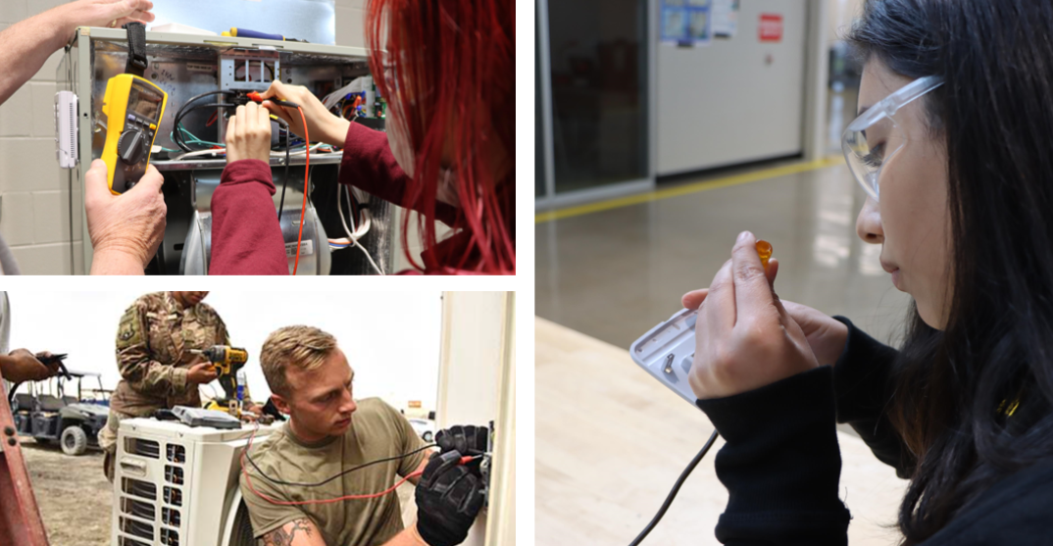




Statewide Program of Study: HVAC and Sheet Metal — Page 1
Revised–November 2025
Architecture and Construction Career Cluster
The Architecture and Construction career cluster focuses on designing, planning, managing, building, and maintaining the built environment. This career cluster includes occupations ranging from architects, carpenters, and construction managers to electricians, plumbers, and heating, air conditioning, and refrigeration technicians.
Statewide Program of Study: HVAC and Sheet Metal
The HVAC and Sheet Metal program of study focuses on occupational and educational opportunities associated with installing, servicing, or repairing heating and air conditioning systems. The program of study addresses fabrication, assembly, installation, and repair of sheet metal products and equipment, such as ducts, control boxes, drainpipes, and furnace casings.
Secondary Courses for High School Credit
Level 1 | Principles of Architecture Principles of Construction
Level 2 | Heating, Ventilation, and Air Conditioning (HVAC) and Refrigeration Technology I Building Maintenance Technology I Entrepreneurship I
Level 3 | Sheet Metal Technology Heating, Ventilation, and Air Conditioning (HVAC) and Refrigeration Technology II
Level 4 | Practicum in Construction Technology Practicum in Construction Technology + Extended Practicum in Construction Technology Practicum in Entrepreneurship Practicum in Entrepreneurship + Extended Practicum in Entrepreneurship Career Preparation for Programs of Study Career Preparation for Programs of Study + Extended Career Preparation
Example Postsecondary Opportunities
Apprenticeships
Heating and Air Conditioning Installer
Associate Degrees
Heating, Air Conditioning, Ventilation and
Refrigeration Maintenance Technology
Construction Site Management
Property Maintenance
Sheet Metal Technology/Sheetworking
Bachelor’s Degrees
Construction Engineering
Construction Management
Building/Construction Site Management
Heating, Air Conditioning, Ventilation and Refrigeration Maintenance Technology
Master’s, Doctoral, and Professional Degrees
Construction Engineering
Construction Management
Work-Based Learning and Expanded Learning Opportunities
Work-Based Learning Activities | Participate in a pre-apprenticeship in HVAC and refrigeration Intern with an HVAC company to practice installing and repairing heating and cooling systems
Expanded Learning Opportunities | Job shadow an HVAC technician or cost estimator Participate in SkillsUSA
Example Aligned Occupations
Helpers—Installation, Maintenance, and Repair Workers
Aligned Industry-Based Certifications
Median Wage: $34,574
Annual Openings: 2,061
10-Year Growth: 22%
Construction Technology Certification Level I
Core
Employment Ready Certification - Air Conditioning
Employment Ready Certification - Electrical
Employment Ready Certification - Gas Heat
Employment Ready Certification - Heat Pumps
Employment Ready Certification - Light Commercial Air Conditioning
HBI Pre-Apprenticeship Certificate Training (PACT), Core
HBI Pre-Apprenticeship Certificate Training (PACT), Heating, Ventilation and Air Conditioning
HVAC Support Technician Certificate
HVACR Level I
Sheet Metal Level I
Heating, Air Conditioning,
and Refrigeration Mechanics
and Installers
Median Wage: $50,195
Annual Openings: 3,519
10-Year Growth: 21%
HVAC and Sheet Metal
Construction Managers
Median Wage: $98,294
Annual Openings: 5,403
10-Year Growth: 24%
Data Source: TexasWages, Texas Workforce Commission. Retrieved 3/8/20240
Successful completion of the HVAC and Sheet Metal program of study will fulfill requirements of the Business and Industry endorsement.
For more information visit: https://tea.texas.gov/academics/college-career-and-military-prep/career-and-technical-education/ac-hvac-extended.pdf

Slide 2











Statewide Program of Study: HVAC and Sheet Metal — Page 2
Architecture and Construction Career Cluster
Statewide Program of Study: HVAC and Sheet Metal
Course Information
Course |  | Prerequisites | Corequisites | Career Clusters
Principles of Architecture* 13004210 (1 credit) |  | Prerequisites: None Corequisites: None Recommended Prerequisites: None Recommended Corequisites: None | 1. Architecture and Construction 2. Engineering
Principles of Construction* 13004220 (1 credit) |  | Prerequisites: None Corequisites: None Recommended Prerequisites: None Recommended Corequisites: None | 1. Architecture and Construction
Level 1
Course |  | Prerequisites | Corequisites | Career Clusters
Heating, Ventilation, and Air Conditioning (HVAC) and Refrigeration Technology I 13005800 (1 credit) |  | Prerequisites: None Corequisites: None Recommended Prerequisites: Principles of Architecture, Principles of Construction, or Construction Technology I Recommended Corequisites: None | 1. Architecture and Construction 2. Manufacturing
Building Maintenance Technology I* 13005400 (2 credits) |  | Prerequisites: None Corequisites: None Recommended Prerequisites: Principles of Architecture or Principles of Construction Recommended Corequisites: None | 1. Architecture and Construction
Entrepreneurship I* 13011101 (1 credit) |  | Prerequisites: None Corequisites: None Recommended Prerequisites: Principles of Business, Marketing and Finance Recommended Corequisites: None
Level 2
Course |  | Prerequisites | Corequisites | Career Clusters
Sheet Metal Technology N1300430 (1 credit) |  | Prerequisites: None Corequisites: None Recommended Prerequisites: Algebra I, Geometry, Introduction to Manufacturing, Principles of Construction, or Construction Technology I Recommended Corequisites: None | 1. Architecture and Construction
Continued on next page |  | -- | --
Level 3
HVAC and Sheet Metal
* Indicates course is included in more than one program of study in this career cluster.
For additional information on the Architecture and Construction career cluster,
contact cte@tea.texas.gov or visit https://tea.texas.gov/cte
[LEA name] does not discriminate on the basis of race, color, national origin, sex, or disability in its programs or activities and provides equal access to the Boy Scouts and other designated youth groups. The following person has been designated to handle inquiries regarding the nondiscrimination policies: [title], [address], [telephone number], [email]. Further nondiscrimination information can be found at Notification of Nondiscrimination in Career and Technical Education Programs.

Slide 3
Statewide Program of Study: HVAC and Sheet Metal — Page 3
Architecture and Construction Career Cluster
Statewide Program of Study: HVAC and Sheet Metal
Course Information
Course |  | Prerequisites | Corequisites | Career Clusters
Heating, Ventilation, and Air Conditioning (HVAC) and Refrigeration Technology II 13005900 (2 credits) |  | Prerequisites: Heating, Ventilation, and Air Conditioning (HVAC) and Refrigeration Technology I Corequisites: None Recommended Prerequisites: Principles of Architecture or Principles of Construction Recommended Corequisites: None
Level 3
Course |  | Prerequisites | Corequisites | Career Clusters
Practicum in Construction Technology* First Time Taken: 13005250 (2 credits) Second Time Taken: 13005260 (2 credits) |  | Prerequisites: Construction Technology ll; Building Maintenance Technology II; Electrical Technology II; Heating, Ventilation, and Air Conditioning (HVAC) and Refrigeration Technology II; Plumbing Technology I; or Mill and Cabinetmaking Technology Corequisites: None Recommended Prerequisites: None Recommended Corequisites: None
Practicum in Construction Technology + Extended Practicum in Construction Technology* First Time Taken: 13005255 (3 credits) Second Time Taken: 13005265 (3 credits) |  | Prerequisites: Construction Technology ll, Building Maintenance Technology II; Electrical Technology II; Heating, Ventilation, and Air Conditioning (HVAC) and Refrigeration Technology II; Plumbing Technology I; or Mill and Cabinetmaking Technology Corequisites: None Recommended Prerequisites: None Recommended Corequisites: None | 1. Architecture and Construction
Practicum in Entrepreneurship* First Time Taken: 13011111 (2 credits) |  | Prerequisites: None Corequisites: None Recommended Prerequisites: Entrepreneurship I and Entrepreneurship II, or successful completion of at least two courses in a CTE program of study Recommended Corequisites: None | 1. Architecture and Construction
Practicum in Entrepreneurship + Extended Practicum in Entrepreneurship* First Time Taken: 13011121 (3 credits) |  | Prerequisites: None Corequisites: None Recommended Prerequisites: Entrepreneurship I and Entrepreneurship II, or successful completion of at least two courses in a CTE program of study Recommended Corequisites: None
Continued on next page |  | -- | --
Level 4
HVAC and Sheet Metal
* Indicates course is included in more than one program of study in this career cluster.
For additional information on the Architecture and Construction career cluster,
contact cte@tea.texas.gov or visit https://tea.texas.gov/cte
[LEA name] does not discriminate on the basis of race, color, national origin, sex, or disability in its programs or activities and provides equal access to the Boy Scouts and other designated youth groups. The following person has been designated to handle inquiries regarding the nondiscrimination policies: [title], [address], [telephone number], [email]. Further nondiscrimination information can be found at Notification of Nondiscrimination in Career and Technical Education Programs.

Slide 4




Statewide Program of Study: HVAC and Sheet Metal — Page 4
Architecture and Construction Career Cluster
Statewide Program of Study: HVAC and Sheet Metal
Course Information
Course |  | Prerequisites | Corequisites | Career Clusters
Career Preparation for Programs of Study* First Time Taken: 12701121 (2 credits) |  | Prerequisites: At least one Level 2 or higher CTE course Corequisites: None Recommended Prerequisites: None Recommended Corequisites: None | 1. Agriculture, Food and Natural Resources 2. Architecture and Construction 3. Arts, Audio Visual Technology and Communication 4. Business, Marketing, and Finance 5. Education and Training 6. Energy 7. Health Science 8. Hospitality and Tourism 9. Human Services 10. Information Technology 11. Law and Public Service 12. Manufacturing 13. Transportation, Distribution and Logistics
Career Preparation for Programs of Study + Extended Career Preparation* First Time Taken: 12701141 (3 credits) |  | Prerequisites: At least one Level 2 or higher CTE course Corequisites: None Recommended Prerequisites: None Recommended Corequisites: None | 1. Agriculture, Food and Natural Resources 2. Architecture and Construction 3. Arts, Audio Visual Technology and Communication 4. Business, Marketing, and Finance 5. Education and Training 6. Energy 7. Health Science 8. Hospitality and Tourism 9. Human Services 10. Information Technology 11. Law and Public Service 12. Manufacturing 13. Transportation, Distribution and Logistics
Level 4
* Indicates course is included in more than one program of study in this career cluster.
HVAC and Sheet Metal
For additional information on the Architecture and Construction career cluster,
contact cte@tea.texas.gov or visit https://tea.texas.gov/cte
[LEA name] does not discriminate on the basis of race, color, national origin, sex, or disability in its programs or activities and provides equal access to the Boy Scouts and other designated youth groups. The following person has been designated to handle inquiries regarding the nondiscrimination policies: [title], [address], [telephone number], [email]. Further nondiscrimination information can be found at Notification of Nondiscrimination in Career and Technical Education Programs.

