Slide 1


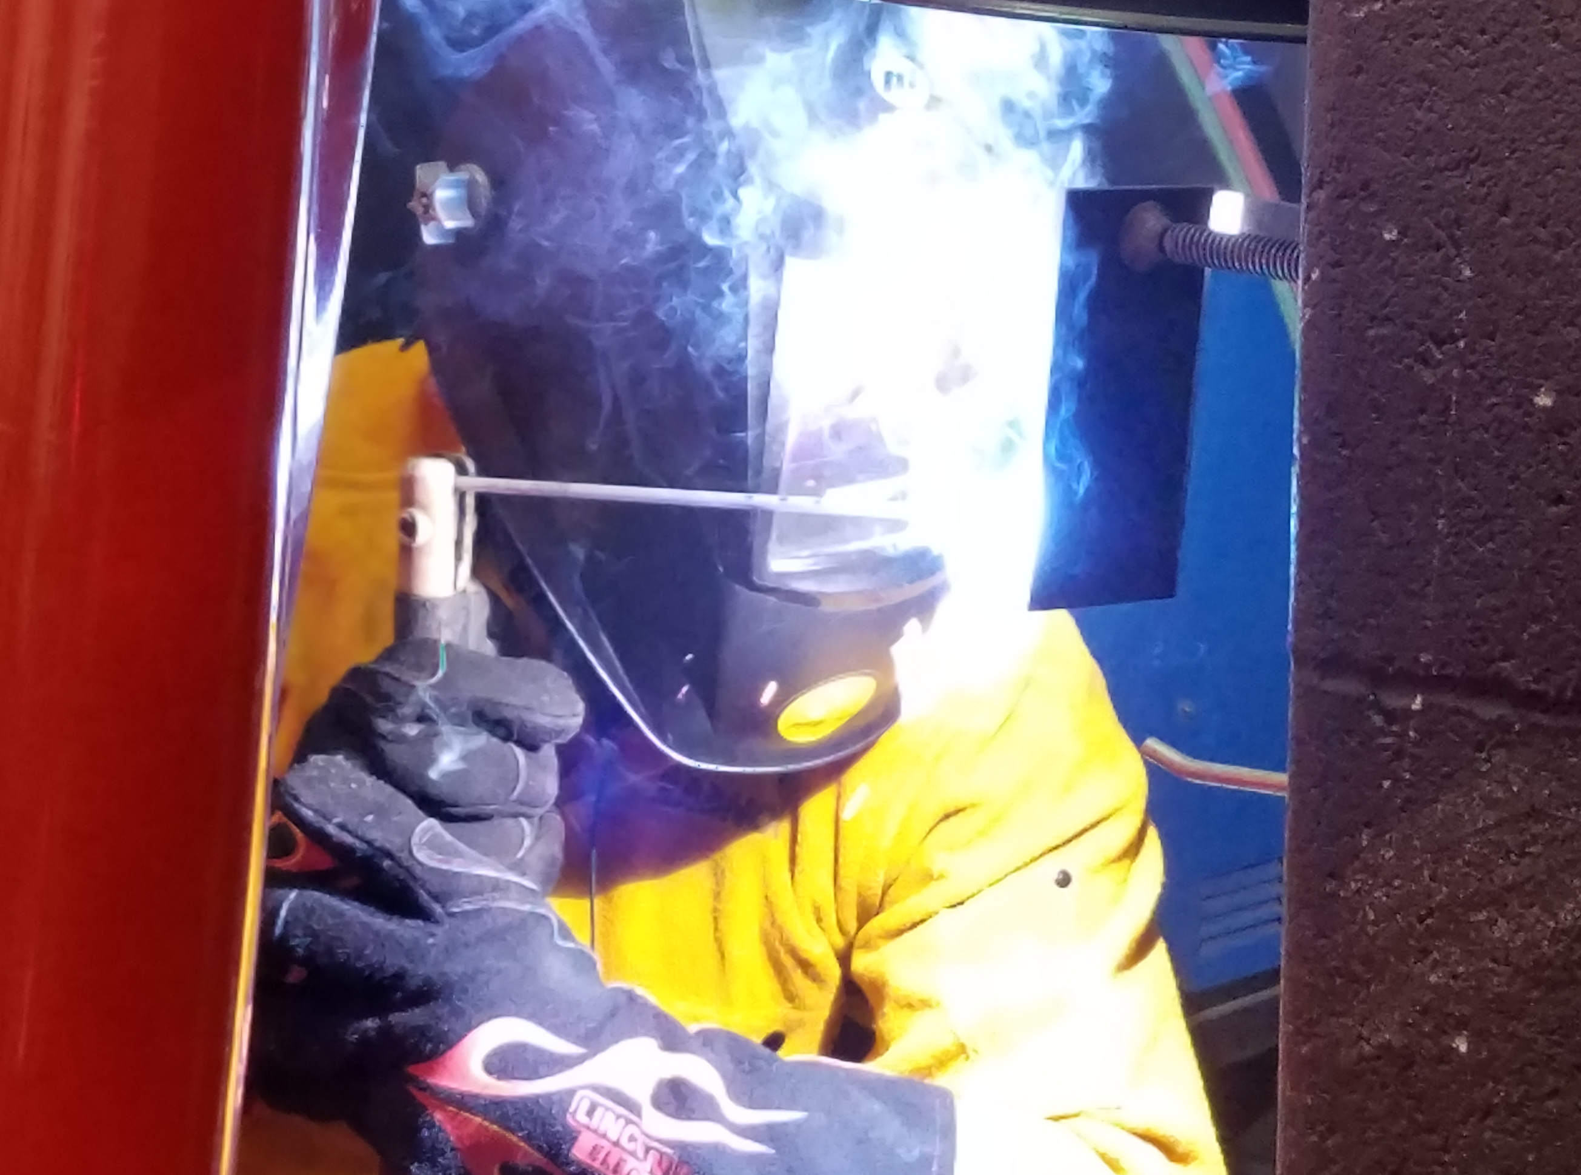




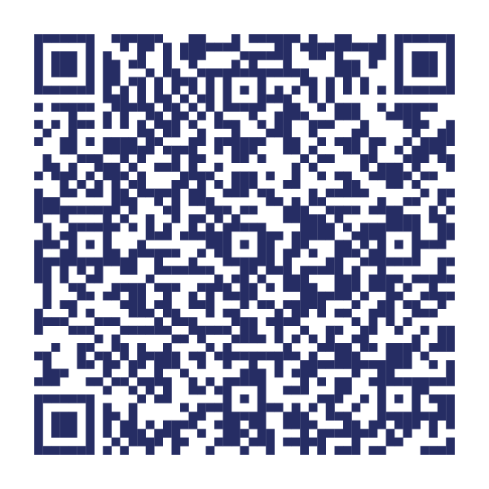
Statewide Program of Study: Manufacturing Technology — Page 1
Revised–November 2025
Manufacturing Career Cluster
The Manufacturing career cluster focuses on planning, managing, and performing the processing of materials into intermediate or final products and related professional and technical support activities such as production planning and control, maintenance, and process engineering. This career cluster includes occupations ranging from welder and machinist to industrial engineering technician and semi-conductor processing technician.
Statewide Program of Study: Manufacturing Technology
The Manufacturing Technology program of study focuses on occupational and educational opportunities associated with the development and use of automatic and computer-controlled machines, tools, and robots that perform work on metal or plastic. It includes exploration of a variety of machine tools that are used to produce precision parts and instruments. This program of study addresses how to modify parts to make or repair machine tools or maintain individual machines, and how to use hand-welding or flame-cutting equipment.
Secondary Courses for High School Credit
Level 1 | Principles of Manufacturing Principles of Applied Engineering Blueprint Reading for Manufacturing Applications
Level 2 | Diversified Manufacturing I Occupational Safety and Environmental Technology I Metal Fabrication and Machining I Entrepreneurship I
Level 3 | Diversified Manufacturing II Metal Fabrication and Machining II Precision Metal Manufacturing I Computer Integrated Manufacturing (PLTW)
Level 4 | Precision Metal Manufacturing II Precision Metal Manufacturing II + Precision Metal Manufacturing II Lab Practicum in Manufacturing Practicum in Manufacturing + Extended Practicum in Manufacturing Practicum in Entrepreneurship Practicum in Entrepreneurship + Extended Practicum in Entrepreneurship Career Preparation for Programs of Study Career Preparation Programs of Study + Extended Career Preparation
Example Postsecondary Opportunities
Associate Degrees
Industrial Technology
Instrumentation Technology
Manufacturing Engineering Technology
Machine Shop Technology
Bachelor’s Degrees
Engineering/Industrial Management
Industrial Engineering
Mechanical Engineering Technology
Manufacturing Engineering
Master’s, Doctoral, and Professional Degrees
Mechanical Engineering
Engineering/Industrial Management
Industrial Engineering
Engineering
Work-Based Learning and Expanded Learning Opportunities
Work-Based Learning Activities | Shadow a metallurgist working at a refinery, steel mill, or aircraft manufacturing company Intern at a manufacturing plant using CNC machines
Expanded Learning Opportunities | Tour a manufacturing facility Participate in SkillsUSA or TSA
Aligned Industry-Based Certifications
Example Aligned Occupations
AM Design and Prototyping
Applied Industry 4.0
Autodesk Certified Associate in CAM for 2.5 Axis Milling
Autodesk Certified Associate in CAM for Turning
Autodesk Certified Professional in CAM for 3 Axis Milling
AWS D1.1 Structural Steel
AWS SENSE Level 1: Entry Welder
C-101 Certified 4.0 Associate I - Basic Operations
C-103 Certified 4.0 Associate III - Robot System Operations
CAM Milling I
CAM Turning I
Certified Logistics Technician (CLT)
Certified Manufacturing Associate (CMfgA)
Certified Process Control Technician Level 1
Certified Process Control Technician Level 2
Certified Process Control Technician Level 3
Certified Production Technician (CPT) 4.0
Certified SOLIDWORKS Professional (CSWA) - Additive Manufacturing
Certified SOLIDWORKS Professional (CSWP) - CAM
Certified Technician-Supply Chain Automation (CT-SCA)
Classic Credential: CNC Lathe II
Classic Credential: Diemaking II
Classic Credential: Diemaking III
Classic Credential: Drill Press II
Classic Credential: EDM II (2-Axis Wire)
Classic Credential: EDM II (Plunge)
Classic Credential: Grinding II (Cylindrical)
Classic Credential: Grinding II (Surface)
Classic Credential: Job Planning, Benchwork & Layout
Classic Credential: Milling II
Classic Credential: Moldmaking II
Classic Credential: Moldmaking III
Classic Credential: Screw Machine Operations II (Multi-Spindle)
Classic Credential: Screw Machine Operations II (Single Spindle)
Classic Credential: Screw Machine Setup and Operations III (Multi-Spindle)
Classic Credential: Turning I (Between Centers)
Classic Credential: Turning I (Chucking)
Classic Credential: Turning II (Between Centers)
Classic Credential: Turning II (Chucking)
CNC 5-Axis Mill Operations
CNC Lathe Operations
CNC Milling II
CNC Turning II
Core
Electronic Control Systems
Introduction to Mechatronics
CNC Lathe Programming Setup and Operations
Machining CNC Mill Operations
Machining CNC Mill Programming Setup and Operations
Machining Drill Press I
Machining Grinding I
Machining Measurement, Material, and Safety
Machining Milling I
Maintenance Technology
Manufacturing Technology
Precision Machining - Job Ready
Welding - Job Ready
Welding Level I
Machinists
Median Wage: $49,608
Annual Openings: 2,098
10-Year Growth: 23%
Industrial Engineering Technologists and Technicians
Median Wage: $60,026
Annual Openings: 462
10-Year Growth: 17%
Manufacturing Technology
Mechanical Engineers
Median Wage: $103,189
Annual Openings: 1,455
10-Year Growth: 19%
Data Source: TexasWages, Texas Workforce Commission. Retrieved 3/8/2024.
Successful completion of the Manufacturing Technology program of study will fulfill requirements of the Business and Industry endorsement.
For more information visit: https://tea.texas.gov/academics/college-career-and-military-prep/career-and-technical-education/m-manufacturing-technology-extendedpptx.pdf

Slide 2












Statewide Program of Study: Manufacturing Technology — Page 2
Manufacturing Career Cluster
Statewide Program of Study: Manufacturing Technology
Course Information
Course |  | Prerequisites | Corequisites | Career Clusters
Principles of Manufacturing* 13032200 (1 credit) |  | Prerequisites: None Corequisites: None Recommended Prerequisites: Algebra I or Geometry Recommended Corequisites: None | 1. Manufacturing
Principles of Applied Engineering* 13036200 (1 credit) |  | Prerequisites: None Corequisites: None Recommended Prerequisites: None Recommended Corequisites: None | 1. Energy 2. Engineering 3. Manufacturing
Blueprint Reading for Manufacturing Applications* N1303684 (1 credit) |  | Prerequisites: None Corequisites: None Recommended Prerequisites: Algebra I, Geometry, and Principles of Construction Recommended Corequisites: None | 1. Manufacturing
Level 1
Course |  | Prerequisites | Corequisites | Career Clusters
Diversified Manufacturing I* 13032650 (1 credit) |  | Prerequisites: None Corequisites: None Recommended Prerequisites: Algebra I Recommended Corequisites: None | 1. Manufacturing
Occupational Safety and Environmental Technology I* N1303680 (1 credit) |  | Prerequisites: None Corequisites: None Recommended Prerequisites: Principles of Transportation Systems, Principles of Distribution and Logistics, or Principles of Manufacturing Recommended Corequisites: None | 1. Energy 2. Manufacturing 3. Transportation, Distribution and Logistics
Metal Fabrication and Machining I 13032700 (2 credits) |  | Prerequisites: None Corequisites: None Recommended Prerequisites: Algebra I or Geometry Recommended Corequisites: None | 1. Manufacturing
Entrepreneurship I 13011101 (1 credit) |  | Prerequisites: None Corequisites: None Recommended Prerequisites: Principles of Business, Marketing, and Finance Recommended Corequisites: None
Level 2
Course |  | Prerequisites | Corequisites | Career Clusters
Diversified Manufacturing II 13032660 (1 credit) |  | Prerequisites: Diversified Manufacturing I Corequisites: None Recommended Prerequisites: Algebra I Recommended Corequisites: None | 1. Manufacturing
Level 3
Manufacturing Technology
Continued on next page
* Indicates course is included in more than one program of study in this career cluster.
For additional information on the Manufacturing career cluster,
contact cte@tea.texas.gov or visit https://tea.texas.gov/cte
[LEA name] does not discriminate on the basis of race, color, national origin, sex, or disability in its programs or activities and provides equal access to the Boy Scouts and other designated youth groups. The following person has been designated to handle inquiries regarding the nondiscrimination policies: [title], [address], [telephone number], [email]. Further nondiscrimination information can be found at Notification of Nondiscrimination in Career and Technical Education Programs.

Slide 3
Statewide Program of Study: Manufacturing Technology — Page 3
Manufacturing Career Cluster
Statewide Program of Study: Manufacturing Technology
Course Information
Course |  | Prerequisites | Corequisites | Career Clusters
Metal Fabrication and Machining II 13032800 (2 credits) |  | Prerequisites: Metal Fabrication and Machining I Corequisites: None Recommended Prerequisites: Geometry and Algebra II Recommended Corequisites: None
Precision Metal Manufacturing I 13032500 (2 credits) |  | Prerequisites: None Corequisites: None Recommended Prerequisites: Principles of Manufacturing and completion of or concurrent enrollment in Algebra I or Geometry Recommended Corequisites: None
Computer Integrated Manufacturing (PLTW) N1303748 (1 credit) |  | Prerequisites: None Corequisites: None Recommended Prerequisites: Introduction to Engineering Design Recommended Corequisites: College preparatory mathematics and science courses
Level 3
Course |  | Prerequisites | Corequisites | Career Clusters
Precision Metal Manufacturing II 13032600 (2 credits) |  | Prerequisites: Precision Metal Manufacturing I Corequisites: None Recommended Prerequisites: None Recommended Corequisites: Precision Metal Manufacturing II Lab | Manufacturing
Precision Metal Manufacturing II + Precision Metal Manufacturing II Lab 13032610 (3 credits) |  | Prerequisites: Precision Metal Manufacturing l Corequisites: None Recommended Prerequisites: None Recommended Corequisites: None
Level 4
Continued on next page
* Indicates course is included in more than one program of study in this career cluster.
Manufacturing Technology
For additional information on the Manufacturing career cluster,
contact cte@tea.texas.gov or visit https://tea.texas.gov/cte
[LEA name] does not discriminate on the basis of race, color, national origin, sex, or disability in its programs or activities and provides equal access to the Boy Scouts and other designated youth groups. The following person has been designated to handle inquiries regarding the nondiscrimination policies: [title], [address], [telephone number], [email]. Further nondiscrimination information can be found at Notification of Nondiscrimination in Career and Technical Education Programs.

Slide 4


Statewide Program of Study: Manufacturing Technology — Page 4
Manufacturing Career Cluster
Statewide Program of Study: Manufacturing Technology
Course Information
Course |  | Prerequisites | Corequisites | Career Clusters
Practicum in Manufacturing* First Time Taken: 13033000 (2 credits) Second Time Taken: 13033010 (2 credits) |  | Prerequisites: None Corequisites: None Recommended Prerequisites: None Recommended Corequisites: None
Practicum in Manufacturing + Extended Practicum in Manufacturing* First Time Taken: 13033005 (3 credits) Second Time Taken 13033015 (3 credits) |  | Prerequisites: None Corequisites: None Recommended Prerequisites: None Recommended Corequisites: None
Practicum in Entrepreneurship* First Time Taken: 13011111 (2 credits) |  | Prerequisites: None Corequisites: None Recommended Prerequisites: Entrepreneurship I and II, or successful completion of at least two courses in a CTE program of study Recommended Corequisites: None
Practicum in Entrepreneurship + Extended Practicum in Entrepreneurship* First Time Taken: 13011121 (3 credits) |  | Prerequisites: None Corequisites: None Recommended Prerequisites: Entrepreneurship I and II, or successful completion of at least two courses in a CTE program of study Recommended Corequisites: None
Career Preparation for Programs of Study* First Time Taken: 12701121 (2 credits) |  | Prerequisites: At least one Level 2 or higher CTE course Corequisites: None Recommended Prerequisites: None Recommended Corequisites: None
Career Preparation for Programs of Study + Extended Career Preparation* First Time Taken: 12701141 (3 credits) |  | Prerequisites: At least one Level 2 or higher CTE course Corequisites: None Recommended Prerequisites: None Recommended Corequisites: None
Level 4
* Indicates course is included in more than one program of study in this career cluster.
Manufacturing Technology
For additional information on the Manufacturing career cluster,
contact cte@tea.texas.gov or visit https://tea.texas.gov/cte
[LEA name] does not discriminate on the basis of race, color, national origin, sex, or disability in its programs or activities and provides equal access to the Boy Scouts and other designated youth groups. The following person has been designated to handle inquiries regarding the nondiscrimination policies: [title], [address], [telephone number], [email]. Further nondiscrimination information can be found at Notification of Nondiscrimination in Career and Technical Education Programs.

