Slide 1


Window Rock Unified School District No 8.
2022- 2023 District Orientation
.
McKinney-Vento
Homeless Education Program
Lambert Holyan, Wellness and Culture Coordinator
August 2022
WRUSD District Administration Fort, Defiance, Arizona

Slide 2

WRUSD Homeless Education Program
The mission of the Homeless Education Program is to ensure that homeless children and youth have access to a free, appropriate public education, comparable to that provided to the children of any Arizona resident and consistent with Arizona’s mandatory school attendance laws.
Through the McKinney-Vento Homeless Act eligible children and youths experiencing homelessness have the right to immediately enroll in school and have educational opportunities equal to those of their non-homeless peers.
As the District Homeless Liaison, I will collaborate with district personnel to indentify students experiencing homelessness and work to meet their needs .

Slide 3
Causes of Homelessness
Lack of affordable housing.
Poverty.
Increase in low vs. middle wage employment.
Health problems.
Lack of health insurance
Addiction disorders, Mental health.
Domestic violence.
Natural and other disasters.
Abuse/neglect/family dysfunction (unaccompanied youth).
NEHCY

Slide 4
Barriers to
Education for
Homeless
Children and
Unaccompanied Youth
Stereotypes and lack of awareness.
Under-identification.
High mobility resulting in lack of school stability and educational continuity.
Enrollment requirements (school records, health records, proof of residence, guardianship).
Poor health, fatigue, hunger.
Emotional trauma, depression, anxiety.
Lack of transportation.
Lack of school supplies, clothing, etc.
NEHCY

Slide 5
Impacts of Homelessness on Children and Unaccompanied Youth
Higher incidences of acute and chronic illnesses, depression and anxiety.
Homelessness in early childhood is associated with poor classroom engagement and poor social skills in early elementary school.
The achievement gaps between homeless and low-income elementary students tend to persist, and may even worsen, over time.
A youth who experiences homelessness is 87% more likely to drop out of school.
NEHCY

Slide 6

McKinney-Vento
Homeless Assistance Act
Originally passed in 1987.
Reauthorized in 2015 by the Every Student Succeeds Act (ESSA).
Amendments took effect October 1, 2016.
Works hand-in-hand with Title IA and other federal education programs.
$93.5 million authorized funding to SEAs for FY20. Largest percentage increase of all federal education programs.
SEAs award competitive sub-grants to LEAs.

Slide 7


Eligibility
Who is Covered?
Children and unaccompanied youth who lack a fixed, regular, and adequate nighttime residence.
Sharing the housing of others due to loss of housing, economic hardship, or similar reason.
Living in motels, hotels, camping grounds due to lack of adequate alternative accommodations.
Living in emergency or transitional shelters.
Living in a public or private place not designed for humans to live.
Living in cars, parks, abandoned buildings, substandard housing, bus or train stations, or similar settings.
No utilities; infestations; mold; dangers (Guidance A3)

Slide 8

Homelessness Defined
The term “homeless children and unaccompanied youth” means:
“individuals who lack a fixed, regular, and adequate nighttime residence –”
What exactly is a fixed, regular, and adequate nighttime residence?

Slide 9
Fixed, Regular, and Adequate
Fixed
  Stationary, permanent, not subject to change.
Regular
  Used on a predictable, routine, consistent basis.
  Consider the relative permanence.
Adequate
  Lawfully and reasonably sufficient.
  Sufficient for meeting the physical and psychological needs typically met in a home environment.
Can the student go to the SAME PLACE (fixed) EVERY NIGHT (regular) to sleep in a SAFE AND SUFFICIENT SPACE (adequate)?

Slide 10
Unaccompanied Homeless Youth
Definition: child or youth who meets the McKinney-Vento definition and is not in the physical custody of a parent or guardian. 11434a(6)
Many youth become separated from parents due to lack of space in living situations or shelter policies.
Many flee abuse: 20-50% sexual; 40-60% physical.
Many flee family dysfunction: Over 2/3 Hotline callers report at least one parent abuses drugs or alcohol.
Roughly 1/3 homeless youth identify as LGBTQ.
10% of currently homeless female teens are pregnant.
Many are not enrolled in school.
NEHCY

Slide 11
Key Provisions of McKinney-Vento
Immediate enrollment without documents.
School stability.
Transportation to school of origin.
Eliminate barriers = ensure school policies and procedures are fair.
Unaccompanied youth=immediate enrollment.
No judgment = communicate with sensitivity and understanding.
No discrimination = create a safe, confidential environment.
Resource Referrals.
Address the social-emotional needs.
District Liaison assigned to every school district.
Dispute Resolution Process.
Receive ongoing support the ADE Homeless Education Program.

Slide 12
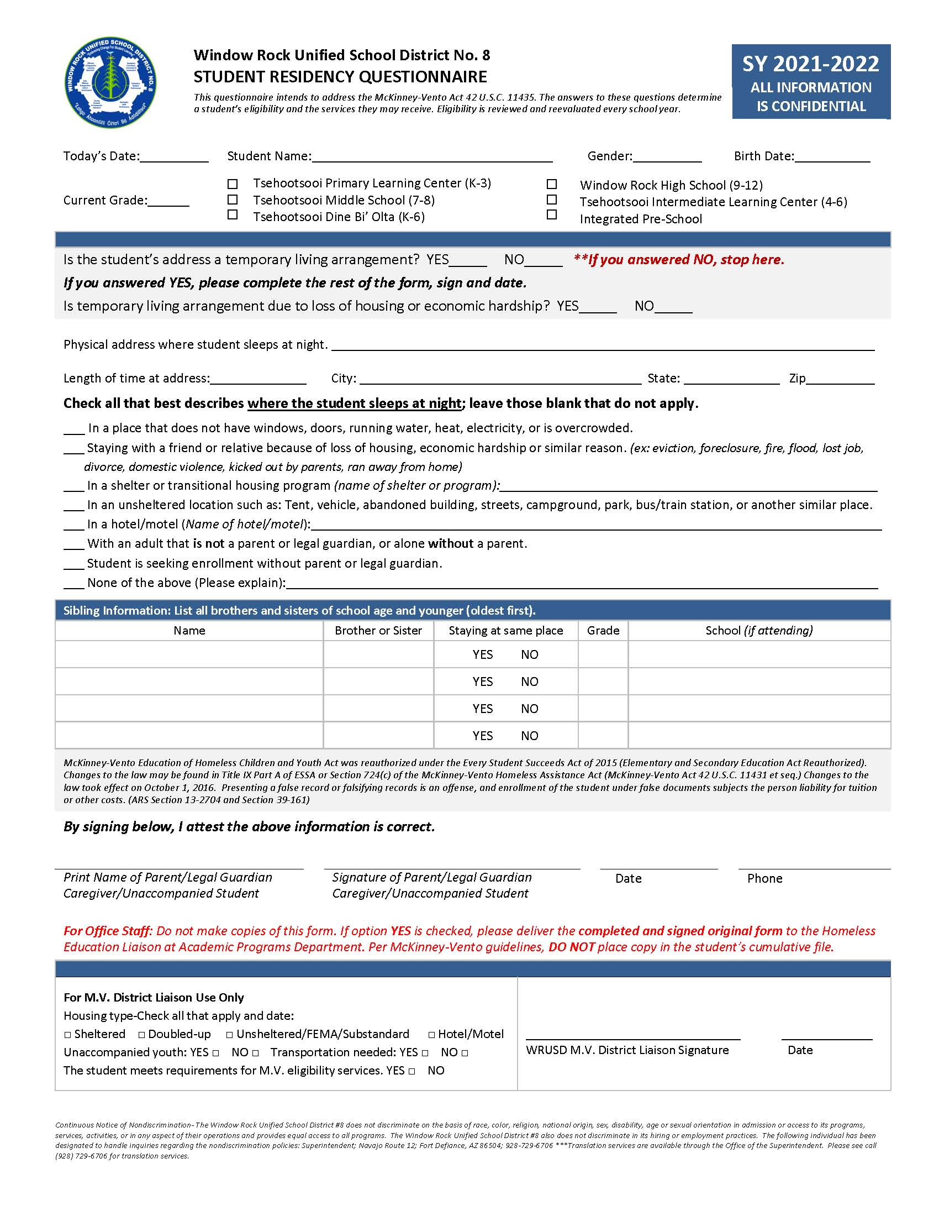
McKinney-Vento Student Eligibility Questionnaire
.

Slide 13

Contact
WRUSD Homeless Liaison
Email: lholyan@wrschool.net
Phone: 928-729-6829
Location WRUSD Admin. Bldg. Room A 148 1st Floor
Arizona State
Silvia Chavez
State Coordinator for Homeless Education
Arizona Department of Education, Bin #2
Office of Communications & Community Outreach
1535 West Jefferson Street
Phoenix, AZ 85007
(602) 542.4963
www.azed.gov/homeless
Resources
Arizona Department of Education
Office of Homeless Education
https://www.azed.gov/homeless/
National Center for Homeless Education (NCHE)
Helpline: 1-800-308-2145
homeless@serve.org
https://nche.ed.gov/contact.php
U.S. Department of Education
Education for Homeless Children and Youth
HomelessEd@ed.gov
http://www2.ed.gov/programs/homeless/index.html

