Slide 1

WELCOME
TO EAST LAKE HIGH SCHOOL
WE ARE GLAD YOU ARE HERE!

Slide 2
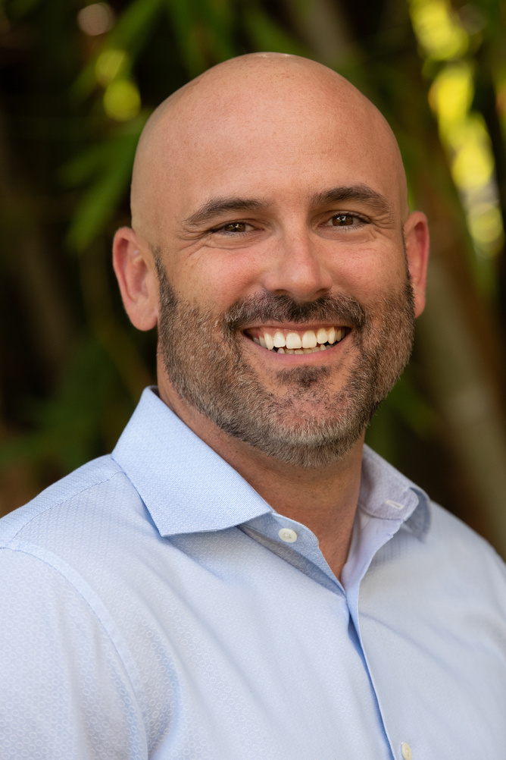
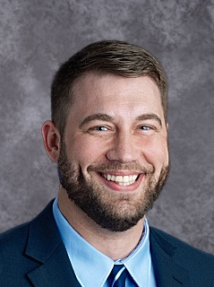
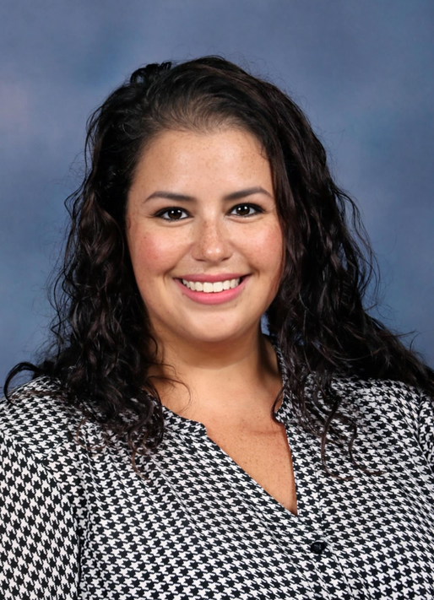
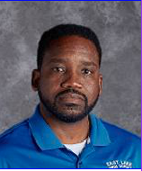
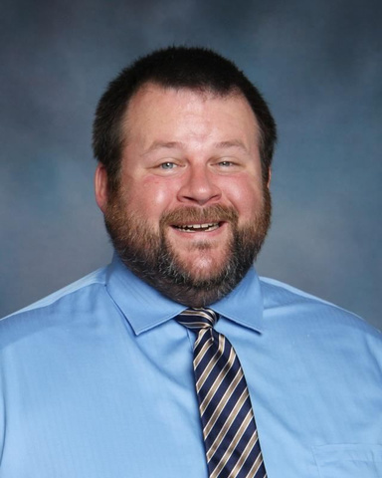


ADMINISTRATION
DR. SMITH
MR. DENTON
DR. HATFIELD
MR. LATIMORE
MR. ANDERSON
Principal
Last Names A-D
Last Names E-K
Last Names L-Q
Last Names R-Z

Slide 3
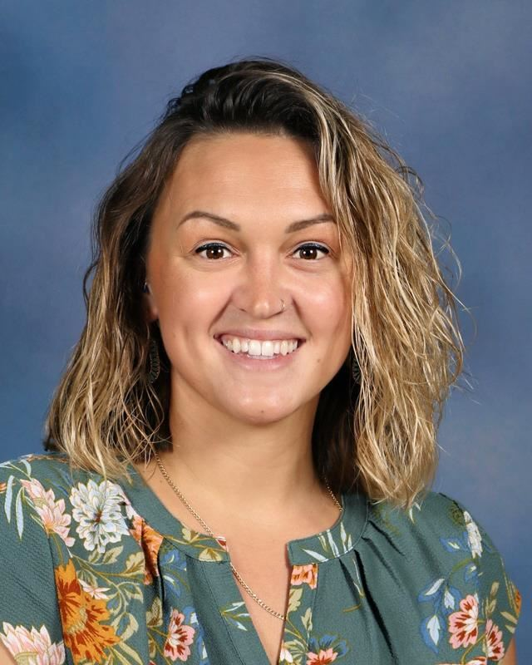
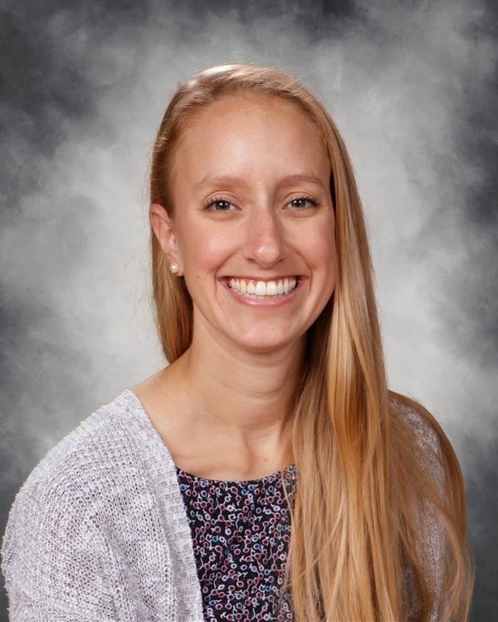
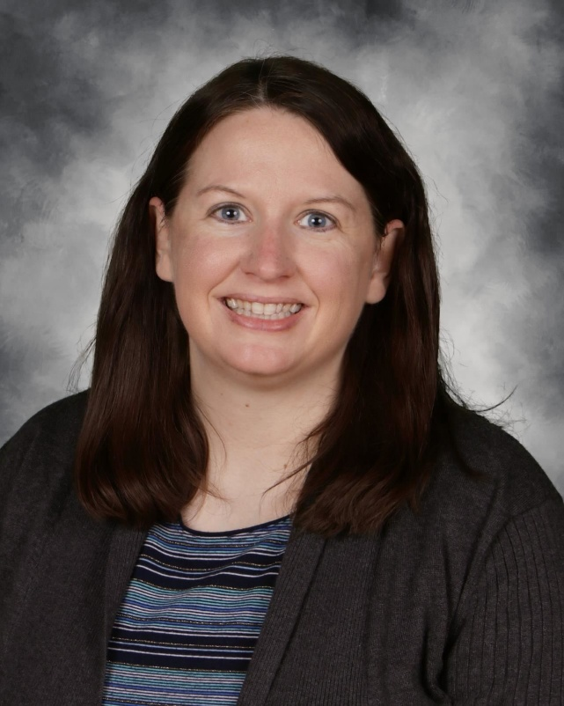
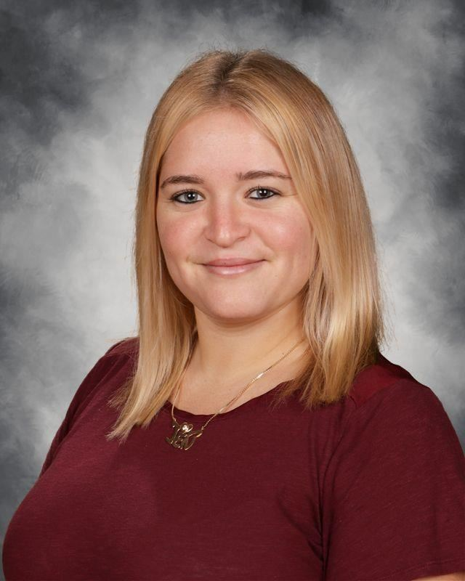
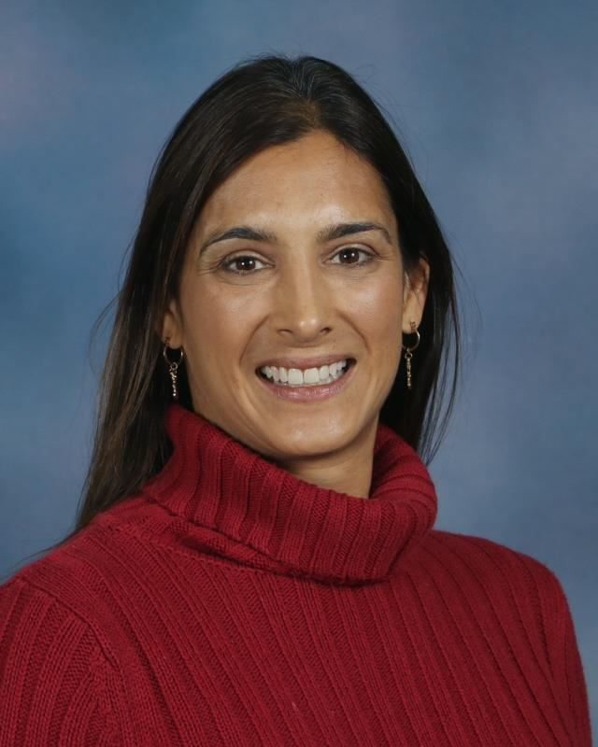



SCHOOL COUNSELORS AND CCC
MS. REGER
MS. BORDENKIRCHER
MS. LIGUORI
MS. FERNANDEZ
MS. GALLATY
Last Names:
A-D
Last Names:
L-Q
Last Names:
R-Z
College and Career Center Coordinator
Last Names:
E-K

Slide 4
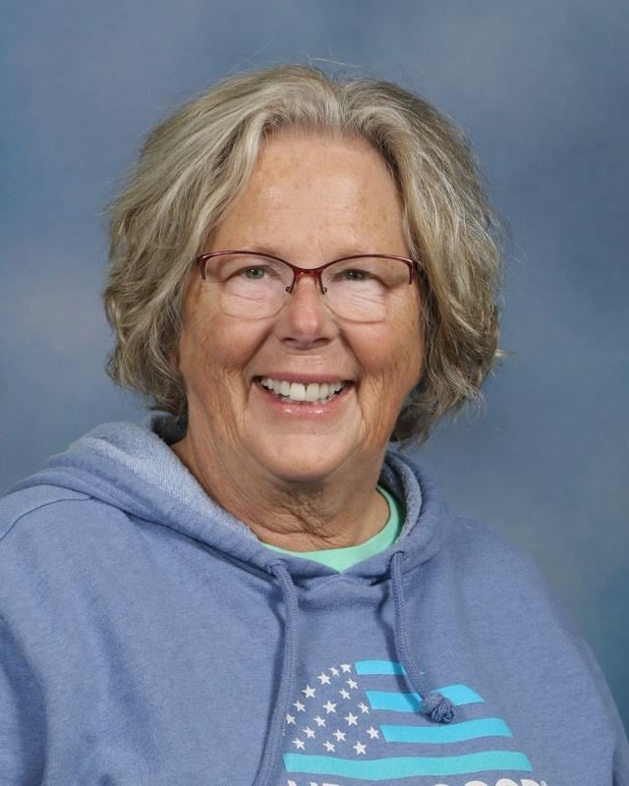
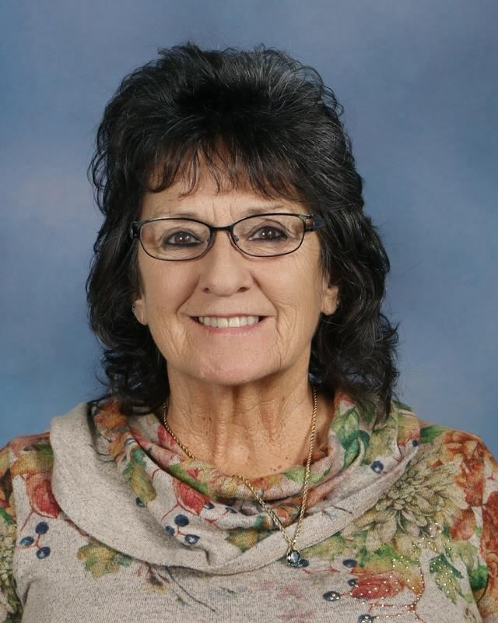
STUDENT SERVICES CLERKS
MS. ACEVEDO
MS. Ramos
Last Names:
A-K
Last Names:
L-Z

Slide 5
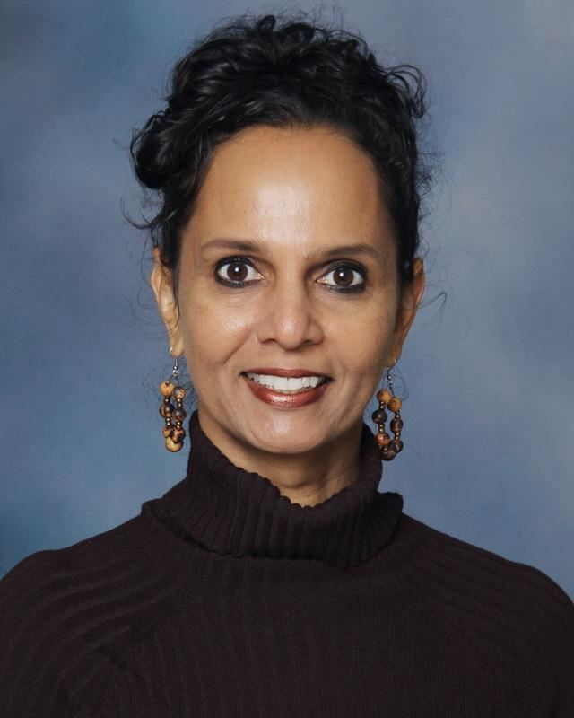
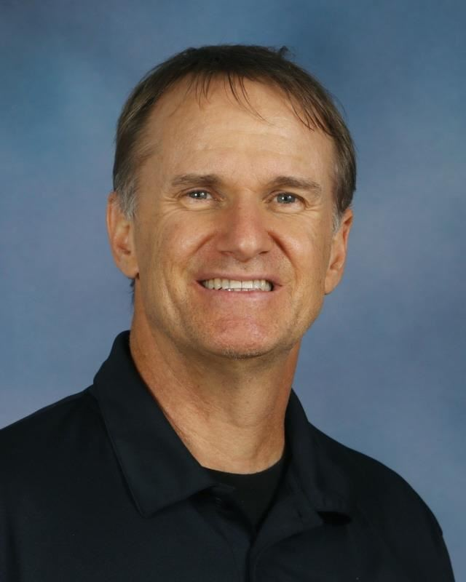
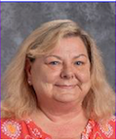
STUDENT SUPPORT SERVICES
MS. FAHEY
MS. HOOPES
MR. ROMINGER
MS. OURS
School Social Worker
School Psychologist
ESE/Behavior Specialist
Attendance Clerk

Slide 6
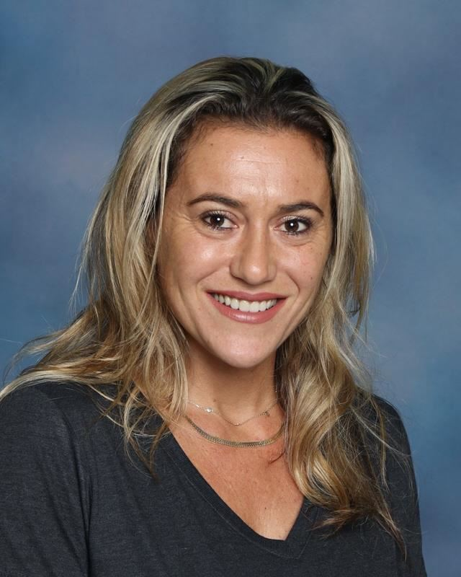
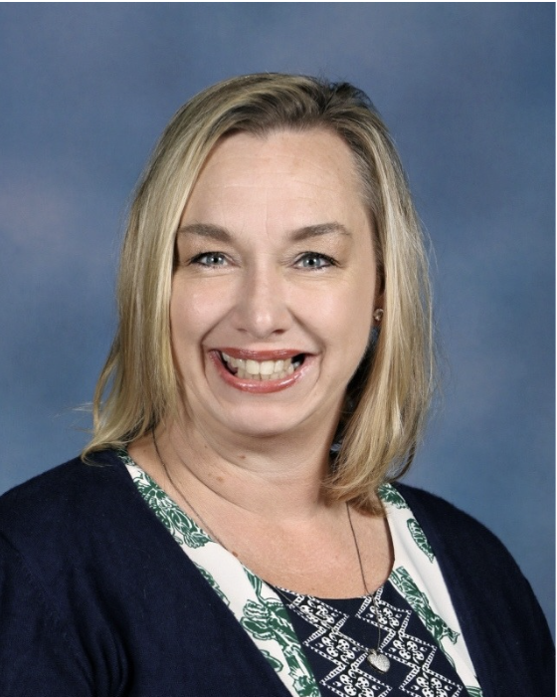
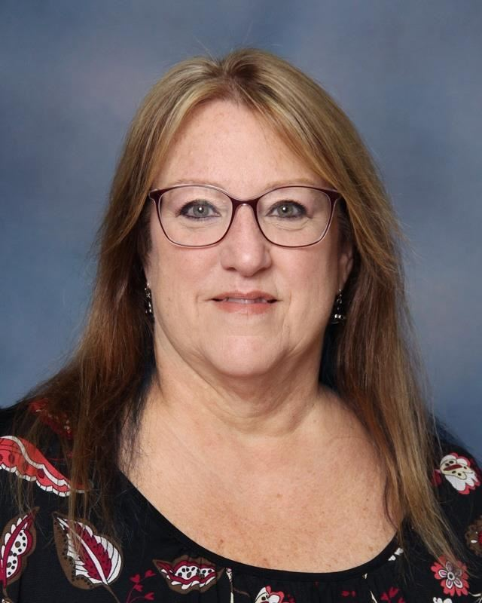
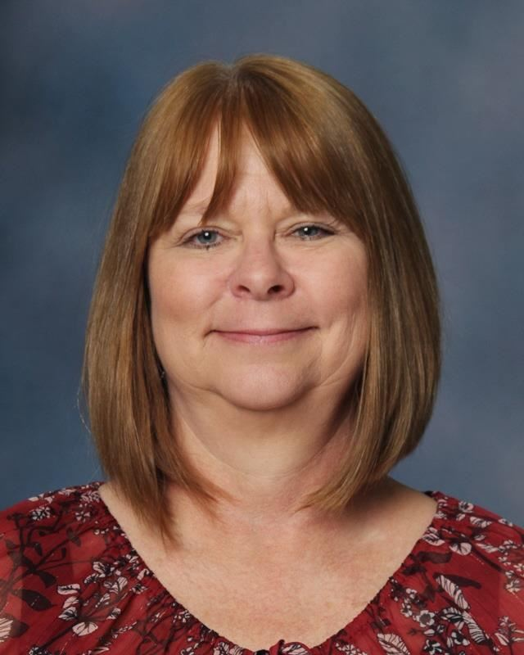
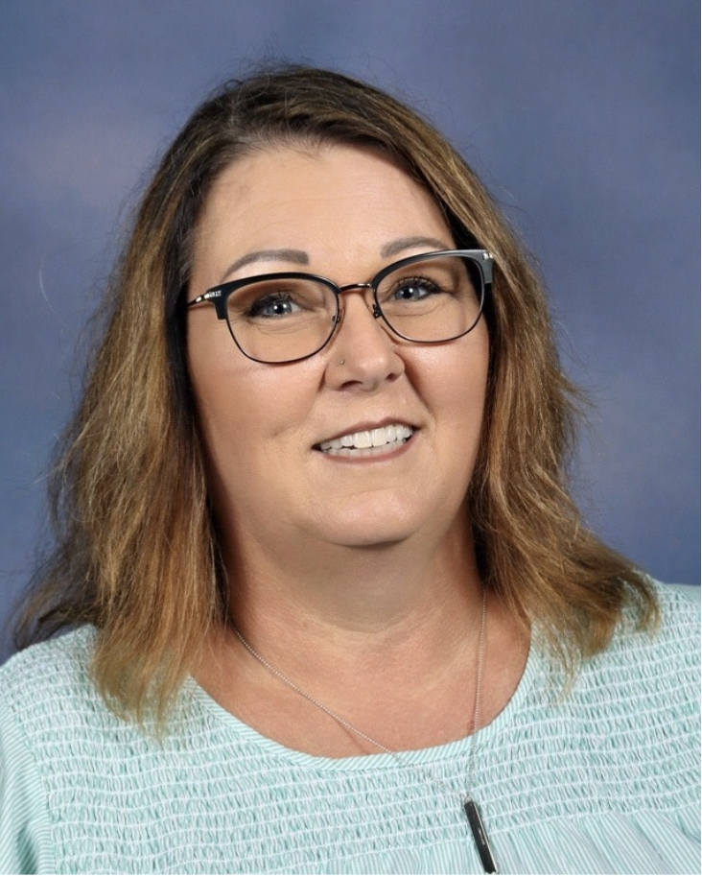
OFFICE STAFF
MS. SKANDALIARIS
MS. MEDINA
MS. BERT
MS. FLETCHER
MS. NELSON
Principal’s Secretary
Records/Registrar
DMT
Bookkeeper
Front Office Clerk

Slide 7
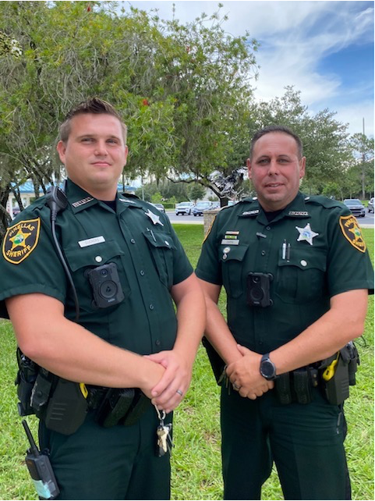
SCHOOL RESOURCE OFFICERS
Your trust in us is valued, and student safety remains our top priority.
We’re committed to maintaining a safe, secure learning environment. Alongside our two full-time School Resource Deputies, we’ve implemented the following measures:
Secured gates/fences with single-point entry
Locked classroom doors during instruction
Visitor check-in via management system
Ongoing security reviews with law enforcement
Monthly safety drills and annual staff training
DEPUTY DUCKERS
DEPUTY CAPPA

Slide 8
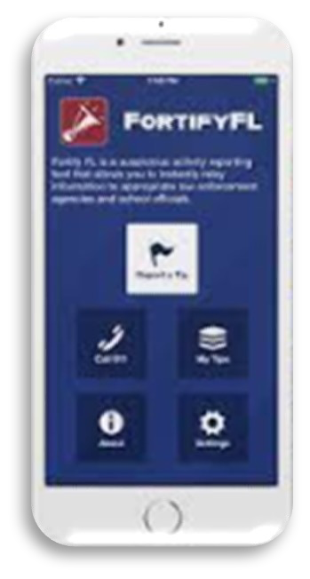

CAMPUS SAFETY
ANONYMOUS REPORTING AND SECURITY MEASURES
Reporting tools: FortifyFL and Say Something—to allow students, staff, and community members to report concerns confidentially. Tips are sent directly to law enforcement and school officials.
Volunteers: must apply and be screened
Level 1: National background check
Level 2: FBI & FDLE fingerprint screening
Volunteers must sign in at the front office and wear an ID badge while on campus or at school events.
Threat Response Badge (new 2025): All staff members can activate a threat response immediately.

Slide 9
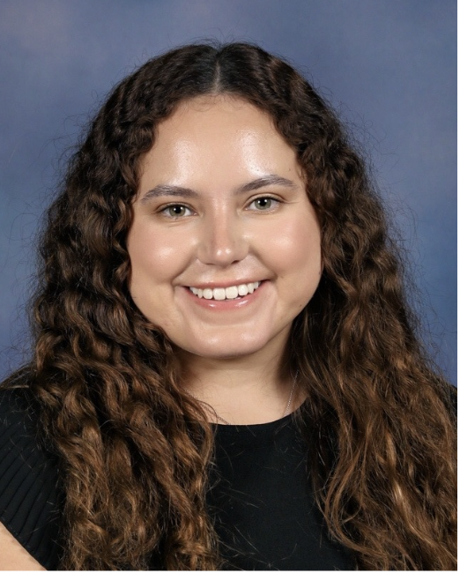
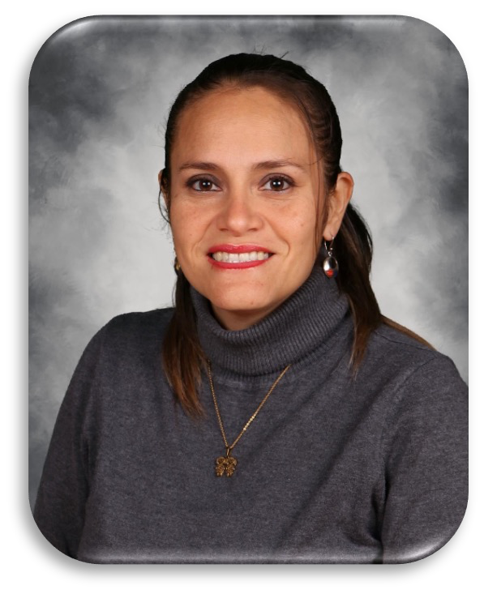

SUPPORT FOR ENGLISH LEARNERS
Ms. Matos-Ruiz and Ms. Kapus provide support and assistance to our English Language Learners (ELL).
MS. MATOS-RUIZ
MS. KAPUS
ELL Teacher/
Coordinator
Bilingual Assistant

Slide 10
ELHS FACTS
Learn more about our school

Slide 11
ABOUT EAST LAKE HS
FACTS AND DETAILS ABOUT OUR SCHOOL AND DISTRICT
East Lake High School was built in 1986, and just graduated its’ 37th class (class of 2025)
East Lake has been ranked as an “A” school 20 times
Our 2025-2026 enrollment is approximately 1950 students
We have approximately 130 staff members
Enrollment for the class of 2026 is approximately 485 students

Slide 12
AWARDS AND RANKINGS
IN THE 2023-2024 SCHOOL YEAR….
East Lake High School received the designation of School of Excellence by the Florida Department of Education.
Our students took over 1800 AP tests, with over 900 students taking at least one and a 69% pass rate
20 of our graduates earned their Associates of Arts college degree from SPC along with their high school diploma.
350 students graduated with the Pinellas County Schools Advanced Scholars designation.
188 students graduated Summa Cum Laude – with a GPA greater than a 3.8.
Our seniors earned 600 industry certifications in areas such as Microsoft Bundle, Adobe InDesign, Adobe Illustrator, Adobe Flash, MTA Networking Security, Networking Fundamentals, Biotech certification, and Engineering Core Certification.
Our senior class contributed over 25,000 documented volunteer hours serving our community.

Slide 13
CURRICULUM
Educational Opportunities at East Lake

Slide 14
COURSEWORK
ACADEMIC OPTIONS AVAILABLE AT EAST LAKE HS
Core courses: Language Arts, Math, Science, and Social Studies
World Languages include French and Spanish
Elective courses: Business, Music, Art, Theater, Physical Education, Engineering, Biomedical, Social Studies, and Language Arts.
Academies include:
  Business Careers, Performing Arts, Biomedical Sciences, and Engineering (our district application program)

Slide 15
EDUCATIONAL OPTIONS
ACADEMIC OPTIONS AVAILABLE AT EAST LAKE HS
Advanced Placement: courses include English Language, English Literature, Biology, Chemistry, Physics 1, Physics 2, Physics C: Mechanics, Environmental Science, World History, US History, US Government and Politics, Microeconomics, Macroeconomics, Human Geography, Psychology, European History, 2D Studio Art, 3D Studio Art, Spanish, French, Statistics, Pre-Calculus, Calculus AB, Calculus BC, Music Theory, Computer Science Principles, Computer Science A, Capstone Seminar and Research
Dual Enrollment Program: students may earn high school and college credits by enrolling in courses at St. Petersburg College and can work toward certain vocational certifications at our local technical school, Pinellas Technical College
Career Certification: opportunities to earn industry certification through CTE, BioMed, & Engineering courses
AICE (Cambridge): students may take courses in Science, or English

Slide 16
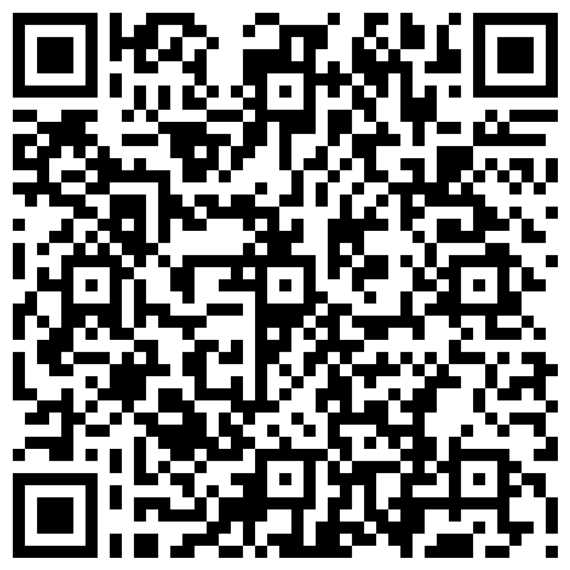
Scheduling Changes
Follow the process from the call-out/email.
Also on the school website.
Steps to Request a Schedule Change:
Click the forms link from site or QR Code
Read the instructions carefully
Complete each question thoroughly
Submit the form by the deadline
  August 15th by 10pm

Slide 17
CAMPUS LIFE
Important Locations and Procedures at East Lake

Slide 18
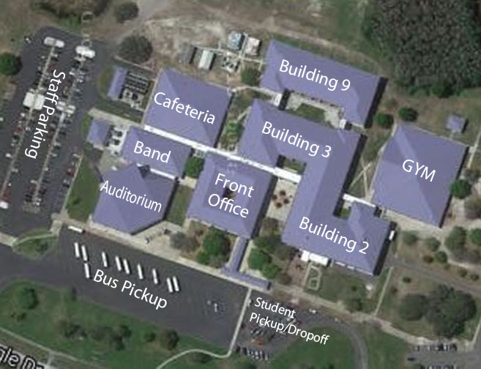
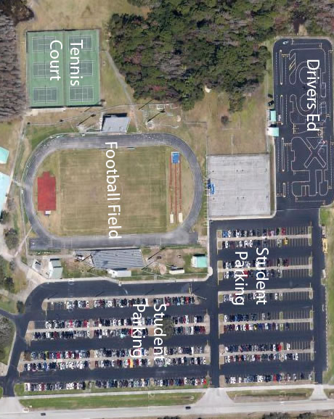
CAMPUS MAPS

Slide 19
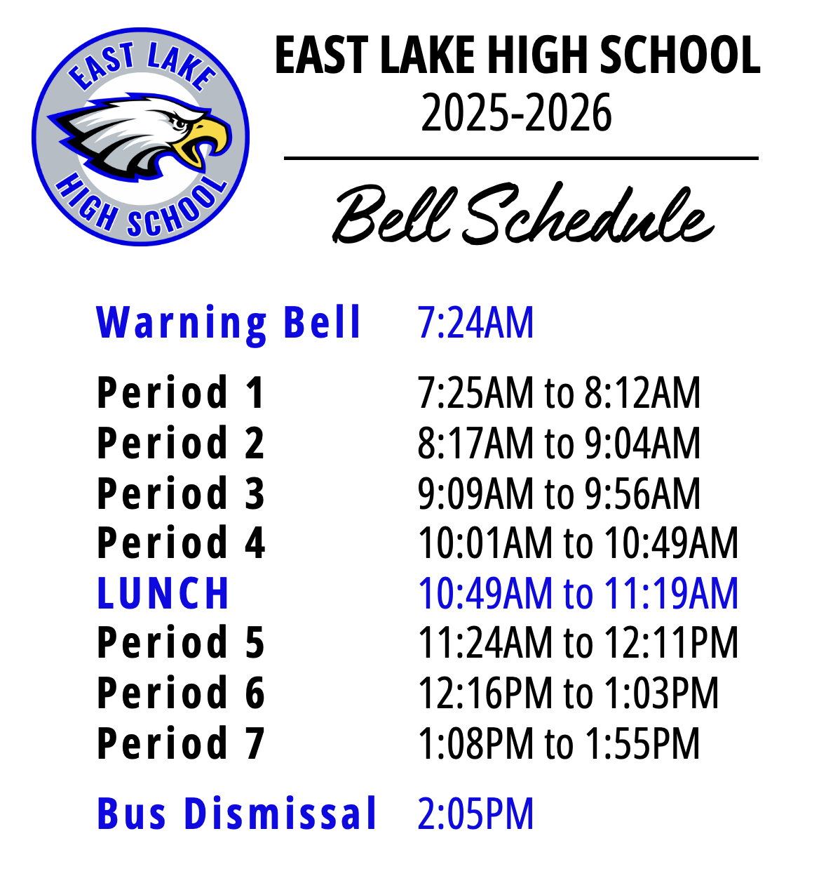
BELL SCHEDULE
FOR THE 2025-2026 SCHOOL YEAR
Campus opens at 7:00am, and buildings/rooms open at 7:15am
Classes run from 7:25am-1:55pm
A long tone signals the end of a class period
Warning bell: Four short tones signal 1 minutes left in passing
A long tone signals the beginning of a class period

Slide 20
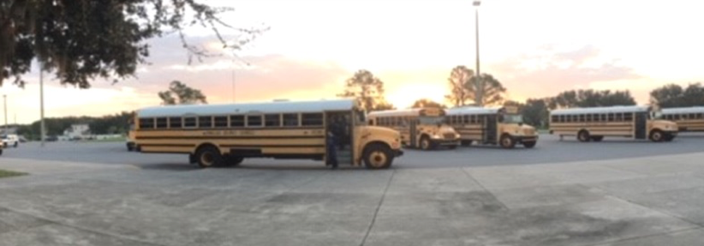
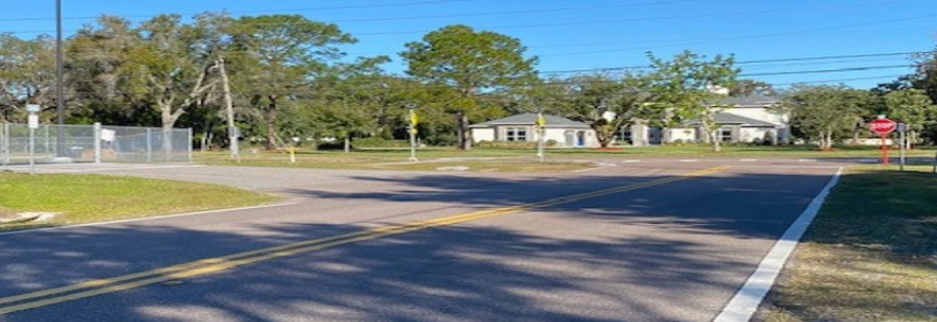
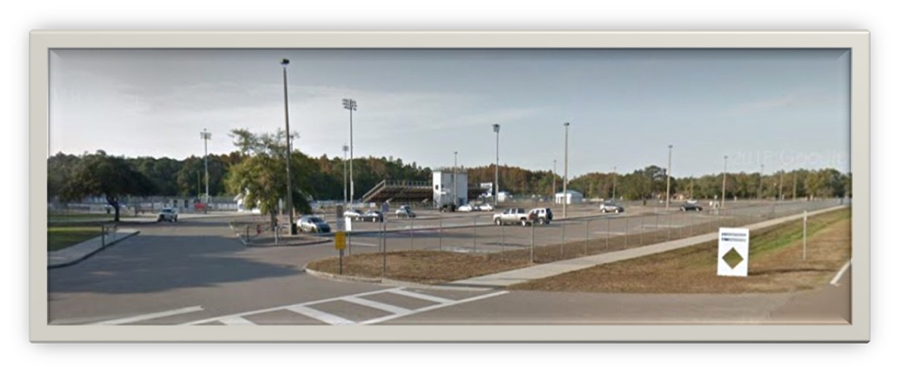
ARRIVAL LOCATIONS & PROCEDURES
BUS RIDERS
School busses will drop students off at the front of the school.
CAR RIDERS
Cars should enter at the North end of the campus, at Gate 3, and proceed through the drop-off line.
STUDENT DRIVERS
Park in the student parking lot. Parking permits are required and can be purchased in the Student Services Office.

Slide 21
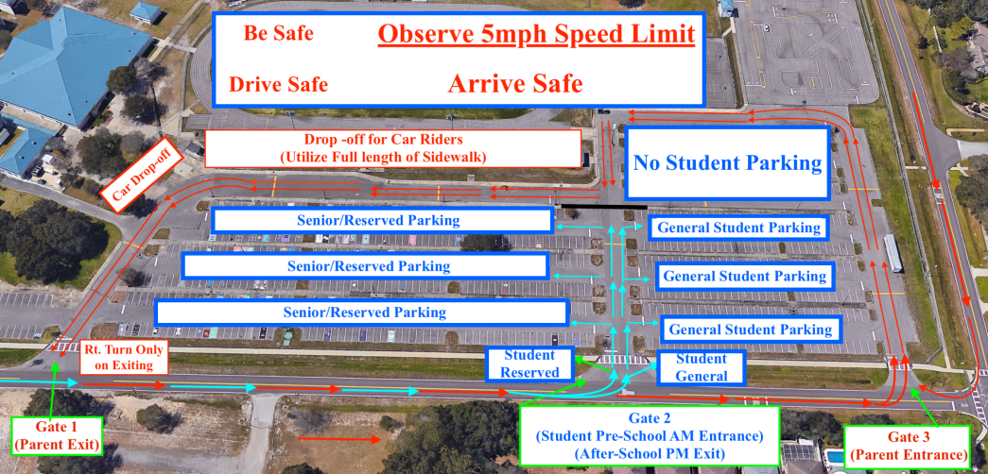

Slide 22





Arrival Procedures & Tardy Policy
Student Parking Lot
Use the cross-walk ONLY and listen to staff directions
Important Times in the Morning:
  Gates open at 7am.
  Classroom Buildings open at 7:15am
  5-minute warning bell at 7:20am
  1-minute warning bell at 7:24am
  Tardy bell rings at 7:25am
If you are not IN THE CLASSROOM when the Tardy bell rings, you must report to a Tardy Kiosk to get a Tardy Pass.
Even if you are en route to class - you are tardy if you aren’t in class by 7:25am.
Buses
If late, enter through the front office
Faculty and visitor parking ONLY. Students may only park in designated spaces in student lot.
Faculty Parking Lot
Once the school day begins, students may ONLY enter campus through the front office.
Late Arrival to Campus

Slide 23
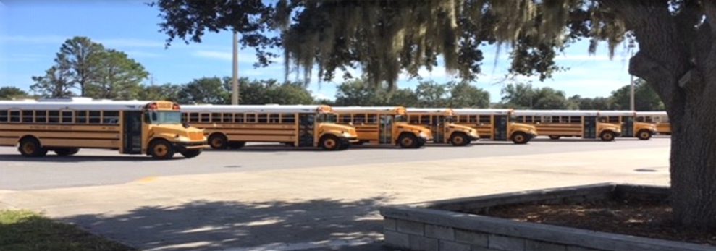
DISMISSAL LOCATIONS & PROCEDURES
BUS RIDERS
School busses will load in the front of school and leave promptly at 2:05pm.
CAR RIDERS
Cars should enter at the North end of the campus, at Gate 3, and proceed through the pick-up line.
STUDENT DRIVERS
Exit carefully from the student parking lot. Be cautious of other students who are walking.

Slide 24
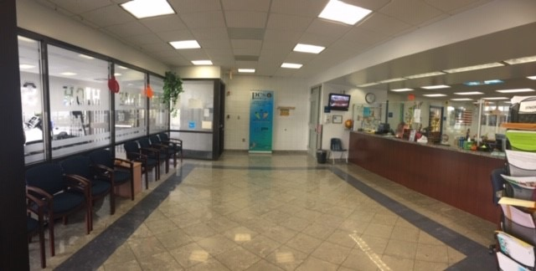
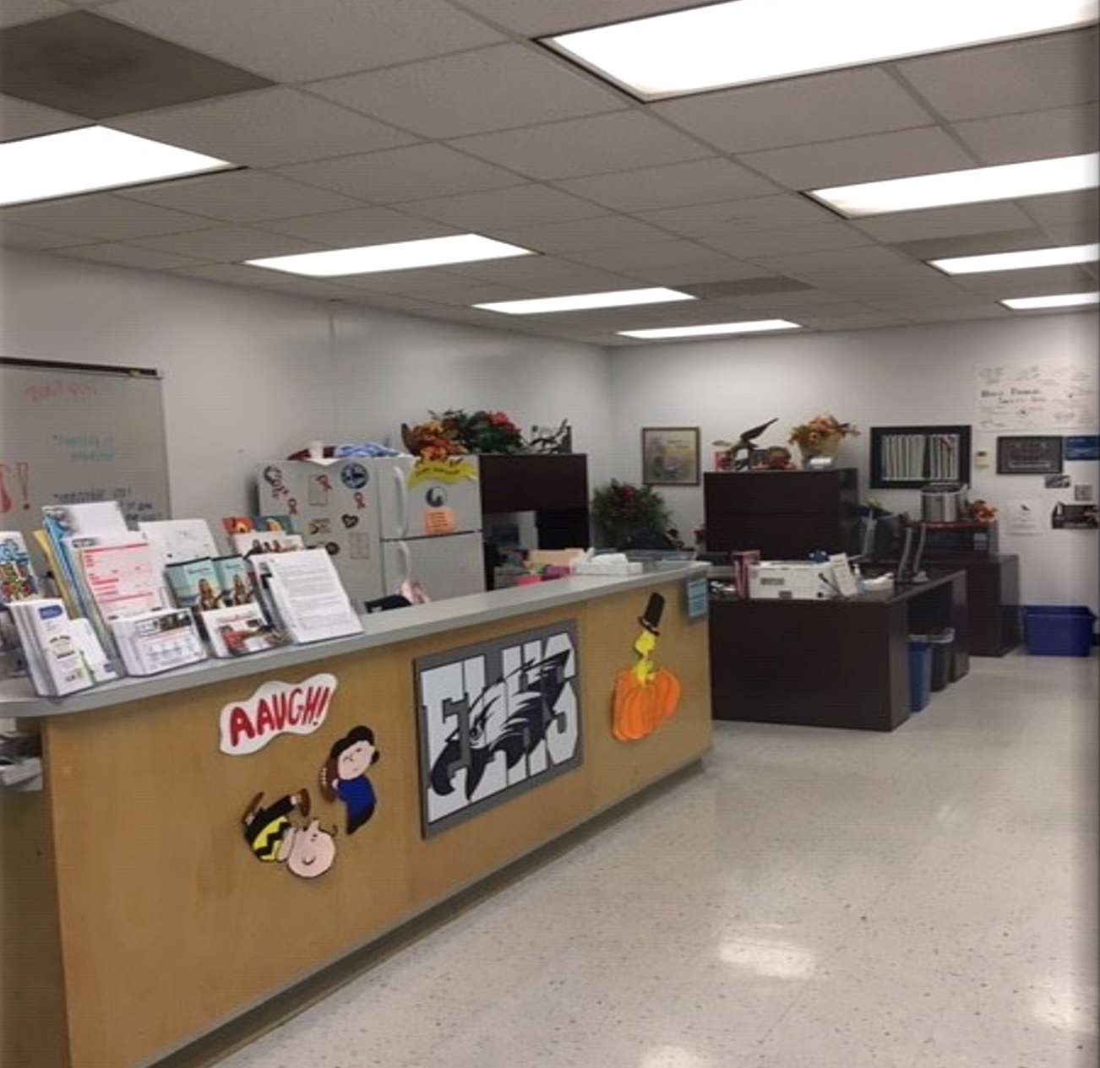
FRONT OFFICE & STUDENT SERVICES
YOU WILL COME HERE TO MEET WITH ADMINISTRATORS, COUNSELORS, THE SOCIAL WORKER, OR BOOKKEEPER. THIS IS ALSO WHERE STUDENTS SIGN-IN OR OUT OF SCHOOL.

Slide 25
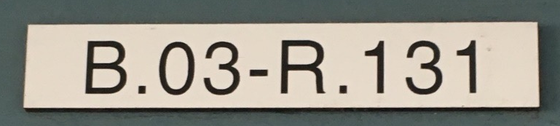
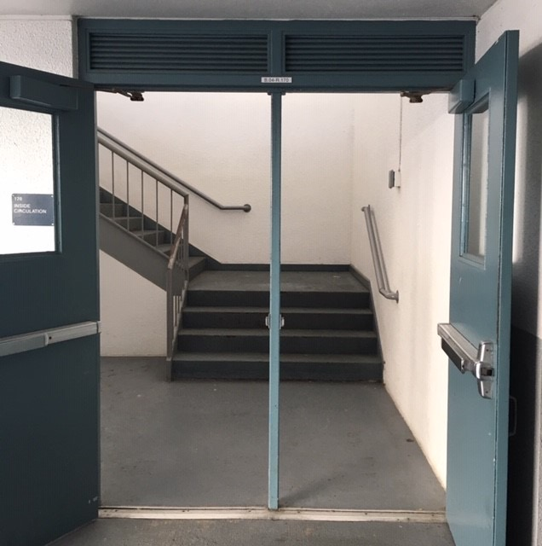
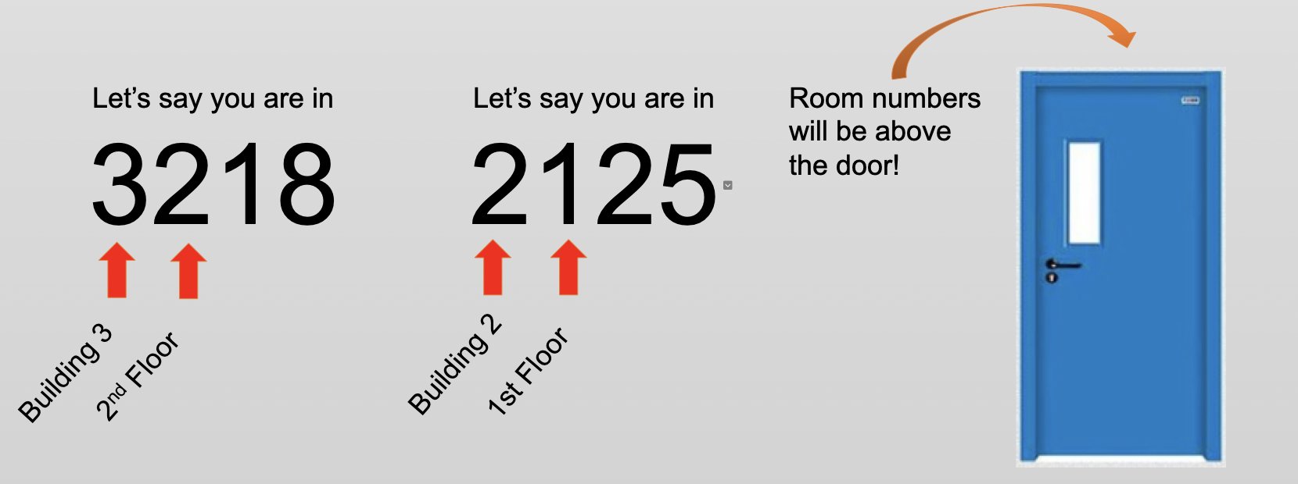
NAVIGATING CAMPUS
BUILDINGS AND ROOM NUMBERS
At the top of most double doors, you will see a small sign.
The B stands for Building and the number that follows tells you the building number. The sign in this image tells you that you are entering Building 3.

Slide 26
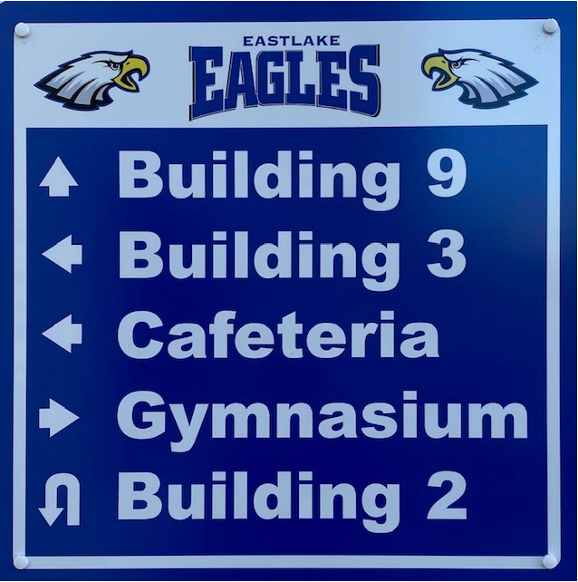
NAVIGATING CAMPUS
FINDING YOUR LOCATION
Signs are posted throughout campus to direct students and visitors to the various buildings.
Stairs are located along the outer edge of each building.

Slide 27
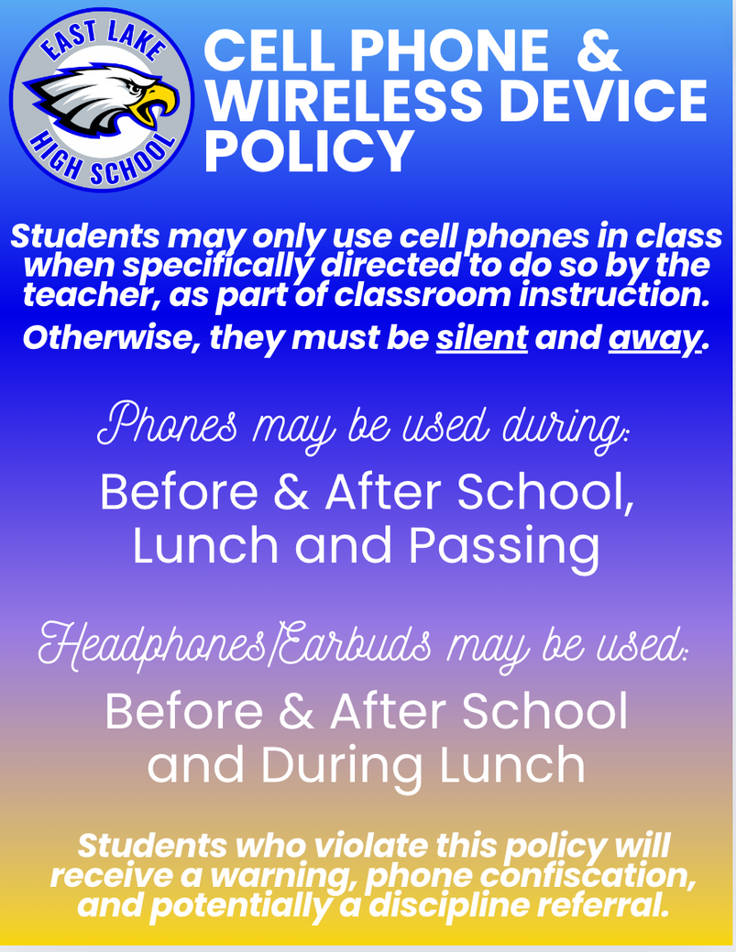
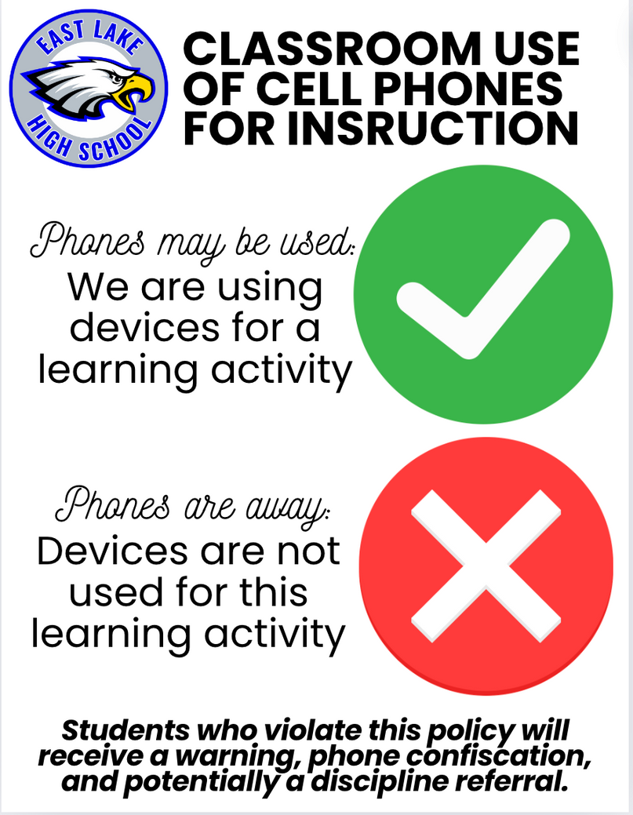
Electronic Devices/Phones

Slide 28
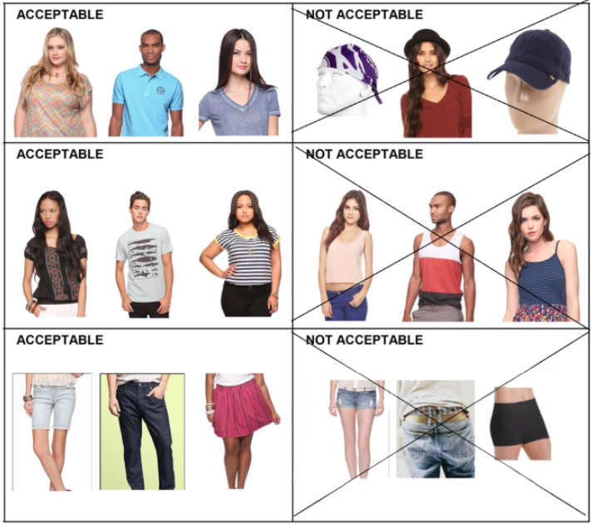
*See PCS Student Code of Conduct
DRESS CODE
HEAD COVERINGS & ACCESSORIES
No hats, visors, hoods, bandanas, or spiked jewelry
No inappropriate images, symbols, logos, or words.
UPPER GARMENTS
  All garments must cover shoulder to shoulder and must be long enough to overlap the beltline.
  No sheer tops, halter tops, tank tops, spaghetti straps, or muscle shirts.
LOWER GARMENTS
  Dresses, skirts, and shorts must reach at least mid-thigh in length.
  No rips/tears, sheer, or skintight items.
Pajama Pants
Pajama pants are acceptable

Slide 29
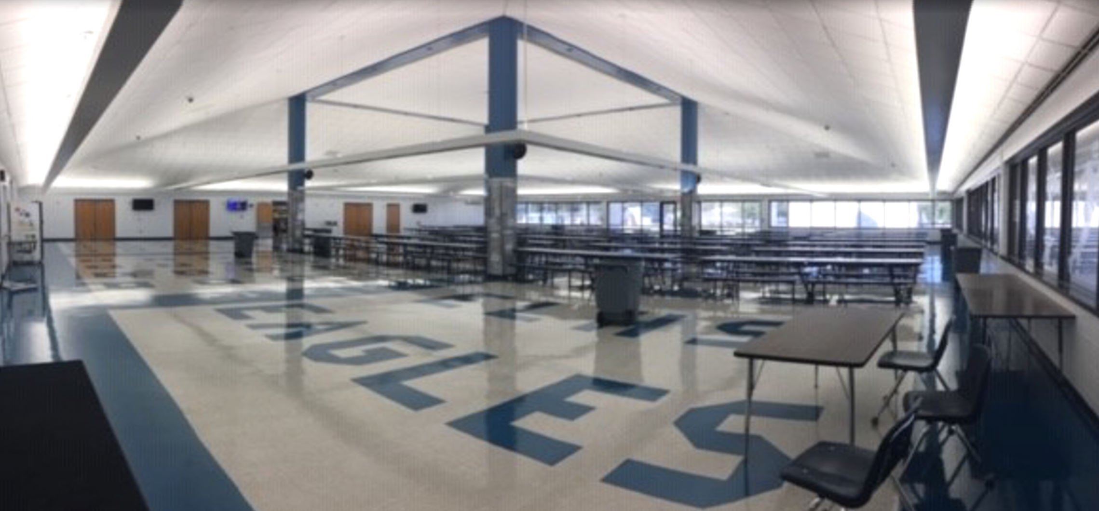
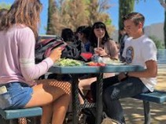

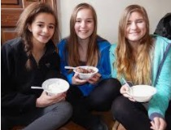
LUNCH AT EAST LAKE HIGH SCHOOL

Slide 30
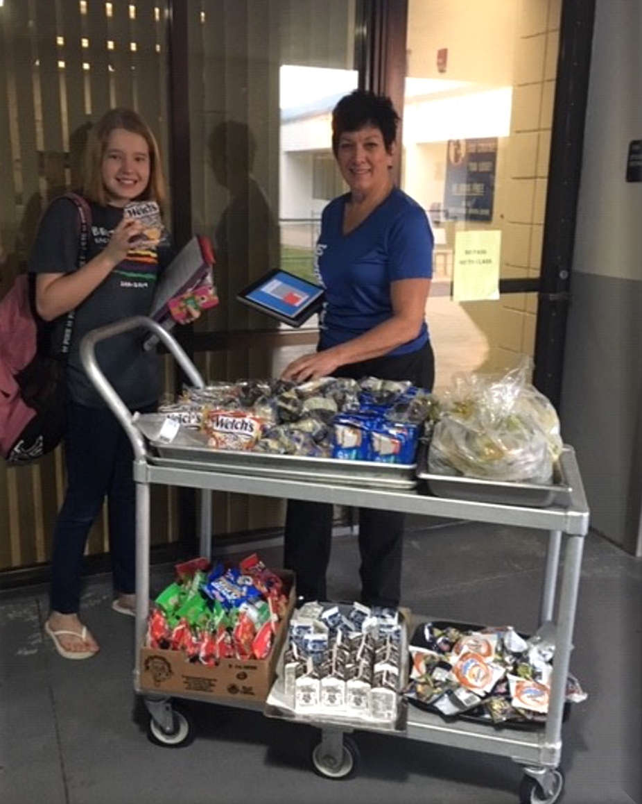
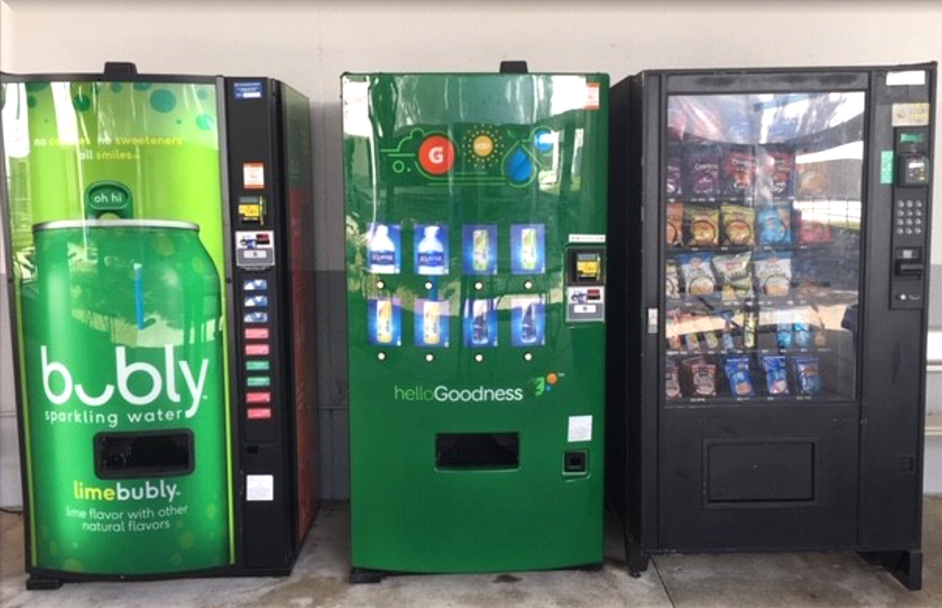
ADDITIONAL LUNCH OPTIONS
FOOD CARTS AND VENDING MACHINES ARE AVILABLE FOR FOOD PURCHASE

Slide 31

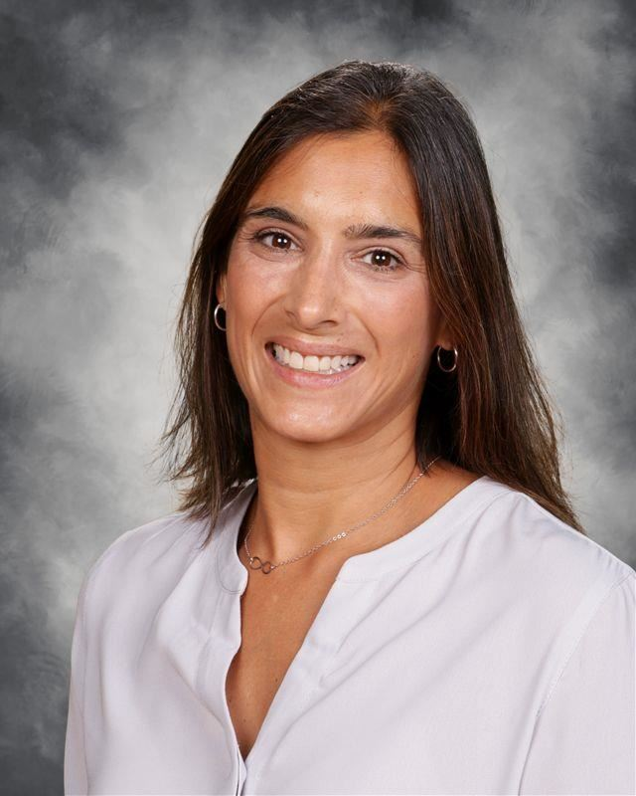
COLLEGE AND CAREER CENTER
The College and Career Center was established in the Spring of 2019 to support our school counselors and instructional leaders in helping students with their post secondary plans. The College and Career Center is the hub of information and support for students and families.​
Working in collaboration with school counselors, the College and Career Center team provides individualized and targeted assistance to navigate the college-going process.
MS. GALLATY
College and Career Center Coordinator

Slide 32
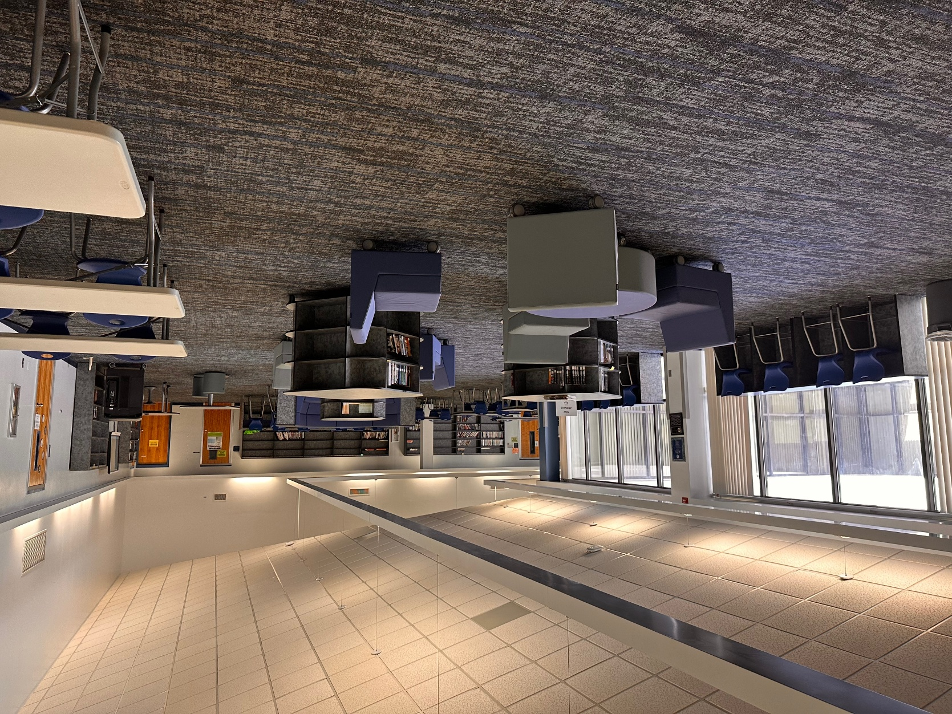
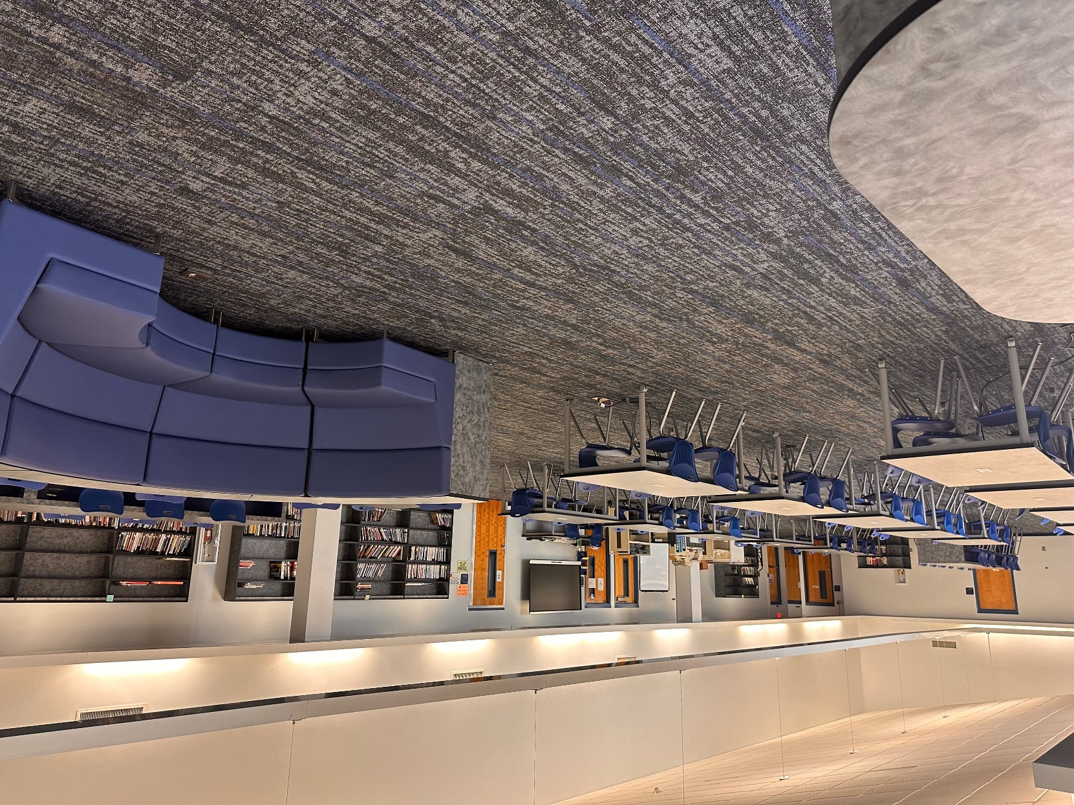

MEDIA CENTER
The Media Center is open during school hours. Students can study, use the computers, and conduct research.
MS. DELK
Media Specialist

Slide 33

EAGLE CORE VALUES
SUCCESS MINDSET
OWNERSHIP OF LEARNING
ATTITUDE: STAY POSITIVE
RESPECT FOR ALL

Slide 34

FOCUS PORTAL
Monitor assignments and grades
NAVIGATING THE ONLINE GRADEBOOK
View your classes, GPA, absences, and calendar
Email your teachers individually or as a group
View your schedule

Slide 35
Scheduling Changes
Follow the process from the call-out/email.
Also on the school website.
Steps to Request a Schedule Change:
Click the forms link from site or QR Code
Read the instructions carefully
Complete each question thoroughly
Submit the form by the deadline
  August 15th by 10pm

Slide 36

Staying on Track
  Make note of deadlines from day one
  Be Accountable: Don’t fall into bad habits Surround yourself with others who will keep you on the path to success
  Prioritize: Create a schedule and include time for studying and reviewing your notes
  Utilize FOCUS: Check your grades and missing assignments regularly
  Be Present: Missing school or individual classes adds up. Missed class = missed learning opportunities.
Notes:
What are some ways you guys know of being organized?
What does it mean to advocate for yourself?
How can you advocate if there is a course or activity you are not interested in?
7

Slide 37


Student Supports
  Teachers & Staff are here to support you!
  Advocate for your needs (IEP, 504, ELL)
  Reach out to others when necessary:
    Teachers & Coaches
    Counselor
    Administrator
    College & Career Center
    Social Worker
    School Psychiatrist
    School Resource Deputies
Notes:
What are some ways you guys know of being organized?
What does it mean to advocate for yourself?
How can you advocate if there is a course or activity you are not interested in?
7

Slide 38


Tips for Success
  Avoid Excessive Tardies
  Resist Negative Influences (Vaping)
  Handle Bullying Incidents Appropriately
  Follow School & District Policies / Rules
  Avoid the Urge to use Cell Phone 24/7
  Academic Integrity (Implications of AI)
  Respect Teachers, Peers, and Property
Notes:
What are some ways you guys know of being organized?
What does it mean to advocate for yourself?
How can you advocate if there is a course or activity you are not interested in?
7

Slide 39











CLUBS AND ORGANIZATIONS (50+ and growing)

Slide 40


Stay Connected!
Follow us on social media for updates, reminders, and to see what’s happening @ the Lake!
@my_eastlakehigh
“East Lake High”

Slide 41
LOCATIONS
IN THE 2023-2024 SCHOOL YEAR….
Sports Teams, Clubs, Organizations – Café
PTSA – Café
School Navigation – Student Volunteers, anyone in a Blue ELHS Polo
Counselors Corner – Auditorium
Focus help – Media Center
Administration – Auditorium, Main hall, Café, Main Office
Teachers – classroom or café (see sign on door)
Registration/Documentation – Main office

