Slide 1

Kingsbury Elementary
Annual Title I Parent Meeting
September 4, 2025
Dr. Ticada Currie, Interim Principal
Monica Ayers, PLC Coach
Jamille Hunter, Guidance
Brenda Nunez, Family Engagement

Slide 2
Today’s Topics
Notice of Title I School Status
Family Engagement Policies
Reporting Pupil Progress
Parent-Teacher Conferences
Parental Involvement Requirements
Availability of Parent Training
School Improvement Plan
Teacher Qualification
Parent’s Right to Know
School / Parent Compact
Student Code of Conduct (MSCS Student Parent Handbook and KES Core Values)

Slide 3
Did you know?
Kingsbury ES is a federally funded school-wide Title I school. The purpose of the Title I, Part A program is to provide federal dollars to supplement educational opportunities for students who attend schools with high numbers or percentages of children from low income families and are most at risk of failing to meet the state’s challenging academic achievement standards. Title I, Part A funds are to be used to provide all students significant opportunity to receive a fair, equitable, and high-quality education, and to close educational achievement gaps.

Slide 4
Family Engagement Plan and Parental Involvement Requirements
Shelby County Schools Policy #5010
Kingsbury Elementary Family Engagement Plan (Developed jointly with parents Spring, 2025)
Purpose
To partner with families in an effort to provide Kingsbury students with a home/school/community environment that helps children achieve academic excellence.

Slide 5
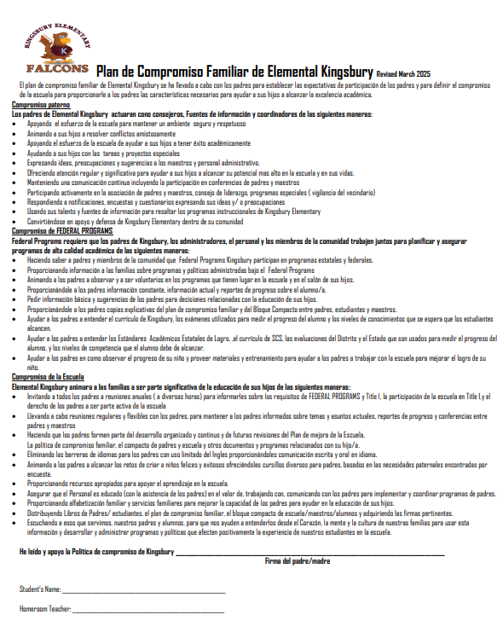
Kingsbury Elementary Family Engagement Plan

Slide 6
Reporting Pupil Progress
Daily Agenda
Thursday Folders
Progress Reports
Report Cards

Slide 7
Parent Teacher Conferences
September 11, 2025 (4:00 p.m. to 7:00p.m.)
January 29, 2026 (4:00 p.m. to 7:00p.m.)
One Wednesday Meetings
As requested by parent or teacher.

Slide 8
Ways for Parents to Get Involved
Ready Readers – One Hour a Week
Volunteer to help your child’s teacher.
Families Connect
Wednesday Monthly Parent Meetings

Slide 9
Availability of Parent Training
Family Resource Center
Phone: 416-5300
160 South Hollywood Street Room 164
SCSface@scsk12.org
Scsk12.org/face25/
Provides:
Bilingual assistance available
Family Forums
Family Resource Centers
Families Connects
Parent Organizations
Team Reads

Slide 10
School Improvement Plan
Analysis of data from State Assessments, School climate surveys, etc.
Development of an action plan in order to address and meet the needs of our students, parents, and teachers
Creation of a Professional Development Plan for teachers and parents
Plan will be submitted in August 2025

Slide 11
Annual Yearly Progress
Kingsbury Elementary remains in good status with the State of Tennessee with a composite growth score of 5 for the 2025 school year.

Slide 12
Teacher Qualifications
Parents Right to Know
All parents have the right to request the following:
A teacher’s professional qualifications, which includes: state qualifications, licensure, grade/s certification, waivers
A teacher’s baccalaureate and /or graduate degree, fields of endorsement, previous teaching experience
A paraprofessional’s qualifications
An assurance that their child’s name, address, and telephone listing not be released to military recruiters

Slide 13
Parents Rights
All parents will receive information on the following:
Their child’s level of achievement in each of the state academic assessments
Their option to request a transfer to another school within the district if their child is the victim of a violent crime at school
Their right to timely notification that their child has been assigned, or has been taught for four or more consecutive weeks by, a teacher who is not highly qualified

Slide 14
School/Parent Compact
Jointly developed with parents to promote positive and productive working relationships
Parent, Student, Teacher, School agreement
Posted on the school website and Facebook Page within the first 3 weeks of school.

Slide 15
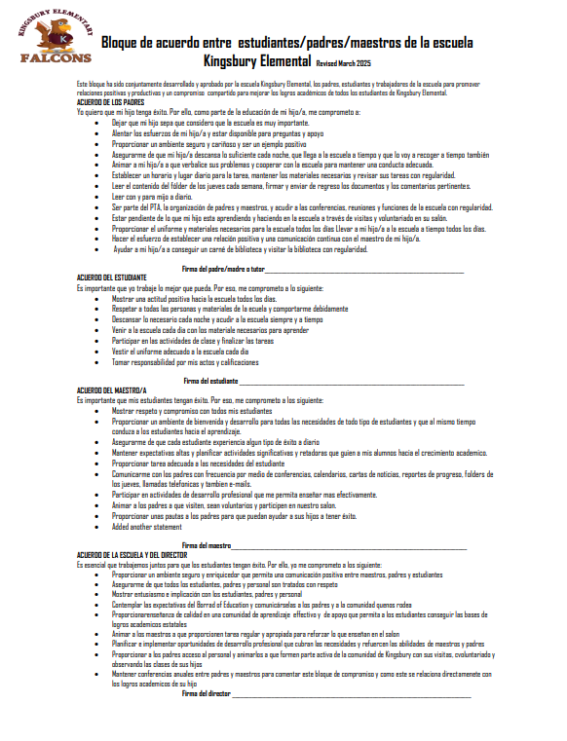
Kingsbury Elementary School/Parent Compact

Slide 16

MSCS Student Parent Handbook
https://www.scsk12.org/eda/?PN=353
Student Conduct (Policy 6022).......page 23

Slide 17
Kingsbury Elementary Core Values
I am a Kingsbury Falcon.
I am a faithful friend.
I aspire to do great things.
I am a life-long learner.
I am committed to work hard.
I am optimistic about my future.
I am neighborly and
I have self-control.

