Slide 1

Ms. Terri Buonomo - Room 223
Reading
Mr. Zachary Clark - Room 222
Math
Ms. Lixie Gomez - Room 228
Writing/Science/Social Studies

Slide 2

Please remember to sign in on the sign in sheet located in the hallway!

Slide 3
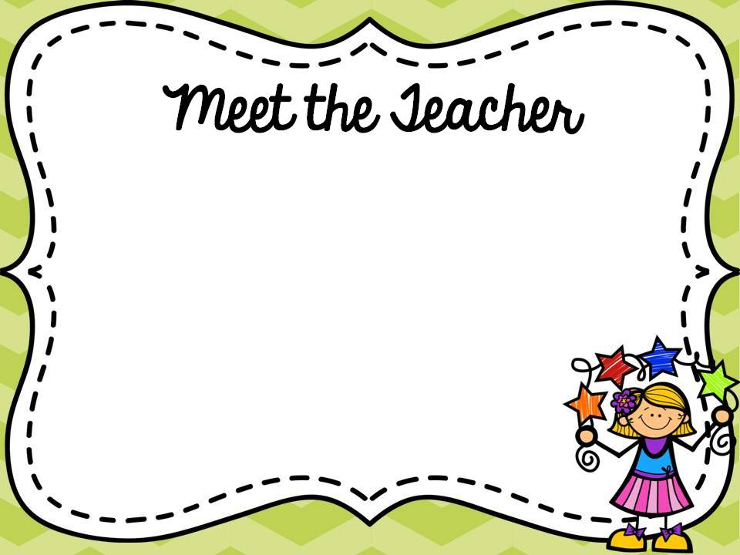
Terri Buonomo
Subject Taught: Reading
Bachelor of Arts in Communication Arts from Fairfield University and Master of Arts in Education from
Sacred Heart University.
8th year teaching in Perth Amboy; 24 years
total

Slide 4

email- terebuonomo@paps.net
My personal- 732-659-0802
School’s Number- (732) 376-6050
Website: https://sites.google.com/paps.net/msbuonomo-2020-2021/home

Slide 5
Mr. Zachary Clark
Subject Taught: Math
B.S. DEGREE ECONOMICS / KEAN UNIVERSITY
SECOND YEAR TEACHING IN PERTH AMBOY
MATH/ECONOMICS TUTOR FOR 5 YEARS

Slide 6
Mr. Clark
email: zachclark@paps.net
School’s Number: (732) 376-6050
Personal: (732) 850-1934

Slide 7
Ms. Gomez
Subjects: Writing, Science, SS
Bachelor of Science in Network and Communications Management and Masters in Curriculum and Instruction with a focus on Technology
21 years teaching in Perth Amboy (Kinder - Adults)

Slide 8
Ms. Gomez
email: lixigomez@paps.net
Google Voice: (732) 588-8027
Remind Code: @dha7dg

Slide 9

Daily blocks (90 minutes) of both Math and Language Arts
45 minutes of Writing Daily
Science and Social Studies alternate on A and B weeks
Special schedules by Homeroom
Lunch/Recess daily

Slide 10
Specials (Ms. Buonomo):
Monday - Gym
Tuesday - Music
Wednesday - Gym
Thursday - Health and Technology/Media
Friday - Art

Slide 11
Specials (Mr. Clark):
Monday - Gym
Tuesday - Music
Wednesday - Health
Thursday - Gym and Technology/Media
Friday - Art

Slide 12
Specials (Ms. Gomez):
Monday - Health
Tuesday - Music
- Technology/Media
Wednesday - Gym
Thursday - Art
Friday - Gym

Slide 13

Please make all efforts to have your child in class on a regular basis. Students must:
Arrive to homeroom before 8:45 a.m.
Have their uniform on
Be prepared with charged chromebooks and pencils
Be active participants
Complete all assignments and homework

Slide 14
If your child is not feeling well, please keep them home.
Call the main office to inform your child will be absent.
If your child attends a doctors/dentist appointment, please have them bring in a copy of the doctor's’ note when returning. This will be sent to the nurse’s office.

Slide 15

Homework is given every night in Reading except on test days and Fridays. Students will be given time in class to start working on it.
Students are also responsible for:
Unfinished classwork
Reading notebook responses
Studying for tests/quizzes

Slide 16
Homework will be assigned in the APPLY book for math, which the students brought home last week.
Students are responsible for 3 iReady lessons per week. There will be time in class throughout the week and can
be completed at home.
Students are also responsible for unfinished classwork

Slide 17
Homework will be given twice a week for writing, mostly grammar and editing. No homework will be given for Science and Social Studies.

Slide 18

Marking Period One
ELA:
Reading Workshop: Fiction
Students will be selecting their own novels and writing responses to their reading.
Focus on characters, setting, plot, summarizing, and predicting.

Slide 19
Marking Period Two
ELA:
Reading Workshop: Non-Fiction
Students will be selecting their own non-fiction books and writing responses to their reading.
Focus on informational text, text features, text structure, and analyzing facts/opinions.

Slide 20
Marking Period Three
ELA:
Reading Workshop: Book Clubs
Students will be working in book clubs to analyze fiction.
Focus is on interpreting author’s purpose and meaning.

Slide 21
Marking Period Four
ELA:
Reading Workshop: Test Prep
Fantasy Book Clubs/Writing Graphic Novels

Slide 22
WRITING: Writing Workshop
Marking Period 1
Narrative Craft
Marking Period 2
Research Report
Literary Essay
Marking Period 3
Research-Based Argument Essay
Marking Period 4
Writing Graphic Novels

Slide 23
SOCIAL STUDIES
Marking Period 1
Geography: People and Environment
Early People of New Jersey: Perth Amboy
Marking Period 2
History of Perth Amboy
Civics, Government, Diversity
Marking Period 3
Amistad: The trans-Atlantic Slave Trade, Civil Rights Movement, Jim Crow Laws
Marking Period 4
Economics
Holocaust

Slide 24
SCIENCE
Marking Period 1
Patterns of Earth and Sky: Earth and Stars in Space, Size and Distance of Stars, Effect of Earth’s Spin
Marking Period 2
Modeling Matter: Composition of Matter, Models of Matter, Solubility
Marking Period 3
The Earth System: Water Shortages and Solutions, Process of Water Cycle, The Movement of Water

Slide 25
Math:
Module 1: Place value concepts
Module 2: Adding and subtracting fractions
Module 3: Multiplying and dividing fractions
Module 4: operations with decimals
Module 5: Area and volume
Module 6: Geometry

Slide 26
SCIENCE (continued)
Marking Period 4
Ecosystem Restoration: Introduction to Ecosystems, Role of Food in the Ecosystem, Energy in Ecosystems

Slide 27

No School- Monday, October 9 th-
Columbus Day
Parent Teacher Conferences- Wednesday,
October 25th & Thursday, October 26th
Fall break- Monday, November 6th -
Friday, November 10th
End of 1st Marking Period- November 16th

Slide 28
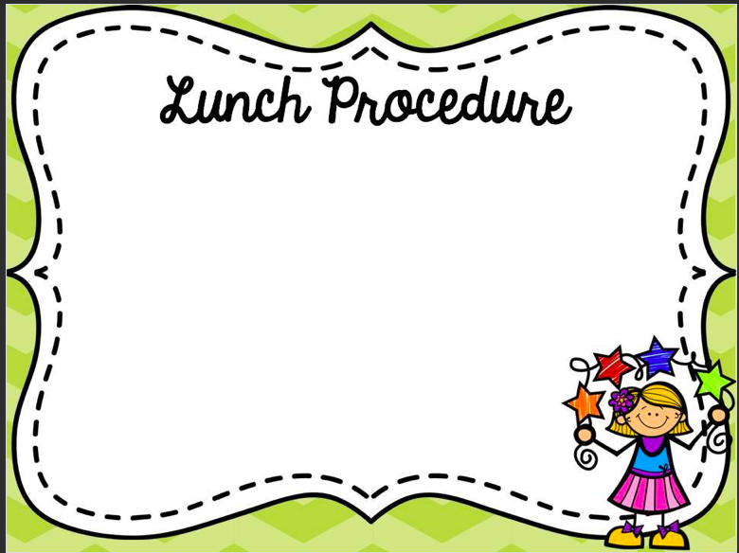
We are an allergy classroom! Please do not send in nuts or dairy products
Students may bring their own lunch or receive school lunch
Split period of lunch and recess
Assigned seating in the lunchroom

Slide 29

Please proceed to your child’s/children’s classes to get important information about the subjects they teach your child/children as well as his/her expectations.
Have a wonderful evening, and thank you again for all that you do!

