Slide 1
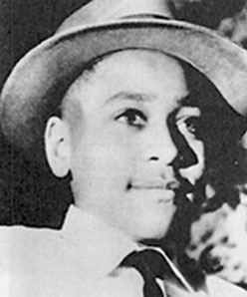
Emmett Till Reflection Paper
After watching the film on the Emmett Till , please respond to the following in a one page reflection paper (3-4 paragraphs)
What were the details or facts of Emmett’s murder? What was the outcome of the trial?
What was your reaction after watching this film?
How do you believe Emmett Till’s murder influenced the Civil Rights Movement?

