Slide 1



Notes:
Fonts/Size:
Titles: Oswald - 28
Body: Oswald - 20

Slide 2
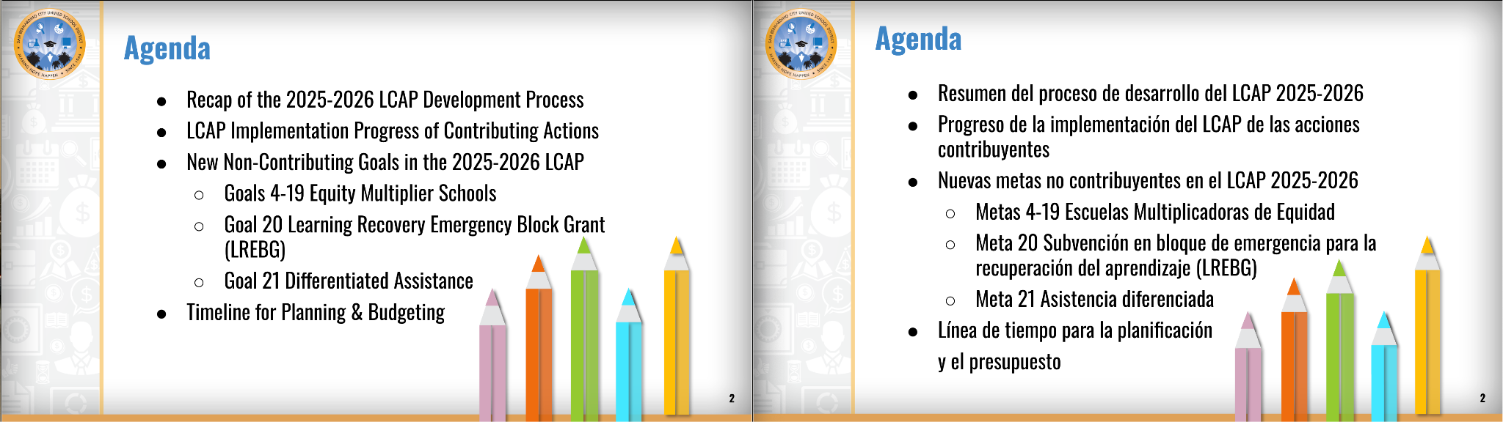
Notes:
Fonts/Size:
Titles: Oswald - 28
Body: Oswald - 20

Slide 3
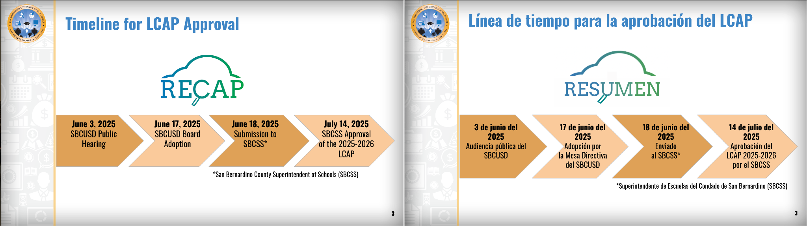
Notes:
Fonts/Size:
Titles: Oswald - 28
Body: Oswald - 20

Slide 4

Notes:
Fonts/Size:
Titles: Oswald - 28
Body: Oswald - 20

Slide 5
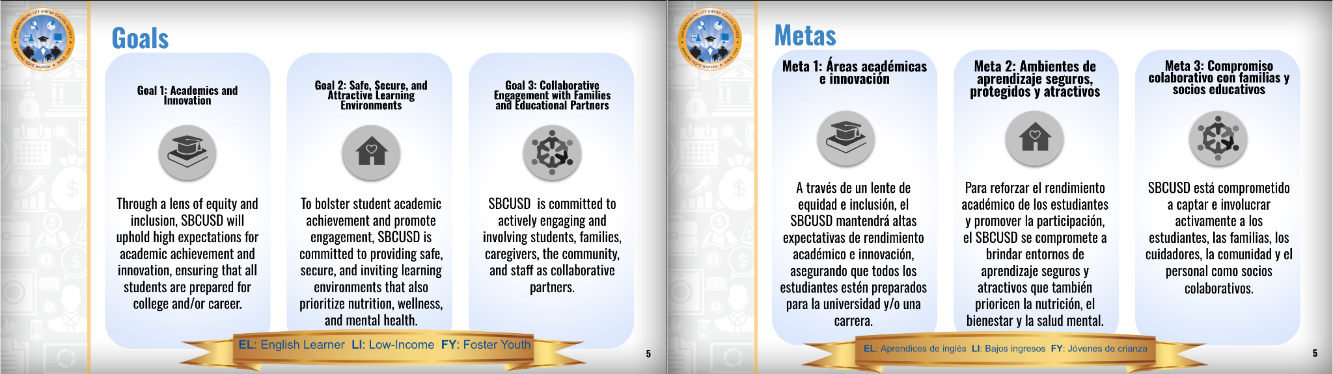

Notes:
Fonts/Size:
Titles: Oswald - 28
Body: Oswald - 20

Slide 6
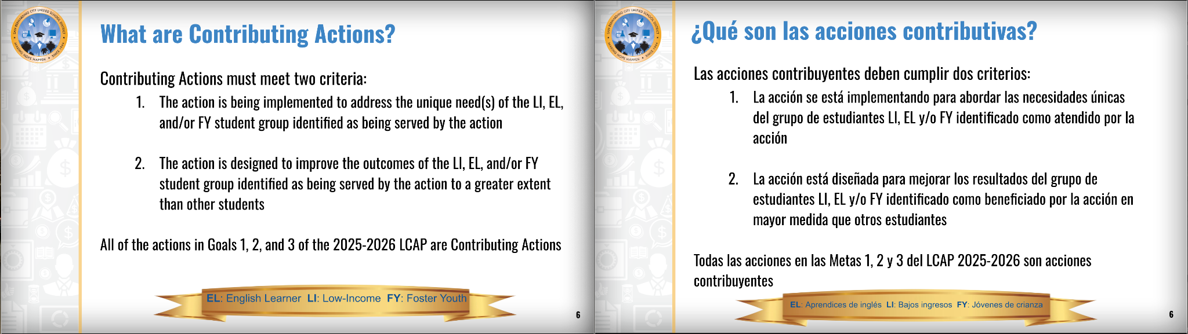
Notes:
Fonts/Size:
Titles: Oswald - 28
Body: Oswald - 20

Slide 7
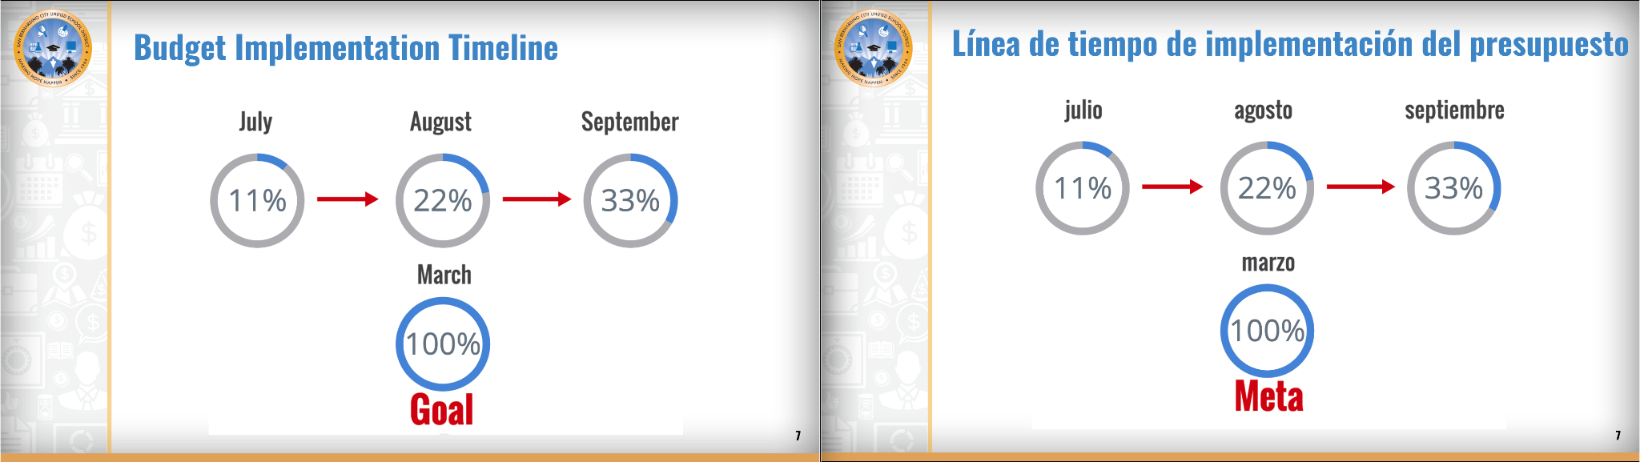
Notes:
Fonts/Size:
Titles: Oswald - 28
Body: Oswald - 20

Slide 8
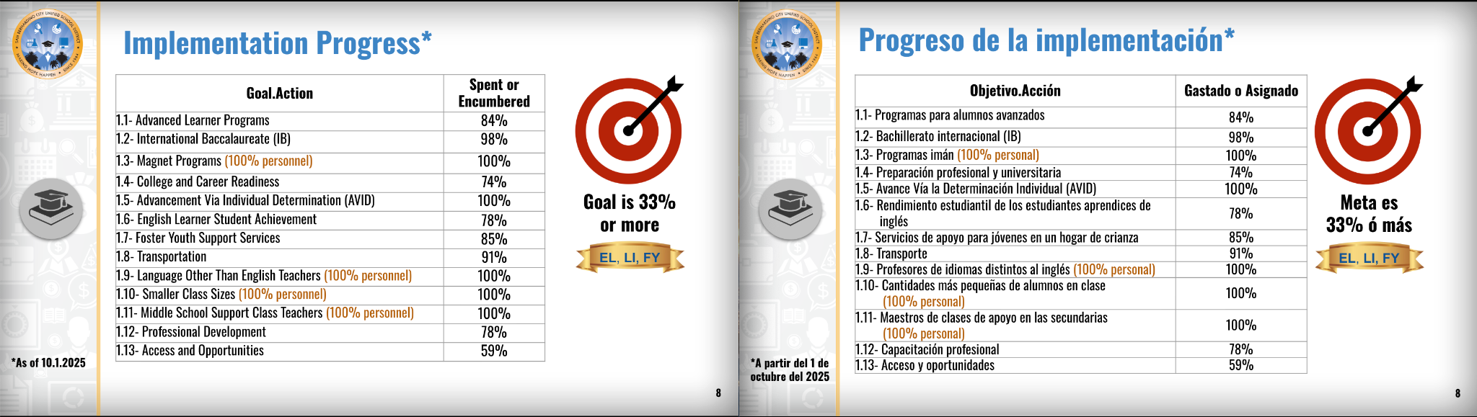
Notes:
Fonts/Size:
Titles: Oswald - 28
Body: Oswald - 20

Slide 9
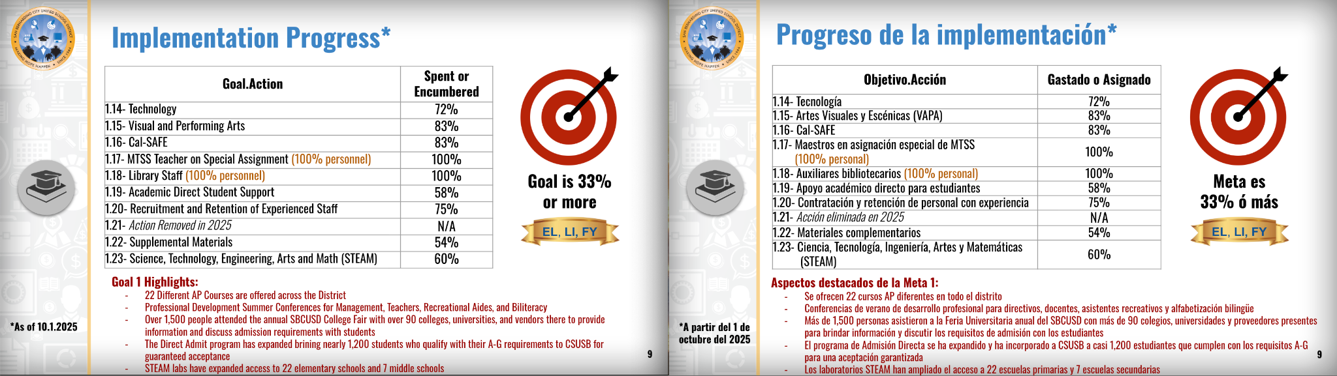
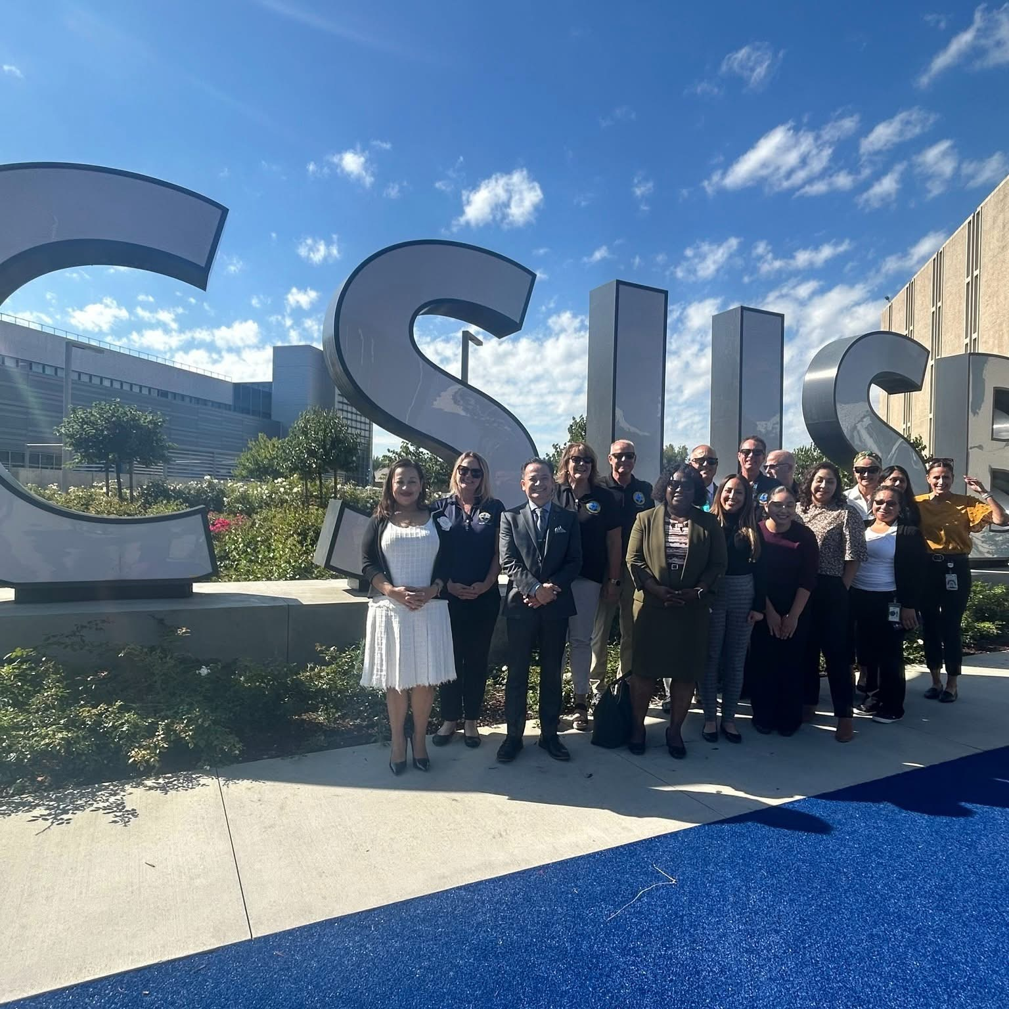
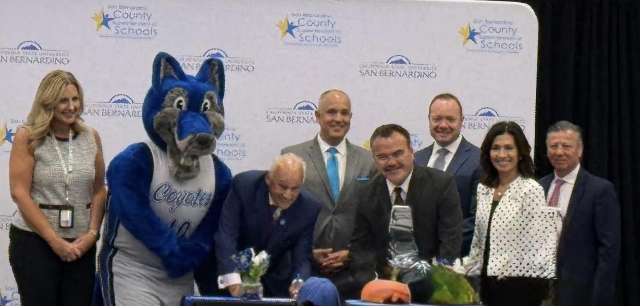
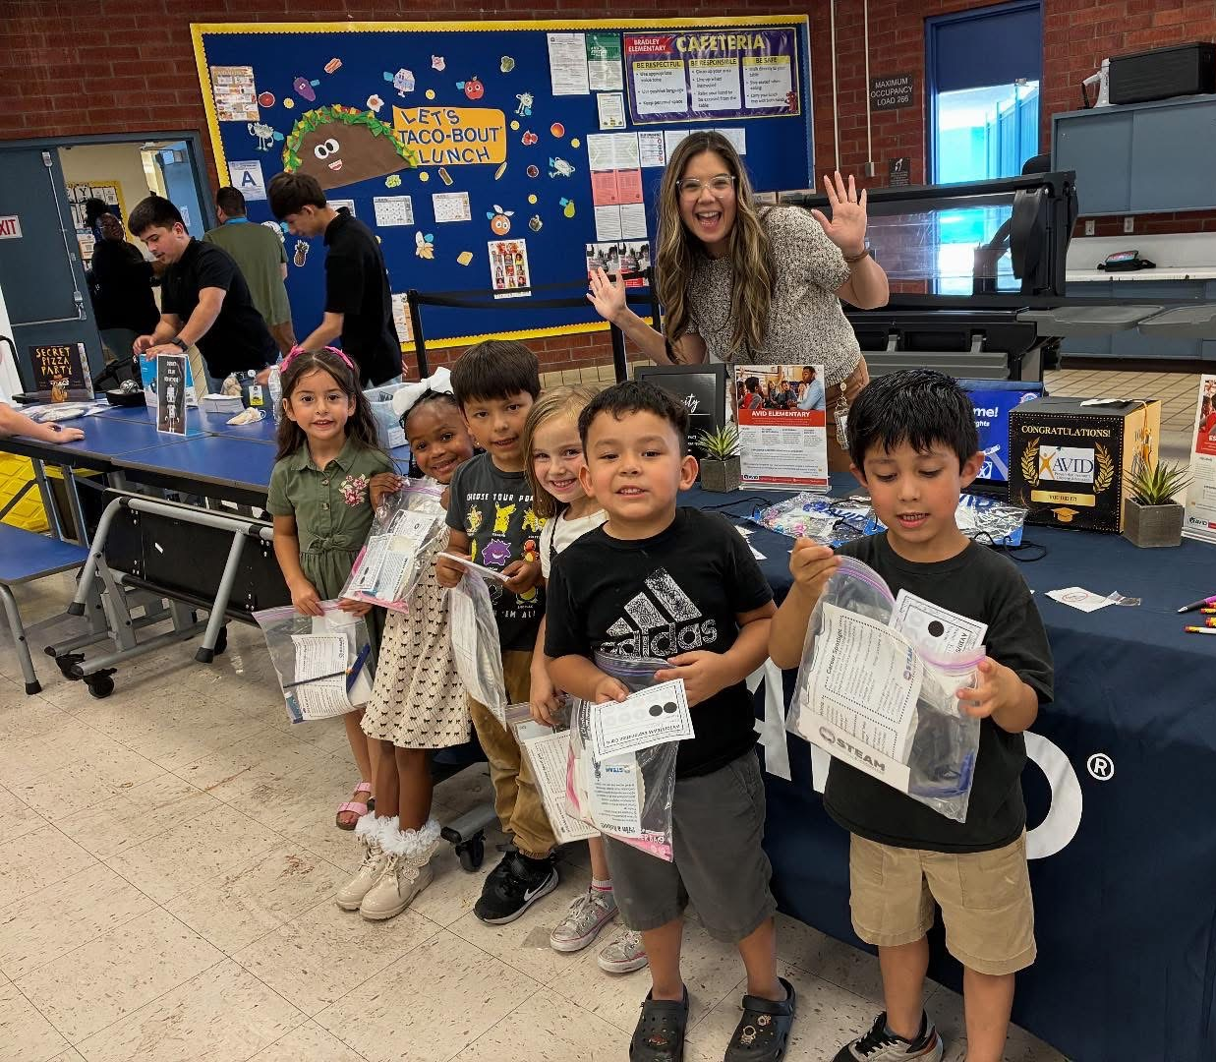
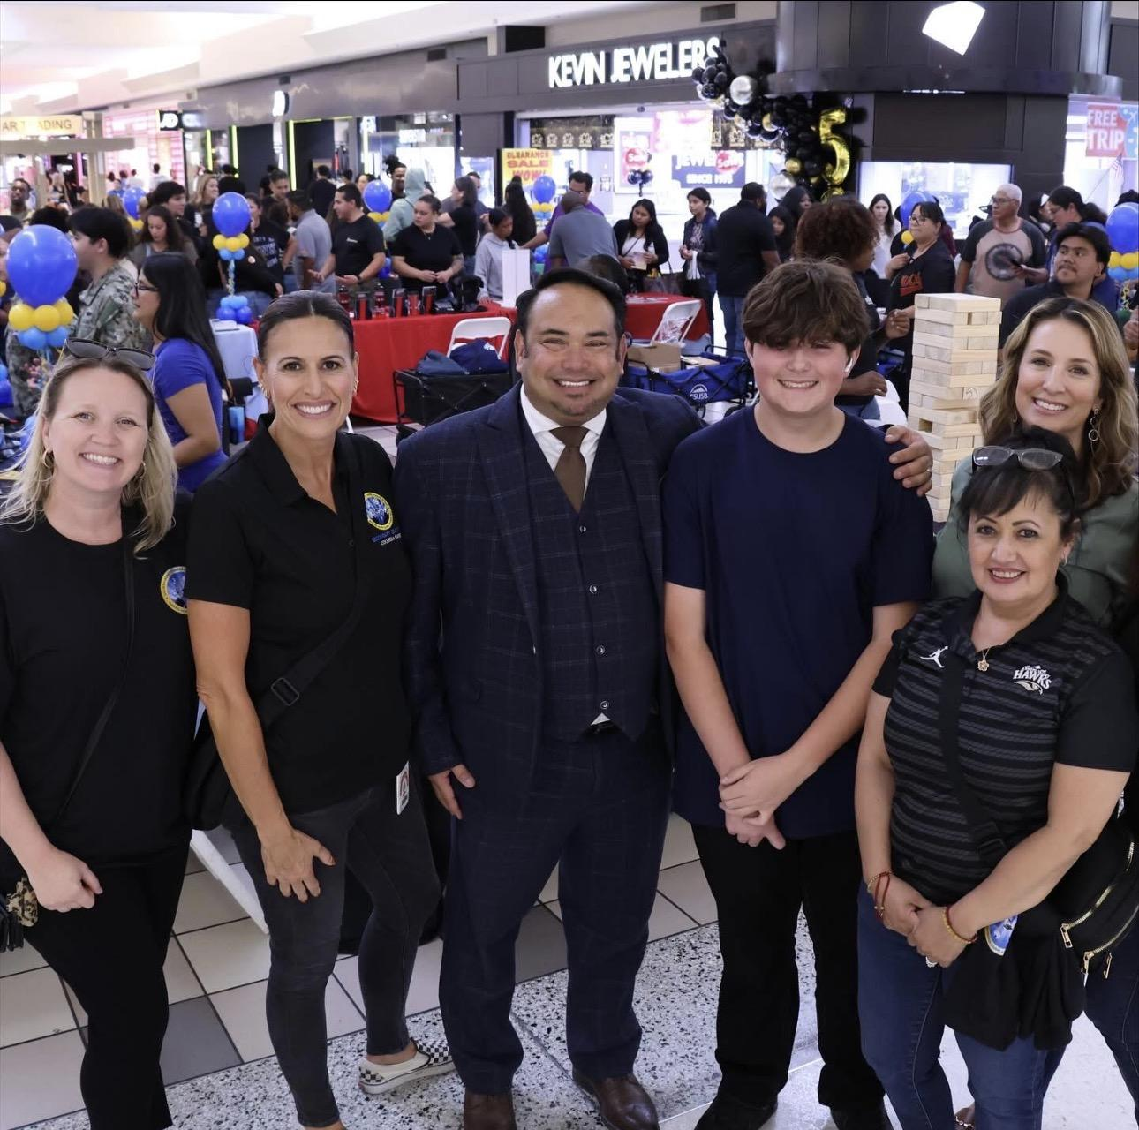
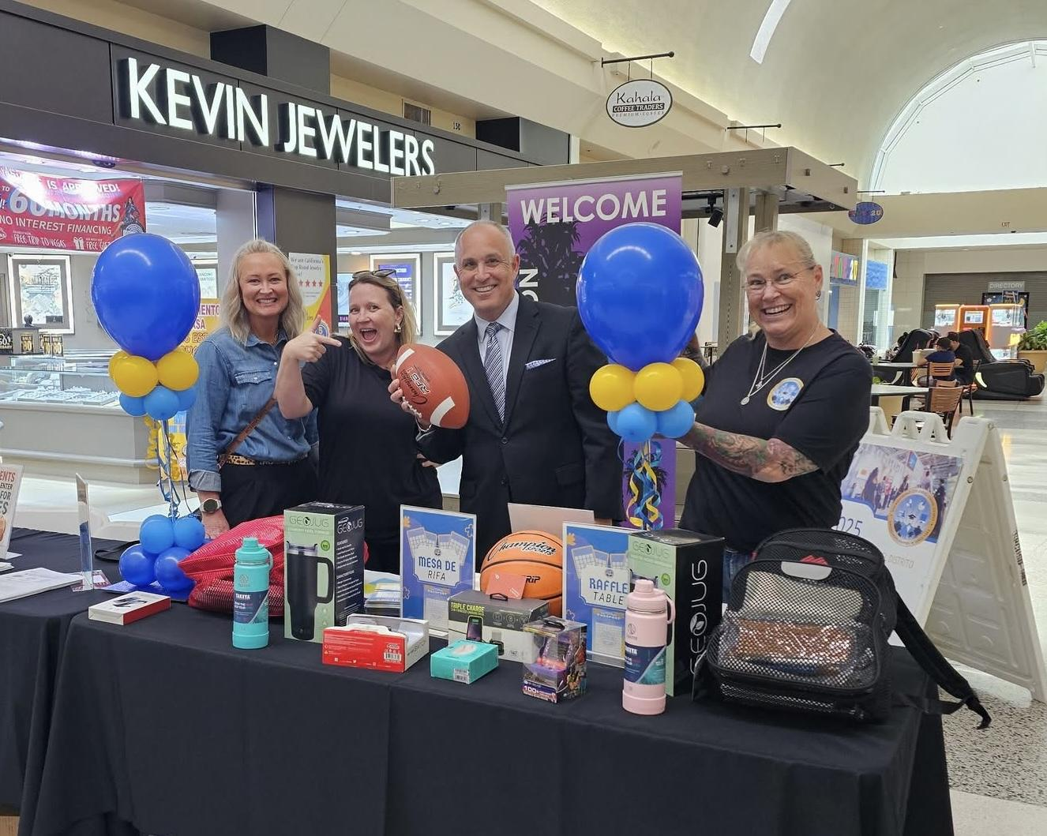
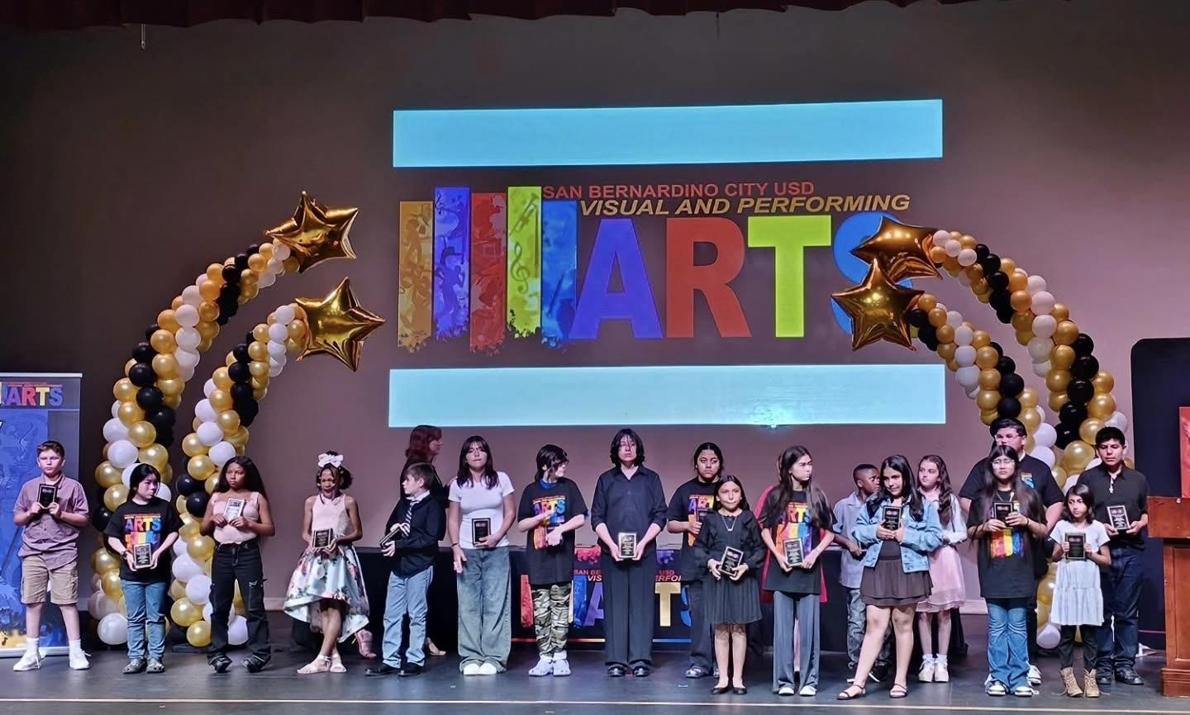
Notes:
Fonts/Size:
Titles: Oswald - 28
Body: Oswald - 20

Slide 10
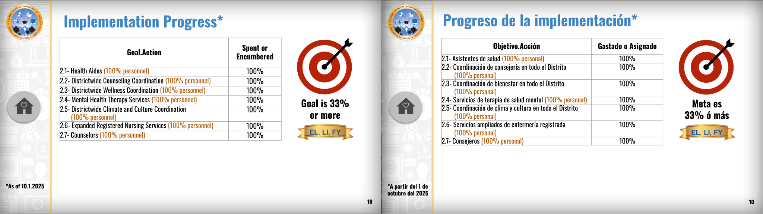
Notes:
Fonts/Size:
Titles: Oswald - 28
Body: Oswald - 20

Slide 11
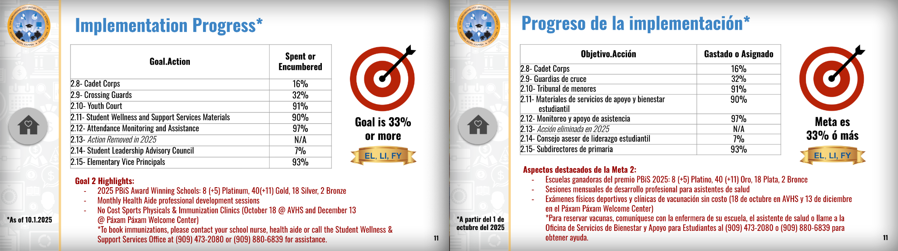
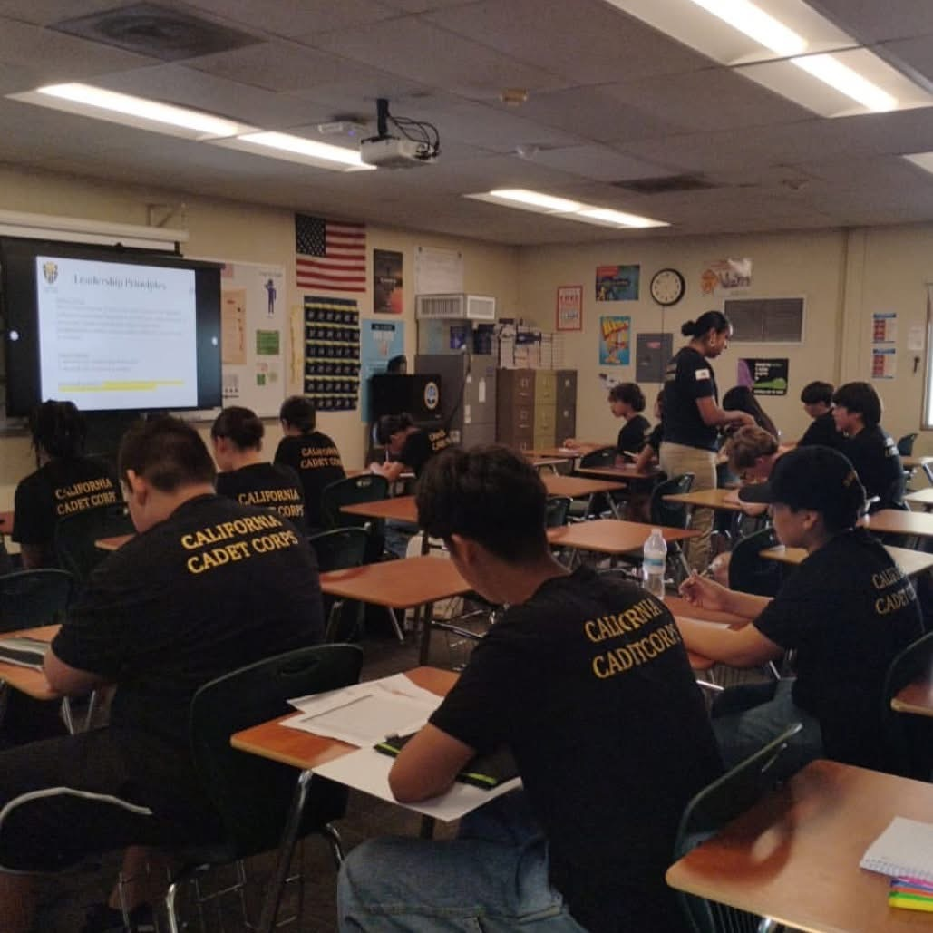
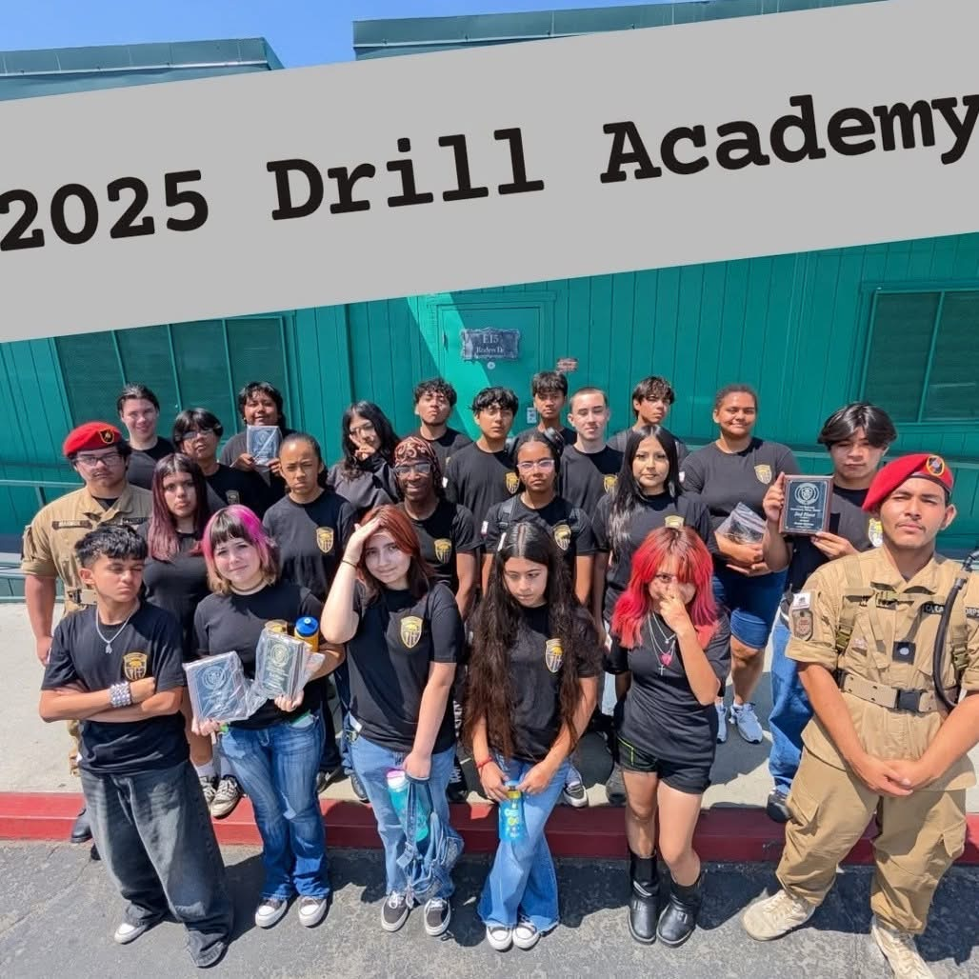
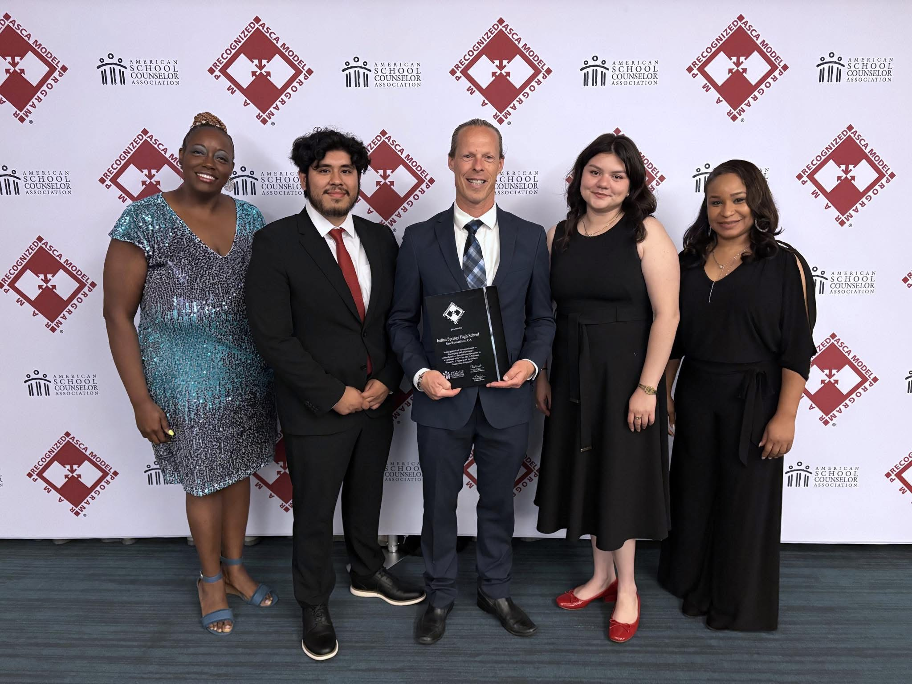
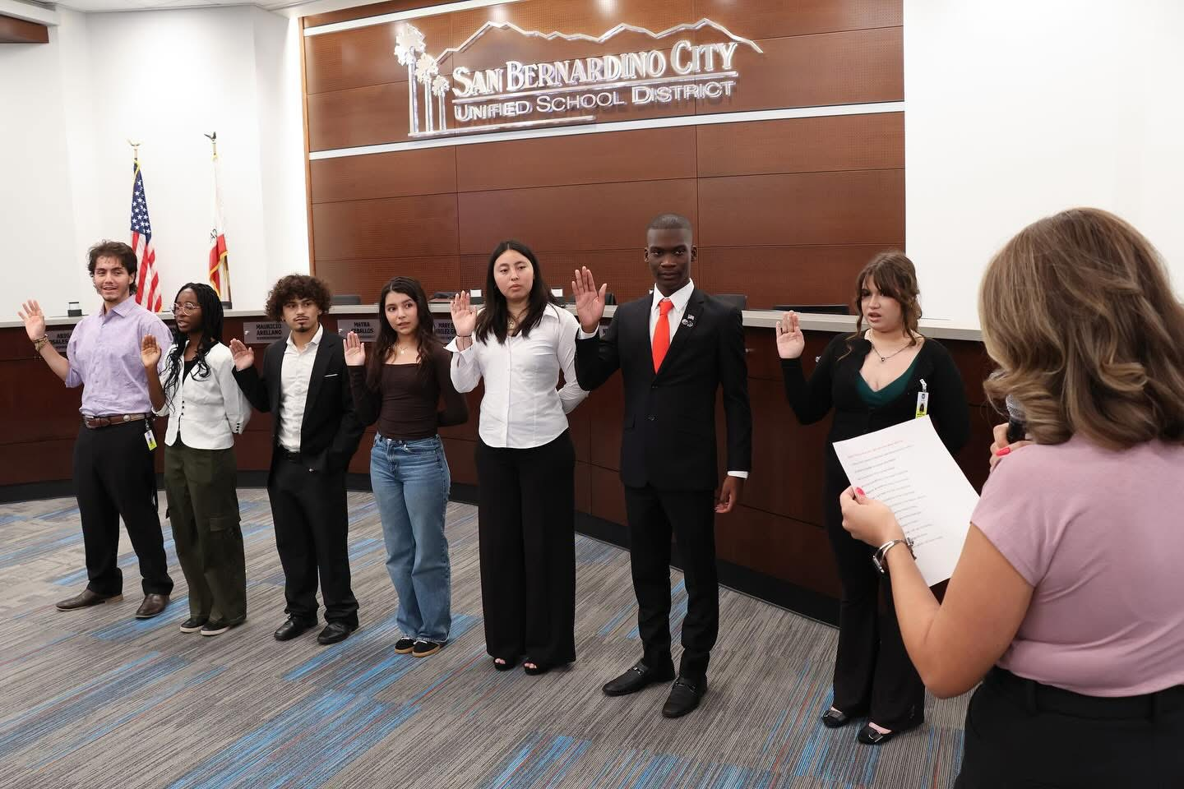
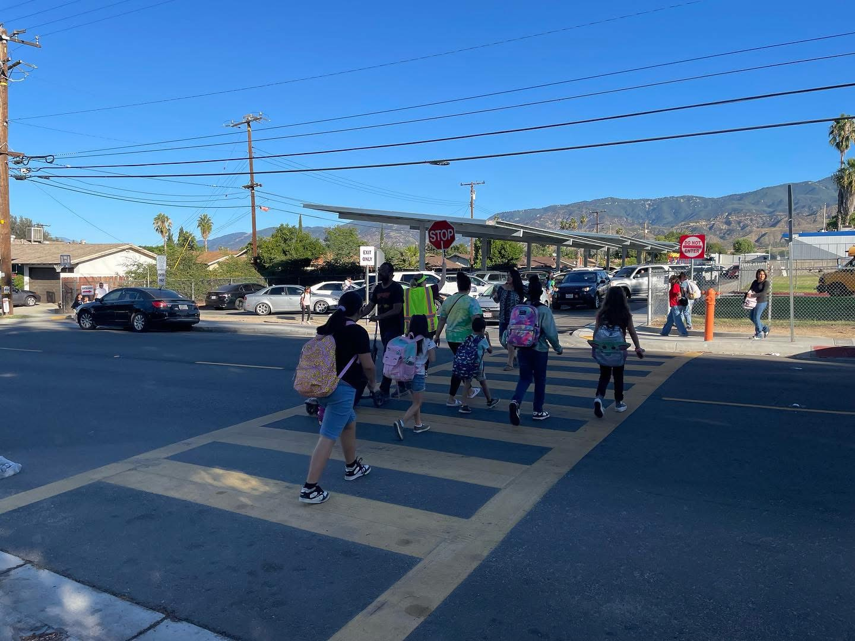
Notes:
Fonts/Size:
Titles: Oswald - 28
Body: Oswald - 20

Slide 12
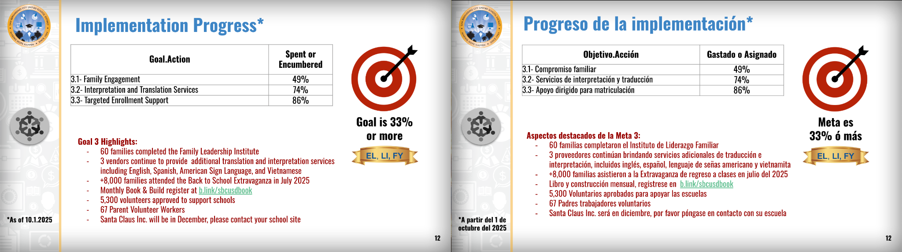
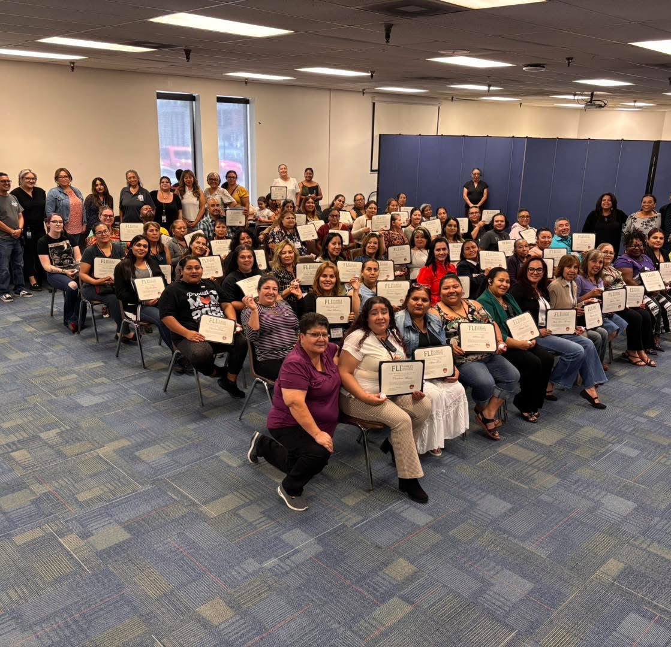
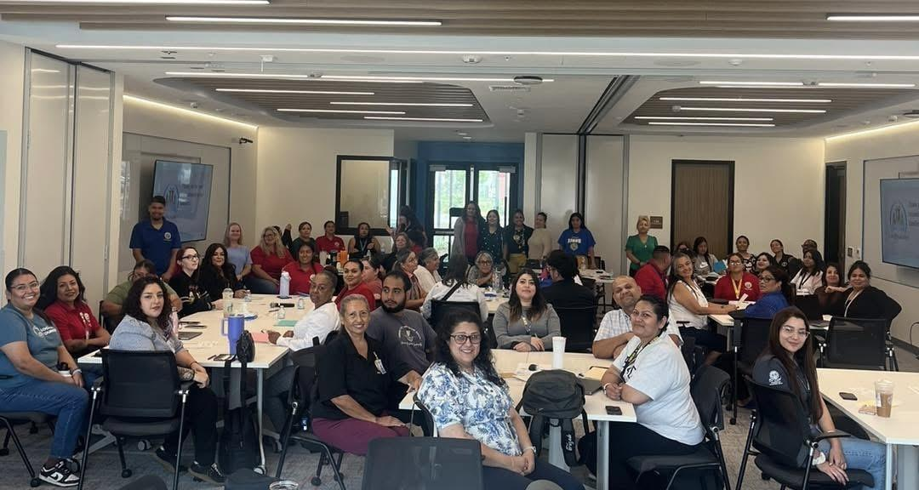
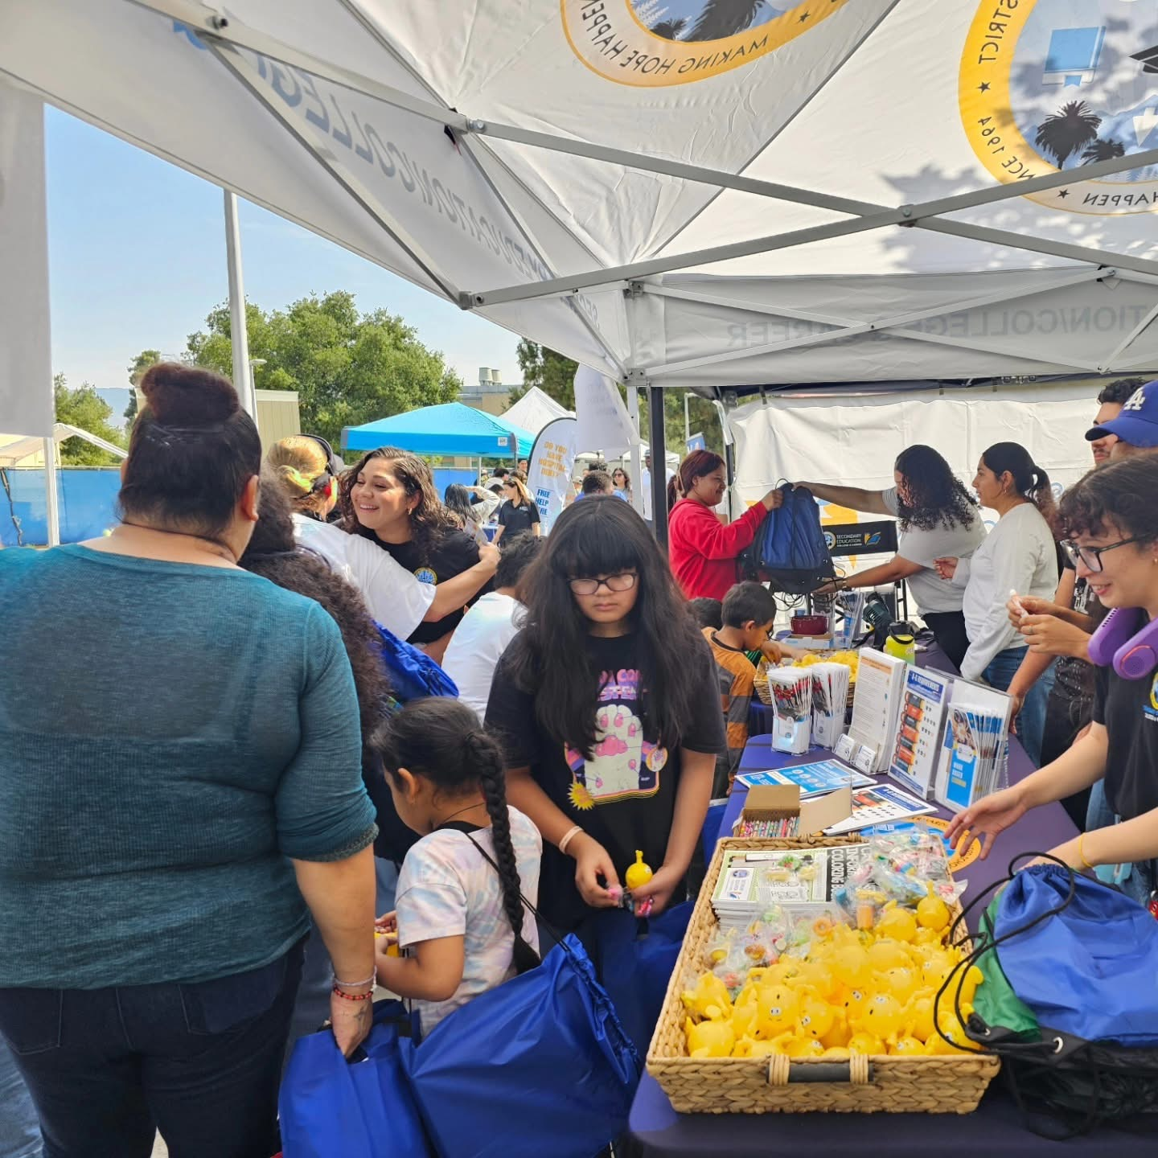
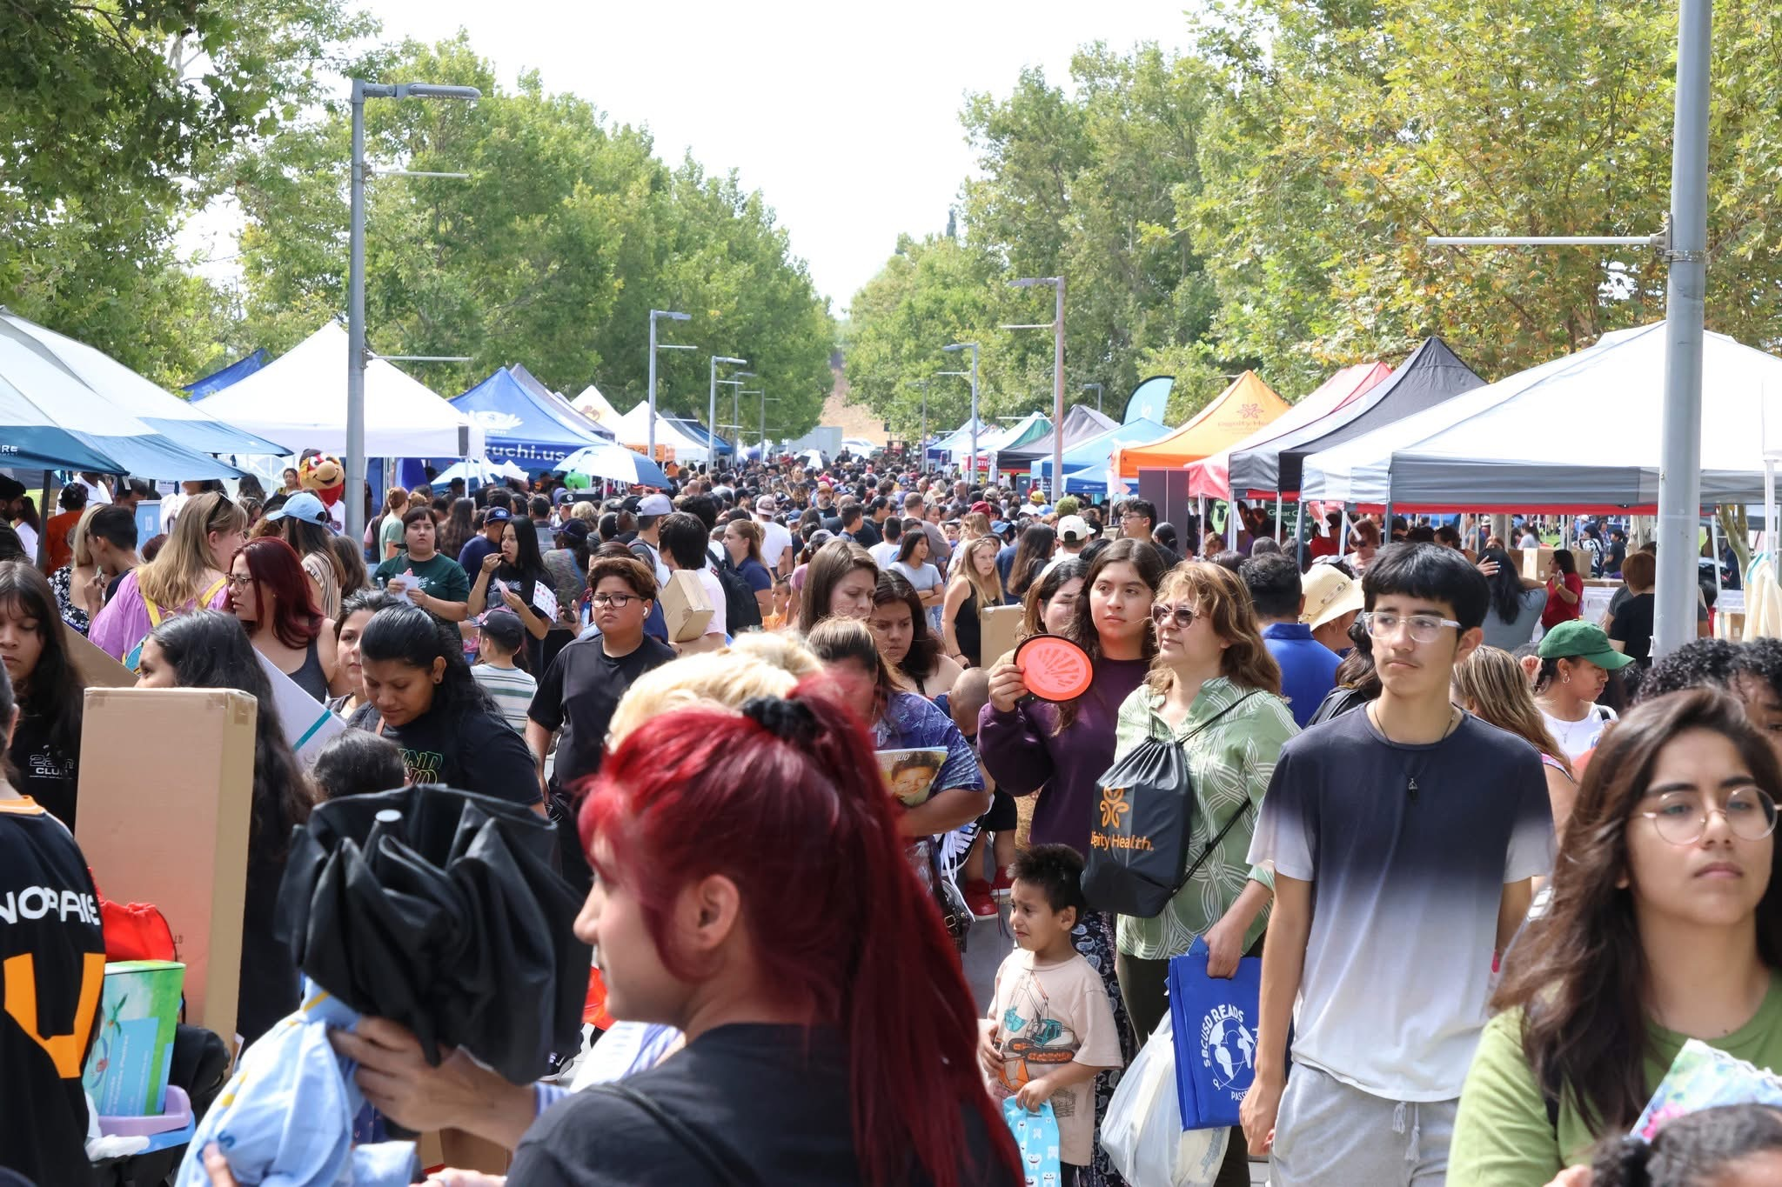
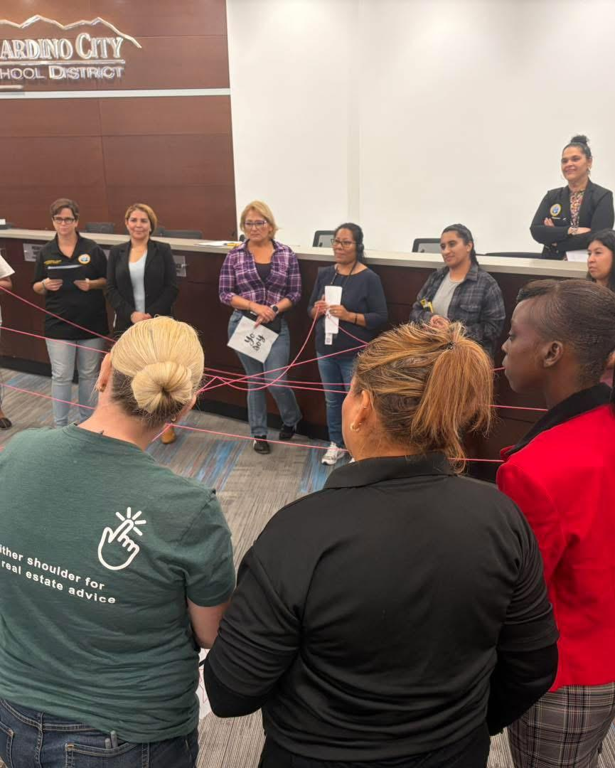
Notes:
Fonts/Size:
Titles: Oswald - 28
Body: Oswald - 20

Slide 13


New Non-Contributing
Goals and Actions
Nuevas metas y acciones
No contributivas

Slide 14
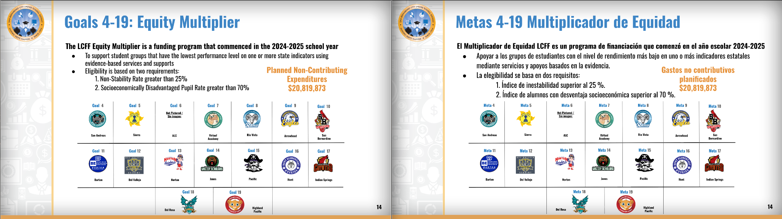
Notes:
Fonts/Size:
Titles: Oswald - 28
Body: Oswald - 20

Slide 15
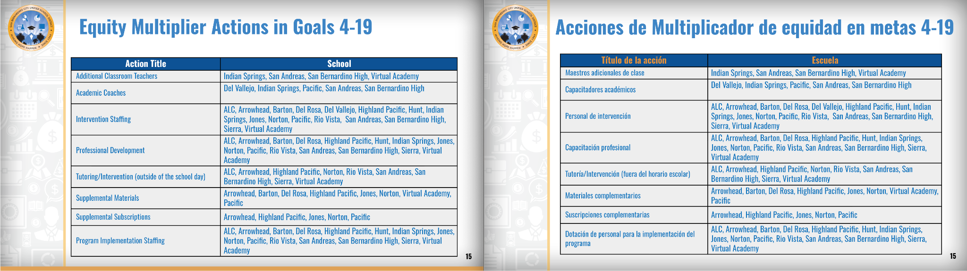
Notes:
Fonts/Size:
Titles: Oswald - 28
Body: Oswald - 20

Slide 16
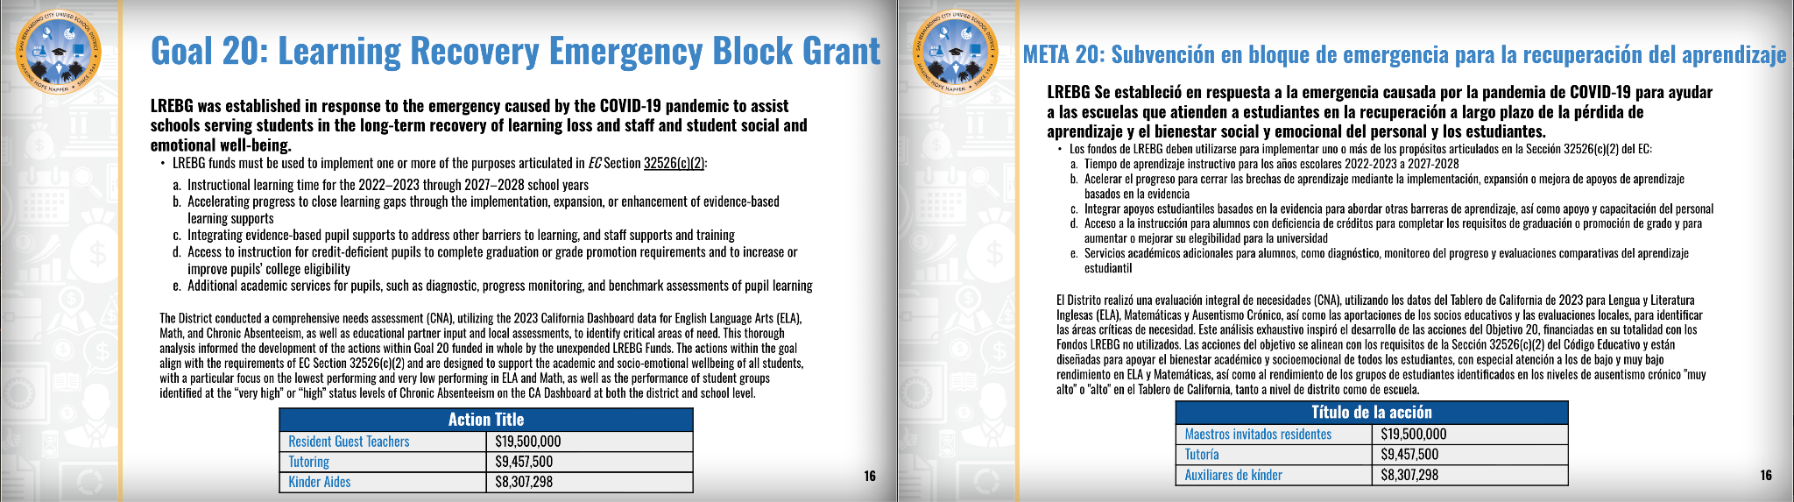
Notes:
Fonts/Size:
Titles: Oswald - 28
Body: Oswald - 20

Slide 17
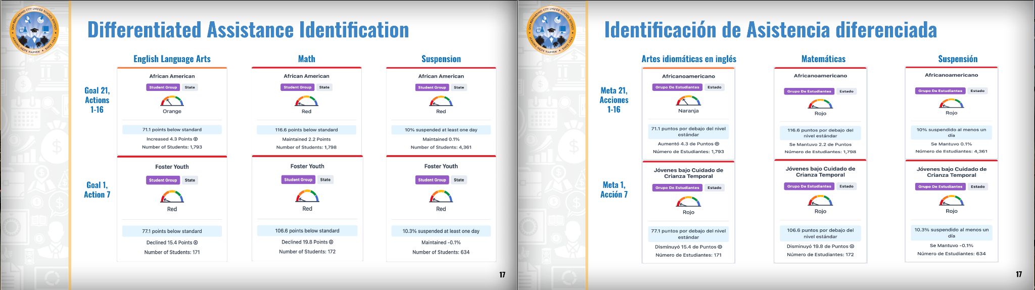
Notes:
Fonts/Size:
Titles: Oswald - 28
Body: Oswald - 20

Slide 18
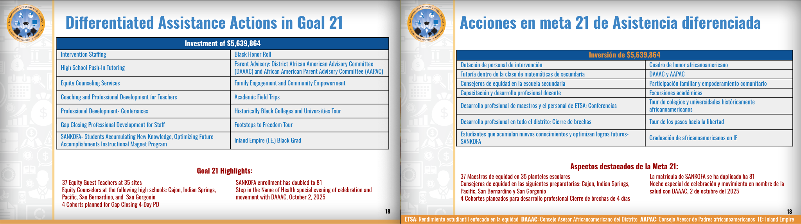
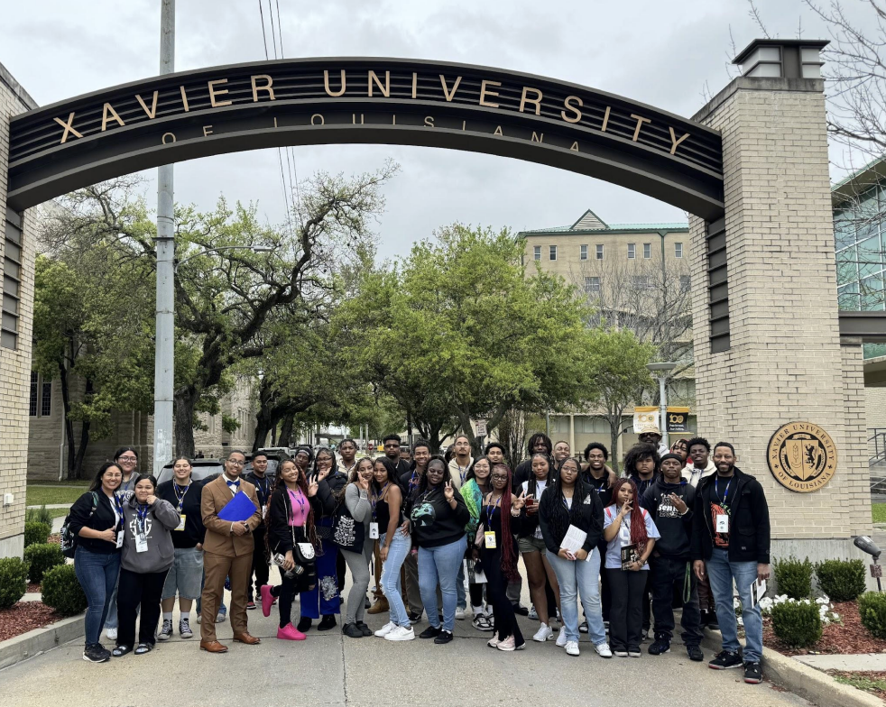
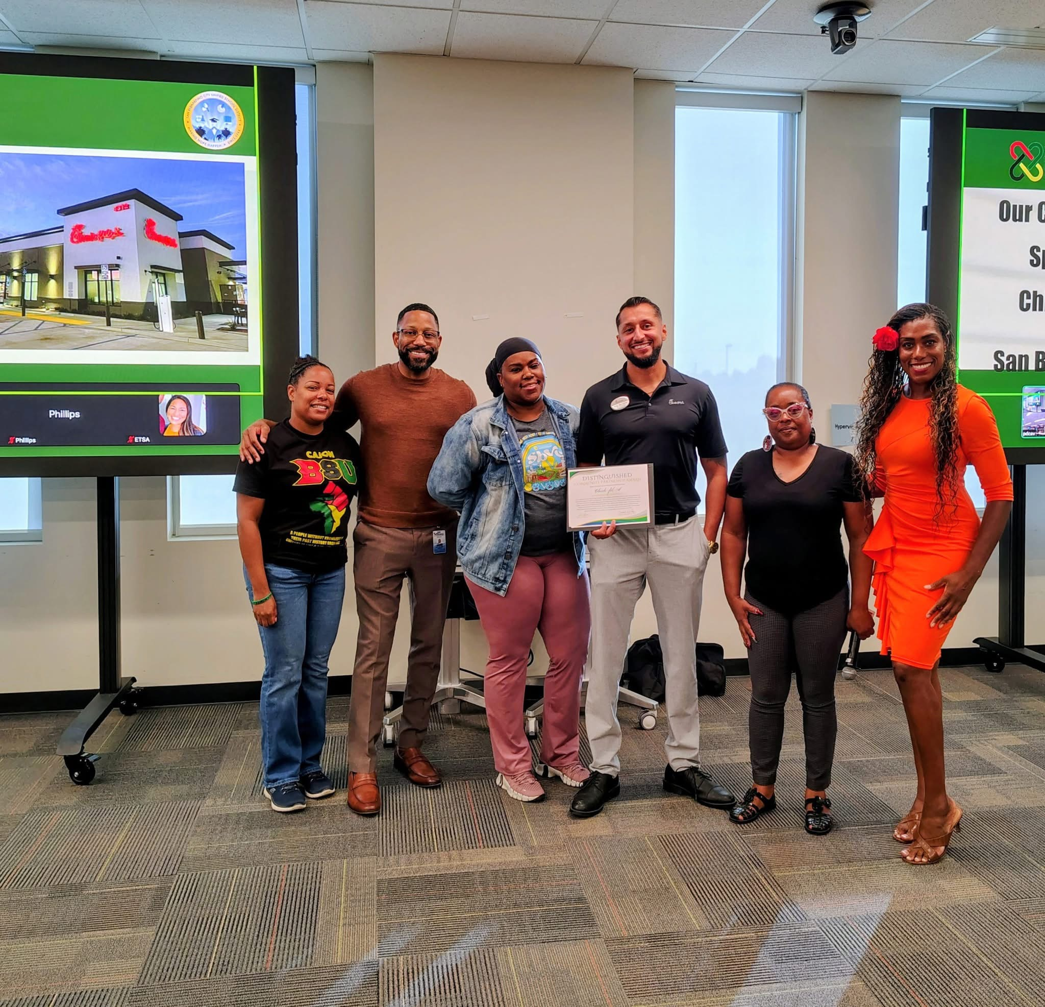
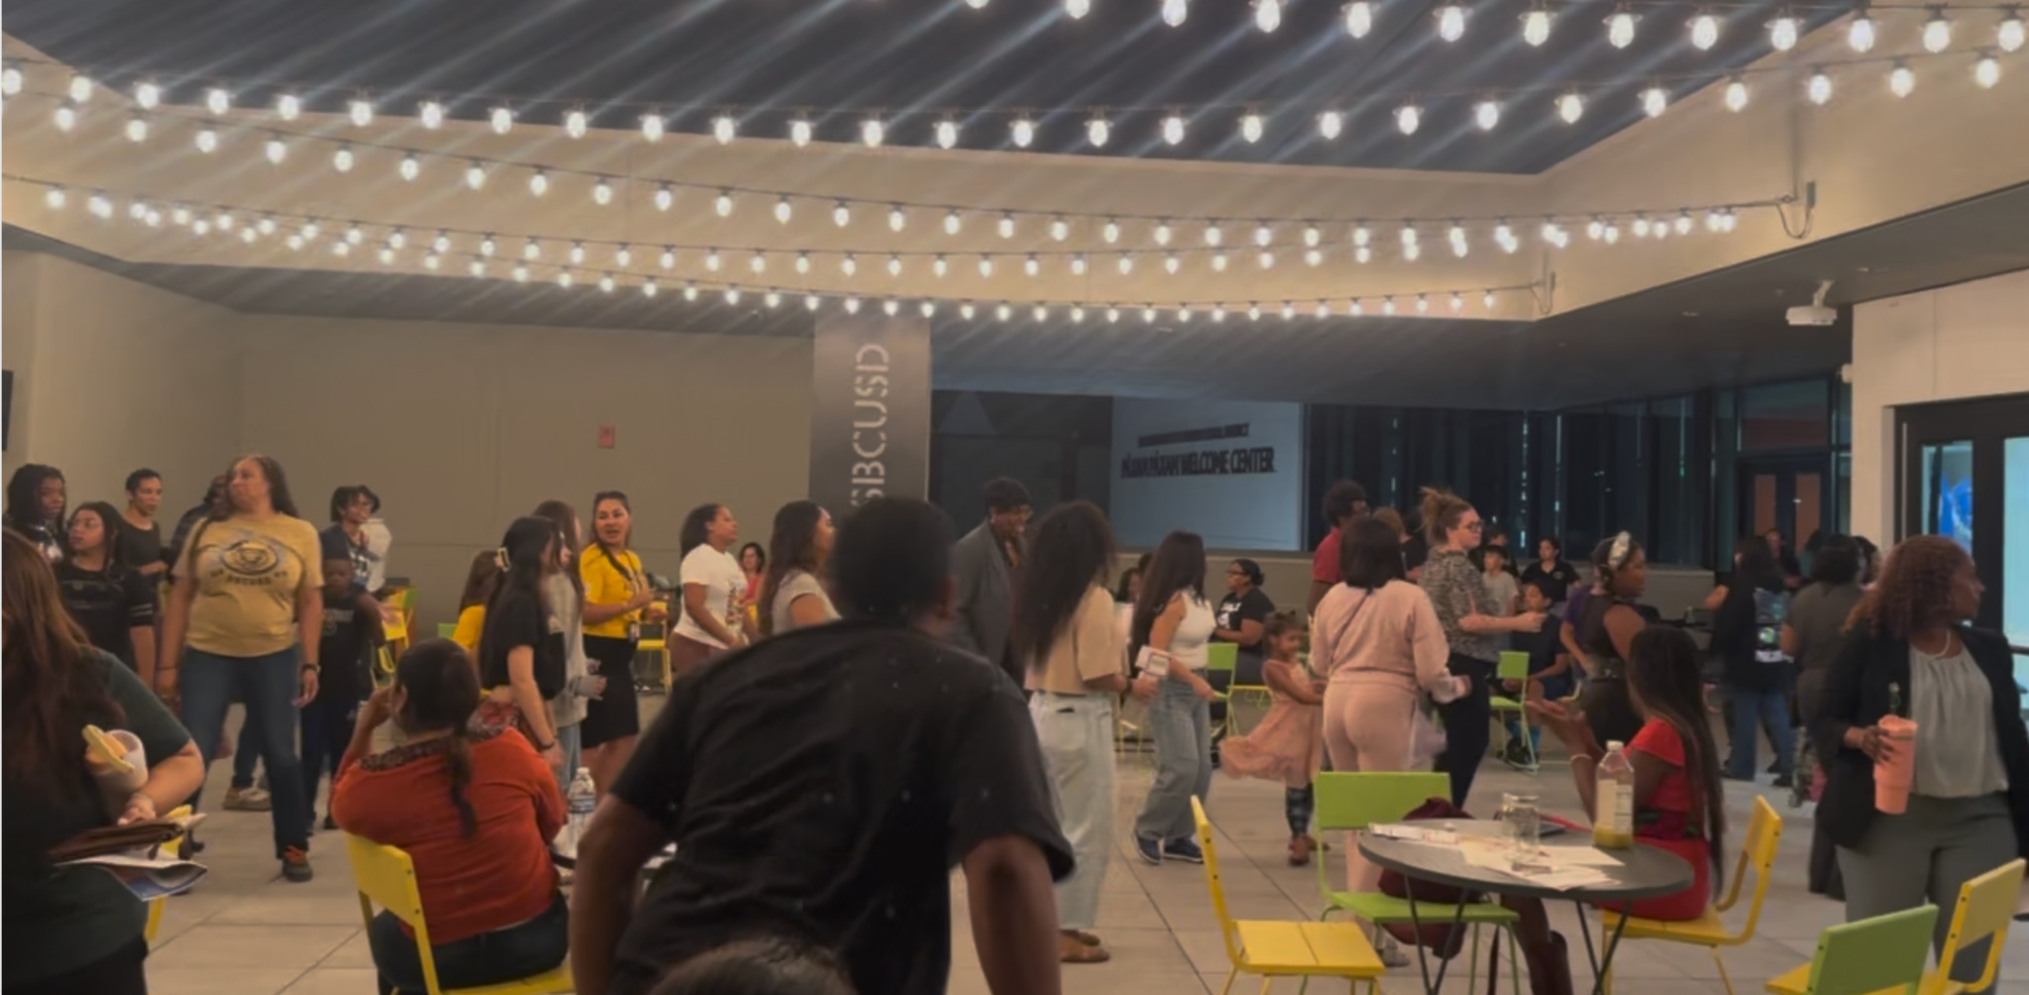

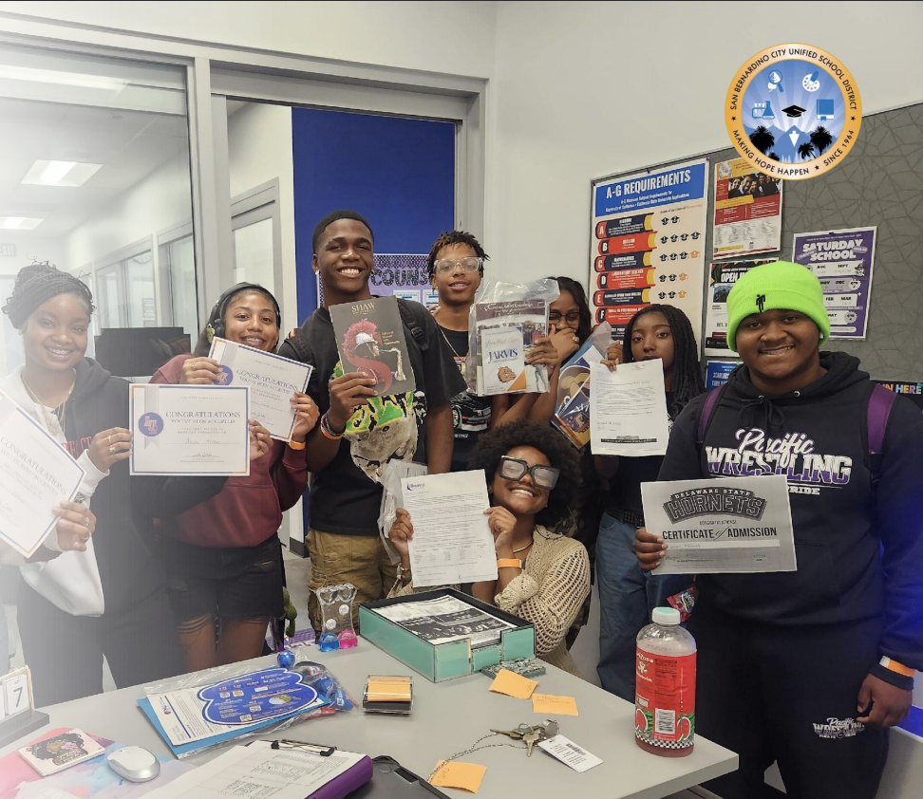
Notes:
Fonts/Size:
Titles: Oswald - 28
Body: Oswald - 20

Slide 19
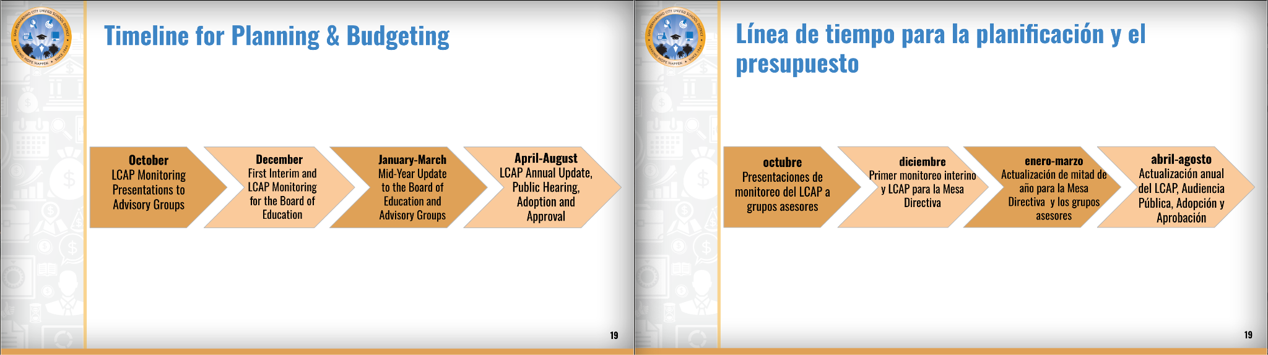
Notes:
Fonts/Size:
Titles: Oswald - 28
Body: Oswald - 20

Slide 20
Thank You!
¡Gracias!
Categorical Programs
Kimbre Sargent, Director
kimbre.sargent@sbcusd.k12.ca.us
909-473-2064

