Slide 1
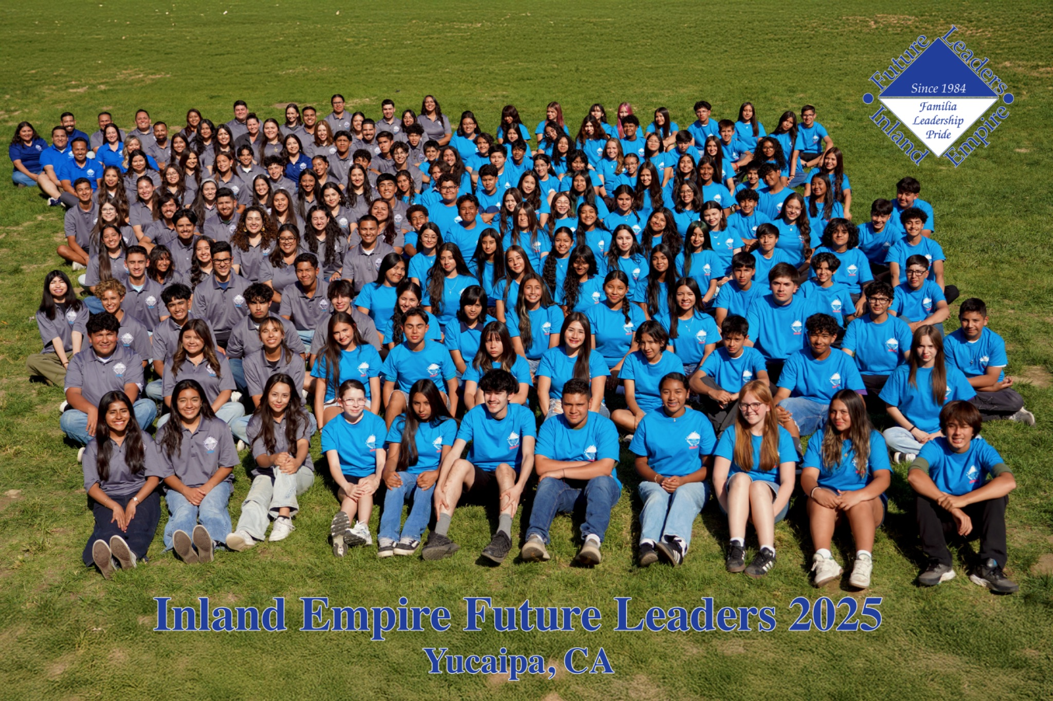


IEFLP 2026
Summer Leadership Conference
June 21 - 26, 2025
Yucaipa, California

Slide 2

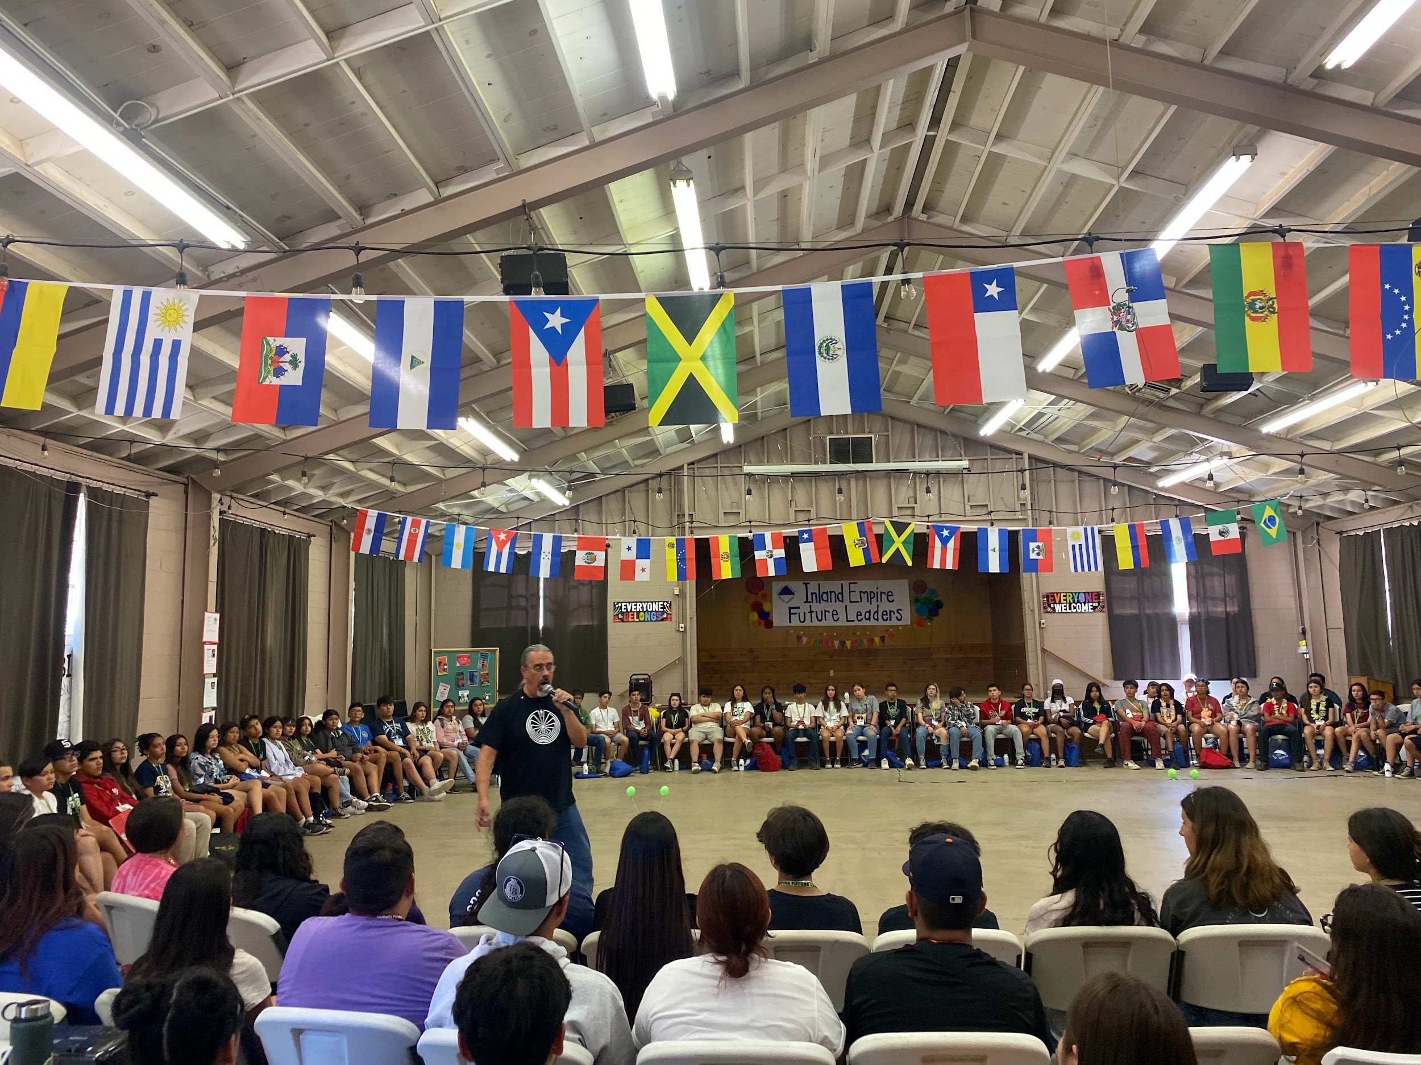
STUDENT LEADERSHIP DEVELOPMENT PROGRAM
“WE DEVELOP FUTURE LEADERS”
1984 - 2026

Slide 3
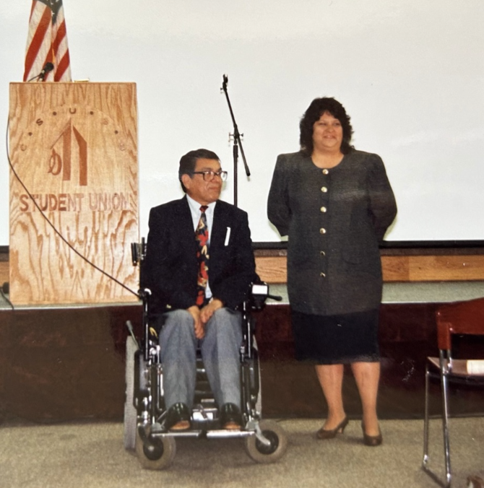
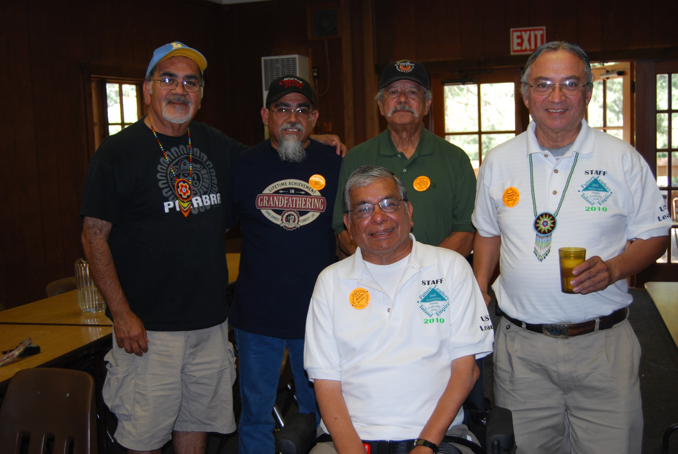
IEFL History
In 1983, San Bernardino County Educator Susan Castro attended a statewide association of Mexican American Educators (AMAE) conference. She was impressed with a presentation by high school students who had attended an AMAE leadership conference. Susan recognized that such a program could benefit Inland Empire Latino Youth, the largest ethnic group in our public schools, and the population with the highest dropout rate. She enlisted the help of local educators to realize her vision. Henry Vazquez, Bill Ellison and Frank Acosta answered her call. Additional support was provided by Dr. Tom Rivera, Associate Dean for Undergraduate Studies at California State University, San Bernardino.
This core group of educators created Inland Empire Future Leaders. And for the next three decades, they dedicated themselves to nurturing the program; training, motivating, and preparing participants to reach their highest potential. in 2010, several dedicated IEFL alums joined the Board of Directors. In 2022, a 13-member Associate Board was established, consisting of IEFL Alum, young professionals. Today, the original founders’ mission is carried on my IEFL Program Alumni.

Slide 4
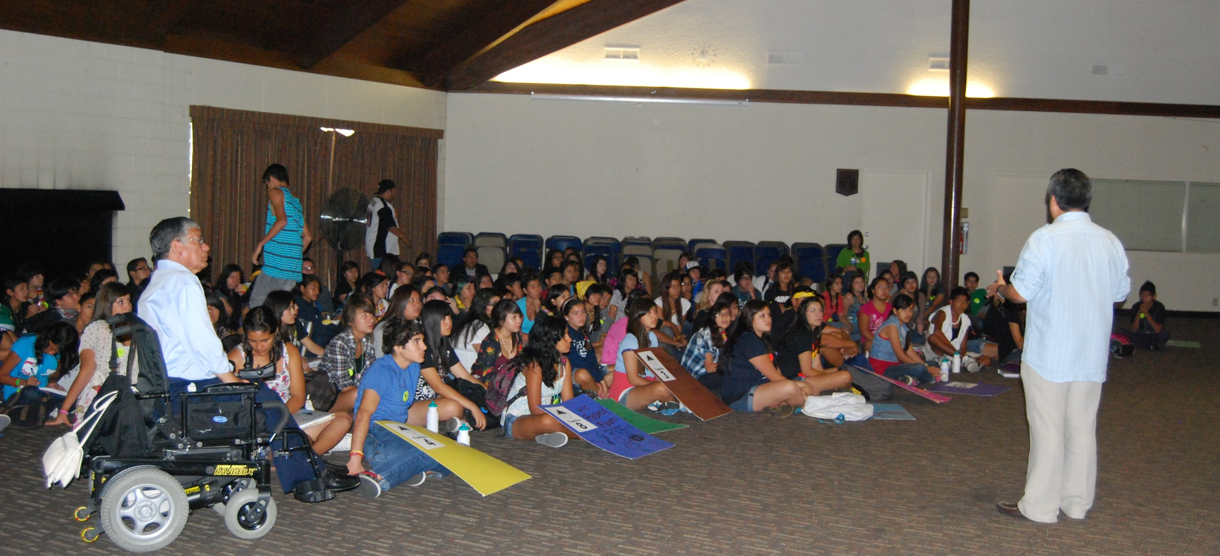
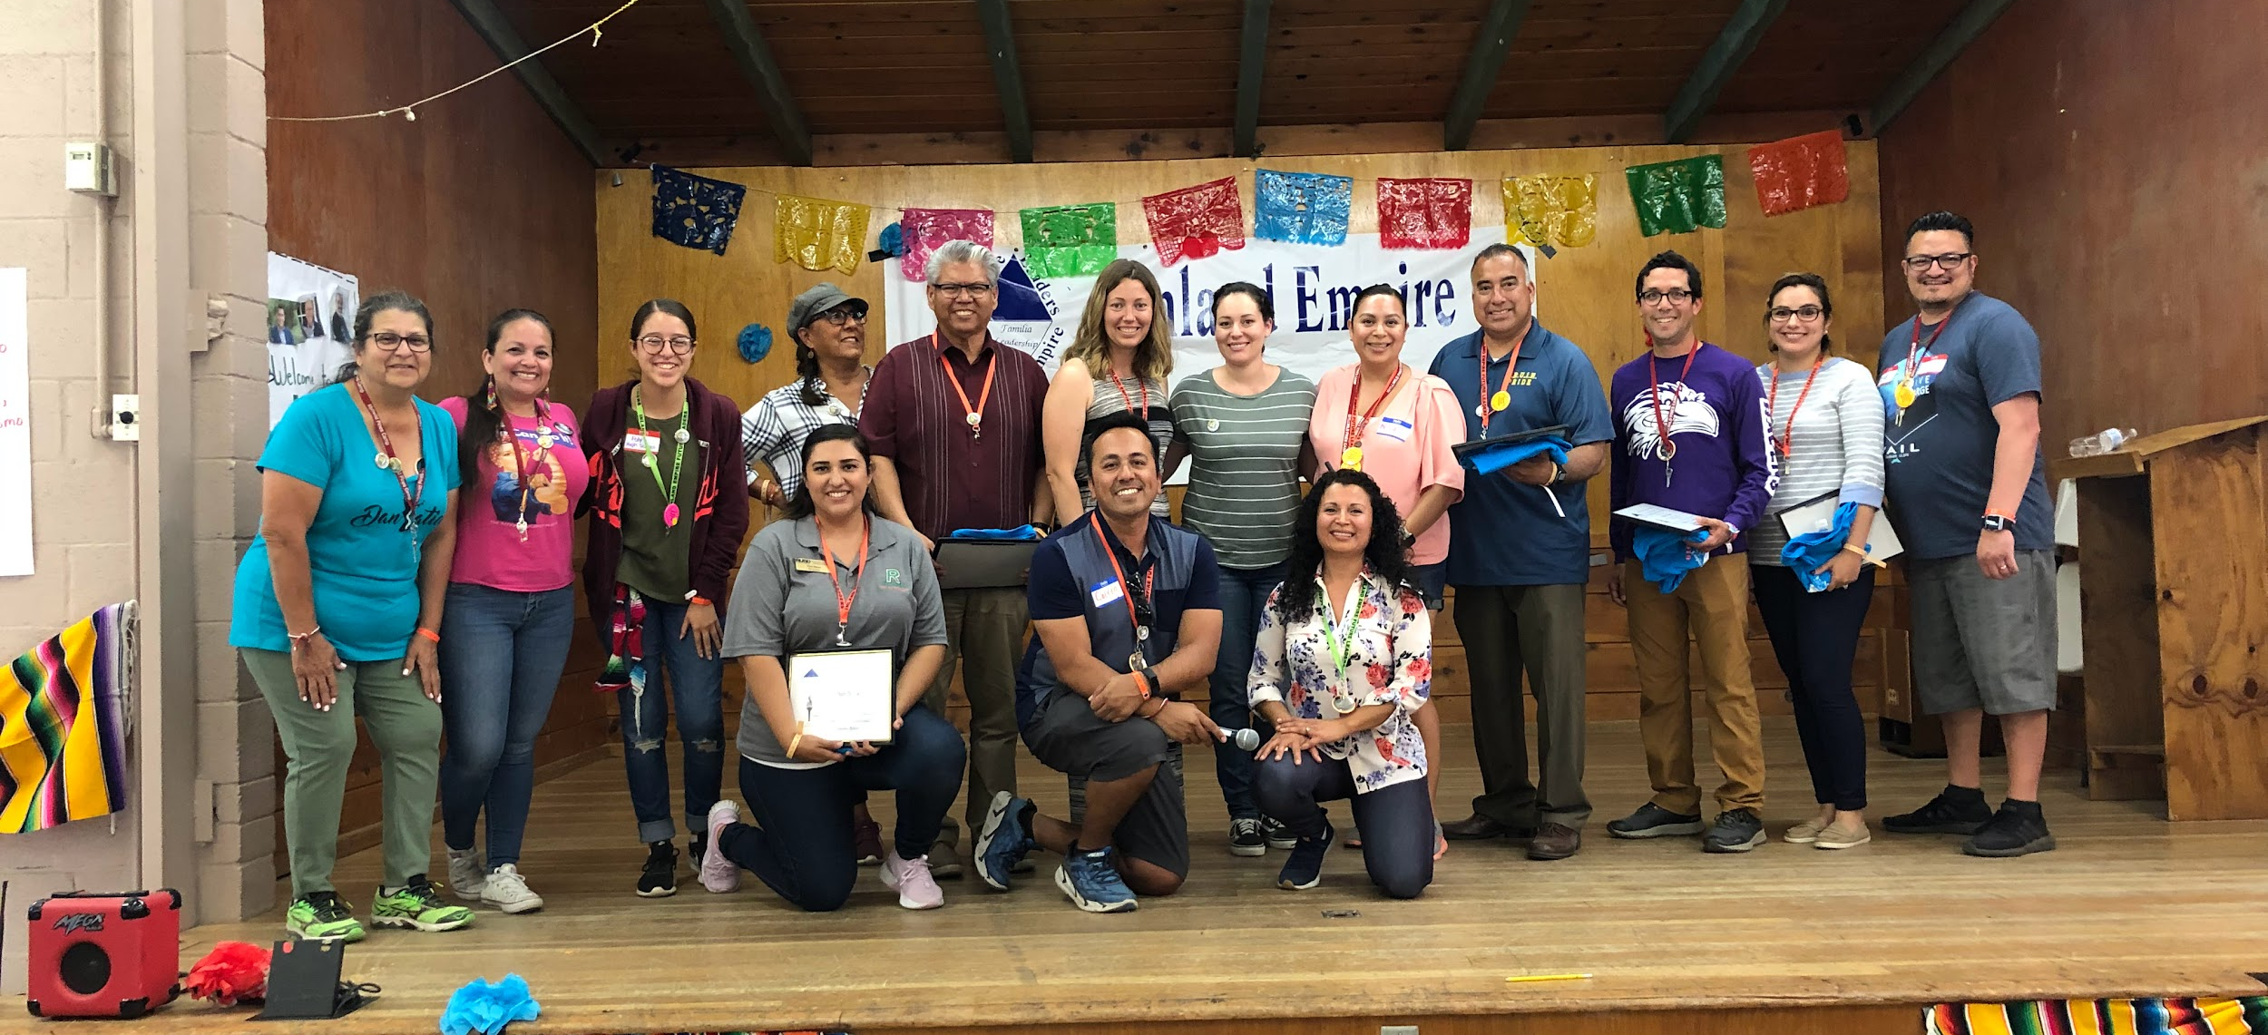
Need for Program:
Hispanics have a “medium” rate of graduation across the district
Hispanic students in the Colton Joint Unified School District are the highest number of students to dropout of school than any other student demographic in the district.
Hispanics are less likely than their white counterparts to complete a bachelor’s degree.
Increase the percentage of students who graduate and are prepared for college and/or a career.
Leaders needed for the 21st century

Slide 5

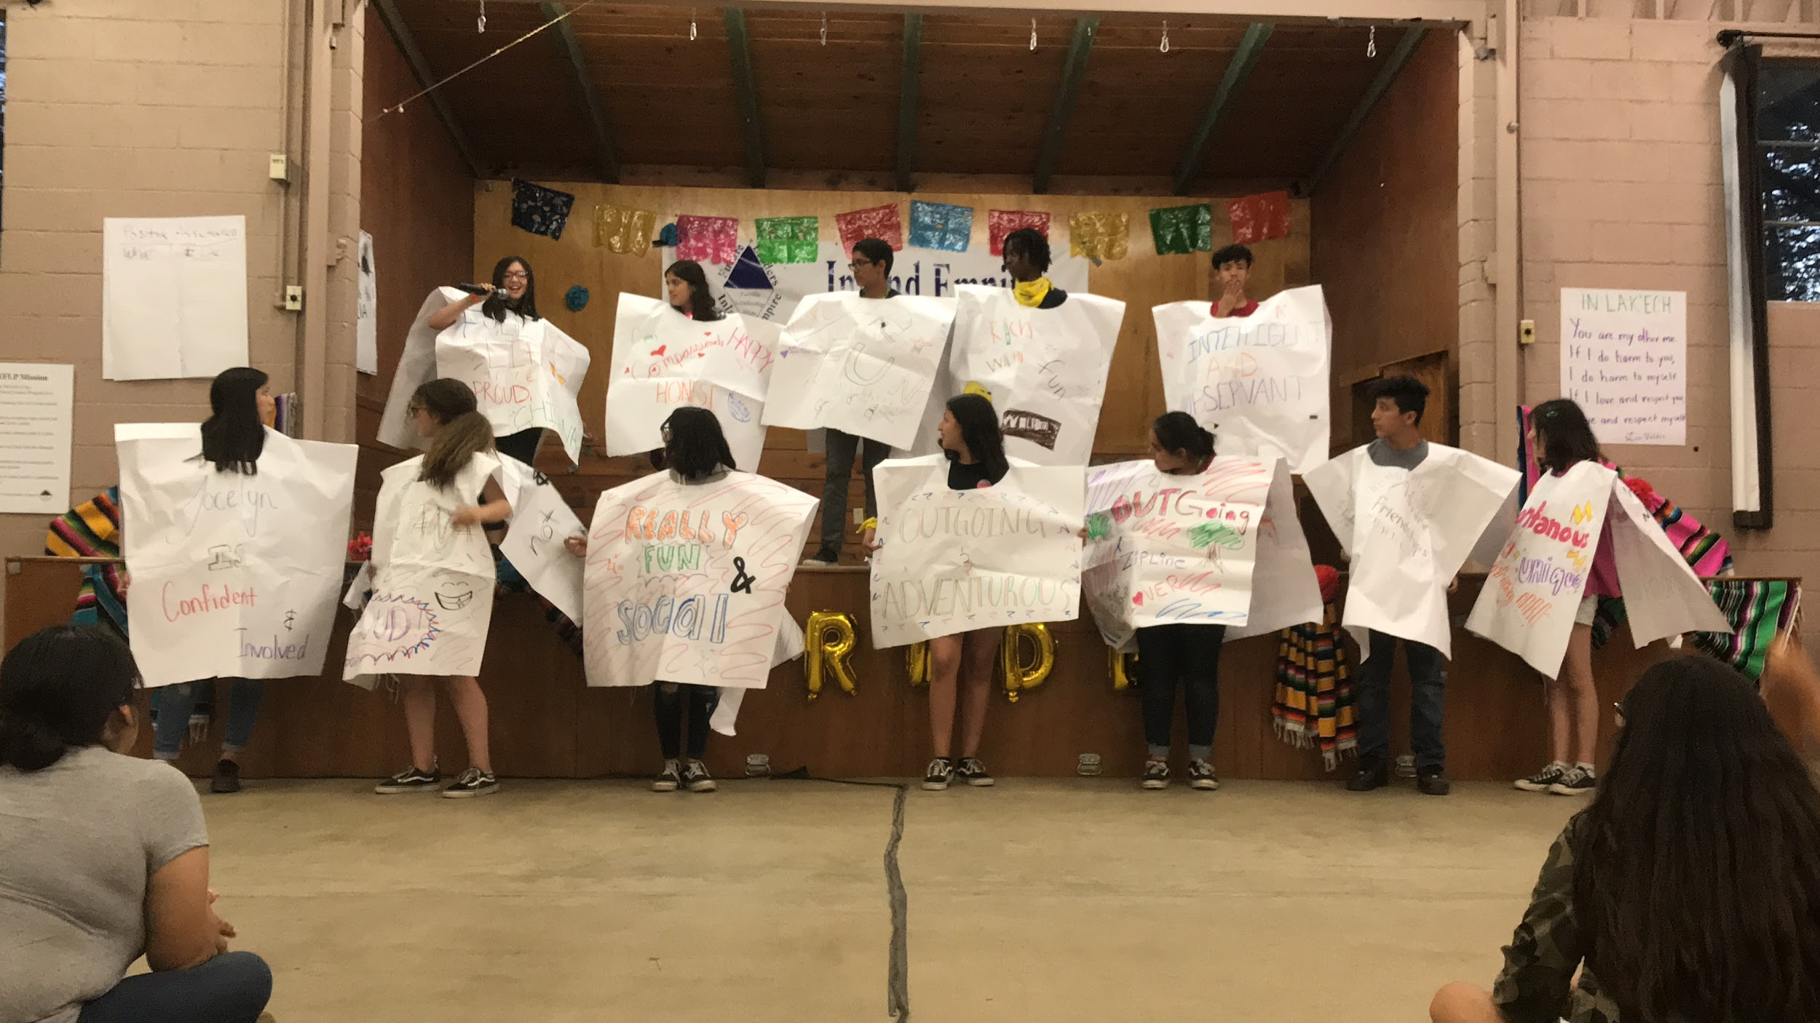
IEFLP
Mission:
To develop leaders for our communities, while instilling the values of Familia, Leadership, and Pride

Slide 6
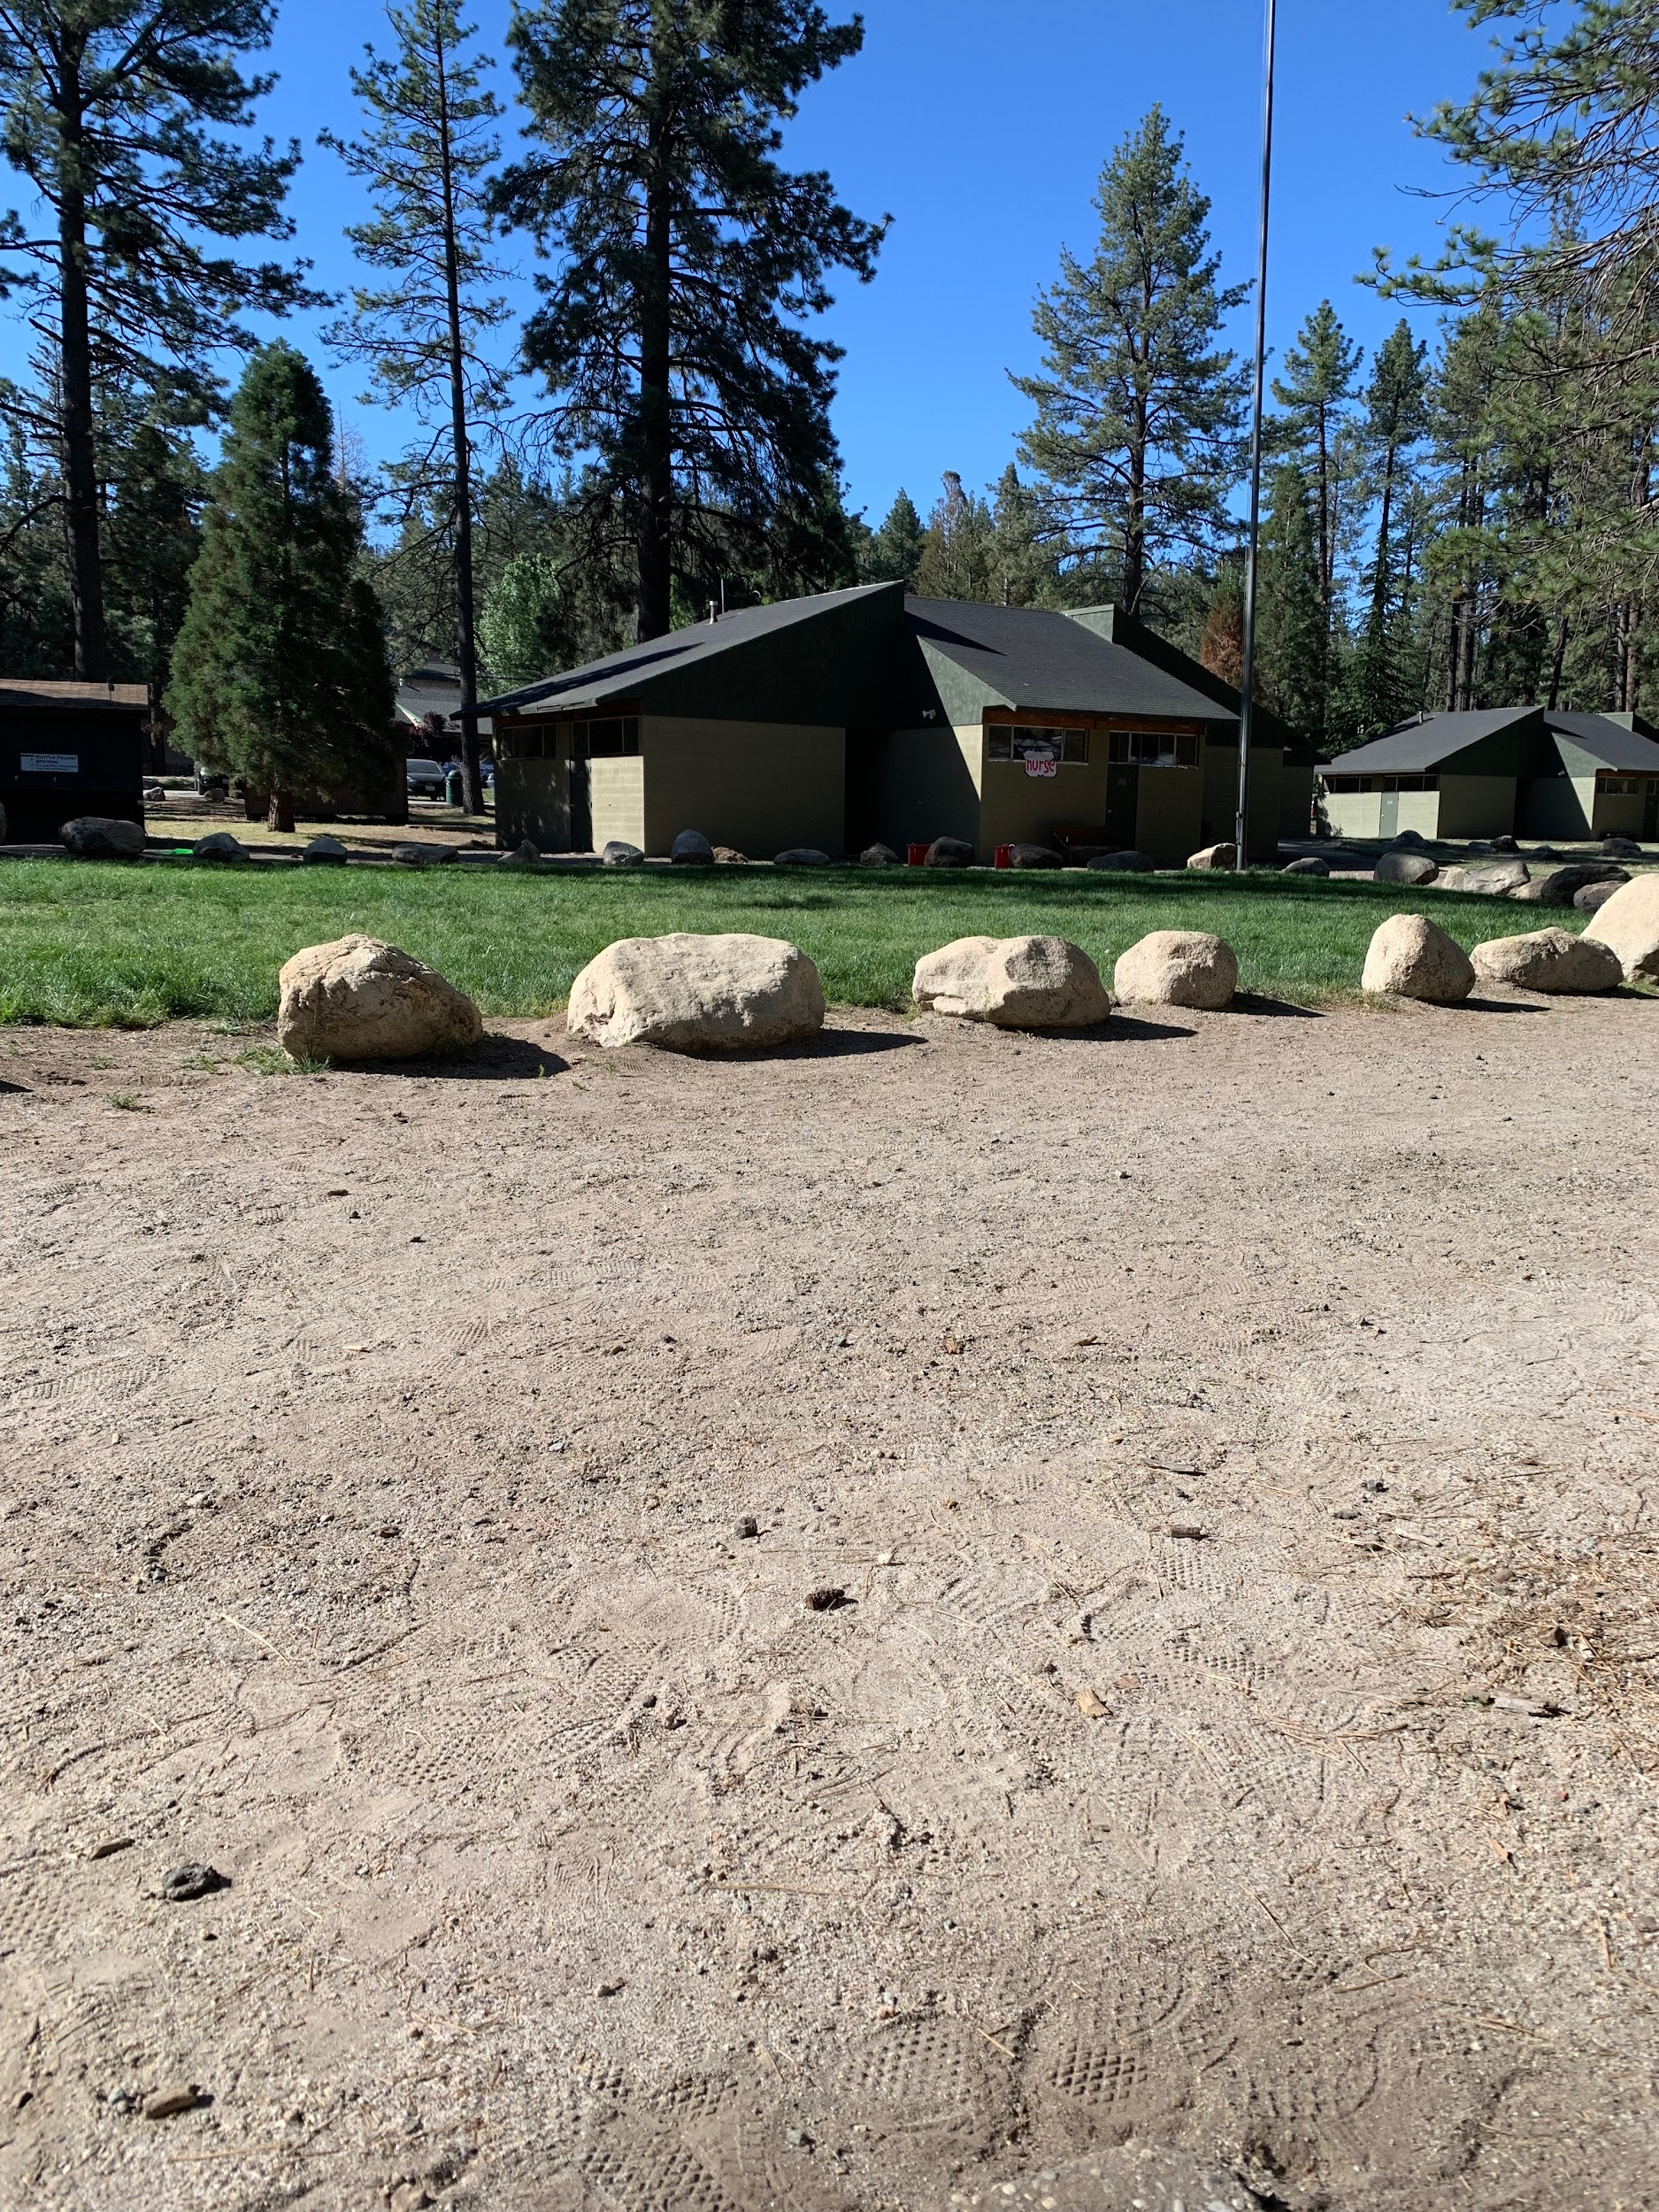

OUR PURPOSE
IEFLP
Explore career choices
Graduate from high school
Enroll in college
Acquire Leadership Skills and Strengths
Learn how to run for office and win

Slide 7
6-day Overnight Conference
120 Students, 65 Staff

Slide 8
IEFLP 2026 CONFERENCE
JUNE 21ND 2026 TO JUNE 26TH 2026
MON 22
WED
24
FRI
26
SUN
21
TUES
23
THUR
25

Slide 9
SELECTION CRITERIA
CURRENTLY AN 8TH OF 9TH GRADER
MINIMUM 2.5 GPA
COMPLETED APPLICATION
LEADERSHIP POTENTIAL/ EXPERIENCE

Slide 10
Application Components
Completed application form
Description of school and Community activities (on app.)
Autobiographical statement (250 words)
Two (2) letters of recommendation
Transcript of grades
Consent and Agreement
Medical History

Slide 11
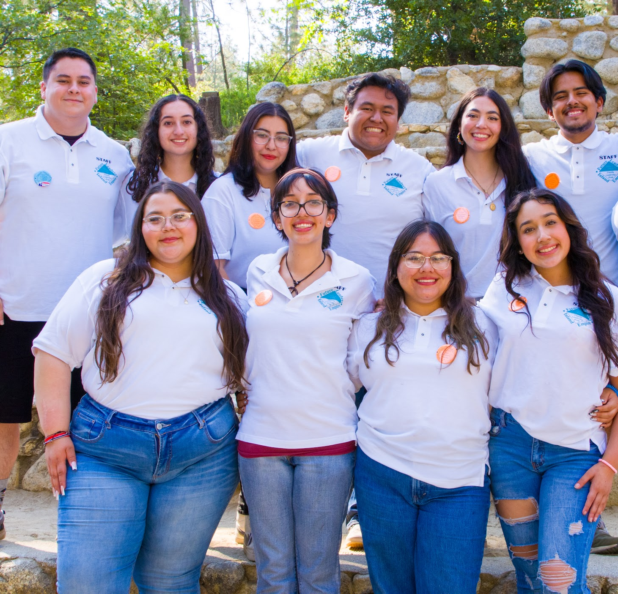

Application for students will open mid December!
Student Applications are due on the first week of March by 11:59 PM
Student Applications can be found online at https://iefl.org

Slide 12
Alumni Quotes:
  “Ever since I attended camp in 2014, many things have happened… I have achieved so much which makes me very proud of myself…. All my accomplishments have motivated me to give back to my community and continue to make a difference in the future.”
  – Maribel R.
  “This experience has increased my confidence level to communicate with a lot of people. It encouraged me to get involved.”
  – Alfredo L

Slide 13
Alumni Quotes:
  “Going to this camp made a major impact on me. This camp also made me realize how much minorities have struggled to get where we are today.”
  – Maribel B.
  “How can I describe with words one of the BEST times I had in many years? It was a MAGICAL experience getting to know everyone and knowing that I could be MYSELF… it made a big change in my person, my soul, my mind and the best thing was that everyone at the camp made me realize how I could be the BEST.”
  – Nubia G.

Slide 14
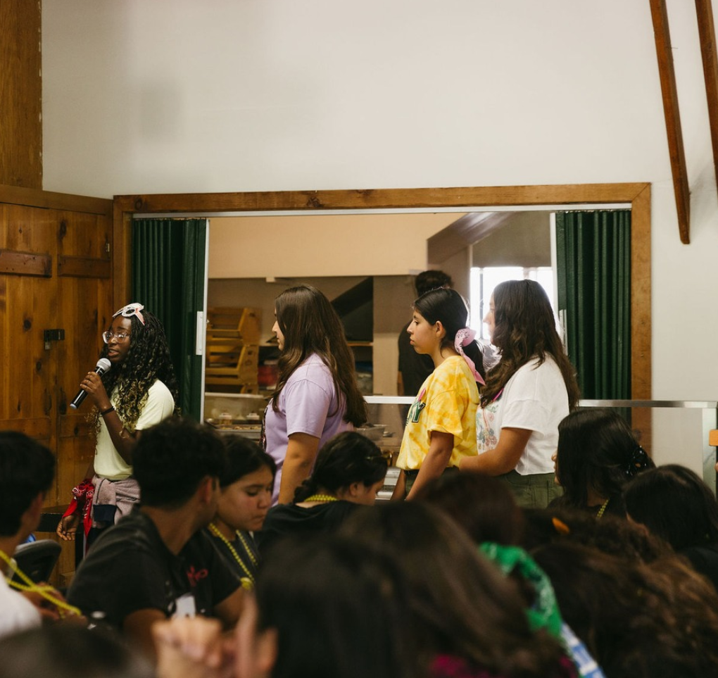
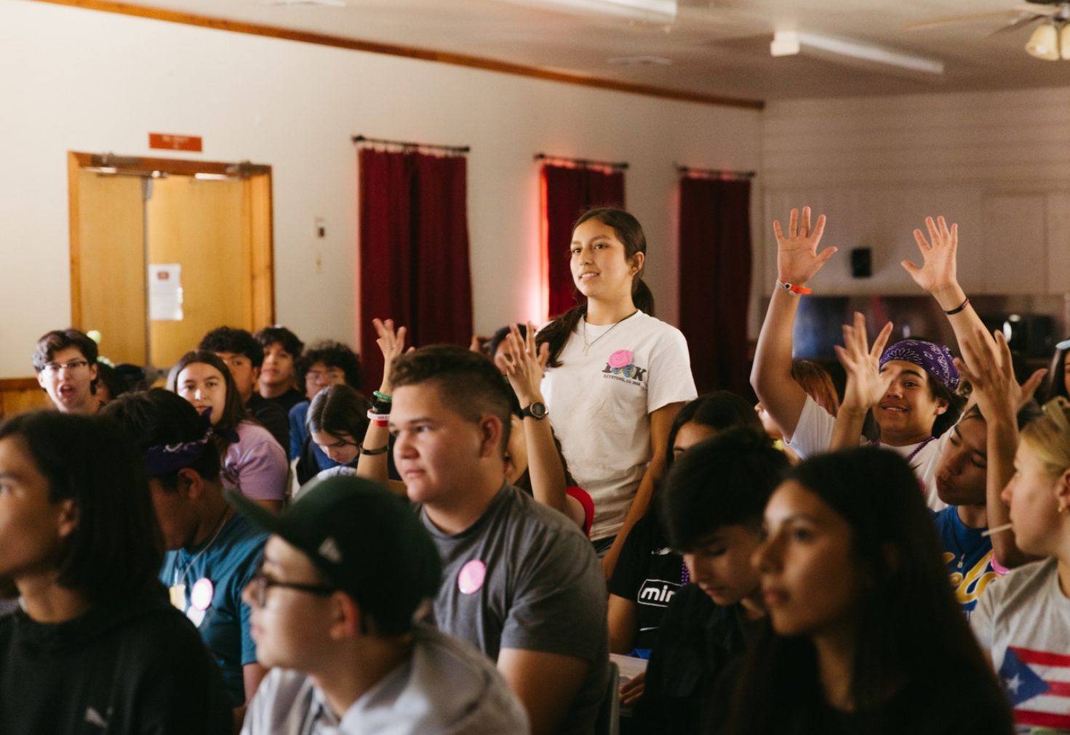
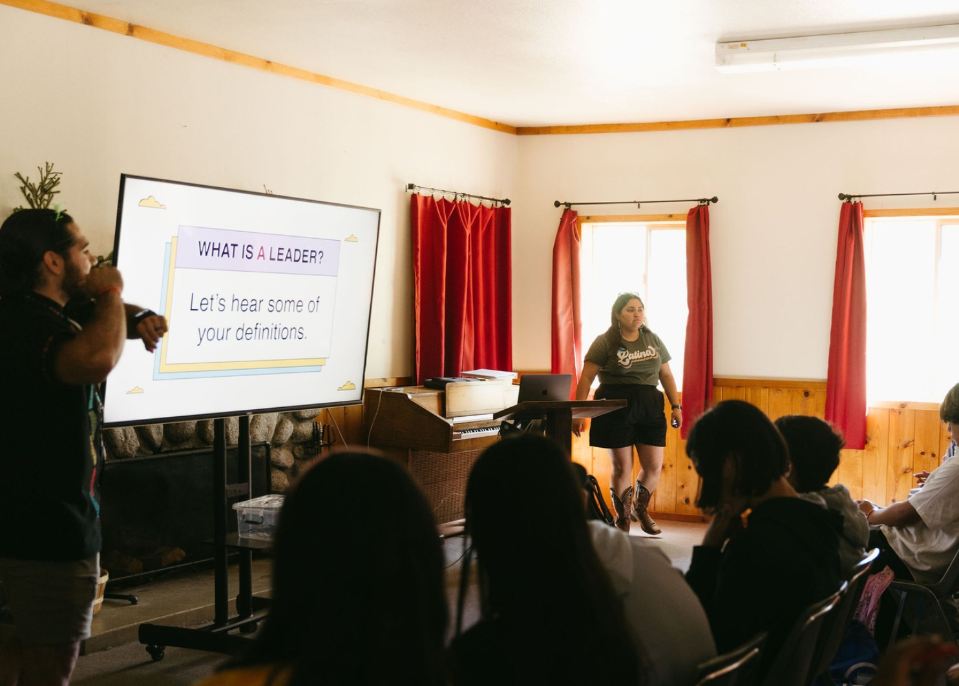
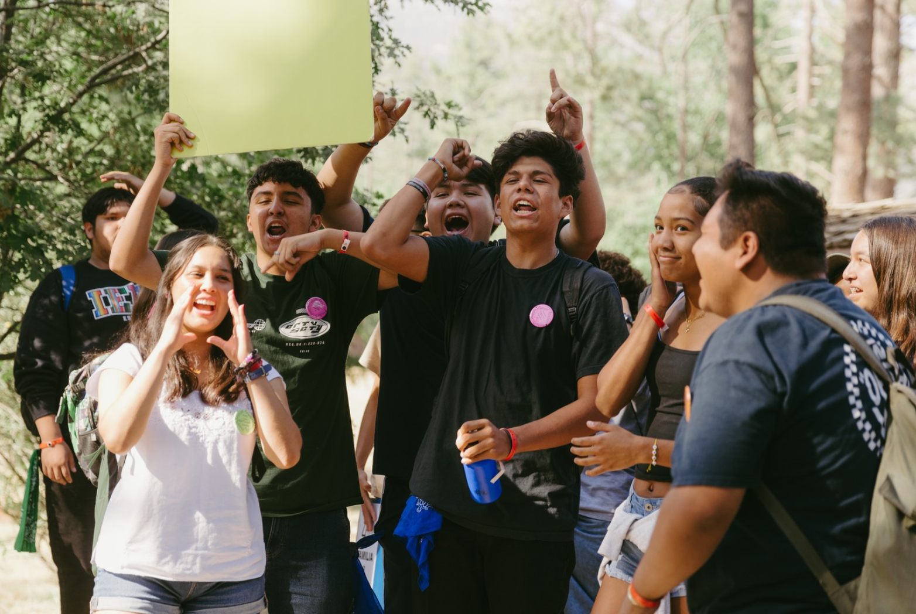
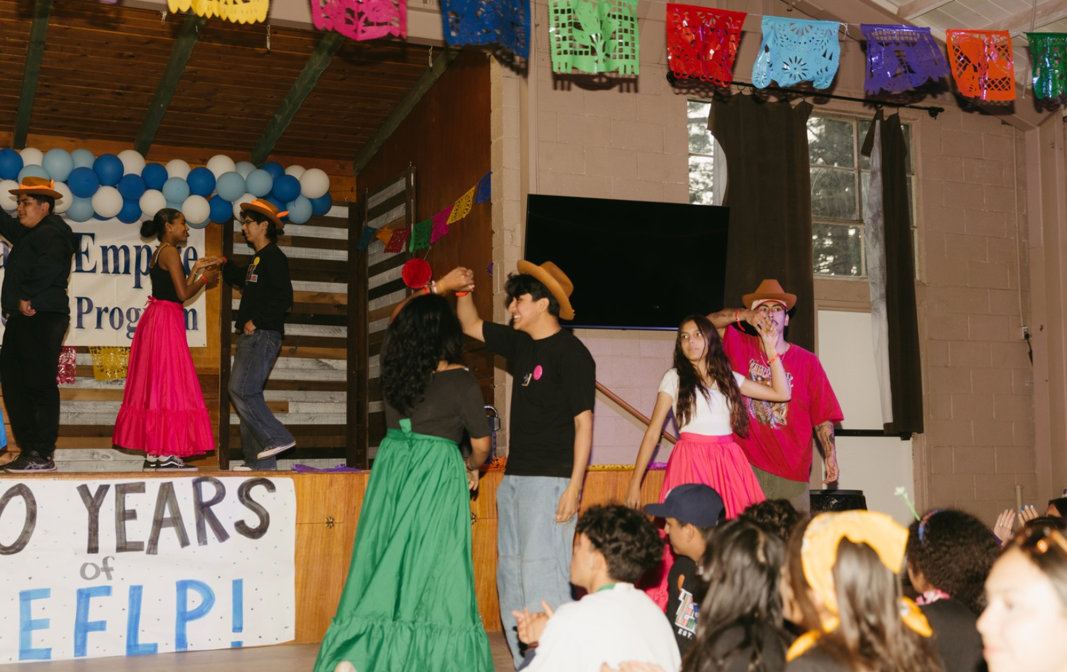
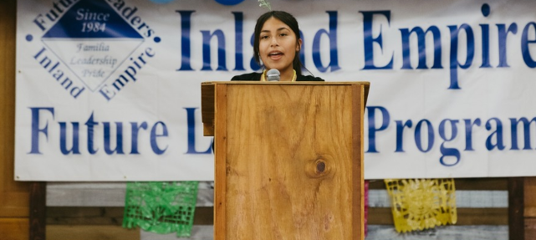
What we do at camp:
Workshops
Public Speaking
Cultura Sessions
Build Community
Recreation Activities
Play games and Chant!

Slide 15
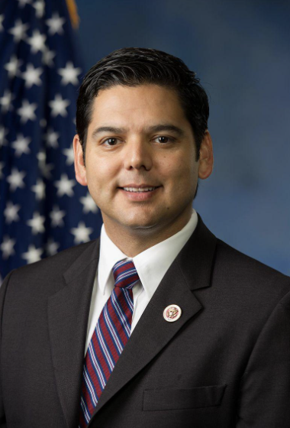
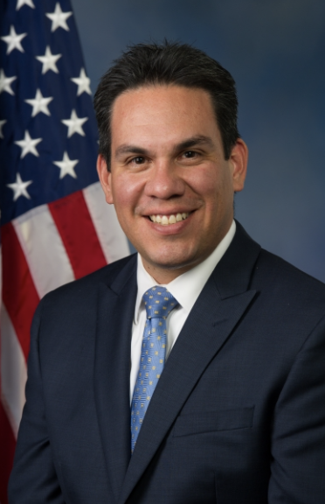

Two notable IEFLP Alumni:
Dr. Raúl Ruiz (’87)
U.S. Congressman
36th California Congressional District
Pete Aguilar (’93)
U.S. Congressman
31st California Congressional District

Slide 16
IEFLP Board of Directors
Officers
Dr. R.C. Heredia ’92, Chair
Richard Cabrera LVN ’88, Vice-Chair
Mindy Danira Gómez ’00, Vice-Chair
Dr. Farah Meadows ’91, Vice-Chair
Rudy Monterrosa, Esq. ’88, Vice-Chair
Judith Segura-Mora ’85 , Vice-Chair
Vanessa S. Ibarra’98, Secretary
Elizabeth Segura Vargas ’87, Treas.
Members
• Michael Arteaga •Marissa Heredia • Michael Arteaga • Carlos E. Monagas, Esq. ’85 • Enrique Monagas •Dr. Cynthia Olivo • Arturo Rodriguez • Carlos A. Trujillo ’95 • Félix Zúñiga
Emeritus Board Members
• Frank Acosta • Susan Castro • Rocket “Reyes” Rios • Henry Vasquez •

Slide 17


Connect with us on social media!
facebook.com/InlandEmpireFutureLeadersProgram
instagram.com/IEFLP

Slide 18
Contact Information
Application support/questions
Email: application@iefl.org
Website: http://www.IEFL.org

