Slide 1


Sea Isle Elementary
School’s
ANNUAL TITLE I PARENT MEETING
Tamara P. McCray
PLC Coach

Slide 2

What Does It Mean to be a Title I School?
Being a Title I school means receiving federal funding (Title I dollars) to supplement the school’s existing programs. These dollars are used for…
  Identifying students experiencing academic difficulties and providing timely assistance to help these student’s meet the State’s challenging content standards.
  Purchasing supplemental staff/programs/materials/supplies
  Conducting parental involvement meetings/trainings/activities
  Recruiting/Hiring/Retaining Highly Qualified Teachers
Being a Title I school also means focusing on parental involvement and making sure that you know your rights as a parent.
We operate as a schoolwide Title I program

Slide 3
Parent Involvement Standards
Standard 1: Welcoming All Families/Dar la Bienvenida a Todas las Familias
Standard 2: Communicating/Comunicando
Standard 3: Supporting Student Success/Apoyando el Exito de los Estudiantes
Standard 4: Speaking Up for Every Child/Defendiendo a Todos los Niños
Standard 5: Sharing Power/Poder Compartido
Standard 6: Collaborating with Community/Colaborando con la Comunidad

Slide 4
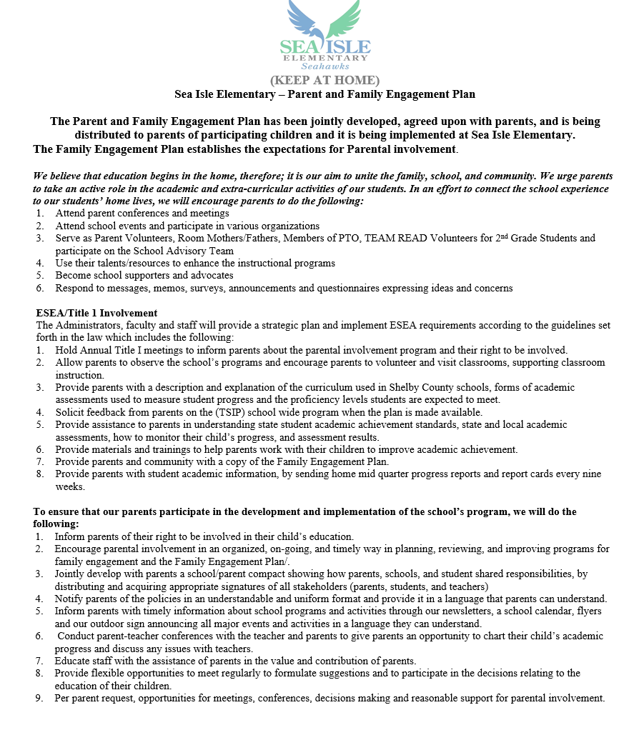

Slide 5
Parent/Family
Engagement Plan
This plan addresses how the school will implement the parental involvement requirements of the Every Student Succeeds Act (ESSA). Components include…
  How parents can be involved in decision-making and activities
  How parental involvement funds are being used
  How information and training will be provided to parents
  How the school will build capacity in parents and staff for stronger parental involvement
You, as a Title I parent/guardian, have the right to be involved in the development of your school’s Parental Involvement Plan.

Slide 6

Parent Involvement Policy
Be involved – support PTO, serve on Site-based Decision-Making Committee, serve on School Improvement Plan Committee
Participate – meetings, programs, parent conferences
Parent University
Support

Slide 7
Reporting Student Progress
Wednesday Folders
Progress Reports every 4 ½ weeks
Report Cards every 9 weeks
Progress Monitoring/Testing Data
Behavior Support (as needed)

Slide 8

Parent-Teacher Conferences
Parent-teacher conferences are an integral part of maintaining communication between home and school.
There are two district-wide conferences days: 9/11/25, and 1/29/26. However, if you need to have a conference with your child’s teacher, please contact the teacher to set up an appointment.

Slide 9

Parent Involvement Activities
PTO
Open House
Nine Weeks Honor’s Programs
Literacy on the Lawn
Family Reading Night at Novel Bookstore
Family Bonding Events
Family Math/Science Night &Science Fair
Seahawk Walk
Book Fair Volunteers
TCAP Volunteers
Classroom Volunteers (contact your child’s teacher)
Islander Olympics Field Day
Field Trips
Parent University
Grandparents Day

Slide 10
Availability of Parent Training
District sponsored trainings
District led FACE workshops
MSCS website –Parent Resources
Parent University
Curriculum Support

Slide 11

School Improvement Plan
Includes school-wide goals and action steps
Updated each year
Has been updated for SY25-26
On the school website

Slide 12

We are a level 3 school!

Slide 13

Opportunities for additional parent meetings
Watch for information and notifications on Class Dojo, the school calendar,& social media.
PTO Meetings
Parent University
Schoolwide Events
Family Curriculum Nights
Schoolwide bonding events

Slide 14

Parents’ Right to Know
All parents have the right to request the following:
A teacher’s professional qualification, which includes: state qualifications, licensure, grades certification, waivers
A teacher’s baccalaureate and/or graduate degree, fields of endorsement, previous teaching experience
A paraprofessional’s qualifications
An assurance that their child’s name, address and telephone listing may not be released to military recruiters
All parents will receive information on the following:
Their child’s level of achievement in each of the state academic assessments
Their option to request a transfer to another school within the district if their child is the victim of a violent crime at school
Their right to timely notification that their child has been assigned, or has been taught or four or more consecutive weeks by, a teacher who is not highly qualified.

Slide 15

Home-School Compact
The compact is a commitment from the school, the parent, and the student to share in the responsibility for improved academic achievement.

Slide 16
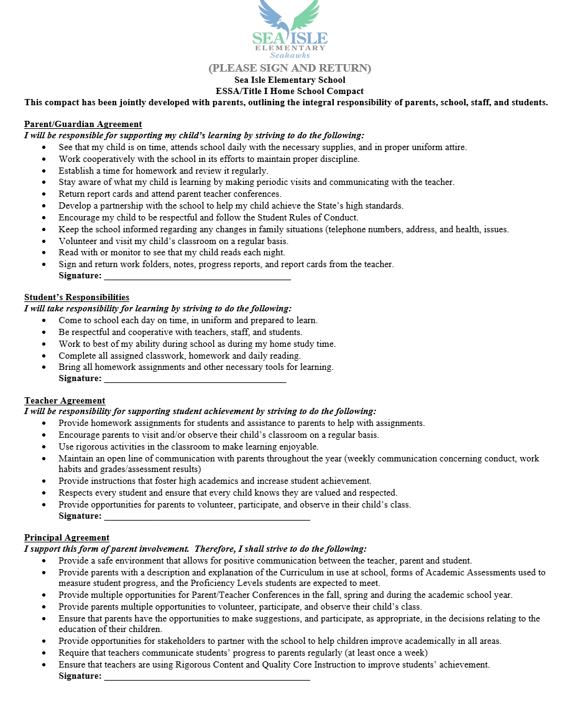

Slide 17

MSCS Discipline Policy
& Code of Conduct
District issued
Sea Isle Discipline Policy

Slide 18

Any Questions?
?
?
?
?

