Slide 1

Welcome to the
1st Senior Meeting
October 29, 2025
Please Remember:
Be respectful of the speakers and your fellow classmates. This mean NO TALKING while others have the floor!
Pay attention! Take notes if need be. Ask questions!
Share the information with your families – direct them to the Senior Website
Check your school email!! LOTS of important Senior information will be communicated to you via email!
These meetings are REQUIRED for all Seniors, including those attending Running Start. Please plan accordingly!

Slide 2
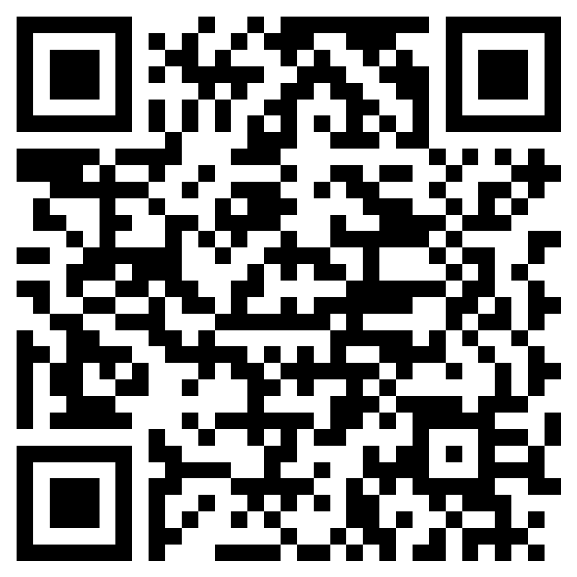
Agenda and Attendance
Senior Welcome
  Mr. Hennig
Xello and Senior Exit Interview (Graduation Requirement)
  Ms. Vermeulen
Cap & Gown Orders
  Mike Annis, Jostens
Parent Sponsored Senior Activities
Last Chance for Senior Merch!
Yearbook Deadlines and Senior Group Photo!
  Mr. Blakney

Slide 3

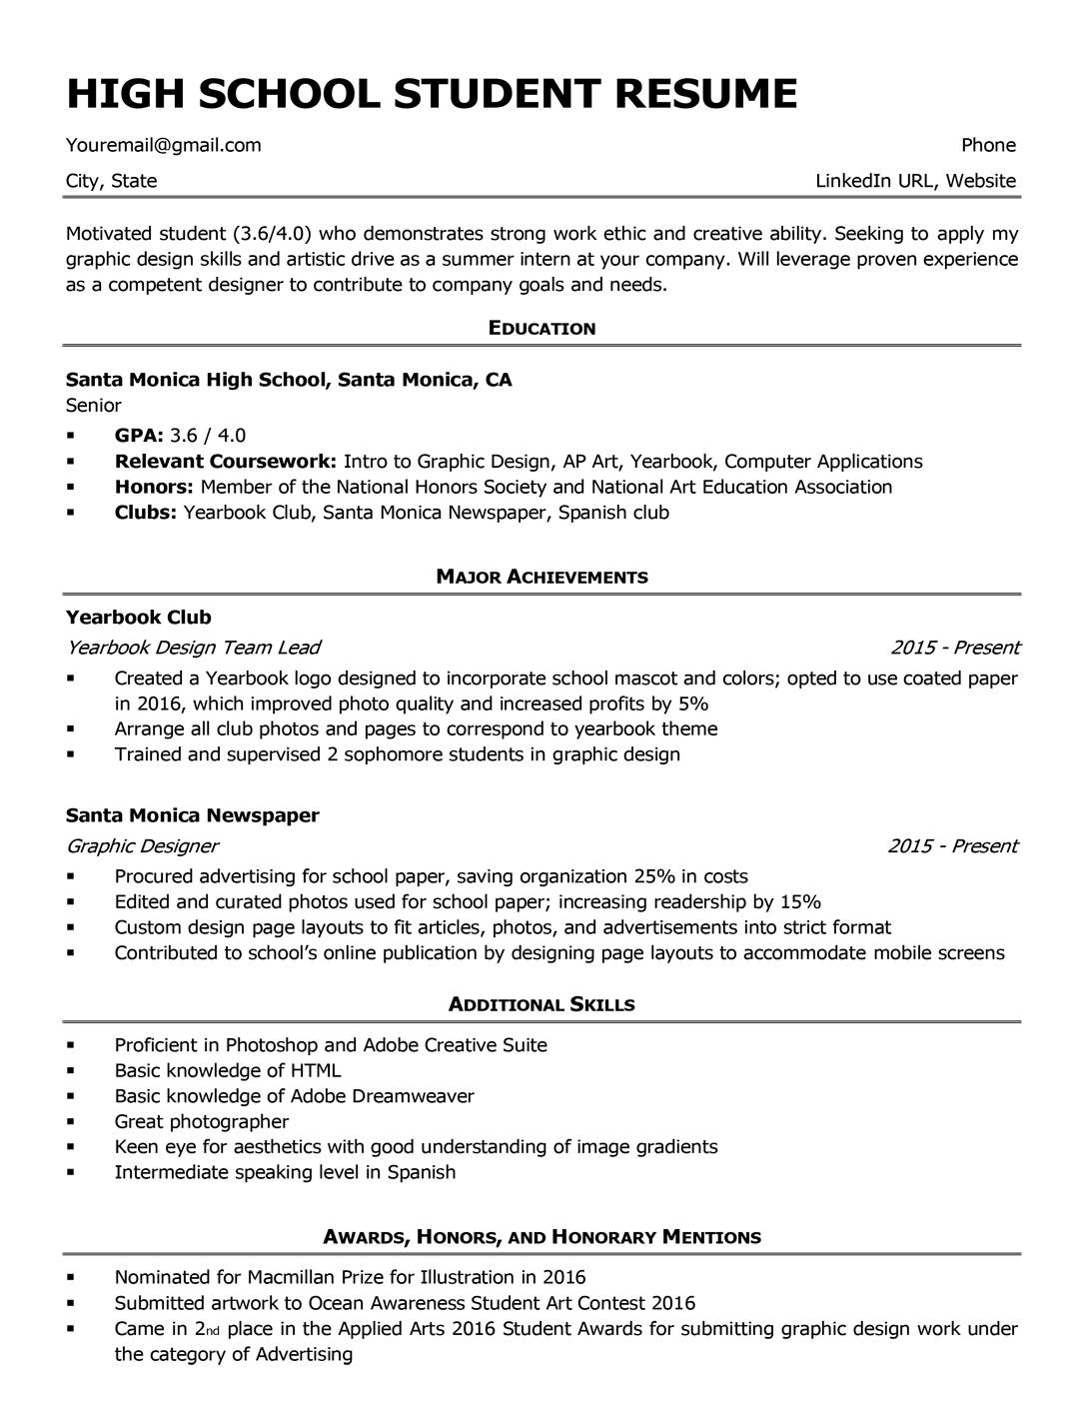
Have you done your Xello?
*Graduation Requirement*
Please write a 200-400 word response to Senior Exit Interview Question #1. Your response should address each of the four parts of the question and provide the reader with a clear picture of the plan you have created for yourself after high school
For example: continuing your education in two or four year college, starting an apprenticeship, entering military service, or joining the work force...
QUESTION #1:
Summarize your plan for life after high school, including career and learning goals.
How have you prepared for these goals, and what further steps will you take to achieve them?
How do your plan and goals relate to your skills, interests, and values?
Include a realistic financial plan for achieving your goals.

Slide 4



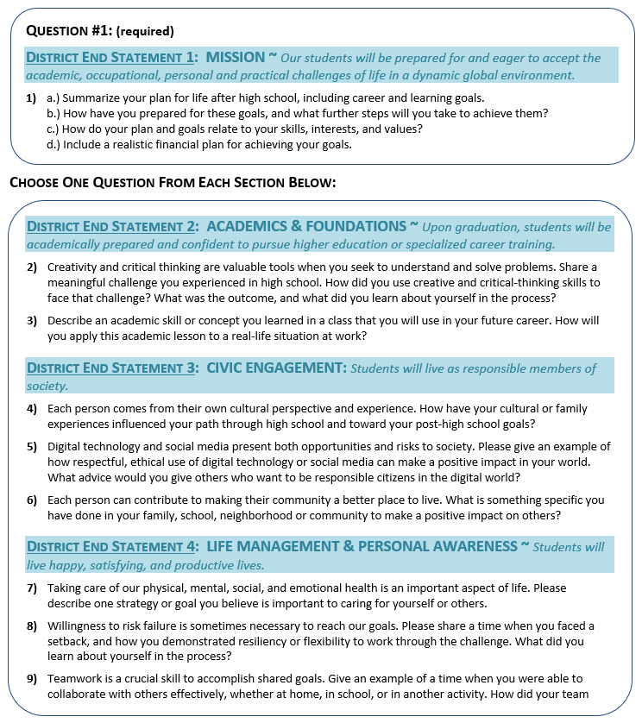


SENIOR EXIT INTERVIEW EXPECTATIONS
SENIOR EXIT
INTERVIEWS 8am
XELLO
DEADLINE
Interview times assigned in March via email.
1.
2.
3.
4.
5.
6.

Slide 5
Cap & Gown Orders
We are continuing with the Cap, Gown & Stole look!
*Cap, Gown & Stole required for all students participating in the Ceremony
*Can use a gown from a sibling/friend, provided that they graduated in 2017 or after
*Will need to purchase Stole separately (year specific)
*Only SKYLINE APPROVED attire can be worn for the ceremony
*IB, GPA & Volunteer Cord/Stole info will be sent via email in early March
*Caps can be decorated! Must be school appropriate and should reflect your future plans, hopes or dreams
*Culturally significant items can be incorporated with advanced approval – reach out to your Administrator!

Slide 6
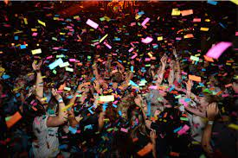

Parent Sponsored Activities
Take place in the days leading up to and including
Graduation
Includes Breakfast before the Senior Assembly and the
All Night Party following Graduation!
More info can be found on the Senior portion of the
Skyline Website
https://skyline.isd411.org/student-life/seniors

Slide 7


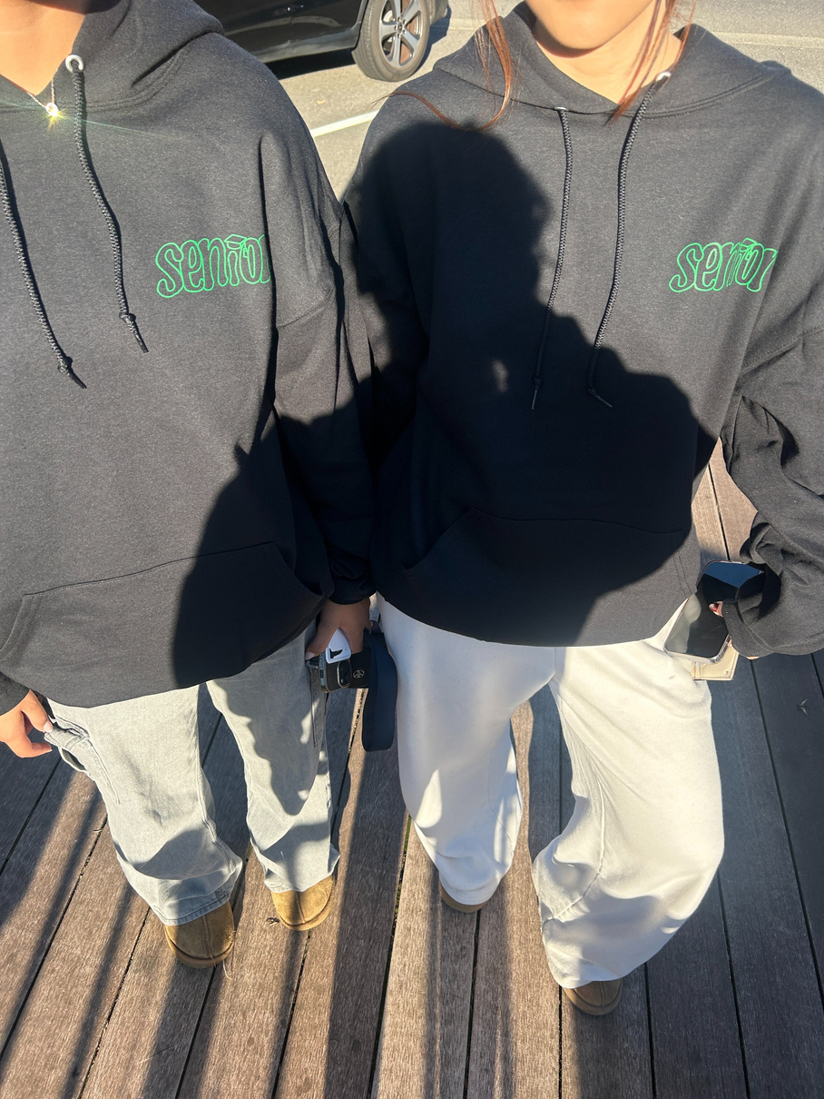


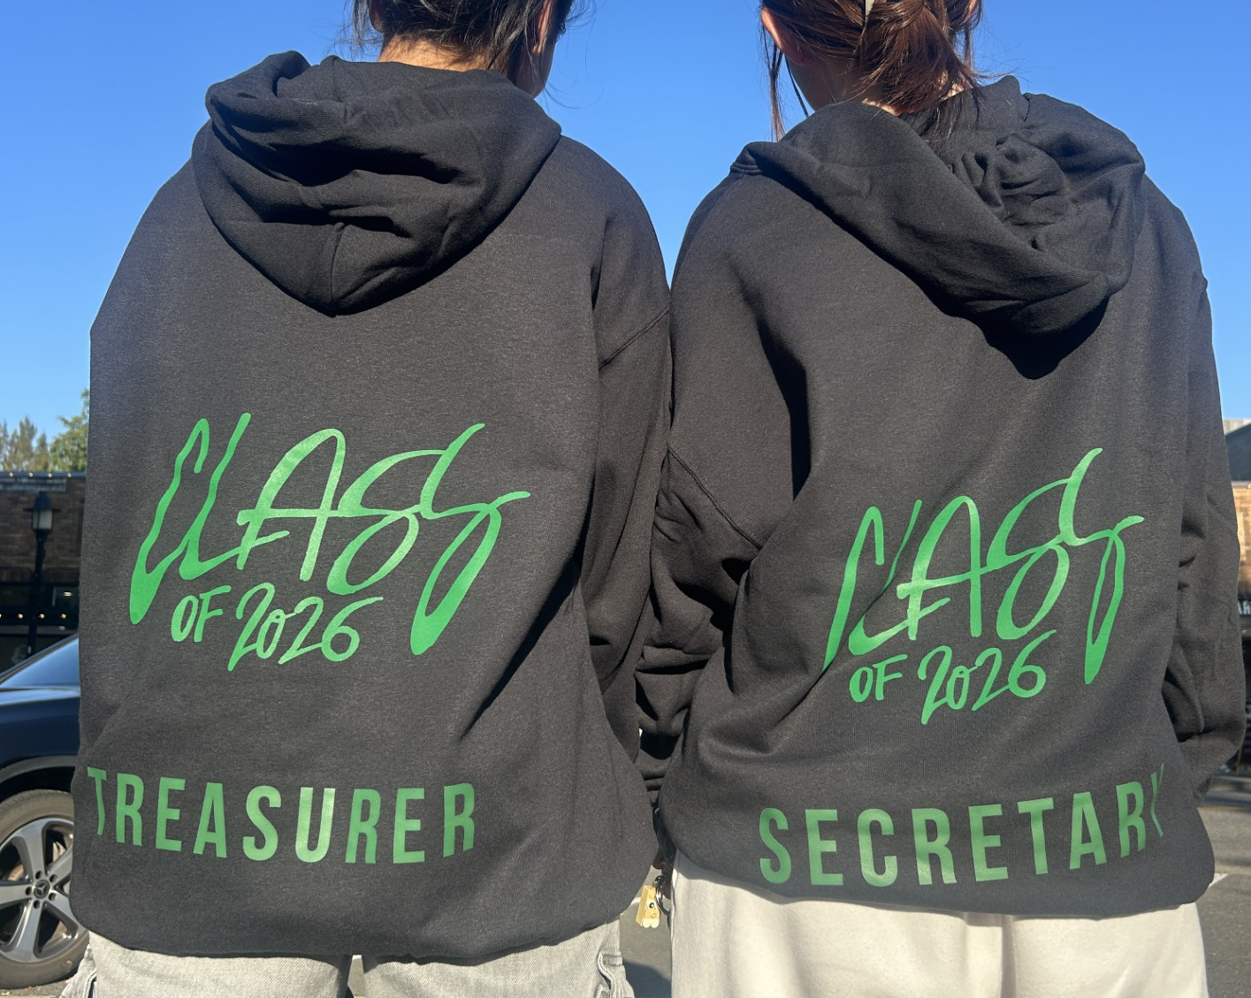
Senior Merch has reopened!
From October 27 to November 10th
Purchase through PayPortal or with ASB Bookkeeper
AVAILABLE FOR PURCHASE:
Flannel pants, hoodies, crewnecks

Slide 8


Yearbook Deadlines
Senior Photos
Due: DECEMBER 1, 2025 – HARD DEADLINE
Must be well lit, high resolution and school appropriate
Submit using the file via the Jostens website using the name format: LAST NAME_FIRST NAME STUDENT ID NO.
Senior Quotes
Due: DECEMBER 1, 2025 – HARD DEADLINE
Must be spoken out loud, be school appropriate and approved by Mr. Blakney & Administrators.
Sign-up can be found using the QR Code on the next slide!
YEARBOOKS ARE STILL ON SALE!
BUY YOURS BY 12/31/24

Slide 9
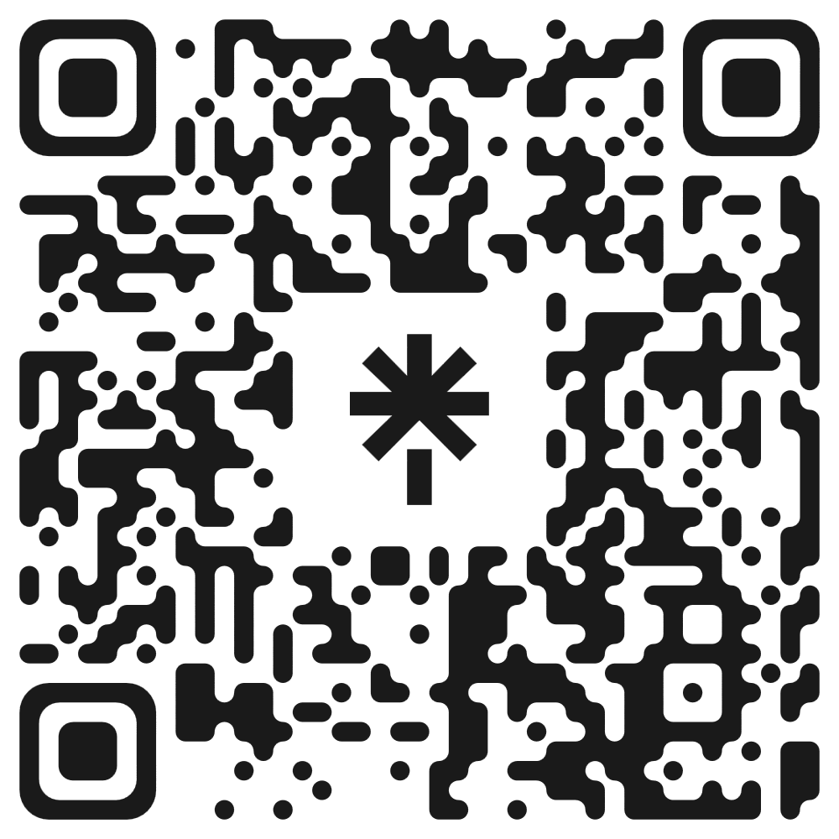
QR Code for Yearbook “STUFF”

Slide 10

Seniors
PAY ATTENTION!! This is important!!

Slide 11
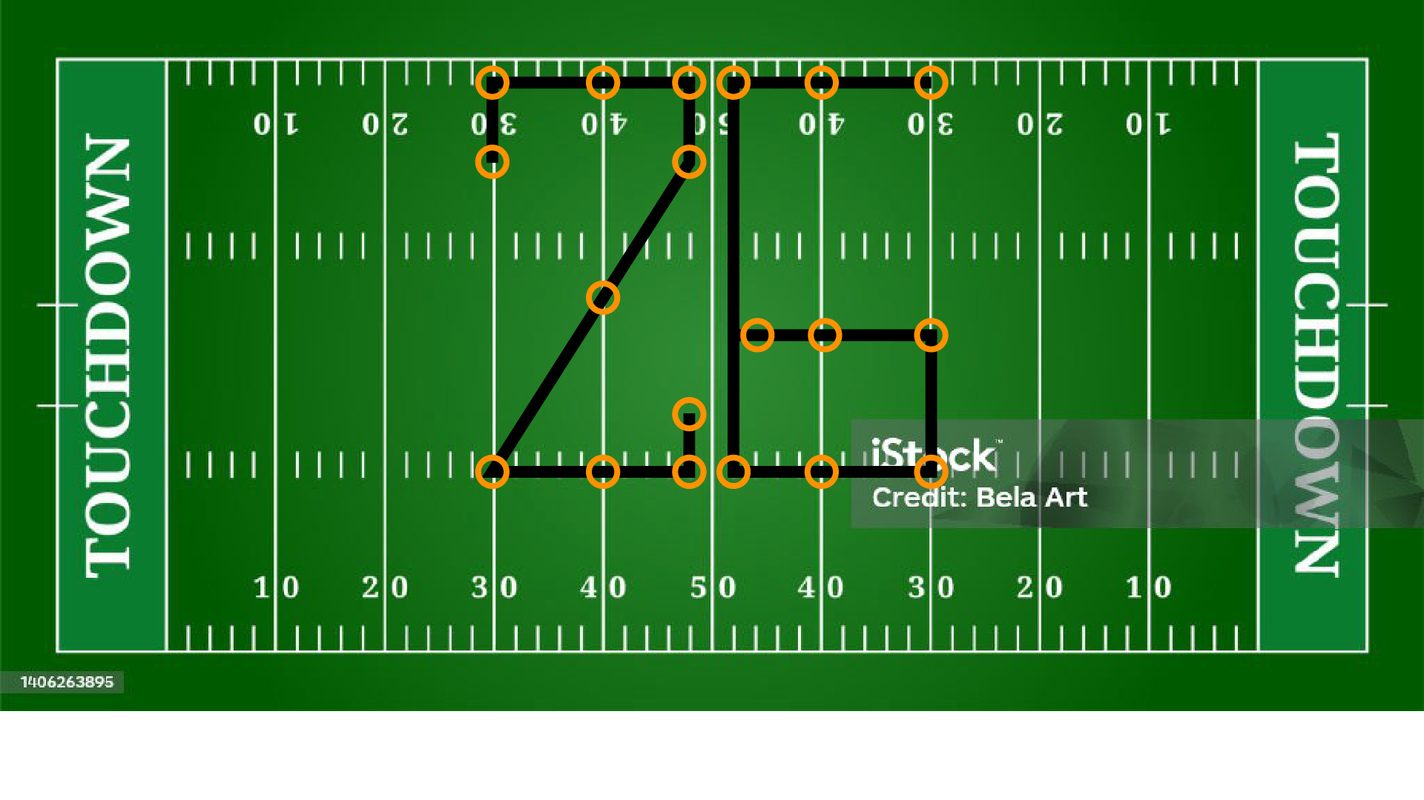
Annual ‘26’ Class Photo
Home Stands
Concessions,
Main Gate
Bathrooms
SE 8th and Student Parking Entrance
Visitor Stands – student will look towards the visitors stand with their back to the home stands

