Slide 1
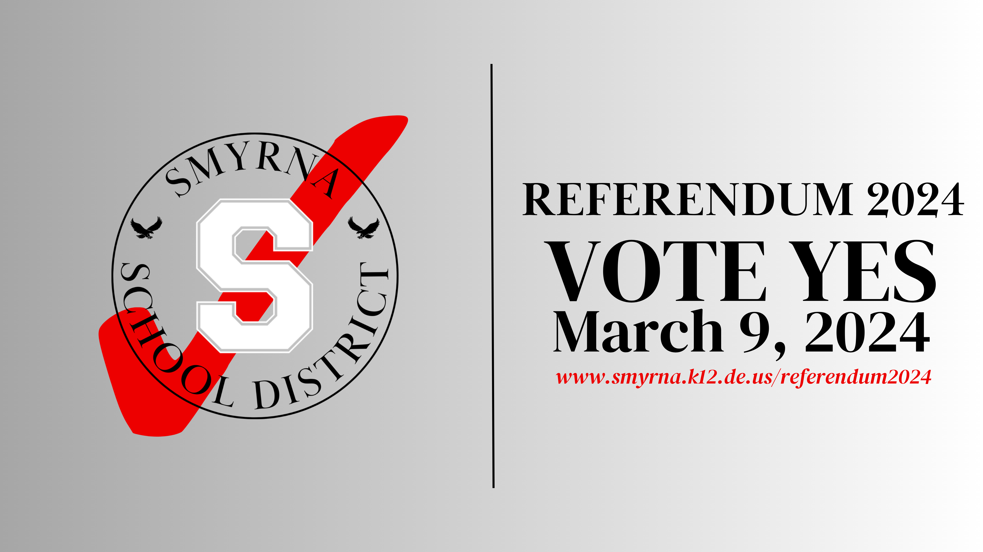


Slide 2
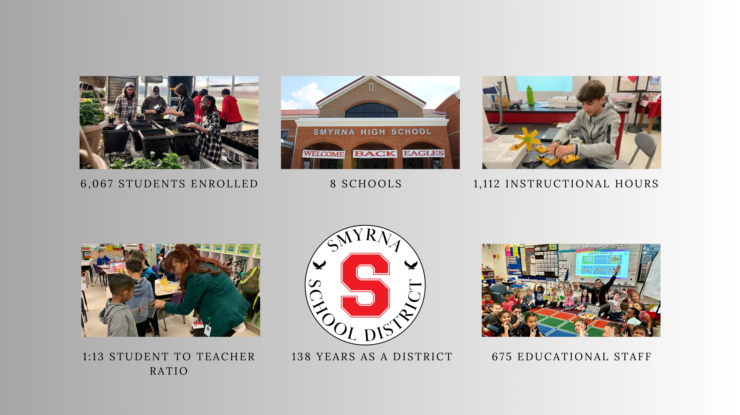

Proud To Be SSD...
2023 Annual District Report

Slide 3
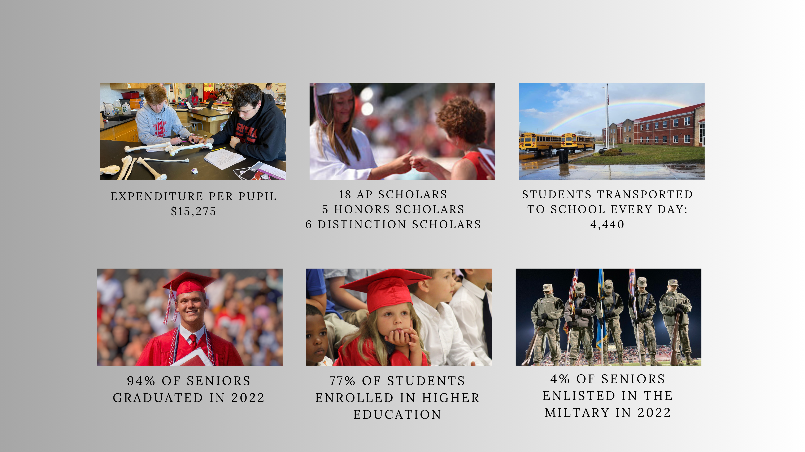
Proud To Be SSD...
2023 Annual District Report

Slide 4
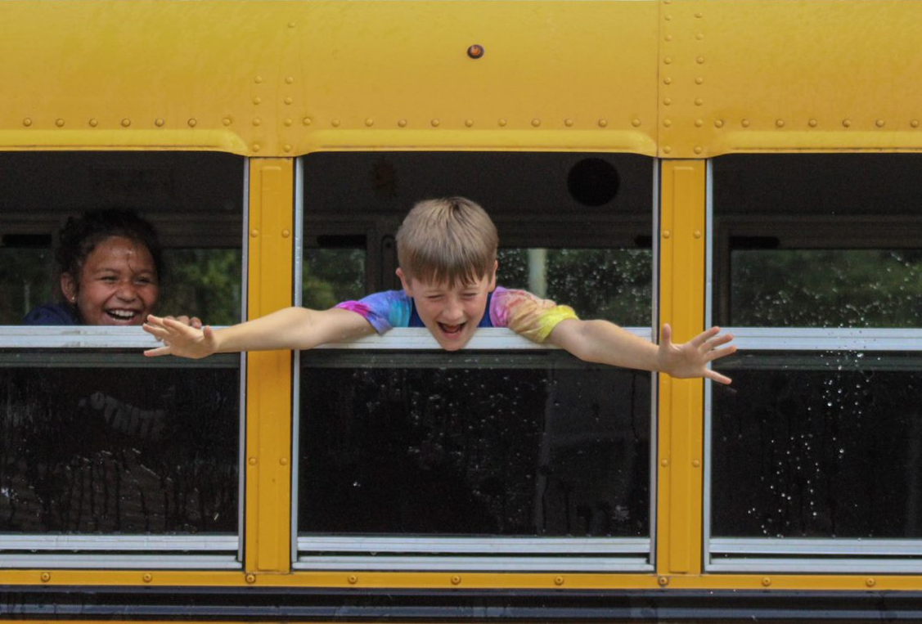
People and Programs
Addition of 2 safety specialists and 1 constable
Addition of 4 social workers in one intermediate and all secondary schools
Mental Health supports with Social Emotional Learning programs for our students
Expansion of the district’s ELL programs
Implementation of an instructional 1:1 program
Addition of district bus drivers and buses to address driver shortages
New outdoor resources for students:
Outdoor Classrooms
Adaptive playground (Smyrna Elementary)
New paved playground area (JBM Intermediate)

Slide 5
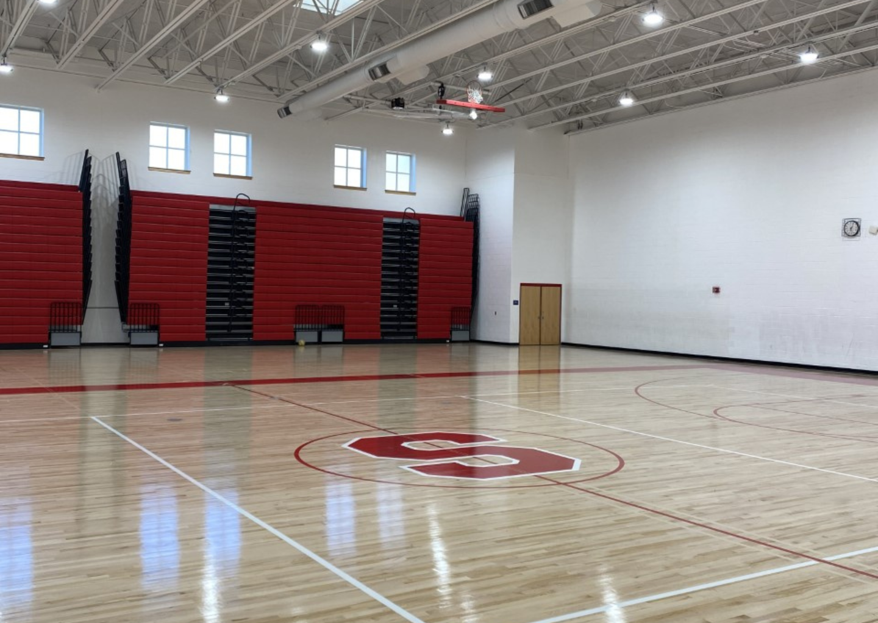
Buildings and Safety
Major capital project at NSE
New mechanical systems
Ballistic rated vestibule
Chiller rebuild at the Central Plant to effectively cool SHS and SMS facilities
Lighting upgrades that have yielded nearly $30,000 in energy rebates
Bottle filling stations installed and located in all 8 schools
Resurfacing of athletic areas at multiple locations throughout the District
Enhance safety features with access controls and updated cameras, doors and locks throughout the District
Currently upgrading components of the HVAC system in Smyrna High School

Slide 6
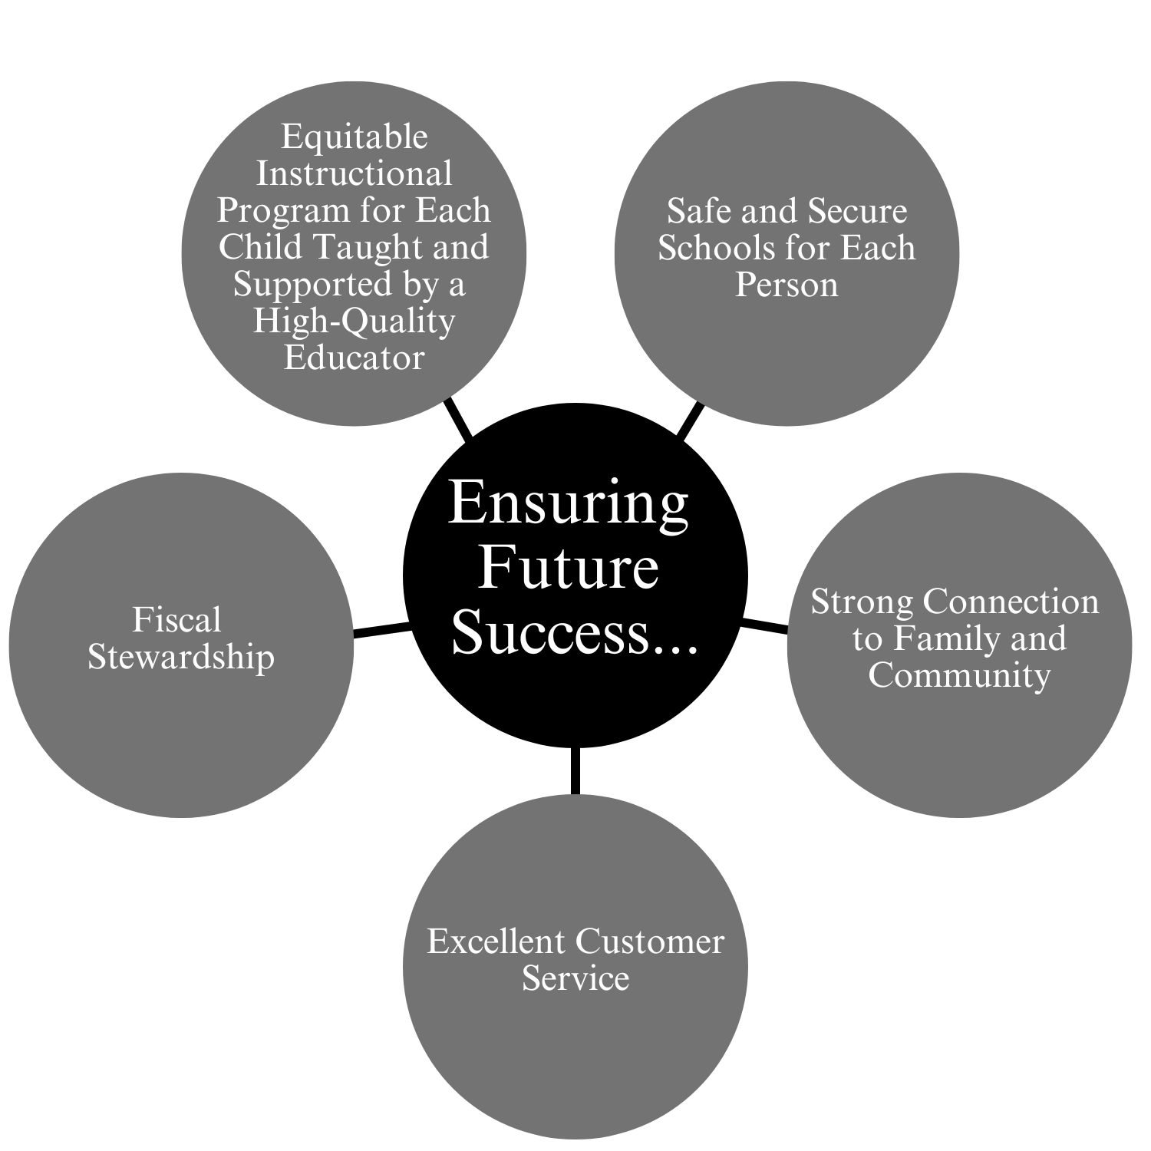
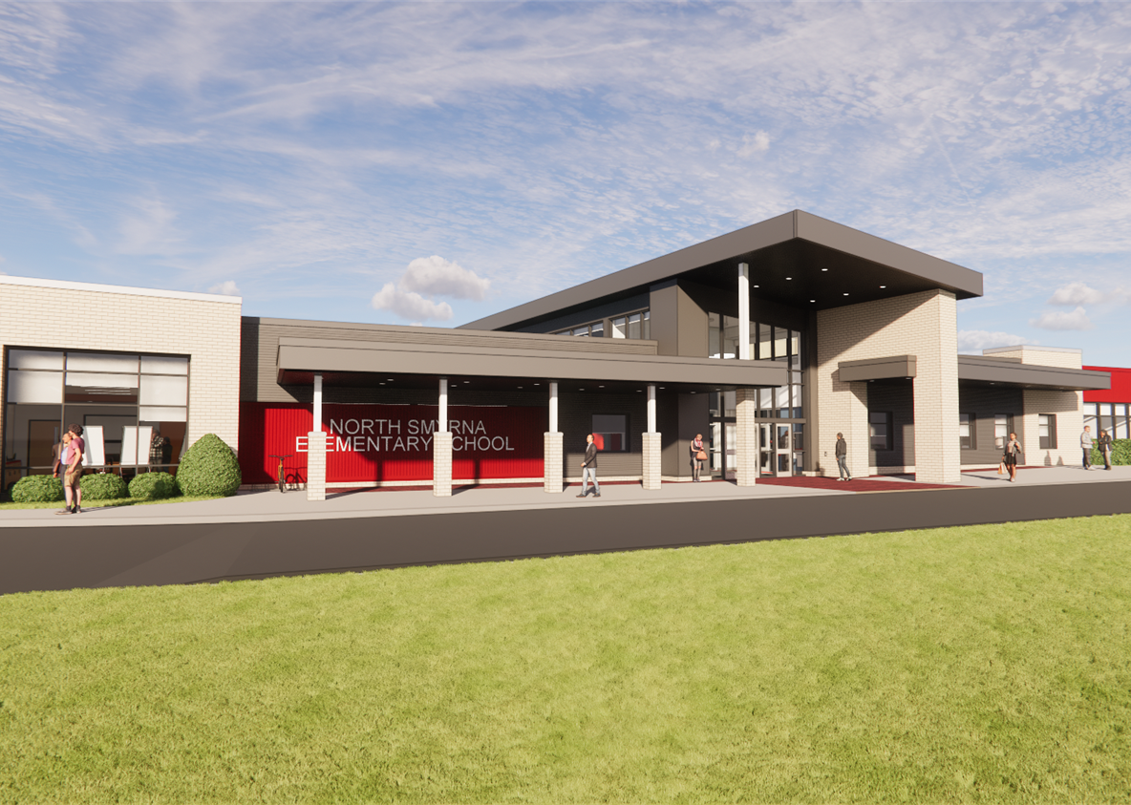

Slide 7
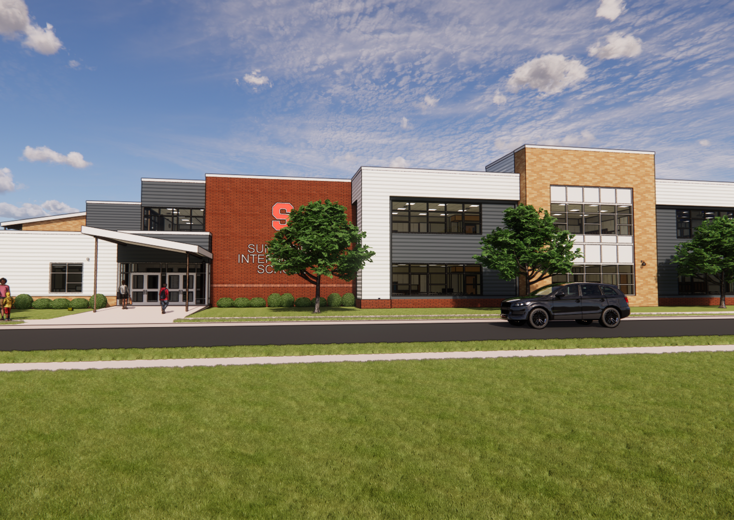
Growth Plan
In 2021, the community supported and approved the following projects:
Land Purchase +/- 15 acres across from Sunnyside Elementary
Construction of a New Elementary School
Clayton Intermediate Addition and Renovations
North Smyrna Elementary Addition and Renovations

Slide 8
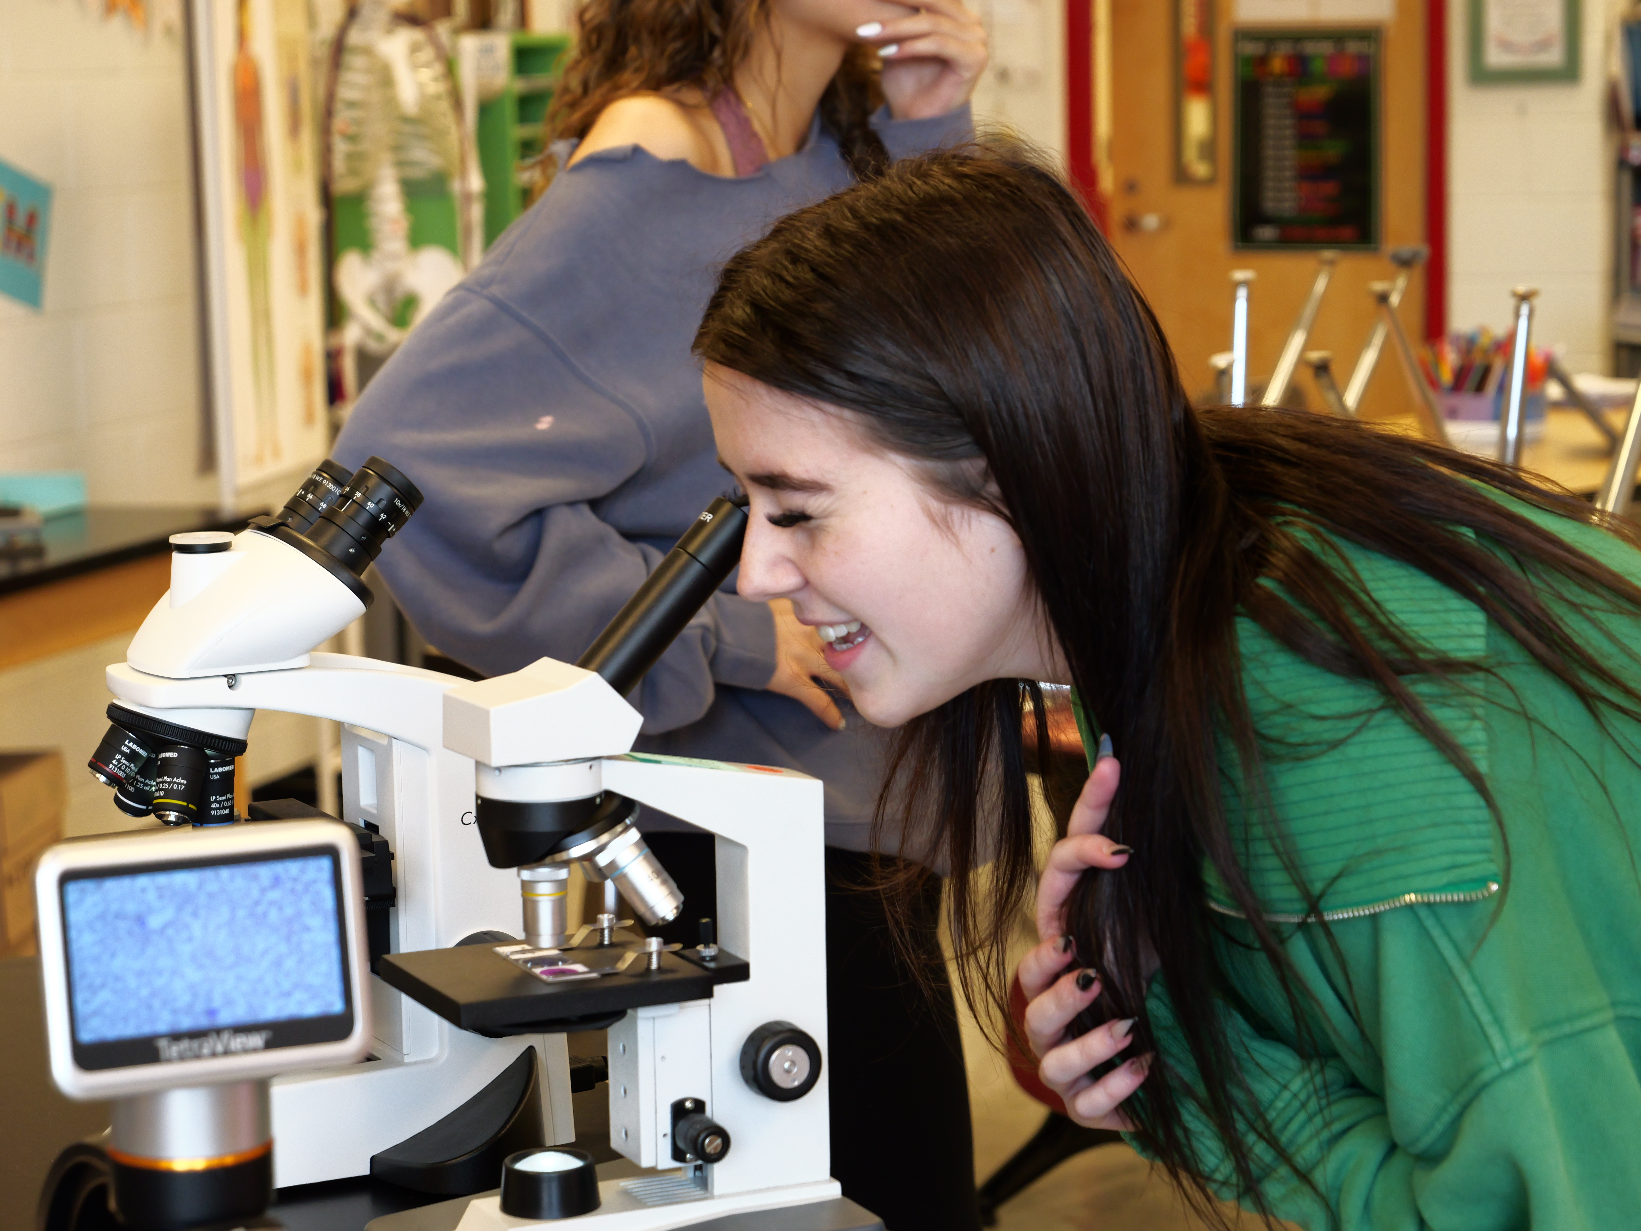
Future Grade Alignment
Grade | School
Pre-K – 3 | North Smyrna Elementary
K – 3 | Clayton Elementary
K – 3 | Sunnyside Elementary
K – 3 | Smyrna Elementary
4 – 5 | New Intermediate School
4 – 5 | JBM Intermediate
6 – 8 | Clayton Middle School
6 – 8 | Smyrna Middle School
9 – 12 | Smyrna High School

Slide 9
Original Estimate of Approved Projects
 | State Share (77%) | Local Share (23%) | Total
Land Purchase | $693,000 | $207,000 | $900,000
New Elementary School | $22,155,500 | $6,617,800 | $28,773,300
CIS Addition | $19,730,900 | $5,893,600 | $25,624,500
NSE Addition | $27,420,100 | $8,190,400 | $35,610,500
Total | $69,999,500 | $20,908,800 | $90,908,300

Slide 10
Inflation Impact
 | State Share (77%) | Local Share (23%) | Total
Land Purchase | $0 | $0 | $0
New Elementary School | $14,988,514 | $4,477,088 | $19,465,602
CIS Addition | $9,654,018 | $2,883,668 | $12,537,686
NSE Addition | $4,212,218 | $1,258,195 | $5,470,413
Total | $28,854,750 | $8,618,951 | $37,473,701

Slide 11
Revised Estimate of Approved Projects
 | State Share (77%) | Local Share (23%) | Total
Land Purchase | $693,000 | $207,000 | $900,000
New Elementary School | $37,144,014 | $11,094,888 | $48,238,902
CIS Addition | $29,384,918 | $8,777,268 | $38,162,186
NSE Addition | $31,632,318 | $9,448,595 | $41,080,913
Total | $98,854,250 | $29,527,751 | $128,382,001

Slide 12
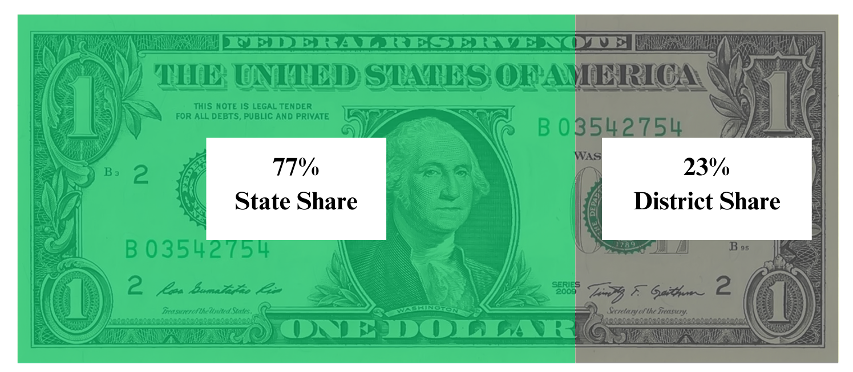
Question #1: Market Pressure Funding
State Market Pressure Funding
Original Cost of Approved Projects | $90,908,300
Revised Cost of Approved Projects | $128,382,001
Inflation Impact | $37,473,701
$28,854,750 $8,618,951

Slide 13
Market Pressure Impact
Year | Impact | Inc/Dec | Year | Impact | Inc/Dec | Year | Impact | Inc/Dec
FY 2025 | $35.80 |  | FY 2032 | $30.23 | ($0.79) | FY 2039 | $24.66 | ($0.80)
FY 2026 | $35.00 | ($0.80) | FY 2033 | $29.43 | ($0.80) | FY 2040 | $23.87 | ($0.79)
FY 2027 | $34.21 | ($0.79) | FY 2034 | $28.64 | ($0.79) | FY 2041 | $23.07 | ($0.80)
FY 2028 | $33.41 | ($0.80) | FY 2035 | $27.84 | ($0.80) | FY 2042 | $22.27 | ($0.80)
FY 2029 | $32.62 | ($0.79) | FY 2036 | $27.05 | ($0.79) | FY 2043 | $21.48 | ($0.79)
FY 2030 | $31.82 | ($0.80) | FY 2037 | $26.25 | ($0.80) | FY 2044 | $20.68 | ($0.80)
FY 2031 | $31.02 | ($0.80) | FY 2038 | $25.46 | ($0.79)
For property with a district average $200,000 market value
Assumes bond sale at a 4.0% interest rate

Slide 14
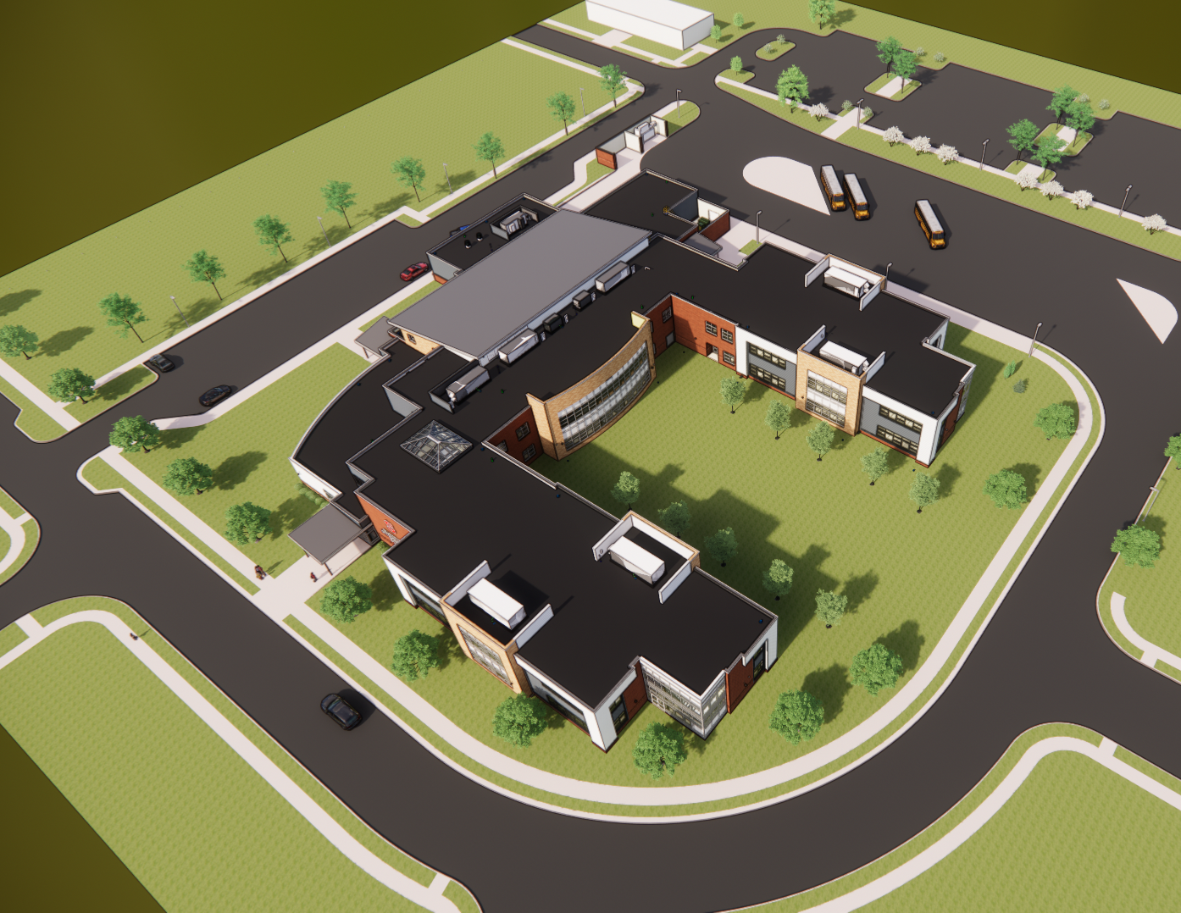
Operating Expenses
Recruit and hire constables for every school building
Deliver mental health supports in every school building
Maintain competitive salaries
Enhance student instructional technology materials
Provide extracurricular activities for the new middle school
Notes:
Constables assigned to every school in the district ~ $1,100,000
Student technology needs for 1:1 devices ~ $550,000
Constables assigned to every school in the district ~ $1,100,000
Student technology needs for 1:1 devices ~ $550,000
Additional substitute costs to cover the additional 2 personal days ~ $190,000
Utility increases of 5% ~ $80,000
Mental health staff local salary match ~ $700,000
Local cost of 6% salary supplement for non-state funded staff ~ $55,000
Maintain competitive local salaries ~ $2,100,000
Expanded athletics program at the new Clayton Middle School ~ $50,000
Additional substitute costs to cover the additional 2 personal days ~ $190,000
Utility increases of 5% ~ $80,000
Mental health staff local salary match ~ $700,000
Local cost of 6% salary supplement for non-state funded staff ~ $55,000
Maintain competitive local salaries ~ $2,100,000
Expanded athletics program at the new Clayton Middle School ~ $50,000

Slide 15
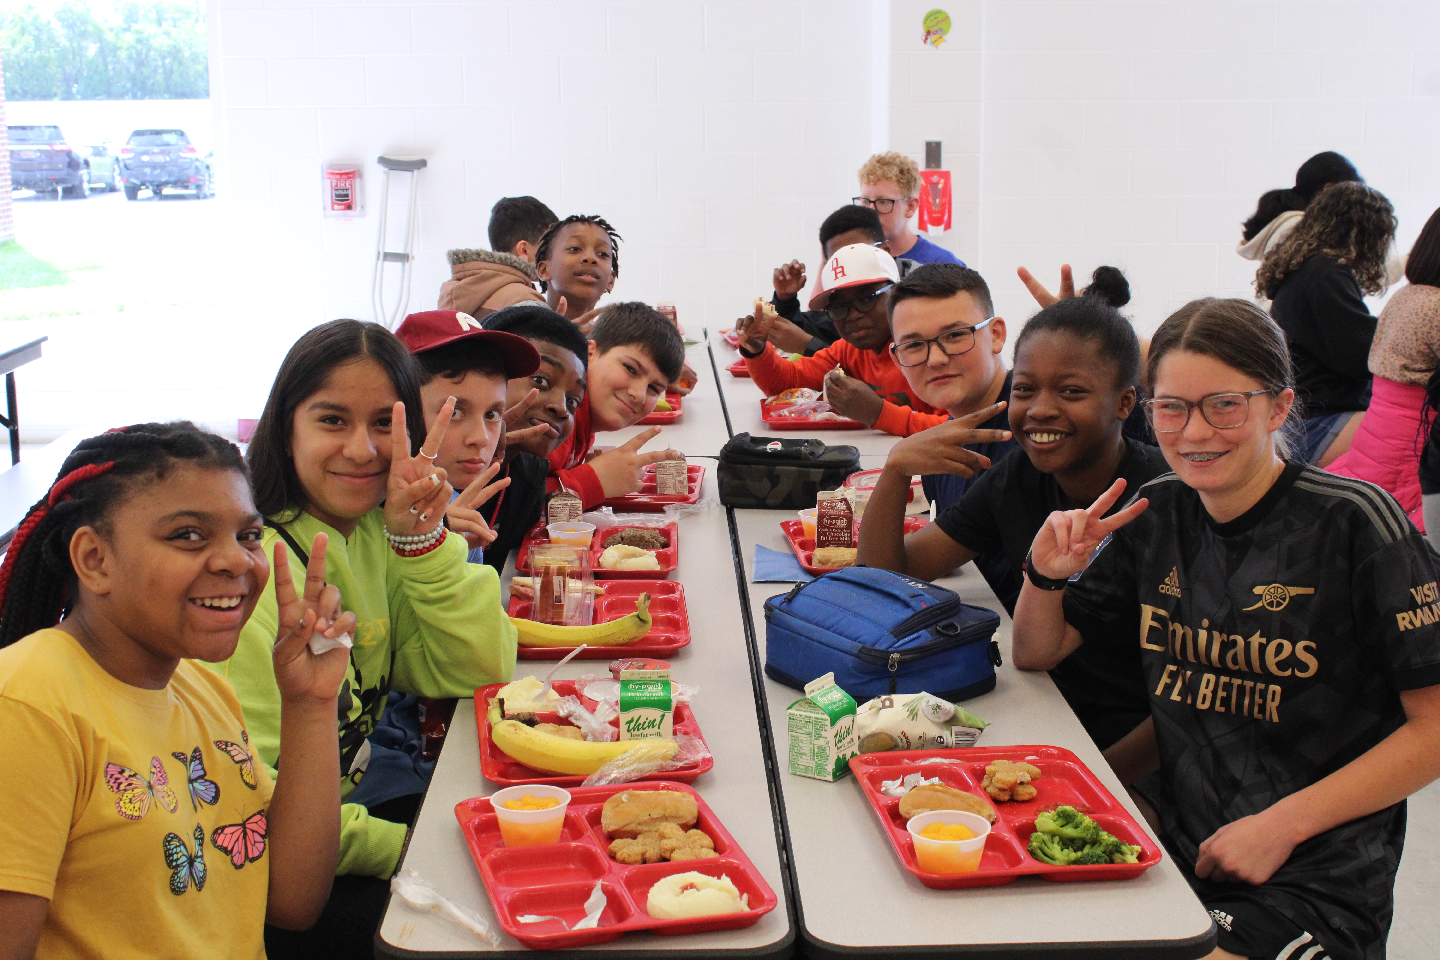
Question #2: Current Expense Referendum
$5,510,000 Annually
Year | Impact
FY 2025+ | $242.98
*For property with a district average
$200,000 market value

Slide 16
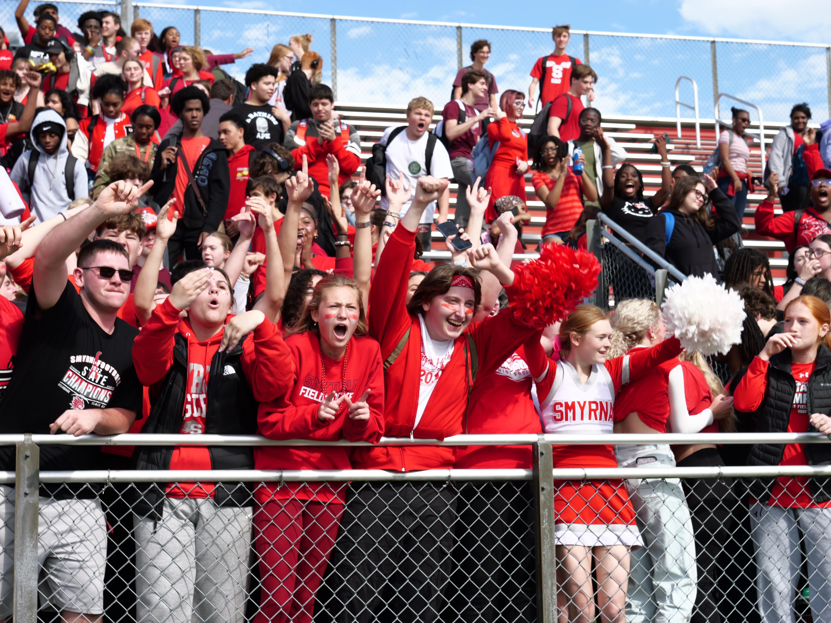
Questions
Email: SmyrnaComms@smyrna.k12.de.us
District Website: www.smyrna.k12.de.us/referendum2024
Phone: (302) 653-8585 for
Susan P. Brown, Ed. D. Superintendent
Deborah Judy, Assistant Superintendent
Kelly Holt, Director of Curriculum
Roger Holt, Director of Operations
Christina Hudson, Director of Finance

