Slide 1

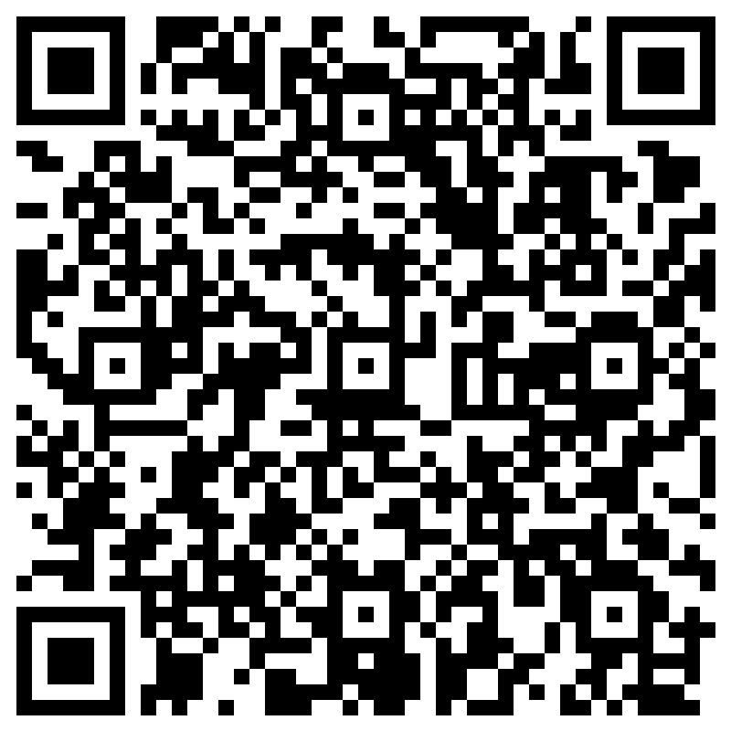

Hydrate to Elevate Challenge
Overview: A hydration challenge is being held August 4th – 29th. All SLPS employees who complete the challenge will be placed in a drawing to win a wellness prize.
Instructions: Use the tracker at the bottom of this page to complete the challenges. To complete the challenge meet your daily water intake goal 8 times during the month and complete 4 other actions listed below. Upon completion, email a picture of this completed tracker to leah_hammel@uhc.com or fill out the form here.
Bonus Entry: Earn an extra entry by sending a photo of yourself enjoying your hydrating beverage or by sharing your favorite smoothie recipe to inspire others!
I met my water intake today! Women – approx. 92oz. Men – approx. 124 oz. Custom goal:______
Hydrate with different beverages: Swap a sugary, calorie dense beverage for something new: infused water, coconut water, herbal tea or occasional electrolyte beverages like sports drinks. | Creative Containers: Use a water bottle with time markers or measurement lines to visually track your intake throughout the day. | Sunrise & sunset hydration: Have a glass available for water before bed to help you wake up refreshed, and a glass to start your morning off with hydration.
Infuse Your Water: Add natural flavors with fruits, herbs, or vegetables like cucumber + mint, watermelon + basil, oranges + limes and kiwis + strawberries. | Pair drinking with other habits: Connect sips of water to other daily habits, such as glancing at your phone, stretch breaks, TV shows, meals & snacks, bathroom breaks. | Hydrate on the go: Grab a refillable water bottle before your head out the door for errands, carpool, dog walking and appointments.
Use Flavor Drops, Electrolyte Mixes or a pinch of salt: Replenish essential minerals after cardiovascular exercise. | Incorporate water-rich foods: Increase intake of hydrating foods such as watermelon, cucumbers, oranges, strawberries and soups. | Try a liquid smoothie: Use your favorite hydrating fruits + water or milk. Consider adding chia seeds and protein powder for staying power!
Use this QR code to complete your challenge form electronically
Factors such as a living and working in a hot climate and/or strenuous exercise necessitate a need for more fluid intake. If you are pregnant or breastfeeding, your fluid needs will also be higher. If you are unsure, always consult with your doctor.
NAME: ____________________________ LOCATION: __________________

