Slide 1

What is a spending plan?

Slide 2

A spending plan is a guide you create
to help you decide how to spend your
money.
Instead of letting what you spend control where your money goes each month, you now control what you spend.
Notes:
Believe it or not, everyone who earns money and spends it has a budget. When you actually write down where your money goes each month, though, you become aware of how you’re spending your money.
There is something called the ABCs of financial literacy. A for Awareness - Being aware of your spending – what’s coming in and what’s going out. Sometimes we refer to this as budgeting, a word that often, unfortunately, makes people cringe. B for Behavior – Engaging in the behavior necessary to both save and pay down your debts. C for Change – Adjusting both your mindset and your activity (or your behavior) to create the changes required to achieve your goals.
It’s hard to overstate how important this shift is. You work hard to get money so give your dollars jobs and make them work for you.
Believe it or not, everyone who earns money and spends it has a budget. When you actually write down where your money goes each month, though, you become aware of how you’re spending your money.
It’s hard to overstate how important this shift is. Instead of letting what you spend control where your money goes each month, you now control what you spend.

Slide 3

Reasons for a Spending Plan
    Keep track of your money
    Gain control and confidence of finances and life
    Reduce or avoid debts
    Prepare for large and surprise expenses
    Accomplish your financial goals
    Aligns spending with values and goals
Notes:
A budget is like a New Year’s resolution.
We all know it’s designed to help us, and yet
we have so much trouble sticking to it.

Slide 4



SHORT TERM GOAL
  Anything that takes less than 1 year
  Ex. Budget
goals
INTERMEDIATE TERM GOAL
  Anything that takes 1 - 5 years
  Ex. Save
LONG TERM GOAL
  Anything that takes 5 or more years
  Ex. Invest

Slide 5
S
Specific
M
Measurable
Create S.M.A.R.T Goals
A
Adjustable
R
Realistic
T
Time-based

Slide 6

List all income
List all income
Steps to a successful spending plan
Notes:
Step 1: Where does my money come from? The first place to start is getting a complete picture of where your money comes from. You may be self-employed, have multiple jobs or receive child support or government benefits, all of these sources should factor into what you have available to make ends meet. Your monthly net income—that’s your take-home pay after taxes and payroll deductions—is used to determine your spending limits.

Slide 7
List all income
Steps to a successful spending plan
Track and list ALL expenses
Notes:
Step 2: Where does my money go? Equally important but the heaviest lift is logging your spending so you get a realistic picture of what your money, on an average month, is going to. Our Spending Tracker helps you both log and sort your spending by categories like utilities and housing to eating out and entertainment. If this feels overwhelming, start small and look at your expenses one week at a time by either reviewing your receipts or checking account. You could also start a daily log of your expenses so you’re making sure to capture those small expenses -- like buying breakfast or lunch instead of bringing it with you -- that add up over time. Track your spending using the method you’re most comfortable with spreadsheet, app or online banking. In order for a budget to be successful, you need to understand where your money is going.

Slide 8


List all hard monthly expenses
Rent/Mortgage
Loan Payments
Subscription Services/Cable
Add a subheading
List all soft or variable expenses
Groceries
Gas
Utilities
Add a subheading
List periodic or occasional expenses
Birthday Gifts
Clothing
Repairs
List ALL Expenses
Notes:
Step 3: What are all my bills and when are they due? If you’re coming up short at the end of the month, it could be that the timing for your bills and income don’t match. Our Bill Calendar is designed to help you remember when your bills are due but also keep in mind weeks when you need to be careful about your spending. Missing payments or not paying on time can also have larger impacts on your credit scores and overall financial well-being. See next slide for monthly bill calendar example.

Slide 9

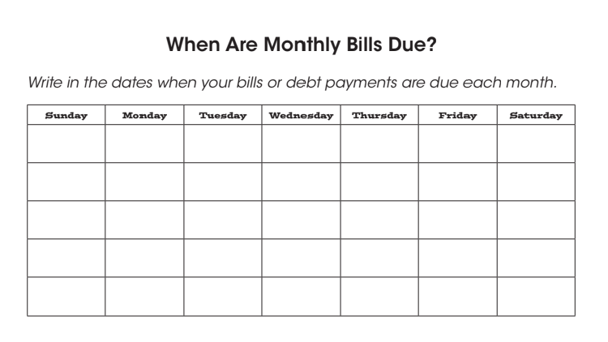

Slide 10
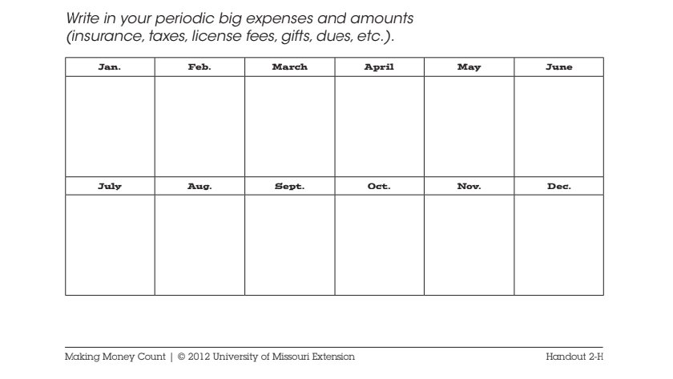

Slide 11
HIGHLIGHT TRANSACTIONS INTO CATEGORIES
Look at Past Statements...Where are you spending your income?
    groceries
    eating out
    household items
    fixed expenses
    gas/transportation
    clothing
    child expenses
    other

Slide 12
List all income
Steps to a successful spending plan
Track and list all expenses
Balance income and expenses

Slide 13



What do you do when your expenses exceed your income?
Increase Income
Reduce Expenses

Slide 14
List all income
Steps to a successful spending plan
Evaluate and Adjust
Track and list all expenses
Balance income and expenses
Notes:
Find a way to budget that works for you. Some people love their apps, and others are happy with pencil and paper.

Slide 15
HOW DOES YOUR SPENDING COMPARE TO YOUR TARGET BUDGET?
Evaluate and maybe ADJUST
Questions to ask yourself:
    Were you able to stay within the guidelines of your spending plan for each category?
    Where are you spending more/less?
    Where can you trim your plan?
    Are you able to set aside savings?
    How close are you to your goals?
Notes:
Sticking to a budget
Changing your money habits won’t happen overnight. Making – and sticking – with a budget takes effort, but here are a few important tips for being successful.
Create a tool that works for you. Be realistic and start looking at your finances one month at a time. Create a way that’s easy for you to track income and spending in real time, whether that’s a daily journal or putting receipts in a folder that you review at the end of each week.
Analyze your spending habits. This is an opportunity to take a comprehensive look at your spending, and it is also the easiest way to look for areas where you can cut back. If you know you’re prone to impulse spending, create a plan that’s doable to help you limit that spending.
Set a goal . Whether it’s small or large, it’s helpful to have an end goal and something you’re working towards. Also, rewarding yourself, even in small ways, can help you keep up with any progress you’ve made.
Develop a support system. Like sticking to an exercise routine, it’s easier when you’re surrounded by families and friends you can trust to offer you support, either by doing a budget with you or listening when you’re struggling.

Slide 16

Spending Plan Tips
    Plan according to what your income is NOW
      (not what you expect or hope it will be)
    Plan ahead for 6 months (at least)
      This gives you a picture of where you are headed
    Include some spending money
      It is not realistic to not have “fun” money.
    Set money aside for maintenance of all major items and keep this money separate
    PAY YOURSELF FIRST!
Notes:
Take savings seriously. Give your monthly savings contribution the same priority as your living expenses.
Check your budget, not your balance. Checking your balance doesn’t do a good job of telling you what you can and can’t afford each month.
Build up an emergency fund. Aim for 3 to 6 months of living expenses.

Slide 17
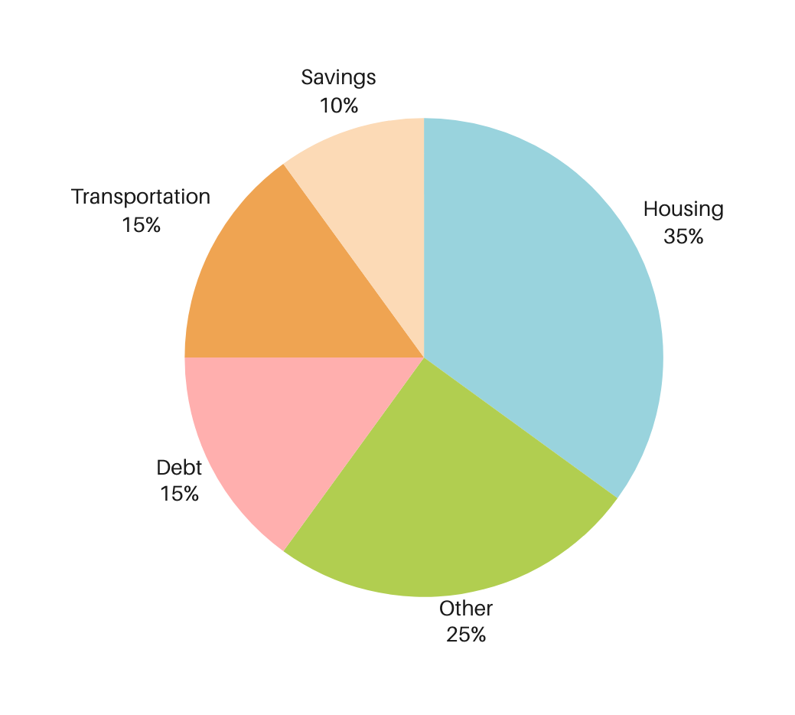
BUDGET GUIDELINES
Housing
Includes mortgage/rent, utilities, insurance, taxes, and maintenance.
Savings
Make sure you have 3-6 months expenses in emergency fund before savings for other goals.
Transportation
Includes car payment, insurance, maintenance, gas, licensing and taxes, etc.
Debt
Includes student loans, credit cards, personal loans, etc.
Other
Includes food, clothing, entertainment, childcare, vacation, etc.

Slide 18
Budgeting Methods
50%
NEEDS
30%
WANTS
20%
SAVINGS
Household bills, groceries, and
other necessities
Entertainment, restaurants,
shopping, etc.
Emergency funds, debt repayments, retirement, investing, etc.

Slide 19

Questions?

Slide 20

What have you heard about credit?

Slide 21

What is Credit?
YOUR "FINANCIAL REPORT CARD"
    How much you have borrowed
    From whom you borrowed
    How well you have repaid your debts
    How you are handling current debts

Slide 22
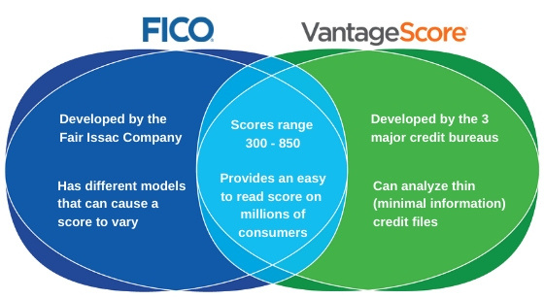
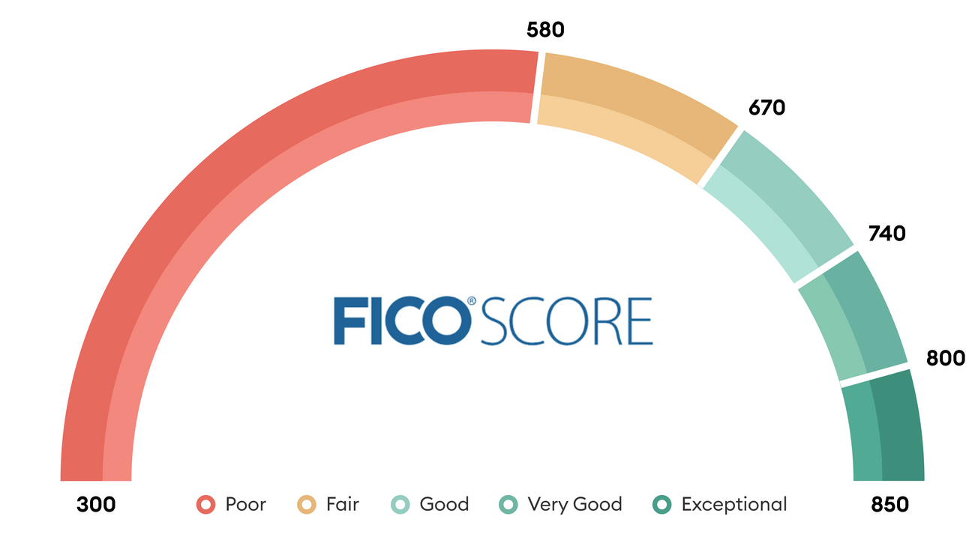
What is a credit score?
A 3-digit number that represents how likely you are to repay a debt.

Slide 23

What is Lending?
BORROWING MONEY AND PAYING IT BACK
    You borrow money and pay it back plus interest
    Interest = the cost of borrowing money

Slide 24
Build Assets
Why Does Having Good Credit Matter?
Insurance
Home/Auto Purchase
Good Credit
Renting Housing
Start a Business
Employment

Slide 25



The Cost of Poor Credit
GOOD CREDIT
POOR CREDIT
Loan Amount: $423,100
Term: 30 Years
Loan Amount: $25,000
Term: 60 months
Type of Auto: 2020 Sedan
Deductible $500
Credit Score Range: 700-749
Interest Rate: 3.507%
Monthly Payment: $1,944
Total Interest Paid: $261,462
Credit Score Range: 620-639
Interest Rate: 4.874%
Monthly Payment: $2,239
Total Interest Paid: $382,876
Credit Score Range: 700-749
Interest Rate: 5.990%
Monthly Payment: $483.20
Total Interest Paid: $3,992.23
Credit Score Range: 639 or less
Interest Rate: 16.990%
Monthly Payment: $621.18
Total Interest Paid: $12,270.80
Credit Score Range: 700-749
Average Annual Rate:
$1,516
Credit Score Range: 620-639
Average Annual Rate:
$2,253

Slide 26

What's in a credit report?

Slide 27




Identifying Information
Employment History
What's in a Credit Report
Creditors and Payment History
Public Records
Inquiries You Initiated

Slide 28

Who can look at your credit report?

Slide 29




Lenders
Who Can Look at Your Credit Report
Landlords
Potential Employers
Insurance Companies
Utility Companies
Financial Institutions

Slide 30
  Secured vs Unsecured
  APR and Interest Rate
  Revolving and Installment
  Minimum Payment Due
  Credit Inquiry
  Hard vs Soft Pulls
Credit Terms to Know

Slide 31
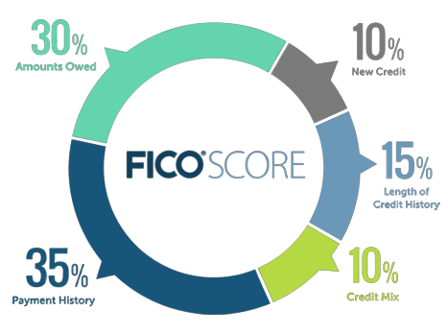
What Makes Up My Credit Score

Slide 32

ORDER YOUR CREDIT REPORT
Go to annualcreditreport.com to order your own or meet with a financial coach.
What to DO for your credit
REVIEW FOR ANY ERRORS & DISPUTE THEM
Check to make sure everything on your credit report is yours and accurate. If there is any incorrect information, dispute them to get them removed or corrected.
CREATE & FOLLOW AN ACTION PLAN

Slide 33
DON'T APPLY FOR EVERYTHING OFFERED TO YOU
What to NOT DO about your credit
Only apply for credit when you need it.
DON'T CO-SIGN ON CREDIT
If under age 18, you should not have anything on your credit report. If 18 or over, check to make sure anything on your credit report is yours and accurate.
DON'T USE PREDATORY LENDERS
Don't use places like these with high-interest rates and bad loan terms:
  PayDay Lenders
  Title Loans
  Buy Here, Pay Here
  Rent-to-Own

Slide 34
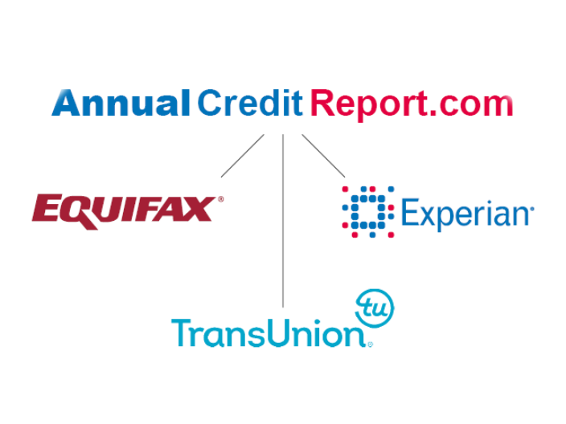
Where to Get a FREE Credit Report
Get one free copy of your credit report from each of the big three credit bureaus per year.

Slide 35
Questions?

Slide 36

Contact Us
Lisette Sangster
lisette.sangster@stlouiscommunity.com
(314) 940-4532
Tim Clavin
timothy.clavin@stlouiscommunity.com
(314) 940-4534

